Slide 1
PREVENTING SLIP, TRIP & FALL
Presented by : Lennon Chung
Date : 5/7/2022

Slide 2
Table of Content:
What is Slip, Trip and Fall.
Work Organization and Tidiness.
Be Careful On The Stairs.
Wear Proper Footwear.
Ways to Prevent Slip, Trip & Fall.

Slide 3

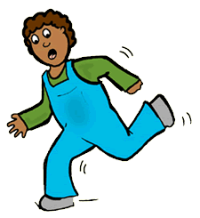
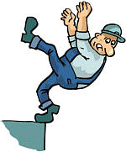
What are Slips, Trips & Falls?
Slip
Trip
Fall
A slip occurs when there is too little traction or friction between the shoe and walking surface.
A trip occurs when a person’s foot
contacts an object in their way or
drops to a lower level unexpectedly,
causing them to be thrown off-balance.
A fall occurs when you
are too far off balance.

Slide 4
There Are Two Types Of Falls:
Same Level
From Elevation
When you fall to the surface you are walking on. Same level falls are more common.
When you fall to a level below the one you are walking on. Falls from elevation are more severe.
Fall From:
Caused by:
Ladders
Stairs
Platforms
Loading Docks
Slips
Trips

Slide 5
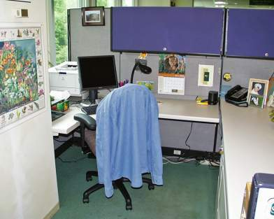
Work Organization & Tidiness
Close your desk, cabinets, and file drawers and doors immediately after each use.
Keep the floor around your workspace free of boxes, cords, cables, materials, and other objects.
Organized and tidy work space

Slide 6
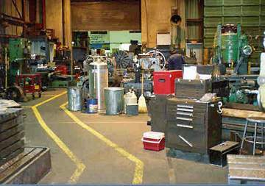
Work Organization & Tidiness
Keep walkways and aisles clear of materials, equipment, and other hazards.
Keep cables, cords, wires, and hoses away from walkways and other paths of travel.
Pathway is clearly marked and free of obstructions.

Slide 7
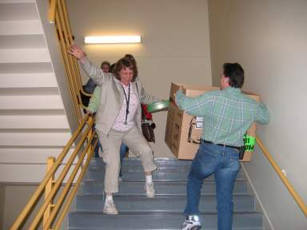
Be Careful On The Stairs
Always use the handrails when ascending or descending the stairs.
Do not rush and skip steps.
Don’t carry anything that will compromise your ability to hold onto the handrail.

Slide 8
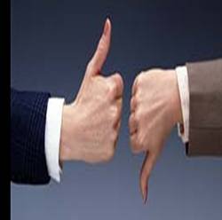
Be Careful On The Stairs
When going to another floor/level, take the elevator if you are carrying things requiring the use of both hands.
Never carry a load you can’t see over or around. Use a cart.

Slide 9
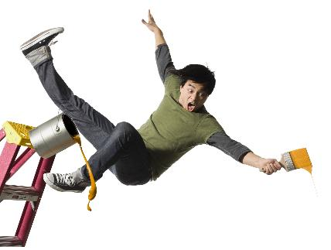
Climbing/Descending Ladder
Have a good hand-hold before stepping up.
Place your foot on the step or rung just in front of your heel, under the arch.
Always make sure you have three points of contact.
Never stand on the top of a ladder.

Slide 10
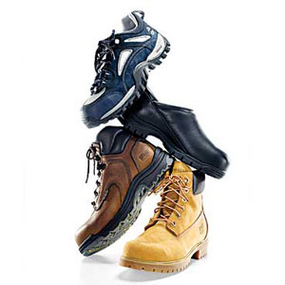
Wear Proper Footwear
Wearing the right footwear for your work environment will help prevent or reduce slip, trip, and fall incidences.
Footwear should fit snugly and comfortably.
Keep your footwear clean and in good condition at all times.
Inspect regularly for any damage; repair or replace worn or defective footwear.
Replace shoes or replace soles before they become worn smooth.

Slide 11
The Right Footwear for the Work
Wear the appropriate type of footwear for your work place.
Wearing shoes with increased traction does not substitute the need for safe walking practices!

Slide 12
Ways To Prevent Slip, Trip & Fall
Pay attention to your surroundings
Look where you are going when you walk
Do not engage in activities that distract your attention
Do not read, write, text, or dial while you are walking

Slide 13
Ways To Prevent Slip, Trip & Fall
Walk carefully and slowly when you transition from one type of walking surface to another
Adjust your walking pace and stride.
Take extra care when you come indoors with wet shoes
Slow down and take small careful steps if the surface is uneven, cluttered, slippery or inclined

Slide 14
Ways To Prevent Slip, Trip & Fall
Maintain clear, tidy work areas free of clutter
Follow good housekeeping procedures by cleaning up and throwing out debris and materials while you work
Fix hazards such as small spills and cluttered walkways if you are able to do so safely
Use caution when entering/exiting vehicles and equipment and when climbing and descending ladders
Report hazards promptly

Slide 15

Go where you are looking,
and look where you are going
If you see a potential hazard, report it immediately

Slide 16
Pay Attention
Be Proactive
Be Careful

