Slide 1
CHS QUALITY MANAGEMENT SYSTEM (QMS)
Prepared by:
M. Noorhafzan Ab. Majid
Quality Engineer
Service Quality Department

Slide 2
CONTENTS
Mission And Vision
DBSB QMS Overview
ISO Definition
Differences between API Q2 & ISO 9001
Benefits of ISO implementation
Quality Policy
Quality Objectives
CHS Operation Procedures & Standard Services Procedure (SSP)
Record & Forms

Slide 3
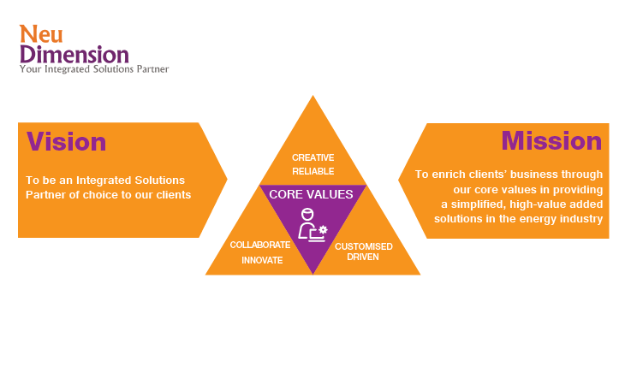
DBSB POLICY, OBJECTIVE & QMS DOCUMENTATION INTRODUCTION
Mission And Vision

Slide 4
DBSB POLICY, OBJECTIVE & QMS DOCUMENTATION INTRODUCTION
DBSB QMS OVERVIEW
What is quality?
Quality is critical to satisfying your customers and retaining their loyalty so they continue to buy from you in the future. Quality products/services make an important in contribution to long-term revenue and profitability. They also enable you to charge and maintain higher prices.
Quality Management System (QMS)
A quality management system (QMS) is a set of policies, processes and procedures required for planning and execution (production/development/service) in the core business area of an organization. (i.e. areas that can impact the organization’s ability to meet customer requirements.) ISO 9001:2015 is an example of a Quality Management System.

Slide 5





DBSB DOCUMENTATION HIERARCHY?
POLICY – The “Laws” or “Regulations” that govern the operations
MANUAL/STANDARD – A mandatory action or rule designed to support and conform a Policy
WIP/SOPS/SSP– Describes “how to” or step by step instructions that implement the process
PROCEDURE – A set of procedures that uses inputs to produce outputs; often illustrated by a flow chart
RECORDS - An evidence for the processes are conducted in the way prescribed in the procedures and work instructions

Slide 6
ISO DEFINITION?
ISO 9001 is the international standard for a quality management system (“QMS”). In order to be certified to the ISO 9001 standard, a company must follow the requirements set forth in the ISO 9001 Standard. The standard is used by organizations to demonstrate their ability to consistently provide products and services that meet customer and regulatory requirements and to demonstrate continuous improvement
The current version is ISO 9001:2015, which was published in September of 2015 (thus the: 2015).
ISO 9001:2015 is applicable to any organization from all types of business sectors and activities such as restaurant, consultancy, manufacturing company and etc.
Dimension Bid was certified to ISO 9001:2015
DBSB was certified to
ISO 9001:2015

Slide 7
DBSB POLICY, OBJECTIVE & QMS DOCUMENTATION INTRODUCTION
Difference between ISO & API Q2:
ISO 9001:2008 (obsolete) | ISO 9001:2015 | API Spec Q2
Related to Quality Management System, applicable to any organization from all types of business sectors and activities. Process Based Management System | Related to Quality Management System, applicable to any organization from all types of business sectors and activities. Risk Based Thinking | Specification for Quality Management System Requirements for Service Supply Organizations for the Petroleum and Natural Gas Industries Is a Risk-based Quality Management system

Slide 8
ISO & API Q2 STANDARD (for OPERATION)
ISO 9001:2015 | API Spec Q2
4.4 Quality Management System and its processes 4.4.1 The organization shall establish, implement, maintain and continually improve a QMS, including the processes needed and their interactions 4.4.2 Maintain documented information to support the operation of its processes Retain documented information to have confidence that the processes are being carried out as planned 7.2 Competence The organization shall: Determine the necessary competence of persons doing work under its control that affects the performance and effectiveness of QMS Ensure that these persons are competent on the basis of appropriate education, training, skills and experience 8.1 Operational planning and control 8.2 Requirements for products and services 8.3 Design and development of products and services (Inputs, design controls and outputs) 8.5 Production and Service Provision – The organization shall implement production and service provision under controlled conditions such as availability of documented information 8.5.5 Post-delivery activities – The organization shall meet requirements for post-delivery activities associated with the products and services such as customer requirements (DOR, Personnel and Equipment Utilization, Offshore activity Summary) and customer feedback (CSS Form) | 4 Quality Management System Requirements 4.1.1 The organization shall establish, document, implement, maintain, measure the effectiveness of, and improve upon a QMS in accordance with the requirements of this document 4.3.2.3 Training and Awareness The organization shall: Provide for QMS training and for job training of the organization’s personnel who effect the execution of services or provision of service-related products. Maintain appropriate records of education, training, skills and experience 5.2 Planning The organization shall identify and plan the processes and documents needed for service and service-related product 5.4 Design and Development (Planning, Inputs, Outputs, verification, Final Review and Approval) 5.7 Execution of Service – Controls for execution of the service shall be documented (checklists, process sheet or other types of documents) 5.9 Service Performance Validation – The organization shall maintain a documented procedure to validate the execution of the service performance to confirm that requirements were achieved

Slide 9
STANDARD REQUIREMENT (ISO & API Q2)
No | Requirements | ISO 9001:2008 | ISO 9001:2015 | API SPEC Q2
1 | Quality manual, policy & objectives | Yes | Yes | Yes
2 | Communications (internal & external) | Yes | Yes | Yes
3 | Management responsibility (org. structure) | Yes | Yes | Yes
4 | Responsibility & Authority | Yes | Yes | Yes
5 | Personnel competence, training & awareness | Nil | Yes | Yes
6 | Control of documents & records | Yes | Yes | Yes
7 | Contract Review | Yes | Yes | Yes
8 | Planning | Yes | Yes | Yes
9 | Risk Assessment and Management | Nil | Yes | Yes
10 | Design and Development (planning, input, output, verification) | Nil | Yes | Yes
11 | Contingency planning | Nil | Yes | Yes
12 | Purchasing Control | Yes | Yes | Yes

Slide 10
STANDARD REQUIREMENT (ISO & API Q2)
No | Requirements | ISO 9001:2008 | ISO 9001:2015 | API SPEC Q2
13 | Control of Service Provision | Yes | Yes | Yes
14 | Service Quality Plan | Nil | Nil | Yes
15 | Identification and traceability | Yes | Yes | Yes
16 | Service-related product status | Nil | Nil | Yes
17 | Customer property | Nil | Yes | Yes
18 | Preservation of service-related product | Nil | Yes | Yes
19 | Validation of Service-related product | Nil | Nil | Yes
20 | Preventative maintenance, inspection and test program | Nil | Nil | Yes
21 | Control of testing, measuring, monitoring and detection equipment | Yes | Yes | Yes
22 | Service performance validation | Nil | Yes | Yes
23 | Control of nonconformities | Yes | Yes | Yes
24 | Management of Change | Nil | Yes | Yes

Slide 11
STANDARD REQUIREMENT (ISO & API Q2)
No | Requirements | ISO 9001:2008 | ISO 9001:2015 | API SPEC Q2
25 | Customer satisfaction | Yes | Yes | Yes
26 | Internal Audit | Yes | Yes | Yes
27 | Analysis of Data | Yes | Yes | Yes
28 | Corrective Action | Yes | Yes | Yes
29 | Preventive Action | Yes | Yes | Yes
30 | Management Review | Yes | Yes | Yes

Slide 12
BENEFITS OF ISO IMPLEMENTATION
Process becomes more efficient.
Enhanced customer satisfaction and improved customer loyalty.
Lower cost and shorter cycle time through effective use of resources.
Consistency in service and product deliverable.
Increase revenue through effective market opportunities.
Integration and alignment of internal processes which will lead to increased productivity and result of job delivered.
Improve communication, planning and administration processes.
Increased credibility, image and competitiveness.

Slide 13
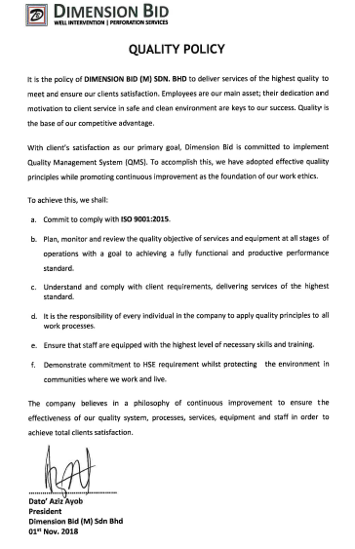
DBSB POLICY, OBJECTIVE & QMS DOCUMENTATION INTRODUCTION
QMS Quality Policy:
Commit to comply with ISO 9001:2015 and applicable customer satisfaction.
Plan, monitor and review the quality objective of services and equipment at all stages of operations with the goal of achieving a fully functional and productive performance standard.
Understand and comply with client requirements and delivering services of the highest standard.
It is the responsibility of every individual in the company to apply quality principles to all work processes.
Ensure that all staff equipped with the highest level of necessary skills and training.
Demonstrate commitment to HSE requirement whilst protecting the environment in communities where we work and live.

Slide 14
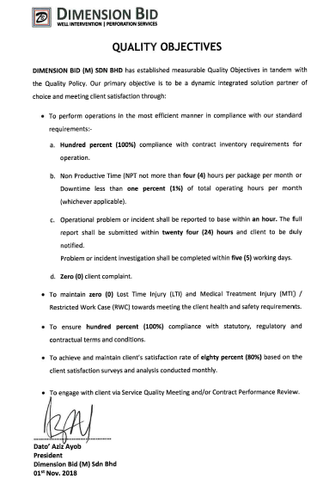
DBSB POLICY, OBJECTIVE & QMS DOCUMENTATION INTRODUCTION
QMS Quality Objectives:
To conduct operations in the most efficient manner in compliance with our standard requirements :-
Hundred percent (100%) compliance with contract inventory requirement for operations.
Non- Productive Time (NPT) not more than four (4) hours per package per month or Downtime less than one percent (1%) of total operating hours per month (whichever applicable).
Operational problem or incident shall be reported to base within an hour. The full report shall be submitted within twenty four (24) hours and client to be duly notified. Problem or incident investigation shall be completed within five (5) working days.
Zero (0) client complaint

Slide 15
DBSB POLICY, OBJECTIVE & QMS DOCUMENTATION INTRODUCTION
QMS Quality Objectives: (cont..)
To Maintain zero (0) Lost Time Injury (LTI) and Medical Treatment Injury (MTI)/ Restricted Work Case (RWC) towards meeting the client health and safety requirement.
To ensure hundred percent (100%) compliance with statutory, regulatory and contractual terms and conditions.
To achieve and maintain client’s satisfaction rate of eight percent (80%) based on the client satisfaction surveys and analysis conducted monthly.
To engage with client via Service Quality Meeting and/or Contract Performance Review.

Slide 16
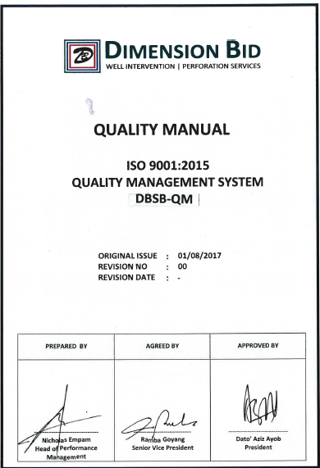
QUALITY MANUAL – as a standard for DB
QUALITY MANUAL
DBSB-QM Quality Manual ISO 9001:2015

Slide 17
CHS PROCEDURE & SOP/SSP
NO | CHS PROCEDURE | SOP | SSP
1 | DBSB-CHS-01: Cased Hole Services | CHS-SOP-01 Log Quality Control | SSP Winch Control and Rig up & Rig Down
2 | DBSB-CHS-02: Service Notification | CHS-SOP-02 Logging Module Operation | SSP MOT
3 | DBSB-CHS-03: Service Planning & Preparation | CHS-SOP-03 Wireline Depth Control Measurement | SSP DC-MOT
4 | DBSB-CHS-04: Service Briefing and Debriefing | CHS-SOP-04 Surface Readout | SSP MIT
5 | DBSB-CHS-05: Mobilization and Demobilization | CHS-SOP-05 EM Cable Operation and Maintenance | SSP EMR
6 | DBSB-CHS-06: Service Executions | CHS-SOP-06 Cable Stuck
7 | DBSB-CHS-07: Service Performance Validation | CHS-SOP-07 Equipment Fueling
8 | DBSB-CHS-08: Control of Testing, Measuring, Monitoring and Detection Equipment | CHS-SOP-08 Lab Management Procedure
9 | DBSB-CHS-09: Training and Development | -

Slide 18
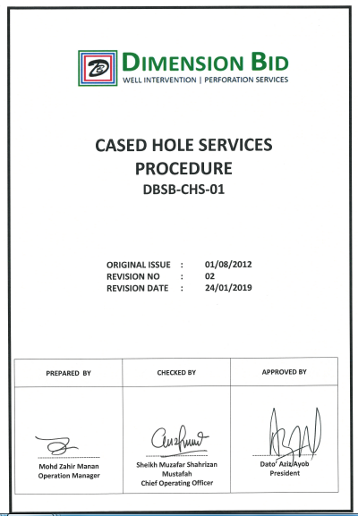
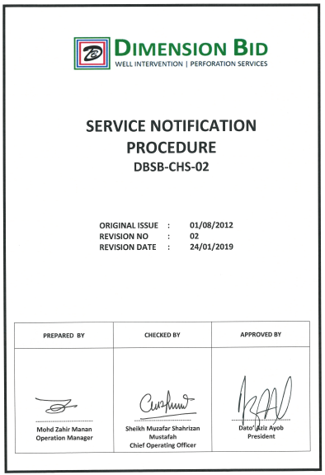
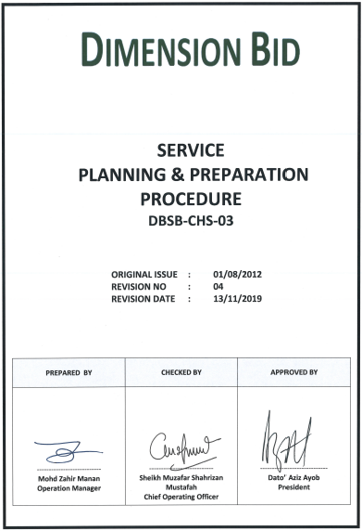
CHS PROCEDURE & SOP/SSP

Slide 19
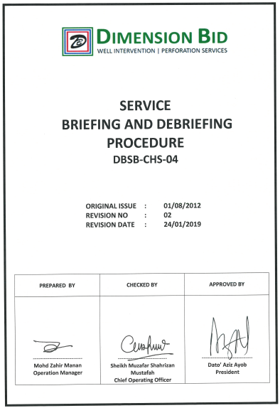
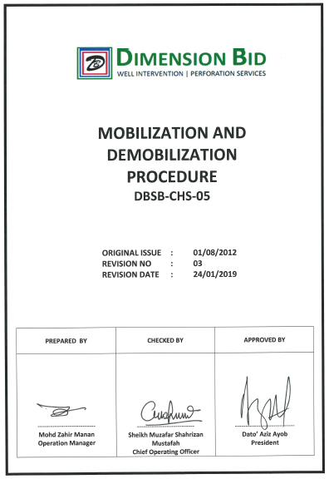
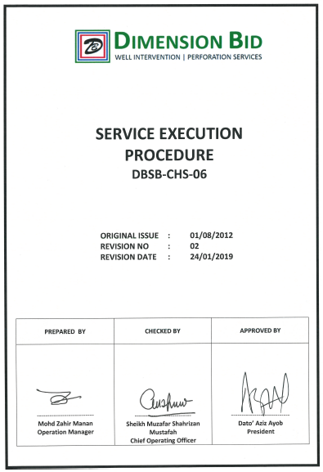
CHS PROCEDURE & SOP/SSP

Slide 20
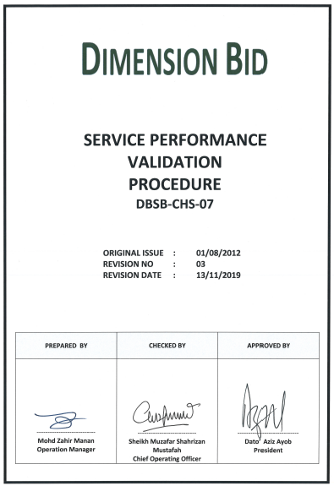
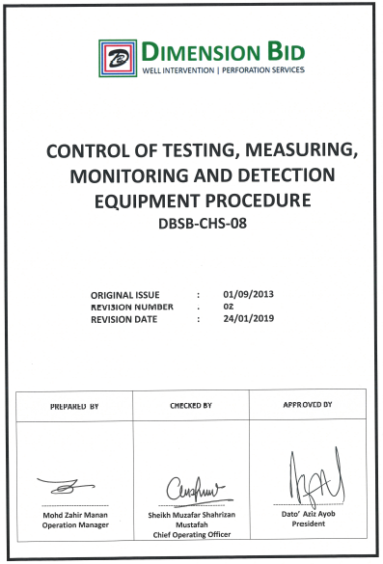
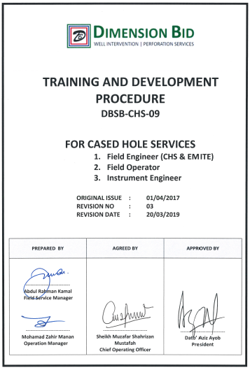
CHS PROCEDURE & SOP/SSP

Slide 21
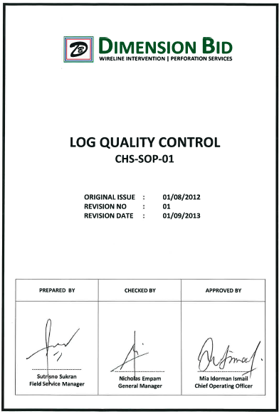
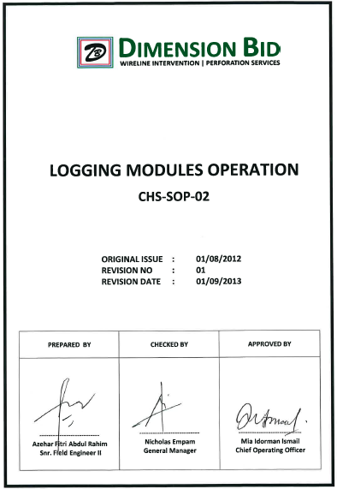
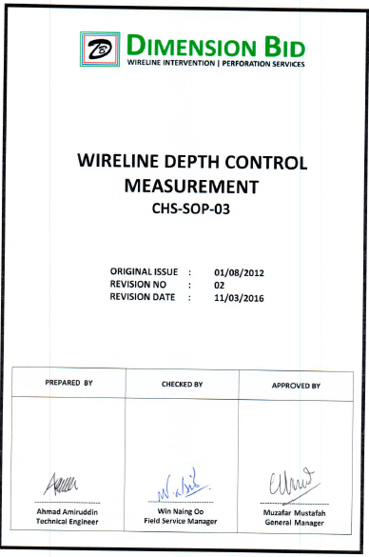
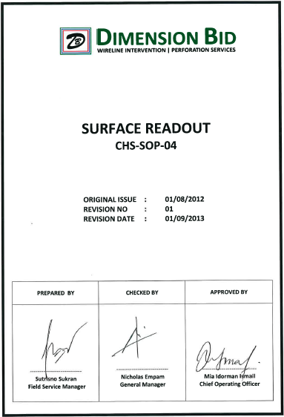
CHS PROCEDURE & SOP/SSP

Slide 22
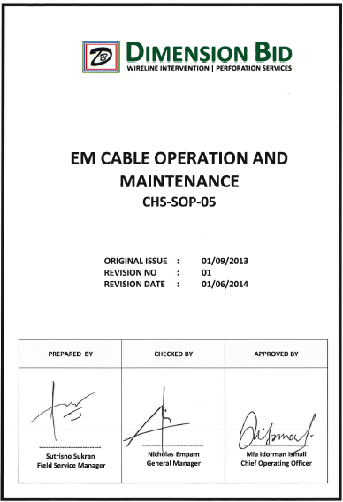
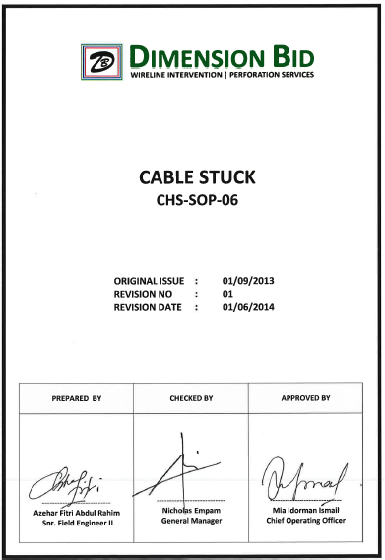
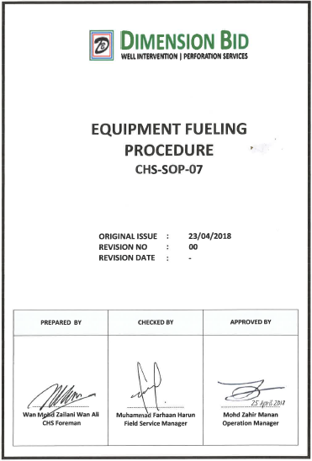
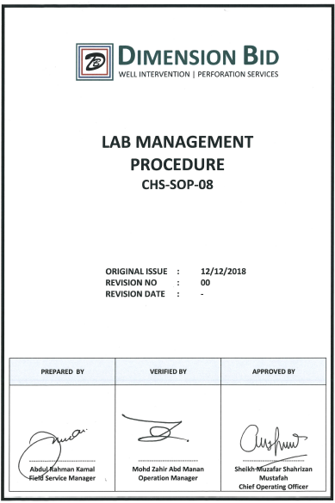
CHS PROCEDURE & SOP/SSP

Slide 23
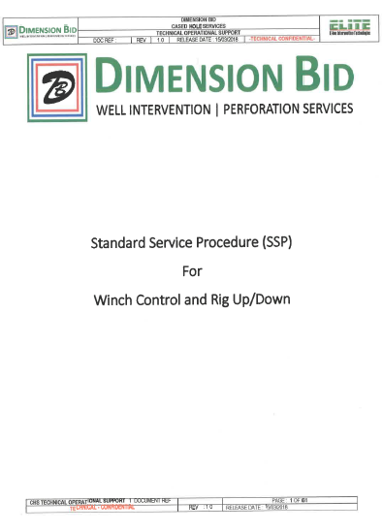

CHS PROCEDURE & SOP/SSP

Slide 24
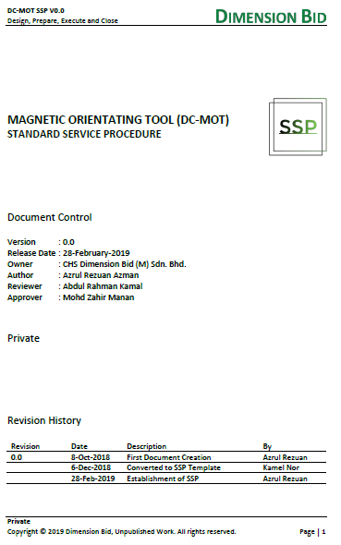
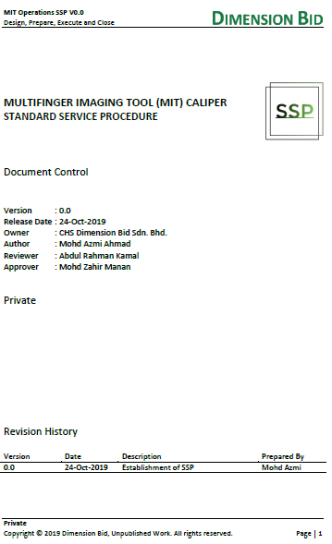
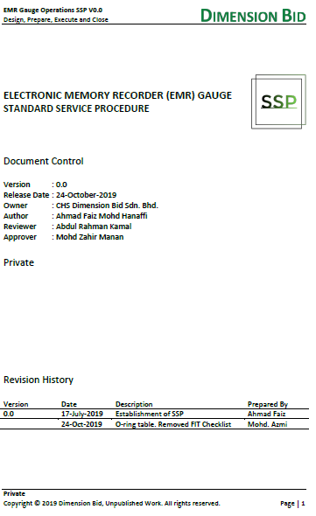
CHS PROCEDURE & SOP/SSP

Slide 25
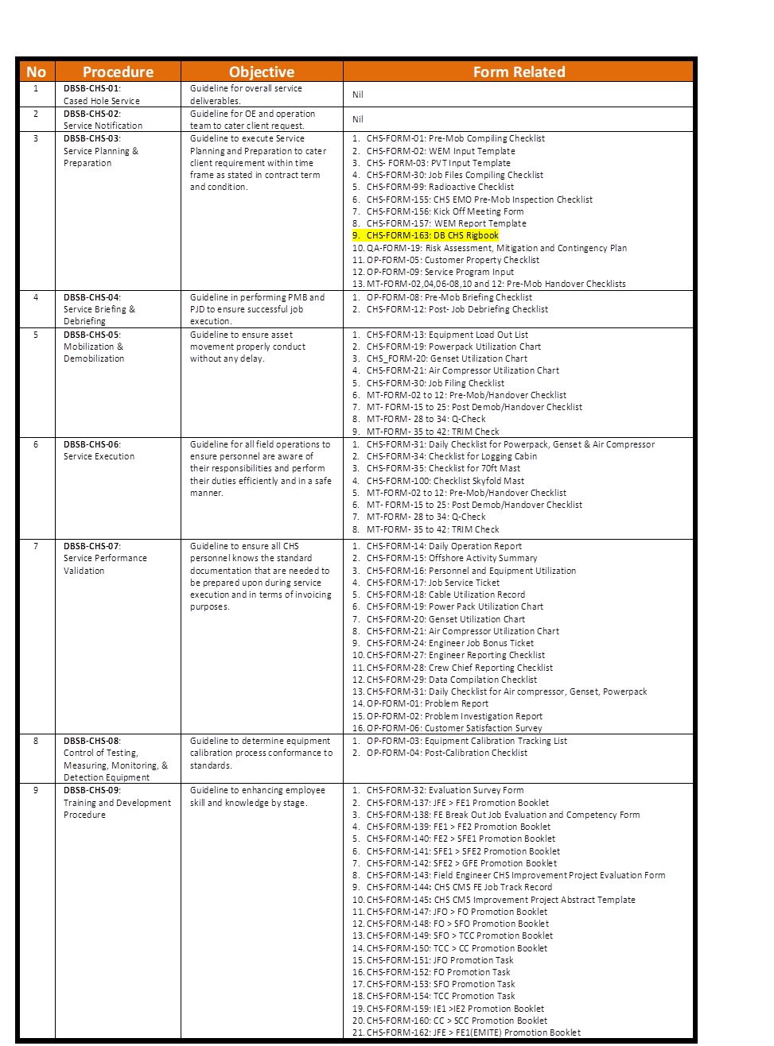
RECORD & FORMS

Slide 26


