Slide 1
STARLINK INSTALLATION ON E-LINE UNIT 3
By Ikram Muslim

Slide 2
Introduction
On 27th March 2024, SIT inspection has been done at Labuan base for E11 PAI tools. As to check the communication between Starlink and E-line package, participants who did not connected to Starlink WIFI being invited by monitoring the log in Live through Microsoft Team.
For info, E-line package #3 being assigned to E11 and Betty for logging job. During the job, town can only monitor on the log in Live, not by controlling the PC onsite. This situation subject to weather condition as it might be effect the internet connection.
Basically, this report summarized on how Starlink satellite been installed at E-line package and snapshot from Microsoft Team during the inspection day.

Slide 3
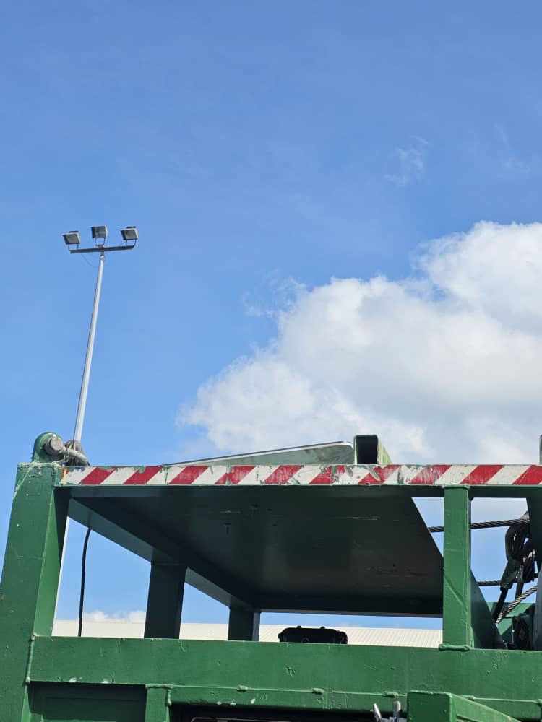
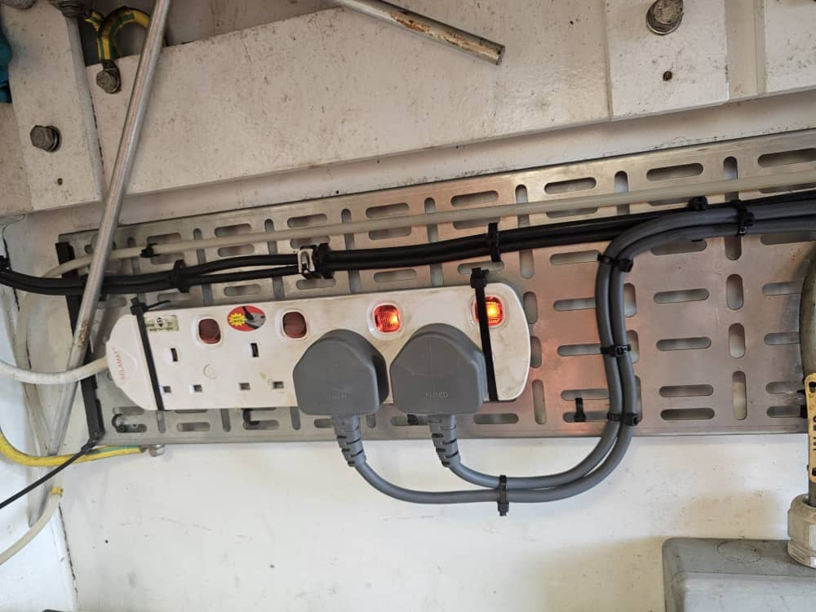
Starlink Set Up at Cabin Unit
Figure 1: Starlink Satellite on top of Cabin Unit
Figure 2: 240V Power Socket

Slide 4
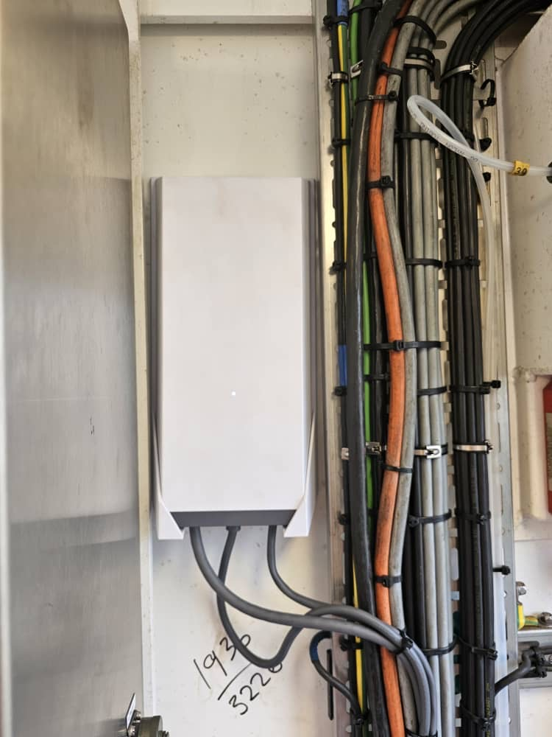
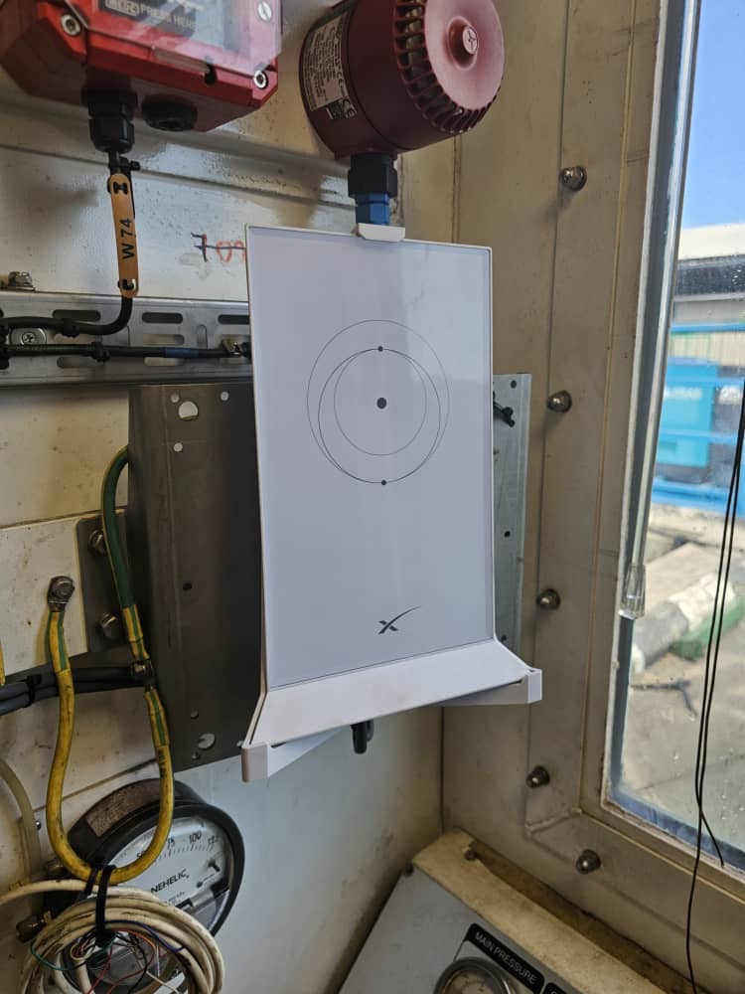
Starlink Set Up at Cabin Unit
Figure 3: Power Supply
Figure 4: Router

Slide 5
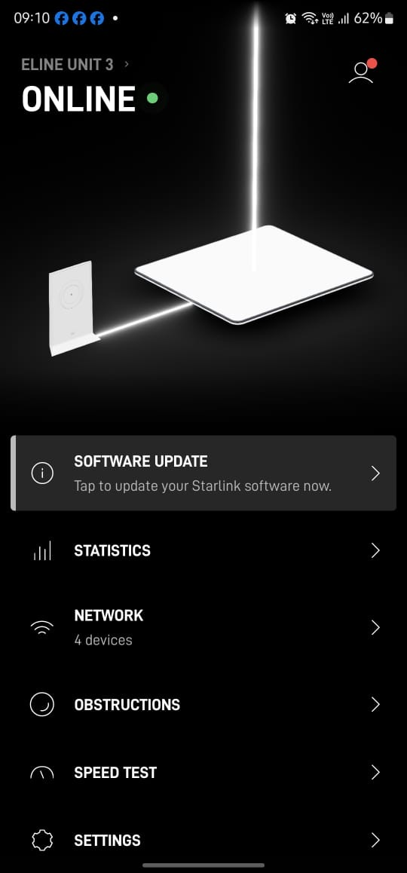
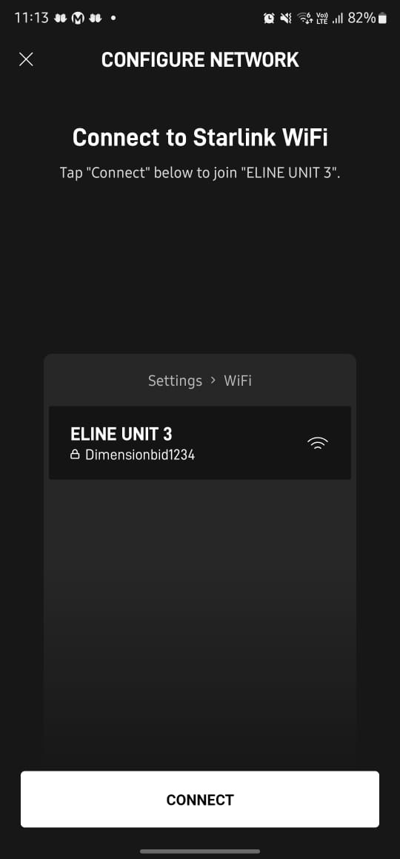
Starlink Interface Application
Figure 5: Starlink Interface App
Figure 6: Configuration of Network

Slide 6
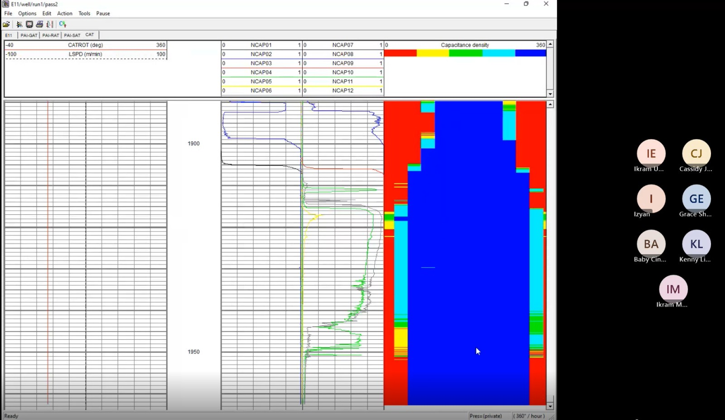
Snapshot from Microsoft Team
Figure 7: Monitor Log Data through Microsoft Team

