Slide 1
X-LINE RUNNING TOOL
Presented by : Christopher Mathew Anak Kipli
Date :

Slide 2
Table of Content:
Running Tool Overview
X-Line Running Tool Assembly
Selective And NON-Selective Position
Assembling The Lock Mandrel To "X" Running Tool
Running Procedure
Basic Maintenance

Slide 3
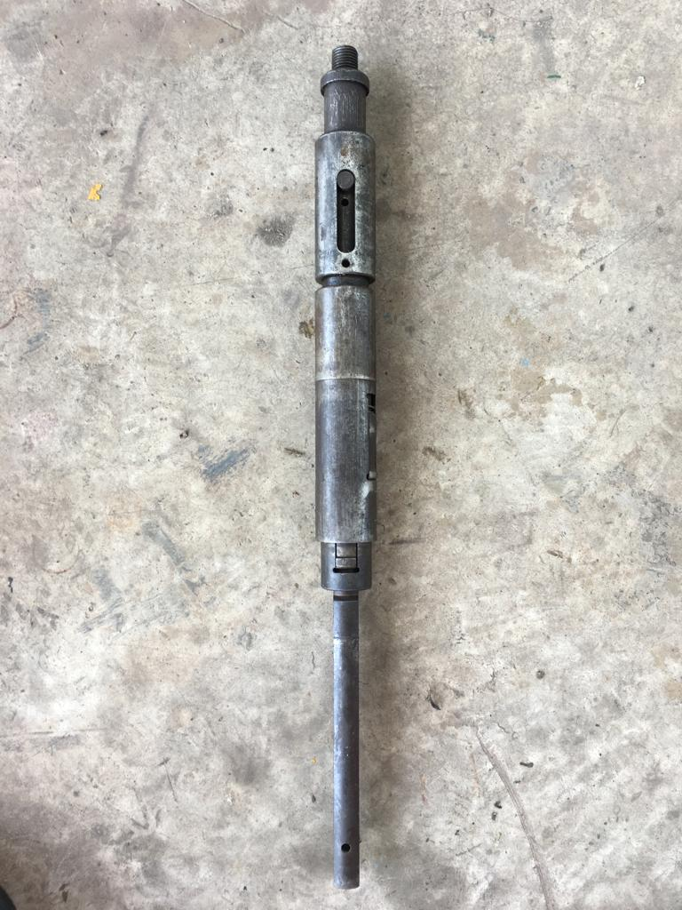
Running Tool Overview
To run X and XN lock mandrel.
3-inch nominal X-line running tools has 2 size; 2.750” and 2.813”

Slide 4
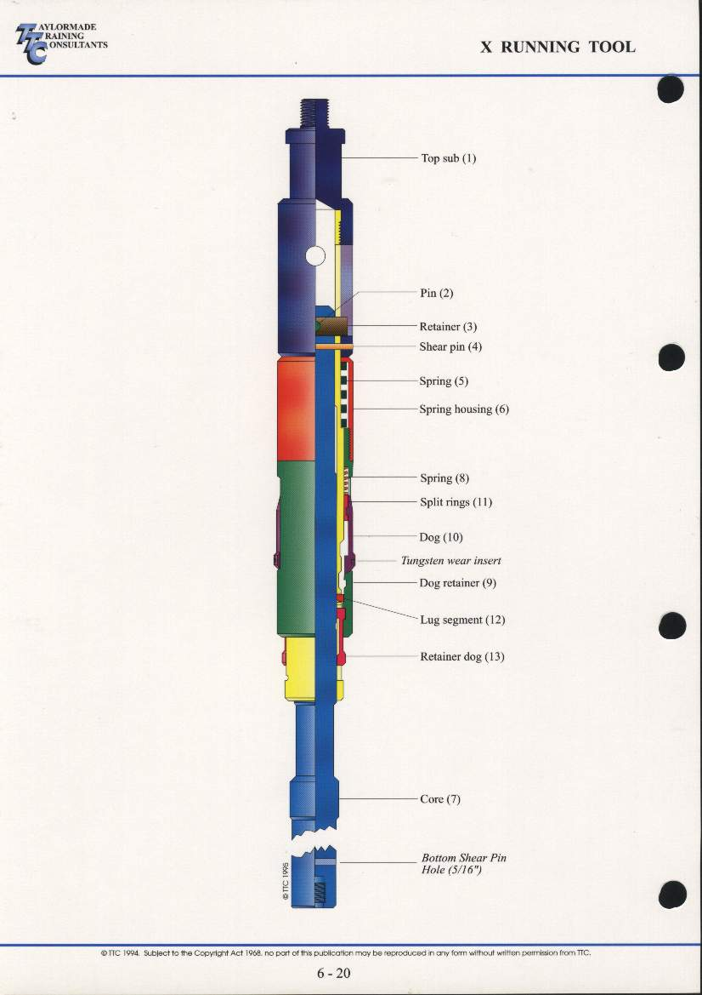
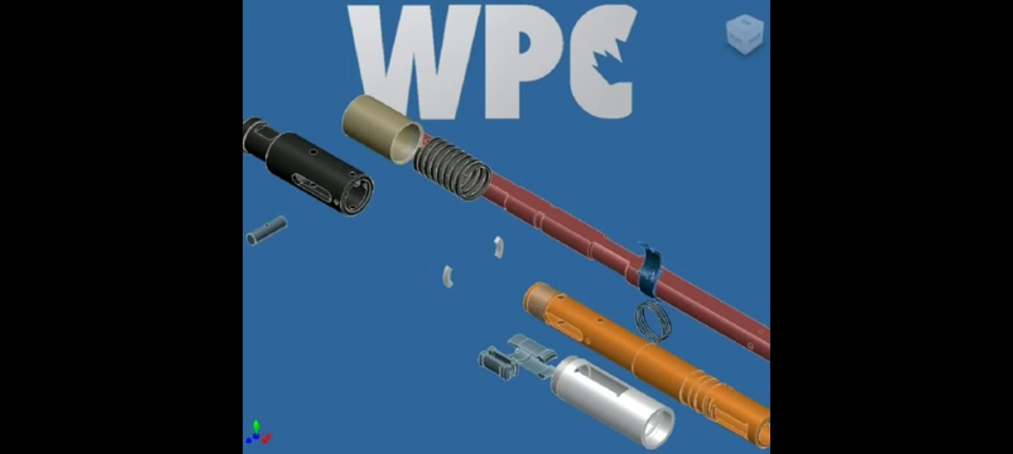
X-Line Running Tool Assembly
Top Sub
Spring Housing
Core Spring
Lug Segment
Core
Split Ring
Dog Spring
Mandrel
Dog Retainer
Locator Dog
Retainer Dog
Core Retainer Pin
1
2
3
4
5
6
7
12
11
10
9
8

Slide 5
Selective And Non Selective Position
Selective Position
Lock Mandrel - Key are FULLY RECTRACTED
Running Tool - Nipple locator OUT
- No GAP between the fishing neck and spring
house.

Slide 6
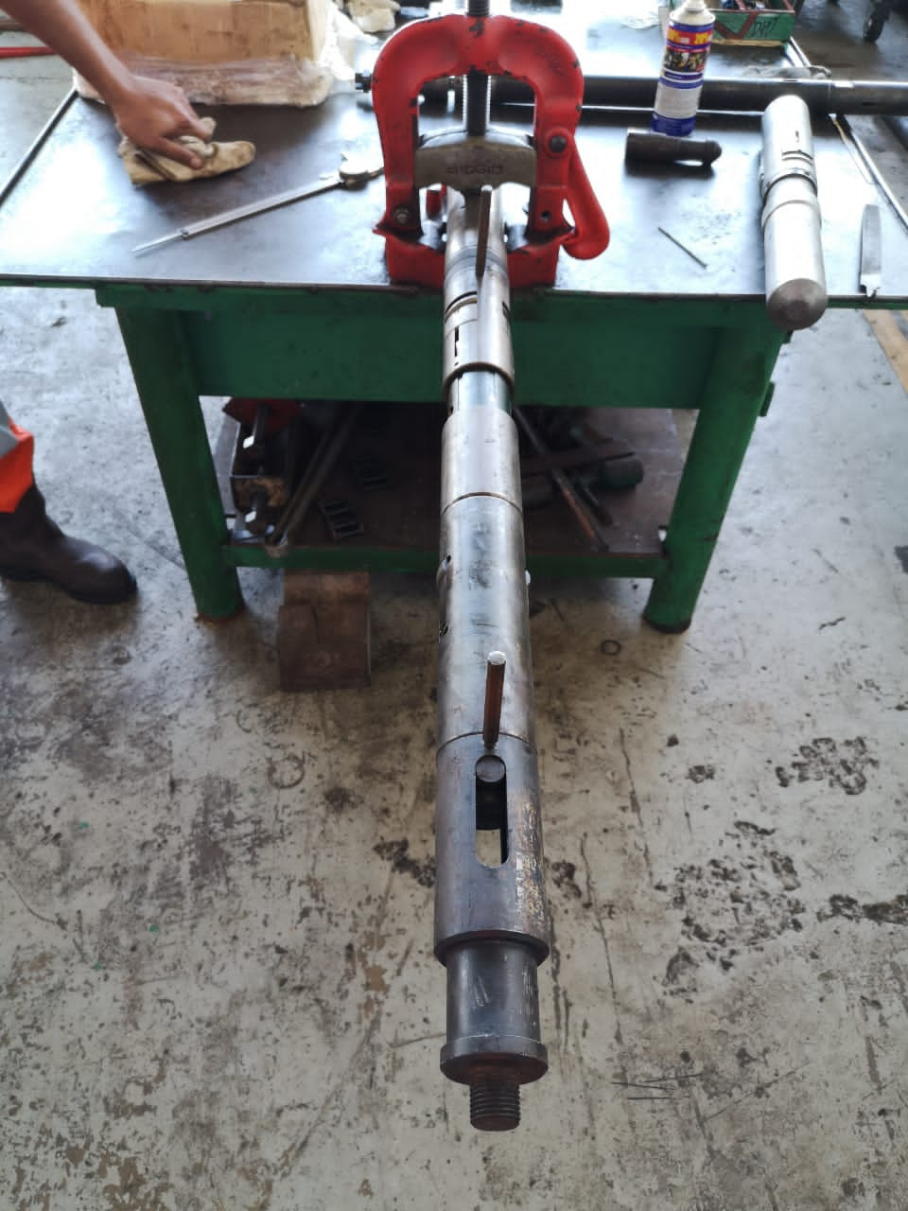
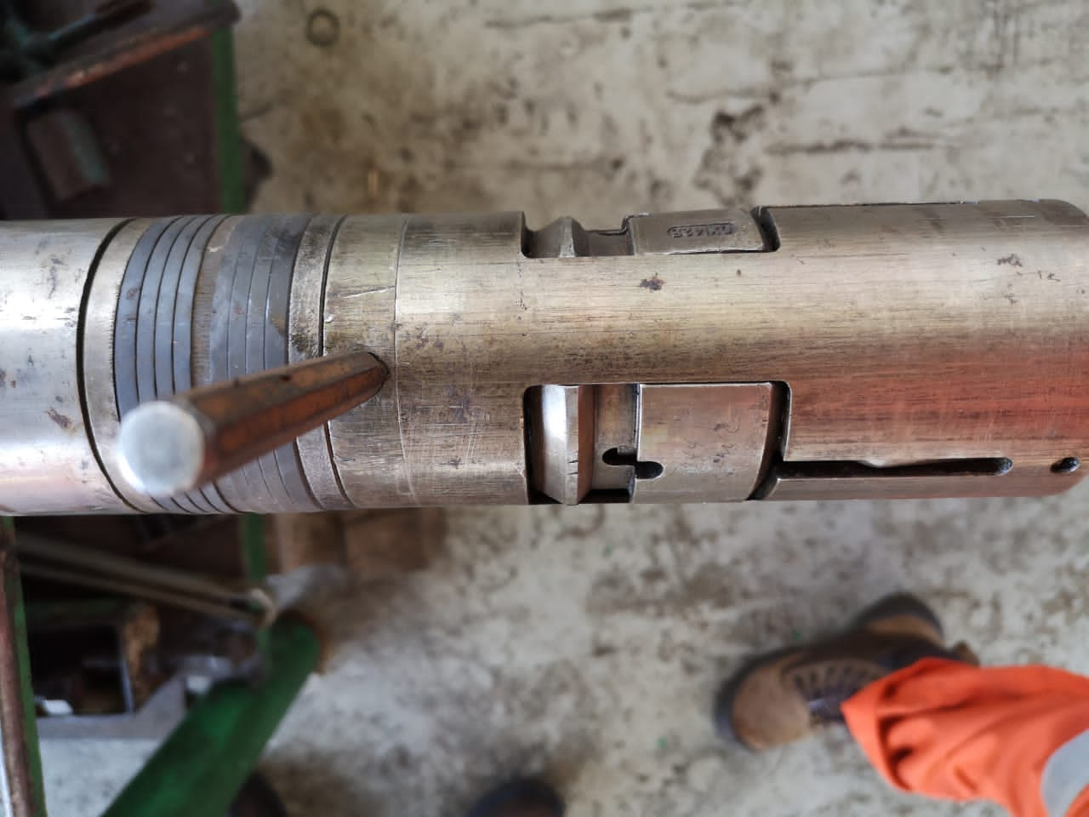
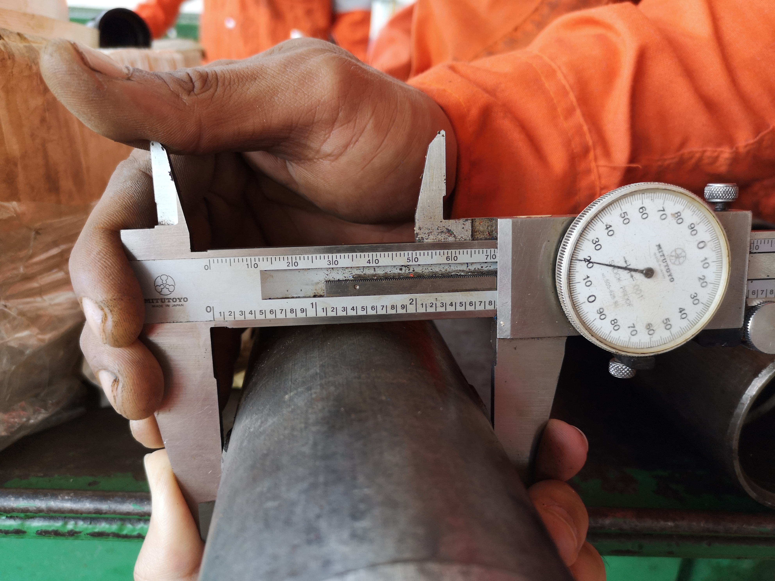
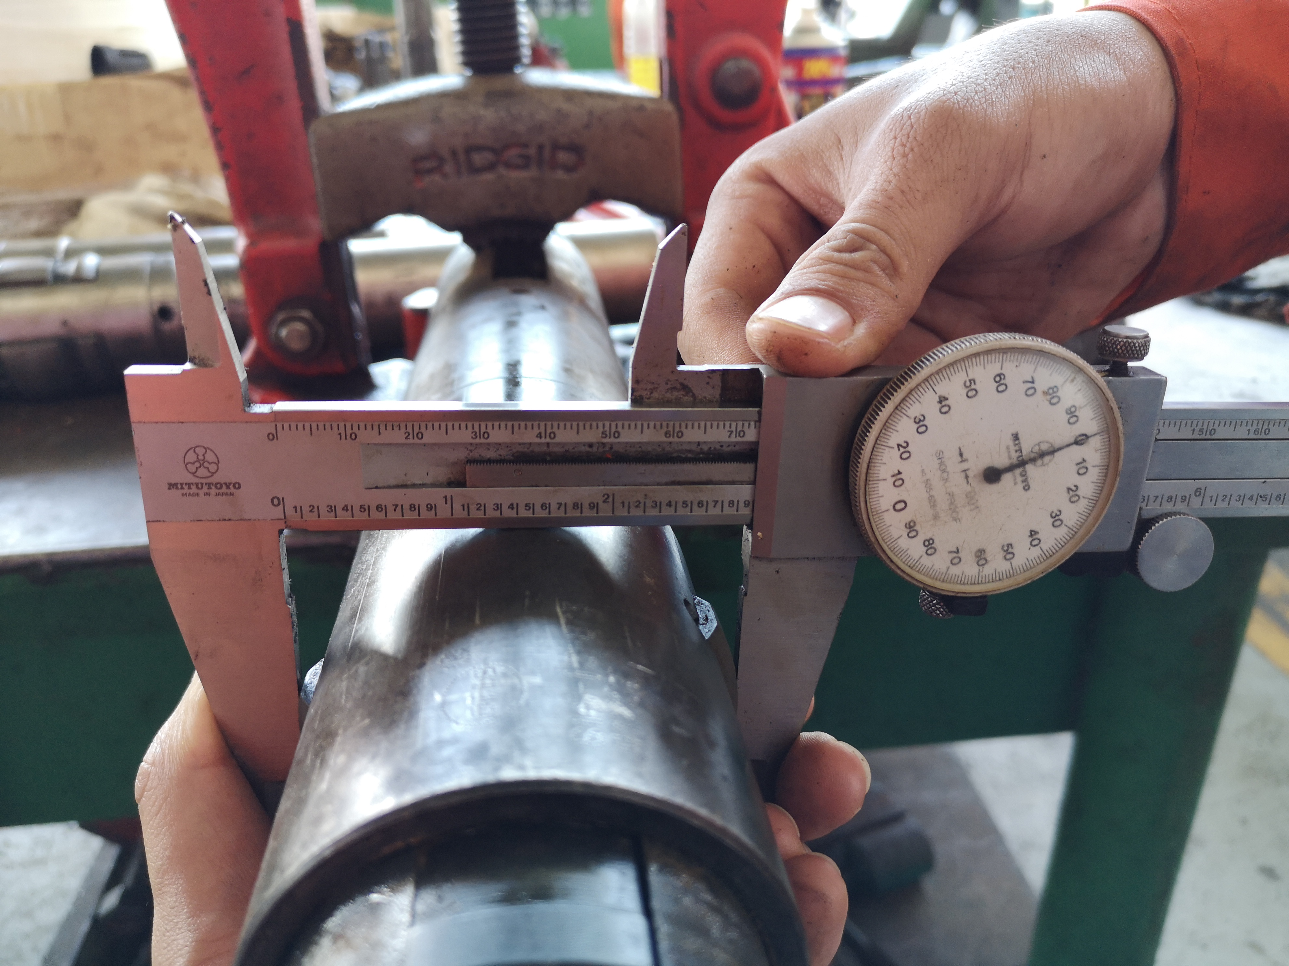
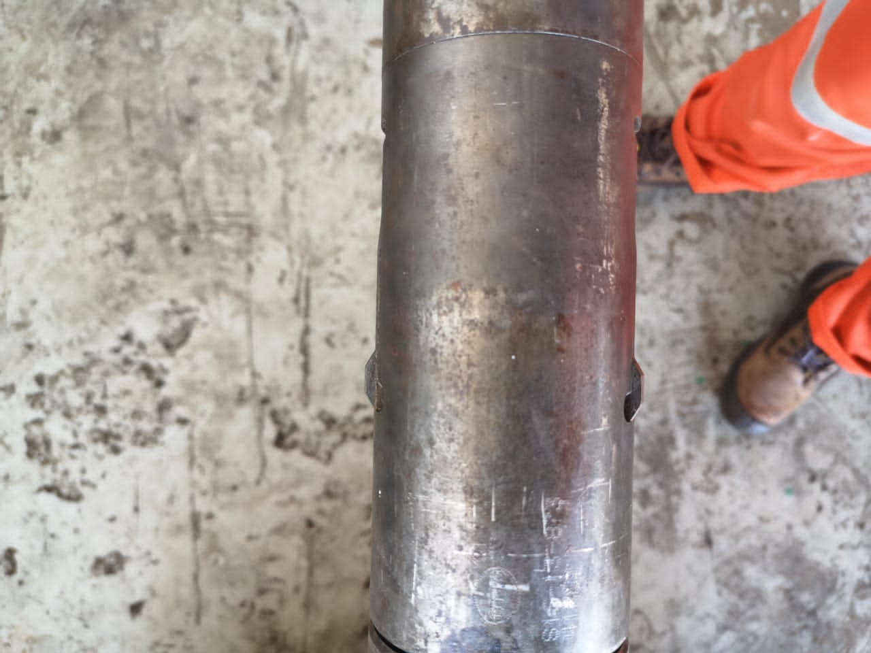
Locator Dog nipple OUT. Size 2.82”
Key Retract
2.750” X-Line
No GAP
Locator Dog nipple OUT. Size 2.90”
2.813” X-Line

Slide 7
Selective And Non Selective Position
NON-Selective Position
Lock Mandrel - Key are expand to permit 90deg shoulder
to locate in the nipple.
Running Tool - Nipple locator dog IN
- GAP between the fishing neck and spring
housing

Slide 8
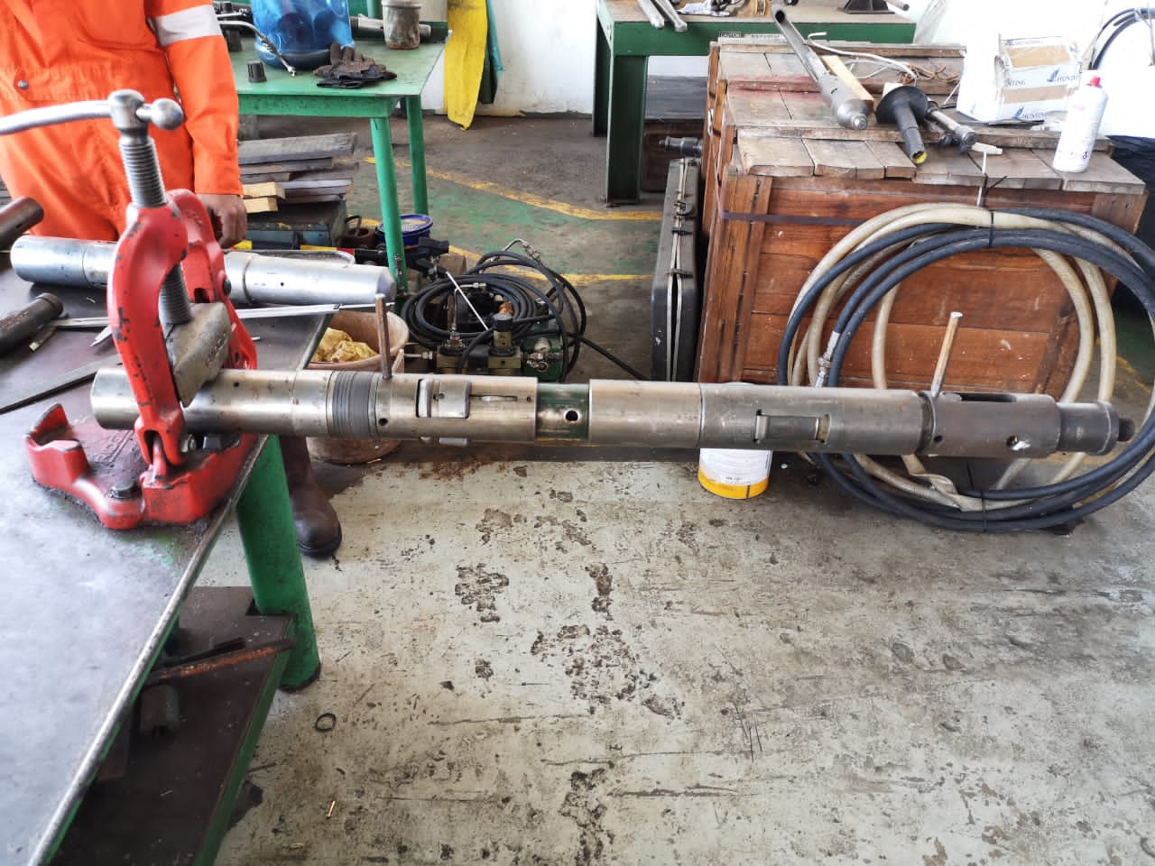
Key Expand
Locator Dog IN
GAP in between spring housing and top sub

Slide 9
Assembling The Lock Mandrel To "X" Running Tool
Insert the "X" running tool core end into the fishing neck
Rotate the running tool as necessary until the releasing shear pin hole in the core is aligned with the releasing shear pin hole in the packing mandrel.
Insert a 5/16" brass pin into this set of releasing shear pin holes until the end of the pin.
Flare the ends of the shear pin with a center punch
Insert a 1/4" pin punch into the other shear pin hole in the packing mandrel

Slide 10
Assembling The Lock Mandrel To "X" Running Tool
Extend the fishing neck of the lock mandrel until the retainer pin at the top of the running tool mandrel sub-assembly shoulders up on the bottom of the slot.
Insert a slightly bent 1/4" brass pin into the upper shear pin hole of the running tool.
Flare the ends of the shear pin to prevent them from dropping out after shearing

Slide 11
Running Procedure
Run in hole the "XX" plug at moderate speed and stop at 10 feet above the “X" profile accessory where the plug to be set (an Otis "X" landing nipple or SSD). Check pulling weight of the tool string assembly.
Then, lower down and tap the plug through this "X" nipple profile.
Pull back the plug slowly until the tripping dogs locate the bottom of the seal bore.
Apply an overpull of 300 to 400 lbs to trip the running tool and bring the "XX" plug lock mandrel into the "Control" position.

Slide 12
Running Procedure
Lower the plug slowly into the landing nipple. Tap down on the plug slowly to get the V-packings into the seal bore, and the lock mandrel keys locate into the landing nipple recess.
Apply downward jarring to shear the setting pin in the running tool and move the lock mandrel expander sleeve behind the keys to lock them in the expanded position.
Check to confirm the plug is fully locked in the nipple by applying a 200 to 350 lbs overpull. When confirmation is positive, jar up to shear the releasing pin attaching the running tool core to the plug and free the running tool.
Once the running tool is free, check pulling weight to be sure that the plug is not attached to the running tool.

Slide 13
Basic Onsite Maintenance
Clean up tool body by using diesel after operation.
Function test the tool. If the locating dog unable to move upward, redress the tool as there is debris that dislodge in the housing/spring
Wipe up tools using hydraulic oil for preservations.
If the tools was not in used for extended period, strip down and service the tools before use.

Slide 14
THANK YOU !

