Slide 1
CHS QUALITY MANAGEMENT SYSTEM (QMS)
Prepared by : Nor Shafiza Binti Ghazali
Prepared for : JFE MODULE
Date : 17 December 2019

Slide 2
CONTENTS
What is QMS?
ISO & API Q2 Definition
ISO and API Q2 Standard (for OPERATION)
Quality Manual as a Quality Standard
CHS Procedures and SOP/SSP

Slide 3
WHAT IS QMS?
A quality management system (QMS) is a set of Policies, Processes and Procedures required for planning and execution (production/development/service) in the core business area of an organization. (i.e. areas that can impact the organization’s ability to meet customer requirements.) ISO 9001:2015 is an example of a Quality Management System.
POLICY – The “Laws” or “Regulations” that govern the operations
STANDARD – A mandatory action or rule designed to support and conform a Policy
PROCEDURE – Describes “how to” or step by step instructions that implement the process
PROCESS – A set of procedures that uses inputs to produce outputs; often illustrated by a flow chart

Slide 4
ISO & API DEFINITION?
ISO 9001:2015 | API Spec Q2
Related to Quality Management System, applicable to any organization from all types of business sectors and activities. | Specification for Quality Management System Requirements for Service Supply Organizations for the Petroleum and Natural Gas Industries
EQUIVALENT
DBSB was certified to
ISO 9001:2015

Slide 5
ISO & API Q2 STANDARD (for OPERATION)
ISO 9001:2015 | API Spec Q2
4.4 Quality Management System and its processes 4.4.1 The organization shall establish, implement, maintain and continually improve a QMS, including the processes needed and their interactions 4.4.2 Maintain documented information to support the operation of its processes Retain documented information to have confidence that the processes are being carried out as planned 7.2 Competence The organization shall: Determine the necessary competence of persons doing work under its control that affects the performance and effectiveness of QMS Ensure that these persons are competent on the basis of appropriate education, training, skills and experience 8.1 Operational planning and control 8.2 Requirements for products and services 8.3 Design and development of products and services (Inputs, design controls and outputs) 8.5 Production and Service Provision – The organization shall implement production and service provision under controlled conditions such as availability of documented information 8.5.5 Post-delivery activities – The organization shall meet requirements for post-delivery activities associated with the products and services such as customer requirements (DOR, Personnel and Equipment Utilization, Offshore activity Summary) and customer feedback (CSS Form) | 4 Quality Management System Requirements 4.1.1 The organization shall establish, document, implement, maintain, measure the effectiveness of, and improve upon a QMS in accordance with the requirements of this document 4.3.2.3 Training and Awareness The organization shall: Provide for QMS training and for job training of the organization’s personnel who effect the execution of services or provision of service-related products. Maintain appropriate records of education, training, skills and experience 5.2 Planning The organization shall identify and plan the processes and documents needed for service and service-related product 5.4 Design and Development (Planning, Inputs, Outputs, verification, Final Review and Approval) 5.7 Execution of Service – Controls for execution of the service shall be documented (checklists, process sheet or other types of documents) 5.9 Service Performance Validation – The organization shall maintain a documented procedure to validate the execution of the service performance to confirm that requirements were achieved

Slide 6
STANDARD REQUIREMENT (ISO & API Q2)
No | Requirements | ISO 9001:2008 | ISO 9001:2015 | API SPEC Q2
1 | Quality manual, policy & objectives | Yes | Yes | Yes
2 | Communications (internal & external) | Yes | Yes | Yes
3 | Management responsibility (org. structure) | Yes | Yes | Yes
4 | Responsibility & Authority | Yes | Yes | Yes
5 | Personnel competence, training & awareness | Nil | Yes | Yes
6 | Control of documents & records | Yes | Yes | Yes
7 | Contract Review | Yes | Yes | Yes
8 | Planning | Yes | Yes | Yes
9 | Risk Assessment and Management | Nil | Yes | Yes
10 | Design and Development (planning, input, output, verification) | Nil | Yes | Yes
11 | Contingency planning | Nil | Yes | Yes
12 | Purchasing Control | Yes | Yes | Yes

Slide 7
STANDARD REQUIREMENT (ISO & API Q2)
No | Requirements | ISO 9001:2008 | ISO 9001:2015 | API SPEC Q2
13 | Control of Service Provision | Yes | Yes | Yes
14 | Service Quality Plan | Nil | Nil | Yes
15 | Identification and traceability | Yes | Yes | Yes
16 | Service-related product status | Nil | Nil | Yes
17 | Customer property | Nil | Yes | Yes
18 | Preservation of service-related product | Nil | Yes | Yes
19 | Validation of Service-related product | Nil | Nil | Yes
20 | Preventative maintenance, inspection and test program | Nil | Nil | Yes
21 | Control of testing, measuring, monitoring and detection equipment | Yes | Yes | Yes
22 | Service performance validation | Nil | Yes | Yes
23 | Control of nonconformities | Yes | Yes | Yes
24 | Management of Change | Nil | Yes | Yes

Slide 8
STANDARD REQUIREMENT (ISO & API Q2)
No | Requirements | ISO 9001:2008 | ISO 9001:2015 | API SPEC Q2
25 | Customer satisfaction | Yes | Yes | Yes
26 | Internal Audit | Yes | Yes | Yes
27 | Analysis of Data | Yes | Yes | Yes
28 | Corrective Action | Yes | Yes | Yes
29 | Preventive Action | Yes | Yes | Yes
30 | Management Review | Yes | Yes | Yes

Slide 9
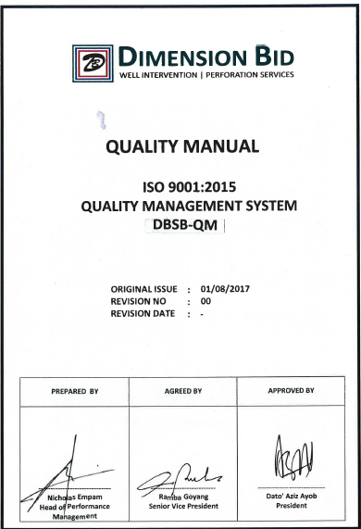
QUALITY MANUAL – as a standard for DB
QUALITY MANUAL
DBSB-QM Quality Manual ISO 9001:2015

Slide 10
CHS PROCEDURE & SOP/SSP
NO | CHS PROCEDURE | SOP | SSP
1 | DBSB-CHS-01: Cased Hole Services | CHS-SOP-01 Log Quality Control | SSP Winch Control and Rig up & Rig Down
2 | DBSB-CHS-02: Service Notification | CHS-SOP-02 Logging Module Operation | SSP MOT
3 | DBSB-CHS-03: Service Planning & Preparation | CHS-SOP-03 Wireline Depth Control Measurement | SSP DC-MOT
4 | DBSB-CHS-04: Service Briefing and Debriefing | CHS-SOP-04 Surface Readout | SSP MIT
5 | DBSB-CHS-05: Mobilization and Demobilization | CHS-SOP-05 EM Cable Operation and Maintenance | SSP EMR
6 | DBSB-CHS-06: Service Executions | CHS-SOP-06 Cable Stuck
7 | DBSB-CHS-07: Service Performance Validation | CHS-SOP-07 Equipment Fueling
8 | DBSB-CHS-08: Control of Testing, Measuring, Monitoring and Detection Equipment | CHS-SOP-08 Lab Management Procedure
9 | DBSB-CHS-09: Training and Development | -
10 | - | -

Slide 11
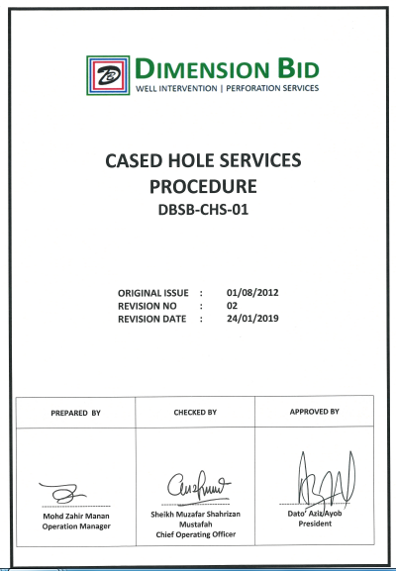
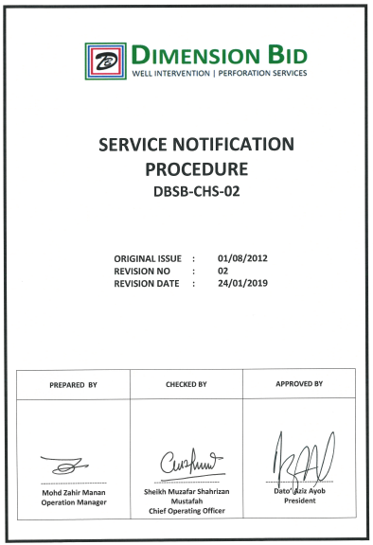
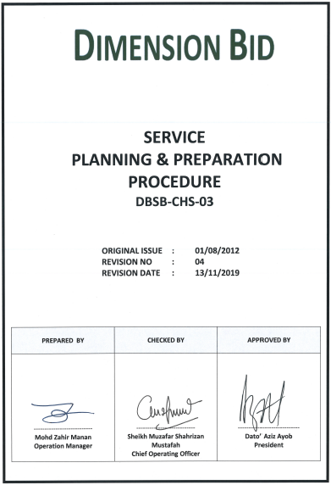
CHS PROCEDURE & SOP/SSP

Slide 12
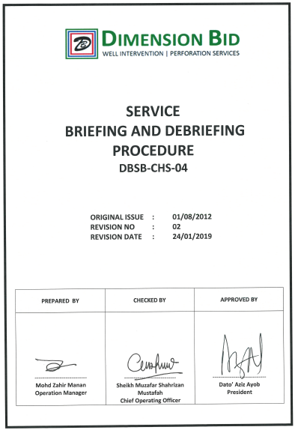
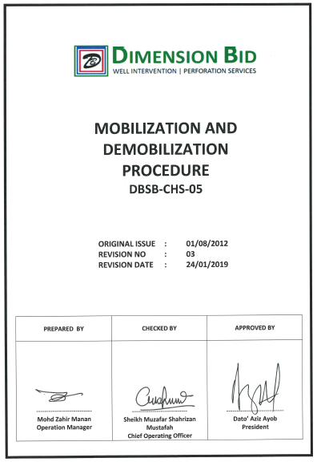
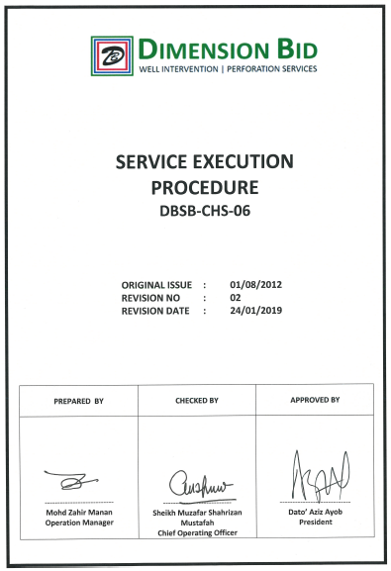
CHS PROCEDURE & SOP/SSP

Slide 13
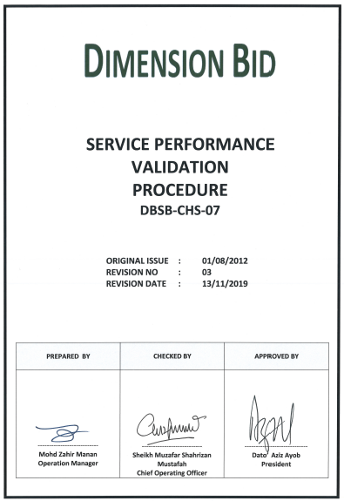
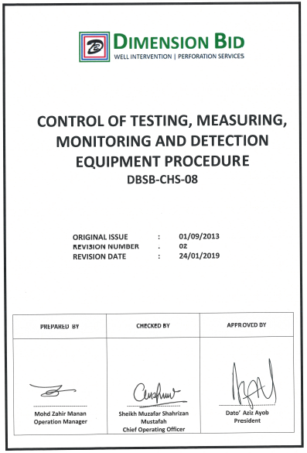
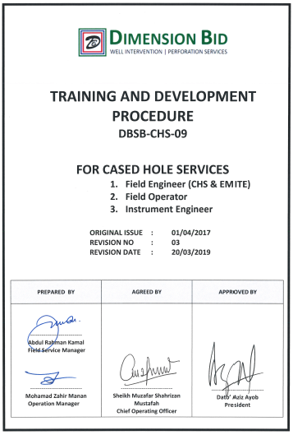
CHS PROCEDURE & SOP/SSP

Slide 14
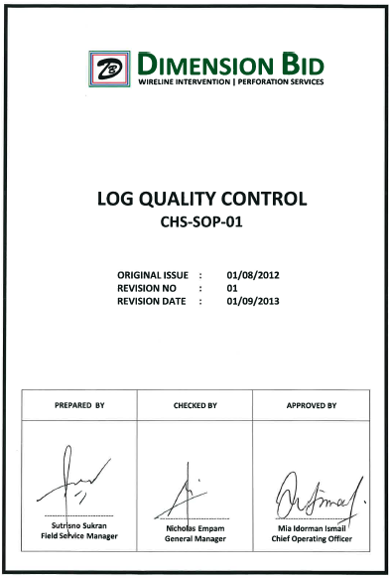
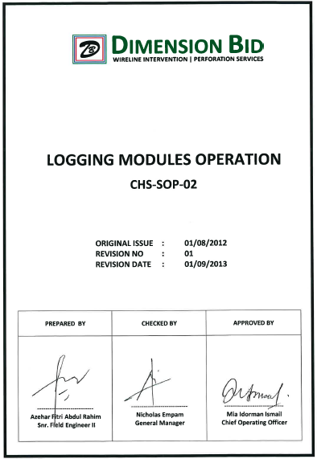
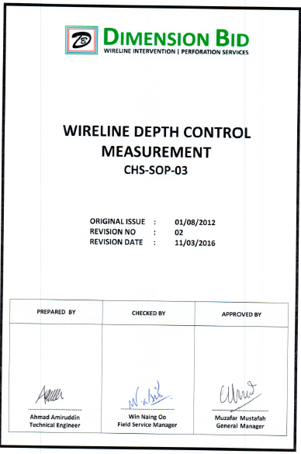
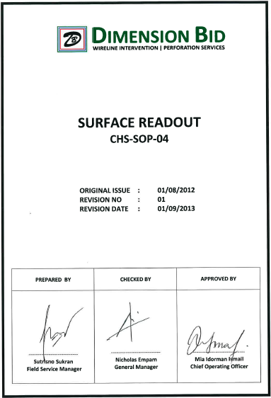
CHS PROCEDURE & SOP/SSP

Slide 15
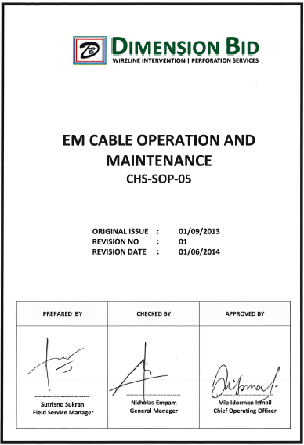
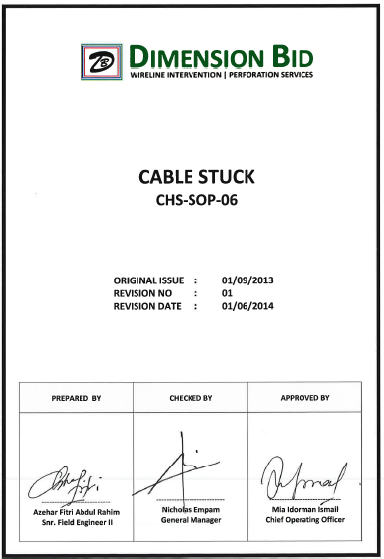
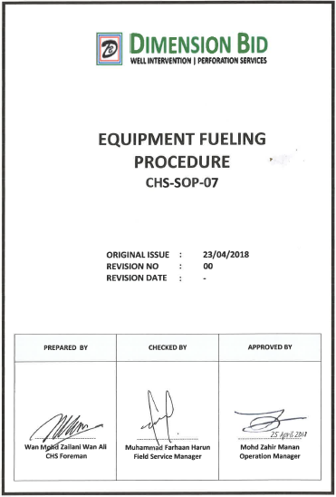
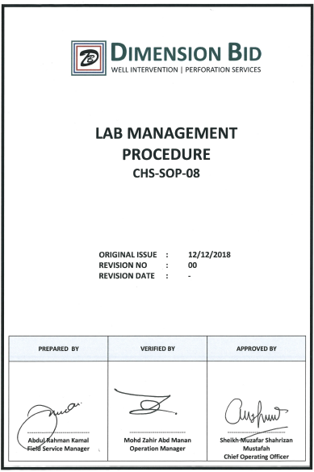
CHS PROCEDURE & SOP/SSP

Slide 16
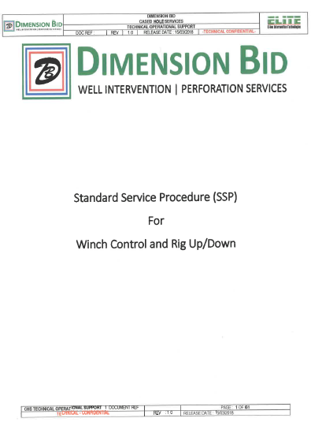
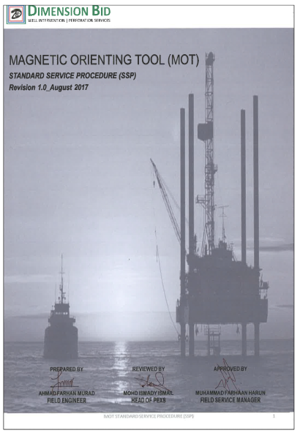
CHS PROCEDURE & SOP/SSP

Slide 17
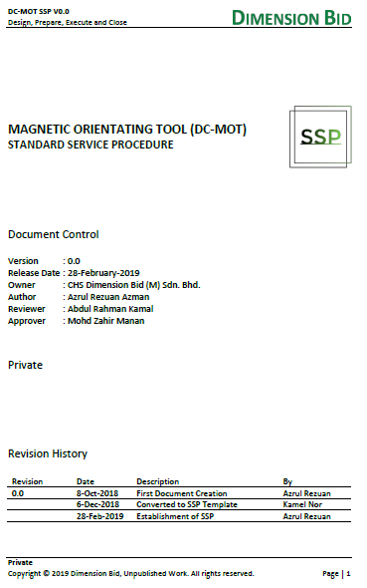
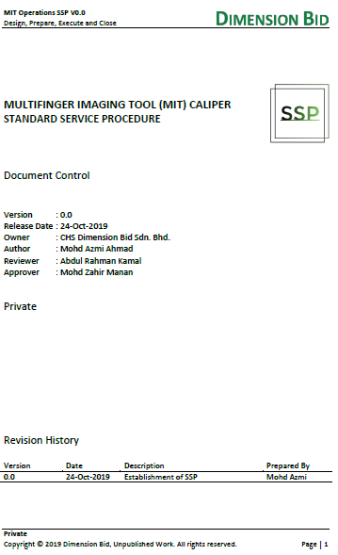
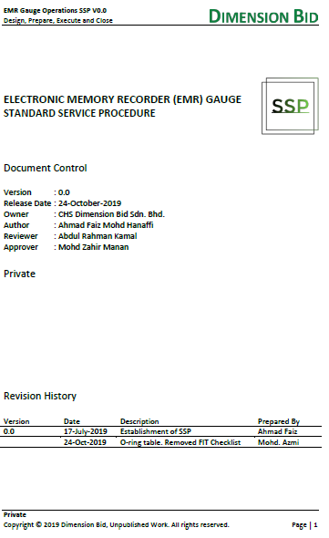
CHS PROCEDURE & SOP/SSP

Slide 18


