Slide 1

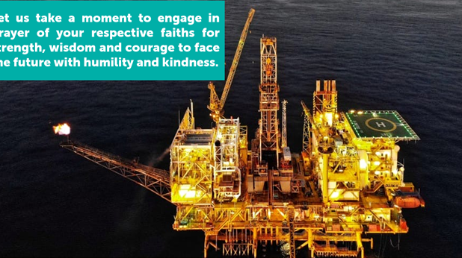


Post Job Review
MILLING & ADD PERFORATION
By: Zainuddin Yaacob

Slide 2
TABLE OF CONTENT
EXECUTIVE SUMMARY
01
WELL OVERVIEW
02
SUMMARY OF INTERVENTION ACTIVITIES
03
JOB ANALYSIS
04
CONCLUSION
06
LESSON LEARNED
07

Slide 3

Executive Summary
Operation at Dulang was a standalone CT package with all equipment and chemical placed on platform assisted by standby boat for accommodation and temporary storage.
CT Operation Duration: 57 Days (16th August to 12th October 2024)
Well: Dulang A-12
  CT Milling on fish from fish depth at 2,611 MDDF until ‘D’ Nogo Nipple
  CT Add Perforation for E34A Zone (2,740 m – 2,749 m MDDF)
CTU Operation completed on 12th October 2024 with all CTU package demobilize to KSB

Slide 4

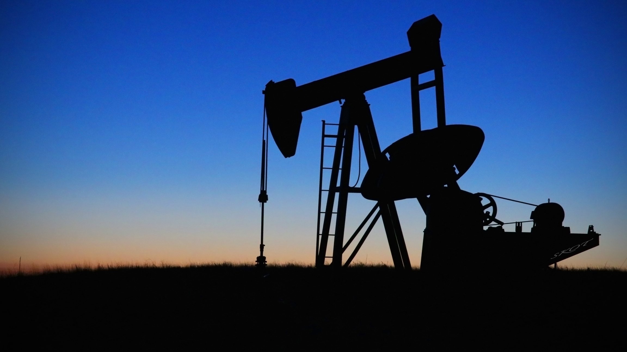


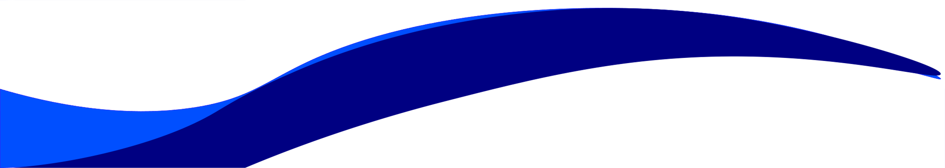
Executive Summary
Objective
To perform CT Milling on fish (parted tubing stop sleeve) with burn shoe mill bit to have wellbore access until depth 2,749 m MDDF.
To perform CT Add Perforation for E34A zone (2,740 m – 2,749 m MDDF).
Well Background
Dulang A-12 is an oil producer. Currently the well is producing from zone E23U & E32 with 392 BOPD & 90% of water cut. Latest HUD depth at 2,611 m MDDF recorded in April 2023 with clear image of parted tubing stop sleeve. PCSB has engaged DB to mill the fish & drift until target depth prior to add perforation at zone E34A.

Slide 5
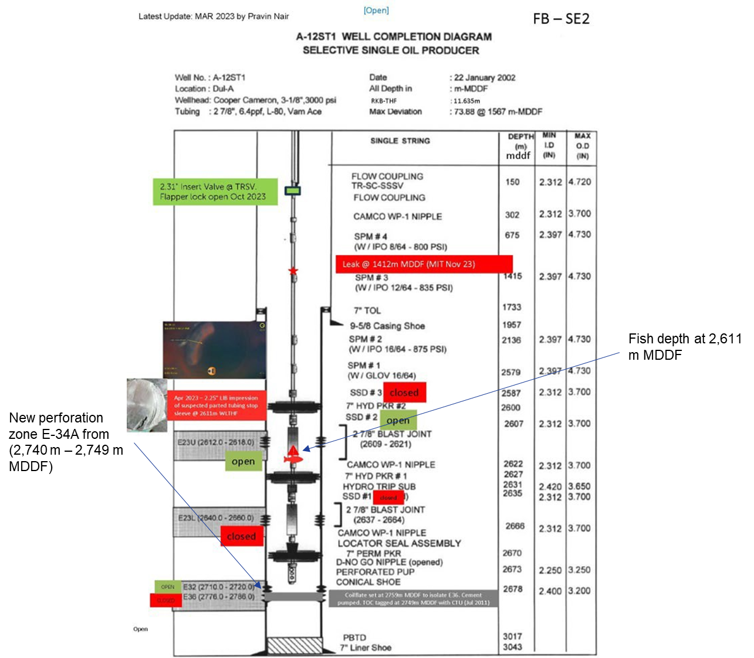



A-12 Well Overview

Slide 6

A-12 Well Overview
Input Parameter | Parameter Value
Field | Dulang A-12
Max. Deviation (degrees) | 73.88 Deg @ 1,567 m MDDF
Min. Restriction (inch) | 2.25” @ 2,670 m MDDF (‘D’ Nogo Nipple)
Tubing Specification | 2-7/8” Production Tubing (Refer Well Schematic)
Type of Fluid & Density | N/A
Top of Fluid | 716 m MDDF
Current Well Status | Flowing
Depth of zone | E23U (2,612 – 2,618 m MDDF) E32 (2,710 – 2,720 m MDDF) Future: E34A (2,740 – 2,749 m MDDF)
Reservoir Pressure (psi) | E32: 1,542 psi, E34A (Future): 1,436 psi
Reservoir Temperature (deg F) | E32: 214 deg F, E34A (Future): 218 deg F
Porosity | E32: 22%, E34A (Future): 24%
Permeability (mD) | E32: 300 mD, E34A (Future): 300 mD
Fracture Gradient | 0.67 psi/ft
H2S Content | 0%
CO2 Content | 65%
Mercury, HG | 0%
Additional Information / Notes / Special Requirement:
Top of Fish (Tubing Stop Sleeve): 2,611 m MDDF
Content Name
Presentation is a public
speaking activity that
aims to convey a message
or information.

Slide 7
Summary of Intervention Activities
Item | Job Description | Plan Run Details | Actual Run Details
A | CTU Operation | CT Run#1: Burnshoe milling top of fish at 2,611 m MDDF (parted tubing stop sleeve) until ‘D’ Nogo Nipple CT Run#2: Drift & depth correlation until PBTD at 3,017 m MDDF CT Run#3: GRCCL with dummy Gun (2.00” OD x 6m length) CT Run#4: CT Perforation (Gun 2.00” OD x 9m length) | CT Run#1: Burn shoe milling top of fish at 2,611 m MDDF (parted tubing stop sleeve) until ‘D’ No go Nipple. CT Contingency for Run#1: Fishing with Magnet CT Contingency for Run#1: Milling with 2.28" Junk Mill Bit. 4. CT Contingency for Run#1: Milling with 2.28" Junk Mill Bit with additional acid soaking CT Contingency for Run#1: Impact hammer c/w Blind box 2.28“ CT Run#2: Drift & depth correlation until 2,717 m MDDF CT Run#3: GRCCL with 2.20” Dummy Spend Gun Unplanned CT Contingency Run: Venturi Junk Basket (VJJB) Cleanout Unplanned CT Contingency Run: Venturi Junk Basket (VJJB) Cleanout
B | CTU Contingency | CT Contingency#1: Fishing with Magnet CT Contingency#2: Venturi Junk Basket (VJB) Cleanout CT Contingency#3: Cement Shut Off to isolate zone E36 until E34A Bottom Perf at 2,749 m MDDF CT Contingency#4: Drift run until tag top of cement (TOC)
Summary of Intervention Activities.

Slide 8
Summary of Intervention Activities
Item | Job Description | Plan Run Details | Actual Run Details
B | CTU Contingency | Cement Integrity Test CT Contingency CT Packer – to isolate leak at depth 1,412m and pressure test cement Bullheading fill-up PCP volume before fill up tubing volume and pressure test CT Contingency#5: Underreamer milling until E34A Bottom Perf at 2,749 m MDDF CT Contingency#6: Post milling cleanout until E34A Bottom Perf at 2,749 m MDDF
Summary of Intervention Activities.

Slide 9
Summary of Intervention Activities
No. | Planned | Days | Actual | Days | Remark | Date, 2024
1 | First Trip Equipment Mob | 1 | First Trip Equipment Mob | 2 | First trip Mob to Dulang Alpha on 16th October 2024 (11:00 pm) Ariived at Dulang field on 17th October 2024 (5:00 pm) | 16-17 August
2 | Lifting Activity to Offload Equipment on Dlg A | 3 | Lifting Activity to Offload Equipment on Dlg A | 3 | Perform lifting acitivity for CTU equipment | 18 – 20 August
3 | Second Trip Equipment Mob | 2 | Second Trip Equipment Mob | 2 | Berthing date defer to 21st August 2024. TK arrived at Dulang Field evening 22nd August 2024 | 21 – 22 August
4 | Lifting Activity / Rig up CTU Equipment / Slickline Activity | 6 | Lifting Activity / Rig up CTU Equipment / Slickline Activity | 8 | Crew arrived late to Dulang Alpha due to washdown maindeck at Dulang Delta. Perform Offload from Two Kasturi to Dulang Alpha. Rig Up CTU equipment Slickline activity to work on well A-12. Slickline unable to close SSD#2. CT rig up on well. | 23 - 30 August
5 | CTU Run#1: Milling TOF with Burn shoe Milling | 3 | CTU Run#1: Milling TOF with Burn shoe Milling | 2.5 | CT flag#1 Initial HUD at 8,606 ft / 2,623 m MDDF Attempt to milling at this depth, motor stall multiple time Overpull few times last milling progress 8,607 ft MDDF, 1 ft progress At Surface observe bit reduce in OD and scratch mark at body Preparation for next run Cut CT 20ft | 31 August - 2 September
5.1 |  |  | CT Contingency for Run#1: Fishing with Magnet | 1.5 | Initial HUD at 8,494 ft / 2,588 m MDDF BHA tag shallower than depth Run#1 (Flag#1 still in reel) Suspected BHA stuck at SSD#3 at 8,488 ft / 2,587 m MDDFor Fish Move upward At Surface only recover small debris metal. | 2 - 4 September
5.2 |  |  | CT Contingency for Run#1: Milling with 2.28" Junk Mill Bit. | 2 | First Tag at depth 8,625 ft / 2628.7 m MDDF After soaking tag at depth 8,622.08 ft / 2,627.8 m MDDF BHA tag 16 ft from first flag depth, tag at depth 8,780 ft / 2,676 m MDDF based on Orion and mechanical counter Reset depth to 8,606 ft / 2,623 m MDDF Motor stall and overpull , same pattern as per Run#1 Based on flag, 1 ft progress below HUD | 4 - 6 September

Slide 10
Summary of Intervention Activities
No. | Planned | Days | Actual | Days | Remark | Date, 2024
5.3 |  |  | Slickline activity | 3.5 | HUD with 2.29" GR at 2,612 m WLTHF HUD with 2.25" Tubing Broach at 2,612m WLTHF HUD with 2.25" LIB, 0.37" fish OD from side LIB HUD with 2" LIB at 2,612 m WLTHF HUD and tool bind with 1.75" magnet at 2,612 m WLTHF Remarks: Crew unable interig to DL-A due to weather pickup and no available boat to DLA on 7th September 2024 | 6 - 9 September
5.4 |  |  | CT Contingency for Run#1: Milling with 2.28" Junk Mill Bit. | 2.5 | First Tag at depth 8,625 ft / 2628.7 m MDDF After soaking tag at depth 8,622.08 ft / 2,627.8 m MDDF BHA tag at 8,625 ft / 2,628 m MDDF, spot 10 bbls of 10% HCl Unload acid and start milling at new tag depth , 8,622.6 ft / 2628m Observe good milling pattern, no motor stall or overpull Last milling pattern for 2 ft progress at 8,624 ft / 2,628.5 m MDDF , weight return to normal Continue RIH and tag No-go nipple. POOH, and re-RIH, tag at depth 8,622 ft MDDF (Initial fish position) during dry tag. Continue POOH to handover to slickline for TCC | 9 - 11 September
5.5 |  |  | Slickline activity | 0.5 | 2.29 GR able to tag No-Go nipple HUD with 2.25" at 2,613 m WLTHF with 0.25" Fish OD from side LIB | 11 September
5.6 |  |  | CT Contingency for Run#1: Impact hammer c/w Blind box 2.28“ | 1 | First tag at 8,629 ft / 2,629 m MDDF BHA Tag at 8,629 ft / 2629 m MDDF BHA able to move few ft below and weight return to normal Pick-up and attempt to tag back, tag at same depth POOH to surface, decided to RIH with 2.2" FC drift CT | 12-13 September
6 | CT Run#2: Drift & depth correlation until PBTD at 3,017 m MDDF | 1 | CT Run#2: Drift & depth correlation until 2,717 m MDDF | 1.5 | First tag at 8,914 ft / 2,717 m MDDF Tag HUD inside casing section | 13-14 September

Slide 11
Summary of Intervention Activities
No. | Planned | Days | Actual | Days | Remark | Date, 2024
7 | CT Run#3: GRCCL with dummy Gun (2.00” OD x 6m length) including Deployment System Rig Up | 2 | CT Run#3: GRCCL with 2.20” Dummy Spend Gun including Deployment System Rig Up | 9 | Platform crew change on 15th September 2024 Rig up deployment system Continue rig up deployment system First tag at 8,933 ft / 2,723 m MDDF(Inside casing section) Do correlation passes twice from HUD inside casing section until 2,600m Tag HUD (Inside tubing) during RIH to drop ball simulation at depth 8,629 ft / 2630 m MDDF Remark: Wait on weather (17th September 2024-20th September 2024) | 15-24 September
7.1 |  |  | CT Contingency#3: Venturi Junk Basket (VJJB) Cleanout | 2 | BHA HUD at depth fish 8,626 ft Attempt to RIH with / without pumping, unable to pass through Active VJJB attempt to suck in the fish, still HUD after attempt to RIH Lighten the CT string and production tubing, by unload the water using gas lift and nitrogen, attempt to RIH after, still HUD. POOH to surface, recover debris (cement, metal) with Tubing stop sleeve | 24 - 26 September
7.2 |  |  | CT Contingency#3: Venturi Junk Basket (VJJB) Cleanout | 1 | -BHA HUD at depth fish 8,626 ft. (Inside Tubing section) Active 4 hours VJB at 1 bpm, with max set down 2,000 lbs downhole, unable to pass through. POOH to surface, recover debris (suspected cement) with parted wire. | 26 - 27 September
8 | Rig down CTU equipment and Deployment system | 4 | Rig down CTU equipment and Deployment system | 3 | Perform rig down on deployment system. Perform rig down CTU equipment. Pack all equipment into Cargo Basket Pack all PCE into Equipment Transfer Basket | 28-30 September
9 | Equipment transfer from Dulang to KSB | 6 | Equipment transfer from Dulang to KSB | 12 | 1st backload 23 lift from Dulang Alpha to KSB (1st October 2024 – 3rd October 2024) MV Kazo Jax breakdown, 2nd backload 9 lift from Dulang Alpha to KSB (4th October 2024 – 9th September 2024) | 1-12 October
 | Total Plan Days | 28 | Total Actual Days | 57

Slide 12
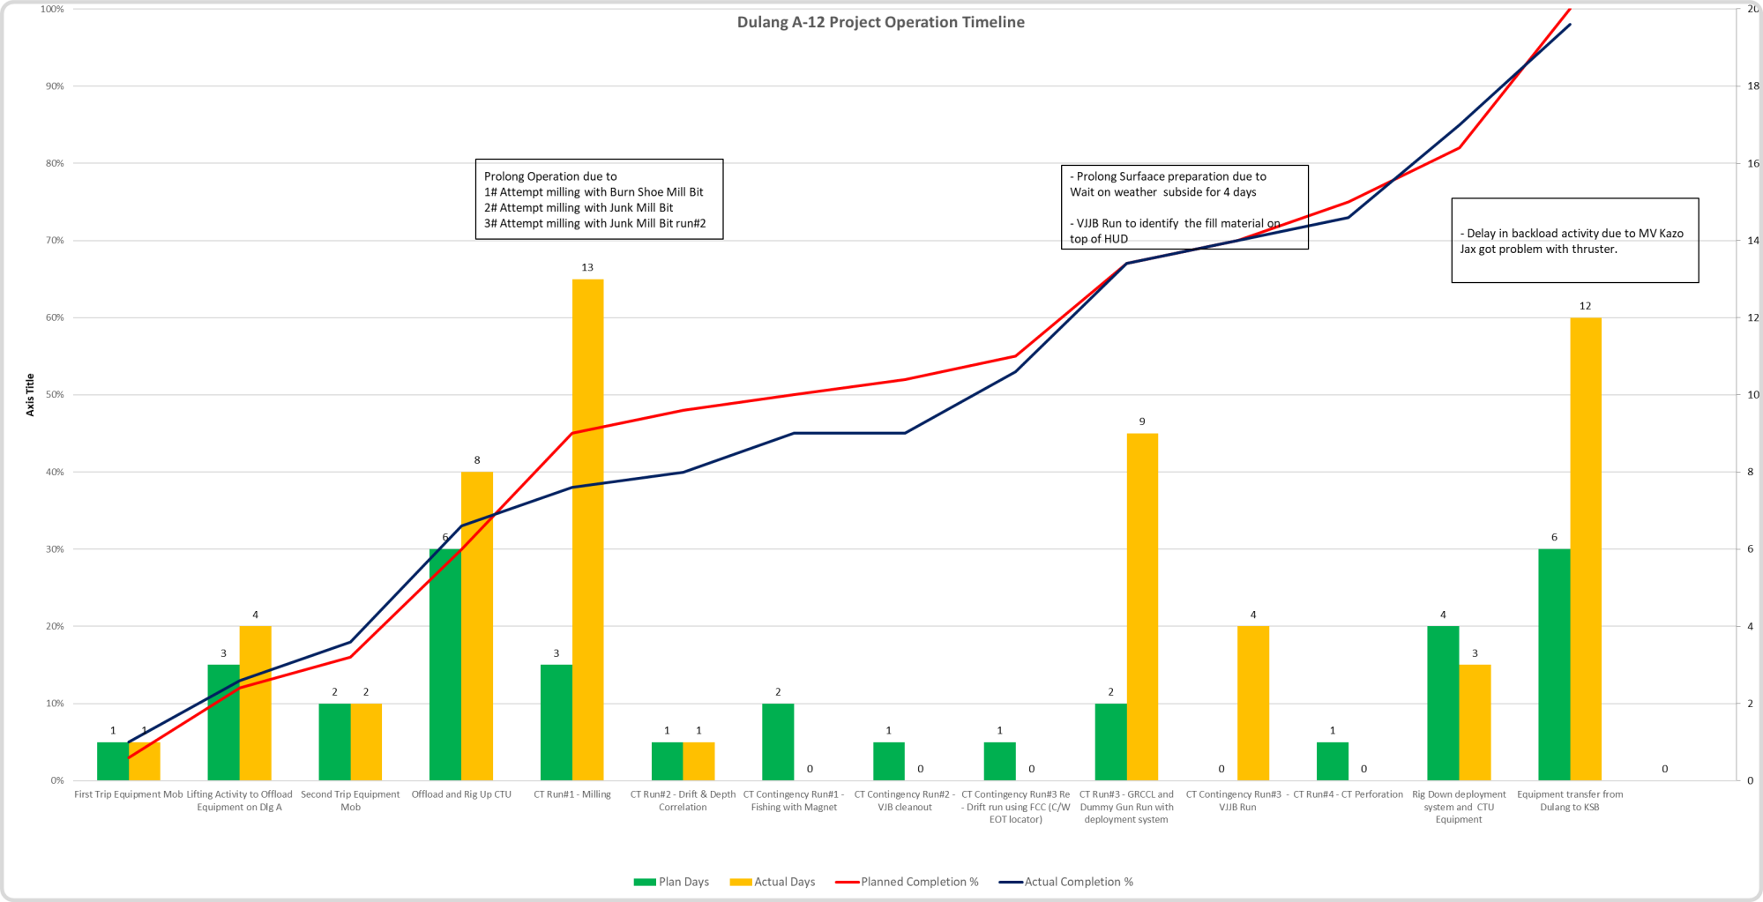
Summary of Intervention Activities

Slide 13
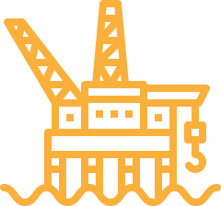
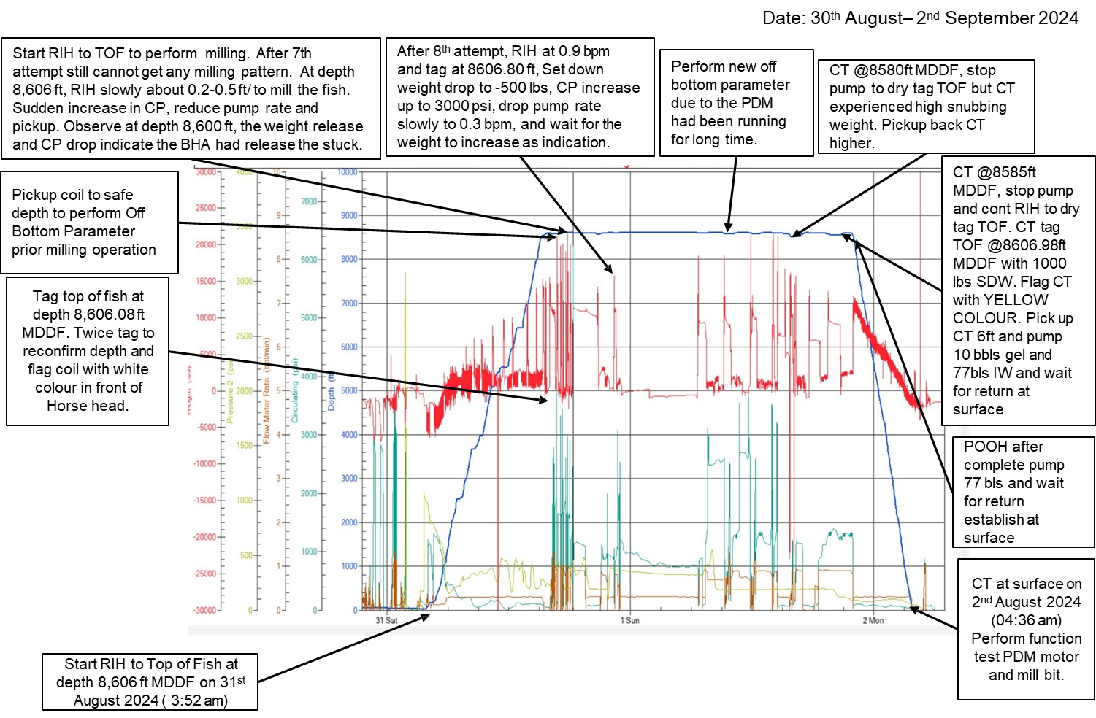
Job Analysis – CT Run#1 – Milling with Burnshoe Mill at TOF until D No Go Nipple

Slide 14
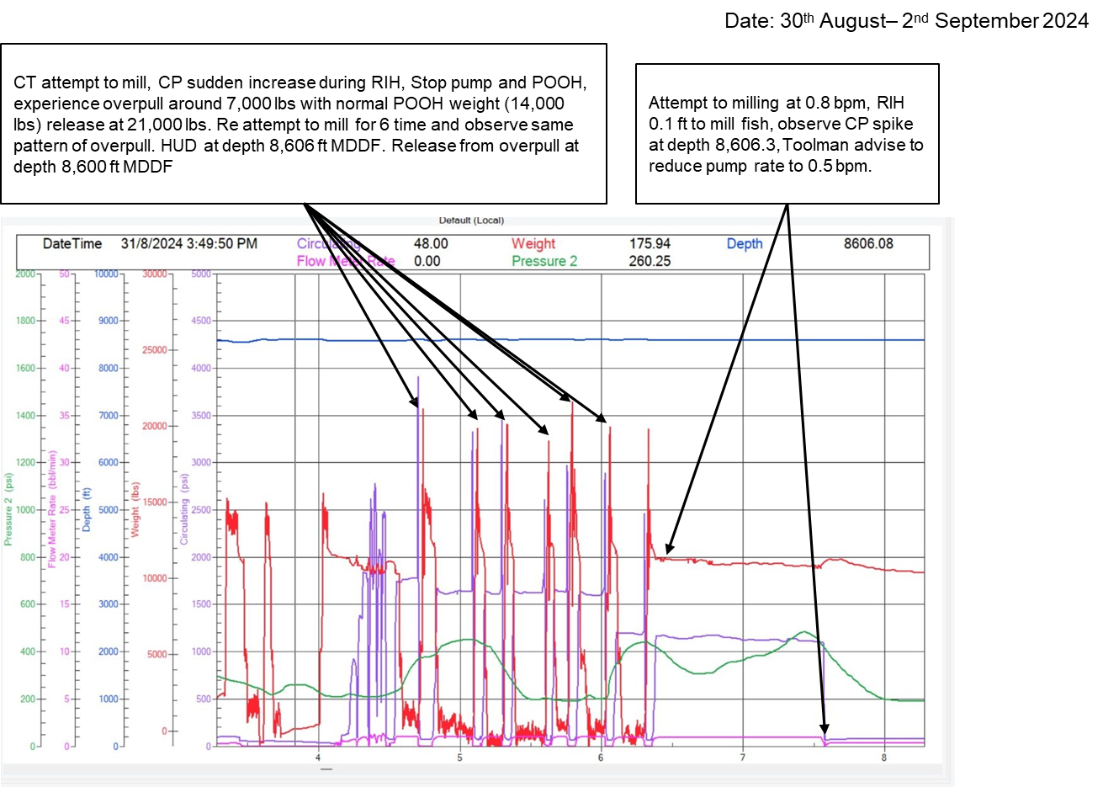
Job Analysis – CT Run#1 – Milling with Burnshoe Mill at TOF until D No Go Nipple

Slide 15
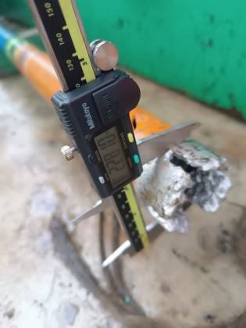
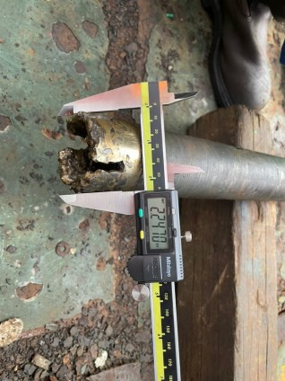
Job Analysis – CT Run#1 – Milling with Burnshoe Mill at TOF until D No Go Nipple
RIH with idle rate until 10 m above last HUD at 2,613 m/8,573 ft MDDF
RIH without pumping and tag HUD at depth 8,606 ft/ 2,623 m MDDF. Pickup 10m above and perform off bottom parameter.
Attempt to milling at fish depth and observe overpull several times. (Normal RIH weight: 1,000 lbs, Set down Weight : 1000 lbs)(Normal POOH weight: 10,000 lbs, Overpull weight: 17,000 lbs)
After 12th attempt, proceed to soft tag HUD depth for confirmation depth.
Pump 10 bbls gel followed by 77 bbls IW to observe any debris at surface.
POOH to surface.
BPM | Pressure (PSI) | Remarks
0.3 | 450 | Start iddle rotate
0.5 | 860
0.7 | 1320
0.9 | 2030
1 | 2520
1.1 | 2980
1.16 | 3070
BPM | Pressure (PSI) | Remarks
0.5 | 120
0.7 | 900
0.9 | 1360
1 | 1835
1.1 | 2100
1.2 | 2490
Burnshoe Millbit Size OD
Before | After
Off Bottom Parameter
Function Test Burnshoe Mill Bit
PCP, psi | THP. psi
1044 | 1044
Initial well pressure before CT Operation

Slide 16
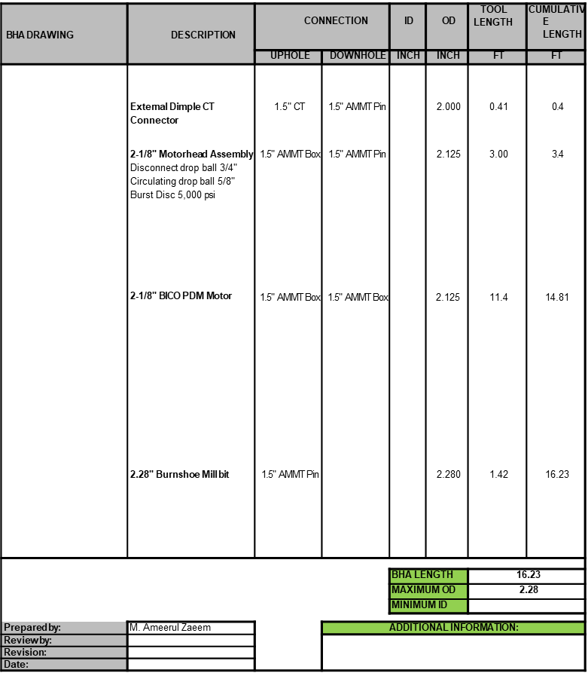
Job Analysis – CT Contingency Run#1 – Fish with High Power Magnet
Date: 30th August– 2nd September 2024

Slide 17
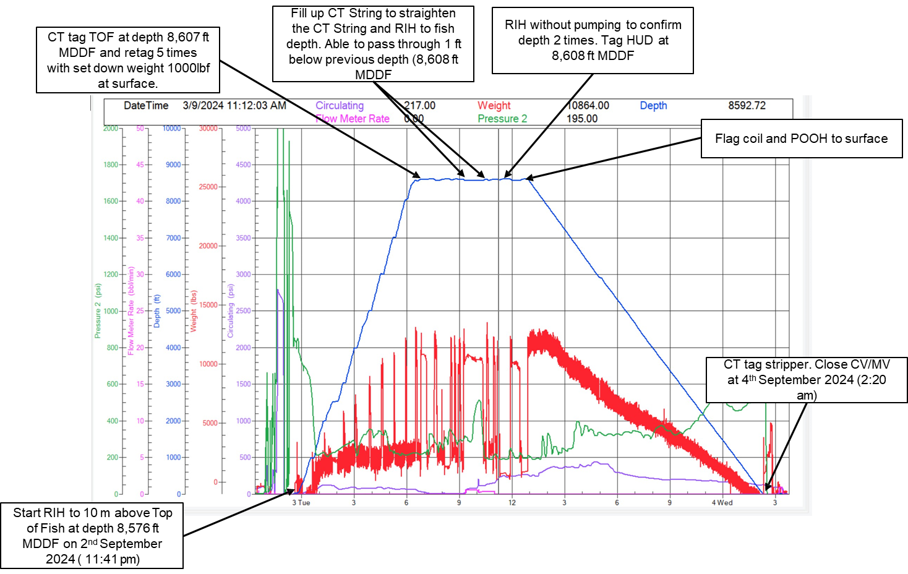
Job Analysis – CT Contingency Run#1 – Fish with High Power Magnet
Date: 2nd September 2024 – 4th September 2024

Slide 18
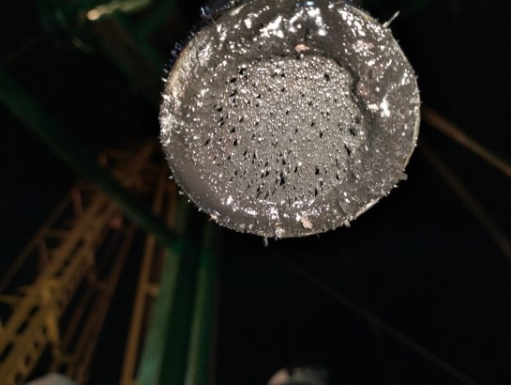
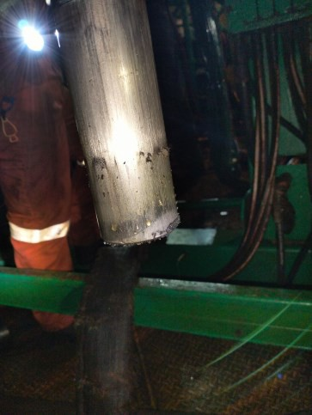
Job Analysis – CT Contingency Run#1 – Fish with High Power Magnet
Date: 2nd September 2024 – 4th September 2024
RIH without pumping until 10 m above last HUD at 2,613 m/8,573 ft MDDF
RIH to tag Top of fish at depth (8,607 ft MDDF). Tag five times with set down weight 1000 lbs on surface
Fill up tubing with 20 bbls of IW to straighten and heavy the CT string. RIH to tag TOF. CT able to pass through 1 ft below previous HUD at depth (8,608 ft MDDF)
CT pickup 30ft above HUD and RIH without pumping IW and tag twice. Tag HUD at 8,608 ft MDDF.
POOH to surface.
Recover metal debris at High Powered Magnet on surface

Slide 19
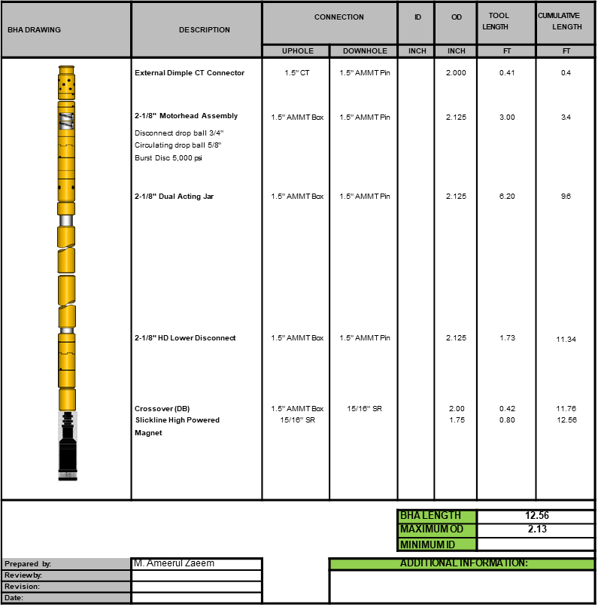
Job Analysis – CT Contingency Run#1 – Fish with High Power Magnet
Date: 9th September 2024 – 11th September 2024

Slide 20
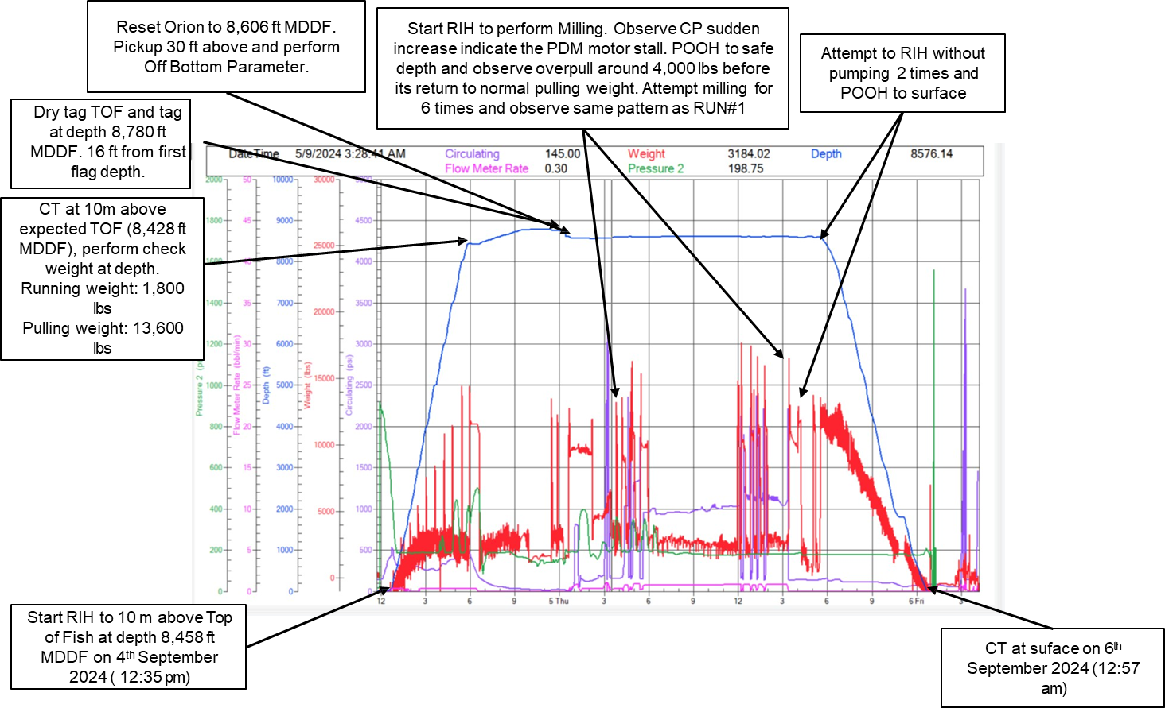
Job Analysis – CT Contingency Run#1 – Fish with High Power
Magnet
Date: 4th September 2024 – 6th September 2024

Slide 21
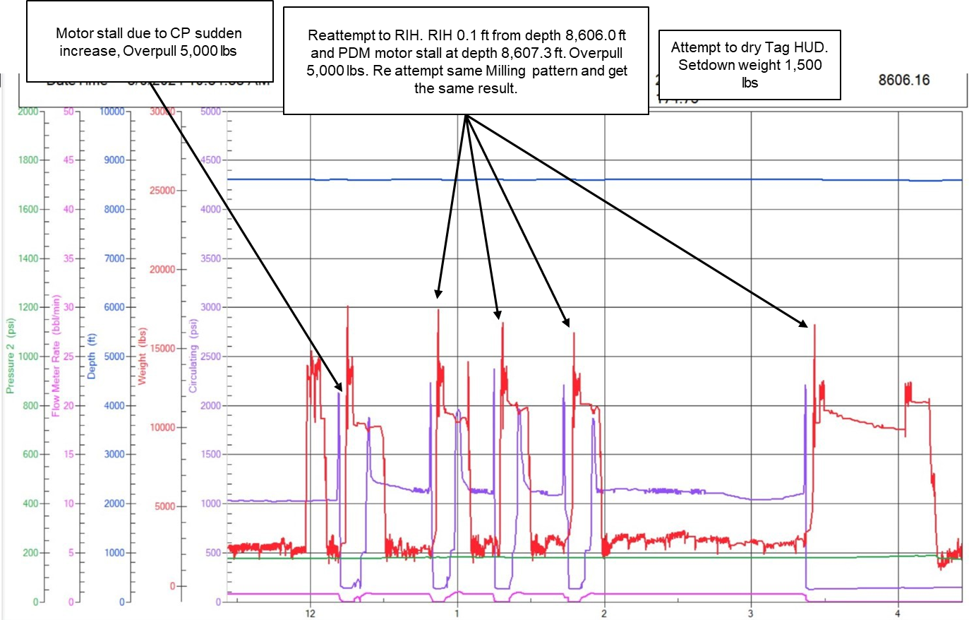
Job Analysis – CT Contingency Run#1 – Milling with 2.28” Junk
Mill Bit
Date: 4th September 2024 – 6th September 2024

Slide 22
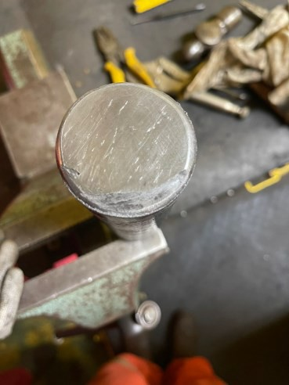
Job Analysis – CT Contingency Run#1 – Milling with 2.28” Junk
Mill Bit
Date: 4th September 2024 – 6th September 2024
RIH with pumping until 10 m above expected HUD at 2,569 m/8,428 ft MDDF
RIH without pumping to tag HUD. Tag HUD at depth 8,780 ft/2,676 m MDDF. Reset the Orion & Mechanical counter to 8,606 ft (Fish depth).
Pickup 10m above HUD and perform Off Bottom Parameter.
Start milling activity. Observe Circulating Pressure sudden increase which indicate the motor stall. POOH 30 ft and observe CT experience overpull 4,000 lbs from normal pulling weight. (Normal RIH weight: 2,500 lbs, Set down Weight : 1,200 lbs)(Normal POOH weight: 10,000 lbs, Overpull weight: 14,000 lbs)
Reattempt milling for 6 times and observe same pattern as first attempt. Able to milling 1 ft below HUD.
RIH without pumping to dry tag HUD 2 times
POOH to surface.
Pump Rates (bpm) | Pressure (psi)
0.3 | 300
0.5 | 500
0.7 | 1030
0.8 | 1570
0.9 | 1950
1 | 2230
1.1 | 2670
1.2 | 3320
Off Botton Parameter Data
BPM | Pressure (psi) | Remarks
0.5 | 205
0.7 | 700
0.8 | 1000
0.9 | 1400
1 | 1870
1.1 | 2300
1.2 | 2900
2.00" LIB to HUD @ 2612m- MDTHF.
Function Test BHA at surface
Off Bottom Parameter

Slide 23
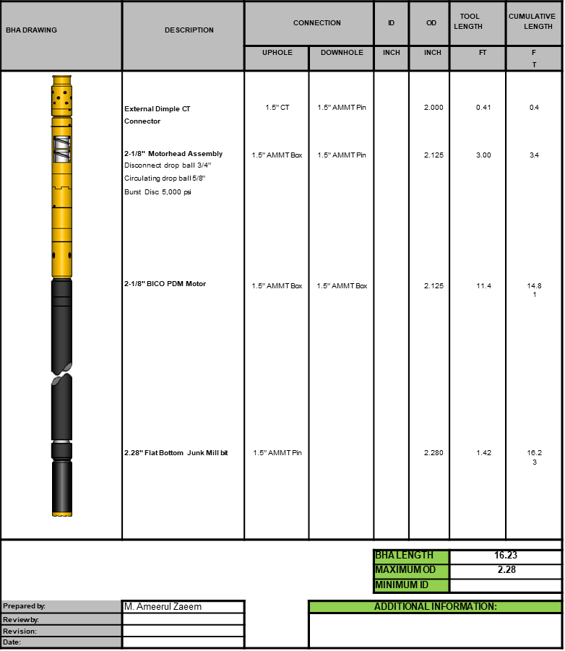
Job Analysis – CT Contingency Run#1 – Milling with 2.28” Junk
Mill Bit
Date: 4th September 2024 – 6th September 2024

Slide 24
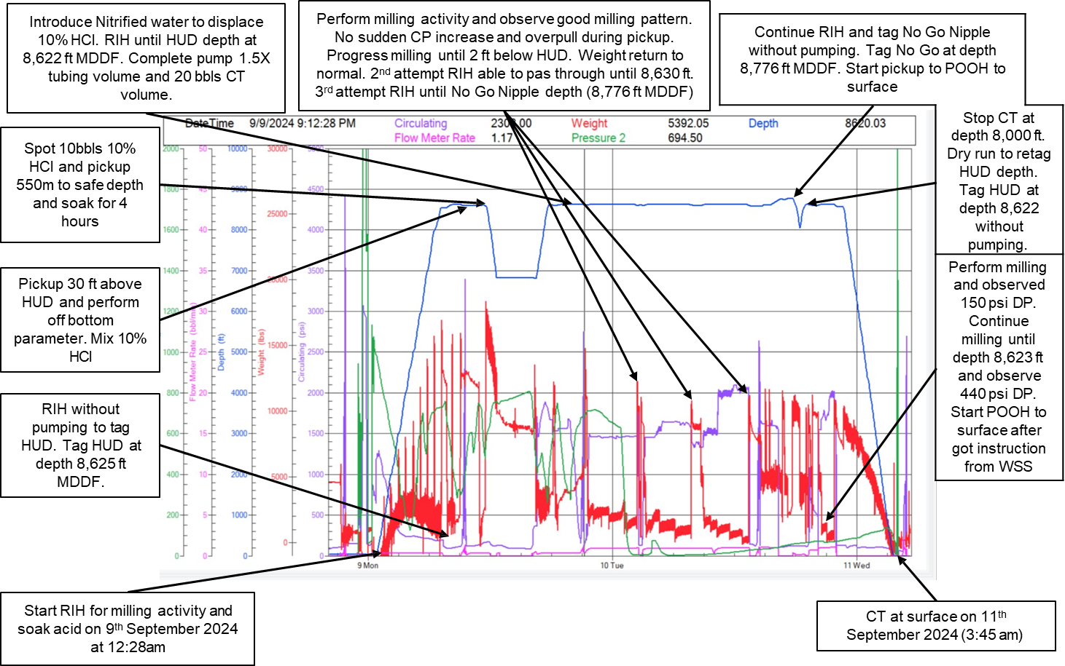
Job Analysis – CT Contingency Run#1 – Milling with 2.28” Junk
Mill Bit with Additional Acid Soaking
Date: 9th September 2024 – 11th September 2024

Slide 25
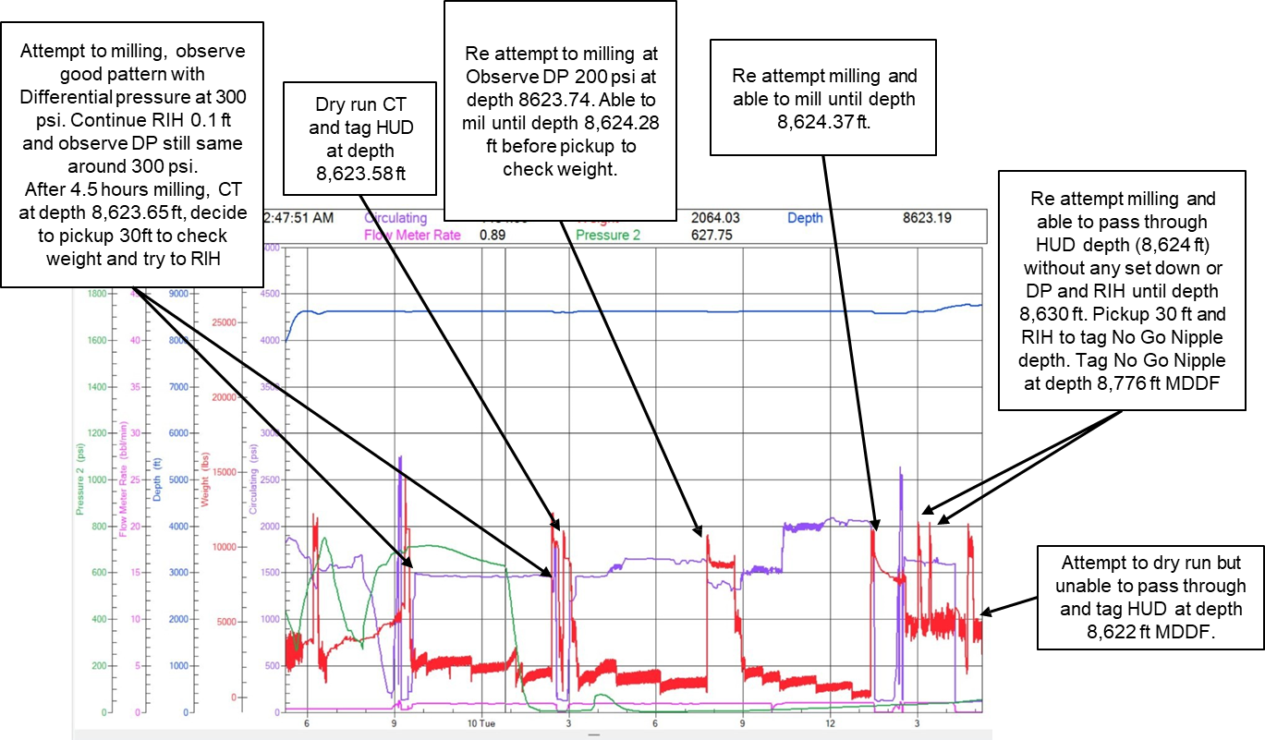
Job Analysis – CT Contingency Run#1 – Milling with 2.28” Junk
Mill Bit with Additional Acid Soaking
Date: 9th September 2024 – 11th September 2024

Slide 26
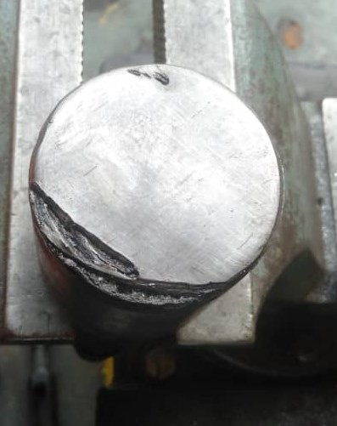
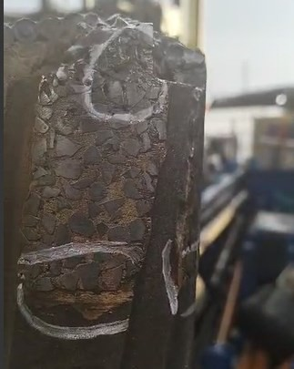
Job Analysis – CT Contingency Run#1 – Milling with 2.28” Junk
Mill Bit with Additional Acid Soaking
Date: 9th September 2024 – 11th September 2024
RIH with pumping until 10 m above last known HUD at 2,613 m/8,573 ft MDDF
RIH without pumping to tag HUD. Tag HUD at depth 8,625 ft/2,629 m MDDF.
Spot 10 bbls 10% HCl and soak for 4 hours. Pickup 550m to safe depth during soaking period.
RIH until HUD depth while pumping nitrified injection water to unload acid until 1.5x tubing volume.
RIH for milling operation with pump rate 0.9 bpm. Observed Differential Pressure (DP) 300 psi and wait until normal weight observed. RIH bit by bit to mill the fish and mill about 2ft below HUD. (Normal RIH weight: 2,700 lbs, Set down Weight : 300 lbs)
Pickup CT 30 ft and RIH to perform milling and able to pass through until depth 8,630 ft MDDF.
3rd attempt milling able to pass through HUD depth and continue milling until D No Go Nipple depth(8,776 ft MDDF). Reconfirm tag D No Go Nipple depth with SDW 1,500 lbs. Flag coil Yellow/Blue colour.
POOH to surface and got information to re-run without pumping to D No Go Nipple, encounter HUD at 8,622 ft MDDF).
POOH to surface.
Off Botton Parameter Data
BPM | Pressure (psi) | Remarks
0.5 | 170
0.7 | 341
0.8 | 840
0.9 | 1230
1 | 1570
1.1 | 2185
1.2 | 2540
LIB 2.25” Impression
Junk Mil Bit Condition after Milling

Slide 27
Job Analysis – CT Contingency Run#1 – Milling with 2.28” Junk
Mill Bit with Additional Acid Soaking
Date: 9th September 2024 – 11th September 2024

Slide 28
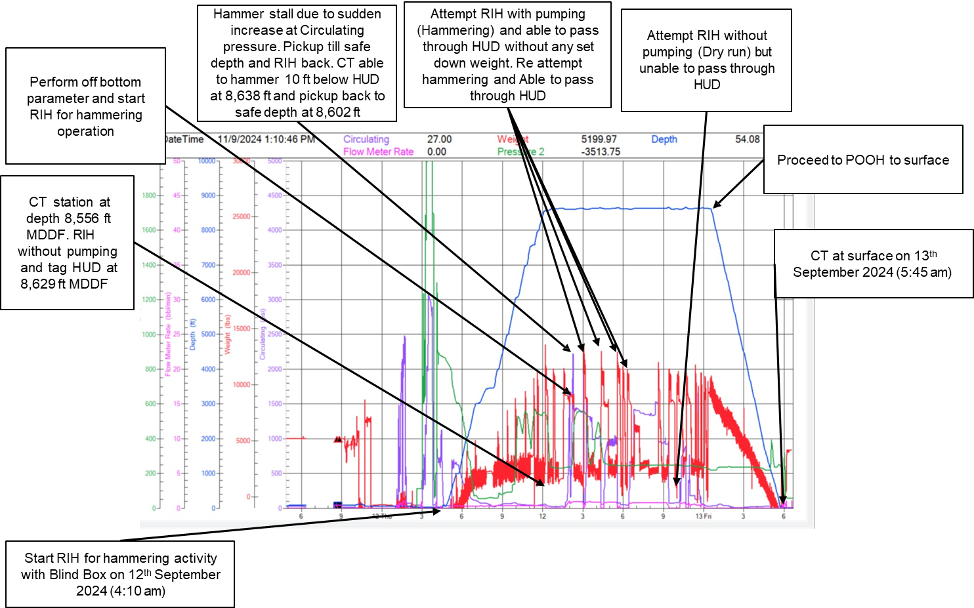
Job Analysis – CT Contingency Run#1 – Impact Hammer come
with Blind Box 2.28”
Date: 12th September 2024 – 13th September 2024

Slide 29
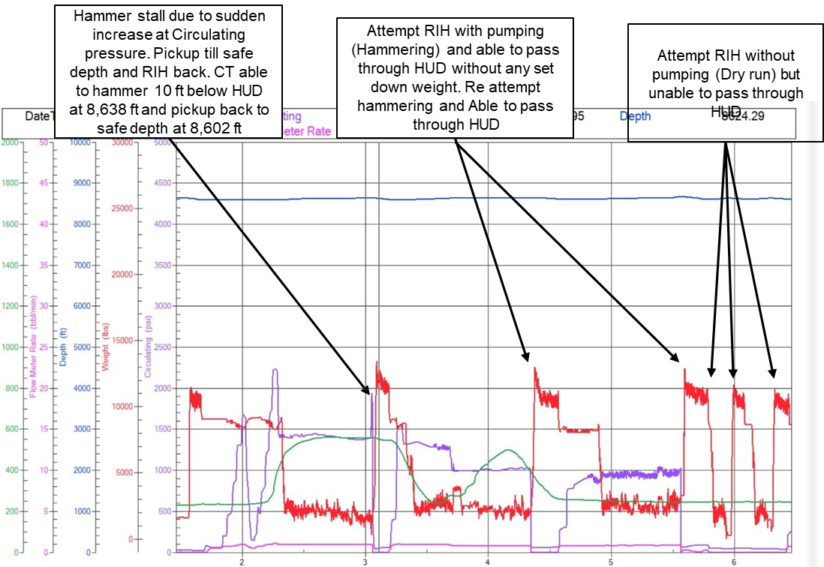
Job Analysis – CT Contingency Run#1 – Impact Hammer come
with Blind Box 2.28”
Date: 12th September 2024 – 13th September 2024

Slide 30
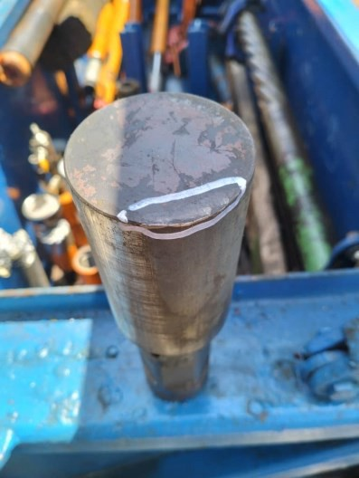
Job Analysis – CT Contingency Run#1 – Impact Hammer come
with Blind Box 2.28”
Date: 12th September 2024 – 13th September 2024
RIH with pumping until 10 m above last known HUD at 2,617 m/8,586 ft MDDF
RIH without pumping to tag HUD. Tag HUD at depth 8,629 ft/2,630 m MDDF.
Perform Off Bottom Parameter for hammering operation.
RIH for hammering operation. Hammer stall due to sudden CP increase. Pickup till safe depth and reattempt to hammer the fish. (Normal RIH weight: 2,300 lbs, Set down Weight : 1,500 lbs)
2nd attempt to hammering TOF, able to pass through HUD depth until depth (8,660 ft MDDF)
3rd attempt dry run to pass through HUD but unable to pass through HUD.
4th attempt hammering, observe DP (RIH weight: 2,500lbs, SDW: 100lbs) then able to pass through HUD depth until 30 ft below HUD (8,660 ft MDDF).
RIH without pumping to dry tag HUD. Unable to pass through the fish depth. RIH with pumping, able to pass through HUD.
POOH to surface.
Off Botton Parameter Data
BPM | Pressure (psi) | Remarks
0.5 | 142
0.7 | 510
0.8 | 790
0.9 | 1400
1 | 1700
1.1 | 2230
Off Bottom Parameter
Scratch Mark at Blind Box

Slide 31
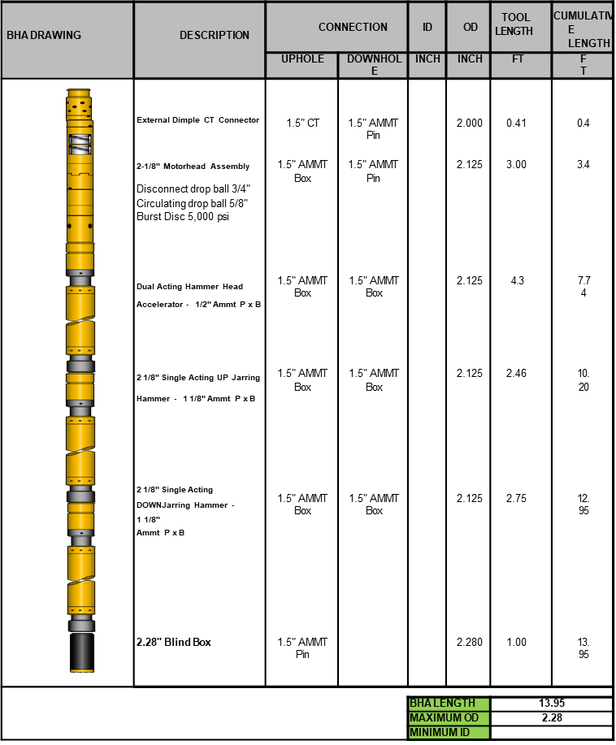
Job Analysis – CT Contingency Run#1 – Impact Hammer come
with Blind Box 2.28”
Date: 12th September 2024 – 13th September 2024

Slide 32
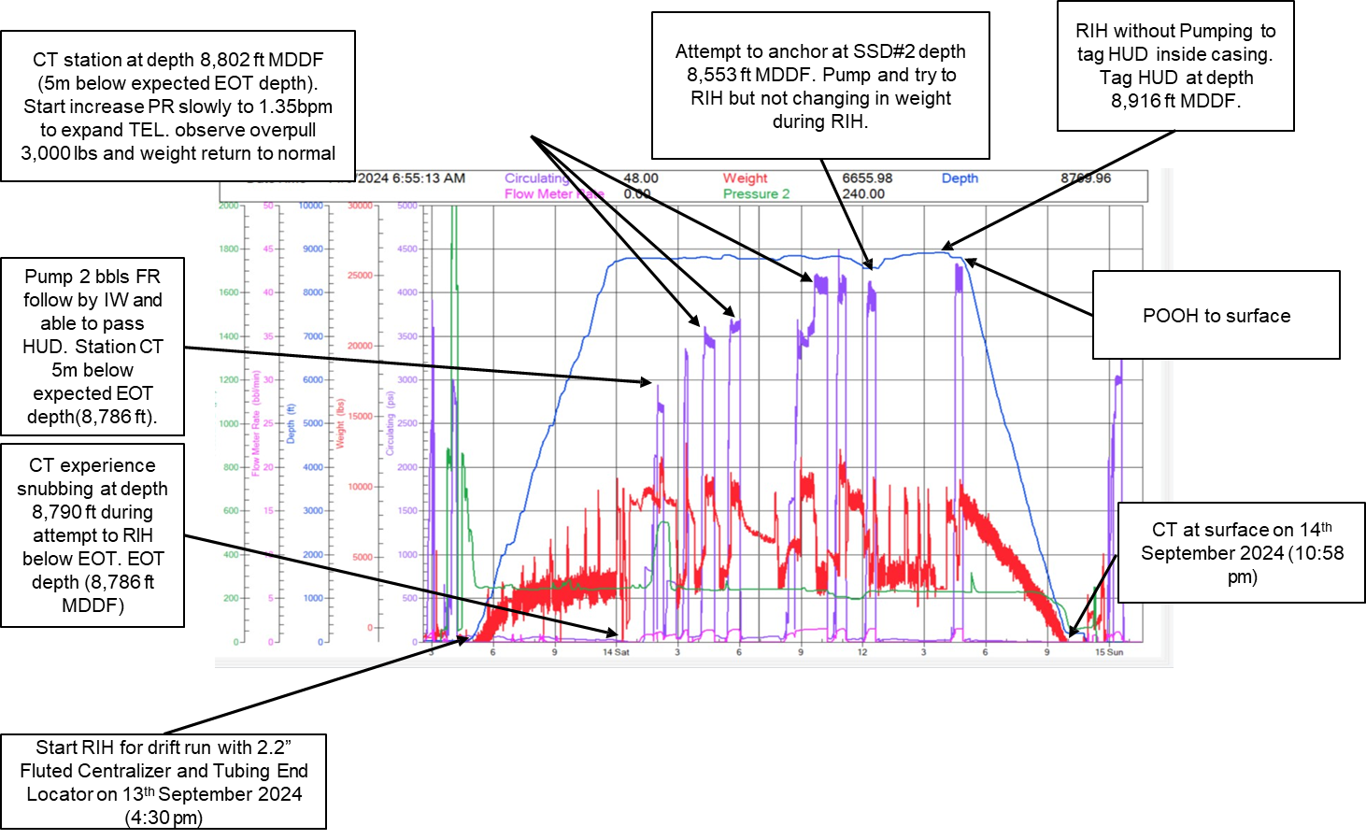
Job Analysis – CT Run#2 – Drift and Correlation Run with Fluted
Centralizer and End Of Tubing Locator
Date: 13th September 2024 – 14th September 2024

Slide 33
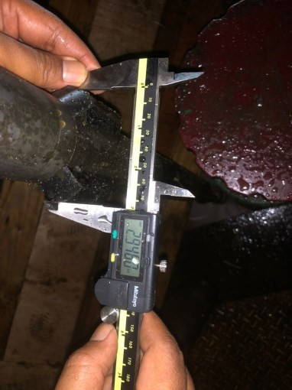
Job Analysis – CT Run#2 – Drift and Correlation Run with Fluted
Centralizer and End Of Tubing Locator
Date: 13th September 2024 – 14th September 2024
RIH without pumping until 10 m above D No Go Nipple depth at 2,667 m/8,753 ft MDDF.
RIH slowly until 2,683 m (5m below EOT). Monitor changes in CT weight before and after entering casing section. Observe CT experience snubbing at depth 8,790 ft MDDF. Pickup 10 ft above, RIH back and experience snubbing weight. Pump FR and able to pass through HUD and stay at depth 8,802 ft MDDF.
Start pump to activate the EOT locator at depth 8,802 ft MDDF. Observe overpull 3000lbs (normal pull weight
: 10,000 lbs) and return to normal weight. Re attempt to locate EOT but no indication of High pulling weight.
Attempt to anchor at SSD#2 depth 8,553 ft MDDF. Pump to activate EOT and RIH to anchor. No indication of
snubbing weight. Stop pump and RIH until tag HUD inside casing.
Tag HUD inside casing at depth 8,916 ft MDDF.
POOH to surface.
Flowrate (bpm) | Pressure (psi) | Remarks
0.3 | 60 | Start Pump
0.4 | 220
0.5 | 480
0.6 | 790
0.7 | 1360
0.8 | 1530
0.9 | 2100 | Start Open
1 | 2560
1.1 | 3320
1.2 | 3560
Flowrate (bpm) | Pressure (psi) | Remarks
0.3 | 67
0.4 | 300
0.5 | 580
0.6 | 880
0.7 | 1240
0.8 | 1550
0.9 | 2050 | Start Expand
1 | 2600
1.1 | 3000 | Fully Expand
1.2 | 3700
Function Test before RIH
Function Test after CT at surface
EOT Locator Fully expand

Slide 34
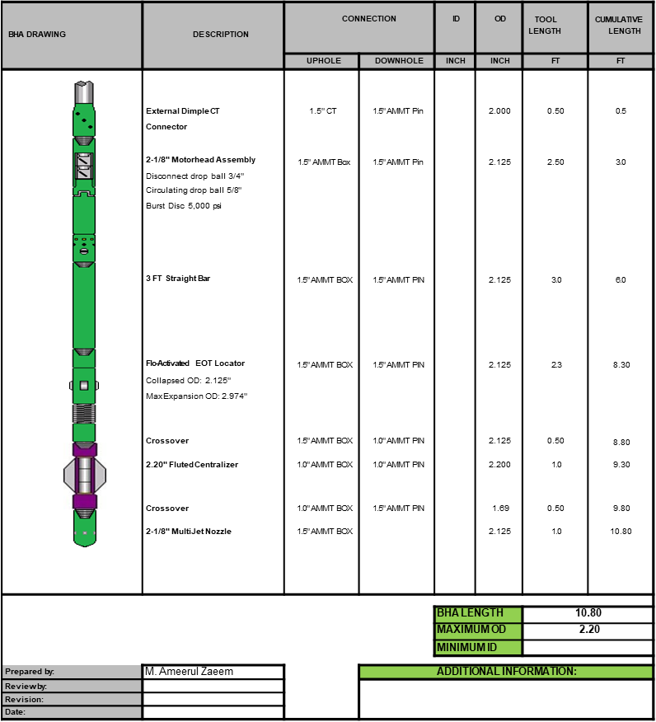
Job Analysis – CT Run#2 – Drift and Correlation Run with Fluted
Centralizer and End Of Tubing Locator
Date: 13th September 2024 – 14th September 2024

Slide 35
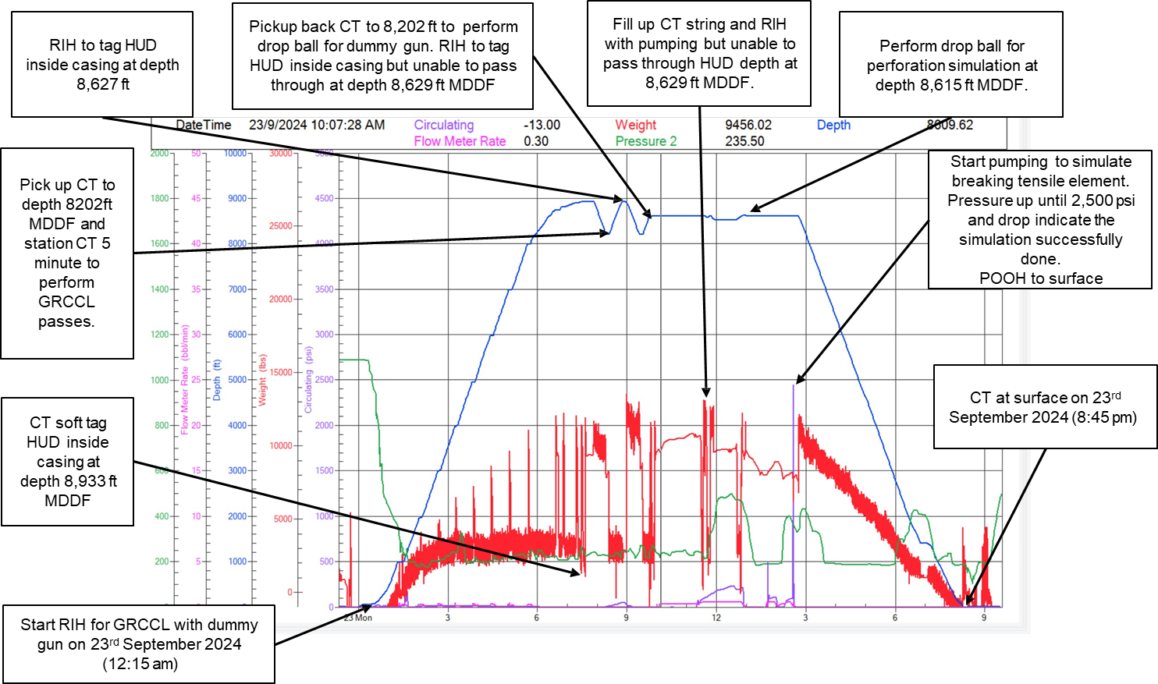
Job Analysis – CT Run#3 – GRCCL with Dummy Gun
Date: 22nd September 2024 – 24th September 2024

Slide 36
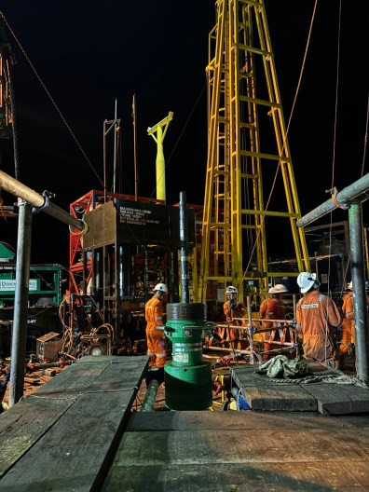
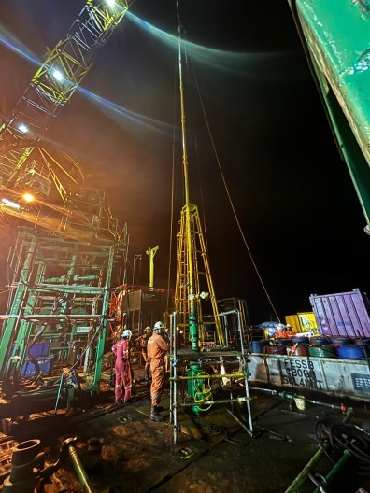
Job Analysis – CT Run#3 – GRCCL with Dummy Gun
Date: 22nd September 2024 – 24th September 2024
RIH without pumping until 10 m above latest HUD depth 2,717 m MDDF.
Break circulation by pumping IW 0.2 bpm every 1000ft.
CT soft tag twice HUD with set down weight 750 lbs at depth 8,927 ft MDDF.
Pickup CT until 8,202 ft/2,500 m MDDF and perform GRCCL passes to 8,927 ft/2720 m MDDF.
Pickup CT until 8,202 ft/2,500 m MDDF and perform dummy fire run at depth 8,927 ft MDDF. CT tag HUD at depth 8,629 ft MDDF. Repeat cycle for multiple times but unable to pass through HUD.
Got instruction to drop ball at depth 8,615 ft MDDF to perform simulation firing gun. Drop ball and pressure
up CT until 2,500 psi and pressure drop simulate the firing head had been activated.
POOH to surface.
Dual Kelly Cock Valve (DKCV)
Deployment system (BHA make up)

Slide 37
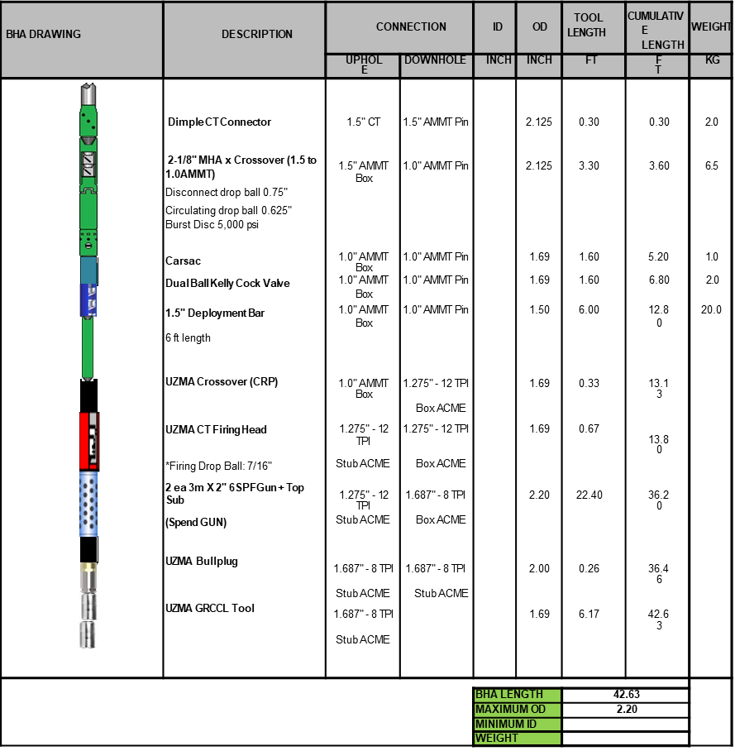
Job Analysis – CT Run#3 – GRCCL with Dummy Gun
Date: 22nd September 2024 – 24th September 2024

Slide 38
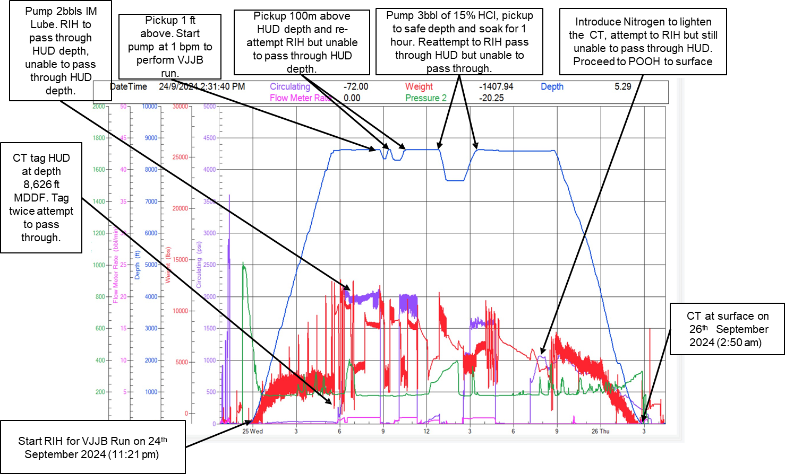
Job Analysis – CT Contingency Run#3 – VJJB run
Date: 24th September 2024 – 25th September 2024

Slide 39
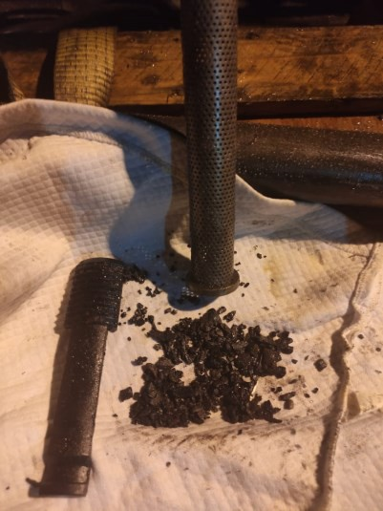
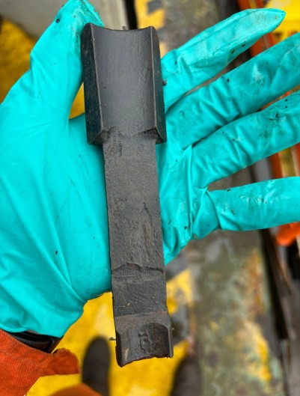
Job Analysis – CT Contingency Run#3 – VJJB run
Date: 24th September 2024 – 25th September 2024
RIH without pumping until 10 m above latest HUD depth 8,530 ft MDDF.
Tag HUD at depth 8,626 ft MDDF with set down 100 lbs. Pickup 10m above HUD and Pump IM Lube and attempt to pass through HUD but unable to pass through HUD depth.
RIH to tag HUD and pickup 1ft and pump 1 bpm for 1 hours to perform Vacuum Cleanout. Attempt to pass through but unable to pass through HUD depth.
Pump 3 bbls 15% HCl and soak for 1 hours then pickup CT to safe depth. RIH to HUD depth and perform CBU. Attempt to pass through HUD but unable to pass through HUD depth.
Start charge PCP to inject through Gas lift to unload the water inside the Production Tubing. Pump Nitrogen
gas at 300 scfm for 1 hour and RIH to pass through HUD 2 times. Unable to pass through HUD depth.
POOH to surface.
Recovered fish and debris at surface
Condition Fish Recovered from VJJB

Slide 40
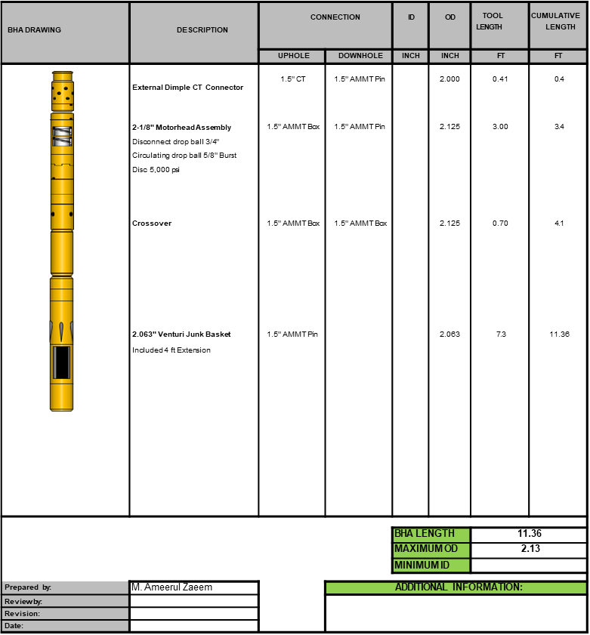
Job Analysis – CT Contingency Run#3 – VJJB run
Date: 24th September 2024 – 25th September 2024

Slide 41
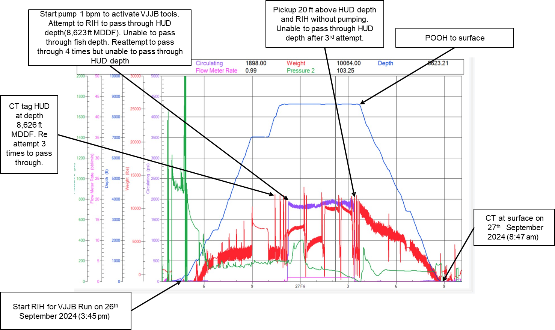
Job Analysis – CT Contingency Run#3 – VJJB run
Date: 26th September 2024 – 27th September 2024

Slide 42
Job Analysis – CT Contingency Run#3 – VJJB run
Date: 26th September 2024 – 27th September 2024

Slide 43
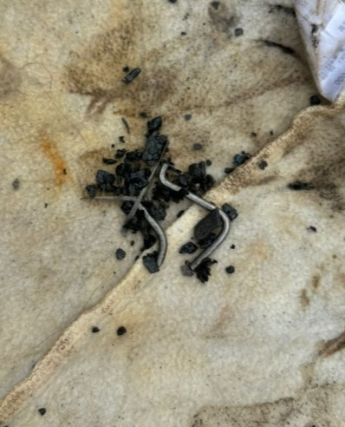
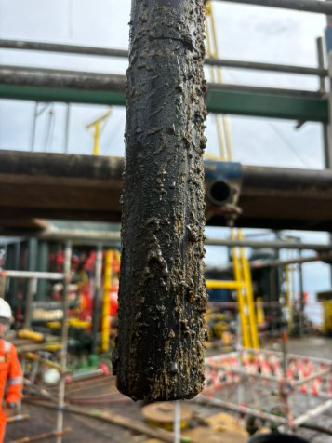
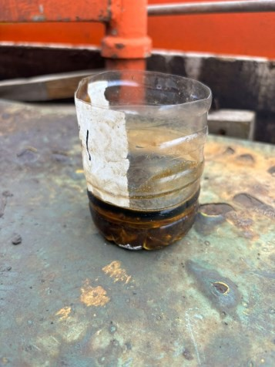
Job Analysis – CT Contingency Run#3 – VJJB run
Date: 26th September 2024 – 27th September 2024
RIH without pumping until 10 m above latest HUD depth 8,594 ft MDDF.
Dry tag HUD at depth 8,624 ft MDDF with set down 1500 lbs for 3 attempt.
RIH to tag HUD and pickup 1ft and pump 1 bpm for 1 hours to perform Vacuum Cleanout. Attempt to pass through but unable to pass through HUD depth.
Dry tag HUD to pass through HUD depth but unable to pass through.
POOH to surface.
Parted wire and debris recovered at surface
Waxy condition on BHA recovered at surface
Test sample with HCl. No reaction.

Slide 44

Conclusion
The job was partially successful despite of challenges faced.
Able to retrieve the Fish (parted tubing sleeve)
Successfully perform GRCCL from depth 2,500 m – 2,720 m MDDF
Unable to pass through HUD depth at 8,624 ft MDDF due to unknown HUD
02
03
Content Name
Content Name
Presentation is a public
speaking activity that
aims to convey a message
or information.
Presentation is a public
speaking activity that
aims to convey a message
or information.
Fish (Parted Tubing Sleeve) recovered

Slide 45
Dulang Campaign Lesson Learnt
Highlight
Overall Operation was successfully completed without any HSE issue.
Successfully recover fish (Parted Tubing Stop Sleeve) during VJJB Cleanout
Lowlight
A shortage of vessels has delayed demobilization, keeping equipment on-site longer than planned. This has increased costs and disrupted timelines.
An additional obstruction has been detected at a specific hang-up depth, requiring a camera inspection to determine the exact cause.
Severe weather has limited safe working periods, slowing down CTU operations. This has led to
extended timelines and increased costs.
Unsuccessful to achieve the full objective of the campaign to perform add perforation at Zone E34A (2,740 m – 2,749 m MDDF).

Slide 46
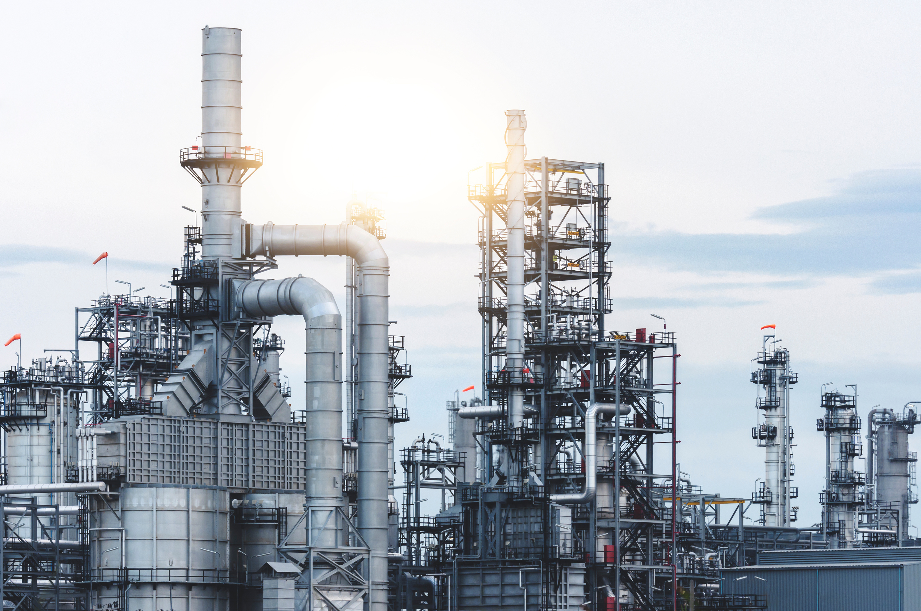
THANK YOU

