Slide 1

K-Set (Patent APPLIED FOR)

Slide 2
Setting Tool – the “K-Set”
PCM
Motor
Gearbox
Linear Actuator
3.6” O.D. K-Set
Non-explosive plug setting tool rated to 15,000psi/135°C for 6 Hrs (HT 225 °C with Flask)
Very short length: <50” O.A.L with 10” stroke as standard
Nominal-Max Output force: 60-90klbs (3.6”), 40-50klbs (2.720”), 30-40klbs (2.125”)
Industry standard connections: Baker #20(3.6”), #10(2.720”), Owen MSST (2.125”)
No special software or surface power supply required
Simple to use and virtually no redress costs
Suitable for use on any conveyance method including:
  e-line, slickline, e-slickline or coil tubing
Modular and simple design which is cost competitive with Baker E4

Slide 3
PCM - Power/Comms/Electronics Module
3.6” O.D. K-Set
Low cost, single use Power/Comms/electronics Module (PCM)
Power delivered by Alkaline cells (no dangerous goods)
Programmable via hand held programmer or laptop
Contains: timer, motion sensor, memory and e-line interface for complete control
PCM capacity – 1 x Surface Test, 12 Hours Logging, 1 x Downhole Set & Tool Reset post-job
Suitable for use on any conveyance method including:
  E-Line, slickline, e-slickline or coil tubing
PCM versions available:
  Slickline PCM, simple timer mode with acceleration to abort option
  E-Line PCM, is our digital comms mode – compatible with CCL only (with diodes removed)
  Voltage Activated PCM is activated by a +ve or -ve 150Vdc pulse for 10s. Compatible with any toolstring.

Slide 4
Motor Module
3.6” O.D. K-Set
48 Volt DC Motor
Shock mounted
Low cost
Easy to replace in the field in less than 2 minutes
  Self-contained module
  No special tools to replace, no soldering, no wiring

Slide 5
Gearbox Module
3.6” O.D. K-Set
Custom-designed gearbox module takes the high speed rotational motion of the motor &
converts it to high torque output which is directly coupled to the Linear Actuator Module
High shock protection (Patent Applied For)
Standard Setting Speed at ½” / Minute
4 x High Speed Gearbox option 2” / Minute (high speed for frac applications)
Easy to replace in the field in less than 2 minutes
  Self-contained module
  No special tools to replace, no soldering, no wiring

Slide 6
Linear Actuator Module
3.6” O.D. K-Set
Custom-designed linear drive module - converts rotational movement from gearbox to linear movement and in turn pulls the slick rod slowly upwards
Max Output: up to 90klbs (3.6”), 50klbs (2.720”) 40klbs (2.125”)
Design in progress 150,000klbs (4.1”), 20,000klbs (1.69”)
10” Stroke as standard
  Longer stroke versions available (12 ¼" and 16”)
  Each 1” of additional stroke adds 2” to total length
Easy to reset in the field using simple command
  Self-contained module
  No special tools to replace, no soldering, no wiring
  Manual reset in 2 minutes, if required

Slide 7
Setting Tool – Maintenance schedule
3.6” O.D. K-Set
Every Run:
  1 x Single use Power Control Module (PCM) – eliminates risk associated with cumulative shock cycling of electronics
  2 x O Rings – to be changed at PCM/Motor Module Interface each run
25 Runs:
  Low cost Motor Module – Kaseum recommend change out after 25 runs – approx. 2 minutes to change
50 Runs:
  Full seal change kit – Kaseum recommend full seal replacement after 50 runs – less than 1 hour for full seal change out
  Dynamic Seal with “wiper” on slick rod – cleans & seals slick rod as it strokes up/down
  All housing connections are identical using same O-Rings & seals (dual O-Rings with PEEK back up)
  Additional In built metal seal at every connection
Competitive OPEX cost per run (new PCM & 2 O-Rings/run – new motor after 25 runs & full seal change after 50 runs)

Slide 8
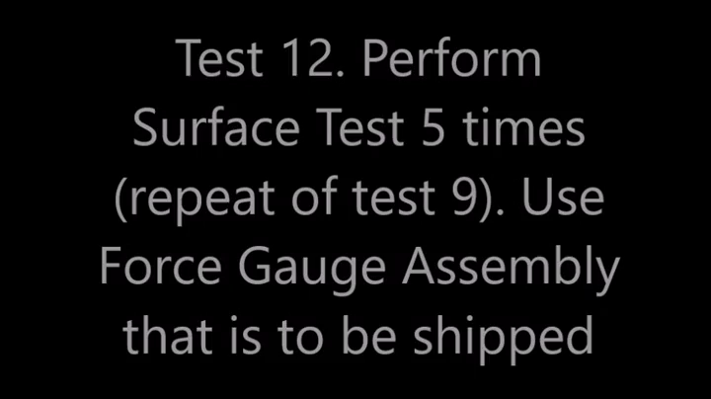
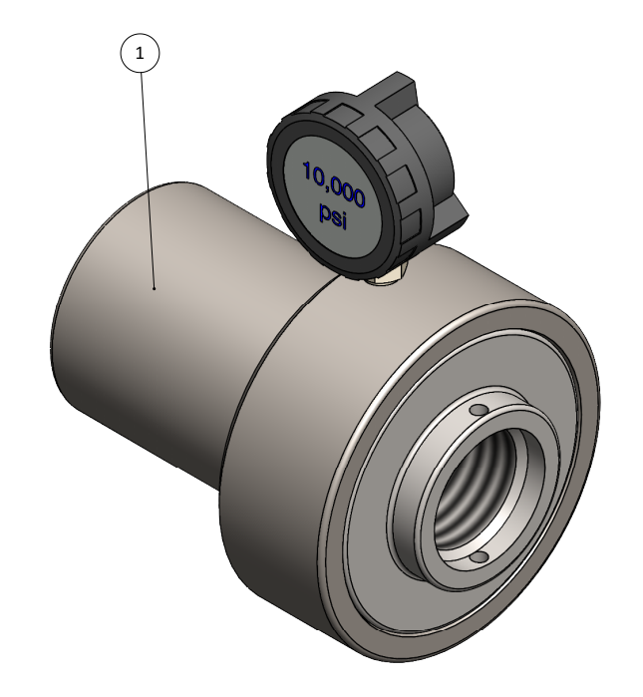
Setting Tool – Surface Test Equipment
2.125” K-Set Force Gauge Installation
3.6” K-Set Force Gauge Assembly

Slide 9
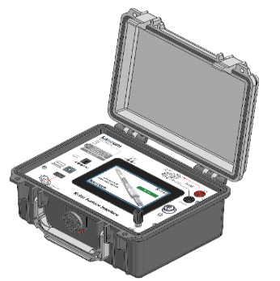
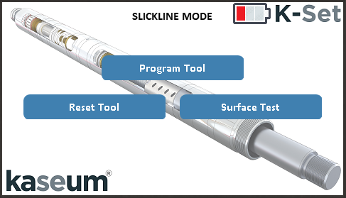
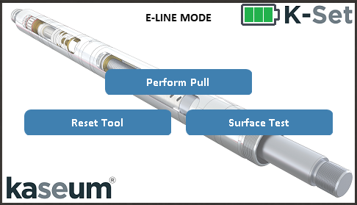
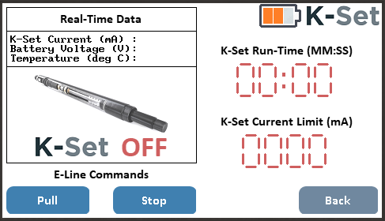
K-Set Surface Interface
Program K-Set without laptop
Pre-job test and reset using single button click
Stream live data and control K-Set in real time
Self-contained in dedicated rugged case

Slide 10
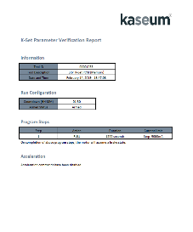
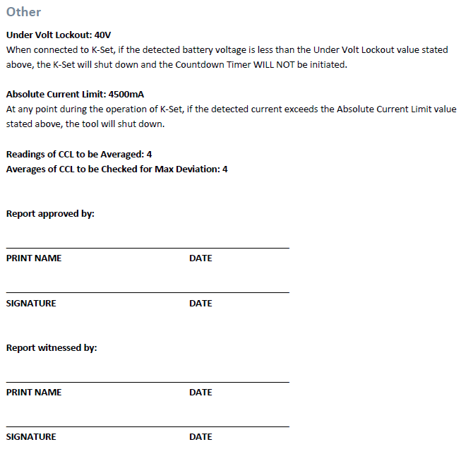
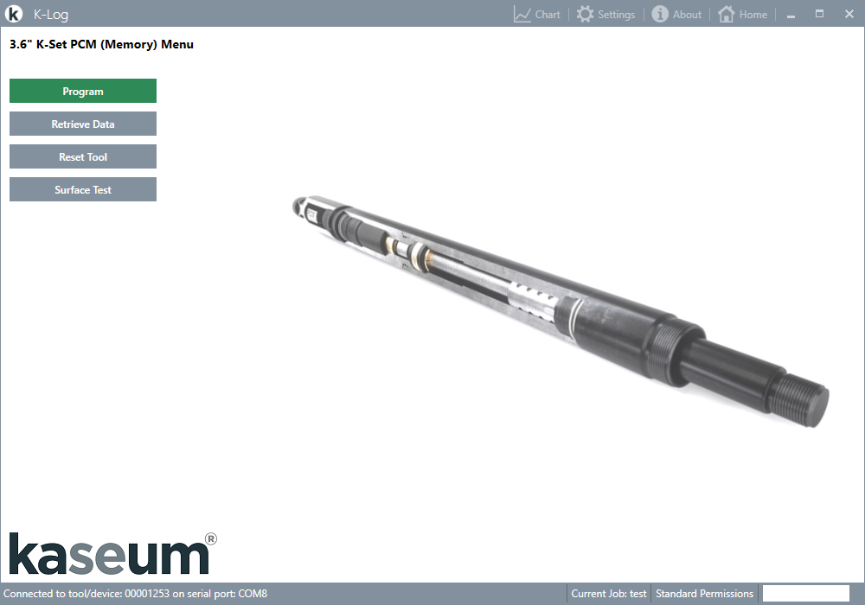
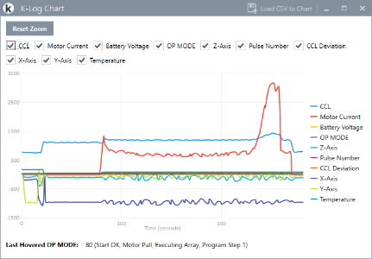
K-Log Surface Software
Program K-Set with laptop
Parameter verification report
Plot live data or display recorded data
CSV Data File for import to Excel

Slide 11
Depth Correlation
If Depth Correlation is required:
  E-Line K-Set can be activated in 2 ways:
    Using a Voltage Activated PCM - voltage pulse +ve or –ve (150 VDC for 10 seconds) - compatible with any Shooting GR or Shooting GR/CCL. Note that no real time data is returned from the K-Set. Also useful when running with other tool strings (Tractor, digital slickline etc) to ensure we can set the K-Set with a simple voltage pulse without interference, or interfering with, the other tool telemetry.
    Using a standard E-Line PCM - Digital E-Line command through K-Set Surface Box – compatible with any Shooting CCL. The E-Line signal is small and low power therefore you must remove any Diodes in the CCL to guarantee the E-Line command reaches the K-Set. Note that real time data is returned from the K-Set.
  Slickline K-Set
    1. When running the K-Set in SLICKLINE mode you can connect any shooting CCL - with no need to remove diodes - and K-Set will log the CCL data. Very useful for post job depth correlation as K-Set allows the additional functionality of a slickline correlation for free.

Slide 12
K-Set Technical details
K-Set Mechanical Properties |  |  |  | Design in Progress
K-SET OD | 2.125" | 2.720" | 3.6" | 1.69" | 4.1"
Make up Length (ELINE & SLINE) | 4.2 ft / 1.28 m | 5.4 ft / 1.65 m | 4.8 ft / 1.47 m | 5.3 ft / 1.62 m | TBC
Weight | 34.2lbs / 15.5Kgs | 66.6lbs / 30.2Kgs | 108lbs / 49Kgs | 34lbs / 15.5Kgs
Standard Stroke Length (12.75" & 16" Extended Stroke available on request) | 10" | 10" | 10" | 12.75" | 12.75"
Max Time for standard full Stroke | 10" - 17 mins | 10" - 16 mins | 10" - 18 mins
Max Time for extended Stroke (16") | 16" - 26 mins | TBC | 16" - Time TBC
Max Pressure* | 15 kpsi (1034 bar)
Min / Max Temp | -10 to 135°C (6 hours) 121°C (8 Hours)
 | (Flasked option available) (12 hours @ 200°C or 6 hours @ 225°C)
High Temperature FLASK OD | TBC | 2.75" | 2.75" | TBC | TBC
Nominal Setting Force | 30,000 lbs | 40,000 lbs | 60,000 lbs | 15,000 lbs
Max Setting Force | 40,000 lbs | 50,000 lbs | 90,000 lbs | 20,000 lbs | 150,000 lbs
Mech. Adaptor (various ADAPTOR Kit options available) | Owen MSST | Baker #10 | Baker #20 | Baker #5 | TBC
K-Set Electrical Properties
K-SET OD | 2.125" | 2.75" | 3.6" | 1.69" | 4.1"
# of AAA Alkaline Batteries / Pack | 48 | 76 | 62 | TBC | TBC
Voltage output | 36 | 57 | 46.5
Battery Capacity | 2.54 Ahr
Countdown Timer Current Consumption (SLINE) | 10mA
Current consumption when transmitting Data (ELINE) | 20mA
Nominal Current consumption (No Output Load) | 300 mA to 1000 mA
Max. instantaneous Current consumption | 8A
PCM Logged Data Storage Capacity | 16 Mbyte (approx. 1M data SETS)
Max Wireline Length (ELINE) | 25,000 Ft (7620 M) always verify prior to RIH
*20 kpsi Version K-Set | 20 kpsi version is available as a special order

Slide 13
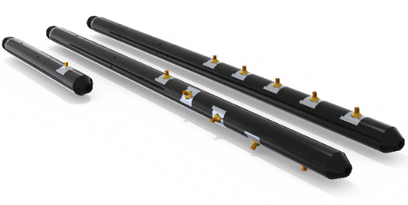
K-Punch
K-PUNCH Specification
Tubing Size | 2.875” | 3.500” | 4.500” | 5.500” | 7.000” | 9.625”
Tubing Grade | J55 L80 P110 | J55 L80 P110 | J55 L80 P110 | J55 L80 P110 | J55 L80 P110 | J55 L80 P110
Example Tubing Weight (lb/ft) | 6.4 to 8.6 | 7.7 to 12.7 | 12.6 to 15.1 | 20 | 23 to 29 | 47 to 53
Punch Hole Size | 0.375” to 0.563” | 0.375” to 0.715” | 0.375” to 0.715” | 0.375” to 0.715” | 0.625” | 0.625”
NUMBER OF HOLES IN A SINGLE RUN | Up to 8 | Up to 6 | Up to 5 | Up to 5 | Up to 3 | Up to 3
Single and Multi-punch
Oriented punching
Connects directly to K-Set
Example physical details of 3.5” K-Punch Actuator with 1 Punch Module
Overall Length 39.2” (0.996 Metres) - add (5” to 6”) per additional Punch Module
Tool Weight 47.8 Lbs (19 Kgs)
Max. operating Pressure (Hydrostatic) 15,000 Psi (1034 Bar)
Pressure Rating (hydraulic system rating when constrained in the correct grade Tubing 30,000 Psi (2068 Bar)

Slide 14
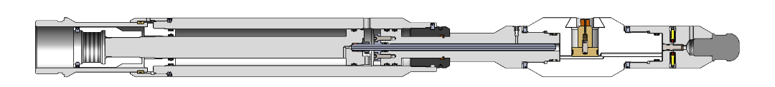
K-Punch design overview
The K-Punch is connected to a K-Set Setting Tool prior to deployment to make up the running string. The Slick Rod of the K-Set is directly connected to the Main Piston of the K-Punch, meaning that any movement generated by the K-Set will be transmitted directly to the Main Piston of the K-Punch.
The K-Punch is a simple hydraulic system that is directly energised or relieved by manipulating the Main Piston upwards or downwards. Once the running string is stationed at the required punching depth the operation can begin.
An electronic ‘Punch’ command is initiated and the K-Set will begin stroking upwards, pulling the Main Piston of the K-Punch, and pressurising the hydraulic chamber within. As the pressure increases the Punch Piston(s) are forced outwards and the connected Punch Button(s) will contact the wall of the tubing.
The hydraulic chamber pressure will continue to rise until a sufficient pressure, and therefore force, has been generated to penetrate the Punch Button through the tubing wall, where the Punch Button will be ejected in to the Annulus leaving behind a communication port to the annular space.
Once all Punch Buttons have penetrated, the K-Punch will vent the hydraulic chamber by means of a Shear Disc rupture event. The K-Set is then commanded to ‘Retract’ and the Punch Piston(s) are retracted into the tool, allowing the running string to be recovered to surface.
The K-Punch consists of 2 separate assemblies. They are:
Hydraulic Actuator assembly.
Punch Module(s)

Slide 15
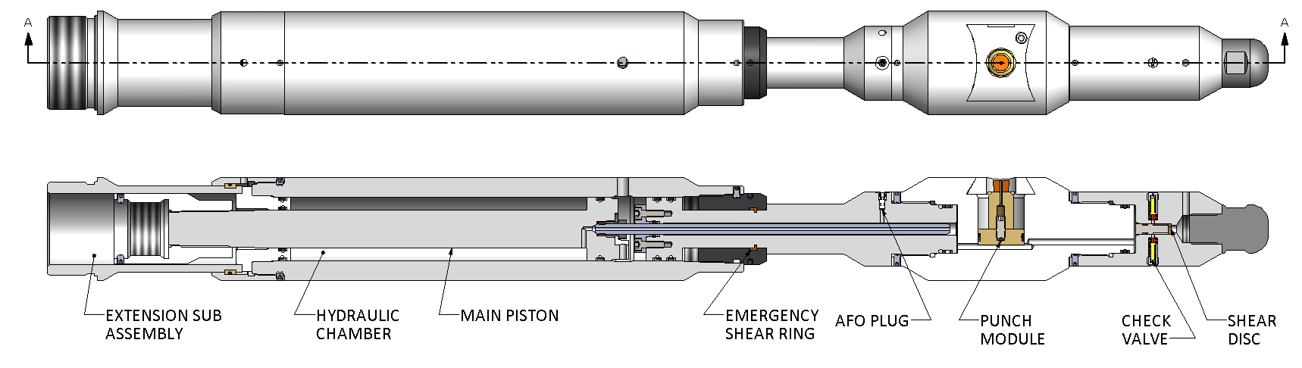
K-Punch - Hydraulic Actuator
The Hydraulic Actuator assembly is a simple piston operated hydraulic chamber. When the Hydraulic Actuator assembly is interfaced with the K-Set the movement generated by the K-Set is applied directly to the Main Piston of the K-Punch, which will increase or decrease the hydraulic chamber pressure accordingly. A ‘Punch’ command will cause this hydraulic chamber to reduce in volume, therefore increasing the pressure, which is used to deploy the Punch Pistons. When a ‘Retract’ command is issued the hydraulic chamber volume is increased causing the pressure to reduce, allowing the Punch Pistons to retract.
When connected to the K-Set the Main Piston of the K-Punch screws directly to the K-Set Slick Rod, transmitting the linear stroke of the K-Set directly to the hydraulic chamber of the K-Punch.
The Hydraulic Actuator assembly also has several features that are integral to the correct and safe deployment of the K-Punch. These include:
A Relief Shear Disc; to vent the hydraulic chamber into the external atmosphere after all the Punch Buttons have been deployed, whilst also protecting the hydraulic system from over-pressurisation.
Check Valves, to allow the hydraulics to be vented at the end of the punching cycle but permit the ingress of well fluid.
An Axial Force Only Plug; (hereby referred to as an A.F.O. Plug) to allow the hydraulic chamber to be vented manually, and in a controlled manner, if a risk of internal trapped pressure on return to surface is thought to be present.
An Emergency Release Shear Ring; to allow the hydraulics to be vented in an emergency situation downhole. In the unlikely event that a complete tool failure occurs during the punching cycle then the running string can be jarred up to release a shear ring that will vent the hydraulic chamber.

Slide 16

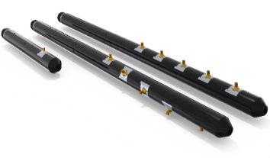
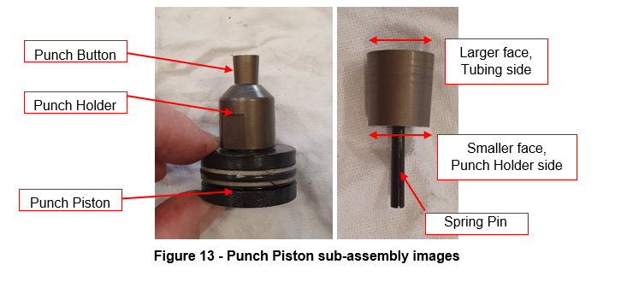
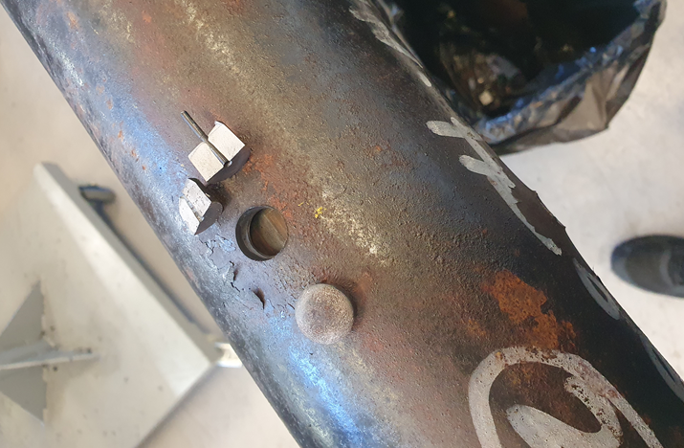
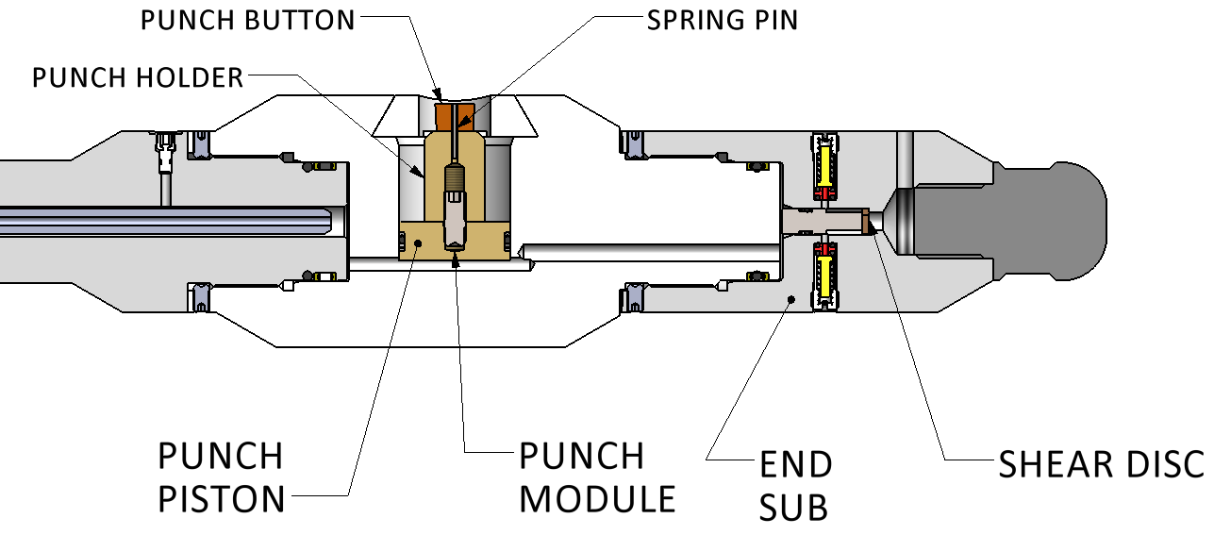
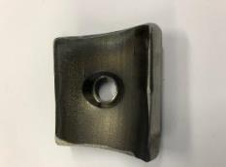
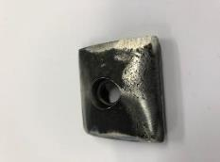
K-Punch – Punch Module(s)
The Punch Module contains the Punch Button arrangement used to penetrate the tubing wall.
The Punch Module, or Modules, can be fitted onto the Hydraulic Actuator assembly and orientated to the required phasing with the addition of Shim Washers.
Each Punch Module has an internal hydraulic chamber that connects into the Hydraulic Actuator assembly hydraulics.
Within the Punch Housing a punching arrangement that comprise a Punch Piston, Button Holder, Spring Pin and Punch Button is fitted. When the hydraulic chamber is pressurised, this punching arrangement moves out radially to contact the tubing wall.
Once sufficient pressure, and therefore force, has been reached the Punch Button will penetrate the tubing and be ejected into the annular space, providing hydraulic communication between the tubing and annulus.

Slide 17

K-Punch 3.5” Pup/2.93” ID/80ksi/13Cr material

Slide 18
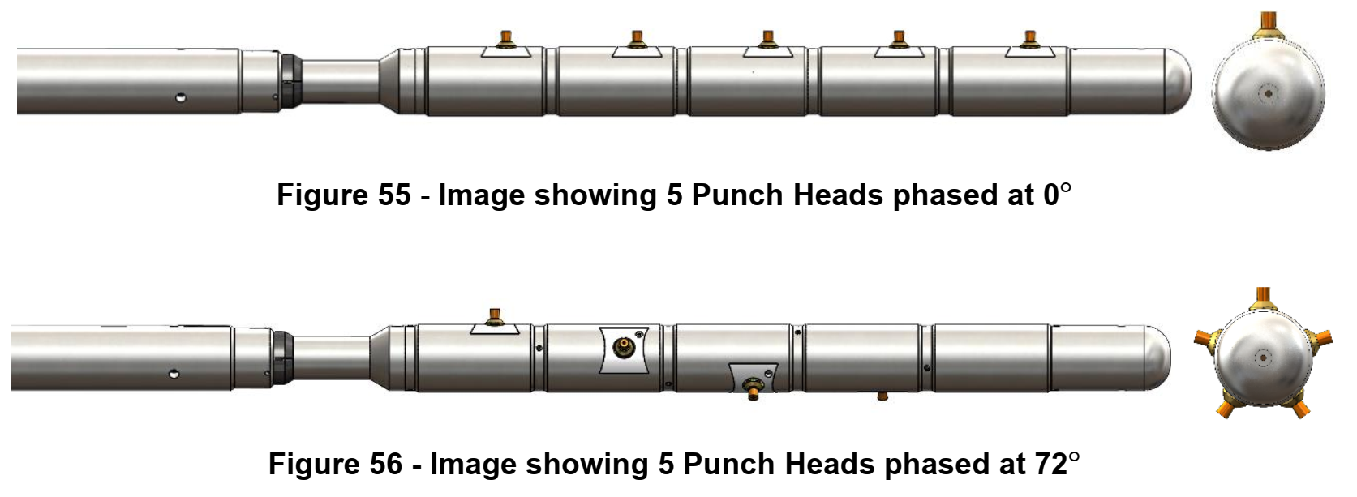
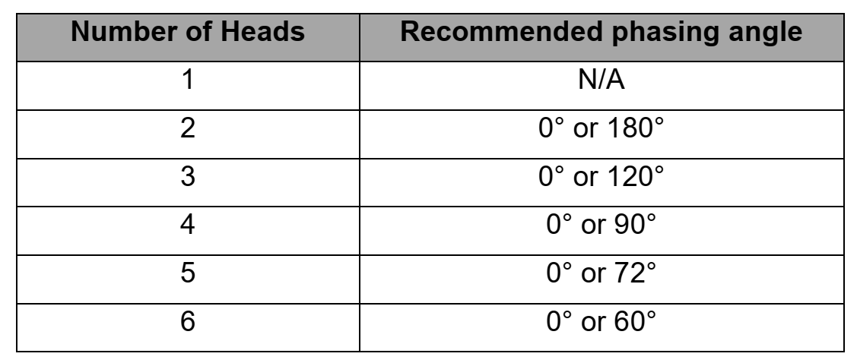
K-Punch Head Orientation & Phasing (E-Line & Slickline)
The Punch Heads can be positioned to the required phasing by adding Shim Washers in between each Punch Head - as per figures 55 & 56 (Note - shim washers are provided as standard parts of all Punch Head Kits)
Kaseum recommends the Punch heads be aligned (0 Deg Phased) or equispaced – refer to below table as example with 6 Punch heads

Slide 19
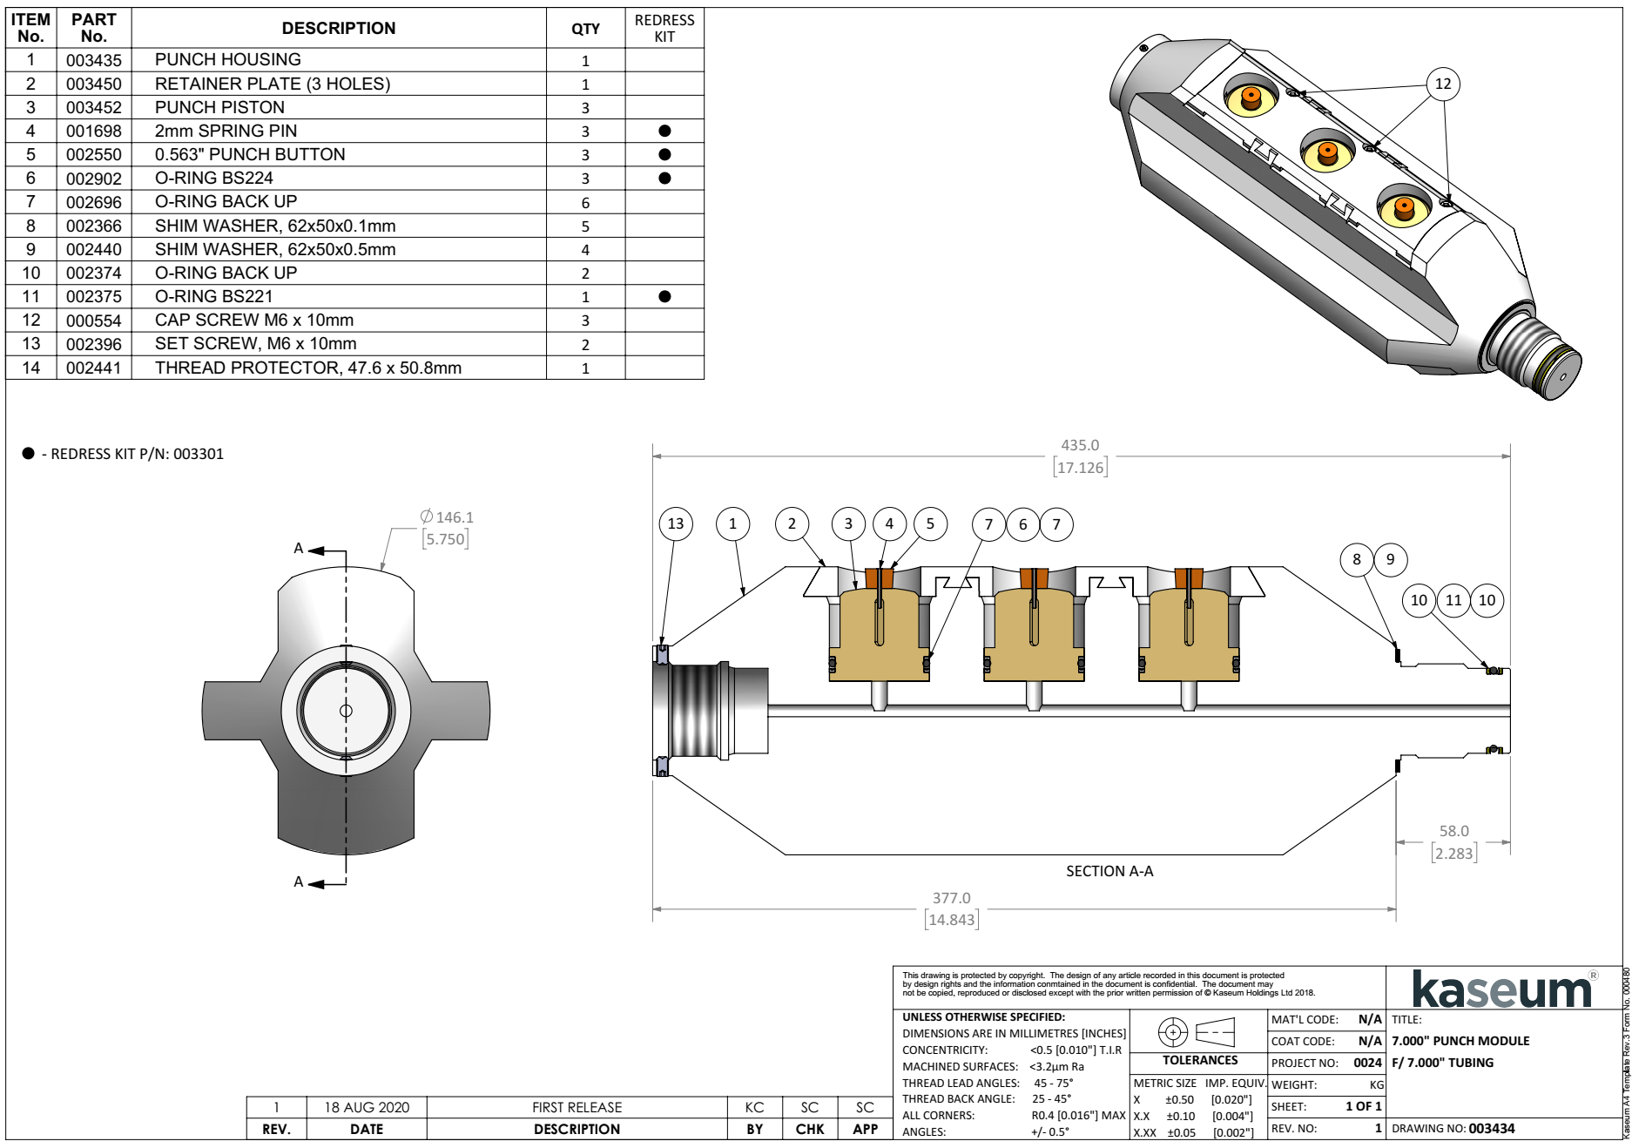
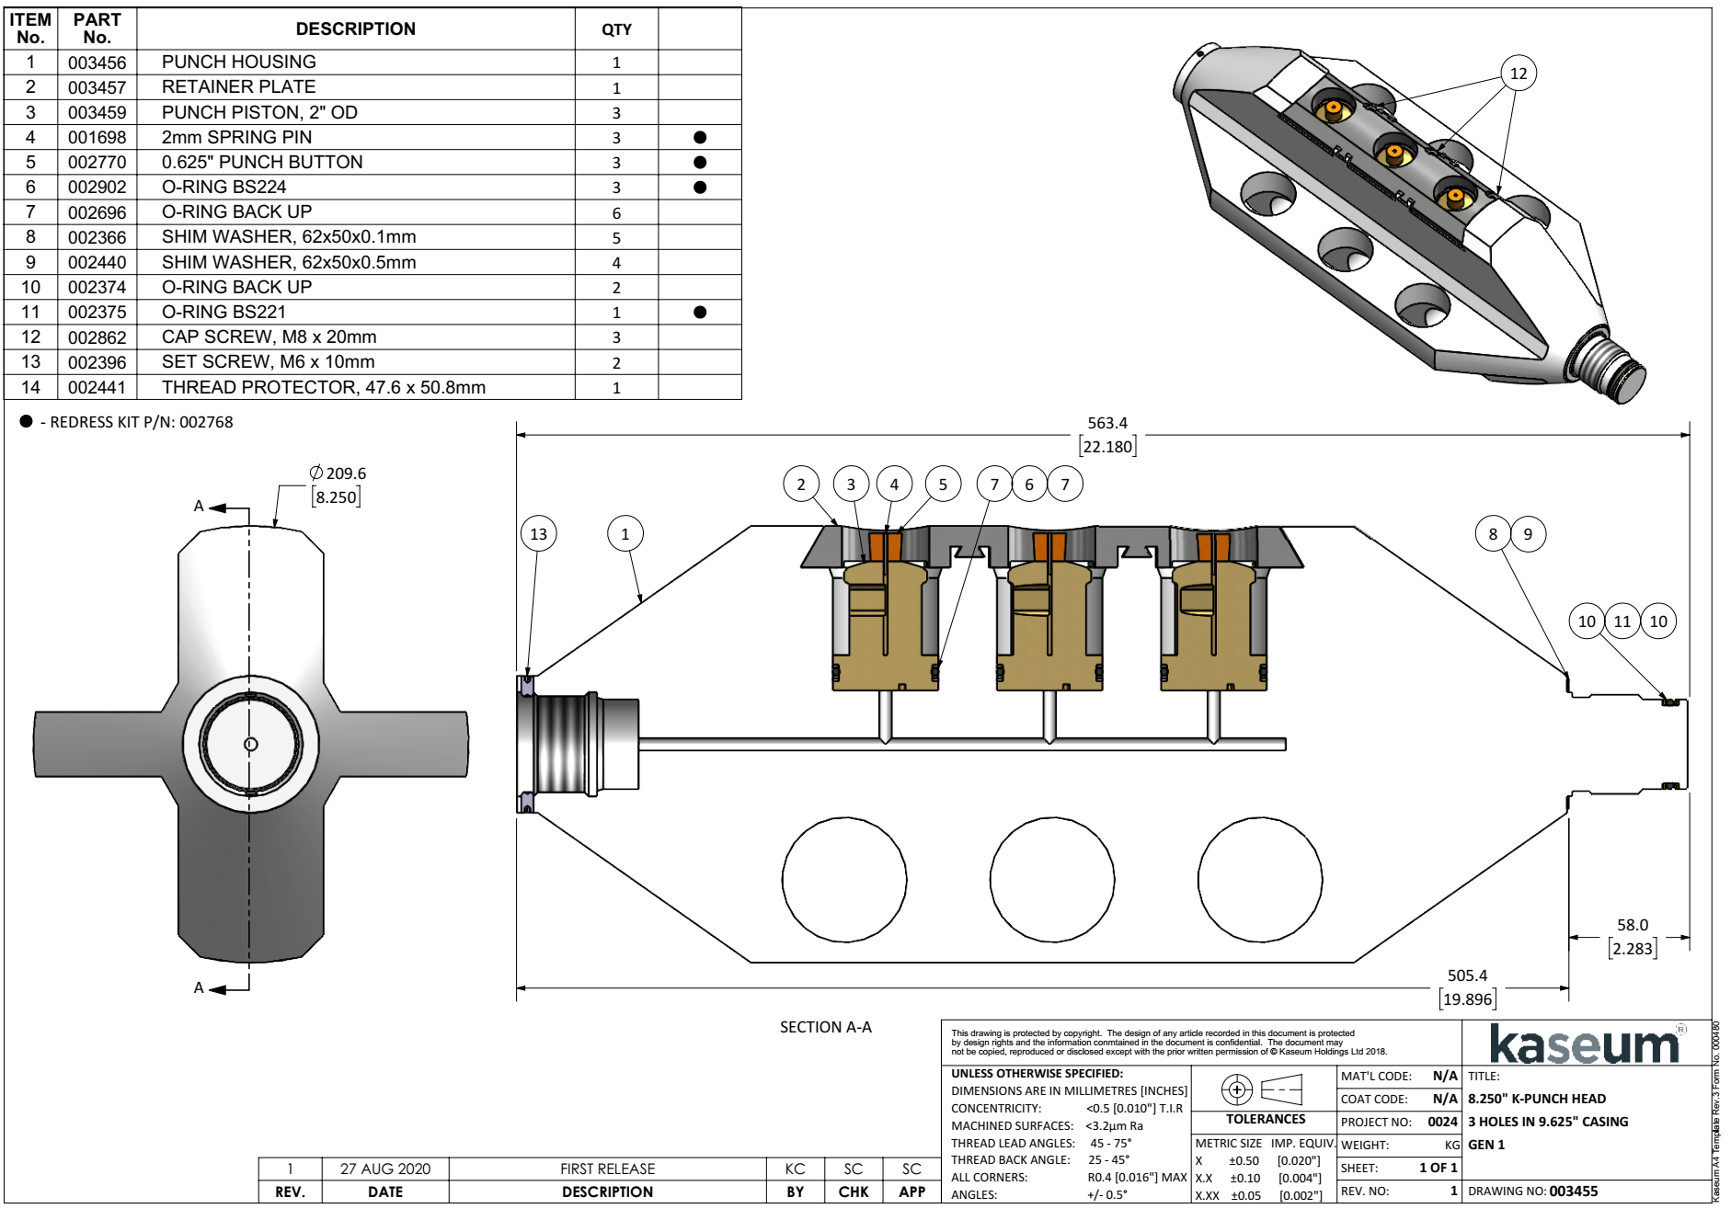
K-Punch Head options for 7” and 9 5/8”

Slide 20
K-Set & K-Punch options
K-SET & K-PUNCH Options with Slickline and ELINE (Rev 9)
K-SET PN (Slickline & ELINE) | Make up Length (SL & EL) (m) | K-Set OD" | K-Punch Hydraulic Actuator PN | (Hyd Actuator) Make up Length (m) (with 1 Punch Module) | Total Length (m) (with 1 Punch Module) (add 5" to 7"per add. Module) | K-Punch (Hyd Actuator) OD" (with 1 Punch Module) | K-Punch Module PN | K-Punch Module OD" | Max. # of Punch Module / Holes | Punch Button OD" * | Flow Area (Sq Inches) per Hole | Flow Area (Total Sq Inches) with all Modules | Suitable for Tubing
2.125" OD K-Set Tool with 2.16" & 2.59" OD K-Punch Options
001435 / 01434 | 1.28 | 2.125" | 002524 | 1.05 | 2.33 | 2.16" | 002521 | 2.16" | 8 7 | 0.375” 0.563" | 0.110 0.249 | 0.880 1.743 | 2 7/8"
001435 / 01434 | 1.28 | 2.125" | 002325 | 1.05 | 2.33 | 2.59" | 003725 | 2.59" | 3 | 0.715" | 0.402 | 1.206 | 3 1/2" x 7.7 to 12.7#
 |  |  |  |  |  |  | 002502 | 3.60" | 3 | 0.715" | 0.402 | 1.206 | 4 1/2" x L80
 |  |  |  |  |  |  | 002500 | 3.85" | 3 | 0.715" | 0.402 | 1.206 | 5" x L80
 |  |  |  |  |  |  | 002546 | 4.50" | 3 | 0.715" | 0.402 | 1.206 | 5 1/2" x L80
2.75" OD K-Set Tool with 2.59" OD K-Punch Options
002323 / 002320 | 1.400 / 1.348 | 2.75" | 002325 | 1.16 | 2.56 | 2.59" | 003725 | 2.59" | 3 | 0.715" | 0.402 | 1.206 | 3 1/2" x 7.7 to 12.7#
 | Conversion Kit |  | 002813 |  |  |  | 002502 | 3.60" | 3 | 0.715" | 0.402 | 1.206 | 4 1/2"
 |  |  |  |  |  |  | 002500 | 3.85" | 3 | 0.715" | 0.402 | 1.206 | 5"
 |  |  |  |  |  |  | 002546 | 4.50" | 3 | 0.715" | 0.402 | 1.206 | 5 1/2"
3.6" OD K-Set Tool with 3.6" OD K-Punch Options
001430 / 001422 | 1.241 | 3.6" | 002532 | 1.315 | 2.556 | 3.60" | 002502 | 3.60" | 5 | 0.715" | 0.402 | 2.010 | 4 1/2" Tubing
 |  |  |  |  |  |  | 002500 | 3.85" | 8 5 | 0.450” 0.715" | 0.159 0.402 | 1.272 2.010 | 5"
 |  |  |  |  |  |  | 002546 | 4.50" | 5 | 0.715" | 0.402 | 2.010 | 5 1/2"
 |  |  |  |  |  |  | 003434 | 5.75" | 3 | 0.625” | 0.307 | 0.921 | 7" L80, 23# & 29#
 |  |  |  |  |  |  |  | 5.75" | 3 | 0.563" | 0.249 | 0.747 | 7" P110, 23#
 |  |  |  |  |  |  |  | 5.75" | 3 | 0.500" | 0.196 | 0.588 | 7" P110, 29#
 |  |  | (17.12" long per module) (with 3 Punch Buttons per Head) |  |  |  | 003455 | 8.25" | 3 | 0.625" | 0.307 | 0.921 | 9 5/8" L80, 47#
 |  |  | (22.18" long per module) (with 3 Punch Button per Head) |  |  |  |  |  | 3 | 0.450" | 0.159 | 0.477 | 9 5/8" P110, 47#

Slide 21
K-Set & K-Punch options
Thank you

