Slide 1

HSSE SHARING
WORKPLACE FATIGUE
BY: SAHIR SAMSURI

Slide 2


DEFINITION
Fatigue is a state of physical or mental exhaustion that results from prolonged exertion, stress, or lack of rest.

Slide 3
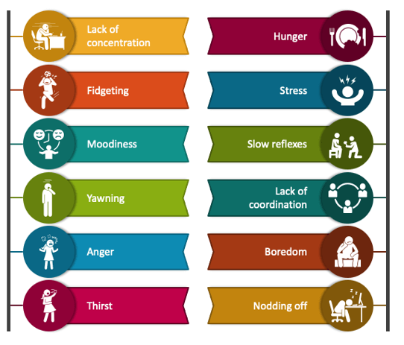
WARNING SIGN

Slide 4
CAUSES OF FATIGUE
PHYSICAL LOAD
MENTAL LOAD
ENVIRONMENTAL LOAD
Force exertion
Awkward posture
Static load
Repetitive movement
Irregular work hours
Job demands
Job stress
Co-worker relationship
Decision autonomy
Temperature
Noise
Light level
Vibration

Slide 5
EFFECT OF FATIGUE
Quality of work gets reduced
Decrease in productivity
Wastage of material and resources
Increase in rework
Increase in absenteeism
Accident rate shoot up

Slide 6
HOW TO HANDLE
Move often
Ask for support
Support your body with food, water and sleep
Take up a relaxing activity
Maintain work-life boundaries

Slide 7
THANK YOU

