Slide 1


SAFETY SHOWER
Prepared By: Zainuddin Yaacob
Date: 26th December 2024

Slide 2
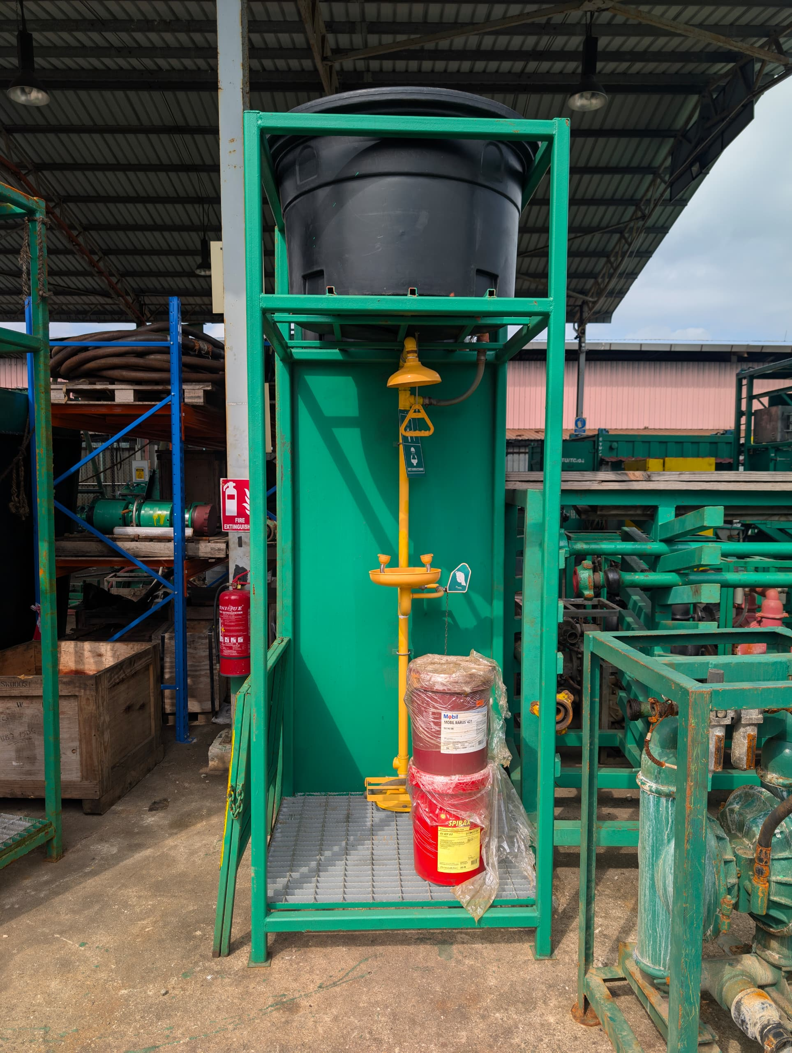
OBJECTIVE
This project provides a solution to the issue of the previously unsuitable location for the water refill of the safety shower. The new safety shower design helps to save time and effort, is space-efficient, and is easier to use during emergencies. Additionally, this project can enhance the company’s reputation for building a more efficient safety shower rack.

Slide 3
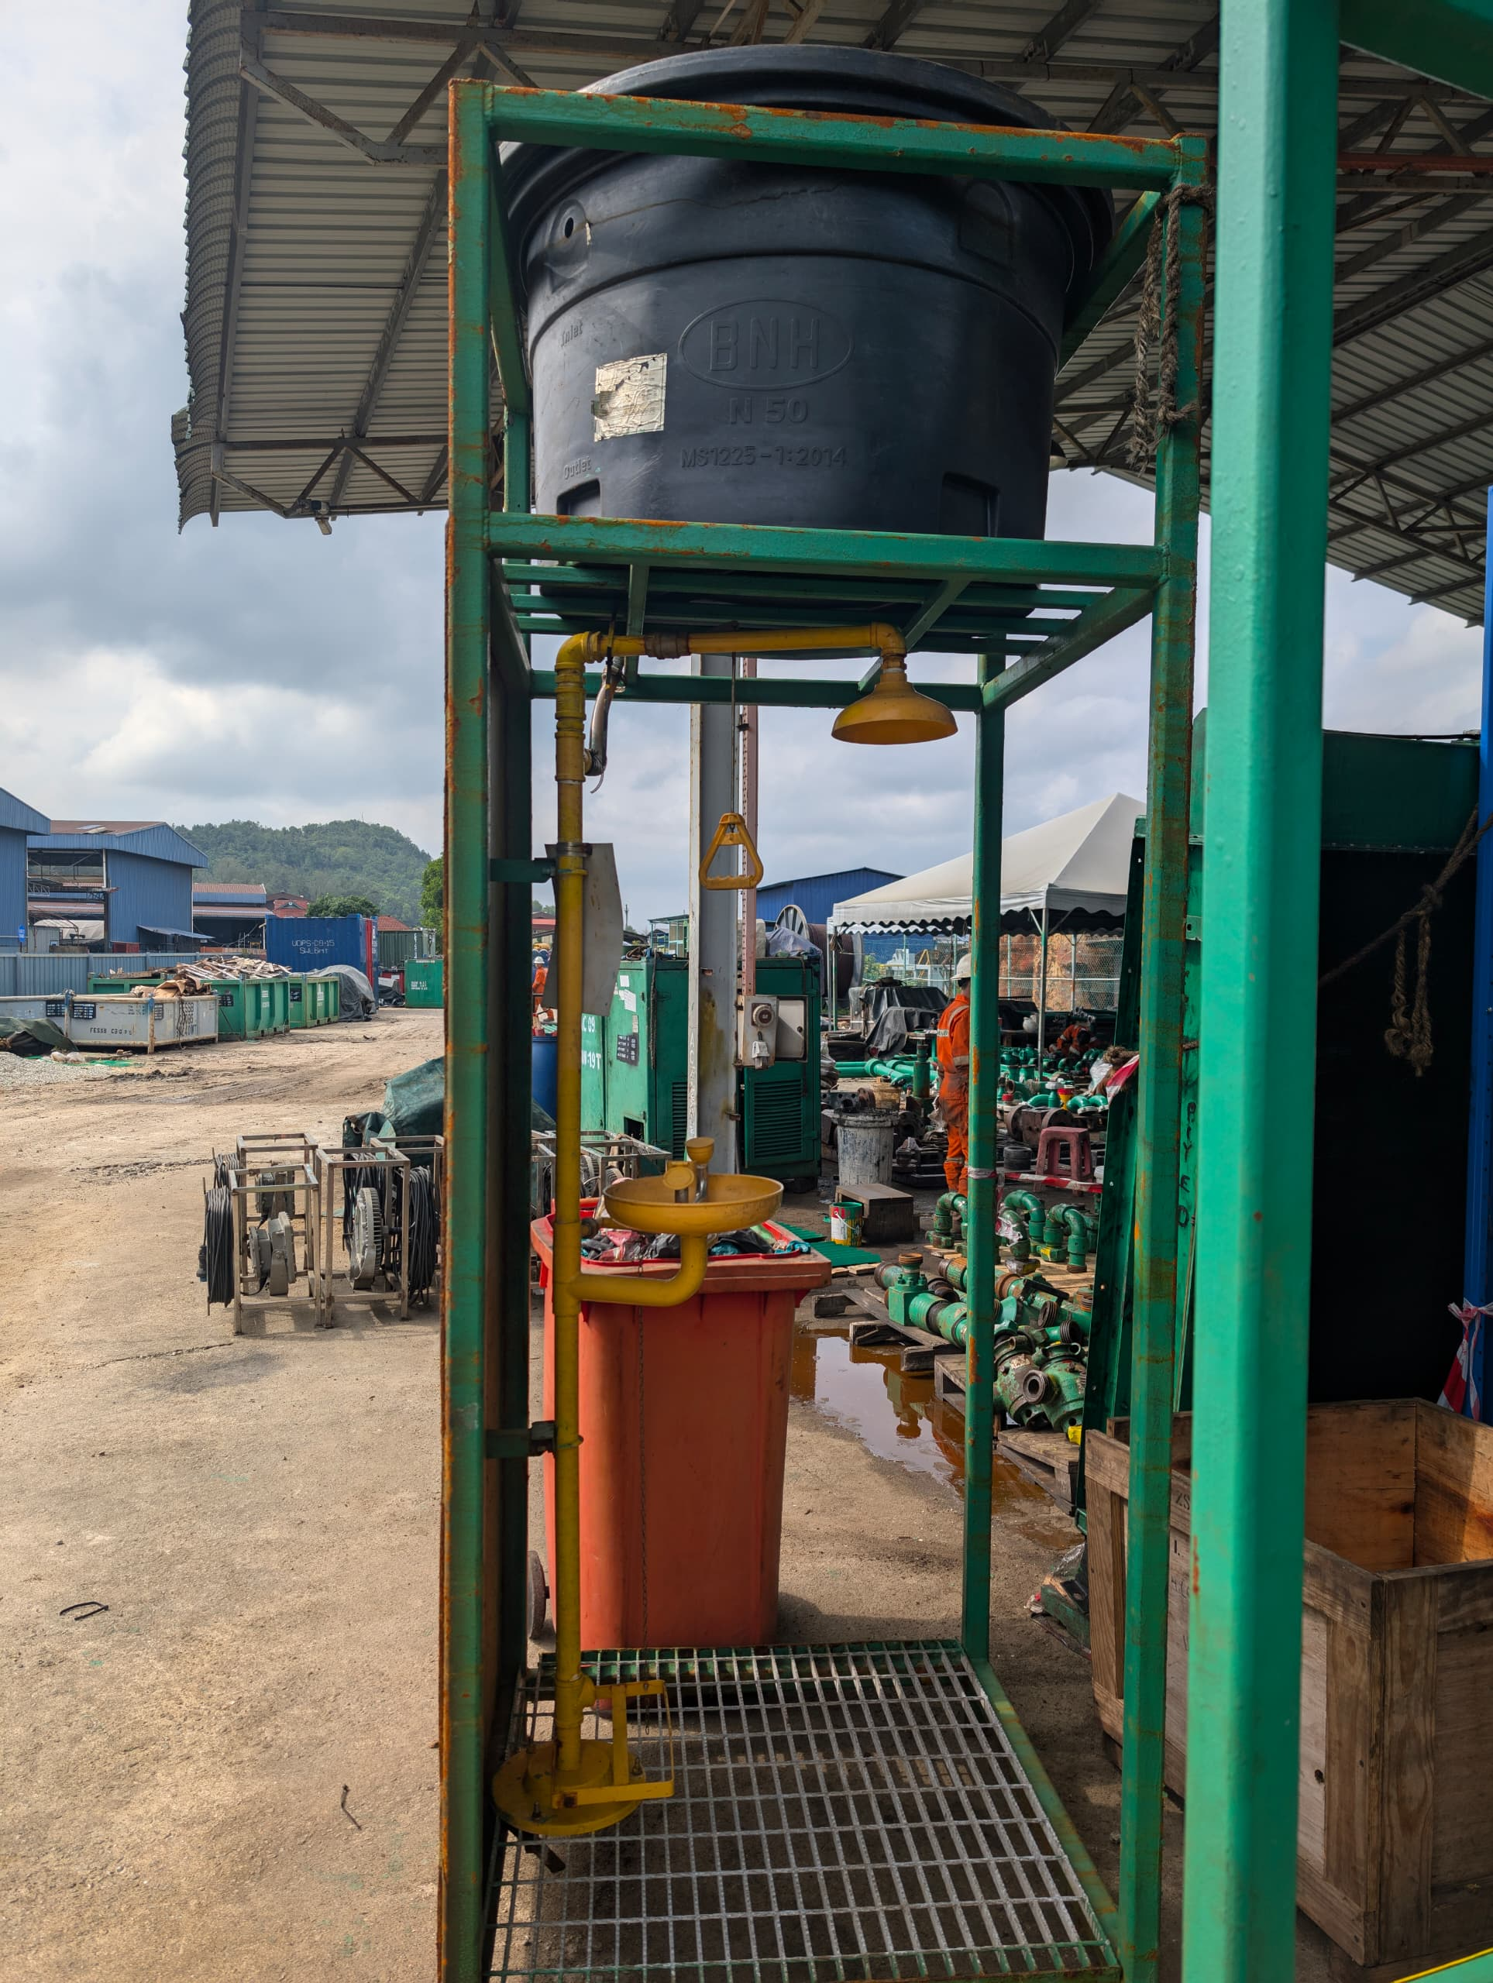
INTRODUCTION
After receiving multiple complaints from the crew about the water storage for the safety shower, it was noted that the pipe and valve are often missing because they are stored separately from the unit.
PROBLEM DEFINITION
  The company's reputation lacks credibility
  Rig up process too slow
  In case of a chemical splash at the workplace, it is challenging to quickly access and use the safety shower

Slide 4
PROBLEM DEFINITION
BENEFIT TO COMPANY & CLIENT
  The company's reputation lacks credibility
  Rig up process to slow
  In case of a chemical splash at the workplace, it is challenging to quickly access and use the safety shower
  Reduce rig up time
  No more parts will be missing
  Reduce the cost
  Easy to use

Slide 5
PROJECT OBJECTIVE
This project has achieved its goal, saving time and reducing maintenance costs
PROJECT DELIVERABLE
This project has achieved its objectives by reducing rig-up time, lowering maintenance costs, and saving space. It also enhances client trust in the company’s reputation
PROJECT TIMELINE
This project took an estimated 15-20 days to complete, including the time for receiving materials from the supplier

Slide 6
PROJECT RESOURCES
The materials required for this project
1. Offer Hollow 1” x 1” x 6 meter (3mm)
2. Offer Hollow 2” x 2” x 6 meter (4.5mm)
3. G.I Grating 25mm x 4.5mm x 3ft x 20ft (LP40)
4. M.S Plate 5mm 4ft x 8ft
5. SS 304 Bolts & Nuts 10mm x 100mm c/w spring & washer
6. 2” U Bolts c/2 2 Nuts
7. SS 304 Reducer Nipple 2” MNPT x 1” MNPT
8. SS 304 Hex Nipple 1” MPNT
9. ABS Bowl Combination Emergency Shower & Eyewash

Slide 7
PROJECT COST
The cost of this project is RM12,547.20 per unit, including the customs clearance agent fees
PROJECT RISK
This project carries no risks, as it is highly necessary. The cost is also well-accepted

Slide 8

CONCLUSION
This safety shower is crucial for the team, providing convenience during rig-up and rig-down activities. It saves time and is easy to use in the event of an emergency, such as a chemical splash on personnel. Additionally, it helps lower repair costs and makes maintenance more straightforward.

Slide 9
THANK
YOU

