Slide 1
MATERIAL HANDLING INJURIES
Presented by : Christopher Mathew Anak Kipli
Date :

Slide 2
Nature of Material Handling (M.H.) type Injuries
The nature of 80% of material handling type injuries result in soft tissue injuries such as strains and sprains.
The remaining 20% result in scrapes, bruises, and lacerations.
Strains and sprains are generally very costly injuries, especially strains or sprains to the extremities or the low back area.

Slide 3
Sprains & Strains
A Sprain is an injury that causes damage to the ligaments, the tissue that connects bone to bone.
A Strain is an injury that causes damage to muscles or muscle tendons,the tissue that connects muscle to bone.

Slide 4
Examples
Sprains and Strains are usually a result of direct trauma . . .
Lifting an object while twisting from the waist
Cumulative or repetitive trauma resulting in weakening of the muscles and ligaments
Making quick body movements, such as standing or squatting very quickly

Slide 5
Common causes of strains & Sprains
When done incorrectly:
Lifting
Stretching
Pulling/Pushing
Other causes:
Poor physical conditioning
Poor posture

Slide 6
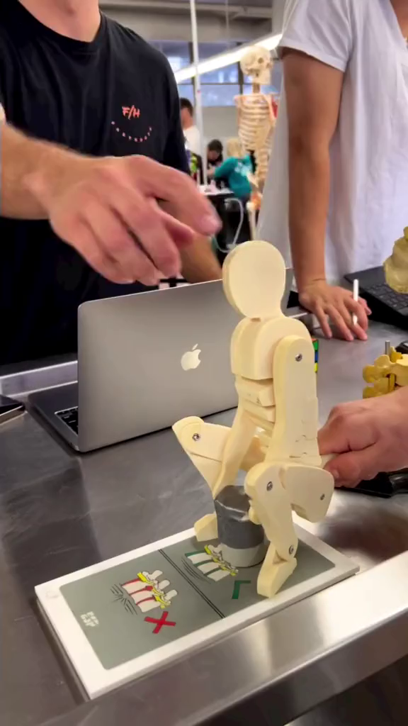

Slide 7
TIPS FOR PREVENTION
Know the risks.
Avoid the risks.

Slide 8
Know the risks
Most strains & sprains affect the arms, shoulders and back.
A worker may try to pull or lift an object that is too heavy or awkward without help, or
A worker may try to pull or lift a heavy object while twisting from the waist.
We know that new employees are more likely to get injured.

Slide 9
Avoid the risks
Bend the knees, not the back.
Carry loads close to the body.
Do not twist. Move the feet and legs as necessary.
If the object is too heavy, ask for help.
Maintain good posture.

Slide 10
Avoid the risks
Watch where they are walking.
Exercise, whenever possible.
Eat well.
Report all injuries immediately!

Slide 11
Workable solutions
Use existing resources to reduce material handling injuries.
Create new ways of reducing material handling injuries.

Slide 12
Workable Solutions Ideas
Increase proper lifting technique training.
Assign new employees to the patronage of seasoned employees in the same crew.
Involve the Lead Personnel in watching and training new employees.
Use mechanical equipment whenever possible to pick-up, move or deposit materials.

Slide 13
Material Handling?
Why the need to reduce material handling related injuries?

Slide 14
Benefits of M.H. injury reduction
Increased productivity
Lower worker compensation and general insurance costs
Lower experience modifier rate
Reduction in direct & indirect costs of injuries
Increased competitiveness
Increased morale among employees

Slide 15
THANK YOU !

