Slide 1

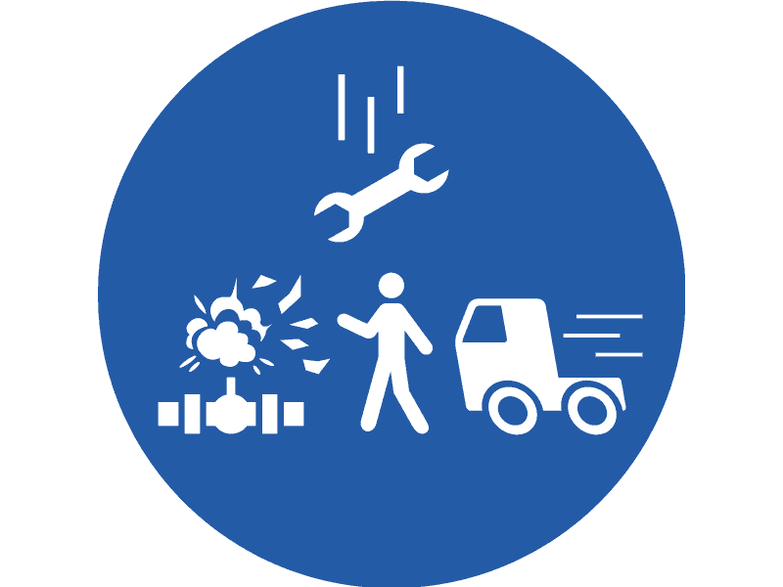
MANSYUR BIN WAHYUDDIN
(SLICKLINE ASSISTANT)
LINE OF FIRE

Slide 2
Content
Line of Fire Definition
Line of Fire Video
Line of Fire Main Categories
Behaviors that lead to being in the LINE OF FIRE
How to protect yourself from the Line of Fire Hazard
Routine checks to prevent being in the Line of Fire

Slide 3
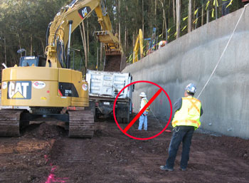
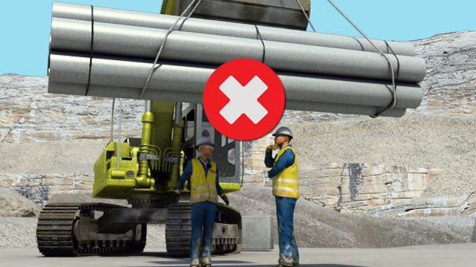
What is Line of Fire??
You are in the Line of Fire when you position your body, or parts of your body, in a way that exposes you to an injury risk from getting hit by or making direct contact with moving parts of machinery, equipment, tools, or static object.

Slide 4
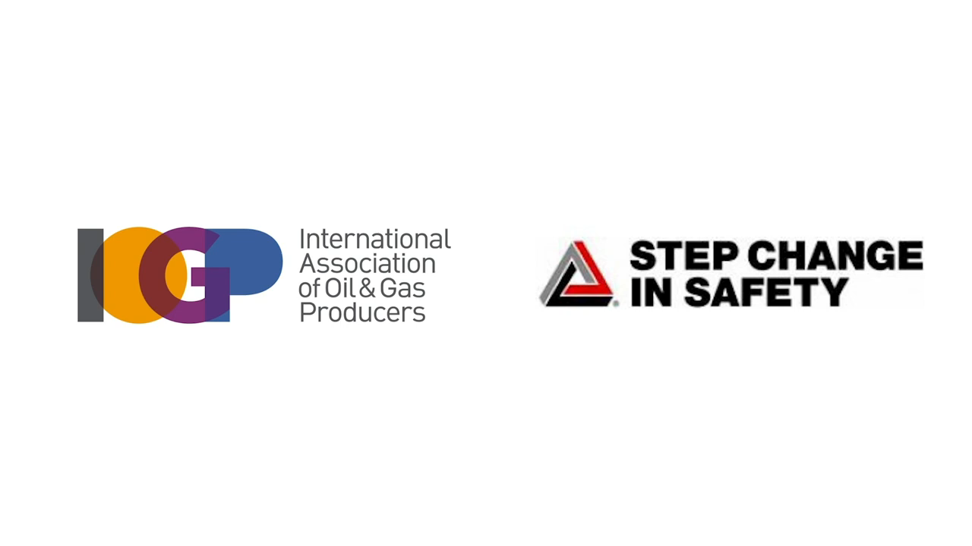
Line of Fire Video

Slide 5
Line of Fire Main Categories
Caught-in or between
Struck-by
Released energy

Slide 6
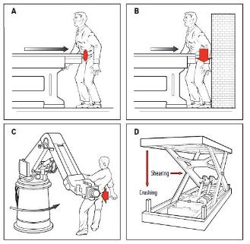
1. Caught-in or between
Caught-in or between incidents happen when someone is either caught in the equipment or between two pieces of equipment.

Slide 7
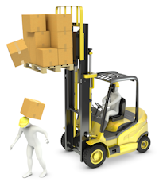
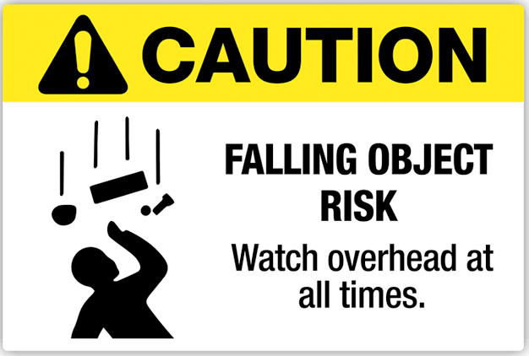
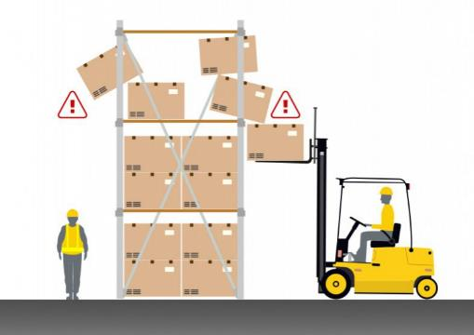
2. Struck-by
Struck-by incidents occur when someone is hit by an object that has been falling from height or ejected from the equipment.

Slide 8
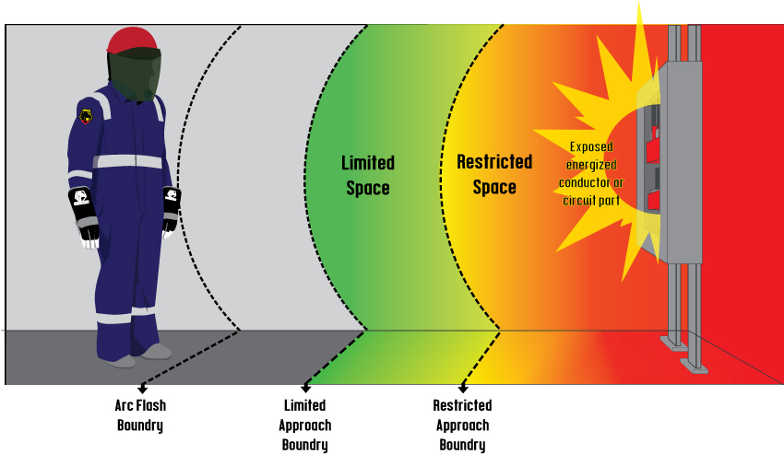
3. Released energy
Released energy incidents happen when energy is released from the equipment, such as an electric shock.

Slide 9
Behaviors that lead to being in the LINE OF FIRE
Rushing
Frustration
Fatigue
Complacency
You are in a hurry to complete a task
You are angry, irritated, or annoyed
You are tired
You have completed a task many times and have never been hurt before

Slide 10
How to protect yourself from the Line of Fire Hazard
Always be aware of your surroundings and identify potential hazards.
Stay alert and follow all safety procedures
If you see a potential hazard, report it to a supervisor/ manager immediately.
Wear the proper PPE which may include gloves, safety glasses, and hearing protection.

Slide 11
Routine checks to prevent being in the Line of Fire
When switching a breaker into position, Always stand aside in case of an arc flash.
When loosening or tightening with tools, remain focused and anticipate the possibility sudden loosening or kickbacks if the tools slipped.
Beware of the potential for line of fire when working with pressurized tools
Always make clear yourselves from being in the line of fire in case parts of the equipment or machines breaks / scattered?
Properly secure your loads before lifting, loading, unloading or transporting.
Properly secure all heavy items or objects with potential to roll, move or fall.
Establish a drop zone under any work being performed at height.

Slide 12
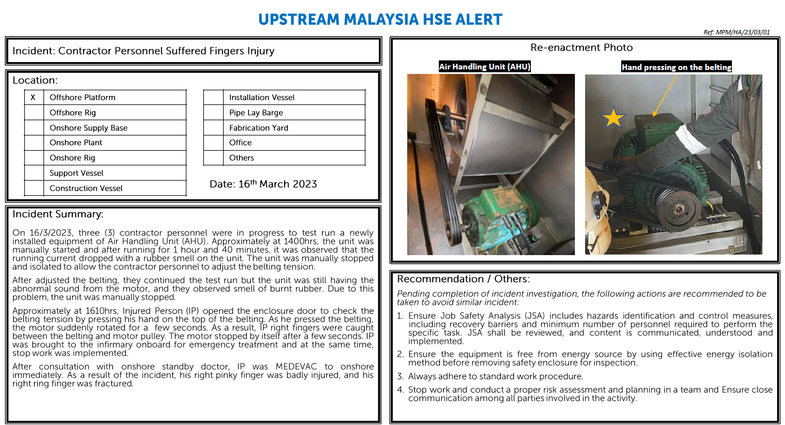
Learning from Line of Fire Recent Incident

