Slide 1
COMPETENCY MANAGEMENT SYSTEM
(CMS)
By
Stephanie Urai
Muhammad Hadi Jasmin

Slide 2
Content
Competency Management System
① | Workshop Objective
② | CMS Introduction
③ | CMS Objectives
④ | CMS Overview
⑤ | How to install/use
⑥ | How to login

Slide 3
OBJECTIVE OF THIS WORKSHOP
To introduce the SLS crew to CMS online and provide comprehensive step-by-step hands-on guidance via actual log-in into an individual profile

Slide 4
What is ND CMS?
Neu Dimension Competency Management System is an Online platform developed and used to manage and assess our human assets to achieve our Training & Development GOAL & OBJECTIVES
The training program for each position is developed to equip the employees with the necessary skills and knowledge needed for their respective position through classroom and / or online learning and the required practical or hands on training as well as the actual exposure through the on-the-job training in the field

Slide 5
CMS Introduction
The CMS was developed with the intention of making it much easier for the crew to gain accessibility on learning the tools and equipment with ease.
The CMS will also capture all the job details completed by the crew required for their promotion.
All the captured data would no longer need to be handed in through email.

Slide 6
Why CMS?
HOW??
To manage training, skills and competency records.
Moving away from manual tracking and records to online - one platform to keep all of our training activities - no more all over the place
To improve transparency – you know your own progress, no more “aku sudah buat semua kenapa tak promote lagi?”
You, your boss and his boss are able to see the cause of any delay
We need to continuously improve our processes and systems - the world is evolving, like it or not, we need to align ourselves and adapt with the changes

Slide 7
Why CMS? (con’t)
Crews will be able to see and plan early on what they need to complete based on the requirement for the next promotion.
Crews will no longer have a hard time to get the learning materials.
CMS will help to guide the crews on what to be expected on the test question. (EG: IWCF)

Slide 8
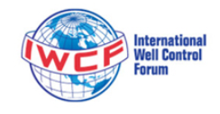




CMS OVERVIEW
+
Step 01
Step 03
Step 02
Step 04
A
LEARNING
C
ASSESSMENT
A1. FUNDAMENTAL MODULE
C1. THEORETICAL
C2. PRACTICAL
A2. PROCEDURE
C3. INTERVIEW
B
TASKS
D
OTHERS
B1. WORKBOOK
D1. OTHER REQUIRED DOCUMENTATION
B2. ON JOB TRAINING
B3. HSSE
D2. WEEKLY REPORT
B4. IN-HOUSE TRAINING

Slide 9


How to install/use CMS (Application/Web)
A. Mobile Apps
2. Google Play Store and Downloading Moodle Mobile
3. Next, Search for the "Moodle" app.
1. First, locate and launch your Google Play Store app.

Slide 10
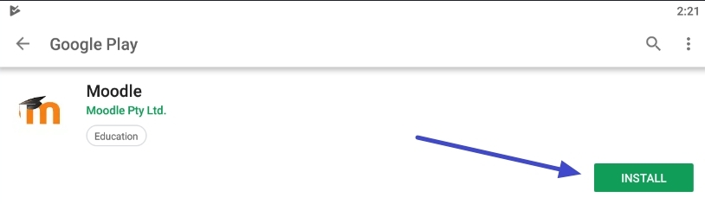
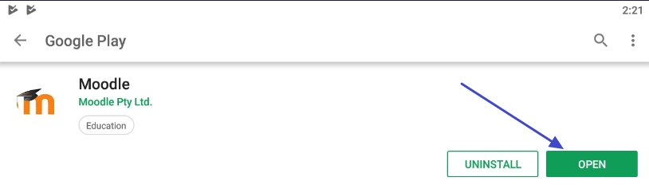
How to install/use CMS (Application/Web)
A. Mobile Apps
4. On the Moodle app page, Tap the green "INSTALL" button to download and install Moodle.
5. Once the app is finished installing, tap the green "OPEN" button to launch the app

Slide 11
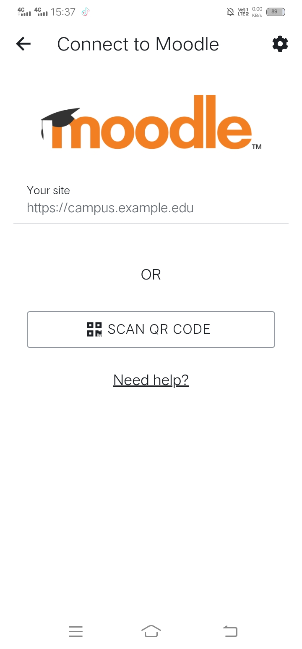
How to install/use CMS (Application/Web)
A. Mobile Apps
6. When starting Moodle for the first time, we recommend allowing notifications if Moodle Mobile requests it so you can be notified of course events.
7. When starting Moodle for the first time, we recommend allowing notifications if Moodle Mobile requests it so you can be notified of course events.
8. On the first launch, the App will request the web address of our Moodle site. Type https://cms.neudimension.com and then press the “CONNECT!” button below.

Slide 12
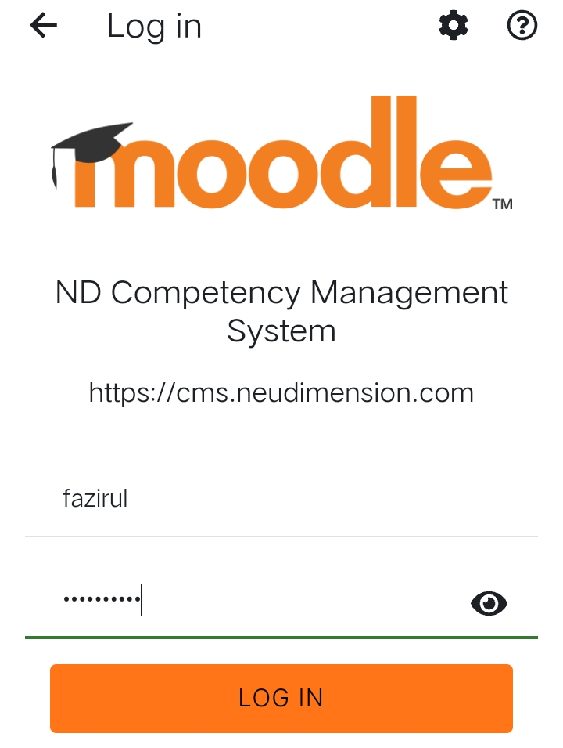
How to install/use CMS (Application/Web)
A. Mobile Apps
9. Now that we are on the Moodle website in the mobile apps on your device, we must log in.
10. Next, type the same username and password you would use to log into Moodle on the computer.

Slide 13
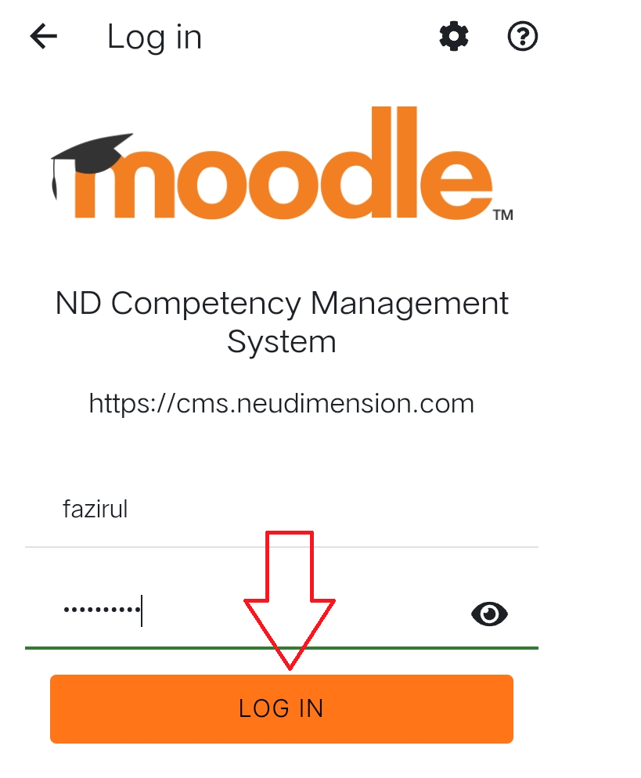
How to install/use CMS (Application/Web)
A. Mobile Apps
11. If your credentials are correct, pressing the “Sign In” button should automatically transfer you back to the Moodle Mobile app within a few seconds.

Slide 14
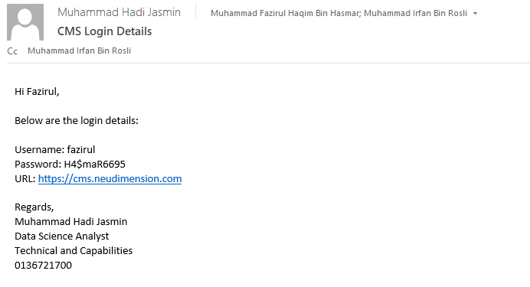
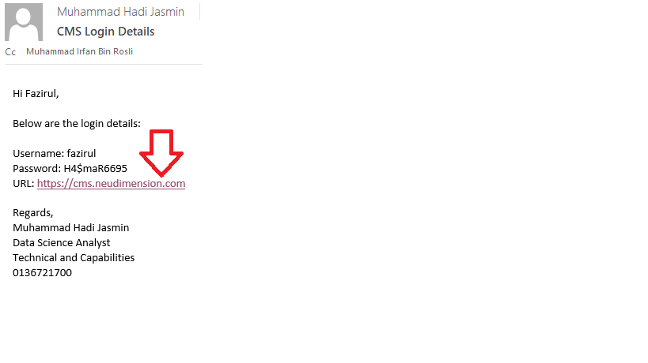
How to install/use CMS (Application/Web)
B. Website
1. Receive information about username and password details for CMS login for the MIS parties.
2. Next, click the URL link that has been given by the MIS parties

Slide 15
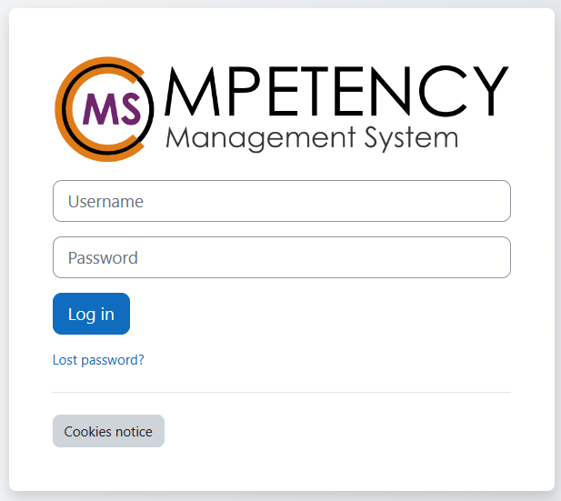
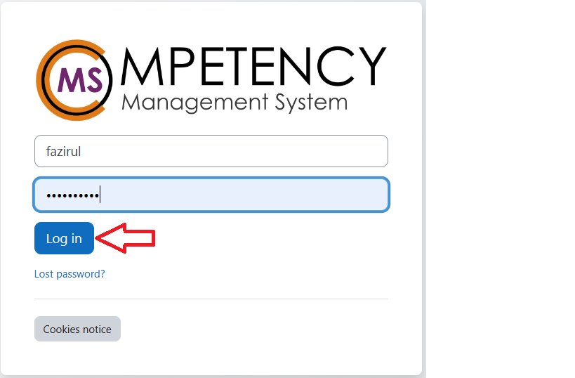
How to install/use CMS (Application/Web)
B. Website
3. By clicking the link, you will go straight to the CMS login page.
4. Next, insert your CMS login account details and click “Log in” .

Slide 16
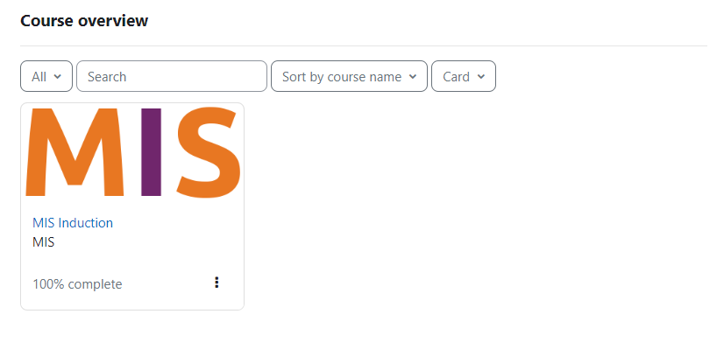
How to install/use CMS (Application/Web)
B. Website
5. After being transferred to the Moodle Mobile App, you should see your courses listed if you are successfully logged in.
6. Congratulations, you are now ready to use Moodle on the go!

