Slide 1
SLIPPED DISK
HERNIATED DISK

Slide 2
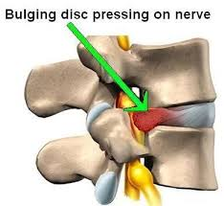

Slide 3
OVERVIEW
A soft cushion of tissue between the bones in your spine pushes out.
It's painful if it presses on nerves.
It usually gets better slowly with rest, gentle exercise and painkillers.

Slide 4
SIGNS AND SYMPTOMS
lower back pain
numbness or tingling in your shoulders, back, arms, hands, legs or feet
neck pain
problems bending or straightening your back
muscle weakness
pain in the buttocks, hips or legs if the disc is pressing on the sciatic nerve (sciatica)

Slide 5
CAUSES
Sprain or strain, but often there's no obvious reason.
Back pain is rarely caused by anything serious.
ageing
exercising too hard
lifting heavy objects the wrong way
vibration from driving or operating machinery
being inactive or overweight

Slide 6
PREVENTIONS
Keep active – take regular exercise
Use a safe technique when lifting heavy objects (BODY MECHANICS)

Slide 7
TREATMENTS
Keep active- gradually increase activity level.
Medications- NSAID, Steroid etc.
Physiotherapy
Surgery- Discectomy, Laminectomy

Slide 8
Thank You
Any Questions?

