Slide 1


Emeraude
Start up Manual
SUBSURFACE DATA SERVICES DEPARTMENT (SDS)
i-Solutions
© 2014 Dimension Bid All Rights Reserved

Slide 2
Emeraude interpretation file – Preparation
Files needed for preparation
  File before start logging:
    OHGR (.las) -> from client
    Well schematic -> from client
    Well deviation survey (TVD, Deviation & etc) -> from client
    PVT data
  After logging:
    Raw data
      Dynamic (.las)
      Station (.las)
    DOR/SOE
    Well test results for each condition

Slide 3
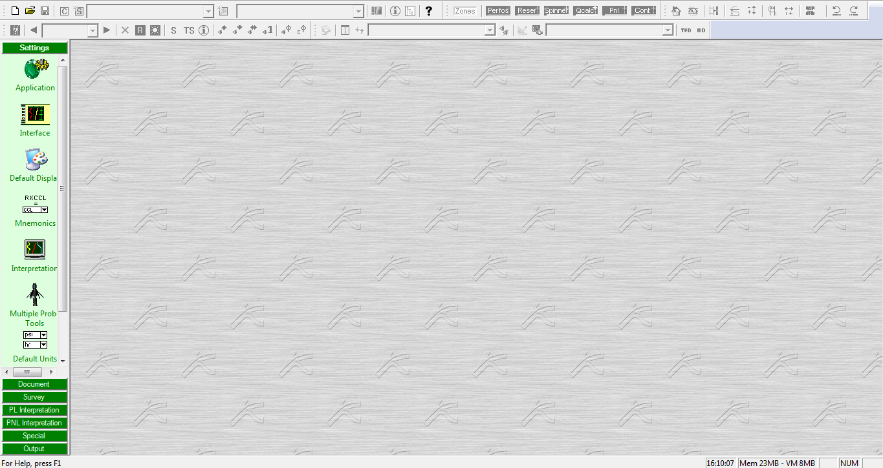
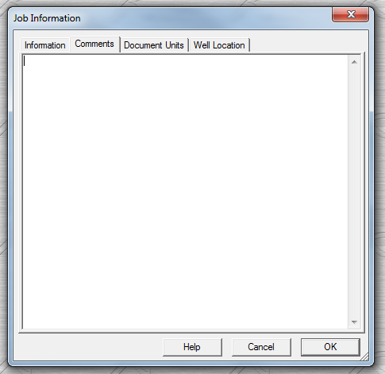
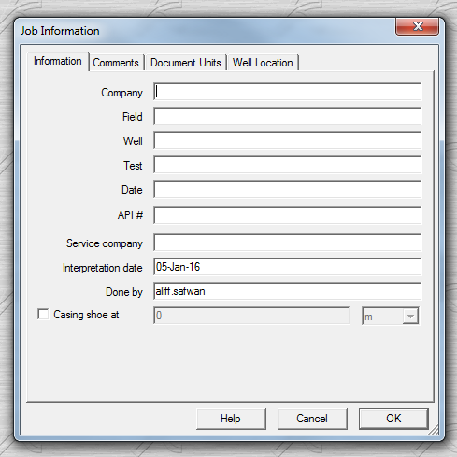
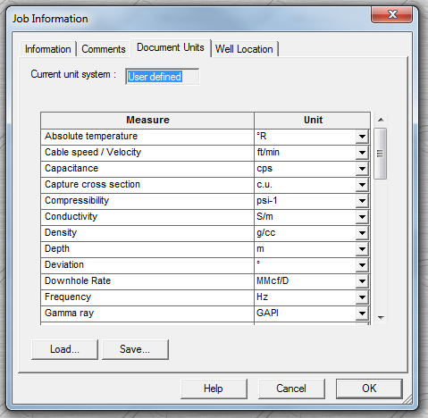
1
3
2
Can put any additional info eg:
Raw value for CWH
Toolstring config
Issue during operation
Etc that will help interp
4
Fill all necessary information for the job
Depth reference: m or ft
*by default, it will be in m

Slide 4
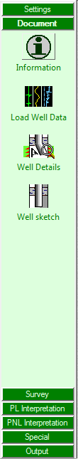
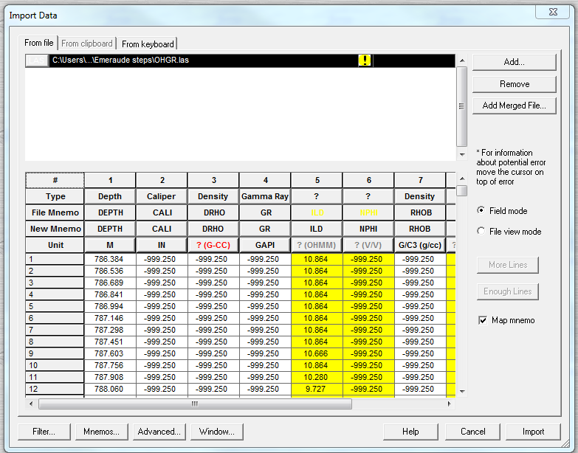
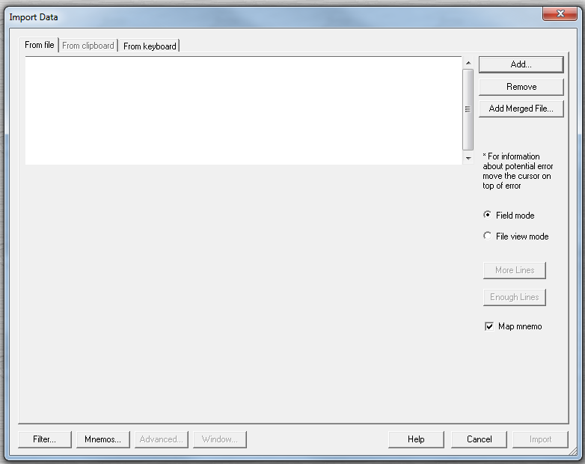
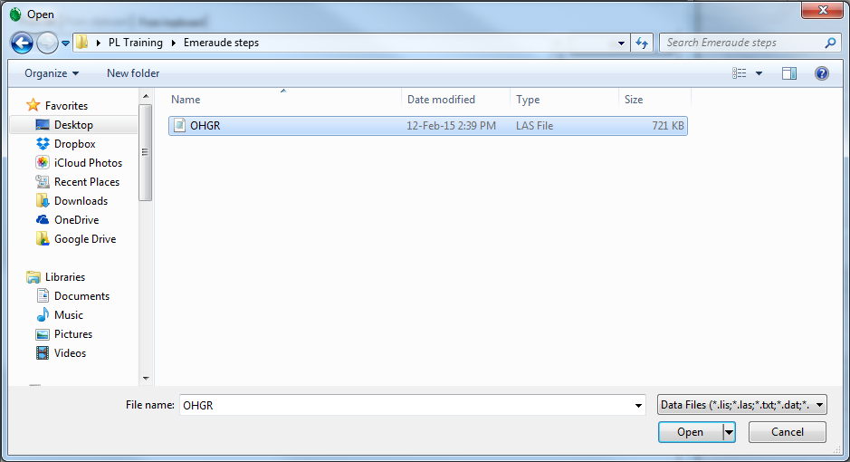
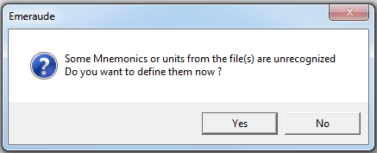
Information filled earlier can always revise here
1
To input:
OHGR
TVD
2
3
5
4

Slide 5
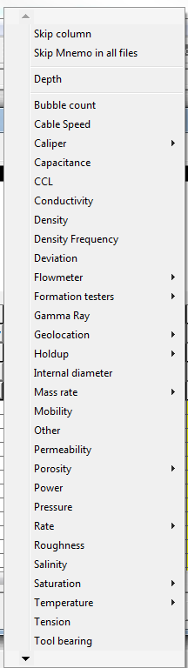
7
6

Slide 6
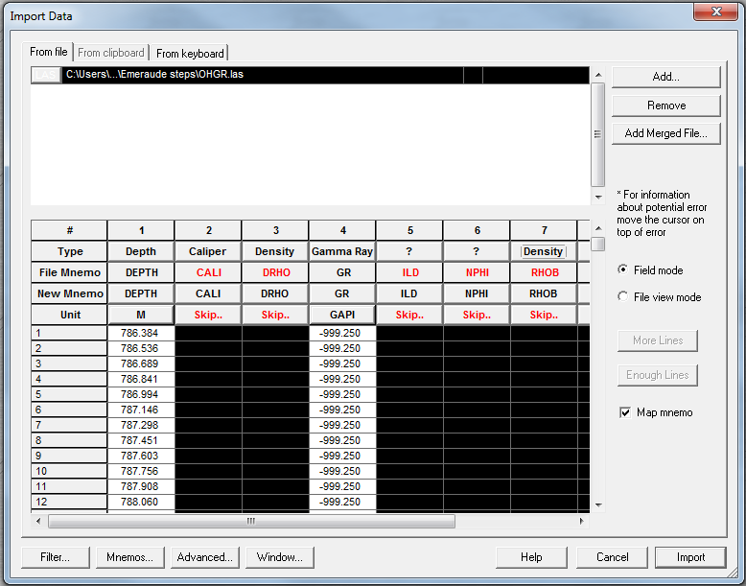
7
Skip all unnecessary data.
Just leave GR & DEPTH
Make sure no here
6
8

Slide 7
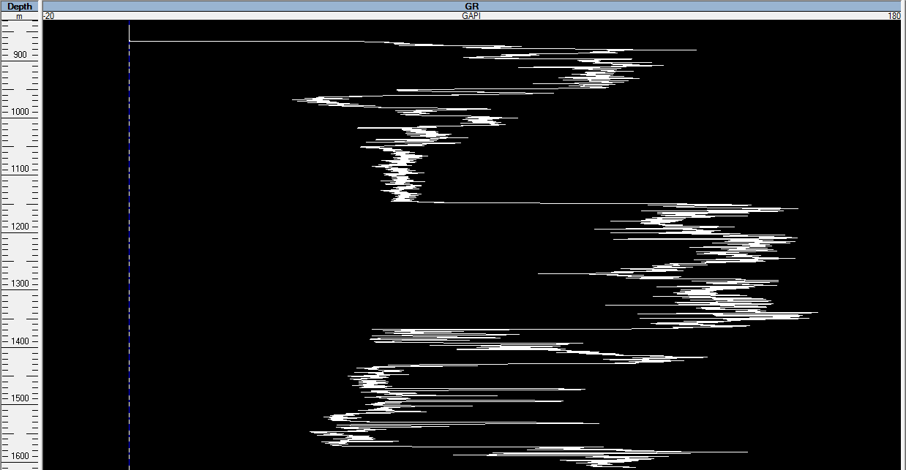
1) To include
well detail such as:
Deviation, perf interval & etc

Slide 8
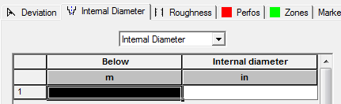
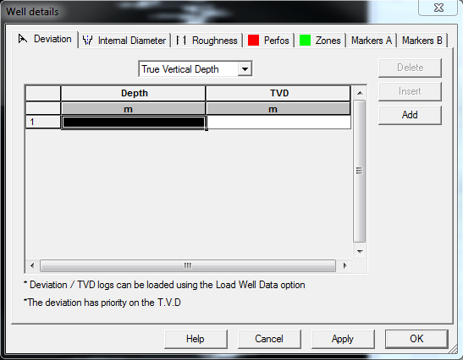
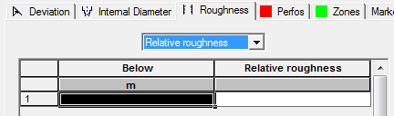
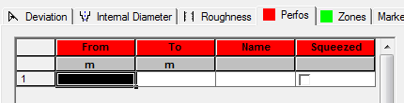
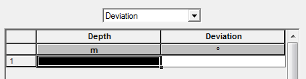
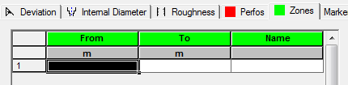

Slide 9
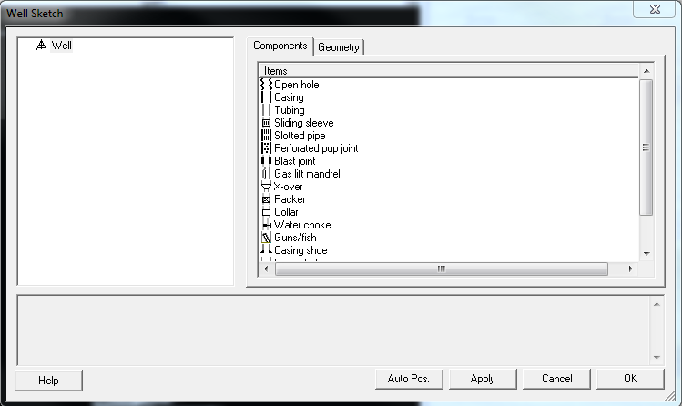
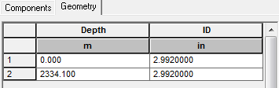
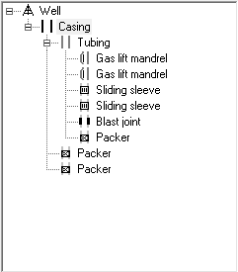

Slide 10
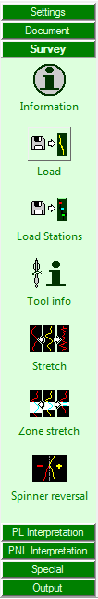
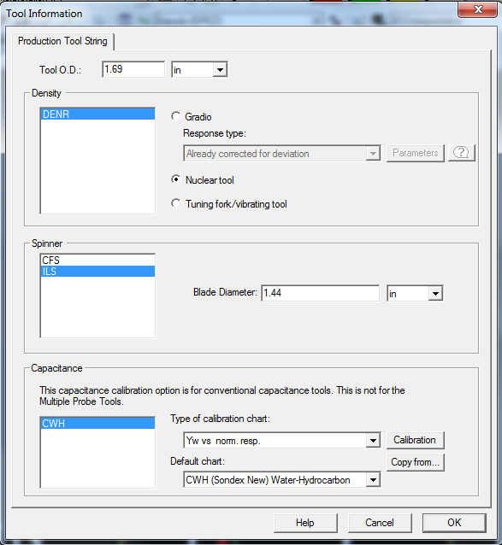
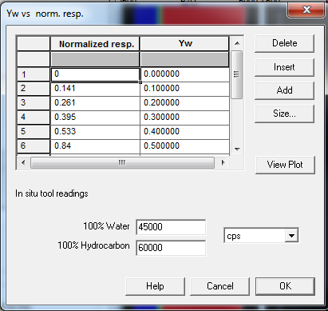
To input passes logging data
To input station logging data
Values taken during shut in condition for each phase
Tool size
Spinners
Spinner size

