Slide 1
SLIM SPLIT C POWERPACK
By Arifin Zaimuddin

Slide 2
STARTERS
Battery operated
E-line Operations are equipped with engine operated equipment
Engine operated equipment are the Air Compressor, Powerpack, and Genset.
Air Compressor is equipped with spring starter whilst the powerpack is equipped with air starter.
The Air Compressor will supply the air to the powerpack for it to start.
Starter types
Spring Operated
Hydraulic
Pneumatic

Slide 3
POWERPACK COMPONENTS
It is important to determine the components that are available inside the powerpack to assist the operation in case of any failure is happening.
Other than this, spares that is to be brought offshore can be identified during preparation phase inside the doghouse.
Maintenance must be done every 200 hours as a preventative measure to uphold the service quality.

Slide 4
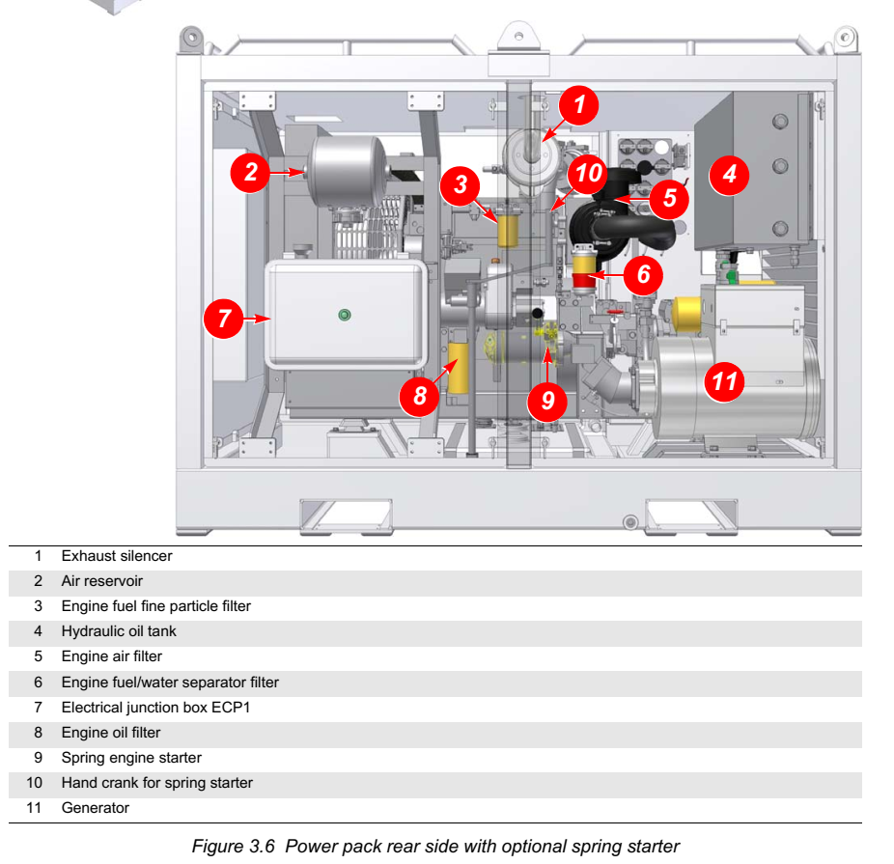
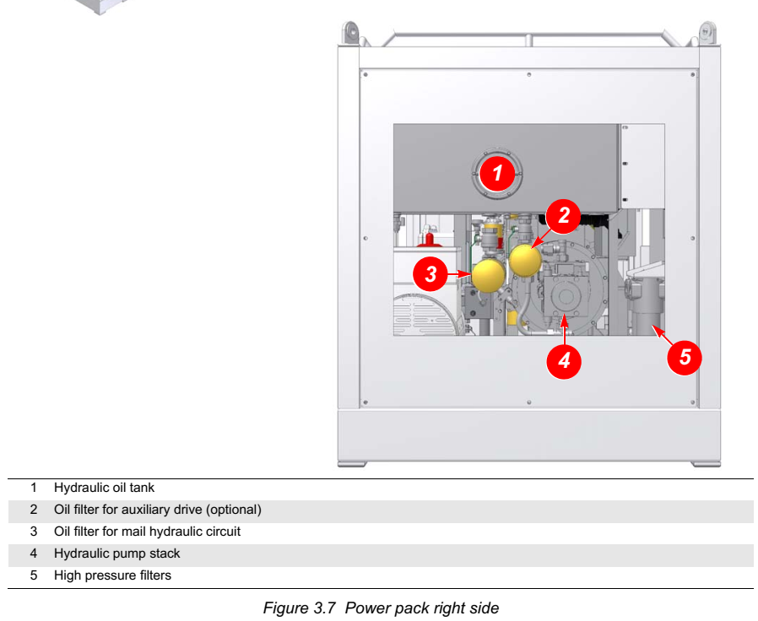
POWERPACK COMPONENTS

Slide 5
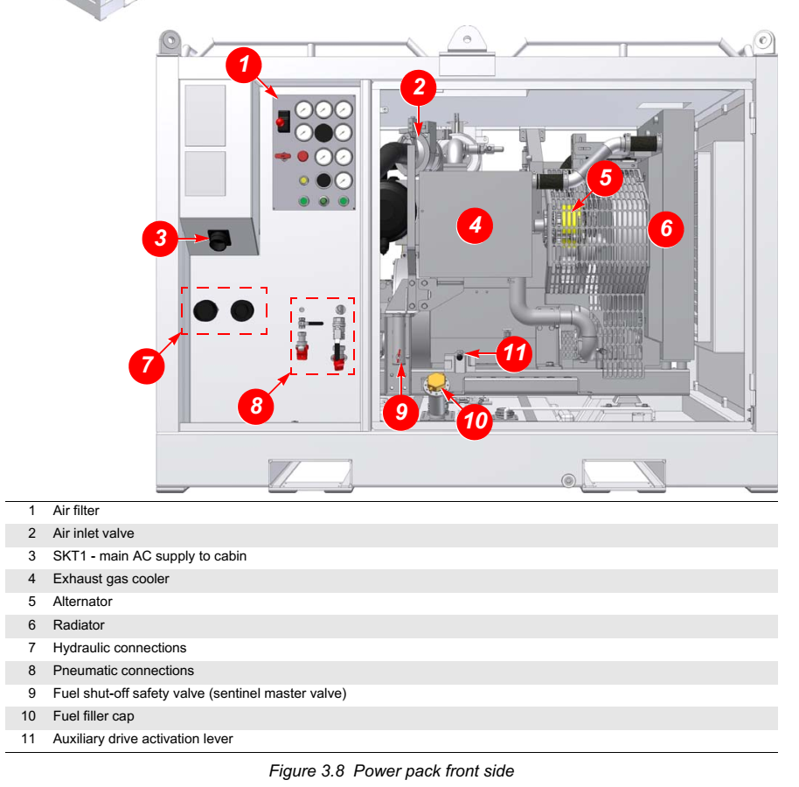
POWERPACK COMPONENTS

Slide 6
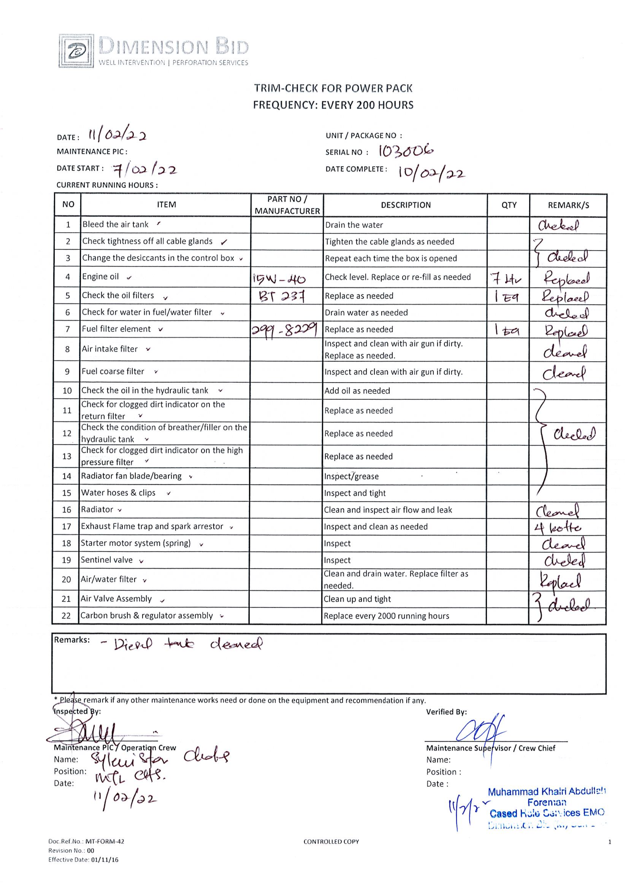
PAPERWORK FOR MAINTENANCE
The PPM must be done at offshore when the Utilization has reached 200 HOURS.
This is to be performed by the offshore crew, or the mechanic, if available on site.
It is crucial to track the utilization by hours, every job.
The lost track of utilization hours can bring damage to the equipment as the PPM is not done as per requirement.

Slide 7
PAPERWORK FOR MAINTANENCE
The utilization chart are usually being printed and pasted on the wall of the doghouse.
When shift ends, the utilization chart is to be filled by the crew and monitored.
Jobs could prolong up until months, and this sheet helps the Operation to maintain the Powerpack well throughout the whole campaign.

Slide 8
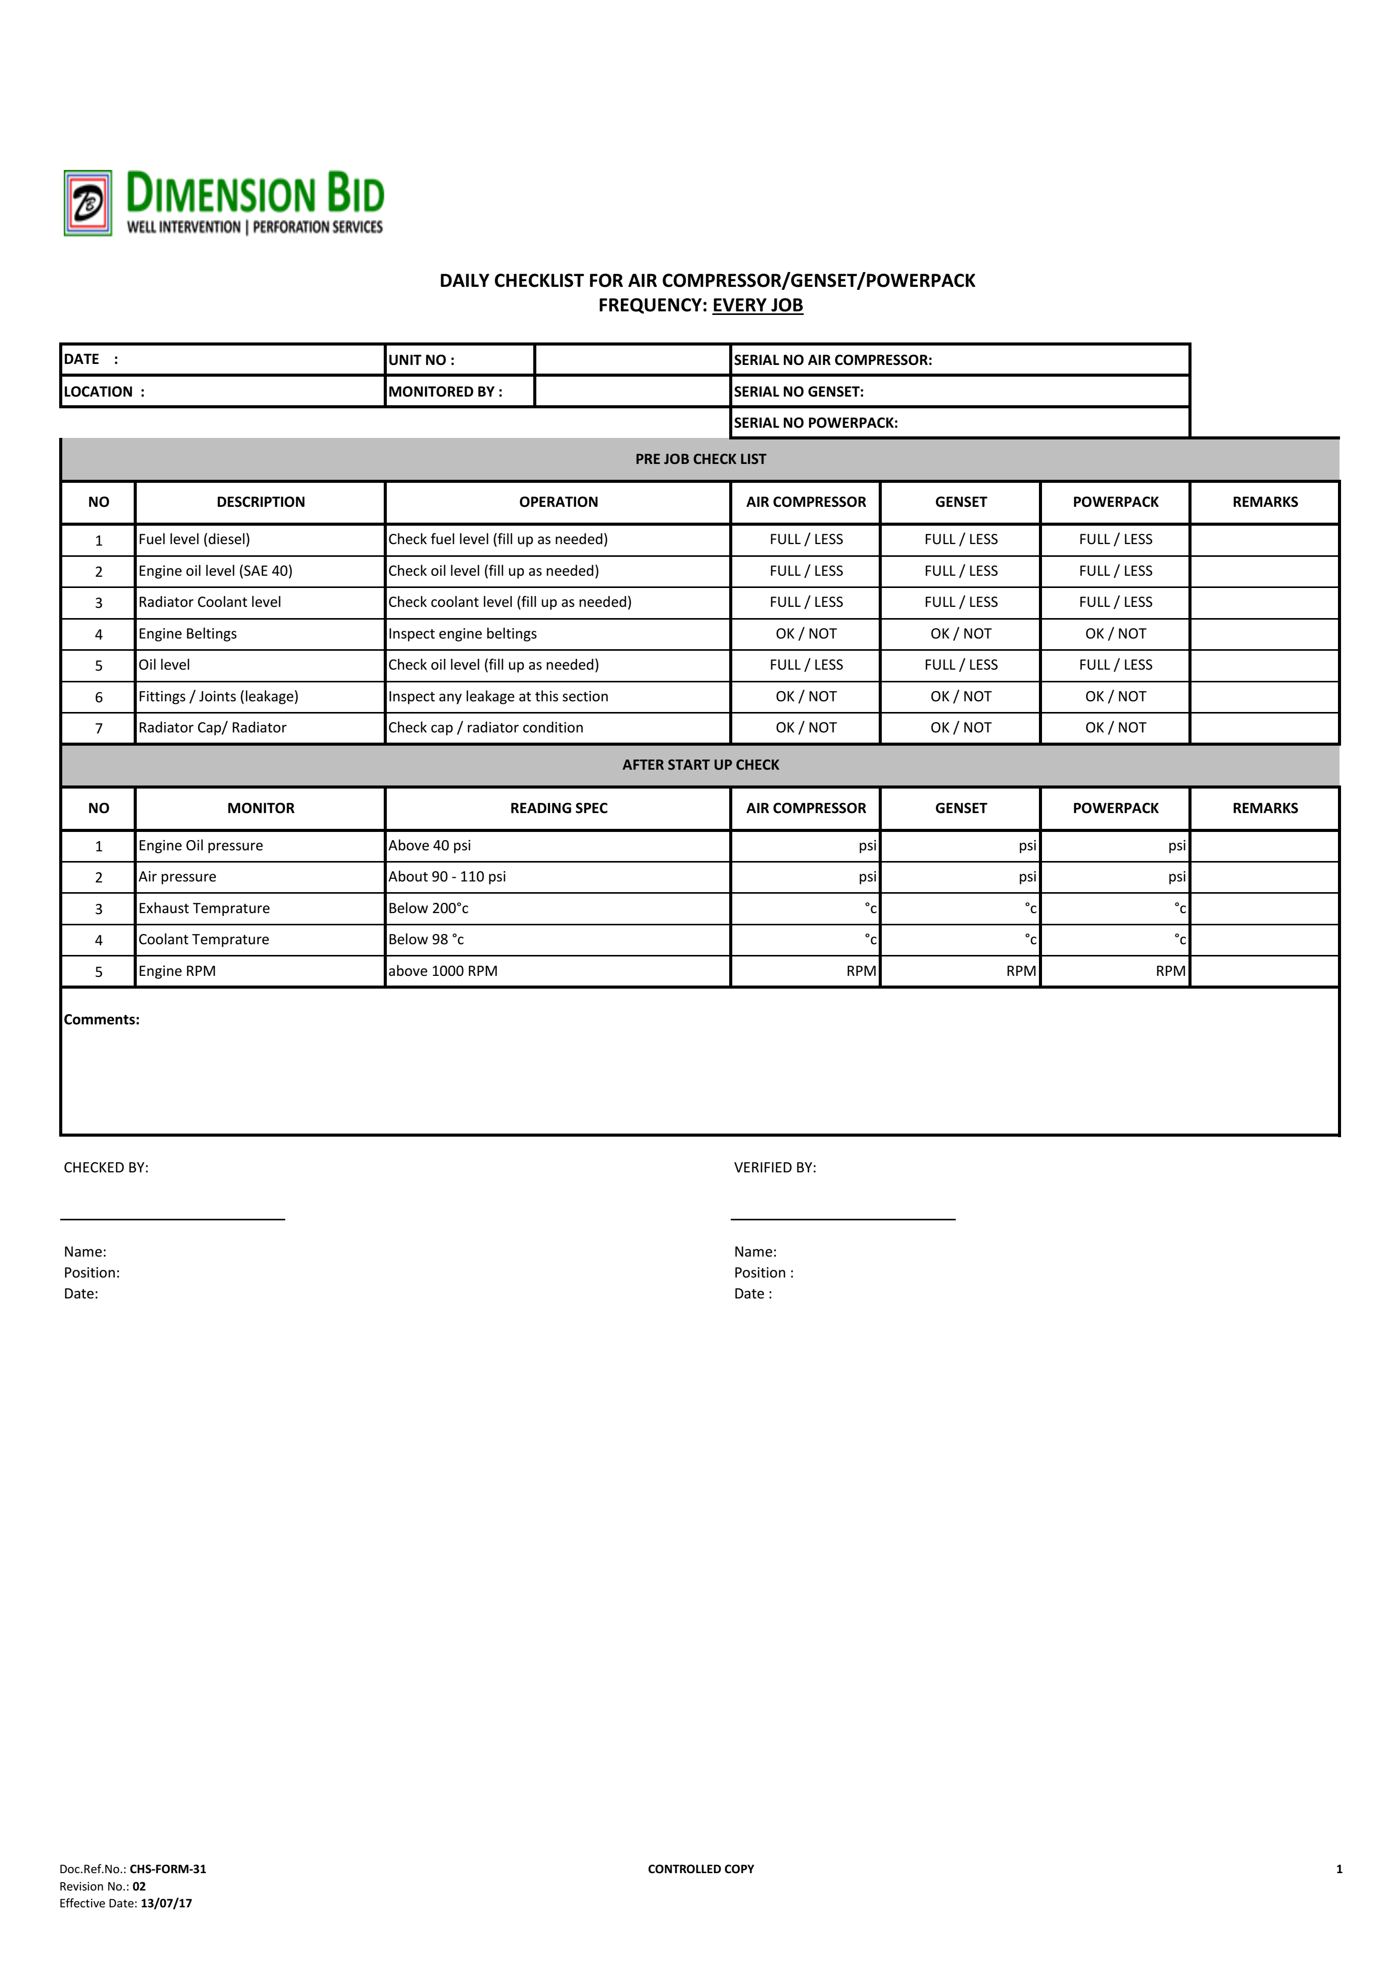
PAPERWORK FOR MAINTANENCE
The Daily Checklist is another form of paperwork that helps the Maintenance Team at Base to track the equipment performance.
These Daily Checklist will monitor the equipment performance, and any abnormalities can be determined earlier by the pattern of the inputs.

Slide 9
SUMMARY
User Manuals are a must have item to be referred to at any times.
The User Manual will be shared amongst the crews, whilst preparation of any jobs are being done, this user manual will be a reference to the job being done.
Every equipment or tools has their own user manuals, and could be obtained from the server or seniors.

Slide 10
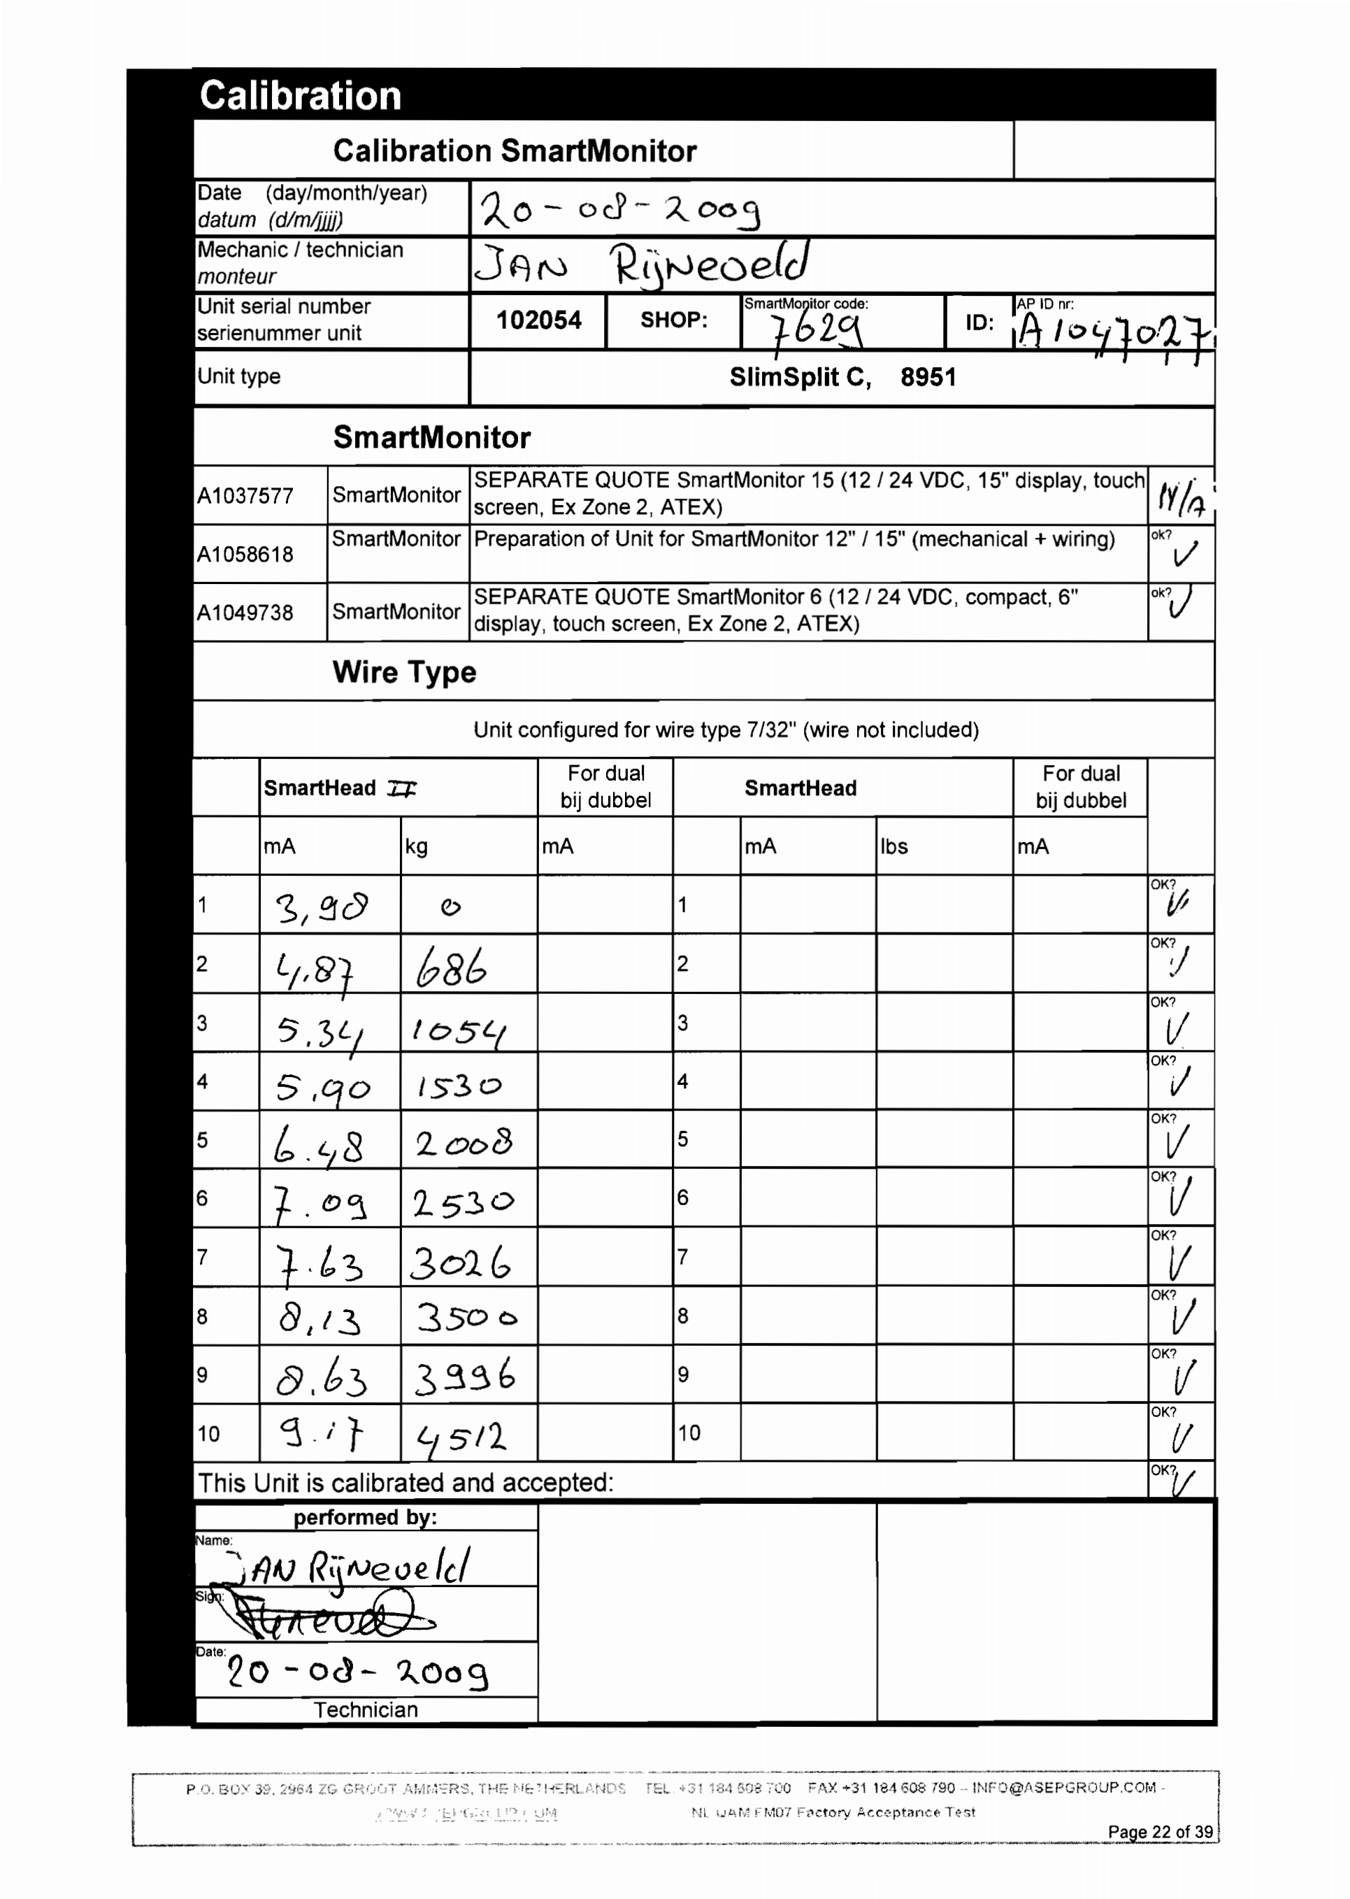
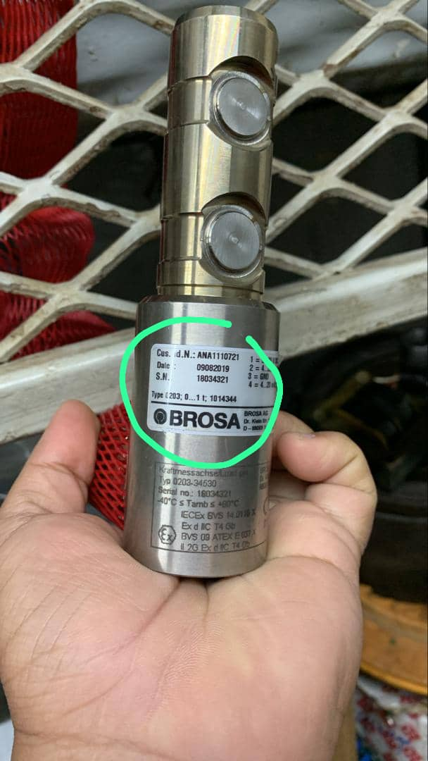
BRAINSTORM SESSION
The pictures shows that the Specifications for the BROSA Load Cell measuring capacity is from 0 until 1tonnes.
The report was a FAT Report that shows the Calibration Report of the Load Cell, whereby the load applied was more than 1 tonnes.
Why is it possible for the Wireline to utilize this Load Cell for the Operation, whereby the tool string and cable tension could go up further than 3000 lbs?

Slide 11
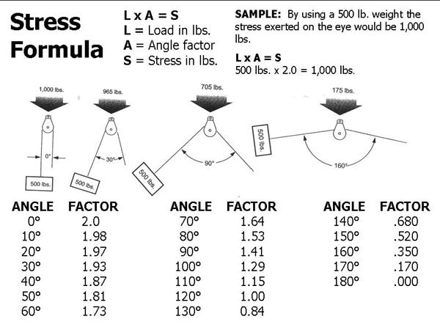
BRAINSTORM SESSION

Slide 12
Q&A

