Slide 1
Triplex Pump Unit (TWS600S)
Prepared by : ZAINUDDIN YAACOB
Position : GEO
Department : Coiled Tubing Services
3 September 2024

Slide 2
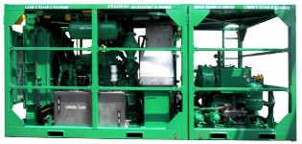
Unit Introduction
Manufacturer : Stelkraft Coiled Tubing & Pumps Pte.Ltd.
Country Of Origin : Singapore
This unit were divided into two skid, which are known as;
Engine Module
Pump Module

Slide 3
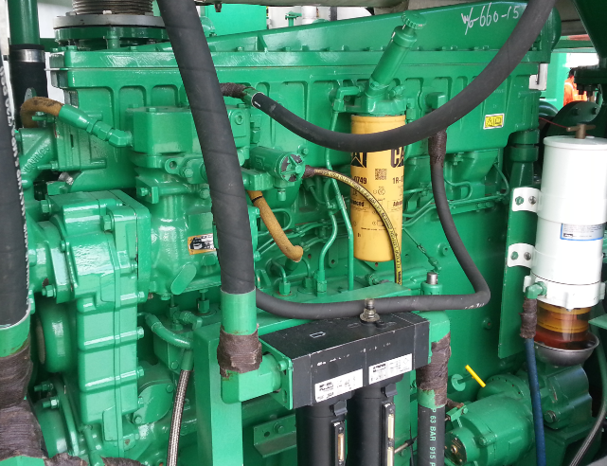
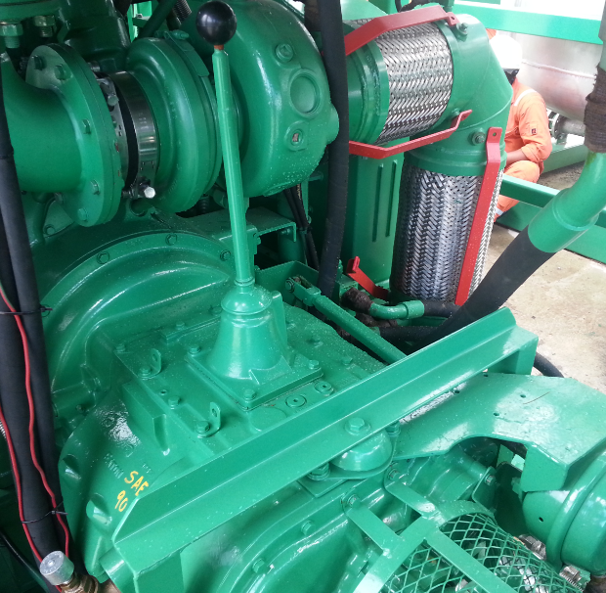
1) Engine Module
Engine Model : Caterpillar 3406
Type Burning Fuel : Diesel
Engine Rating : 490bhp @ 2100rpm
Engine Bore Size : 137mm (5.4”)
Stroke : 165mm (6.5”)
Transmission
Gearbox Model : Eaton Fuller
Type : Manual 7 Speed

Slide 4
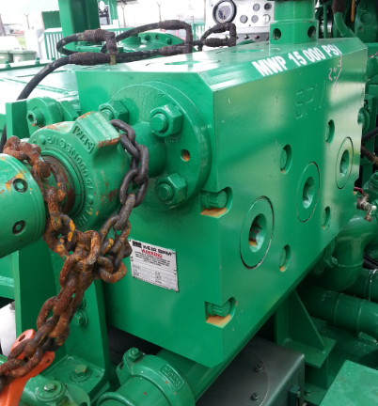
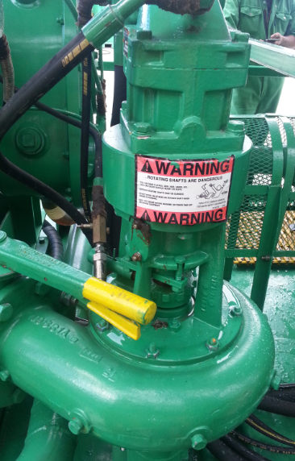
2) Pump Module
Pump Model : SPM TWS600S
Type : Horizontal triplex single acting plunger pump
SPM Pump Plunger Size : 2.75”
Maximum Working Pressure : 22500 psi
(but limited to 15000 psi due to discharge
flange Max Working Pressure is 15000 psi)
Maximum Pump Rate : 4.5 bpm
Stroke Length : 6 inch
C-Pump Brand : Gardner Denver
C-Pump Size : 4” (discharge) X 5”(suction)
C-Pump Flow rate : 22.6 bpm @ 2400 rpm

Slide 5
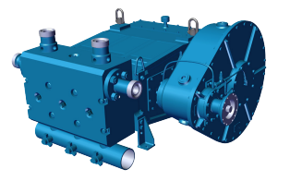
Descriptions
SPM TWS600S PUMP
-The SPM TWS600S is a reciprocating, positive displacement, horizontal single-acting, triplex plunger pump that is rated at 600 Brake Horsepower input maximum. The TWS600S is designed for intermittent duty well service applications such as acidizing, cementing, fracturing and well killing.
-The TWS600S Pump consists of a Power End, Speed Reducer Assembly and a Fluid End Assembly. The speed reducer can be installed on either the right hand or left hand side of the pump and can be installed in any one of different input shaft location to accommodate a number of different pumping unit drive train configurations. Two different fluid cylinders are available to accommodate several plunger sizes for a variety of pressure and volumes.

Slide 6
Definition
What is TWS600S stand for?
T = Triplex
W = Well
S = Service
600 = Brake Horsepower
S = Short (gear box)

Slide 7
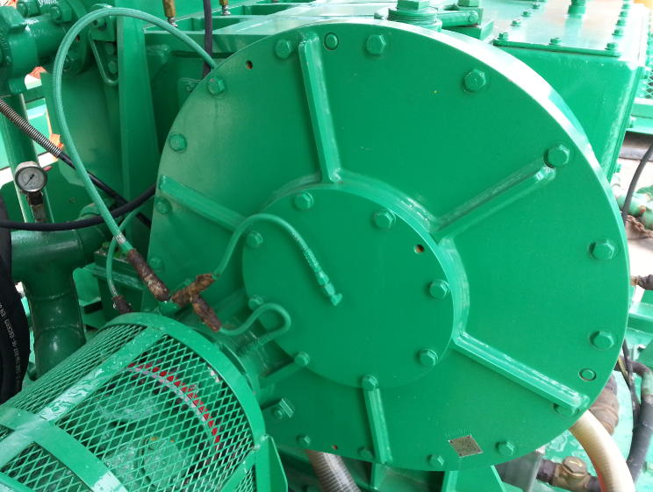
Part & Functions
Speed Reducer
- It converts from a low-torque, high rpm engine output to a high-torque, low rpm output more suited to the power end requirements.

Slide 8
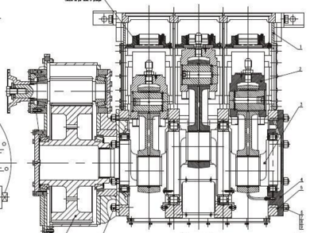
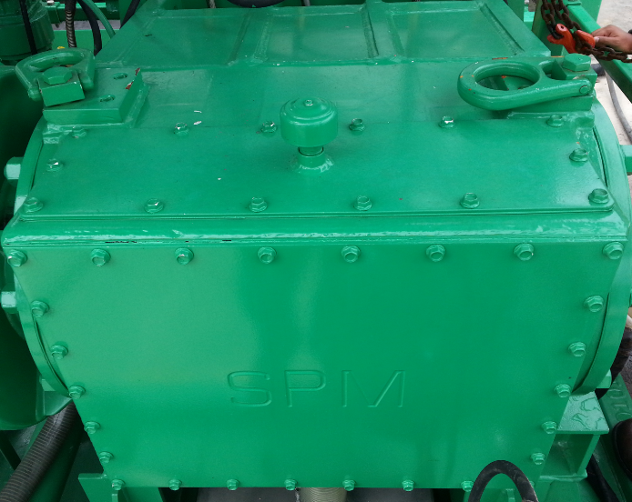
Power End
- Converts rotational power into reciprocating power. The power end functions the same way as a crankshaft in a motorcar engine. The pinion shaft drives the crankshaft using bull gears. The eccentrics of the crankshaft change the rotation of the main-shaft into a reciprocating action. The reciprocating force is then transferred to the connecting rods and crosshead, moving the plungers in the fluid end.

Slide 9
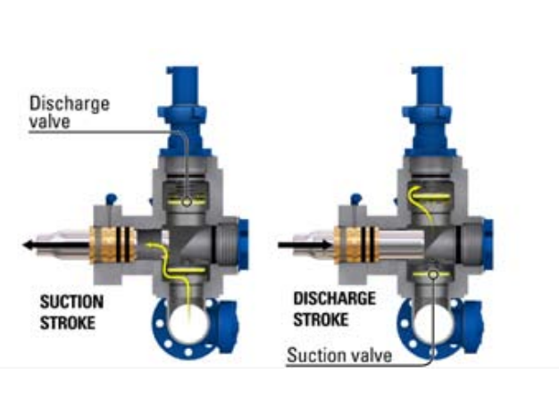
Fluid End
- The fluid end receives the power from the power end. This part of the triplex pump receives fluid at a low pressure, applies horsepower to the fluid and discharge fluid at a high pressure.

Slide 10
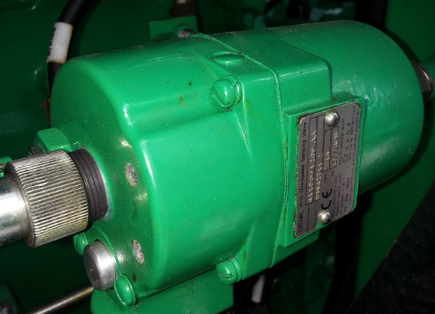
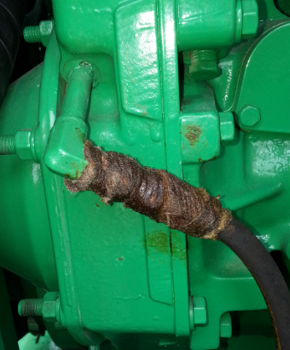
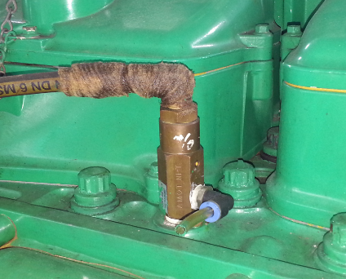
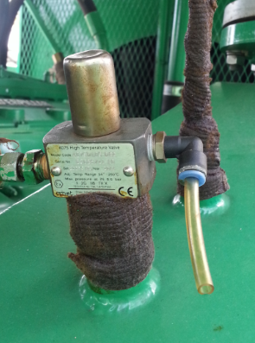
Safety Features
Zone II System
Over Speed Shutdown (2200 rpm)
Low Oil Pressure (10 psi)
High Coolant Temperature (100⁰C)
High Exhaust Temperature (200⁰C)

Slide 11
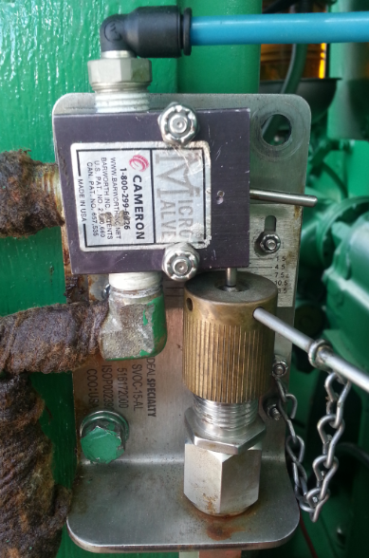
Overpressure Shutdown Valve
- Functions the overpressure shutdown valve on the control console to confirm pump stops as gearbox drop to manual.

Slide 12
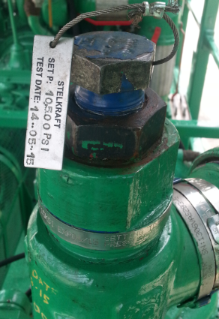
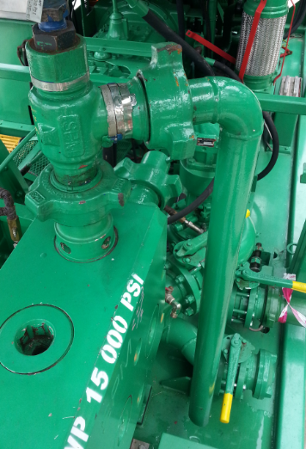
Pressure Relief Valve (PRV)
- The pressure relief valve is a type of valve used to control or limit the pressure in a system which can build up for a equipment failure.

Slide 13
Operation
Safety
1) To prevent of any accidents is a basic requirement that all personnel to accept and follow established safety regulations and procedures.
2) Only qualified personnel should be authorized to operate and perform maintenance on this unit.
3) Personnel who are operating and performing maintenance on this unit must wear suitable PPE.
4) Safety practices should be adhere to at all times when starting up, operating, shutdown and maintenance of this unit.
5) Personnel should not operate the unit unless they are thoroughly familiar with the unit.
6) Ensure pressure in pipping connected to the unit has been bled to zero pressure before attempting to disconnect.
7) Keep unauthorized personnel away from the unit when operating or performing maintenance.

Slide 14
Priming Procedures
Step of Priming the Triplex Pumps Using Gravity Feed
- Place the first pump in high gear at idle speed. Make sure there are fluid returns in the batch mixer tank. Increase the Triplex pump rate to 3 bpm. Continue pumping until you have a smooth return of the fluids. Return the pump to neutral gear and run the engine at idle speed.
- Close the gravity feed lines and open the pressure feed lines to the pumps.
Step of Priming the Triplex Pump Using the Pressurizer Pump
- Using the Engine that drives the hydraulic system start the prime up procedure.
- Place the pump that is driven by this engine in high gear at idle speed.
-Make sure there are fluid returns in the batch mixer tank. Increase the pump rate to 3 bpm and run the engine at a fast enough speed to operate the hydraulic system.
- Continue pumping until you have a smooth return of fluids. Return the pump to neutral gear.
- Prime each pump through the mixing equipment.

Slide 15
Thank you so much

