Slide 1
Coiled Tubing Services – Downhole Tools
By ZALANI B IBRAHIM
G.E.O CTS

Slide 2
OBJECTIVE
To introduce the basic coiled tubing downhole tools of Dimension Bid CTS
SECTIONS
CT Connectors
Motorhead Assembly (MHA)
Double Flapper Check Valve
Straight Bar
Nozzle
Rotary Wash Tool
X-Over

Slide 3
CT CONNECTORS
Application: Connect coiled tubing to the BHA
5 types of CT connectors available:
  Roll On
  External Dimple
  Internal Dimple
  Grapple
  External Slip
Type of CT connector used depend on operation
Connection AMMT

Slide 4
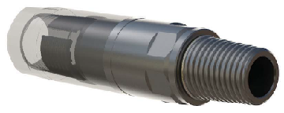
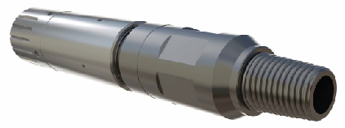
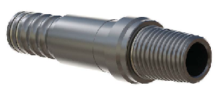
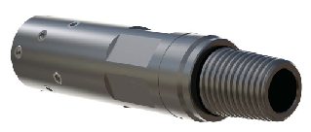
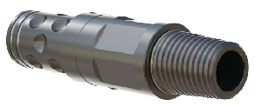
5 TYPE CT CONNECTORS
Internal Dimple
Grapple
Roll On
External Dimple
External Slip

Slide 5
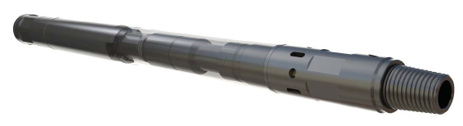
MOTORHEAD ASSEMBLY ( MHA )
Application:
  Use directly below CT connector
  Provide a barrier from well pressure
  Release mechanism for contingency
  Dual circulating function
3 sizes available:
  1-11/16” OD – 10,000 psi
  2” OD – 5,000 psi
  2-1/8” OD – 10,000 psi
Connection AMMT

Slide 6
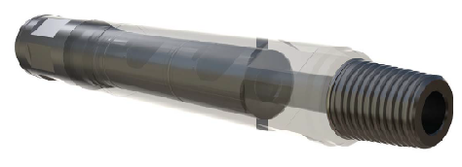
DOUBLE FLAPPER CHECK VALVE
Application:
  Provide a barrier from well pressure
3 sizes available:
  1-11/16” OD – 10,000 psi
  2” OD – 5,000 psi
  2-1/8” OD – 10,000 psi
Connection AMMT

Slide 7
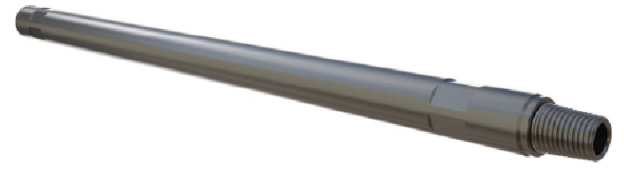
STRAIGHT BAR
Application:
  Extend the length or increase the weight of CT BHA
3 sizes available:
  1-11/16” OD – 3 ft and 5 ft
  2.0” OD - 3 ft and 5 ft
  2-1/8” OD – 3 ft and 5 ft
Connection AMMT

Slide 8
NOZZLE
Application:
  Well stimulation and cleanout – nitrogen / fluid pumping, cementing & displacement
Different type of jetting patterns depending on types of nozzles
Types of jetting pattern:
  Multi Jet
  Single Bore
  45° Down Jet
  SpinCat
Size available: 1-11/16” & 2-1/8”
Connection AMMT

Slide 9
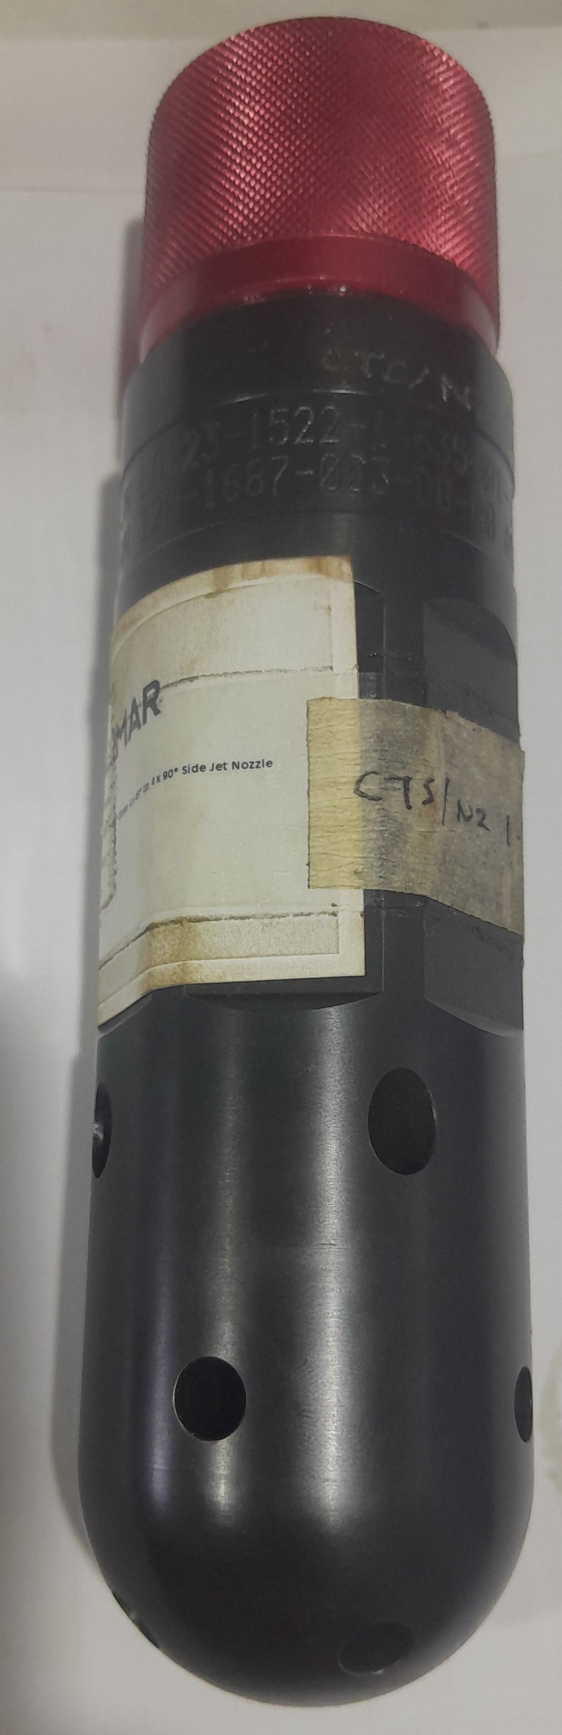
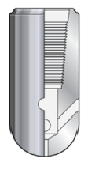
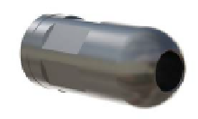
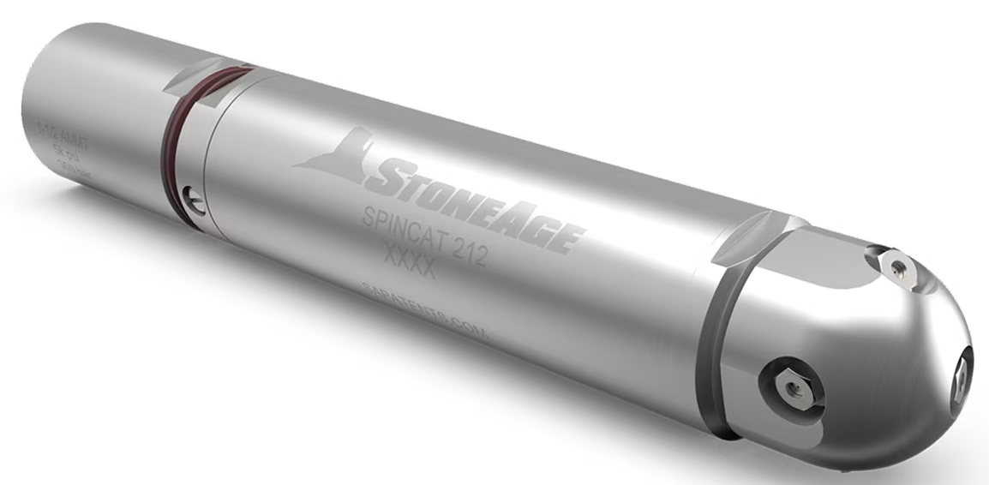
NOZZLE
Multi-Jet
45° Up Jet
Single Bore
SpinCat

Slide 10
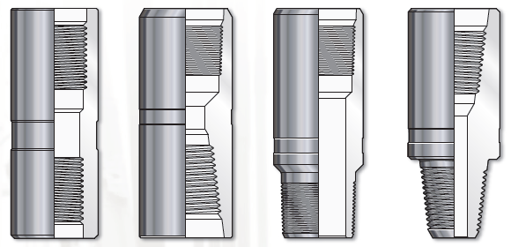
X-OVER
Application:
  Connect 2 different tools with different connection
Type available: Pin x Pin, Box x Box, Pin x Box, Box x Pin
Size available: 1-11/16” & 2-1/8”
Connection AMMT and SA 10

Slide 11
Thank You

