Slide 1
Fundamental of Wireline
Module 05
JFE Learning Material Package

Slide 2
Course Outline…
Learning Outcome
Well Intervention Structure
Wireline History
Introduction to DB and Key Milestone
Introduction of Well Intervention Conveyance
Slickline Services (SLS)
Braided Line Services (SLS)
E-Line Services (CHS)
Coiled Tubing Services (CTS)
Comparison of Method of Conveyance
Workover Operation
Summary

Slide 3
By the end of the course, JFEs should be able to:
Explain the wireline history, its development and well intervention structure
Explain on type of Well Intervention Conveyance System
Differentiate between Slickline, Braided Line, E-Line operation and Coiled Tubing.
Explain on each conveyance the principle, basic equipment and its application
Explain the importance of well intervention and role of wireline in general.
Define the comparison between all those conveyance in well intervention services.
Explain on the workover operation, steps and application.

Slide 4
Well Intervention Structure
Well Intervention
Mechanical Wireline
Electric Wireline
Subsurface
CTU
SlickLine
Braided Line
CH Logging
Perforation
Mechanical
Services
Pipe Recovery
Data Analysis
Well Review Consultation
Data Management
Memory
CH Logging
Perforation

Slide 5
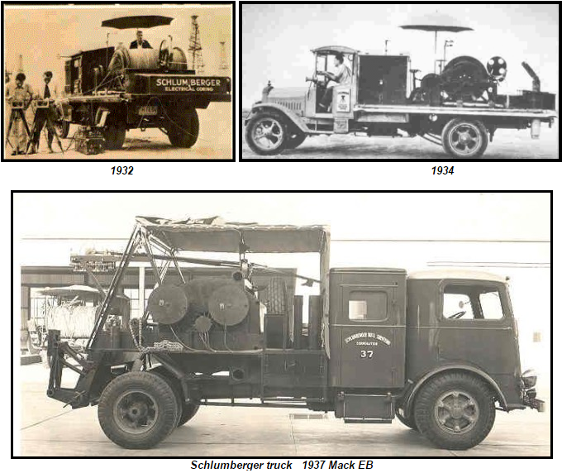
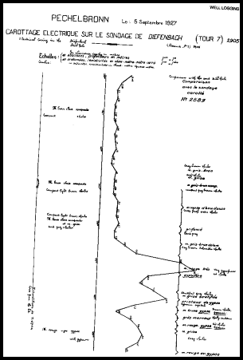
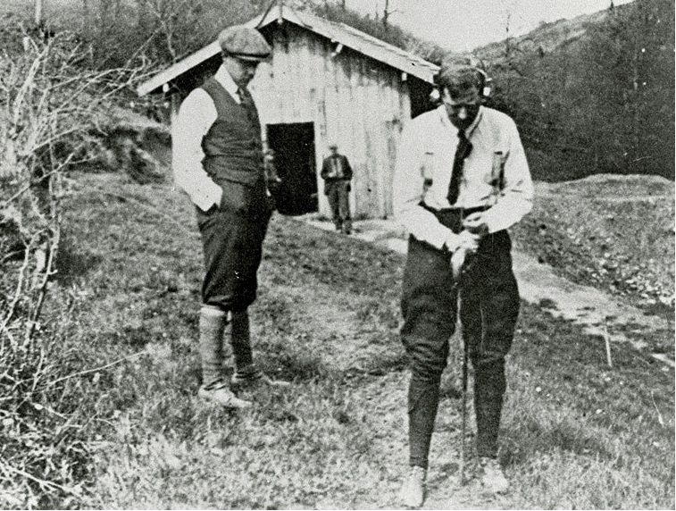
Wireline History

Slide 6
1923 : The Sclumberger brothers begin conducting geophysical survey
1931 : Introduction of Spontaneous Potential (SP) Log
1932 : Conrad and Marcel Sclumberger present the first comprehensive description of the principle of the well logging
1930 : Introduction of continuous recording enabling plotting of continuous log
1971 : Introduction of first logging that combined gamma ray, SP, induction, Spherical Focused Resistivity, sonic and caliper log – the “triple combo”
1942 : Gus Archie of Shell Oil published research underpinning “Archie’s Law”, key to log interpretation
1946 : Deploys first casing collar locator to measure changes in magnetic flux at the collar location
1946/1947 : First offshore rigs deployed in the Gulf of Mexico
1947 : Record first induction log to distinguish oil from water-bearing rock when the borehole contains fluid that does not conduct electricity
1956 : Introduction of Laterolog system for focusing currents into thin rock layers beyond the borehole
1951 : Introduction of Micro-Laterolog tool for measuring the resistivity near the borehole
1954 : Introduction of Micro-caliper for recording borehole diameter
1957 : Completes first density log, enabling realization of bulk density measurement using gamma ray attenuation
1966 : Develop small minitron and constructed 1-11/16” TDT tool for thru tubing production logging
1969 : Incorporates experimental lithology into Litho-Density tool for direct measurement of formation lithology
1980 : Completes first measurement while drilling (MWD) job in the Gulf of Mexico

Slide 7
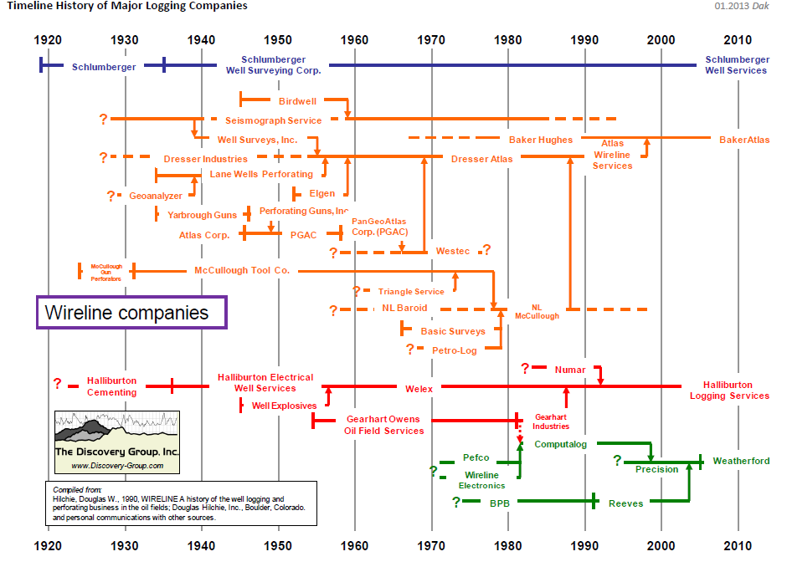

Slide 8
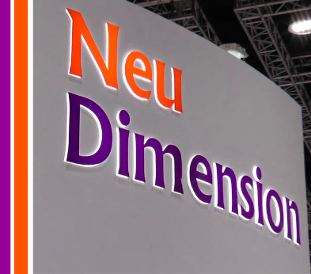
INTRODUCTION
About Us :
Our main objective is simple – To collaborate with our clients in increasing their oil barrels and gas productions.
A vibrant and agile company with 20 years of experience under our belt, we deliver professional and world class services to National Oil Companies (NOCs) as well as International Oil Companies (IOCs). Our footprint is located across Malaysia, South East Asia and Central Asia while our warehouses are strategically located nationwide to provide fast and efficient services to achieve maximum advantage over operational costs.
Notes:
Neu Dimension provides high ends specialist solution that cover E-line Cased Hole services, Slickline services and coil tubing services.

Slide 9
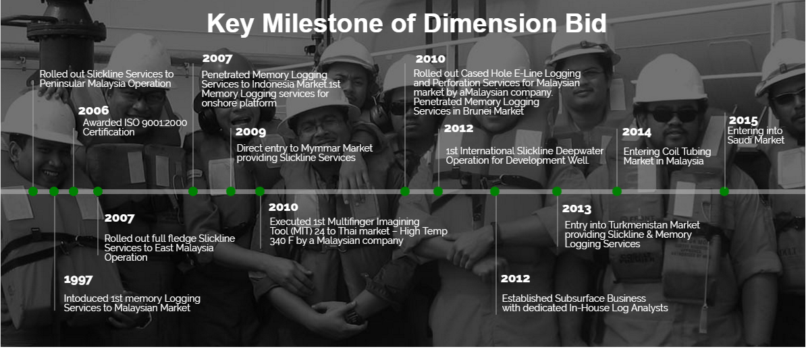

Slide 10
INTRODUCTION
2012
Awarded ISO 9001:2008 Certification
2006
Awarded ISO 9001:2000 Certification
1994
Rolled out SLS to PMO
1999
Introduced the 1st Memory Logging Services in Malaysian market
2007
Rolled out full fledged SLS to EMO
-------------------
Penetrated MLS to Indonesian market
2008/09
Entry into Vietnam & Myanmar with MLS & SLS
-------------------
Penetrated Turkmenistan with our HPHT PDG
2010
Rolled out ELLP in Malaysia
-------------------
Entry into Brunei with MLS
-------------------Executed 1st MIT in Thailand
2012
1st international SL DW operation for development well
-------------------Established Subsurface Business
2013/14
Entry into Turkmenistan with SLS & MLS
-------------------
Entering CT market in Malaysia
-------------------
Successful completion of idle well rejuvenation study
2016
Entry into Saudi Arabia with SLS
-------------------
Officially launched Geoscience & Subsurface Study. WL Analysis and Production Enhancement Technology services

Slide 11
INTRODUCTION
Turkmenistan
SLS unit - 1
Myanmar
SLS unit - 2
C
D
B
Malaysia
Saudi Arabia
A
SLS unit - 19
ELS unit - 5
CTS unit – 1
300+ personnel
Full fledged base in WMO & EMO
Offices in KL, Kemaman, Miri & Labuan
SLS unit - 6

Slide 12
SLICKLINE SERVICES
No. of Jobs (2012 – 2017)
MPLT / Survey
Downhole Sampling
Plug / Valve Set / Retrieval
374
4
316
Well Integrity
Perforation
~900++ Slickline jobs
80
15
Fishing
19
SSD Exercise
44
20
38
Well Diagnostic
20
GL Change Out
Bailing

Slide 13
Well Intervention

Slide 14
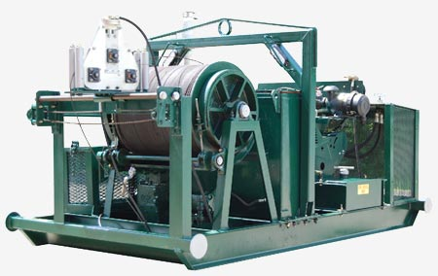
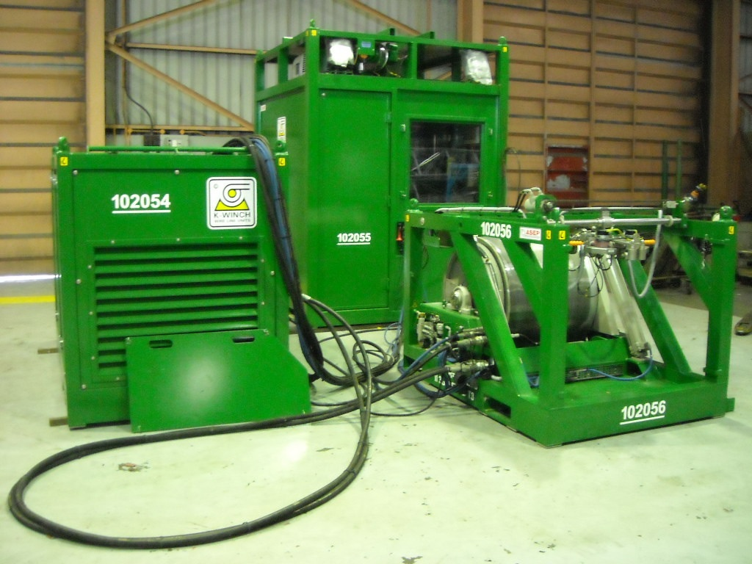
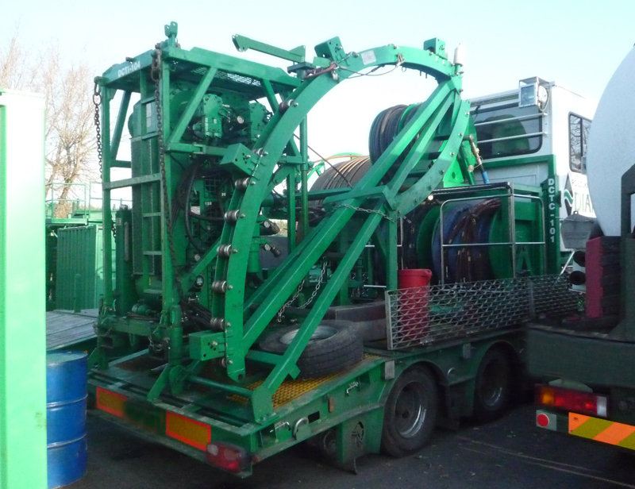
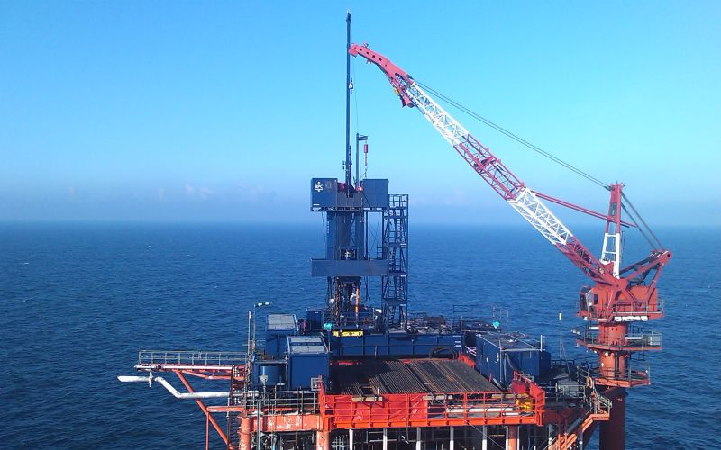
TYPES OF WELL INTERVENTION CONVEYANCE
SLICKLINE
E-LINE
COILED TUBING
WORKOVER

Slide 15
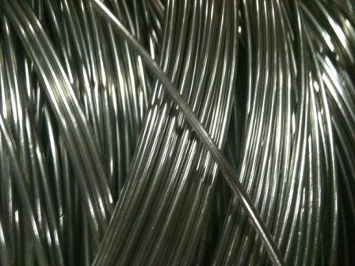
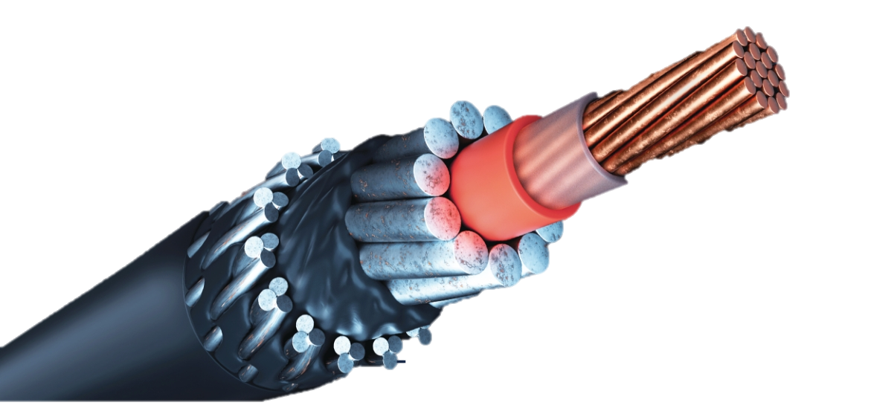
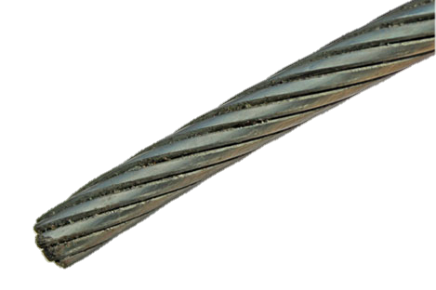

Wireline Classification
Wireline Classification
Slickline Services
E-Line Services
Braided Line Services
electrical
Mechanical only
mechanical
mechanical

Slide 16
What is Wireline?
“ A technique to convey tools downhole using Wire or Cable”
“ Wireline is a cabling technology used to lower equipment or measuring devices into a well for the purposes of well interventions and reservoir evaluation.
“ First developed by Conrad and Marcel Schlumberger in 1923.”

Slide 17
Methods
Can be performed in live or dead well.
Depending on the well’s fluid pressure, tool weight and gravity for lowering the tools downhole.
Advantage
Small OD cable used.
Depth accuracy
Less space required for operation
Less manpower required.
Cost effective.
Real time downhole information. (E-Line Only)
Application
Formation Evaluation (resistivity, conductivity, pressure, temperature, etc.)
Pipe recovery (tubing cut, wellbore clean up, etc.)
Water Shut-Off (plug setting)
Perforation (creating the path for reservoir fluid to flow into tubing).

Slide 18
SLICKLINE SERVICE (SLS)

Slide 19
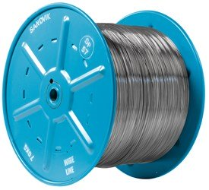
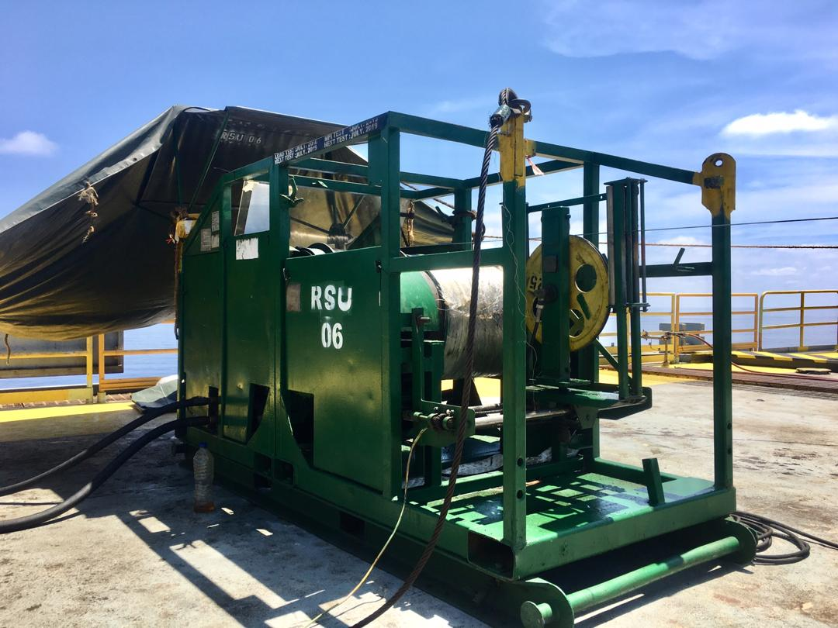
What is Slickline?
The term Slickline relates to the use of a wire or braided line to convey downhole tools or equipment in a wellbore
Using a single stand of cable (no armor or core) and it’s a downhole mechanical operations.
Limited to well deviation as it greatly depends on gravity.
Small diameter wire with sufficient strength to accomplish the operation without breaking.
Minimize the load of its own weight and Minimizing the cross-sectional area reduces the effect of wellhead pressure

Slide 20
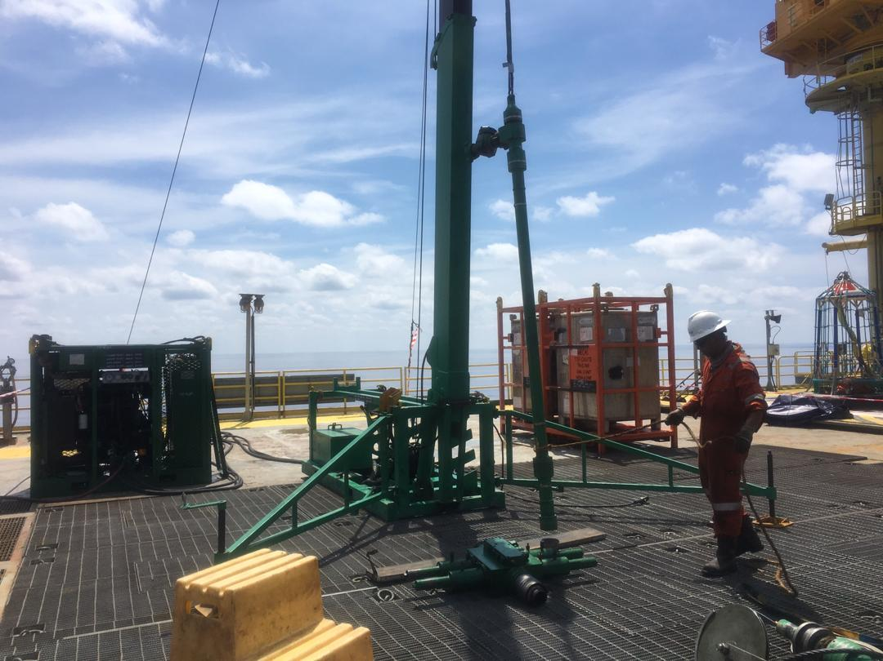
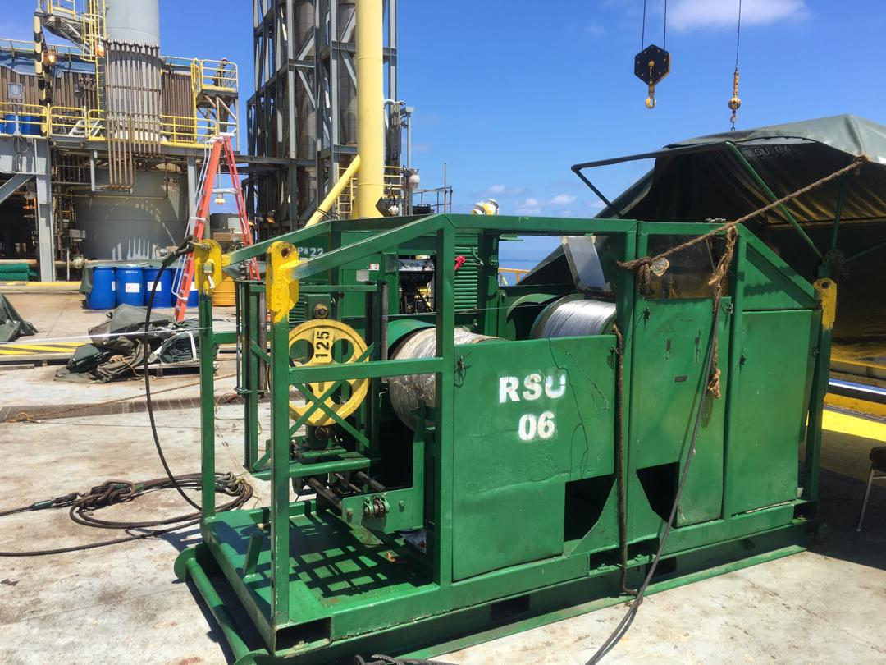
Slickline Basic Surface Equipment
Basic surface equipment for wireline are:
  Wireline Reel Skid Unit
  Wireline Drum
  Power Pack
  Air Compressor
  Pressure Controlled Equipment (PCE)
  Toolhouse
  Wellhead Control Panel
  Mast / Ginpole complete with hoisting unit

Slide 21
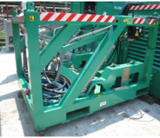
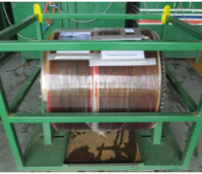
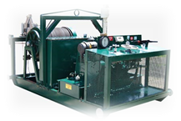
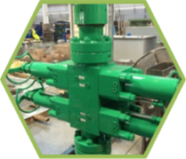
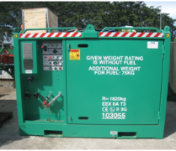
Slickline Basic Surface Equipment
Slick / Braided line
40’ / 70’ mast
Well control equipment
Power pack
Slickline Reel Skid Unit

Slide 22
Slickline Application
Slickline operations involve routine wellbore maintenance, such as:
Checking the production tubing drift
Checking the build up of wax, Scale or wellbore deposits
Confirming the well depth or clearance to perforations
Running and pulling plugs or flow control devices.
Zone Isolation (Opening and Closing SSD or similar completion equipment)
Gauge Cutting
Memory Logging using Memory Production Logging Tools (MPLT)
Set and remove a variety of flow control devices such as plugs, subsurface chokes, regulators, GLV, and etc.
Downhole Mechanical Data Acquisitions (Pressure and Temperature Surveys)
Perforating

Slide 23
BRAIDED LINE SERVICE

Slide 24

What is Braided Line?
Made up of multi-strands of cable consisting of outer armour, inner armour and non-electrical core
Greater breaking strength compared to single strand slickline cable.
This type of wire has once become popular for “heavy” fishing jobs over last few years worldwide, because of the forces involved
A well is sometimes killed before the fishing job is attempted.

Slide 25
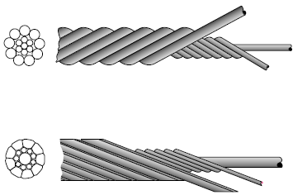

Braided Line Application
Multi strand wireline is used for heavy work such as fishing jobs and swabbing operations.
Because the additional forces created by the well pressure acting on the larger cross-sectional area may be significant, a well is sometimes killed before the fishing job is attempted.
The most common size of wire used is 3/16 in., with the options of 1/4 in. and 5/16 in. for heavy-duty applications.
The conventional 3/16 in. cable comprises 16 (9 + 6 + 1) strands.
The core and right-lay inner wires are thinner than the left-lay outer wires. By using right and left-lay, the twisting tendency of the wire under load is prevented.
Braided Line Construction

Slide 26
E-LINE SERVICE (CHS)

Slide 27
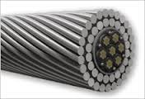
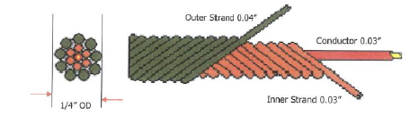

What is Electrical Line (E-Line)?
Braided line with electrical conductor in the core.
Not limited to well deviation (using downhole tractor in high angle well)
Variety of cable size (e.g. 7/32, 9/32”)
Usually 2 types of cable:
  Monoconductor cable
    Normally for cased hole operation
    Single electrical conductor inside the core
  Heptacable
    Normally for open hole operation

Slide 28
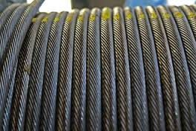

E-Line Application:
Real Time Production Logging
Cement Bond Evaluation
Reservoir Monitoring
Packer/Plug Setting
Pipe Recovery
Perforation
Downhole Tractor Application (for very high angle well)

Slide 29
E-Line Operation
Basically, E-Line works by sending an amount of voltage (depending on types of tool) to the downhole tool to power up them.
Once the tools are powered up, it will start sense the surrounding wellbore information depending on each tool function and send the data directly to the computer on the surface in terms of log.
Engineers then can analyze the log and advise the clients on what is happening inside their well.
E-Line toolstring consists of :
  Cable Head
  Crossover
  Weight/Sinker Bar
  Logging Tools

Slide 30
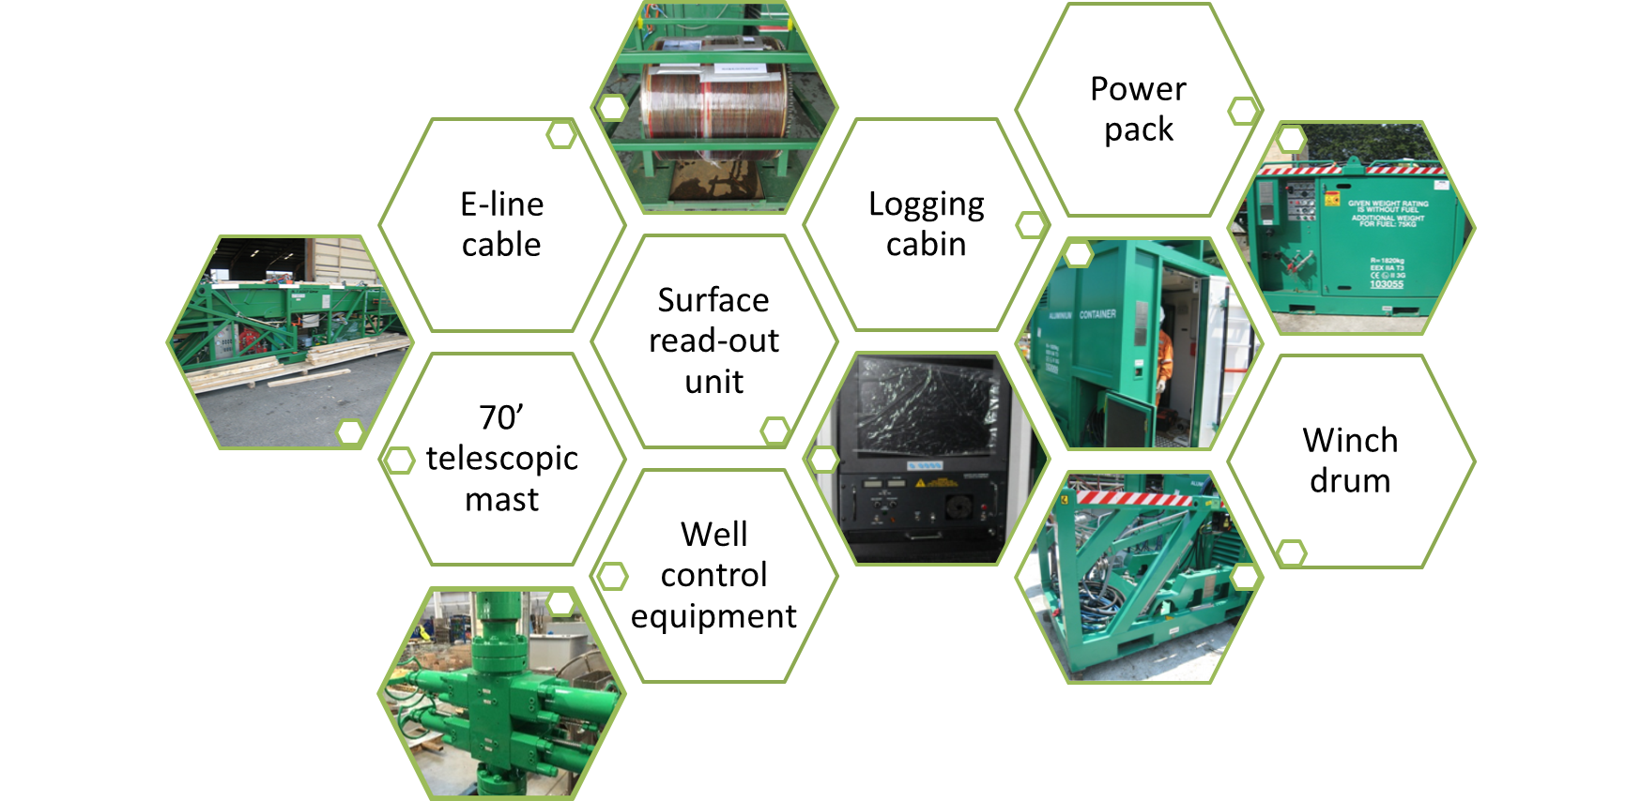
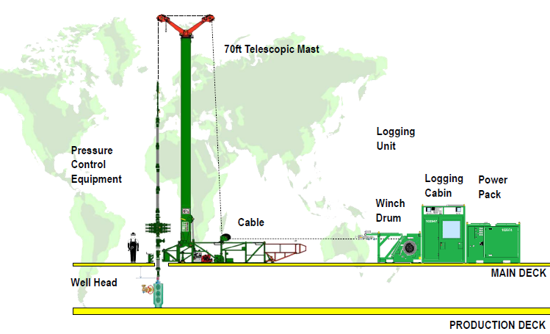
E-Line Surface Equipment
5-set E-LINE PACKAGE

Slide 31
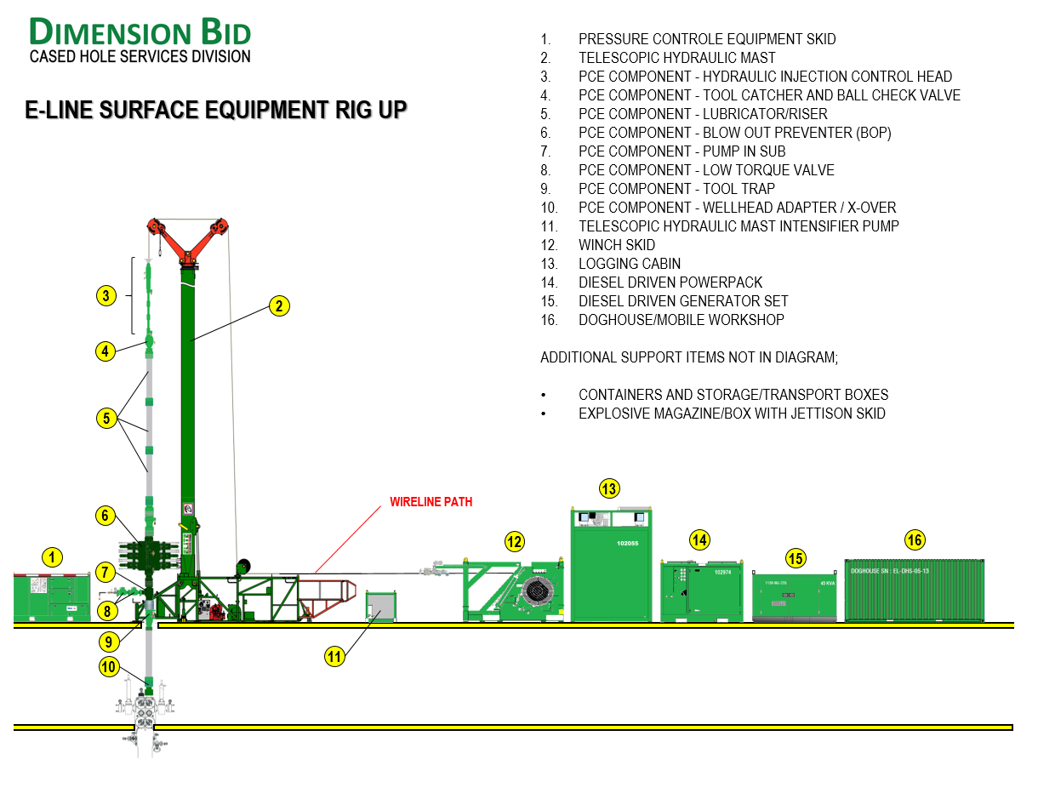

Slide 32
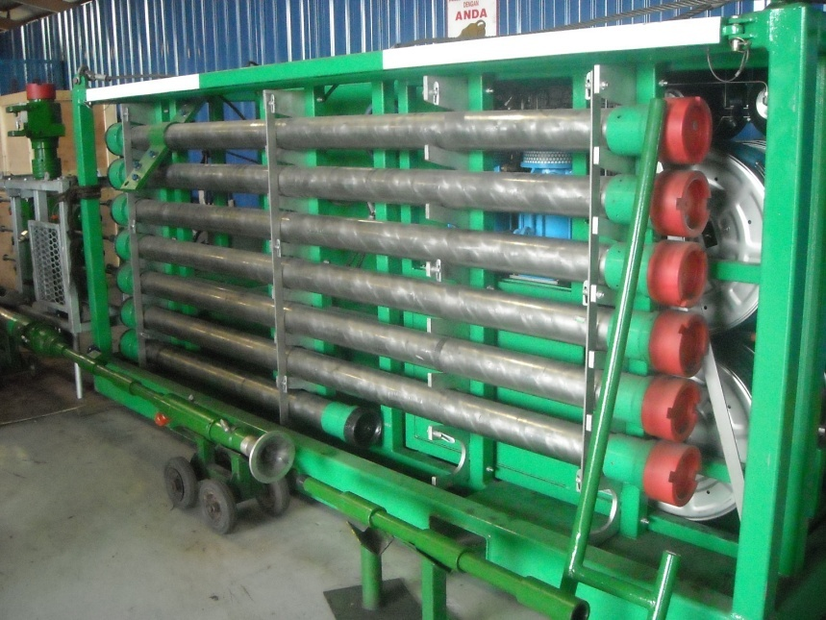
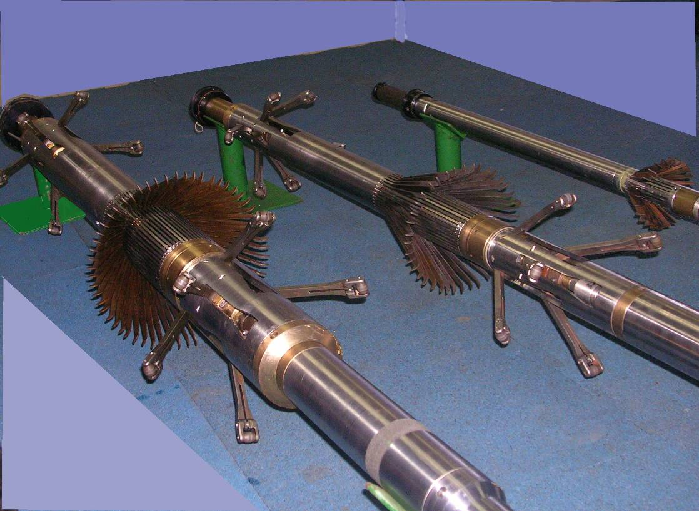
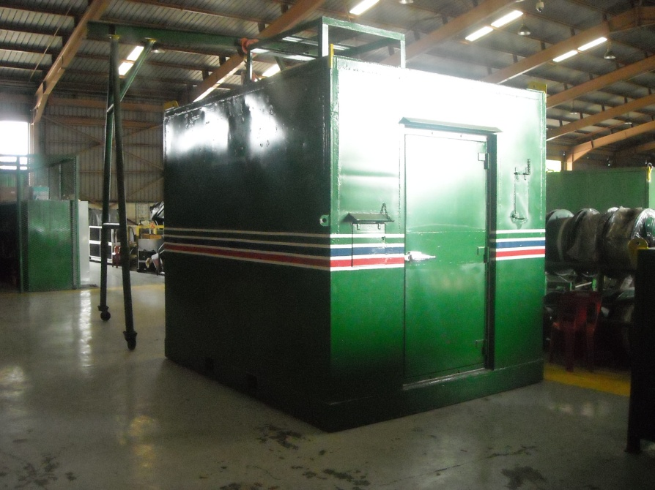
OVERVIEW
Pressure Control Equipment
MIT 40
MIT 24
E-Line Unit
MIT 60
Logging Tools

Slide 33
COILED TUBING SERVICE (CTS)

Slide 34
What is Coiled Tubing?
Coiled Tubing is a well intervention method that is conveyed on Coiled Tubing to improve well and reservoir performance.
It has been defined as any continuously milled tubular/pipe manufactured in lengths that require spooling onto a take up reel.

Slide 35
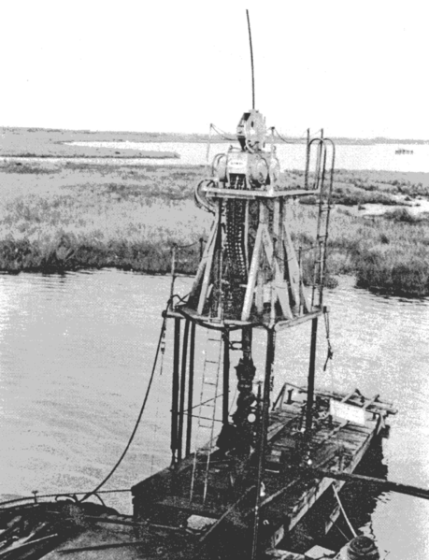
COILED TUBING SERVICES HISTORY
Pioneered by Allied engineering teams during the Second World War. Project 99, code named "PLUTO" (an acronym for Pipe Lines Under The Ocean), involving the deployment of pipelines from the coast of England to the coast of France.
In 1962 the California Oil Company and Bowen Tools developed the first CT unit. The unit was called a ‘continuous-string light workover unit’. The size of pipe used was 1.315” OD

Slide 36
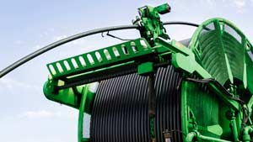
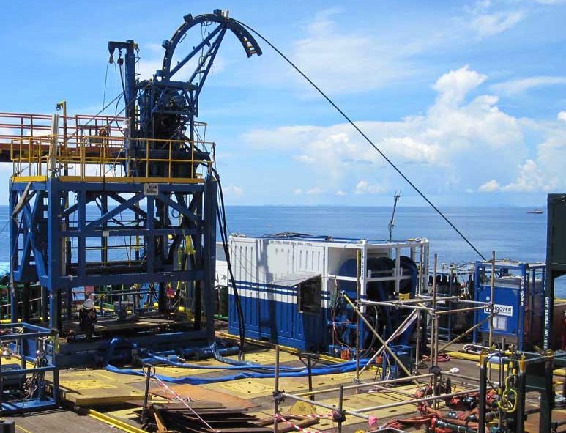
COILED TUBING SERVICES…cont
Coiled tubing refers to a very long metal pipe, normally 1 to 3.25 in (25 to 83 mm) in diameter which is supplied spooled on a large reel.
The spool is driven by hydraulic and also by injector head.
Commonly used to perform mechanical job such as fishing, cleaning and also fluid lifting.
Enhanced utilization including logging, drilling and also milling operation.
Does not affected by gravity during operation.

Slide 37
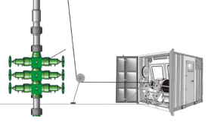
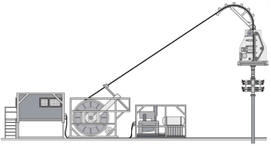
WIRELINE vs CONVENTIONAL CT
CONVEYANCE METHOD ASPECT | WIRELINE | CONV. COILED TUBING
GRAVITY DEPENDANT | YES | NO
EQUIPMENT FOOTPRINT | MEDIUM | LARGE
CREW REQUIRED | 3-5 PAX/SHIFT | 6-10 PAX/SHIFT*
JOB NATURE | LOGGING & PERFORATING | MECHANICAL SERVICES, PUMPING
SENSOR INTEGRATION | YES | NO
RIG UP TIME | 4-5 HOURS | 12-14 HOURS
*For rig up. For operations will be 3-4 pax, depends on type of job

Slide 38
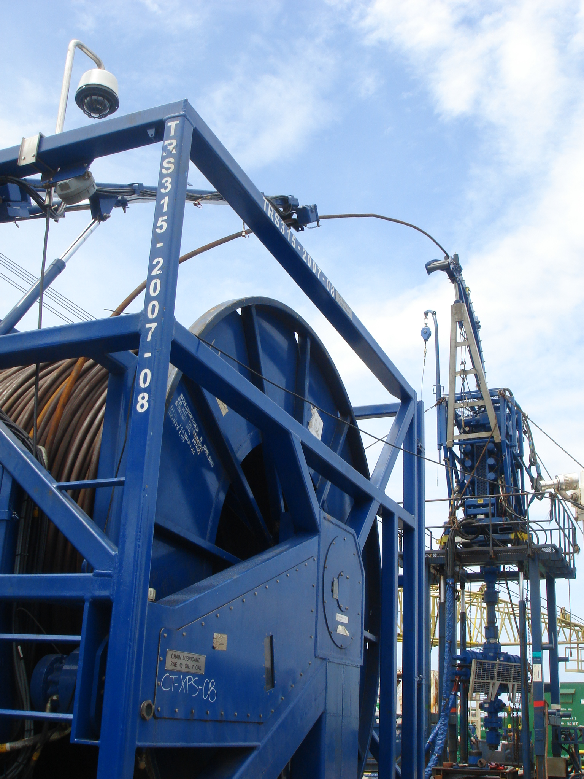
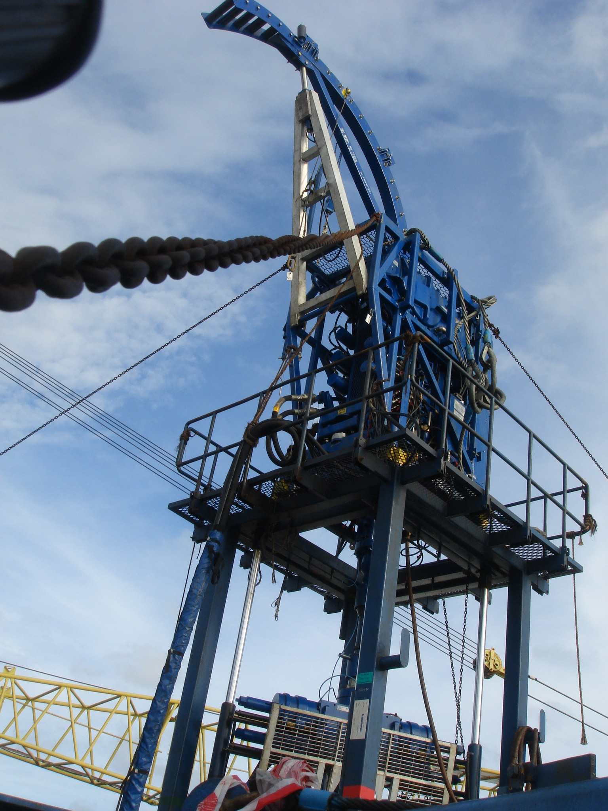
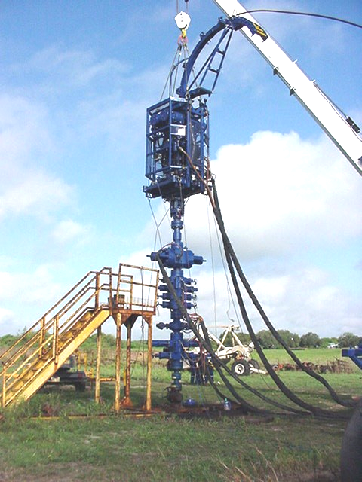
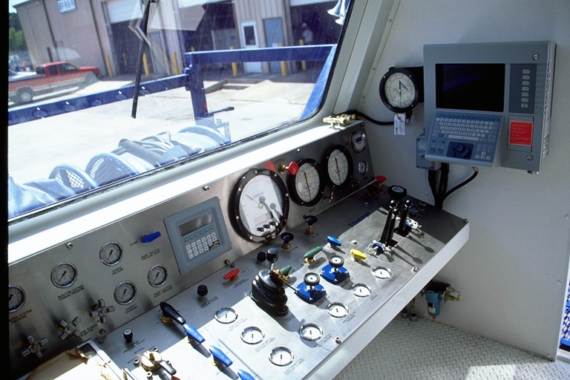
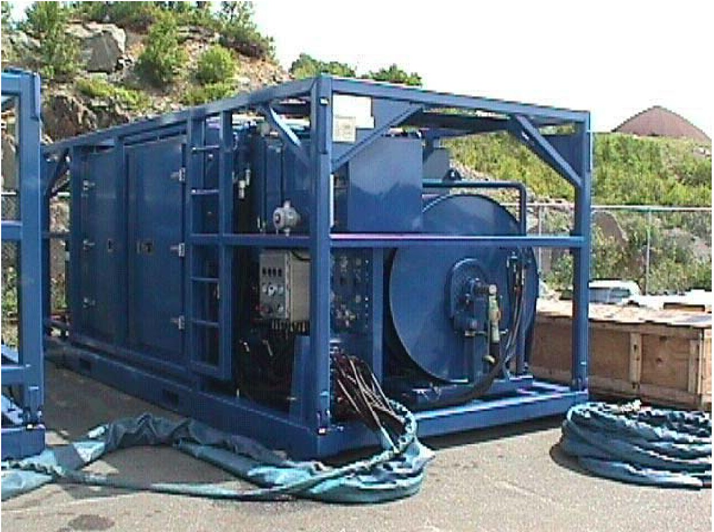
Basic Coiled Tubing Components
6
Control Cabin
Prime Mover/ Power Pack
Coiled Tubing Reel Manifold
Injector Head
Well Control Equipment
Pumping and Mixing Unit
3
4
5
1
2

Slide 39
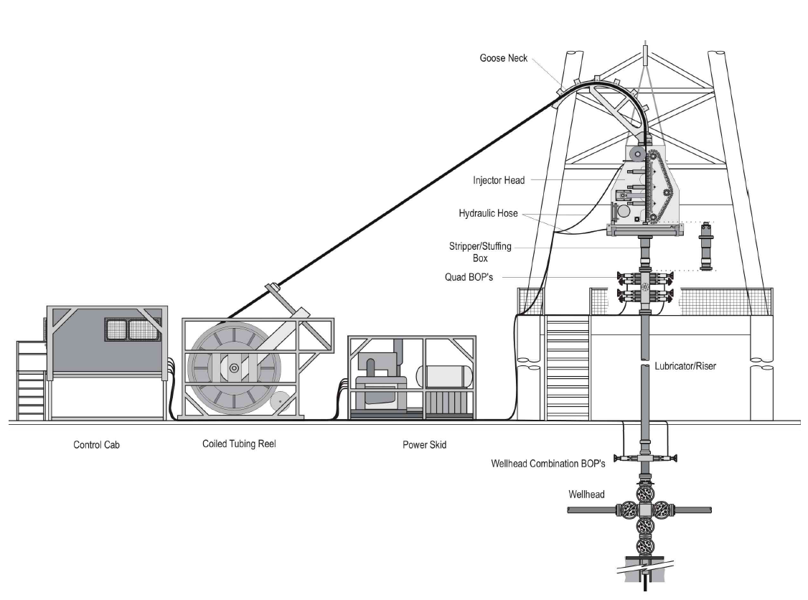
Basic CT Rig Up

Slide 40
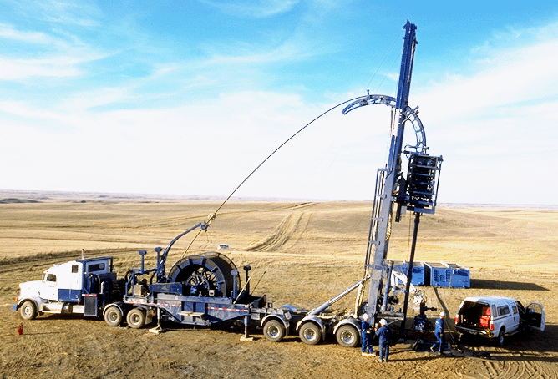

Slide 41
Coiled Tubing Applications

Slide 42
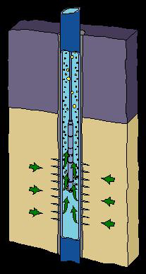
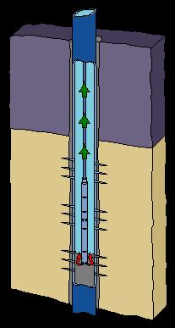
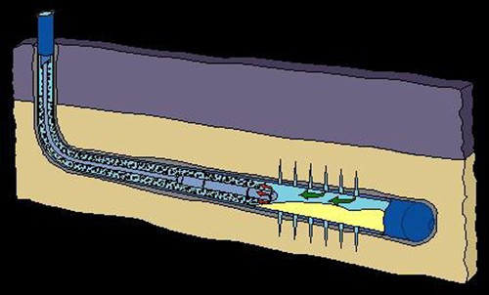
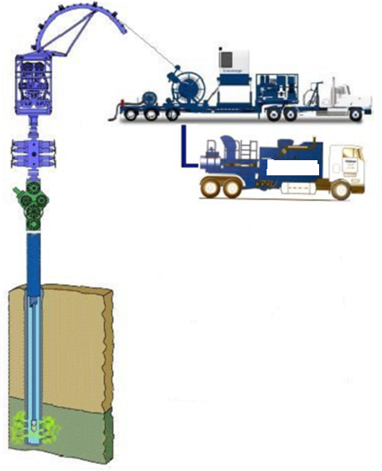
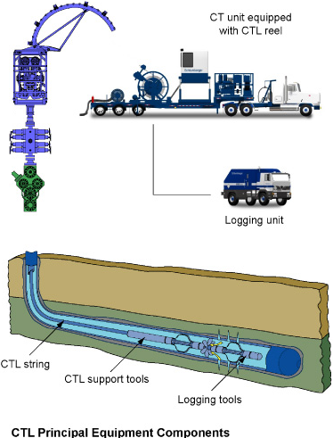
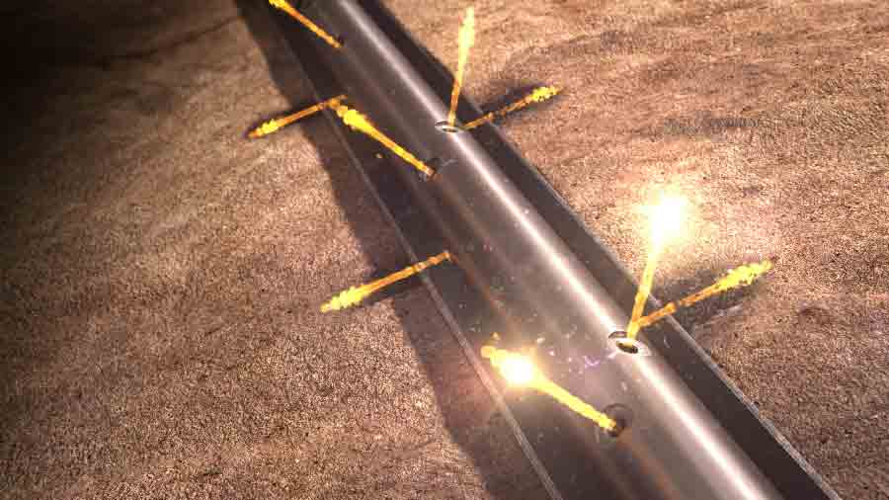
WELLBORE CLEANOUT
To remove sand, or other debris, that may be produced into a wellbore, that will restrict the flow of hydrocarbon to surface.
Can be extremely challenging on wells with larger tubular and restrictions.
NITROGEN KICK-OFF/LIFT
During a nitrogen kick-off, nitrogen is circulated through the coiled tubing to lighten the hydrostatic weight of the fluid that is being exerted on the formation.
This allows the formation fluid to begin flowing into the wellbore.
CEMENTING THROUGH CT
Selectively place cement in the wellbore or perforations.
Used to Plug & Abandon the well
Shut off water/gas zones
WIRED SERVICES
Coiled tubing is flexible and strong.
Used for logging and perforating.
Coiled tubing is used in both deviated and horizontal wells, as well as in vertical ones.
CT PERFORATING
Can be performed with or without e-line installed in the CT
Can perform under balanced perforating with a long gun string using deployment methods
Can be used with depth control tools for accurate perforation location
ACIDIZING THROUGH CT
Acid, normally either HCl or HF, is pumped through the coiled tubing to protect the customer’s tubular, and to increase the accuracy regarding placement into the formation.
The acid acts to remove damage from the perforations and near wellbore area.

Slide 43



Slide 44
Comparison between Well Intervention Services
Conveyance | Slickline | E-Line | Coiled Tubing
Data Acquired | Memory | Real Time | Memory
Depth Accuracy | No | Yes | No
Costly | No | Yes | Yes
Primary Pressure Barrier | Stuffing Box | HGT | Stripper
Required Space Onboard | Small | Medium | Large

Slide 45
WORKOVER OPERATION

Slide 46

What is workover operation?
The term Work-over, is used to refer to a kind of well intervention that is aimed at enhancing the performance of a well.
It involves recompleting already completed well for improved performance.
The process of performing major maintenance or remedial treatments on an oil or gas well after initial completion .
In many cases, work-over implies the removal and replacement of the production tubing string after the well has been killed and a work-over rig has been placed on location.

Slide 47



Hydraulic Work Over Rig (HWU) & Snubbing Unit

Slide 48
What is workover operation?
The operations involved in maintenance and servicing, repairing, installation of down - hole production equipment etc. in an initially completed well (production well) is termed as workover operation
To some degree Workover operations varies depending on the reasons for which they are carried out. The first basic operation done during Workover is well killing.
Well killing involves circulating a fluid (called workover fluid e.g. Brine) into the well whose weight is appropriate to control the formation pressure.
The workover begins by removing the well head and possibly the flowline, then lifting the tubing head from the casing hanger thus beginning to pull out the tubing from the completion.
Workover Operations involves well kill operation, retrieval of tubing and completion hardware, re-perforating, stimulating, running of completion and wellhead hardware equipment and tubing

Slide 49
Steps in Workover Operation
Rig-up Mast
Well killing
Rig down of X-mass tree & rig up of BOP
Circulation
Tripping of Tubing
Specified jobs
Final Running in of Tubing
Rig down BOP

Slide 50
Workover Applications
Mechanical Reason
Repair/Replace of damaged equipment
Replace artificial lift equipment
Cement and Casing Problems
Reservoir Related Reasons
Repair natural damage within the well
Zone Transfer
Stimulation
Convert well from production to injection

Slide 51
References
Schlumberger Slides Presentation
Remi Chesnel - Schlumberger. (2015). 3a - Slickline Wire. Indonesia Training Center (ITC), Jakarta, Indonesia.
SKG 2018 Slide Presentation
Dimension Bid Sdn. Bhd. (2018). Module01 E-Line VS Slickline. Dimension Bid WH 22, Kemaman, Malaysia.
Training Manual Wireline Refresher Workshop
Dimension Bid Sdn. Bhd. (2006). Wireline Refresher Workshop. Dimension Bid Open Yard, Kemaman, Malaysia.

Slide 52
Job Well Intervention siapa yang jaga?
Pelbagai nama
Wireline Supervisor (WS)
Wellwork Supervisor (WWS)
Well Intervention Supervisor (WIS)
Company Man
Schlumberger: Wireline = E-Line

Slide 53
Q&A

