Slide 1






DCS Transmittal Form
Prepared by: Data Services & Consultancy Team
© Neu Dimension 2018

Slide 2
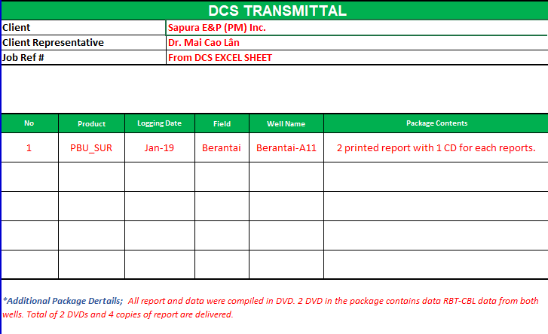
Highlights - Transmittal Form (Tab 1, Page 1)
Product code - drag down list of the jobs that we are delivering. The explanation of each codes are available on the pricelist tab (TAB 3). I.E. In any normal case where we have an MIT interpretation and also delivering the report, we will have two codes: The interpretation code (MIT_INTERP) and (DCSReport_01) selected from the drag down list. So the package contents column can be merged.
Client List – Drag down style for the client we are dealing with. The current list has most of the clients we had dealt in the past. Additional client can be added from time to time.
Job Ref # - Taken from DCS list of job excel sheet.
Additional package details – To fill up if you have additional details on the package you’re currently sending. I.E. Is the DVD / CD of the package combined together in a single disc. Detail contents of the CD/DVD.
Package contents – some / simple details on what we are delivering to the client or anything relevant to the package you are delivering. I.E. Amount of CD / report etc.

Slide 3
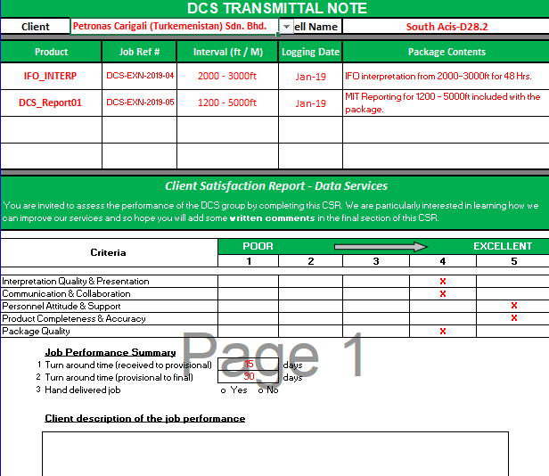
Highlights - Transmittal Note (Tab 2, Page 2)
Upper Half of the Form – Very similar to the first page (transmittal form) except for the additional interval length column of the interpretation. Second half of the form consists of the CSR part itself.
The CSR section where the client can rank our service quality. The rating is ranked from 1 (poor) to 5 (excellent). The client will have to fill this up based on the criteria.
The performance summary indicates two things:
TAT from the date data is received to the first provisional (draft).
TAT from the provisional (draft) to final.
The client description is where the client is given a space to fill up what he / she / he-she feels about the service quality of our job / interpretations.

