Slide 1
Table of Content
- Objectives
- Tool Review
- Logging program
- Interpretation Inputs (from client & FE)
- Interpretation steps/concept
- Logging Interpretation limitations
- Previous Analysis Report review

Slide 2
NOISE TOOL

Slide 3
Noise Tool
Objectives :
  To detect possible leak.
  Evaluate flow profiles.
  Locate channels behind well case.
  Locate gas entries.
  Locate gas-liquid interfaces (single phase/two phase).

Slide 4
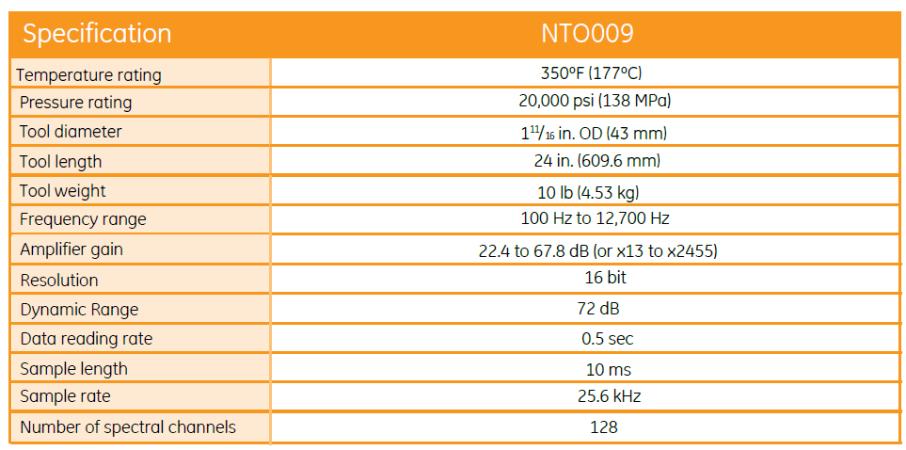
Noise Tool
Tool Review

Slide 5
Noise Tool
Logging program
Create condition.
Job program
1st condition (shut in)
RIH. Observed any anomaly during RIH (temperature deflection/increase in amplitude).
Stop 25m below leak point, station stop for 1min for every 1m until 25m above the leak point.
Playback the log and verify if the data is okay.
2nd condition (inject/bleed pressure)
RIH. Observed any anomaly during RIH (temperature deflection/increase in amplitude).
Stop 25m below leak point, station stop for 1min for every 1m until 25m above the leak point.
Playback the log and verify if the data is okay.

Slide 6
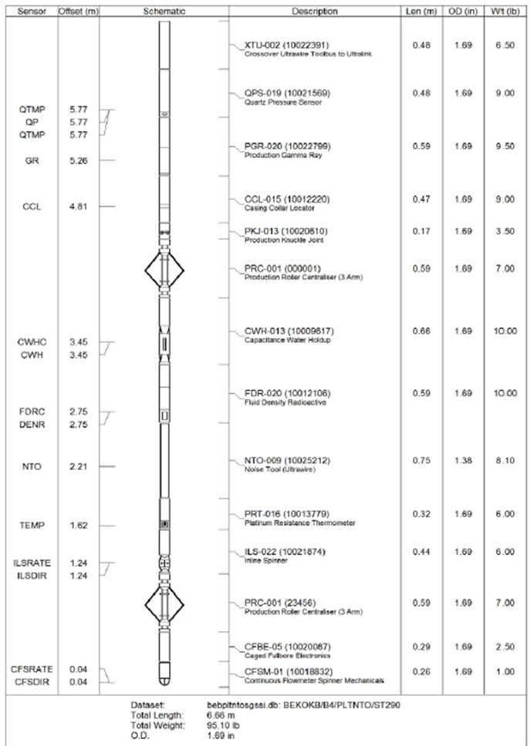
Noise Tool
Interpretation Input
Using warrior
Field data
.db file
DOR/SOE
BHA
Client data
Well sketch

Slide 7
Noise Tool
Logging / Interpretation limitation
Best for gas leak detection. Run static log and then again during flow or negative test. Upward gas movement (percolation) at actual 10 ft3/D or more should be detectable.
Best performance of noise logs is with gas flow.
Autogain does not constantly check the signal, but only for 10 seconds after you click the Autogain button.The system then sets the gain to the appropriate level for the environment during the 10 seconds it was measuring.
Autogain best use when in stationary – the acoustic coupling in fluid is better – lower gain.
The gain needs to be high enough to see a signal but not too high that the tool saturated.
As trying to record Noise tool data whilst moving will generally have a changing environment it is difficult to get the gain perfect – i.e. high enough but without saturating. The Engineer should use his best judgement here. Recording stationary readings is easier as you can optimise the gain – best to use Autogain for stationary readings.

Slide 8
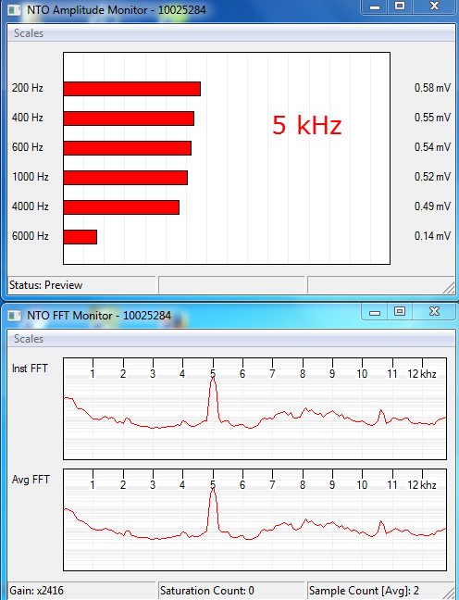
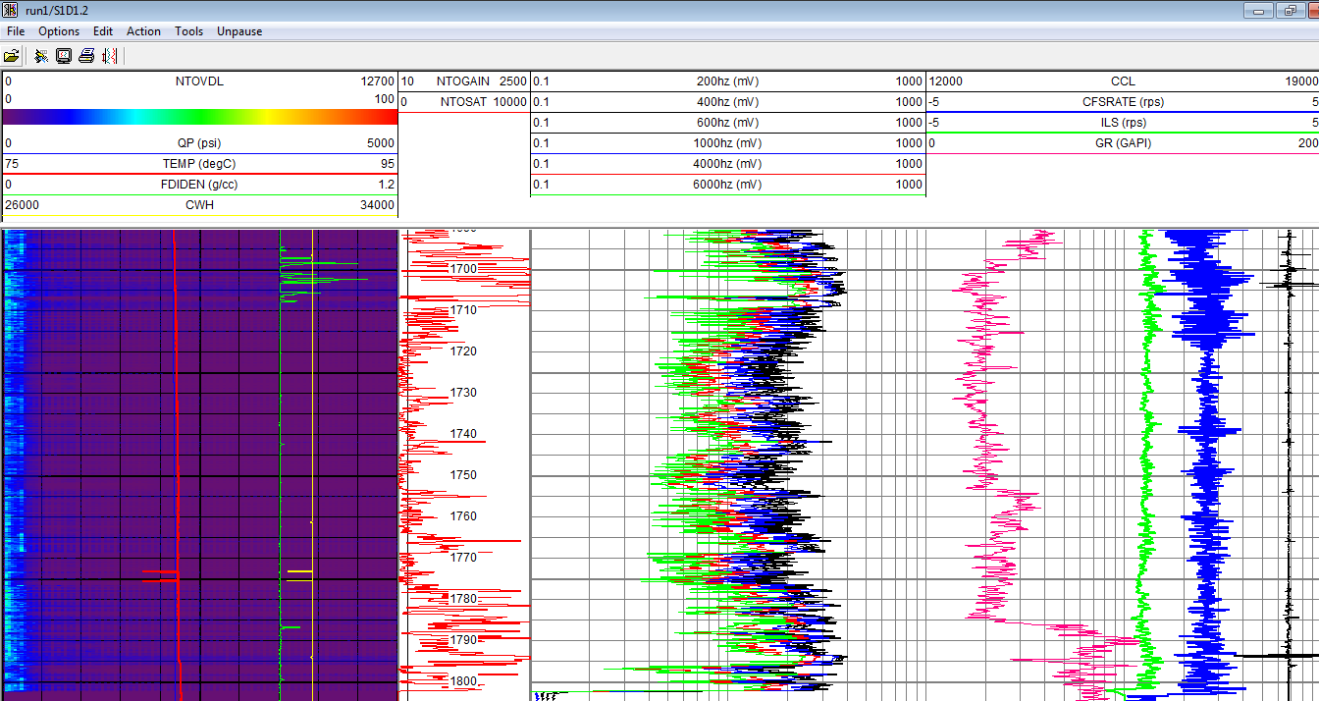
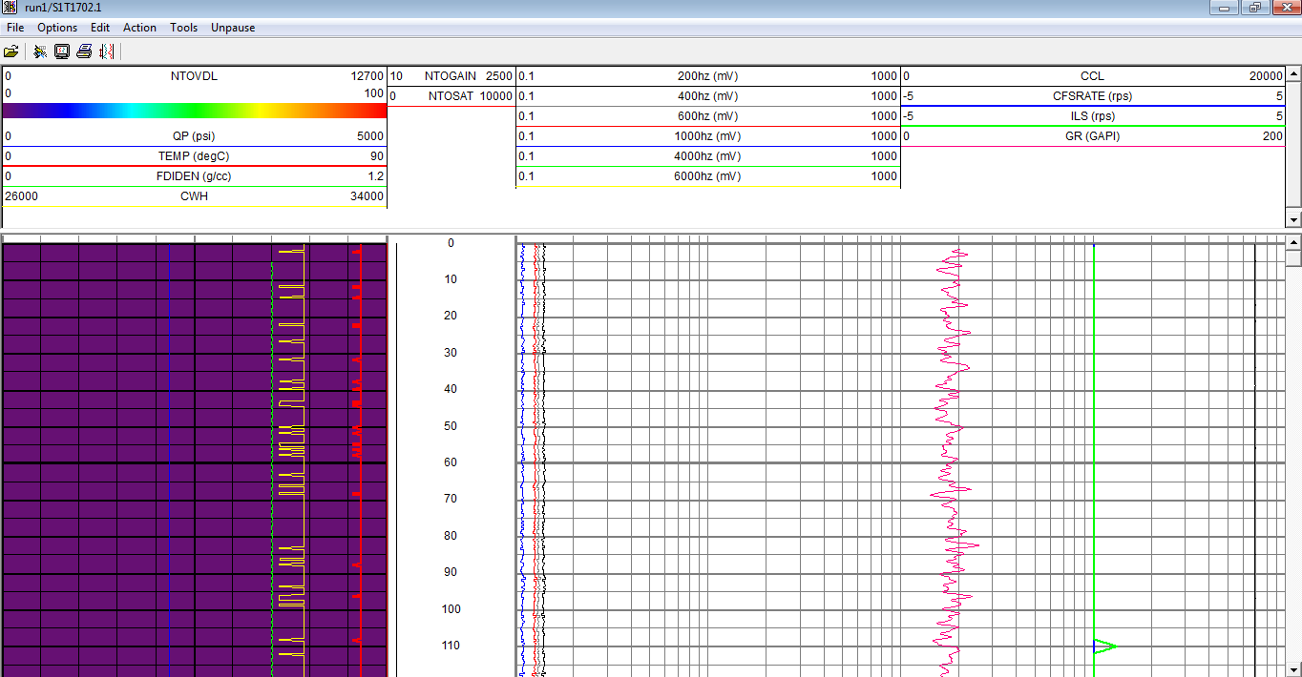
Noise Tool
Logging / Interpretation limitation
The log data has a left hand track showing the amplitude (loudness) of the sounds versus frequency (0 – 12.7 kHz).
The louder the sound the brighter the colour. Purple is the quietest and red the loudest.
This is an example of a stationary reading recorded in time drive – the green road noise is missing as the tool is not moving

Slide 9
CEMENT BOND LOG

Slide 10
CBL
Logging / Interpretation limitation
Interpretation often qualitative from a visual appraisal.
Engineer and client can look onto the data and agree with the cement condition and also for remedial work action – if not needed can send the data to town.
Travel Time (also known as Arrival/Transit Time)
For bonded pipe the travel time should increase as it triggers on the E3 peak or later arrivals.
For free-pipe, the travel time should match the expected time for that casing size.
If the travel time decreases below casing arrival time and the amplitude drops then suspect eccentralisation and cross check against the cement map.
If the travel time decreases below casing arrival time and the amplitude increases suspect fast formations.
The travel time difference between the 3ft and 5ft receivers should be 114 μs. If it less than this suspect fast formations.

Slide 11
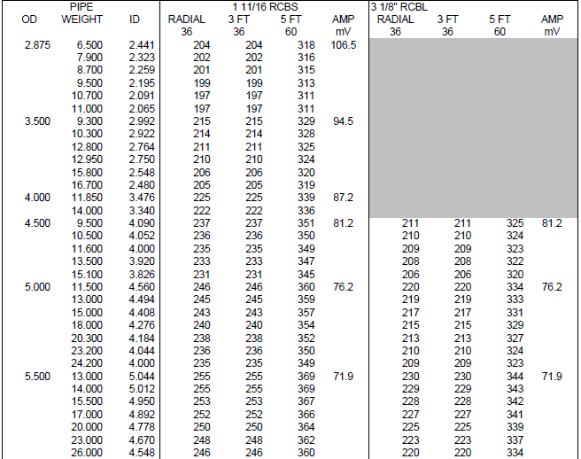
CBL
Example of expected TT & Amplitude table

Slide 12
CBL
Amplitude
For bonded pipe the amplitude should be low.
For free-pipe the amplitude will be high.
If the amplitude is intermediate cross check with the cement map to see if the problem is cement channelling or low compressive strength cement.
The lower the amplitude (less than 10 mV from CBL – BI more than 80%) or high acoustic impedance (>4 Mrayl from your ultrasonic tool) will indicate good casing to cement bond.
Cement Map
In bonded pipe the cement map should show uniform low amplitude.
In non bonded pipe the cement map should show uniform high amplitude.
In cases with channelling the signal amplitude at some of the receiver segments will be high.
In cases of low compressive strength all the segments will show intermediate amplitude.
If the tool is eccentralised the cement map will be non uniform.
If the pipe is lying against the formation the cement map may be non uniform.

Slide 13
CBL
Bond Index
Ratio of measured signal attenuation (taken from the log) to maximum attenuation.
0.8 or higher is accepted as indicating good cement.
Hydraulic isolation in ft is 2 x Casing OD – 5. Eg.in 9 5/8” casing the minimum interval of good cement for hydraulic isolation would be 13.25ft.
Compressive Strength
Strength is a measure of the strength of the cement to support the casing and its resistance to crushing.
Unit measures in psi.
standard CBL is almost impossible to differentiate between low compressive strength cement and a cement channel.

Slide 14
CBL
Fast Formations
Formations signal can arrive at 3ft receiver before casing signal – fast formation is a hard rock such as chert.
TT arrival should less than expected, amplitude high.
Microannulus
poor acoustic coupling - can be due to a lowering of pressure in the casing after the cement job or thermal contraction.
If a micro annulus is suspected the usual course of action is to re-run the log with the casing under pressure (500 to 1000 psi).
If the casing amplitude decreases and the formation signals get stronger then a micro annulus is suspected and the cement bond is considered to be OK.

Slide 15

CBL
Foamed or Lite cement
formation pressures are low in depleted fields - not always possible to run standard cement due to lost circulation or formation fracturing problems.
This type of cement provides isolation but has an extremely low compressive strength
Collars DO NOT chevron but may exhibit a straight line response.

Slide 16
CBL
Interpretation Inputs from field
Well Sketch
DOR
.db file for main/repeat pass
Interpretation beneficial info
Type/density of cement
Curing time of the cement
Density and type of mud displacing cement
Size and weight of casing
Any staging of the cement/other cement slurries used

Slide 17
CBL
Interpretation Rule
Interpretation Rule #1 : Low amplitude – good cement
Interpretation Rule #2 : High Attenuation – good cement
Interpretation Rule #3 : High BI – good cement
** Except when first formation arrivals appear
Interpretation QC
Check scalling for radial map
VDL pattern at free pipe
Check TT and amplitude for free pipe
TT higher at cemented area
CCL tied-in with tubing tally

Slide 18
Production Logging Tool

Slide 19
PLT
Interpretation Inputs
OHGR
Survey Data / TVD
PVT
RAW data for CWH & FDR
Well Sketch
  Perf Interval – influence of the calculations that used to define initial position of inflow zones – Emeraude assigns the contributions (display as Red Marker).
  Reservoir Zones – do not influence the rate calculations but they are essentials (display as Green Marker).
  Roughness – friction/slippage fluid-fluid and tubing wall.

Slide 20
PLT
Interpretation Inputs
Objective:
Production/Injection contribution or profile
Investigation of cross flow
Investigate channeling behind casing
Investigate source of water

Slide 21
PLT
Application | How (from PL)
Check perforation effectiveness | Spinner, temperature
Check for tubing, casing and packer leaks | Spinner, temperature, CCL
Check for channeling | Spinner, temperature
Determine production profile | Spinner, fluid identification, temperature
Source of water | Spinner, density, water holdup device, temperature

Slide 22
PLT
PL QC
GR & CCL
  Depth correlation
    PL-GR to OH-GR
    CCL to tubing accessories
Spinner
  Changes in spinner rotation:
    Inflow or Outflow at SSD/leak/perforation area
    Change in ID
  Positive reading : Fluid flow upward
  Negative reading : Fluid flow downward

Slide 23
PLT
3. Capacitance & Density :
  Fluid phase identifier
  To differentiate phase column during SI or phase dominant during FL.
  Give the RAW data for CWH to Log Analyst for interpretation.
4. Temperature
  Indication of fluid flow either cooling or heating effect @ SSD or perf interval
  Change in temperature gradient can be due to different phases.
5. Pressure
  Reservoir pressure during stable SI condition (assuming no fluid movement during SI)
  Wellbore pressure during FL
  Can be used to generate density (DPDZ)

Slide 24


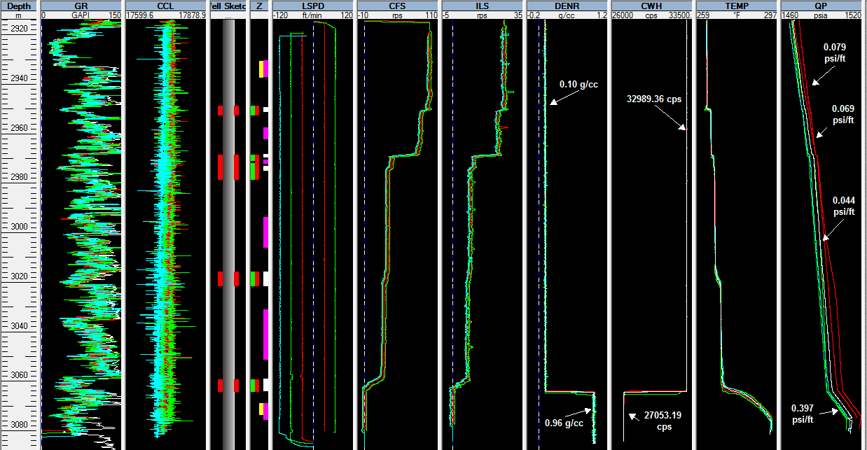
Gas Condensate Well
GR-PL Tally with GR-OH
Increased in spinner rotation indicate fluid inflow into the tubing
Cooling effect suggesting gas entry
Change in Density and Capacitance reading at the same depth suggesting liquid contact inside wellbore

Slide 25
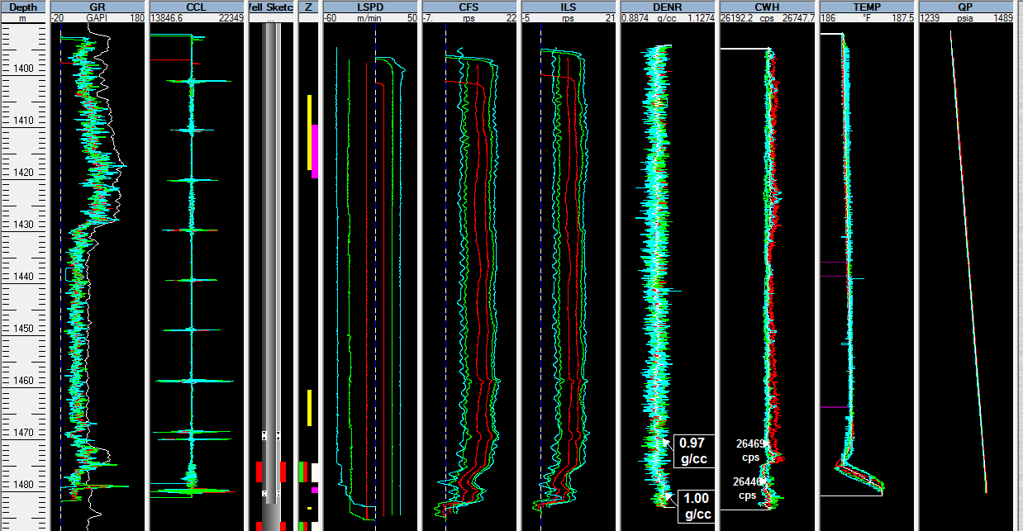
High Water Cut (WC) Wells
GR-PL Tally with GR-OH
Increased in spinner rotation indicate fluid inflow into the tubing
Change in Density and Capacitance reading at the same depth suggesting there was hydrocarbon flow into the tubing
Cooling effect suggesting inflow

Slide 26
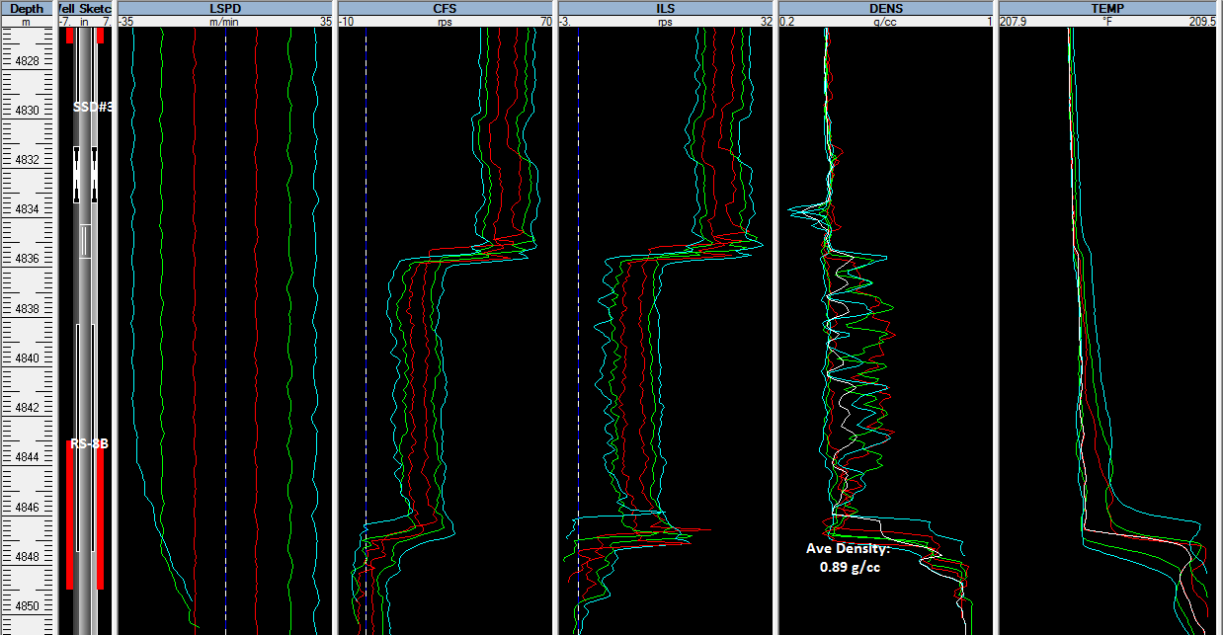
Leak Detection
If perf sand is behind tubing, how the fluid come into the tubing??
Inflow from opened SSD
Opened SSD
Temp deflection indicate inflow
Is it possible to have inflow here??

Slide 27
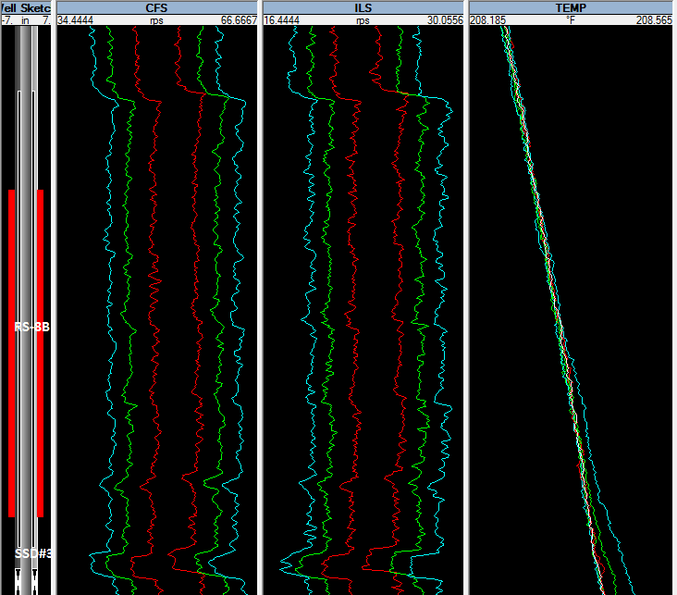
There are several changes in spinner rotation
Is it due to presence of leak??
Is there any temp deflection indicating fluid movement??
Spinner rotational speed changes. Why?

Slide 28
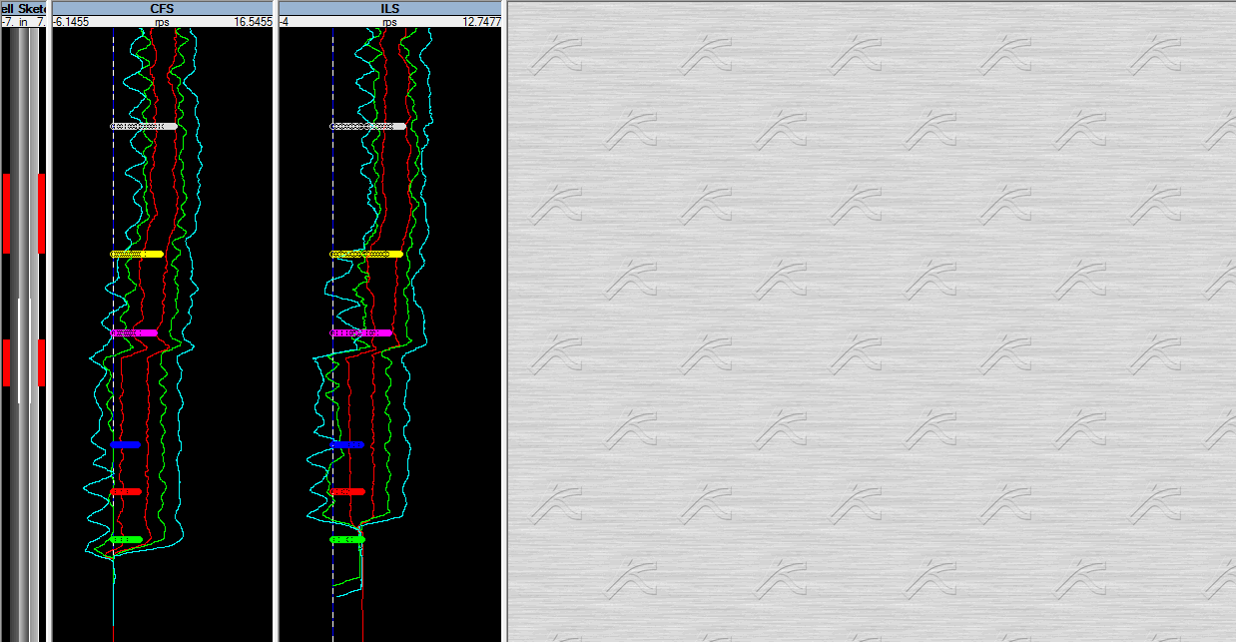
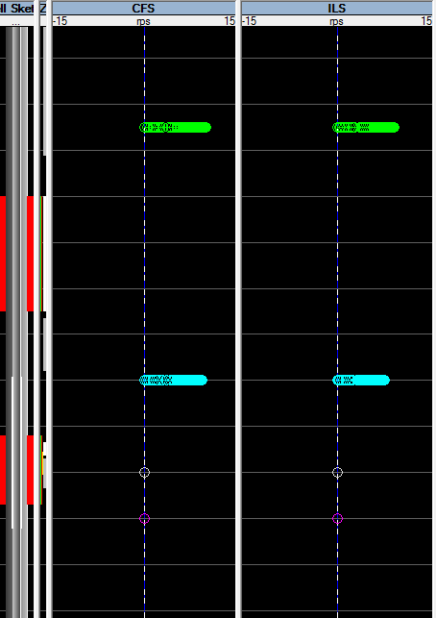
Leak @ Bridge Plug
If perf sand is behind tubing, how the fluid come into the tubing??
Station Stop above Bridge plug
Station Stop above Bridge plug
Set Bridge Plug
Set Bridge Plug

Slide 29
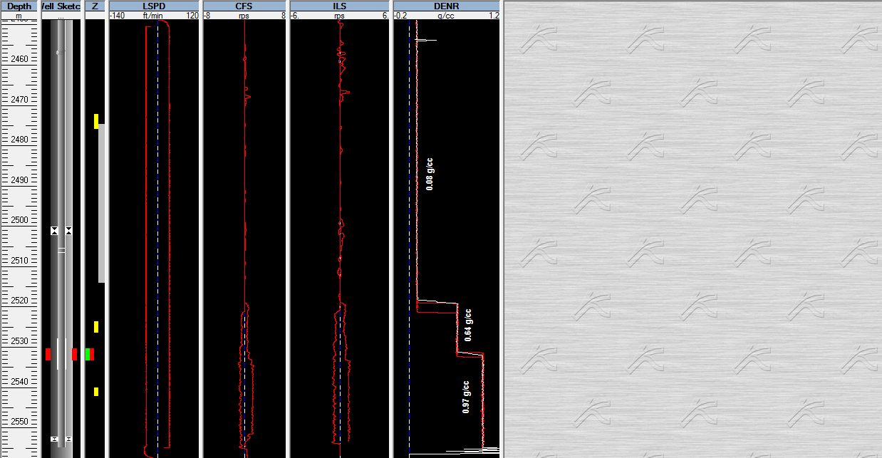
Spinner Anomaly
1) Why spinners didn’t record any rotation data??
  Possibly spinner was clogged due to sand production
  Action: Take picture of the spinner if there was presence of sand and share with iSol.
  Spinner in gas phase which required faster logging speed to overcome Spinner Threshold. (refer to log attached)
  Always occurred during slowest logging speed
Zero Spinner Rotation

Slide 30
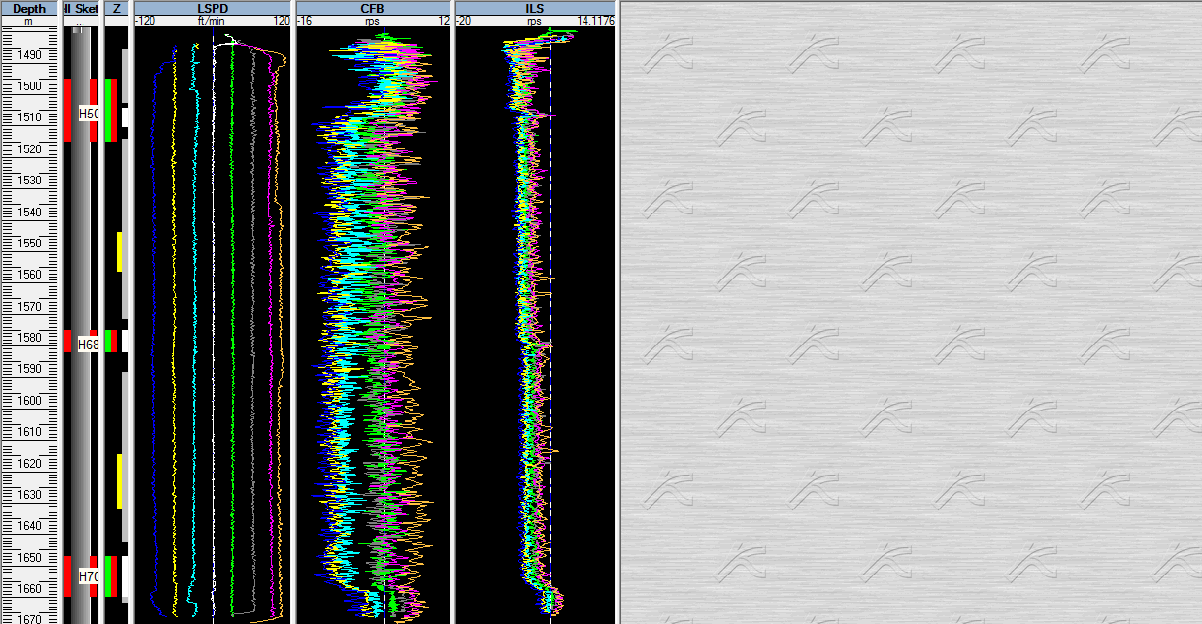
Spinner Anomaly
Apparent Downhole Flow (ADF)
  ADF also can be simplified as water/oil/heavy phase circulating in borehole.
  Condition/situation possible for ADF:
    High deviated well
    Multiphase flow
  Spinner will mostly show negative spinner rotation because spinner was at lower side of the well. So spinner only recorded the circulated liquid.
  Nothing can be done to fix ADF from PLT.
Spinner only shows negative rotation.
  So, if spinners shows negative spinner rotation, how to calculated contribution from each zone?

Slide 31
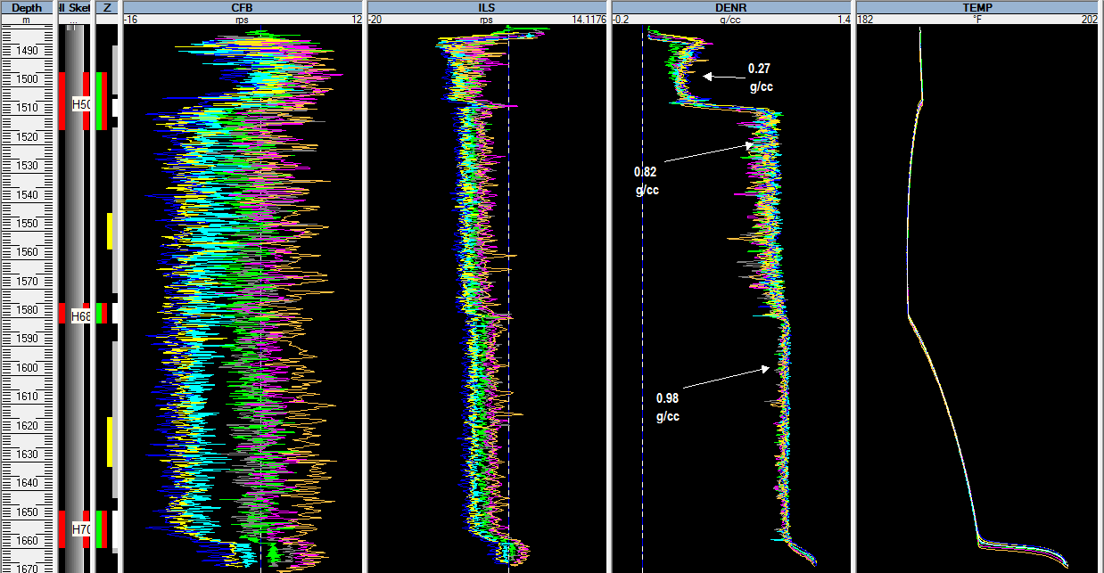
Temp deflection indicate activity (inflow/outflow) @ perf interval
Spinner only shows negative rotation.
Presence of density changes every time tool pass perf interval
With presence of ADF, Quantitative Analysis for zonal contribution unable to realize due to spinner only recorded negative flow.
However, Qualitatively can explain which perf interval in contributed to well production.

Slide 32
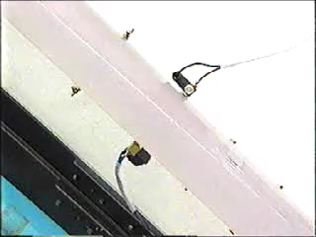

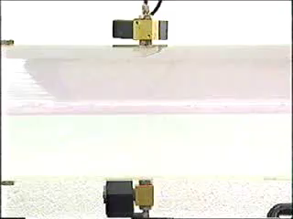
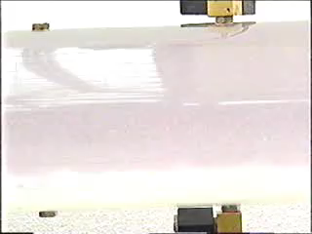
45⁰
88⁰
90⁰
92⁰

Slide 33
Why need good Spinner data during Shut in Survey?
How many good spinner passes needed?
Why RIH & POOH data is needed

Slide 34
Why need good Spinner data during Shut in Survey?
Assuming during Shut in Survey well is in stable condition and there is no fluid movement (best case)
  This data will be use for SPINNER CALIBRATION.
Each phase have different spinner threshold value.
  Vth (gas) > Vth (oil) > Vth (water)

Slide 35
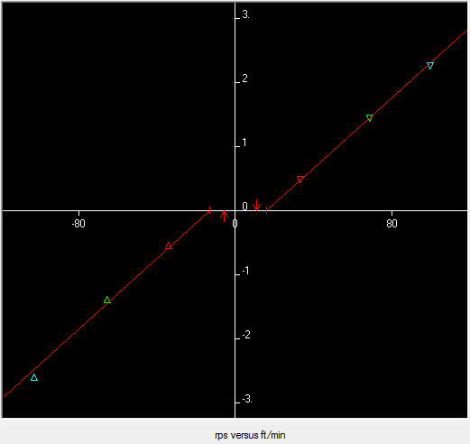
How many good spinner passes needed?
1 up pass and 1 down pass?
  How to get the slope that represent wellbore fluid??
2 up pass and 2 down pass?
  Can get the slope by connecting both 2 points
  But how confident that slope from 2 points will represent the fluid phase??
3 up pass and 3 down pass?
  Will average the straight line between the 3 points.
  Give clearance for interpreter to justify the suitable slope
Basic : To construct a straight line, at least 2 points is needed.

Slide 36
Why RIH & POOH data need to share with Log Analyst?
RIH & POOH are the only data that cover from the top until logging interval.
What does RIH & POOH gives:
  Give what are the current condition above the logging interval such as leak.
  Temp data (Shut in) can be used as Geothermal gradient.
    Can identify packer leak.
Example: PLT was performed for Zonal Contribution at interest area. However, there are several leak points above logging interval.

Slide 37
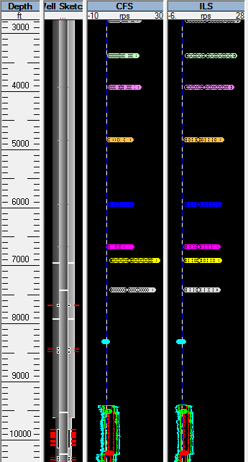
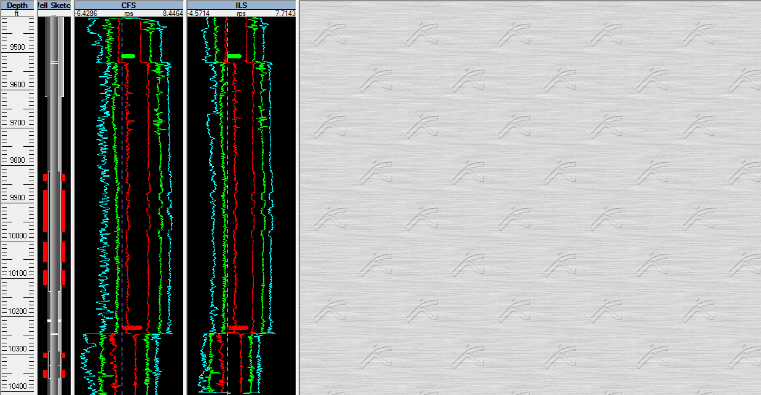
How this will effect the interpretation??
Calculated rate will be far off from the well test results
Station Stop above logging interval indicate increased in spinner rotation

Slide 38
CONCLUSIONS
Flowmeter is considered to be “ King of PL tool”.
Flowmeter is the only tool that gives direct flowrate.
If a log has poor / no spinner response, then most likely the job need to be repeated.
Log Quality:
  Threshold of the spinner
  Linearity response with increasing upward and downward fluid velocity.
  How the measured response relates to known surface flowrates.

