Slide 1
Offshore Debrief / Technical Sharing
DIMENSION BID
M. Ameerul Zaeem

Slide 2
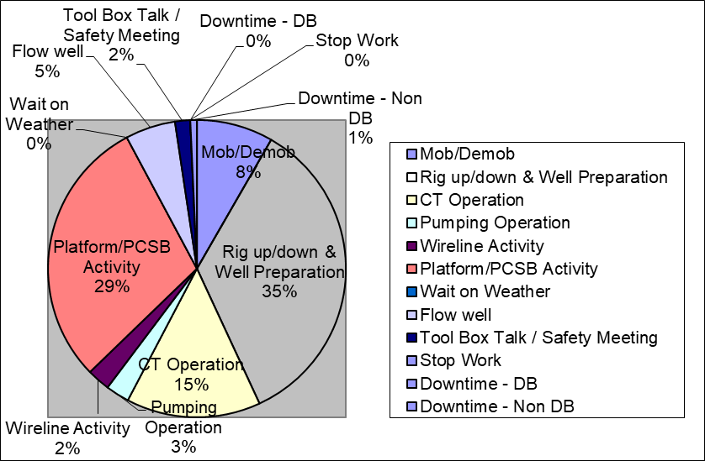
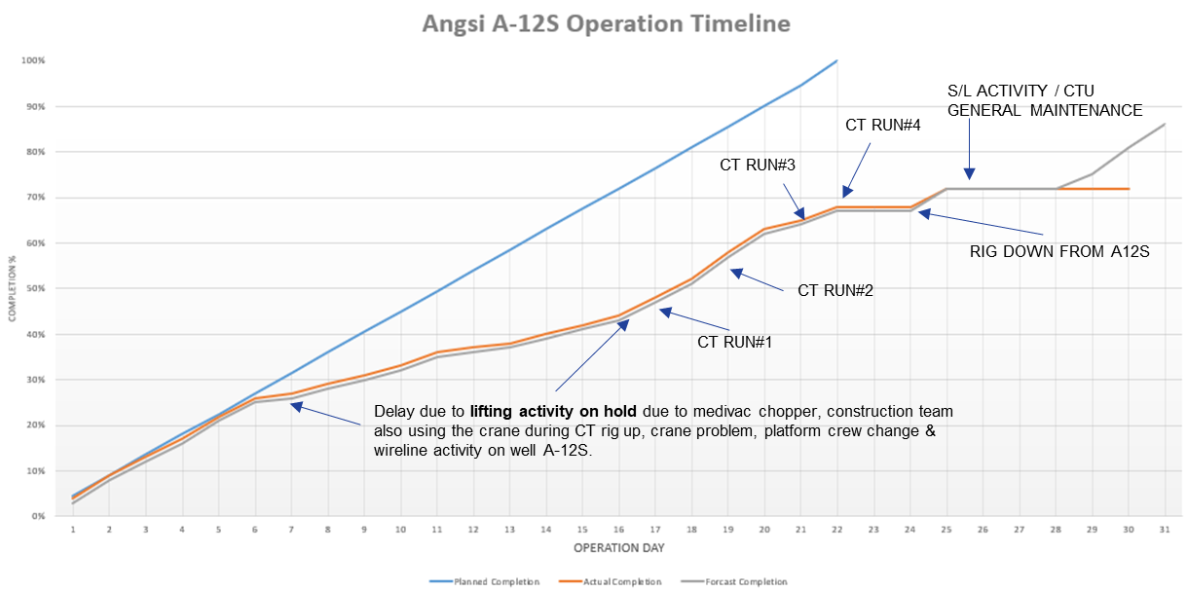
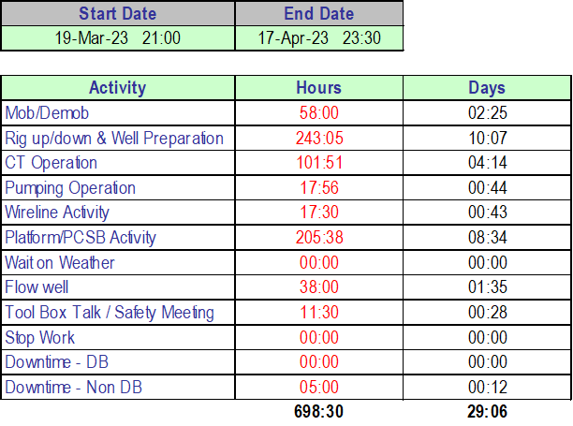
Angsi A-12S Summary
CT Operation Duration: 30 Days (19 March till 17 April 2023)
  Angsi A-12S - Well Diagnosis with Camera Run
Operation start on 4th April once PCE & Jacking Frame rig up on Well A-12S after complete slickline activity (Retrieve PXX Plug)
Operation complete on 17th April once skid to A-24L
Actual Operation: 30 days, Planned Operation: 22 days

Slide 3
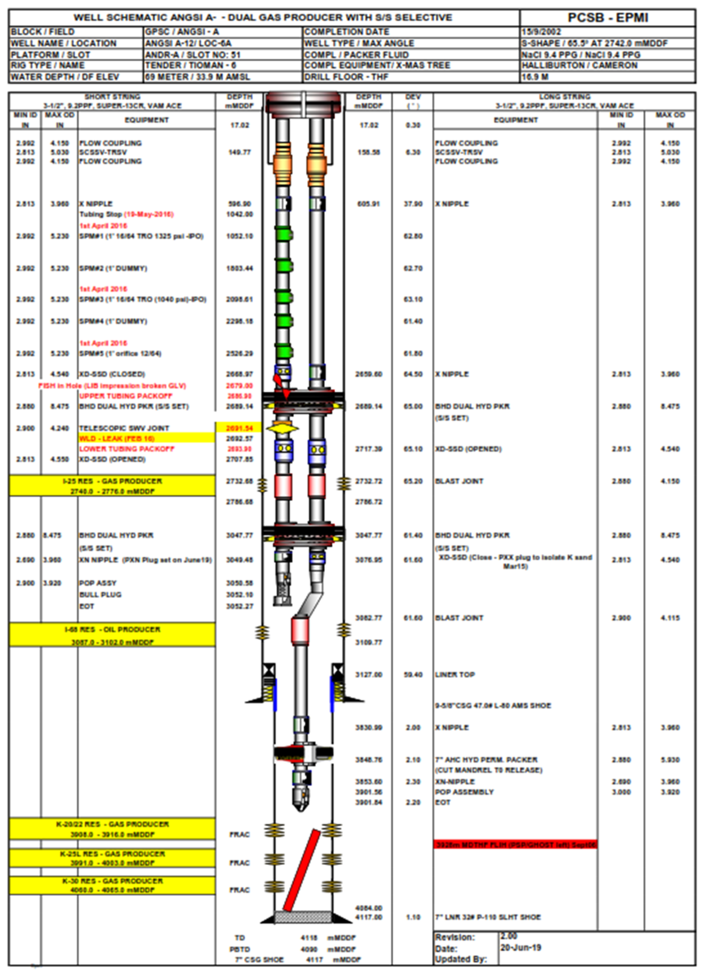
Angsi A-12S – Objective &
Scope of Work
  Objectives:
To confirm the top of Top of tubing cut / PXN plug condition (3,049m MDDF)
To perform acid stimulation on I-68 zone
  Scope of Work:
Plan | Actual
Run#1: Drift Run Until TOF | Run#1: Drift Run Until TOF
Run#2: Camera Logging Run | Bullheading: Fill Up Well (2x Completion Volume)
Run#3: Acid Stimulation on I-68 zone | Run#2: Camera Logging Run
Contingency Run: Hammering TOF | Contingency Run: Hammering TOF
Bullheading: SISQ | Bullheading: Injectivity Test
 | Run#3: Acid Stimulation on I-68 zone

Slide 4
Issues & Challenges
Operation | Issues / Challanges | Wayforward / Solution
CT Run#1: Drift Run until TOF | Return handling | If THP > backpressure from header (280 psi), divert to production system. If THP < backpressure from header (280 psi), divert to CDV (low test sep). If CDV full, water divert to Overboard & oil divert to Surge Tank.
Bullheading: Fill Up Well | Pressure spike at early stage of pumping | Check Master Valve, Crown Valve & Plug Valve position and ensure in open condition. Check with WSS / DPIC on TRSV (SSSV) either in open / close position before any intervention activity.
CT Run#2: Camera Logging Run | Camera Nozzle stucked at Single BOP profile for a few times during RIH due to end of nozzle design (flat surface). | Change the orientation of Single BOP
Contingency Run: Hammering TOF | Chart understanding (Surface weight vs downhole weight). | Refer next slide
CT Run#3: Drift Run & Acidizing | Dead volume confusion. Mixing 15% of HCl 80 bbls but pump into well only 74 bbls. | Dead volume (additional volume left inside Tank) is important to avoid loss prime during pumping.
 | Sampling point & injection point. | Must have at least 2 sampling point where injection point (Soda ash) is in between to compare pH before & after neutralize the acid.

Slide 5
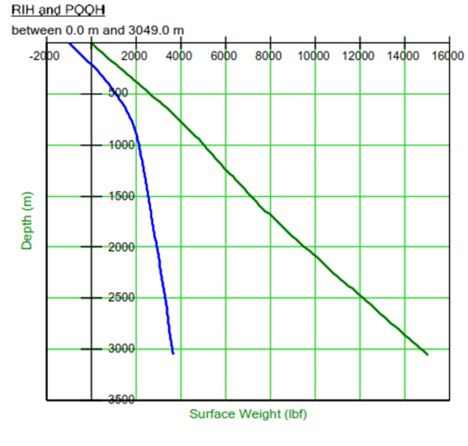
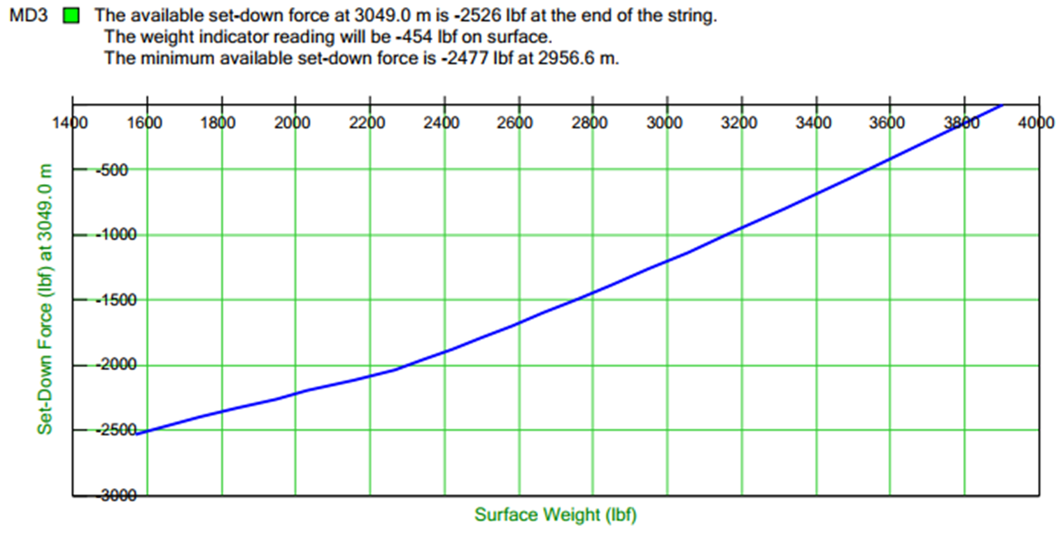
Surface Weight Vs Downhole Weight
3,900 lbf
3,900 lbf
3,150 lbf

Slide 6
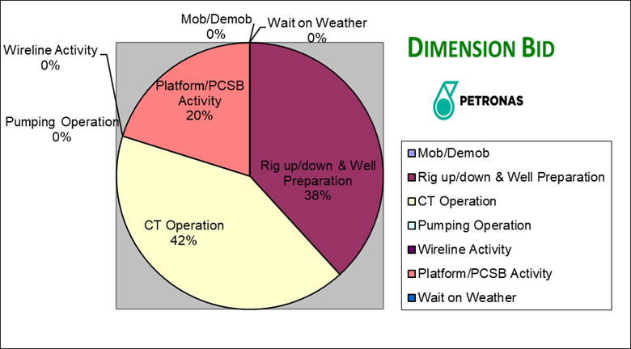
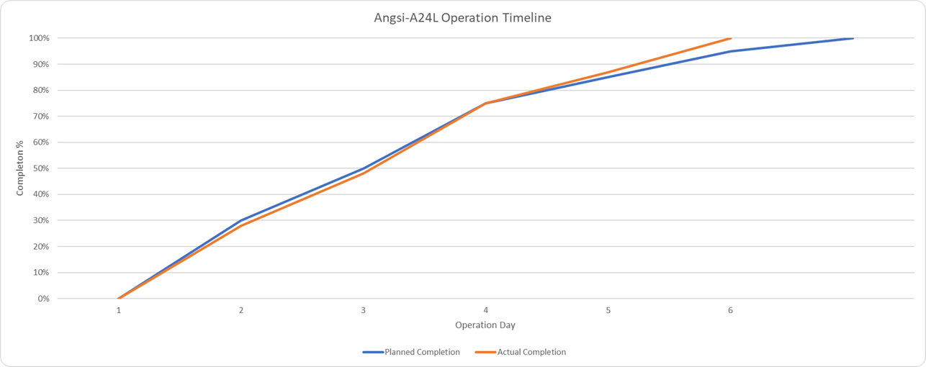
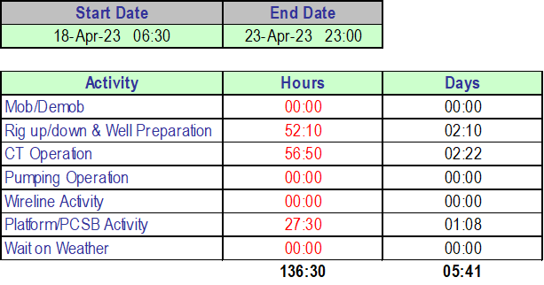
Angsi A-24L Summary
CT Operation Duration: 6 Days (18 April till 23 April 2023)
  Angsi A-24L - Nitrogen Unloading
Operation start on 18th April once PCE & Jacking Frame rig up on Well A-24L
Operation complete on 23rd April once CTU is fully rig down & sailing to Bekok A
Actual Operation: 6 days, Planned Operation: 7 days
Received instruction from town to fully rig down
Sailing to Bekok A
Rig up on well
1 day ahead schedule due to skip contingency CT run (Nitrogen Unloading) & monitor well flowing during POOH
CT RUN#1

Slide 7
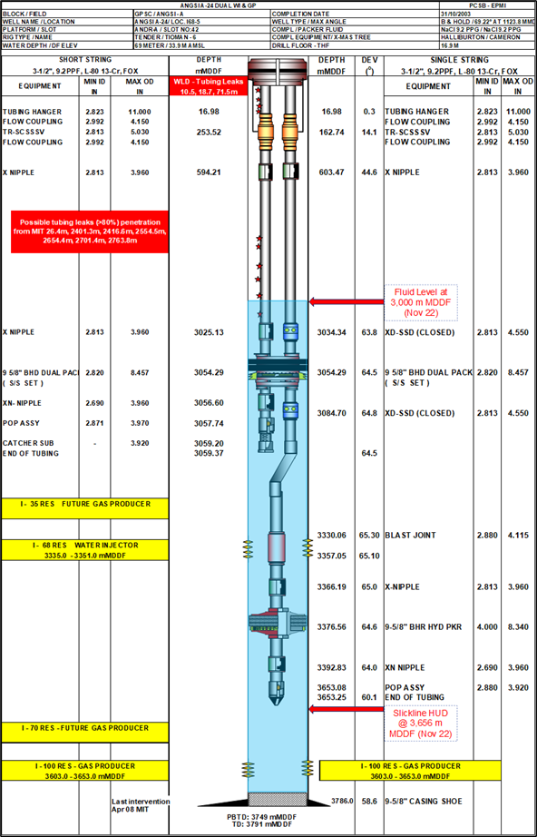
Angsi A-24L – Objective &
Scope of Work
  Objectives:
To perform well unloading via Coiled Tubing (CT) to unload liquid held up inside completion tubing until across I-100 Perf Interval.
  Scope of Work:
Plan | Actual
Run#1: Well Unloading | Run#1: Well Unloading
Contingency Well Unloading

Slide 8
Issues & Challenges
Operation | Issues / Challanges | Wayforward / Solution
CT Run#1: Well Unloading | Miscount volume | If liquid return at surface, divert return into Surge Tank to measure volume recovered.
 | Return solid N2 gas at surface after 60 minutes at depth | RIH 300 ft deeper as per job program.

Slide 9
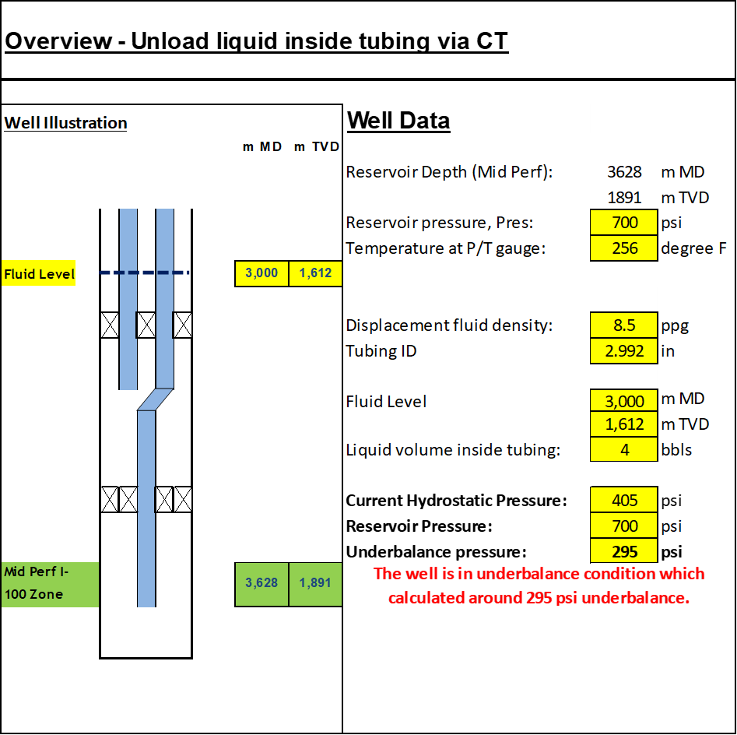
What went wrong?

Slide 10
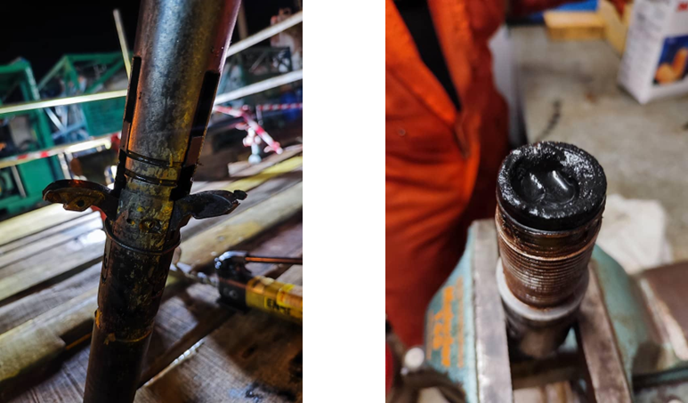
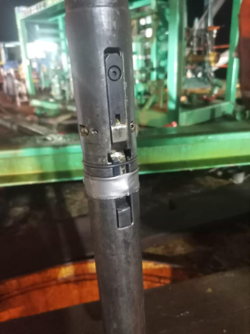
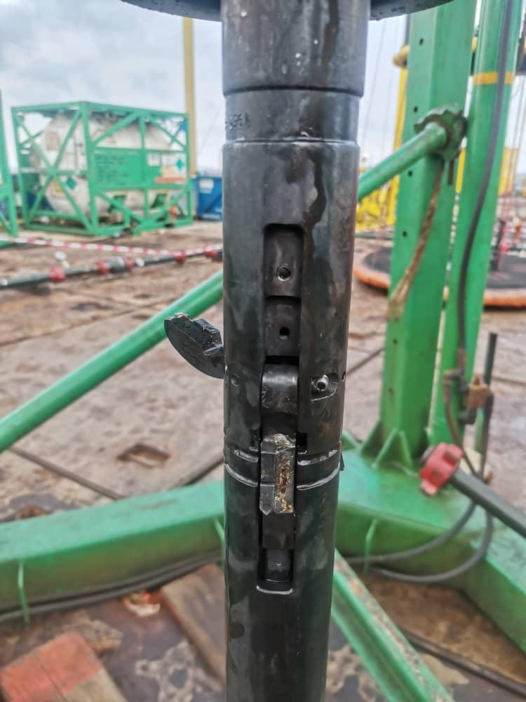
Issues & Challenges A-12S Tubing Cutter
Operation | Issues / Challanges | Wayforward / Solution
CT Run#1: Tubing Cut | CT encounter HUD at X Nipple at 605.6 m / 1,987 ft MDDF. Several attempts made to pass thru HUD but fail to pass thru. POOH CT to surface & observed the cutter was damaged & found fine debris in nozzle due to suspect cutter was hang-up at X Nipple profile. | Flush CT string & treating line, pig the CT string, fill up tubing volume & purge CT with N2 to ensure no hydrostatic inside CT, place extra retainer & wrapped to ensure the cutter is not opened prematurely, Isolate valve to CT & line up to CT Annulus and pumping thru CT Annulus while RIH to lubricate between CT & tubing wall.
CT Run#2: Tubing Cut | CT encounter HUD at SSD#1 at 2,445.4 m / 8,757 ft MDDF. Several attempts were made to pass thru HUD and managed to reach TOF at 3,049.43 m / 10,005.18 ft MDDF. Once get approval at cutting depth 10,004 ft MDDF, initiate cutting operation. After 1 hour & 15 minutes cutting operation, there was no significant indication that the tubing is fully cut. RIH & tag top of fish to verify the tubing is fully cut & no restriction at TOF depth. However, the TOF is still there. POOH CT to surface & observed only one of the cutter was seen still intact and the other two cutter was damaged. | Reconfigure BHA by adding fixed stabilizer and retain the cutter with wire to avoid cutter from opened prematurely.

Slide 11
Issues & Challenges A-38 Milling
Operation | Issues / Challanges | Wayforward / Solution
CT Run#1: Milling | Gas lift availability | Check PCP valve & gas lift valve is not isolated. Compare pressure gauge at PCP & transmitter reading at CCR. Check gas lift injection rate at CCR & get WSS or DPIC to check.
 | Lost return at surface during milling / cleanout | Pick up CT to safe depth or less deviation section depth (<40 degree) Keep pumping Try to manipulate choke size first & maintain at least 30 minutes then open a bit. If return still gas, reduce or increase pump rate. Last resort, get approval from Toolman to intro Nitrified Fluid.
 | Scale debris recovered at surface | Perform dissolution test with 15% HCl to check whether there is presence of calcite.
 | Differential Pressure Calculation | Refer next slide

Slide 12
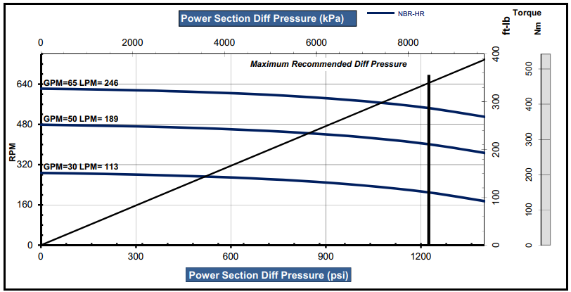
Differential Pressure Calculation
800 psi
C. Pressure (Off Bottom) = 1,900 psi
C. Pressure (On Bottom) = 2,700 psi
Differential Pressure = 2,700 – 1,900 psi
= 800 psi
Off Bottom
On Bottom
Scale

