Slide 1

Noise Tool – Leak Detection Tool
7th -Jan-2017

Slide 2
CONTENTS
Introduction
NTO Applications
NTO Specifications
Principle of Operations
Noise Logging Concept
Logging Speed Guidance
Toolstring configurations
Case Study
Q&A

Slide 3
LEAK DETECTION APPLICATIONS
Measure noise downhole
Frequency range from 100Hz - 12.7kHz.
Sensitive hydrophone
Sends spectra frequency
6 high pass frequency cut-off
NOISE TOOL (NTO) to HELP YOU
Evaluate flow profiles
Locate channels behind a well case
Locate gas-liquid interfaces
Locate leaks in a well case
Locate gas entries

Slide 4
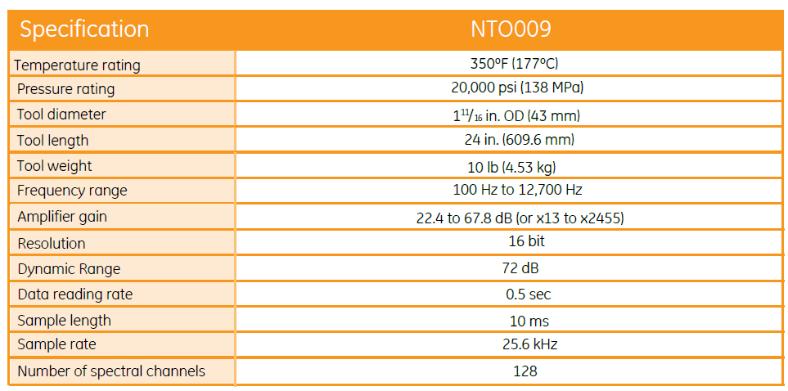
TOOL SPECIFICATIONS
NTO Specification

Slide 5
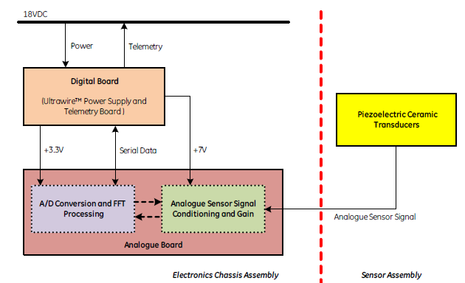
PRINCIPAL OF OPERATONS

Slide 6
PRINCIPAL OF OPERATONS
A piezoelectric crystal receives the sound in the audible frequency range of 100 Hz to 12700Hz.
The signal is sampled every 0.5 s in the software
A number of samples are averaged based on a selectable parameter (5 by default)
The instantaneous waveform and the averaged waveform can be displayed in a software window
The signal is also binned via 6 selectable high-pass filters. All frequency content amplitudes below each filter value is excluded and the result is displayed in the classic logarithmic format. Eg: 200Hz, 400Hz, 600Hz, 1000Hz, 2000Hz and 6000Hz.
Notes:
Humans can hear sounds at frequencies from about 20 Hz to 20,000 Hz, though we hear sounds best from 1,000 Hz to 5,000 Hz, where human speech is centered.

Slide 7
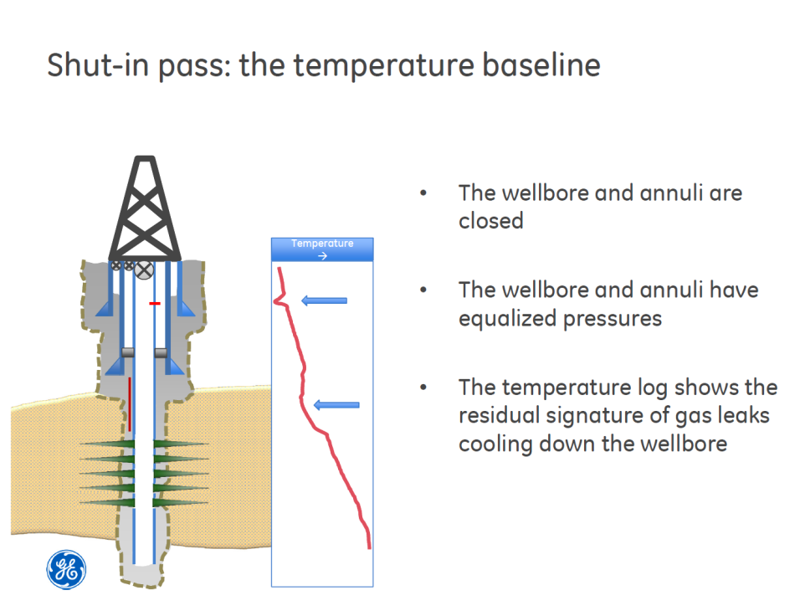
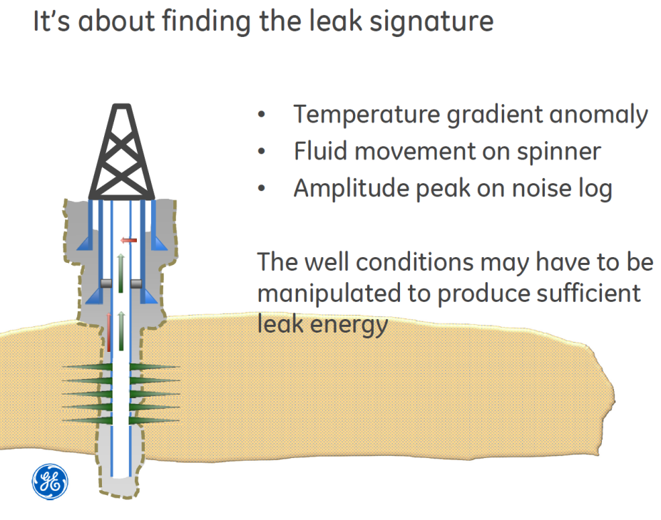
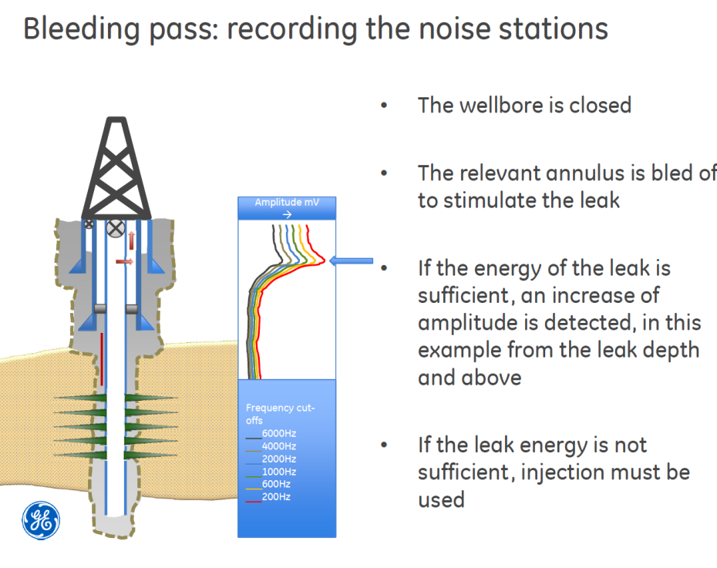
LOGGING CONCEPT
Noise Log Tool
- Concept

Slide 8
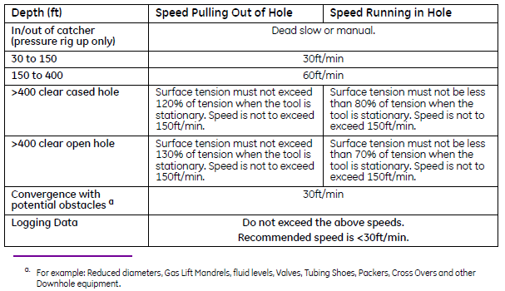
LOGGING SPEED GUIDANCE
**Note: This guidelines is for near vertical wells and must be adjusted when in deviated wells. However, refer with both downhole and surface condition is needed.

Slide 9
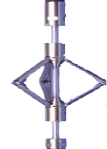


TOOLSTRING CONFIGURATIONS
PLT/NTO BHA
1-11/16” CHD
1-11/16” WB
2-1/8” ART-H
1-11/16” WB
PGR
XTU
CCL
QPS
PRC
FDR
CWH
ILS
PKJ
NTO
PRC
PRT
CFS

Slide 10
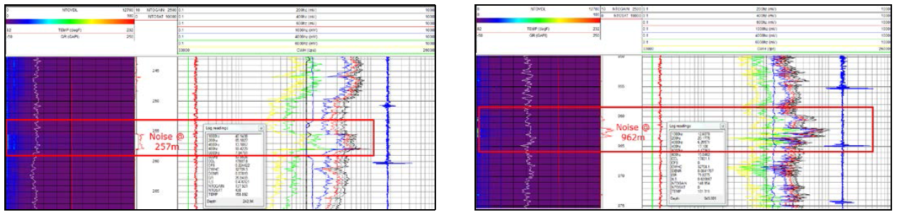
NTO – Case Study
Case Study 1: Identifying Leak Behind Dual Concentric Pipe Using Noise Tool
PROBLEM STATEMENT
Pressure in B Annulus of Well A encounter significant pressure increment.
As safety measure and prevention from any accident event, the source of leak need to be identified.
FIELD EXPERIENCE
Noise Logging was performed in 2 conditions;
  Shut in tubing & A annulus while bleed B annulus
  Shut in tubing, injecting A annulus while bleed B annulus

Slide 11
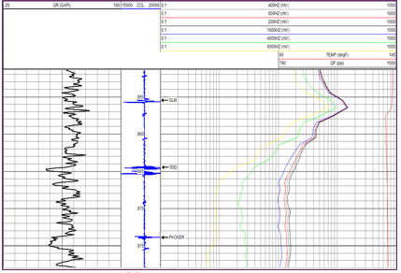
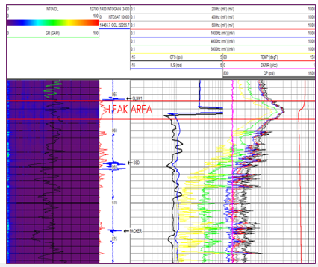
NTO – Case Study
Case Study 2: Leaking Well Problems, How Should You Deal With It?
FIELD EXPERIENCE
Two (2) wells; B and C has been identified.
For both wells, presumption of communication between Tubing and A annulus has been made.
Three conditions survey were introduced to create dynamic environment
  shut in tubing and A annulus for baseline
  shut in tubing, bleed A annulus
  shut in tubing and inject A annulus

Slide 12
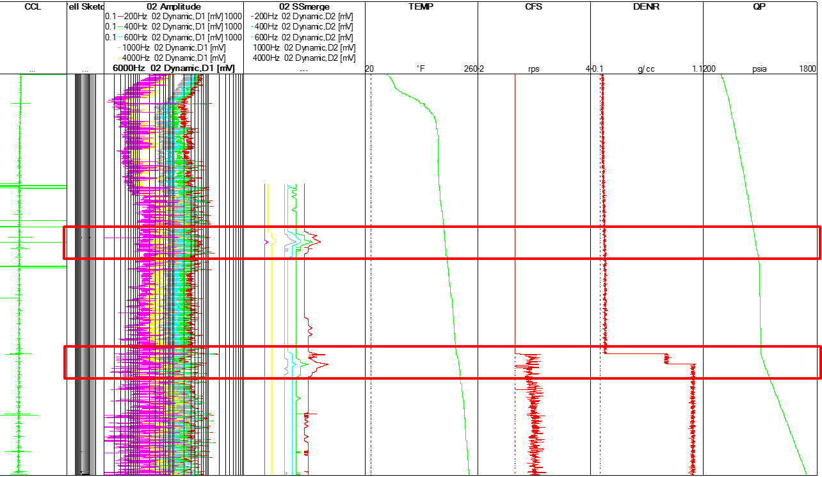
NTO – Case Study
Case Study 3: Bringing back highest oil producer due to gas robbing issue
PROBLEM STATEMENT
Well D having gas robbing issue since middle of 2015.
The gas lift rate for this well was suddenly increased until well test results showing well is underperformed.
Saw gas lift header pressure of 90% gas lift wells drop thus conclude there is communication (tubing leak) at this well.
RESULTS

Slide 13
Q & A
THANK YOU

