Slide 1
Coiled Tubing Services – Downhole Tools
Prepared by : ZAINUDDIN YAACOB
Department : Coiled Tubing Services

Slide 2
OBJECTIVE
To introduce the coiled tubing downhole tools of Dimension Bid CTS
SECTIONS
CT Connectors
Motorhead Assembly
Double Flapper Check Valve
Straight Bar
Nozzle
Rotary Wash Tool
X-Over
Flo-Release GS Pulling Tool

Slide 3
CT CONNECTORS
Application: Connect coiled tubing to the BHA
5 types of CT connectors available:
  Roll On
  External Dimple
  Internal Dimple
  Grapple
  External Slip
Type of CT connector used depend on operation

Slide 4
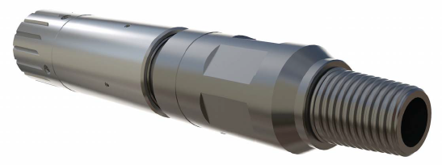
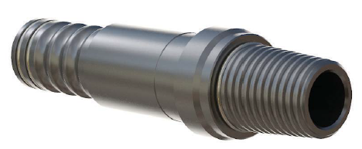
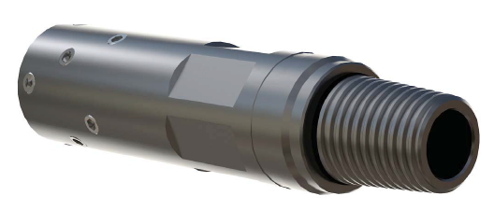
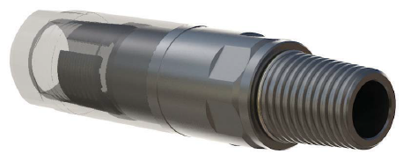
CT CONNECTORS
Roll On Connector
Grapple Connector
External Dimple Connector
External Slip Connector

Slide 5
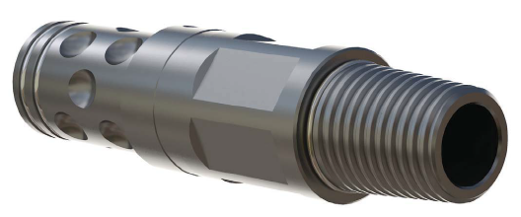
CT CONNECTORS
Internal Dimple Connector

Slide 6
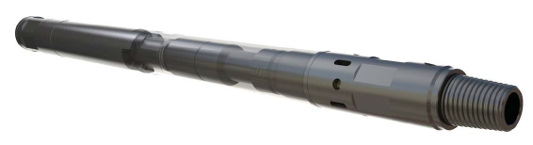
MOTORHEAD ASSEMBLY
Application:
  Use directly below CT connector
  Provide a barrier from well pressure
  Release mechanism for contingency
  Dual circulating function
3 sizes available:
  1-11/16” OD – 10,000 psi
  2” OD – 5,000 psi
  2-1/8” OD – 10,000 psi

Slide 7
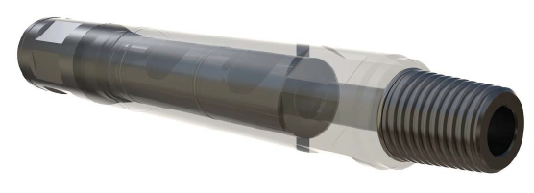
DOUBLE FLAPPER CHECK VALVE
Application:
  Provide a barrier from well pressure
3 sizes available:
  1-11/16” OD – 10,000 psi
  2” OD – 5,000 psi
  2-1/8” OD – 10,000 psi

Slide 8
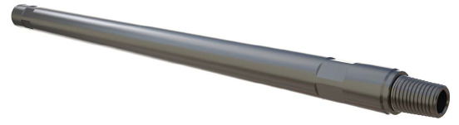
STRAIGHT BAR
Application:
  Extend the length or increase the weight of CT BHA
3 sizes available:
  1-11/16” OD – 3 ft and 5 ft
  2-1/8” OD – 3 ft and 5 ft

Slide 9
NOZZLE
Application:
  Well stimulation and cleanout – nitrogen / fluid pumping, cementing & displacement
Different type of jetting patterns depending on types of nozzles
Types of jetting pattern:
  Multi-Jet Wash – Jetting pattern and port size can be configure in the field
  45° Up Jet
  45° Down Jet
  Cementing/Displacement – Single Bore
Size available: 1-11/16” & 2-1/8”

Slide 10
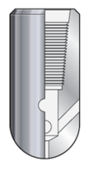

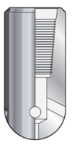

NOZZLE
Multi-Jet Wash
45° Up Jet
45° Down Jet
Single Bore Nozzle

Slide 11
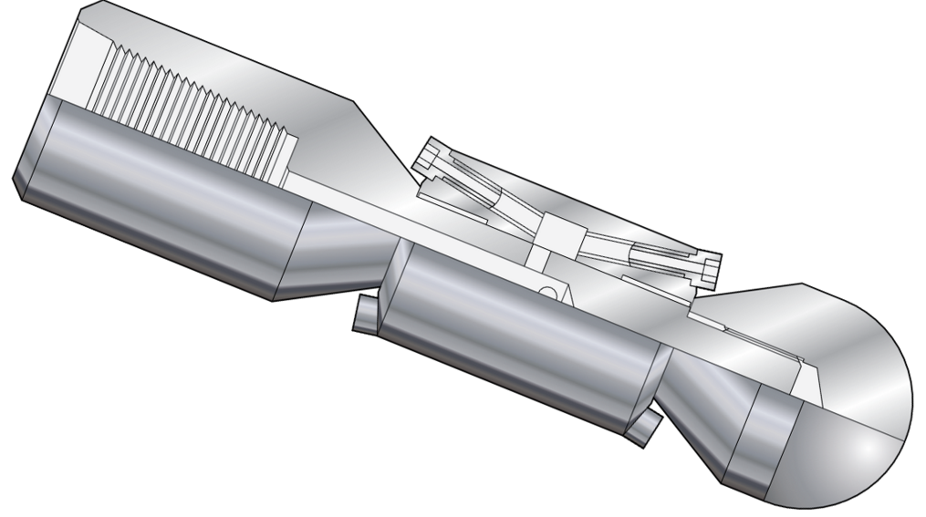
ROTARY WASH TOOL
Application:
  Forward and reverse jetting
  Numerous jetting option
  Simple design
Size available: 1-11/16” & 2-1/8”

Slide 12
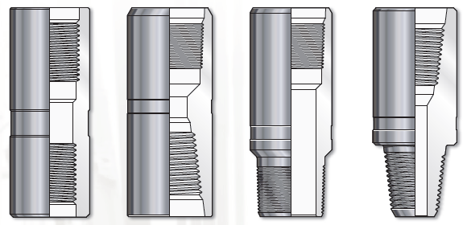
X-OVER
Application:
  Connect 2 different tools with different connection
Type available: Pin x Pin, Box x Box, Pin x Box, Box x Pin
Size available: 1-11/16” & 2-1/8”

Slide 13
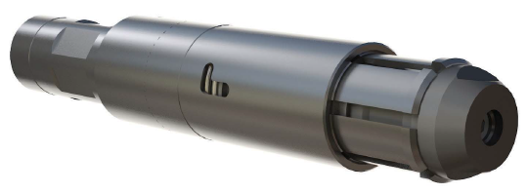
FLO-RELEASE GS PULLING TOOL
Application:
  Setting and retrieval of items with internal ‘Otis’ profile
2 sizes available:
  1-11/16”
  2-1/8”

