Slide 1
DULANG B-3 LS
CT SAND/SCALE CLEANOUT
OPERATION ON PAPER
PRESENTATION TO TP SHAHRIL - KL

Slide 2
TABLE OF CONTENT
1. Introduction & Well Overview
    Objective & Well Background
    Operation Summary
    Well Schematic
    Completion Volume
    Tubing Force Analysis
2. Job Execution
    CT Run#1: Sand cleanout using 1.69” spincat nozzle until cement retainer
    Cleanout analysis – CIRCA
    Tubing force analysis – sensitivity analysis

Slide 3
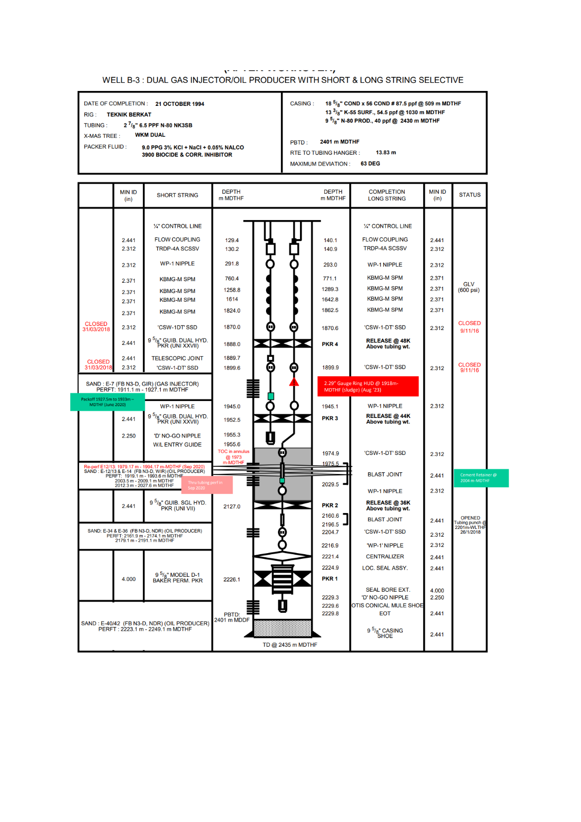
Well Schematic B-03L
OBJECTIVE AND WELL OVERVIEW
Input Parameter | Parameter Value
Field | Dulang Bravo
Max. Deviation (degrees) | 63 degree
Min. Restriction (inch) | 2.25” @ No Go nipple
Type of Fluid & Density | 9.2 ppg (based on data in Well Diagram)
Top of Fluid | N/A
Current Well Status | Idle since 2020
Reservoir Pressure | E12/13 (915 psi)
Fracture Gradient | 0.6 – 0.7 psi/ft
H2S Content | Never test for this string (B03S ~16 ppm but from different reservoir)
CO2 Content | 60%
Mercury, HG | N/A
Completion volume

Slide 4
OBJECTIVE AND WELL OVERVIEW
Operation Objective
  To perform CT Sand/Scale cleanout inside tubing from latest slickline HUD (1,918m-MDTHF (Aug 2023)) until top of Cement Retainer (2,004m-MDTHF) in order for PCSB to install sand screen above top of perforation
  Latest slickline HUD at depth 1,918m
  Re-perf zone E12/13, 1,979.17 – 1,994.17m
  Cement retainer at depth 2,004m

Slide 5
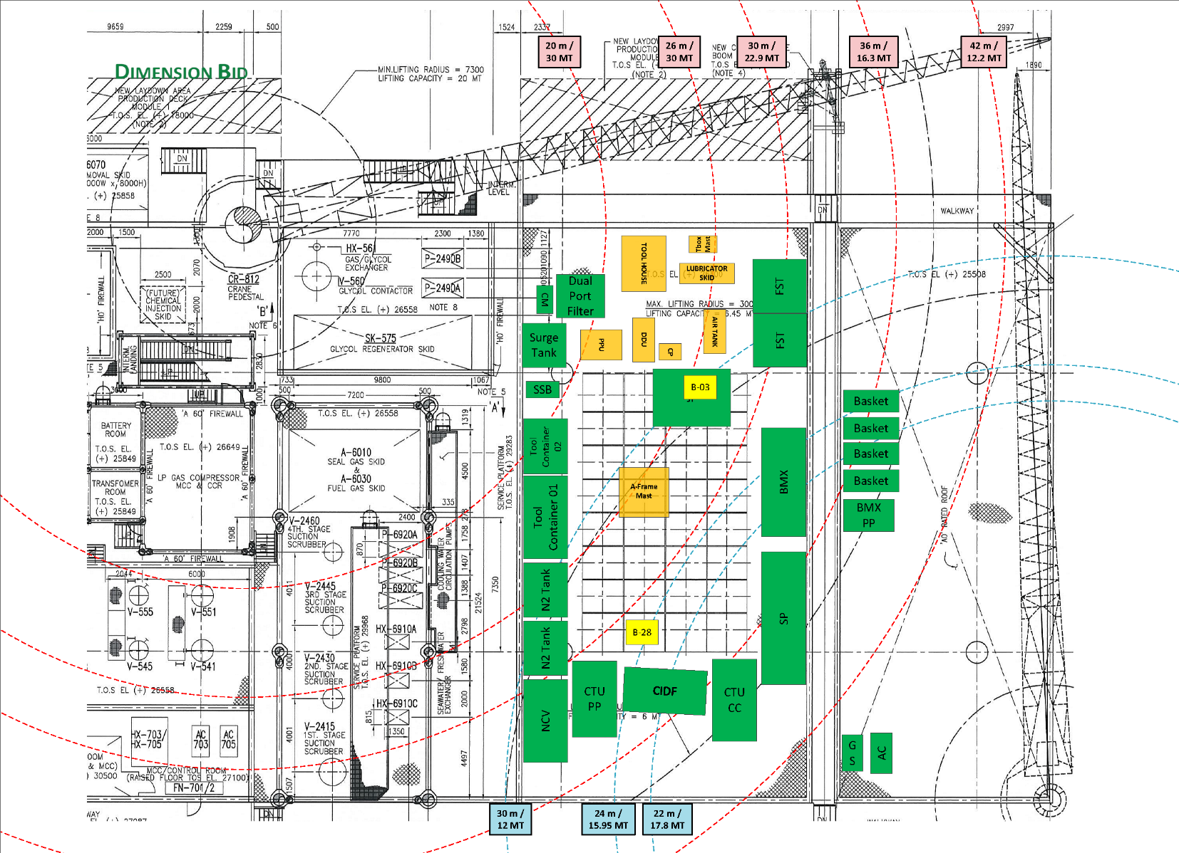
CTU LAYOUT AT DULANG BRAVO

Slide 6
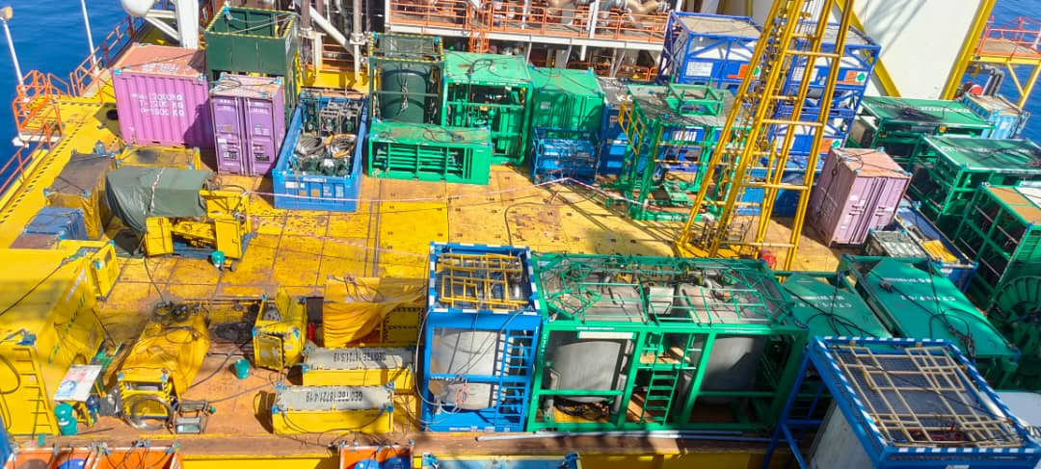
CTU LAYOUT AT DULANG BRAVO

Slide 7
CTU RIG-UP SCHEMATIC

Slide 8
Operation Summary
Item | Job Description | Remark
A | Coiled Tubing Operation | Run#1: Sand clean out using SpinCat nozzle until top of cement retainer 2,004m-MDTHF
B | Slickline | Tubing clearance check until cement retainer

Slide 9
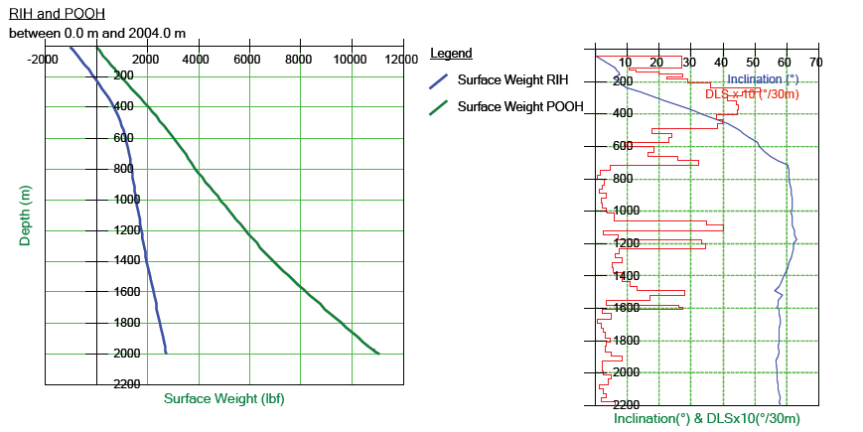
TUBING FORCE ANALYSIS
CT RIH & POOH until top of cement retainer (0.3 bpm 300 scfm)

Slide 10
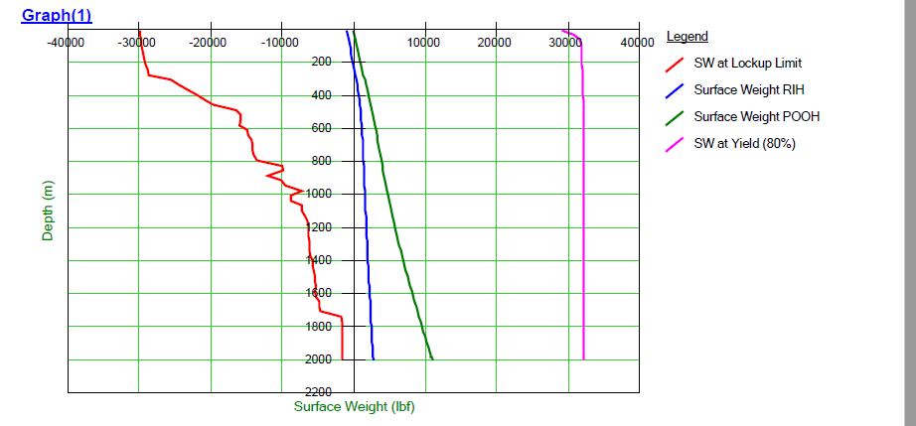
TUBING FORCE ANALYSIS
CT RIH & POOH Until CR

Slide 11
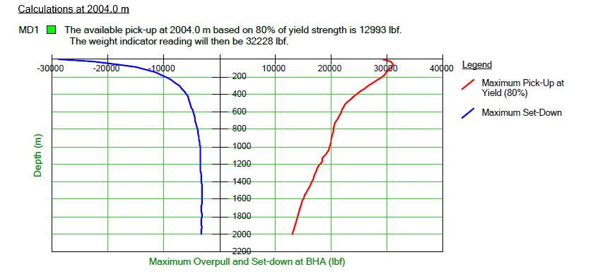
TUBING FORCE ANALYSIS
Maximum Pick-up Limit at CR

Slide 12
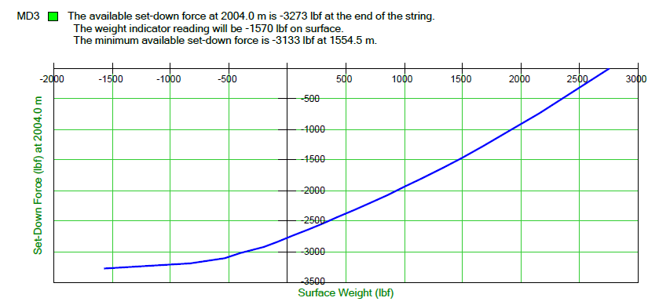
TUBING FORCE ANALYSIS
Maximum Set Down Limit at CR

Slide 13
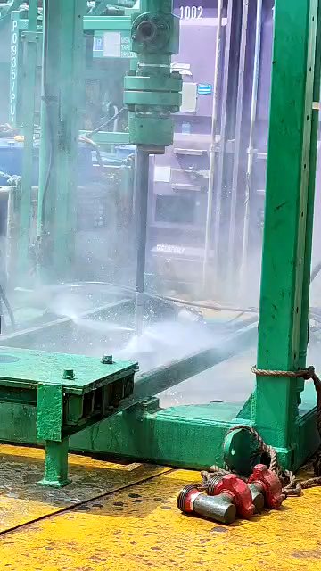
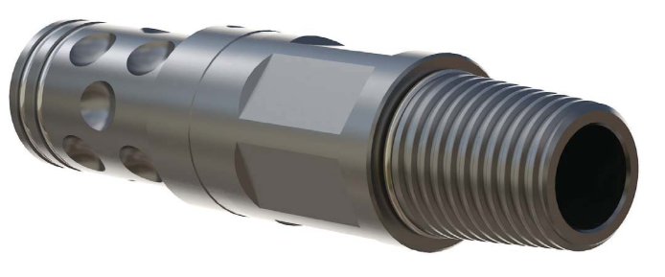
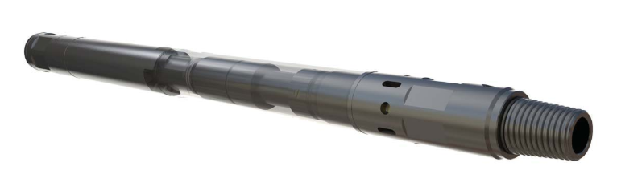
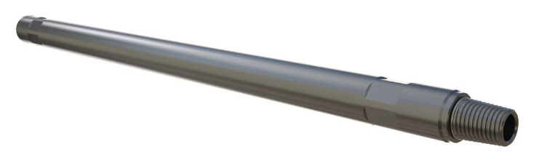

CT RUN#1 – SCO TILL CEMENT RETAINER
CT Run#1 – SCO until top of cement retainer (1-11/16 BHA Configuration)

Slide 14
CT RUN#1 – SCO TILL CEMENT RETAINER
CT Run#1 – SCO until top of Cement retainer
  Rig up Coiled Tubing Equipment, Pumping & Surface Flowback equipment on DLG-B03L
  Make up SpinCAT nozzle BHA ,Pressure test Treating iron and CT Stack up. (1-11/16” BHA configuration)
  RIH CT into production string while pumping idle rate till slickline hard tag depth (or 10m below slickline HUD area), soft tag twice HUD (if no tag, pick-up to slickline HUD area before proceed as per below
  Mix 10 bbls 15% HCl, soak 5 bbls 15% HCl for 2 hours. Upon complete soaking, RIH at last HUD/Slickline HUD and jetting remaining 5 bbls 15% HCl. Once complete jetting, circulate acid out and neutralize at surface.
  Attempt to penetrate 2-3 ft below HUD, if unable to pass through, high jetting with TSW. If able to pass through, pick-up BHA 10m above and establish circulation using circulation rate from CIRCA simulation (0.3 bpm 300 scfm).
  In the event of encounter waxy return at surface, spot 3 drum of waxclean and soak for 2 hour while pick-up at safe depth. (Proceed with this step before soaking 15% HCl).
  Once return establish at surface, perform leak rate test and calculate volume losses to reservoir.
  Proceed penetrate until cement retainer depth at 2,004m, in the event unable to penetrate, repeat step 4.
  Once at CR depth, pick up 4 m and above CR pump 20 bbls of gels follow with 3 hour circulation. After complete CBU, wiper trip at rate 10 ft/m until depth 1,000m.
  Once at surface, handover to slickline for TCC.

Slide 15
CT RUN#1 – SCO TILL CEMENT RETAINER
CT Run#1 – SCO until top of Cement retainer(cont.)
No. | Stage | Fluid | Liquid Rate | Volume Pumped | N2 Rate | CT Speed | Duration | Depth | Remark
 |  |  | BPM | BBL | SCFM | ft/min | Minute | m
1 | CT at 10m above HUD | TIW | 0.3 | - | 300 | 0 | 0 | 10m above HUD | Establish return on surface
2 | Penetrating HUD/Fill | TIW | 0.3 – 1.0 | - | 300 | 5 | 6 | HUD + 10m | Monitor return & coil weight on surface
3 | Circulate | D801 Gel | 0.3 | 5.0 | 300 | 0 | 17 | Stationary CT | Provide suspension to the fill and lift to surface
Pull Test 10m, repeat step until reach top of cement retainer (2,000m / 6,562ft MDTHF)
4 | Circulate | D801 Gel | 0.3 – 1.0 | 20 | 300 | 0 | 25 | Stationary CT at 4m above CR | Provide suspension to the fill and lift to surface
5 | Circulate | TIW | 0.3 | - | 300 | 0 | 120 | Stationary CT at 4m above CR | Bottom up till for 3 hour

Slide 16
SAND CLEANOUT PRACTICE
Previous practice | Current practice (improvise)
After arrived HUD depth, establish circulation, proceed with clean-out with high jetting rate | After arrived HUD depth, Acid soaking to decomposed potential scale build up at tubing wall to prevent any sand accumulate at tubing wall due to scale at tubular side before proceed with clean-out
- | During clean-out, if got abnormality during penetration, stop penetrate and CBU until gel return at surface to evaluate the risk before proceed with penetration,
Once arrived at Target depth, perform CBU and Wiper Trip to surface. | If long interval of cleanout, before arrived at target depth, partially circulate out the sand first by CBU and Wiper trip to less angle depth before continue to penetrate until TD
Higher rate for circulation rate once establish return at surface. | Circulation rate base on CIRCA simulation rate.
  Current SCO practice been implement since last year from Dulang campaign. 100% success rate so far. However, for acid soaking cleanout been implement starting Dulang Delta campaign, Aug 2023

Slide 17
CLEANOUT ANALYSIS

Slide 18
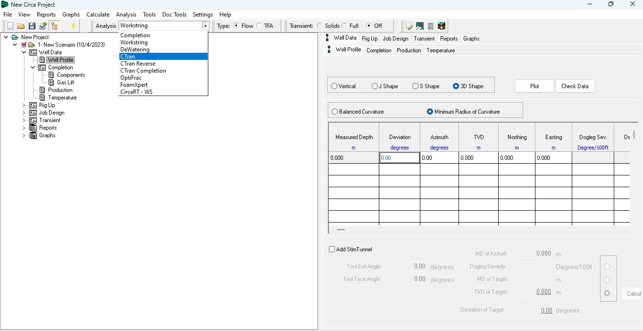
CLEANOUT ANALYSIS
CIRCA Main Page

Slide 19
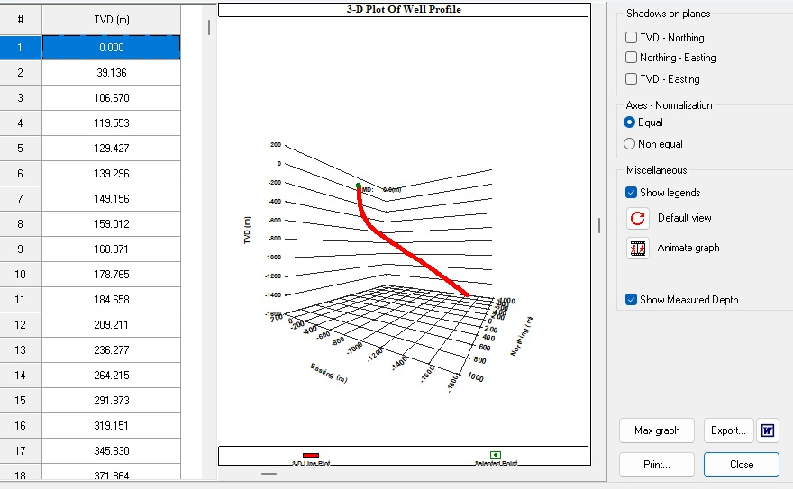
CLEANOUT ANALYSIS
CIRCA Well 3-D Modelling

Slide 20
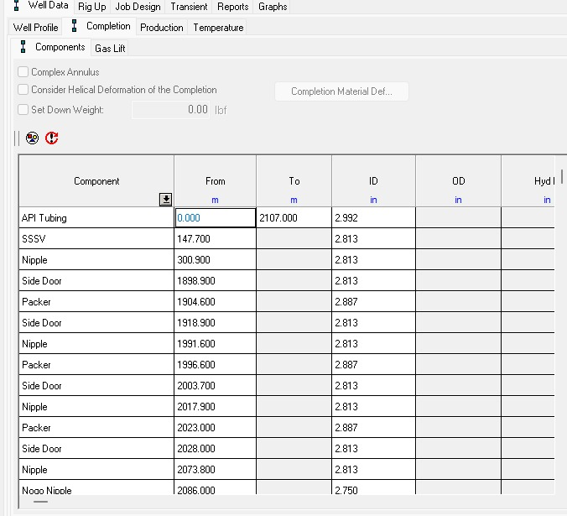
CLEANOUT ANALYSIS
CIRCA Completion Jewelry Input
If gas lift can be online, we can input the depth of Gas lift mandrel & rate in scf.
Input Tubing Type & Interval Depth with Min ID

Slide 21
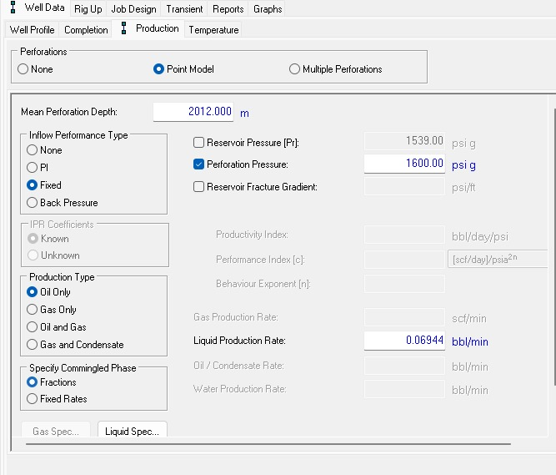
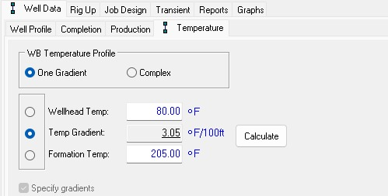
CLEANOUT ANALYSIS
CIRCA Production data input

Slide 22
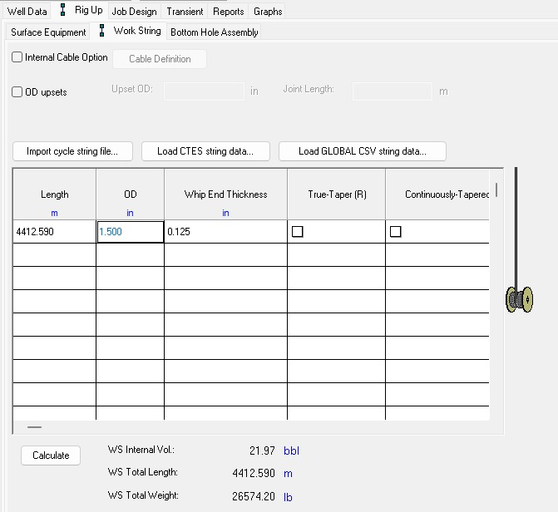
CLEANOUT ANALYSIS
CIRCA Work string input
Input CT String Information;
Length
OD
Thickness
CT Grade
Auto calculated the weight and volume of CT.

Slide 23
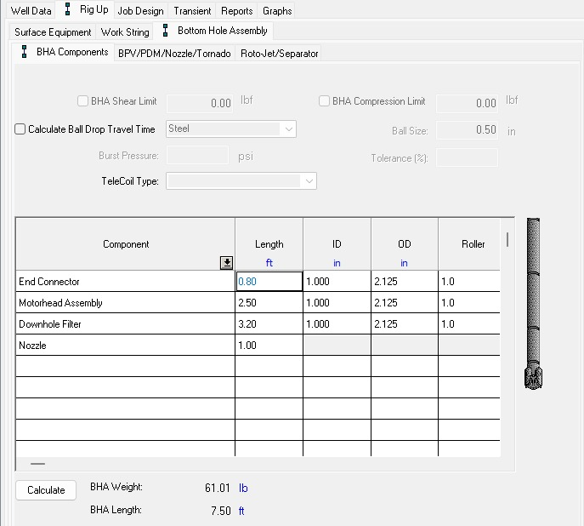
CLEANOUT ANALYSIS
CIRCA Bottomhole assembly input
Nozzle Input;
Number of Port
Orifice Size
Input BHA Component Detail such as.
Length
ID
OD
Auto Calculated BHA weight and length

Slide 24
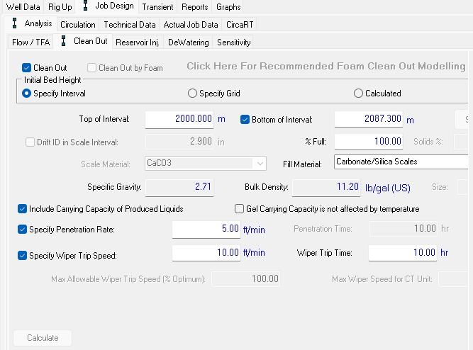
CLEANOUT ANALYSIS
CIRCA downhole fill input
Data such as top of fill until target depth of cleanout is required
Fill Material will be based on sample/information acquired from client.
Penetration Rate
Wiper Rate
Circulation Time
Wiper Time
These will need to be adjust until we can obtain the highest cleanout efficiency.

Slide 25
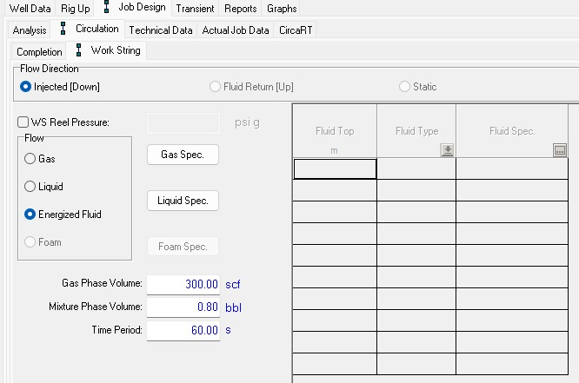
CLEANOUT ANALYSIS
CIRCA circulation input
Click here to change to injected fluid type, ie; water,gel, acid or custom fluid properties
To key in the;
Nitrogen rate in scf (if needed)
Liquid rate in bbl
These will need to be adjust until we can obtain the highest cleanout efficiency.

Slide 26
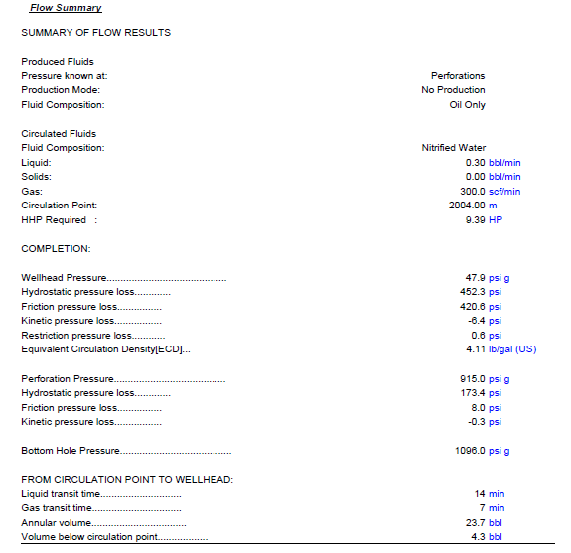
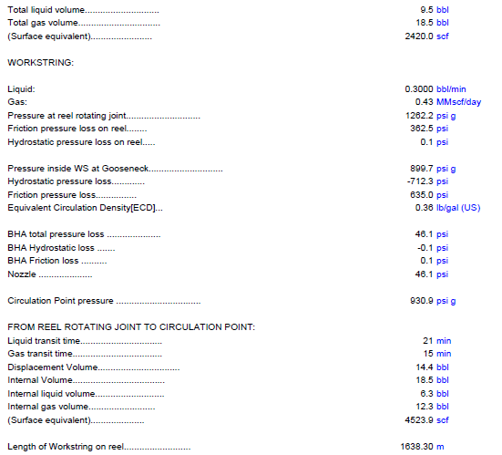
CLEANOUT ANALYSIS

Slide 27
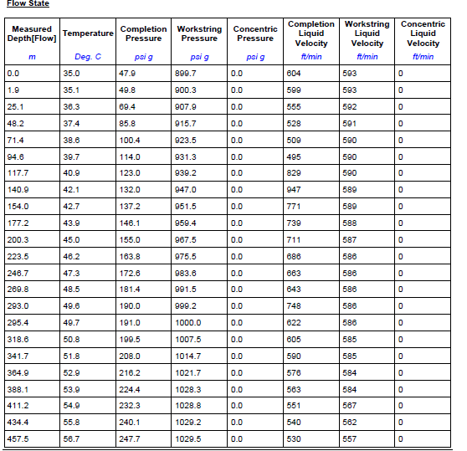
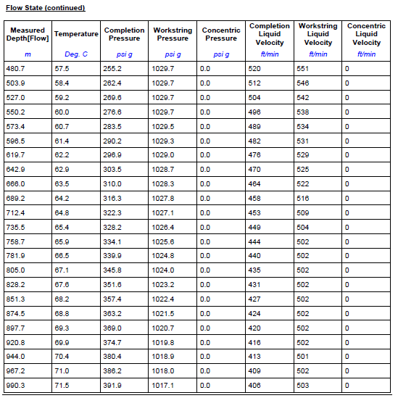
CLEANOUT ANALYSIS

Slide 28
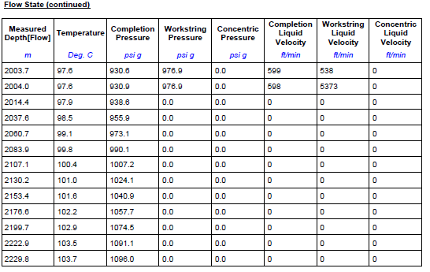
CLEANOUT ANALYSIS

Slide 29
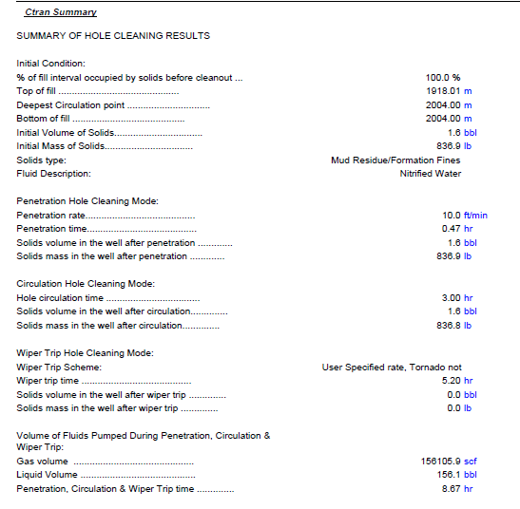
CLEANOUT ANALYSIS
Cleanout is completed with 0% solid left inside well!

Slide 30
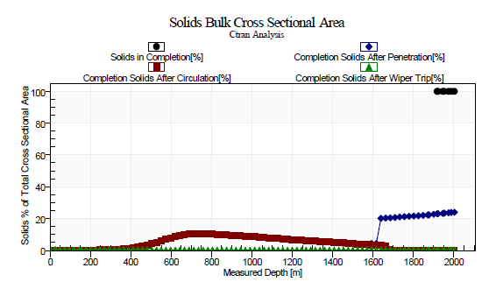
CLEANOUT ANALYSIS

Slide 31
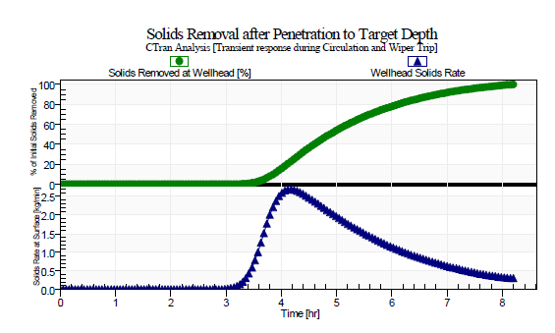
CLEANOUT ANALYSIS

Slide 32
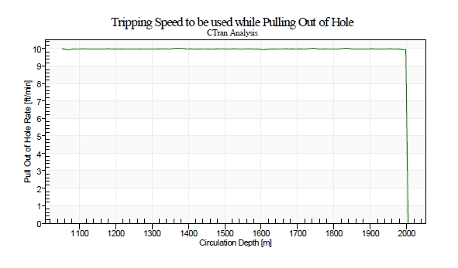
CLEANOUT ANALYSIS

Slide 33
TUBING FORCE SENSITIVITY ANALYSIS

Slide 34
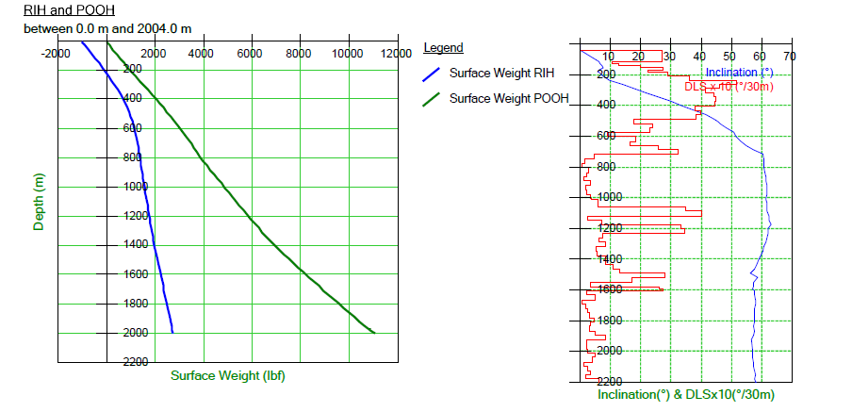
TUBING FORCE ANALYSIS
CT RIH & POOH Until CR
IDLE RATE (0.3 bpm 300 scfm)

Slide 35
TUBING FORCE ANALYSIS
CT RIH & POOH Until CR
Nitrified (1 bpm 300 scf)

Slide 36
TFA SENSITIVITY ANALYSIS.
Friction Factor

Slide 37
TFA SENSITIVITY ANALYSIS.
TFA Sensitivity Analysis with various Friction Factor – 0.3BPM, 300scfm
Friction Factor | Depth (m) | Lock-up Limit (lbf) | RIH Weight (lbf) | POOH Weight (lbf) | Max Pulling Weight at 80% Yield Limit
0.2 | 500 | -23177 | 1056 | 2446 | 32163
 | 1,000 | -11894 | 1881 | 4358 | 32208
 | 1,500 | -8048 | 2668 | 6572 | 32219
 | 2,004 | -6251 | 3559 | 9232 | 32227
0.3 | 500 | -16143 | 973 | 2573 | 32142
 | 1,000 | -8625 | 1570 | 4853 | 32201
 | 1,500 | -5361 | 2115 | 7599 | 32213
 | 2,004 | -1570 | 2753 | 11042 | 32228
0.4 | 500 | -19580 | 892 | 2715 | 32164
 | 1,000 | -5126 | 1246 | 5340 | 32209
 | 1,500 | -2825 | 1560 | 8751 | 32222
 | 2,004 | -2805 | 2022 | 13233 | 32227

Slide 38
TFA SENSITIVITY ANALYSIS.
TFA Sensitivity Analysis with various Friction Factor – 1 BPM, 300scfm
Friction Factor | Depth (m) | Lock-up Limit (lbf) | RIH Weight (lbf) | POOH Weight (lbf) | Max Pulling Weight at 80% Yield Limit
0.2 | 500 | -23393 | 881 | 2267 | 29999
 | 1,000 | -12067 | 1528 | 3976 | 30318
 | 1,500 | -8436 | 2155 | 5934 | 30251
 | 2,004 | -5655 | 2931 | 8356 | 30086
0.3 | 500 | -17524 | 789 | 2371 | 30007
 | 1,000 | -7204 | 1200 | 4443 | 30339
 | 1,500 | -5374 | 1580 | 6838 | 30244
 | 2,004 | -2109 | 2150 | 10054 | 30080
0.4 | 500 | -19941 | 715 | 2532 | 30031
 | 1,000 | -6397 | 851 | 4887 | 30336
 | 1,500 | -4008 | 986 | 7891 | 30237
 | 2,004 | -3984 | 1371 | 12123 | 30088

Slide 39
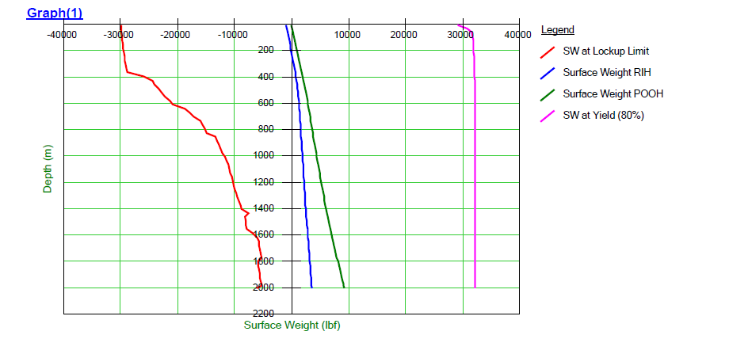
TUBING FORCE ANALYSIS
Friction factor : 0.2

Slide 40
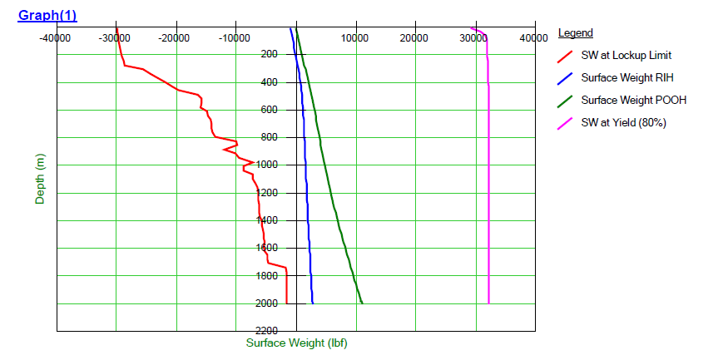
TUBING FORCE ANALYSIS
Friction factor : 0.3

Slide 41
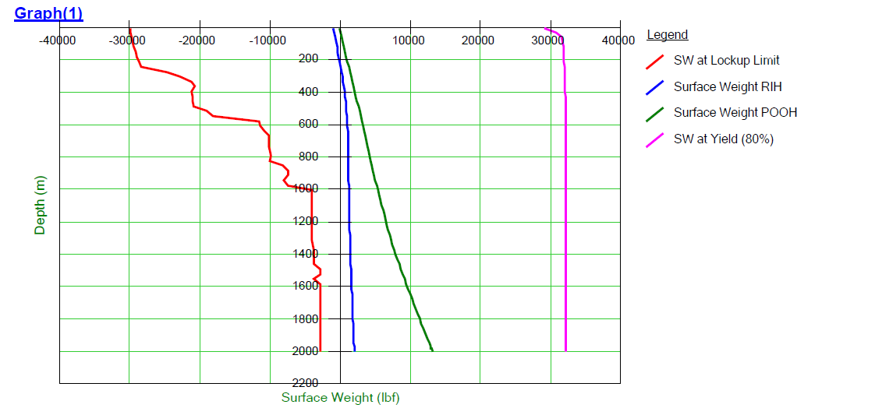
TUBING FORCE ANALYSIS
Friction factor : 0.4

Slide 42
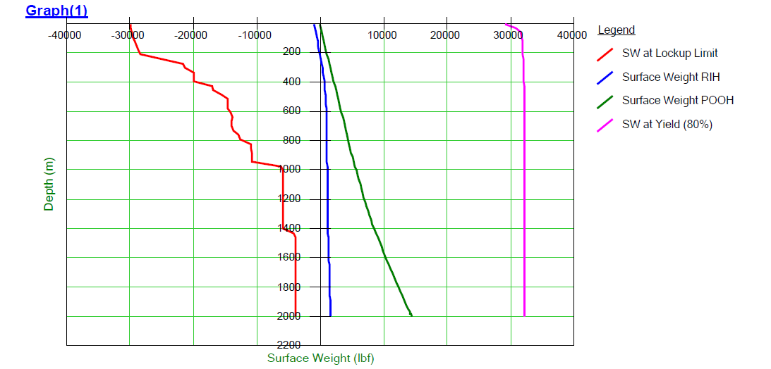
TUBING FORCE ANALYSIS
Friction factor : 0.45

