Slide 1
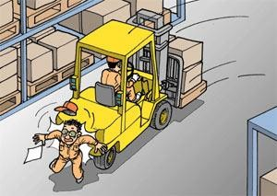

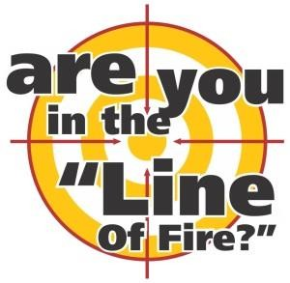
LINE OF FIRE AWARENESS

Slide 2
WHAT IS “LINE OF FIRE”?
Line of Fire, which was originally a military term, is now commonly used in industrial safety.
  Situations where workers put themselves in harm's way by virtue of the type of work they are carrying out.
  Lack of awareness
  Lack of education
Hazards can be hard to recognize and can
  Cause injury
  Incapacitate
  In severe cases, kill the employee or coworkers

Slide 3
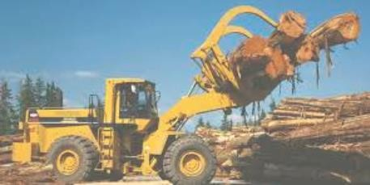

COMMON TARGET AREAS OF CONCERN
Heavy Equipment
Machinery
Manufacturing
Assembly
Hand and Power Tools
Material Handling

Slide 4


Slide 5
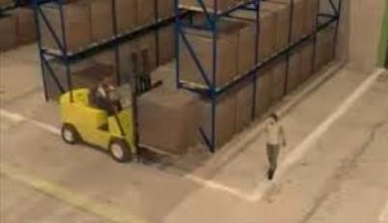
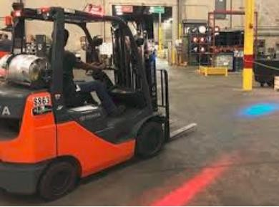
LINE OF FIRE EXAMPLES
Opening and closing energy control devices
Being aware of automated equipment and their potential movement
Pedestrians and moving vehicles
Contact with stationary hazards

Slide 6

BEHAVIORS THAT LEAD TO HAZARDS
Rushing – You are in a hurry to complete a task
Frustration – You are angry, irritated, or annoyed
Fatigue – You are tired
Complacency – You have completed a task many times and have never been hurt before

Slide 7
WHAT TO DO WHEN HAZARDS ARE IDENTIFIED
Use best practices for minimizing hazards
  Organize the work area to provide unobstructed and easy access to equipment.
  Use signs to warn of known line of fire.
  Keep pathways clear.
  Eliminate possible pinch points on guarding.
  Use the correct tool for the job.

Slide 8
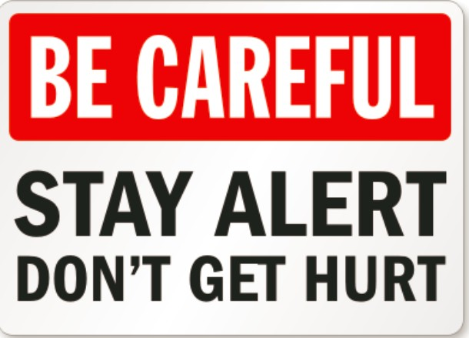
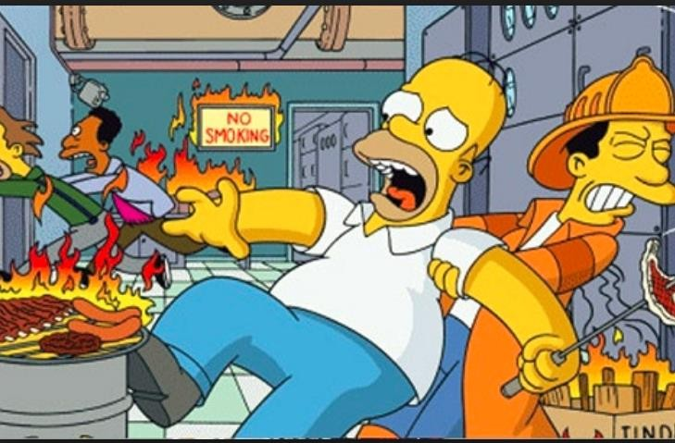
KEEPING YOURSELF SAFE IN THE LINE OF FIRE
Be aware of the hazards around you
Understand the machines and operations in your work area
Take time to think about the consequences that could result from what you are about to do

Slide 9
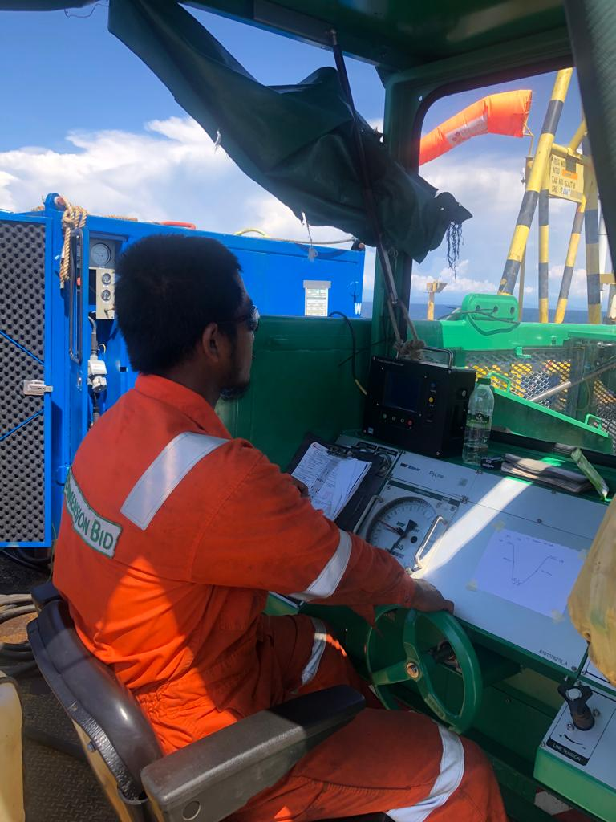
💪
ANY QUESTIONS?
THANK YOU ENJOY AND WORK SAFE! 💪💪💪

