Slide 1
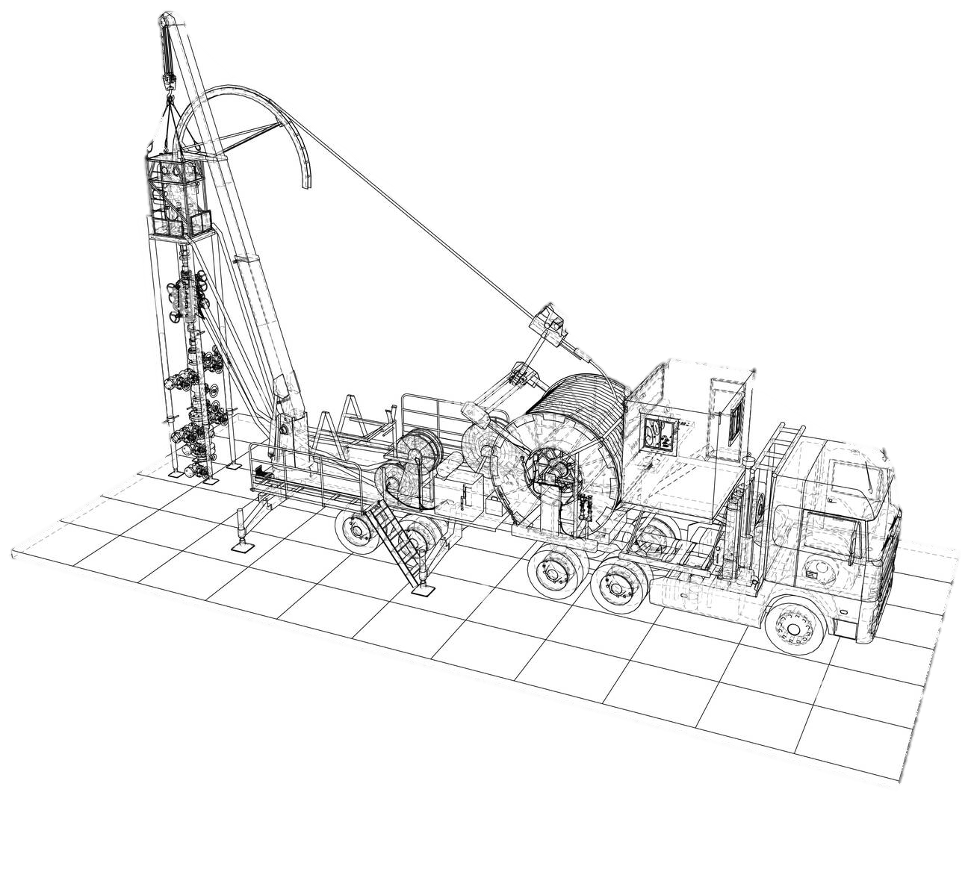
Emergency Relief Valves(Pop off valve)
Prepared by: MOHD BURHAN BIN YUSOF
Department: Coiled Tubing Services
Notes:
Assalamualaikum and good morning, everyone. We are Junior Field Engineer from Dimension Bid. My name is Nur Izzah and here is my teammates, Haziq, Farhanah and Shahir. As you all know, the purpose of this presentation is to provide a brief overview of Coiled Tubing Services. If you have any questions during my presentation, you may interrupt or list your questions to ask during the Q&A session at the end.
For this presentation, we have 3 objectives, firstly to

Slide 2
Table of Content
01
Information/Function
02
Pop off valve assembly
03
Operation
04
Troubleshoot

Slide 3
Objectives
01
Understand function of Pop off valve
02
Identify component of Pop off valve
03
Know how to troubleshoot/repair

Slide 4
Information/Function
01

Slide 5
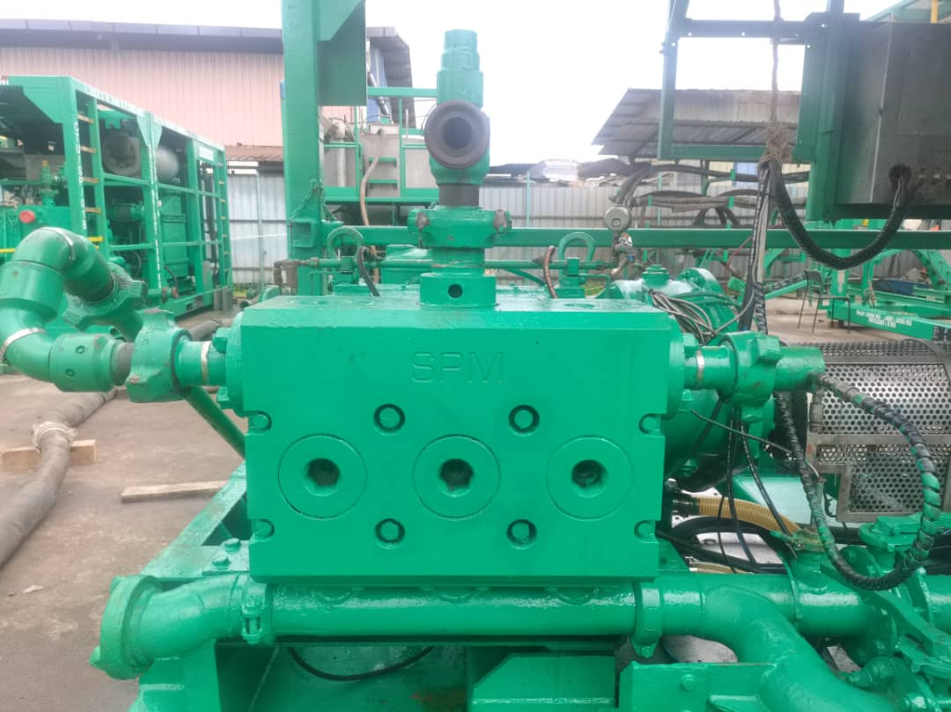
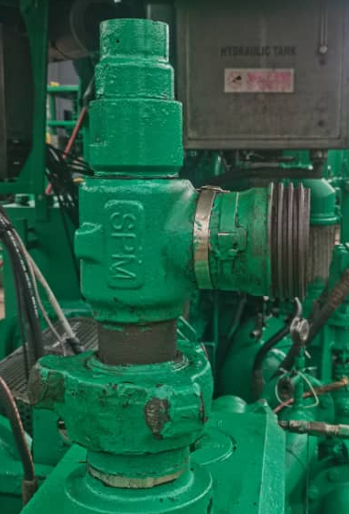
Emergency relief valve(pop off valve)provides overpressure protection for pumps unit, treating lines, pressure vessels, and other equipment operating under high pressure.
The operation of the SPM® back pressure relief valve is a simple balance between the spring loaded keeper which holds the ball in the seat and the inlet liquid pressure acting on the ball.

Slide 6
Information/Function
Size | Connection Type | Outlet/Branch Configuration | Temperature | Service Type
2" | Hammer Union | 2" LPTL F Outlet | Low Temp | Standard
2" | Hammer Union | 2" 1502F Outlet | Low Temp | Standard
2" | Hammer Union | 2" 2002F Outlet | Low Temp | Standard
2" | Hammer Union | 2" 1502F Outlet | Low Temp | H2S
Inlet | Low Pressure Discharge | Pressure Range | Int. End NSCWP | Service | Temp. Range
2" - 1502M | 2" LPTL | 0 - 15000 | 15000 | Standard | -30°C - 110°C
2" - 1502M | 2" - 1502F | 0 - 15000 | 15000 | Standard | -30°C - 110°C
2" - 2002M | 2" - 2002F | 0 - 20000 | 20000 | Standard | -30°C - 110°C
2" - 1502M | 2" - 1502F | 0 - 10000 | 10000 | H2S (Sour) | -30°C - 176°C
2" - 2202M | 2" - 2202F | 0 - 15000 | 15000 | H2S (Sour) | -30°C - 176°C

Slide 7
Pop Off Valve assembly
02

Slide 8
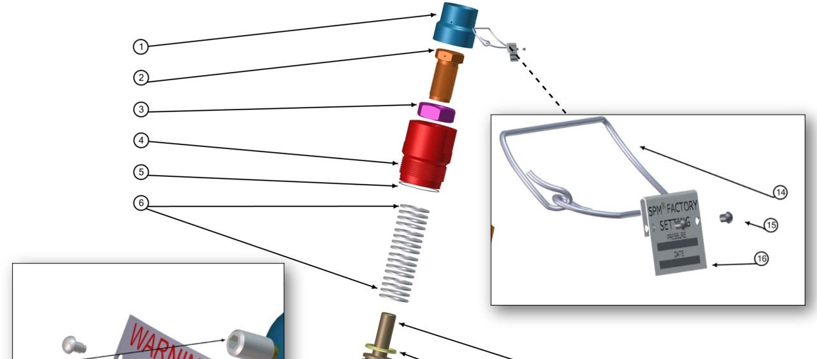
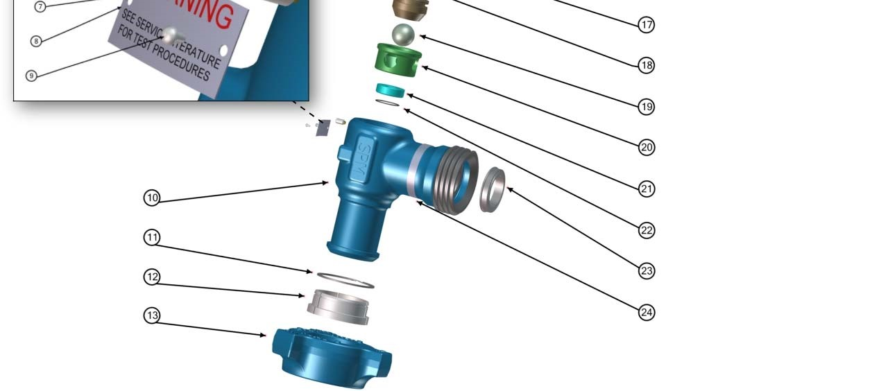
Pop off valve assembly
FACT SEAL INST/RELIEF VA/2-3FF OPTION
ADJUST SCRW/ADJ/2 RLF VA/LO-TMP
1 1/2-12UNF HEX NUT, JAM (LOCK NUT)
CAP/2 RELIEF VA
SEAL/OR26327506
SPRNG/DISK/RLF VA/STL
CAP/FACT SEAL/RELIEF VA/2
RIVET/POP/.13 DIA X .13 LG ALUMINUM
NAMEPLT/FACT SEAL
SCRW/SHSS/ .31-18NC X .50/BRASS TIP
RELIEF/EMERG/KEEPER/2
ERV/WARNING LABEL
SCRW/DRV/4 X 3/16/TYPE U
1-3/4 x 2-1/8 x .187 SEAL
BALL/1.38/COBOLT
SPIDER/2 RLF VA/LO-TMP
BDY/RELIEF VA/2-1502MXF
SEAT/2 RLF VA/.750 BORE/COBOLT
RET RNG/2-1502
SEAL/OR2-028/ANTI-EXT
RET SEG/2-1502
SEAL RNG/UNION/2
WING NUT/2-1502
DATA BAND

Slide 9
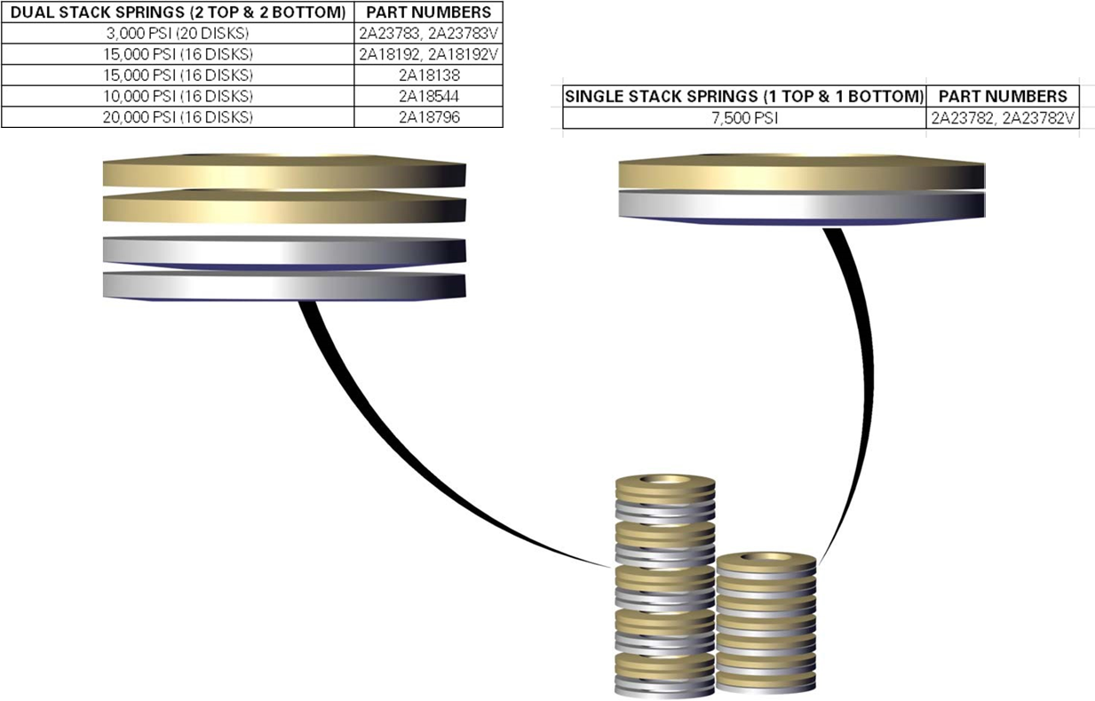
Spring/Disk

Slide 10
Operation
03

Slide 11
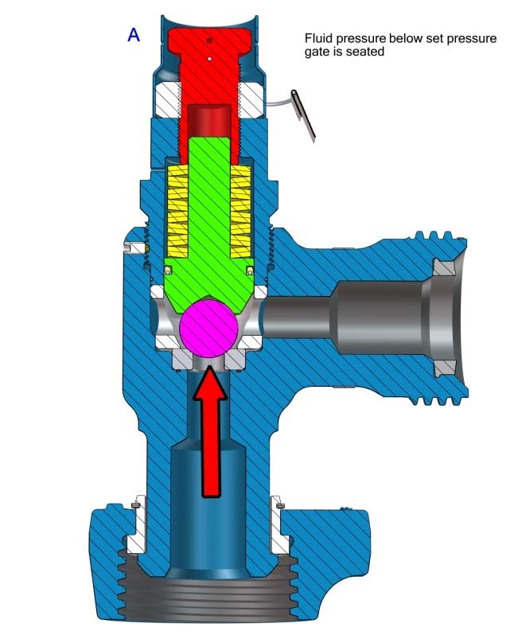
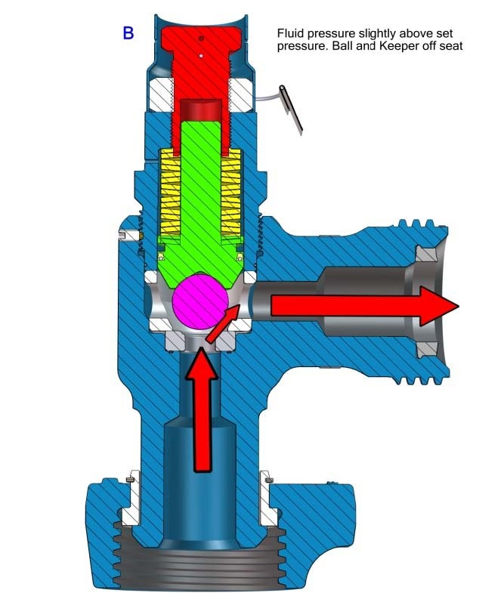
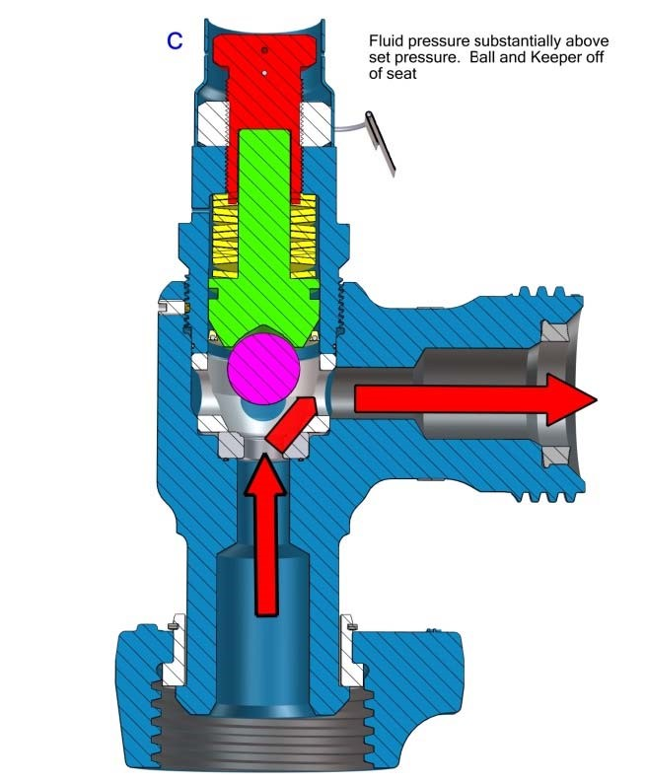
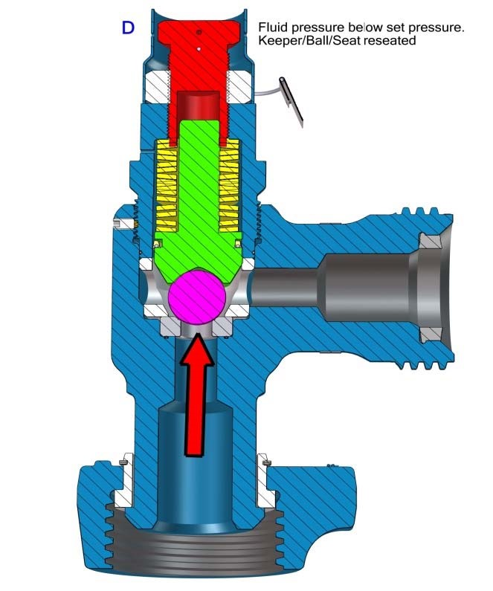
Operation
-The spring pressure is set by tightening the hex bolt on top which pushes on the keeper
-When the inlet fluid pressure rises and overcomes the set spring pressure, the ball is lifted off its seat thereby discharging fluid to the outlet end
-Once the pressure of the inlet fluid falls below the set spring pressure, the ball will be pushed back on to its seat and the fluid can pass downstream.

Slide 12
Troubleshoot
04

Slide 13
Troubleshoot
SYMPTOM | PROBLEM | SOLUTION
Loss of pressure (Valve does not seal | Valve not set properly | Set valve correctly.
Pressure not release when pressure test | Stuck at Ball/Keeper | Service the valve
Valve leaks through valve body and cap | Damaged inner or outer or both Spider seals | Replace damaged seals

Slide 14
Thank you

