Slide 1
Inspection and Testing of Treating Equipment
By ZALANI B IBRAHIM
G.E.O CTS

Slide 2
Annual Inspection Requirement:-
Visual inspection
Wall thickness test
Union inspection
Identification and banding of the component
Pressure test
Documentation of results

Slide 3
SCOPE OF INSPECTION
Inspection | Equipment used
Visual Inspection | Light
Thread & Wing Half Union Inspection | Size Gauge Kit
Wall Thickness Test | Ultra Sonic Thickness Tester
Swivel Ball Races Inspection | Ball Race Go-No Go Gauge
Pressure Test | Air Operated Test Pump

Slide 4
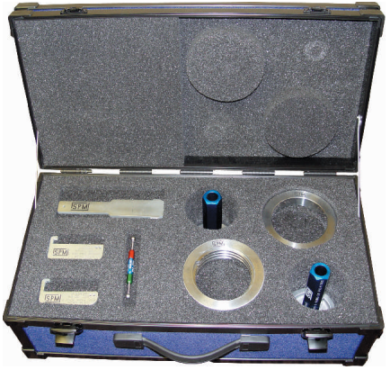

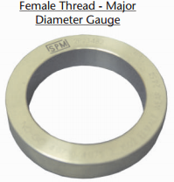
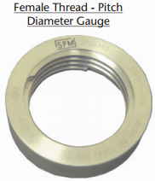
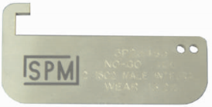

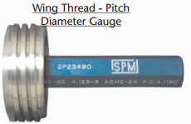
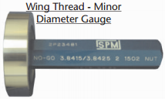
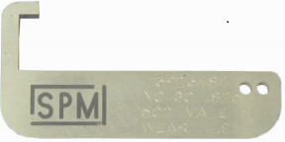

NO-GO GAUGE KITS
Gauges use for qualification of worn hammer union assemblies, swivel ball races, and sub connections.
Inserting the gauge into the components, the part will be determined as acceptable or unacceptable.

Slide 5
1.0 VISUAL INSPECTION
Clean all components
Complete visual inspection
Component(s) with suspected erosion will be subjected to ultrasonic thickness testing
Component(s) with suspected crack will be subjected to Magnetic Particle Inspection (MPI)

Slide 6
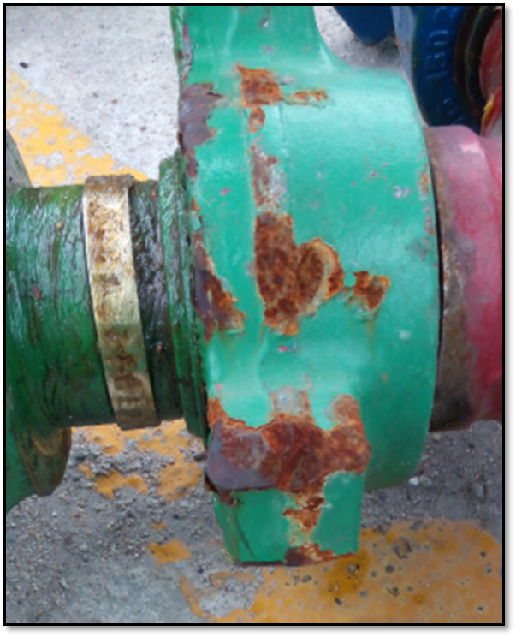
1.1 VISUAL INSPECTION - CHIKSANS
Bore condition for wear or erosion.
Cracks and damage of the 1502 acme thread.
Wing nut lug.
Seal rubber.
Swivel condition (stiffness).
Check the ball race with the Go (Smooth pattern end) gauge and No Go (Knurl pattern end) gauge.
If there is no clearance for both gauges, replace ball race’s section.
Lug

Slide 7
1.2 VISUAL INSPECTION – TEE, LATERAL & CROSSOVER
Bores(intersecting) condition for internal erosion and cracks.
Damage and cracks of the 1502 acme thread.
Wing nut lug.
Seal rubber.

Slide 8
1.3 VISUAL INSPECTION – VALVE
Internal bore condition for erosion.
Damage and cracks of the 1502 acme thread.
Wing nut lug.
Seal rubber.

Slide 9
1.4 VISUAL INSPECTION – CHECK VALVE
Sign of internal erosion.
Flapper or dart valve assembly is complete and free to move.
Flapper sealing rubber is bonded to the flapper.
Damage and cracks of the 1502 acme thread.
Wing nut lug.
Seal rubber.

Slide 10
1.5 VISUAL INSPECTION – TREATING PIPE
Damage and cracks of the 1502 acme thread.
Wing nut lug.
Seal rubber.

Slide 11
2.0 WALL THICKNESS TEST
Wall thickness of the components will be measured through the use of an ultrasonic thickness tester.
Components that cannot be disassembled require complete ultrasonic testing.
Equipment will be removed from service and destroyed when the wall thickness of the component is equal to or lower than the requirements.

Slide 12
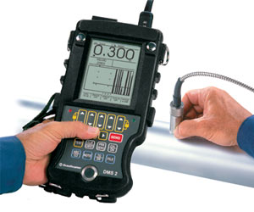
2.0 WALL THICKNESS TEST
Ultrasonic Test Procedure:-
Calibrate the ultrasonic tester.
Clean the target area.
Measure the wall thickness at the desired area.
Compare the results of the tests to the Allowable Wall Thickness for the components.
Component that shows a wall thickness equal to or less than the allowable thickness must be removed from service and destroyed.

Slide 13
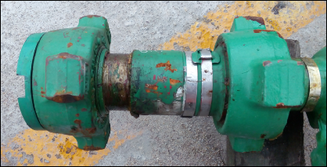
3.0 UNION INSPECTION
The gauge kit is used to check the following items:-
Thread condition and wear on the male wing nut.
Thread condition and wear on the female thread half.
Wear of the wing nut segments.
Wear on the backside of the male hub where the wing nut rests.

Slide 14
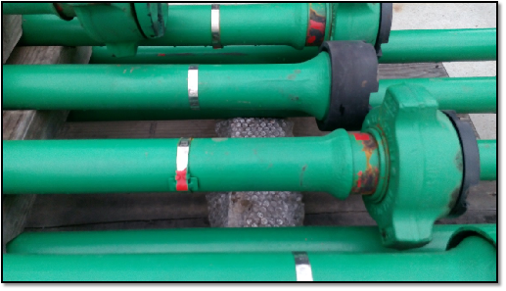
4.0 IDENTIFICATION AND BANDING OF THE EQUIPMENT
Stainless steel banding should contain:-
IDENTIFICATION NUMBER, e.g.: CTU-10-001
TEST DATE (Month/Year) e.g.: 05/24

Slide 15
4.0 IDENTIFICATION AND BANDING OF THE EQUIPMENT
ITEM | ID No
10 Ft Long Joint | CTU-10-001, CTU-10-002, …, CTU-10-XXX
8 Ft Long Joint | CTU-8-001
6 Ft Long Joint | CTU-6-001
4 Ft Pup-Joint | CTU-4-001
2 Ft Pup-Joint | CTU-2-001
1 FT Adapter (W x T) | CTU-WT-001
1 FT Adapter (W x W) | CTU-WW-001
Elbow | CTU-EL-P-001
Flapper Check Valve | CTU-FCV-001
Pop Off Valve | CTU-POV-001
Dart Check Valve | CTU-DCV-001
Choke - Fix (0.25) | CTU-C-0.25-001
Choke - Fix (0.50) | CTU-C-0.50-001
Choke - Adjustable (3/4" Max) | CTU-C-ADJ-001
Lateral - W x T x T | CTU-L-001
Lateral "Y" - W x T x T | CTU-Y-001
Tee - W x W x T | CTU-T-001
Swivel 2 Way | CTU-2W-001
Swivel 3 Way - W x T | CTU-3WT-001
Swivel 3 Way - W x W | CTU-3W-001
Plug Valve (2" x 2") | CTU-2PV-001
Plug Valve (2" x 1") | CTU-1PV-001
Surface Filter (200 micron) | CTU-SF-001
Weco Plug | CTU-WP-001
Weco Plug + 1/2" NPT Female | CTU-WP-NPT-001
Weco Plug + 1/4" NPT Female | CTU-WP-NPT-003
Swivel 2" 15K Non H2S | CTU-REEL-001

Slide 16
5.0 PRESSURE TEST
Pressure test to the maximum working pressure of the treating iron.
Duration: Three (3) minutes unless otherwise specified.
A minimum of every 12 months.
Tested with water.
Tested will be done using Air Operated Test Pump.

Slide 17
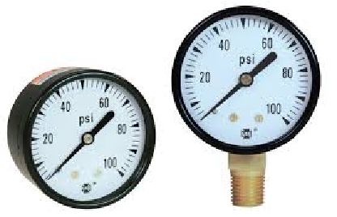
5.0 PRESSURE TEST
  An acceptable pressure test is when the pressure stabilizes at the pressure at which the test is being conducted.
  The equipment (gauges) being used to read the pressure should falls within 25% to 75% of the range of the gauge.

Slide 18
5.0 PRESSURE TEST
Acceptable Requirement for Respective Equipment Rating

Slide 19
5.0 PRESSURE TEST
High-pressure valve will be tested in two conditions:-
  Open position.
  Differential testing of plug valves (closed position).
Check Valves (dart and flapper) utilize two working pressure tests:
  Test against the checking assembly (opposite to the normal direction of flow).
  Test in the direction of flow for body integrity.

Slide 20
6.0 DOCUMENTATION OF RESULTS
The documentation format can be paper or electronic and stored digitally.
The documentation must show:
  Serial number of the individual components inspected
  Inspection date
  Person and company performing inspection
  Visual inspection
  Wall thickness test
  Union inspection
  Pressure test
  Rejection details (if any)

Slide 21
6.0 DOCUMENTATION OF RESULTS
Result of inspection:
  Ready to go: GREEN TAG
  Temporary Out of Service for Further Action: RED TAG
Quarantine area for rejection of treating equipment.
Equipment that passed the inspection must have a stainless steel band installed and the in-service date stamped on the band.

Slide 22
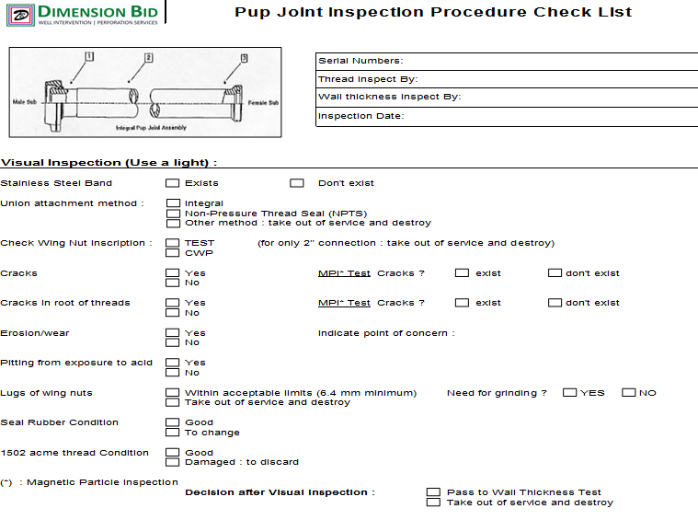
EXAMPLE: INSPECTION CHECK LIST

Slide 23
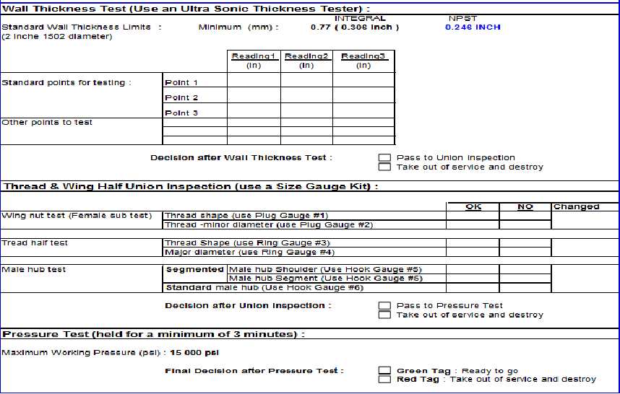
EXAMPLE: INSPECTION CHECK LIST

Slide 24
THANK YOU

