Slide 1
Tubing Force & Cleanout Analysis for HM-1
Dimension Bid

Slide 2
Tubing Force Analysis
Dimension Bid

Slide 3
Well Schematic
Production tubing size: 5.5”(13Cr), 4.5” (13Cr), 3.5” (13Cr)
Min Id: 2.635” – Nipple BXN
Target Depth for SCO 10m below Perforation zone P1a at depth: 2756m

Slide 4
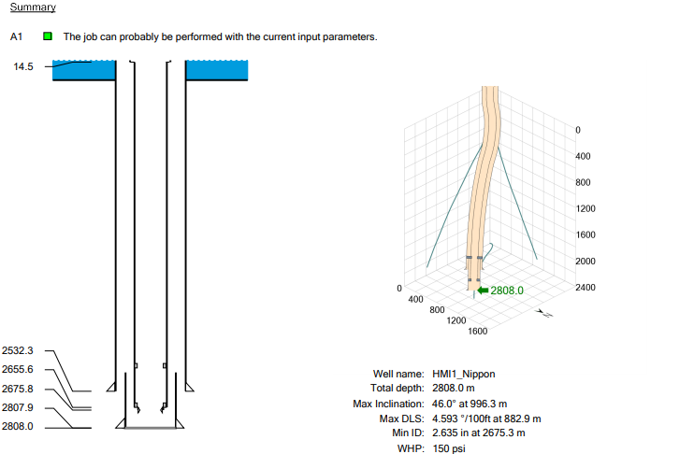
TUBING FORCE ANALYSIS – Well Geometry

Slide 5
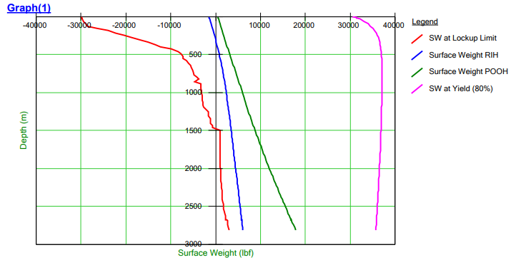
TUBING FORCE ANALYSIS
CT RIH & POOH Until 2808m MDDF
Fluid -1.1BPM, 400scfm

Slide 6
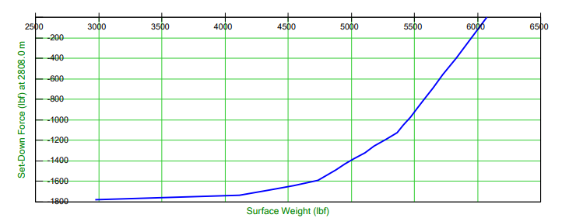
TUBING FORCE ANALYSIS
CT Setdown at 2808m MDDF
Fluid -1.1BPM, 400scfm

Slide 7
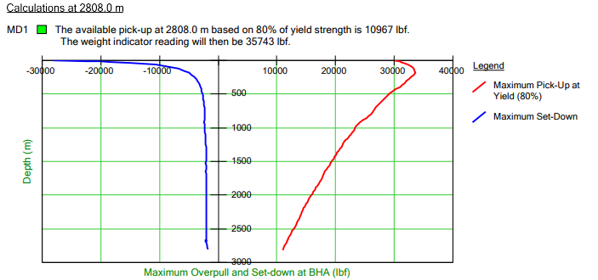
TUBING FORCE ANALYSIS
CT Overpull at 2808m MDDF
Fluid -1.1BPM, 400scfm

Slide 8
Conclusion
Based on the TFA, 1.5” CT able to reach depth until 2808m-MDDF without any issue.

Slide 9
Cleanout Analysis
Dimension Bid

Slide 10
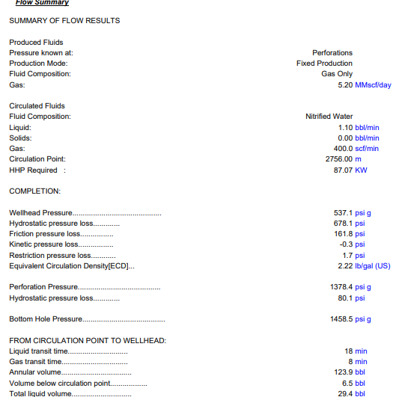
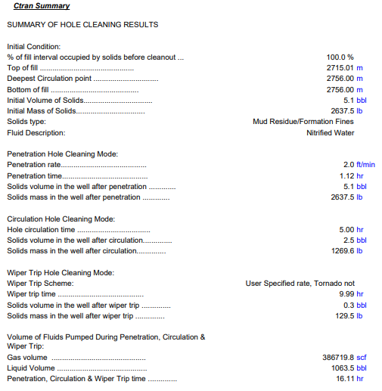
CIRCA SIMULATION - Overall Summary
Rate: 1.1bpm, 400scfm. Fill Type: Formation Fines (density: 12.20lb/gal)

Slide 11
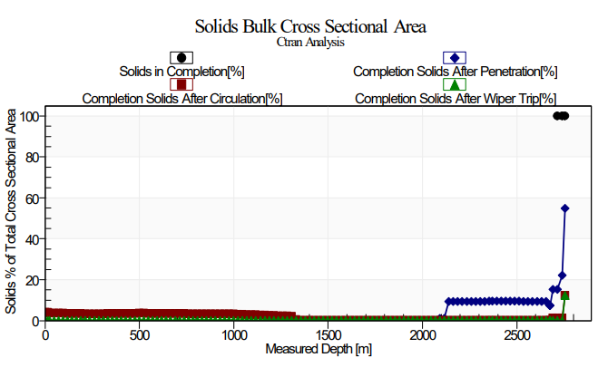
Solid Area %

Slide 12
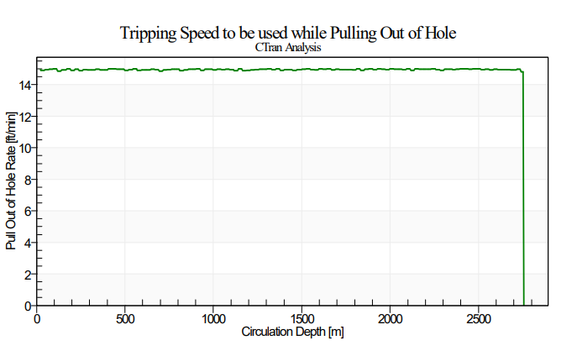
Tripping Speed

Slide 13
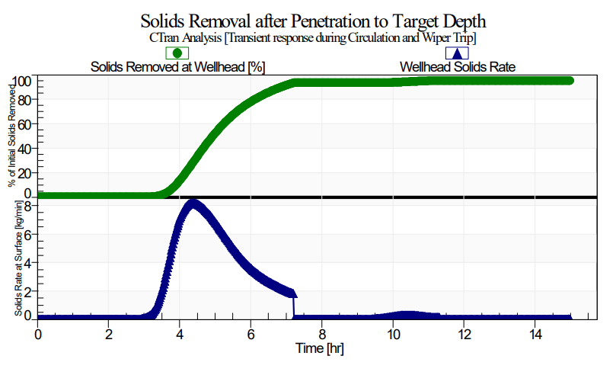
Solid Travel

Slide 14
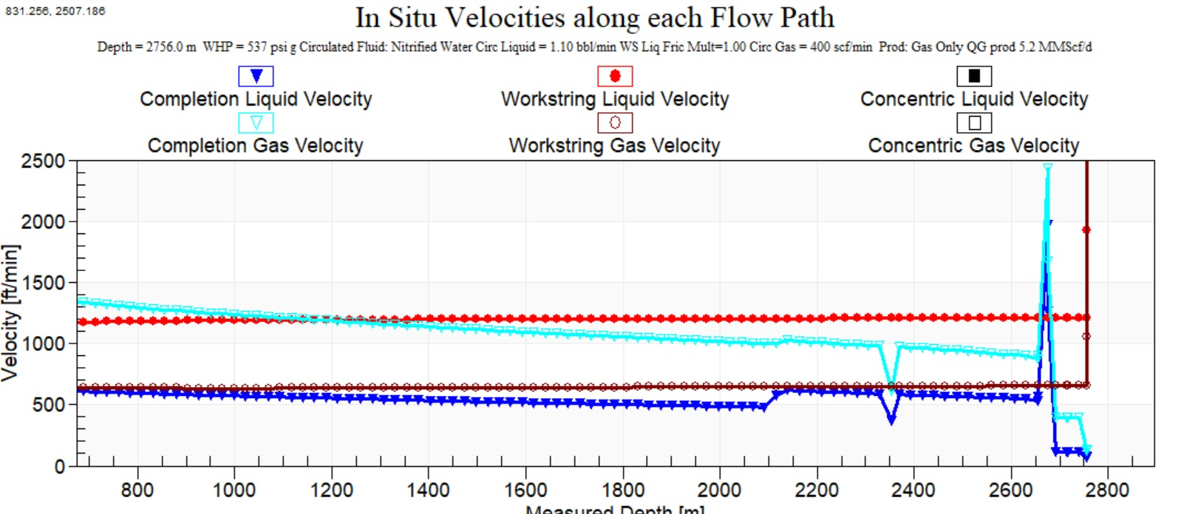
Annular Velocity

Slide 15
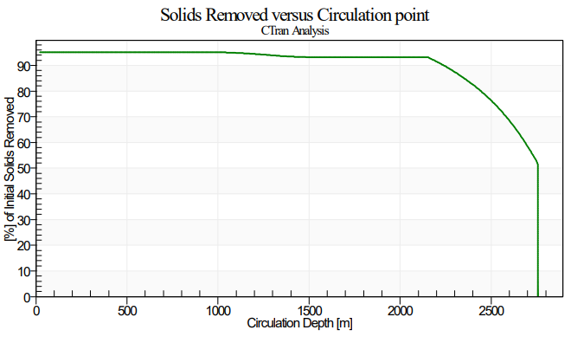
Solid Removed %
Percentage Solid Removed: 95%
Pump Rate, BPM | N2 Rate, scfm | Circulation Depth, m-MDDF | Fill Type | Penetration Rate, ft/min | Wiper Rate, ft/min | Cleanout Percentage, % | Circulation Time, hrs | Remark
1.1 | 400 | 2756 | Formation Fines | 2 | 15 | 95 | 5 | 5% solid left in hole

Slide 16
Conclusion
Based on the cleanout simulation, we are able to perform cleanout using 1.5” CT and obtained percentage cleanout more than 95%.

Slide 17
THANK YOU

