Slide 1
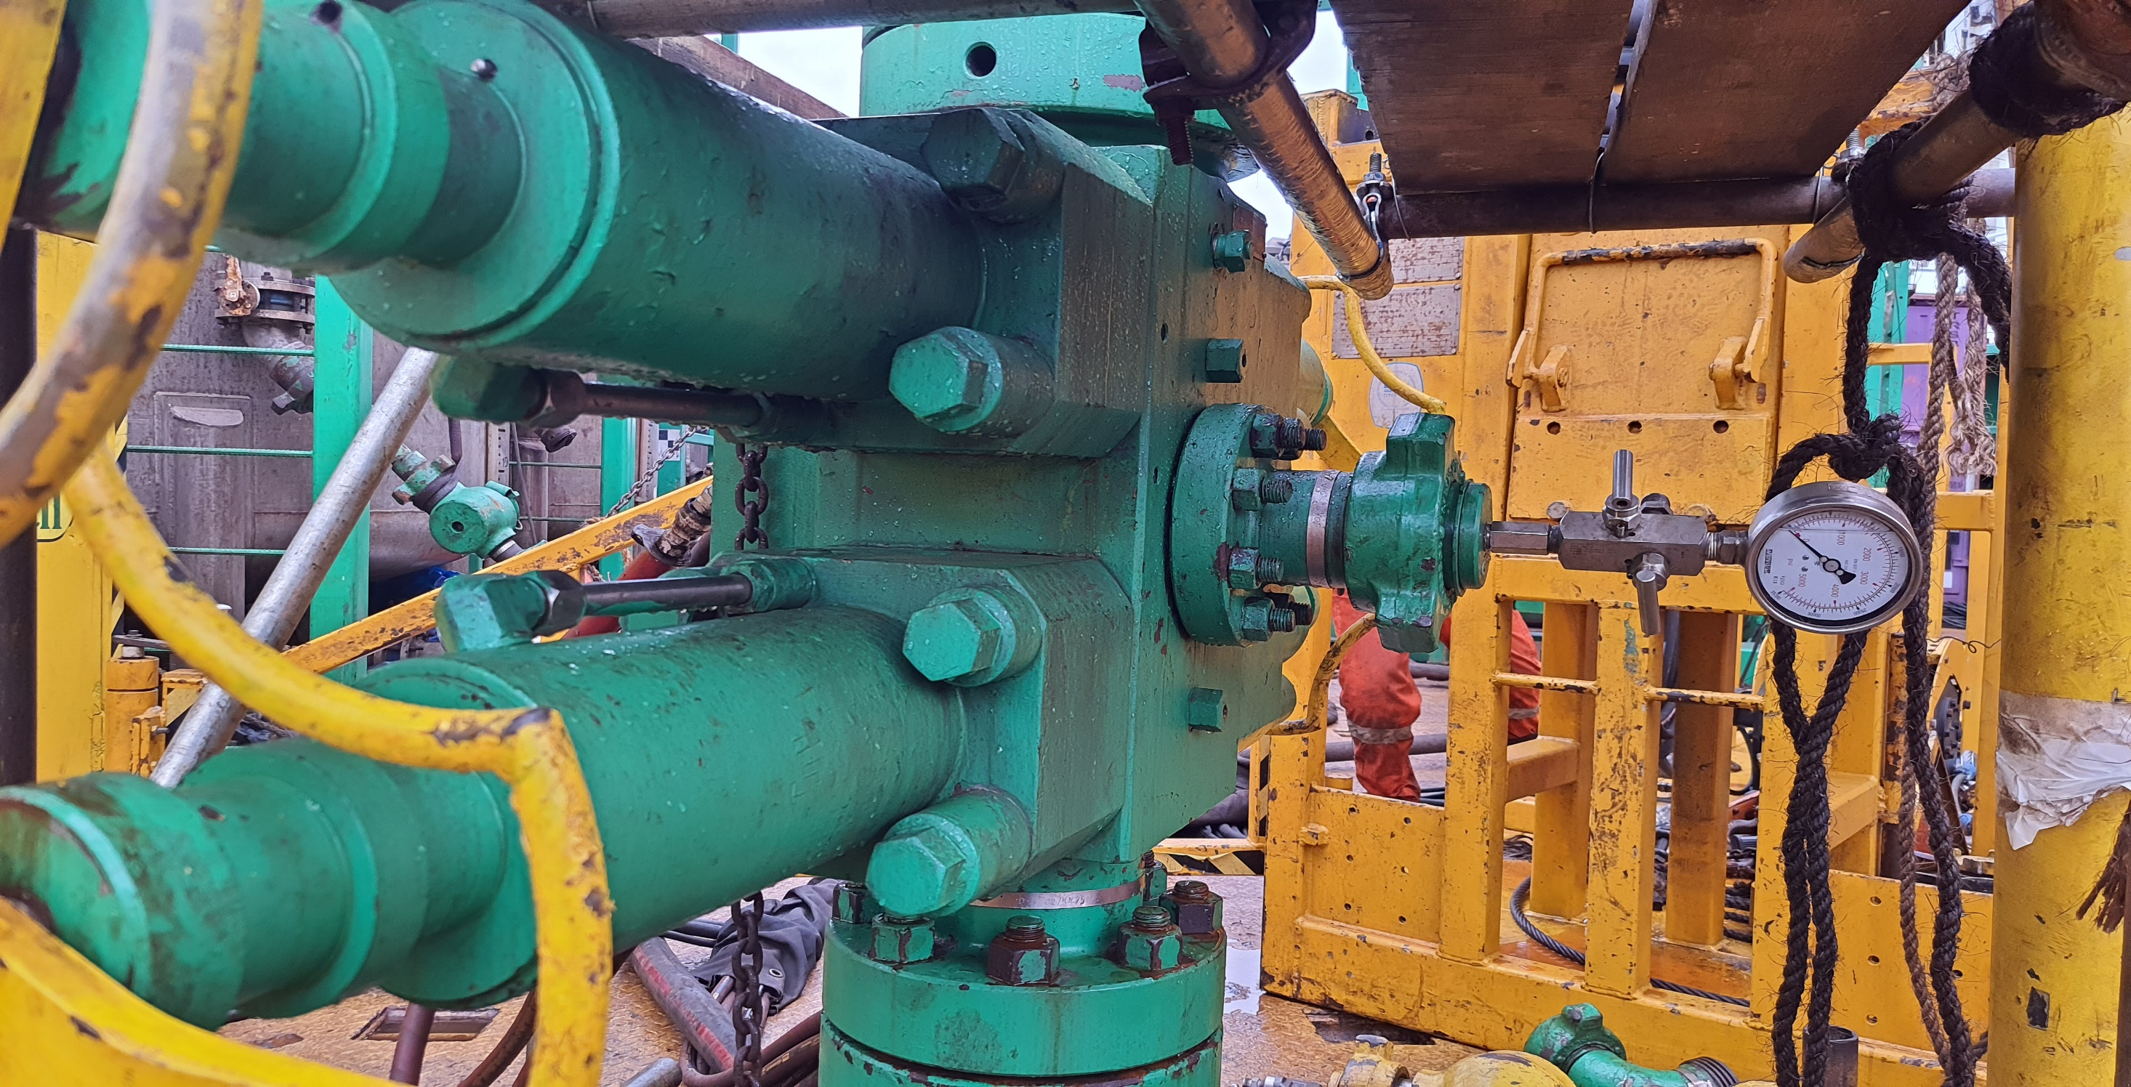
POST JOB PRESENTATION
DULANG B-07S (OIL PRODUCER)
SAND CLEAN OUT USING DEPLOYMENT SYSTEM
Nurul Farhanah Binti Muhammad Khairul Teo
Junior Field Engineer
Dimension Bid Sdn. Bhd.
5th November 2024

Slide 2
PRESENTATION OUTLINE
Introduction
Objectives & well Background
Well Overview
Summary of Intervention Activities
Sand Clean Out Operation
Process of Sand Clean Out
Process of Deployment System
D07S P&ID
Well PCE Stack Up
BHA configuration
Process flow of Deployment System
Job Analysis
Summary and Conclusion

Slide 3
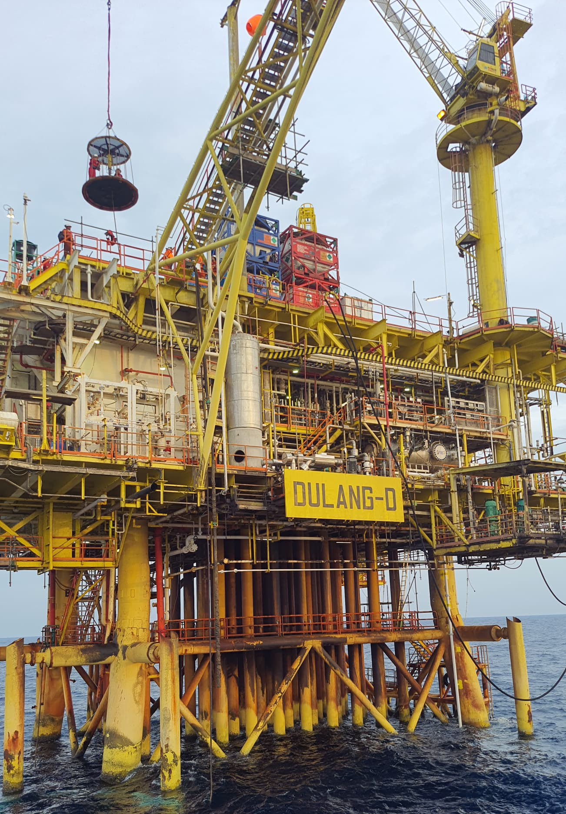
INTRODUCTION
B7S well, located in the Dulang Field with dual string oil producer well in 9 5/8” casing .
It is a larger initiative to enhance energy production and optimize resource extraction. B7S represents the ongoing efforts to efficiently and sustainably extract energy resources in the Dulang Field.
Employed a standalone coiled tubing package, with all required equipment and chemicals positioned on the platform. A standby vessel was available to provide accommodation and temporary storage for the operation.
CT Operation Duration: 18 Days (25th Aug to 11th Sept 2024)
Notes:
The B7S well, located in the Dulang Field, is an important asset in the region's hydrocarbon exploration and production efforts.
This well is part of a larger initiative to enhance energy production and optimize resource extraction. The Dulang Field itself is known for its rich reserves, and the B7S well plays a crucial role in accessing these resources.

Slide 4
OBJECTIVES
To perform sand cleanout inside casing, until 17m below bottom perforation (1,545m MDTHF)
WELL BACKGROUND
Dulang B-07S is dual string oil producer well in 9 5/8” casing selective type 5, completed completion on 1991.
In 2020, CT perform SCO inside casing and encountered two times HUD at 5020ft and 5028ft. CT continue RIH and experienced HPW at depth 5040ft. 4 hours stuck during cleanout stage inside casing and able to release with overpull 14500lbs. (Target SCO depth: 5052ft).
Based on latest current well status, B7S experienced decline in production rate, suspected sand accumulate outside of the tubing in short string. Hence, decided to perform sand cleanout inside casing until 17 m below bottom perforation, depth 1,545 m MDTHF.
Notes:
2. CT penetrate, experienced high pulling weight at 5040 (stucked). From that SCO, they get instantaneous oil gain 1000 bbl/day. This year, they want to replicate the same SCO inside casing because they foresee the previous history in 2020.
3. 17 meter below perforation is to have sufficient interval

Slide 5
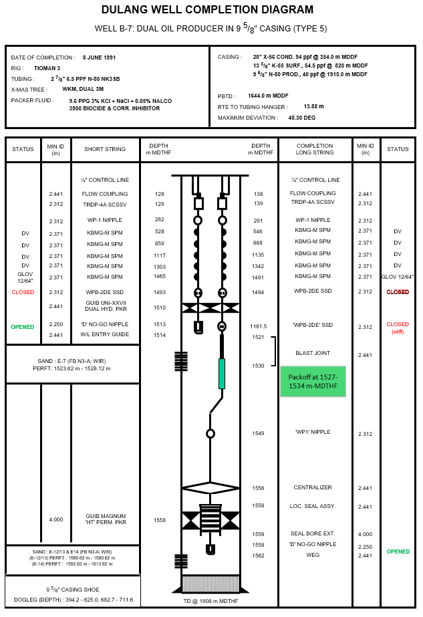
WELL OVERVIEW
Input Parameter | Parameter Value
Field | Dulang Bravo
Max. Deviation (degrees) | 48.3 degree
Min. Restriction (inch) | 2.25” @ No Go nipple
Type of Fluid & Density | 9.6 ppg (based on data in Well Diagram)
Top of Fluid | N/A
Current Well Status | Prior Intevention
Reservoir Pressure | 1600-1900 psi
Fracture Gradient | 0.72
H2S Content | 0 ppm
CO2 Content | CO2 - 15-30 mole% (oil), 50-60 mole% (gas)
Mercury, HG | N/A
Target depth 1,545m
Notes:
Status well before job : Flowing with less than 500 bbl/day
Current well status : Idle due to integrity issue

Slide 6
SUMMARY OF INTERVENTION ACTIVITIES
Item | Job Description | Plan Run Details | Actual Run Details
A | CT Operation | CT RUN#1 using Multi Jet Nozzle: Cleanout from 1,514m (EOT) to 1,545m (17m below bottom perforation zone) | CT RUN#1 using Multi Jet Nozzle: Cleanout from 1,514m (EOT) to 1,545m (17m below bottom perforation zone)

Slide 7
SUMMARY OF INTERVENTION ACTIVITIES
Highlight:
Total planned duration base on NOWIP – 17 Days
Platform/PCSB Activity includes attend DLB morning meeting and Toolbox meeting with WSS & all Intervention crew participant / highlight safety issues
Wireline activity – Deploy 12 section lubrications for deployment system and reverse deployment system
Single Shift Operation due to Rig Down Activity
Start Date | End Date
25-Aug-24 06:30 | 11-Sep-24 18:30
Activity | Hours | Days
Demobilization | 128:00 | 5.33
Rig up/down & Well Preparation | 71:30 | 2.98
CT Operation | 25:00 | 1.04
Wireline Activity | 15:15 | 0.64
e-PTW Approval | 15:35 | 0.65
Platform/PCSB Activity | 20:10 | 0.84
Lifting Activity | 57:00 | 2.38
Flowback well to flowback system | 17:30 | 0.73
Single Shift Operation | 36:00 | 1.50
Wait on Weather | 02:15 | 0.09
Surface Preparation | 31:45 | 1.32
 | 420:00 | 17.50
Notes:
1. Glaring dekat demobalization lama sebab FCB is not available and Two Kasturi is not permitted to be release to KSB because TK been used as a movement vessel to send crew to remote platform from DLB and PO and other reason is Two Kasturi Sailing to KSB (estimated more than 30 hours sailing) due to engine boat problem
2. Rig Up/Down & well preparation lama due to rig up and rig down deployment system, surface equipment, unstab CT from Injector and etc.

Slide 8
DULANG B07S
Sand Clean Out Operation

Slide 9
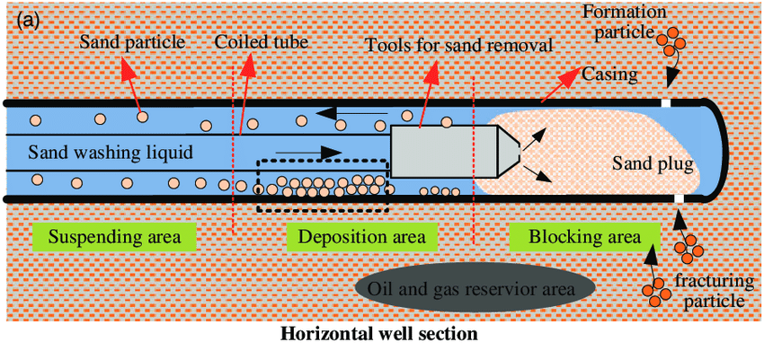
PROCESS OF SAND CLEAN OUT
The process of removing sand or similar fill from a wellbore. Many wells produce sand that may accumulate and restrict production if not removed from the wellbore by the production fluid.
To remove fill, a cleanout fluid is pumped through the CT string. The fluid is circulated back up the annulus between the CT string and completion tubing to carry the fill back to surface.

Slide 10
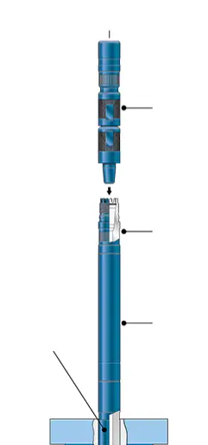
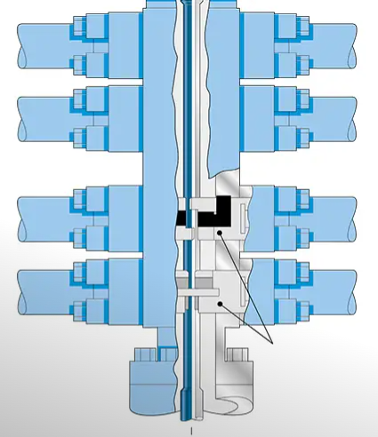
COMPARISON EXECUTION PLAN
 | SAND CLEAN OUT INSIDE CASING 2020 | SAND CLEANOUT INSIDE CASING USING DEPLOYMENT SYSTEM 2024
Technique | This method involves deploying coiled tubing directly into the well to remove sand and debris. Its typically uses basic tools like jetting nozzles or simple flushing techniques. | This method incorporates deployment systems, allowing for the use of specialized tools such as CARSAC, DKCV and deployment bar for effective sand removal.
Equipment | Uses standard coiled tubing units and basic cleaning tools. | More sophisticated tools such as CARSAC, DKCV, Deployment BOP, Deployment Bar, increase in the usage of straight bar are used alongside coiled tubing due to long BHA been utilized.
Process | The operation may be straightforward, focusing primarily on flushing out sand through the coiled tubing without extensive customization or specialized techniques. | More customized approach targeting specific areas.
Flexibility/ Efficiency | May not fully utilize coiled tubing's advanced capabilities. | Enhances the effectiveness of sand cleanout by providing better control, quicker operations, and the ability to tackle larger or more problematic sand accumulations.
Notes:
The difference between normal sand cleanout inside casing using coiled tubing and sand cleanout inside casing using a deployment system with coiled tubing revolves around the specific techniques and tools employed for the operation.
Combination Anti-Rotation Self-Aligning Connector (CARSAC)
A CARSAC High-Torque (HT) Connector is a downhole tool that helps with tubing makeup when it's difficult to rotate tools to engage threads. It's particularly useful for long tool string applications and is often used with integral ball valves and deployment bars.
Dual Kelly Cock Valve (DKCV)

Slide 11
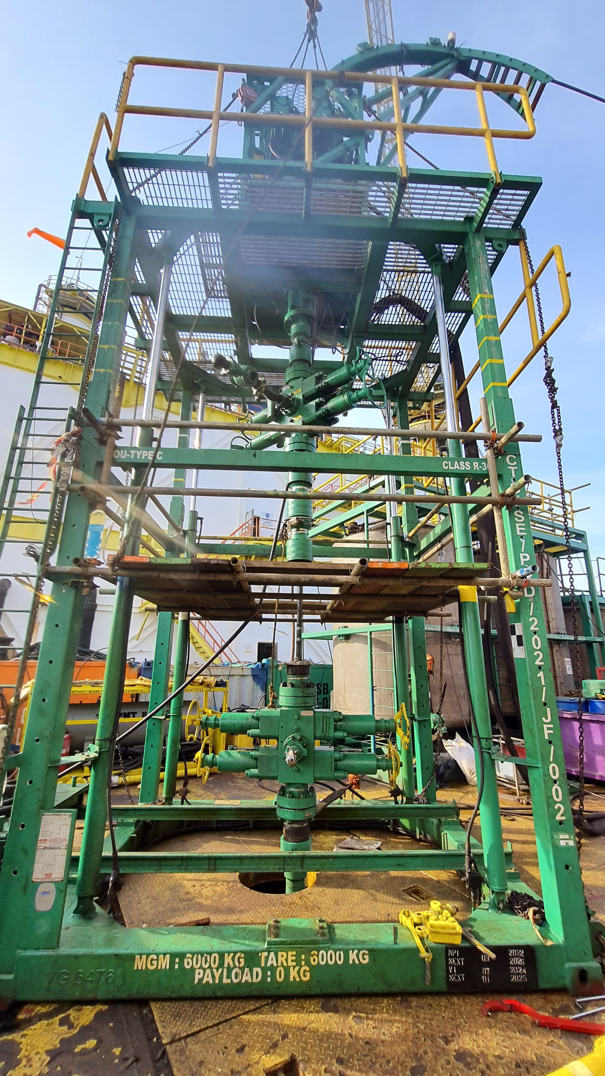
PROCESS OF DEPLOYMENT SYSTEM
Sand clean-out using a deployment system with a long Bottom Hole Assembly (BHA) configuration involves specialized equipment designed to effectively remove sand and other particulates from the wellbore.
Key Point of the Situations where the deployment of a long BHA is necessary due to the constraints of the setup:
Target Depth for Sand Clean-Out
BHA Length Limitations
Using a Long BHA (103 ft)
Avoiding Sticking Risks
Notes:
We are dealing with a specific situation in well intervention where the deployment of a long BHA is necessary due to the constraints of our setup.
1. Target Depth for Sand Clean-Out: You're aiming to clean out sand inside the casing, which requires navigating through normal curvature areas.
2. BHA Length Limitations: The maximum BHA length you can use is 35 feet due to the jacking frame and the height from the maindeck to the wellhead. This limitation prevents effective pressure testing against the wellhead if exceeded.
3. Using a Long BHA (103 ft): To achieve the required depth while avoiding the risk of getting the coil stuck, a longer BHA is needed. The longer configuration allows for better maneuverability through the casing and minimizes the chances of the coil getting stuck, especially in spring conditions.
4. Avoiding Sticking Risks: One of the primary reasons for choosing a long BHA is to prevent the coil from becoming stuck while transitioning from tubing to casing. The flexibility of a longer BHA helps mitigate the risks associated with bends and curves.

Slide 12
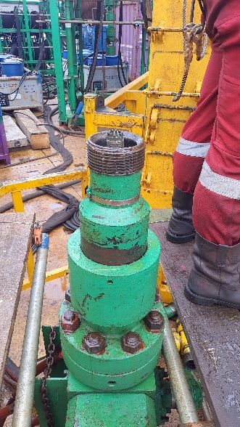
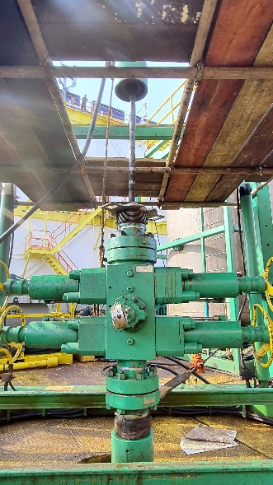
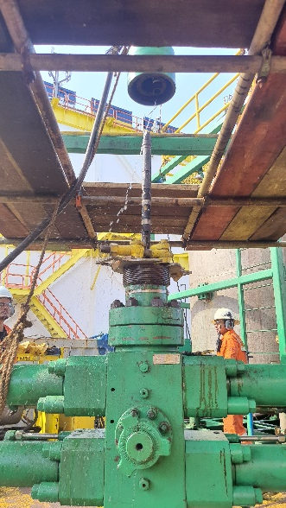
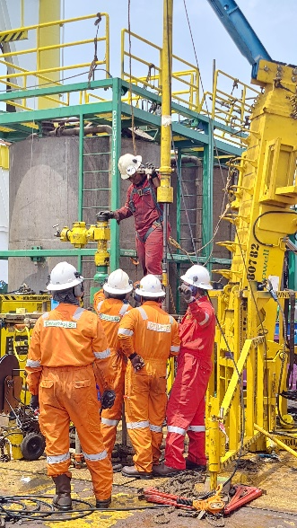
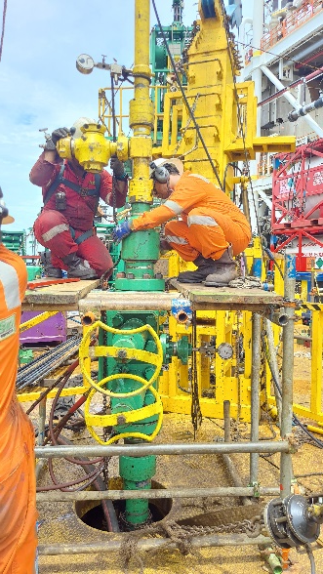
PROCESS OF DEPLOYMENT SYSTEM
Benefits of the Deployment System:
Flexibility: The deployment system allows for the use of longer BHAs without exceeding the physical constraints of your equipment setup.
Enhanced Control: This approach provides better control over the clean-out process, reducing the likelihood of complications that could arise from using a standard coil or shorter BHA.
Efficiency: By effectively removing sand from the wellbore, the overall production efficiency can be improved, preventing downtime caused by sand blockage.

Slide 13
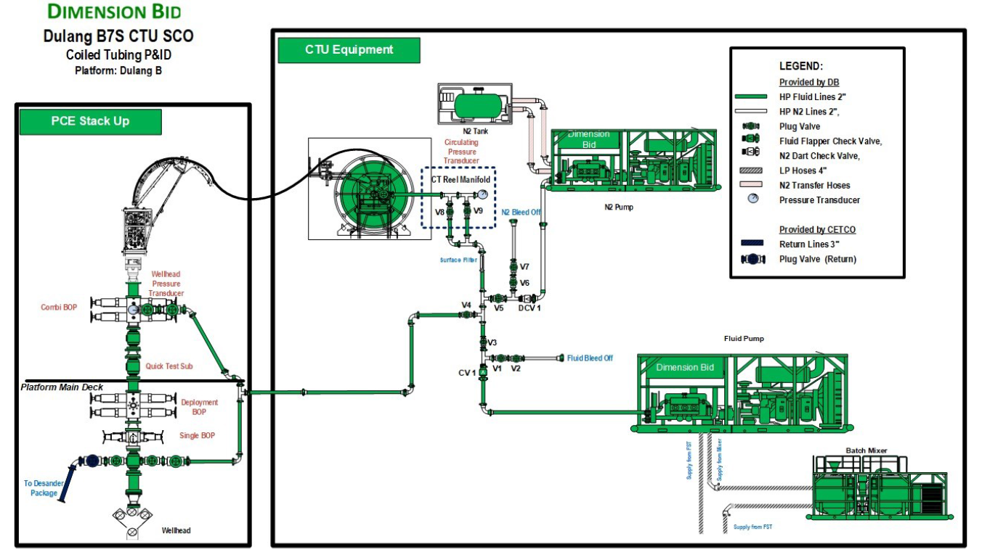
B07S P&ID

Slide 14
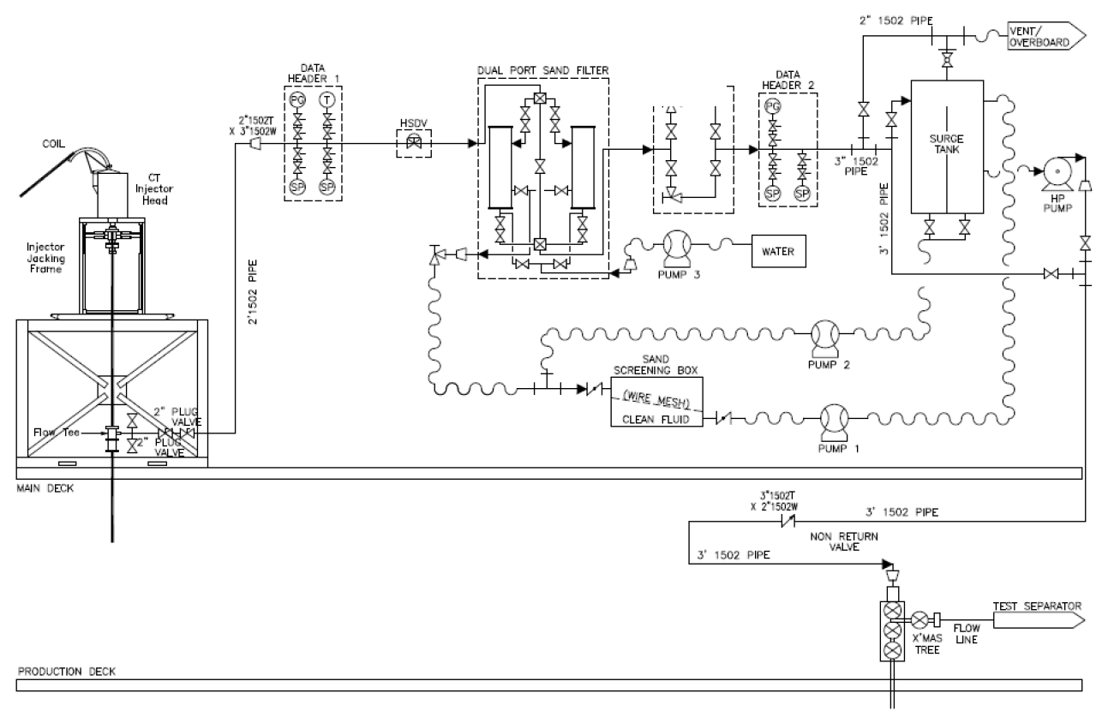
B07S P&ID

Slide 15
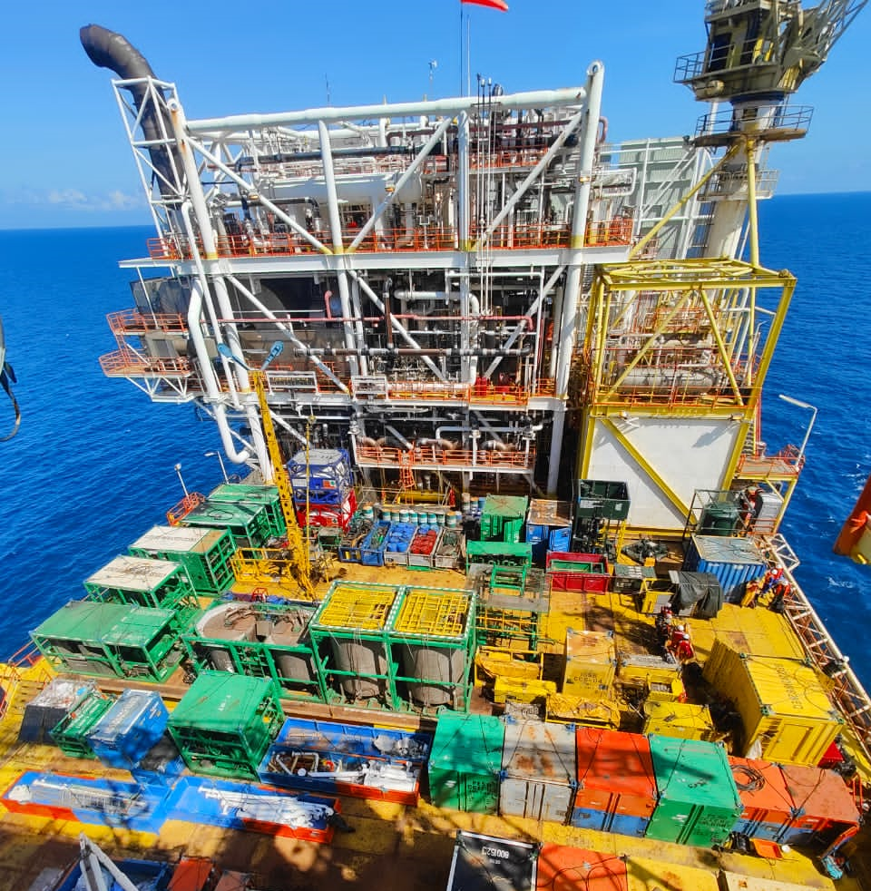
REAL SETUP

Slide 16
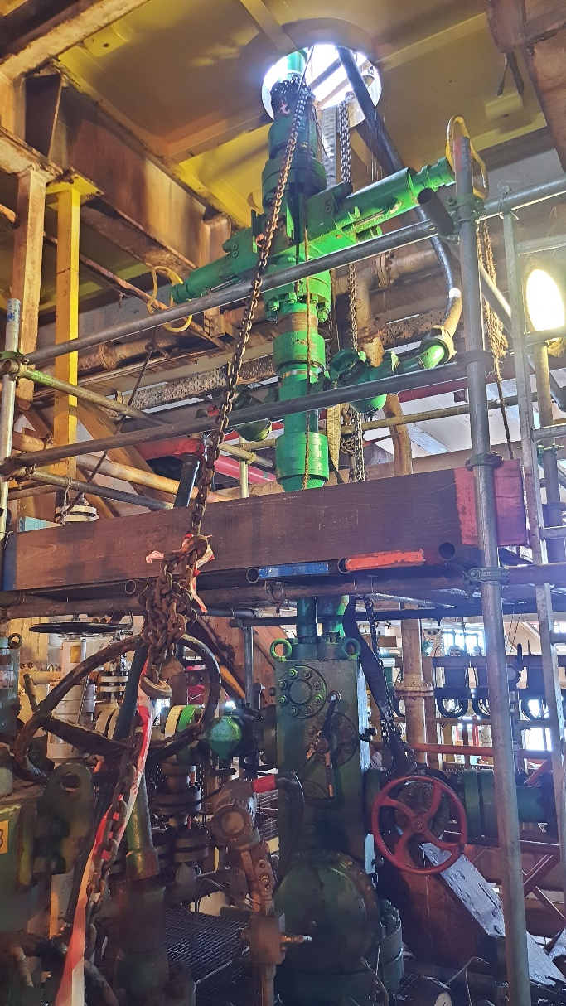
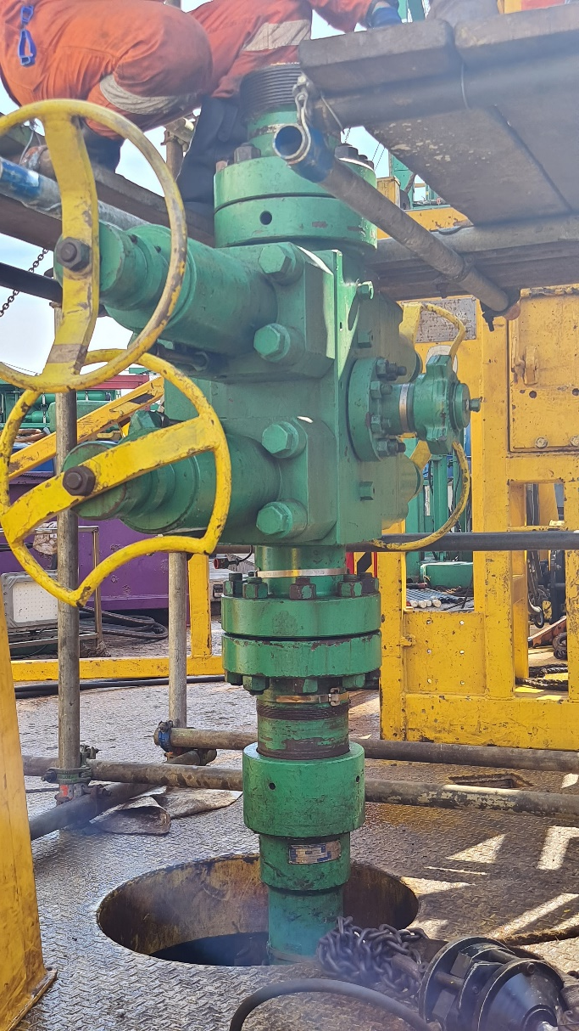
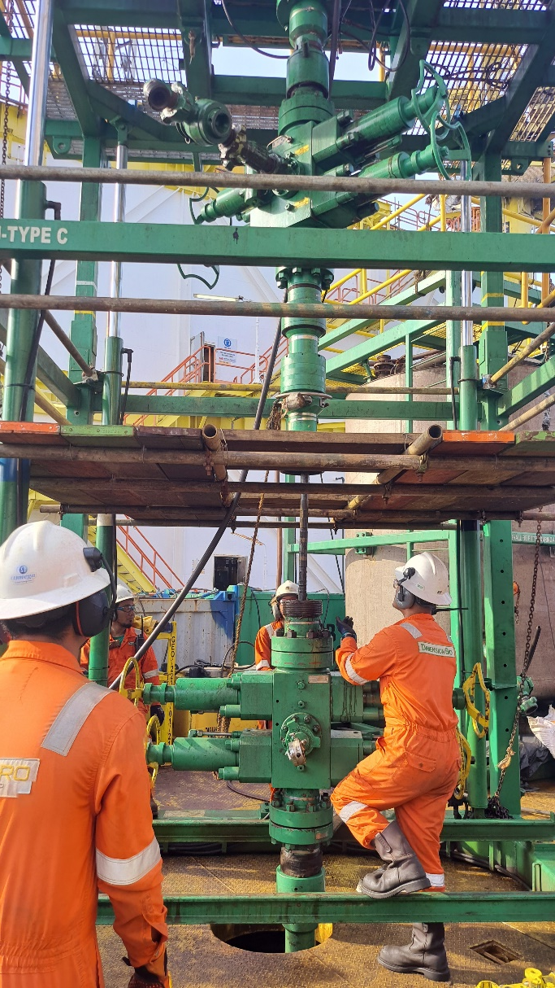
WELL PCE STACK UP
Pump in Tee
Combi BOP
Single BOP
Deployment BOP
Quick Test Sub
Flow Cross
Wellhead and wellhead deck
Main deck Floor (Deployment BOP)
Main deck Floor (Combi BOP)

Slide 17
VIDEO WELL
PCE STACK UP

Slide 18
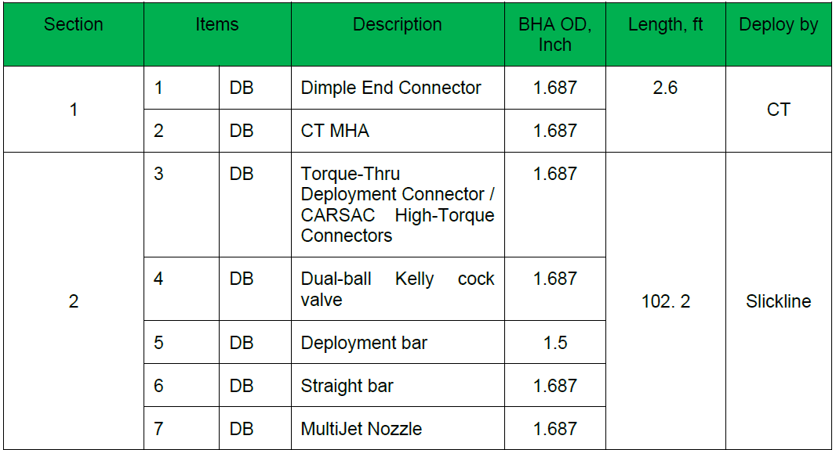
BHA CONFIGURATION

Slide 19
BHA CONFIGURATION

Slide 20
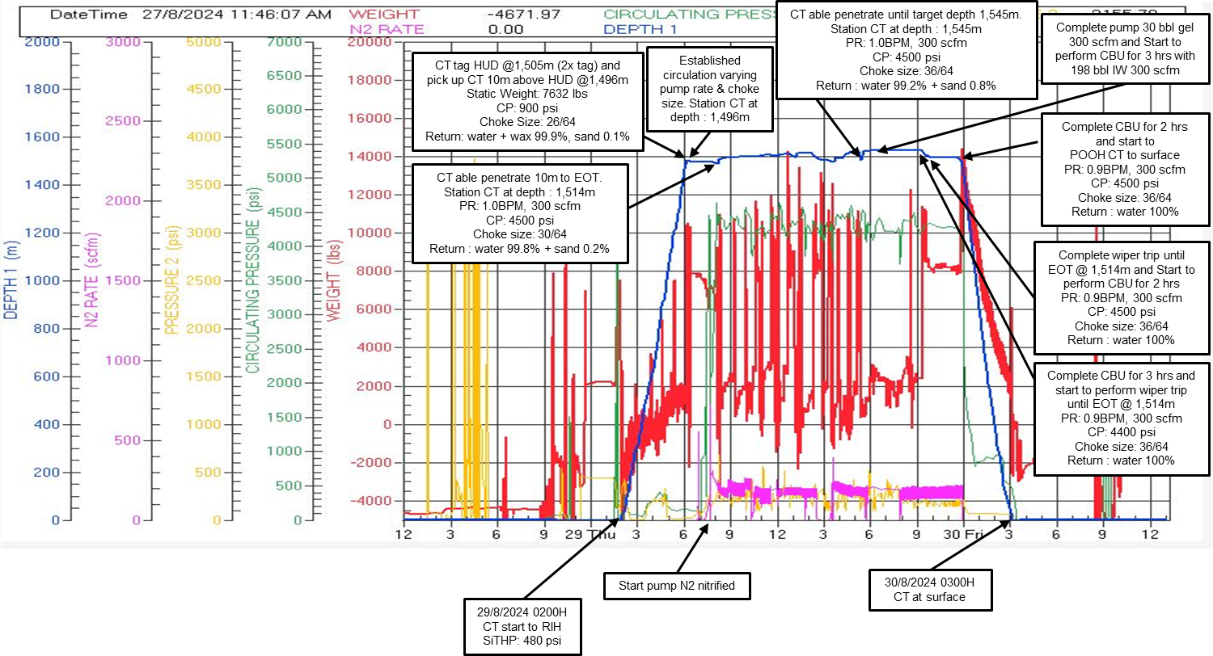
JOB ANALYSIS – CT RUN#1 – SCO
Date: 29 ^{th} Aug – 30th Aug 2024

Slide 21
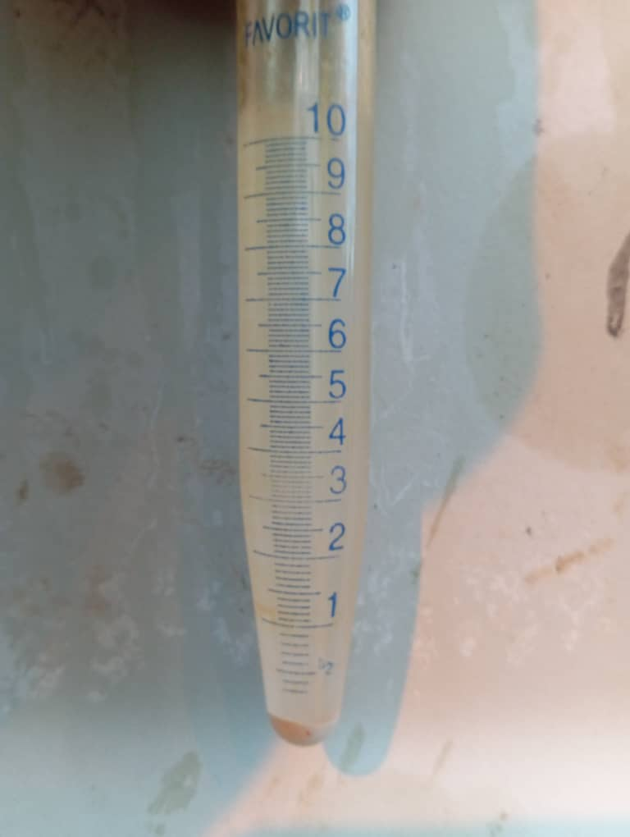
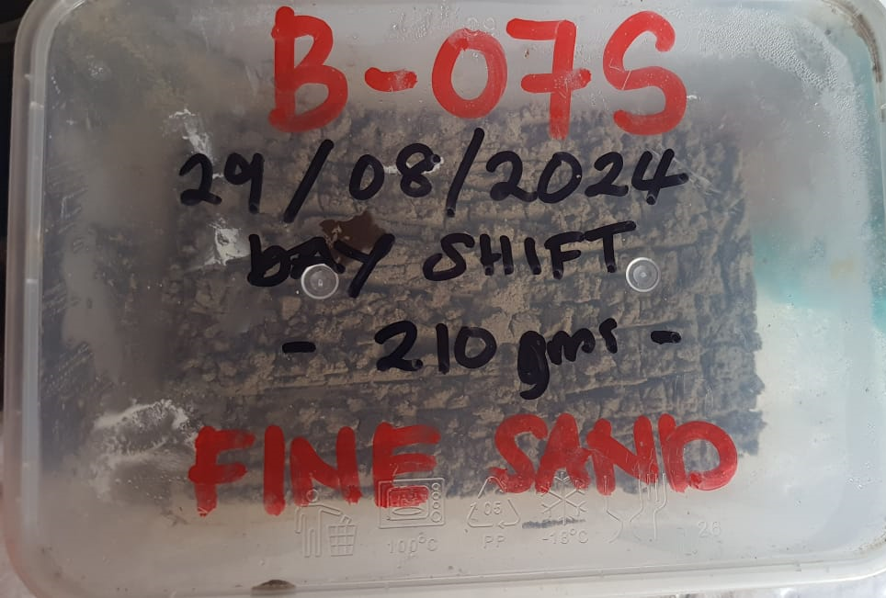
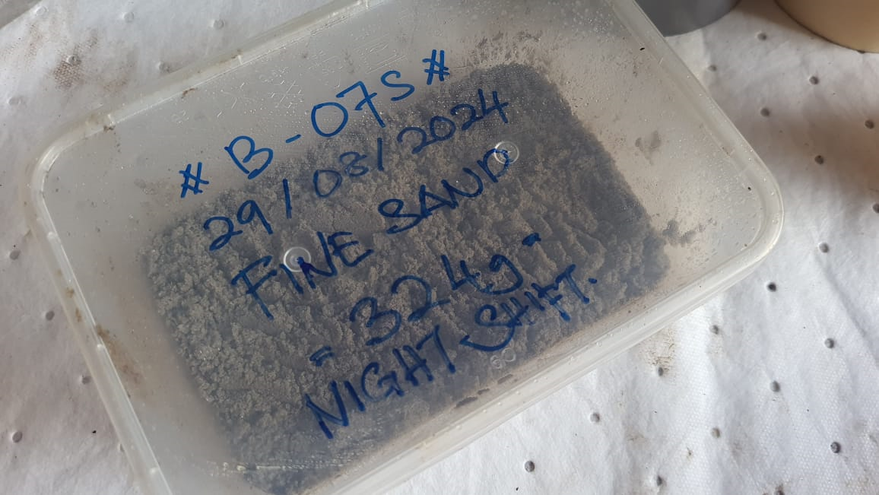
JOB ANALYSIS – CT RUN#1 – SCO
CT was start to RIH with pumping IW at idle rate 0.24 bpm till 10m above HUD @ 1,496m / 4,907 ft MDTH and the HUD was encountered inside tubing.
HUD was detected by 2x tag CT @ 1,505m / 4,937 ft MDTHF and CT was pick up 10m above HUD @ 1,496m / 4907ft MDTHF.
Once establish circulation with nitrified, started to cleanout bite per bite.
CT @ 1,496m / 4907ft MDTHF (30ft above HUD) start to pump N2 nitrified with 0.7bpm IW. Choke sizes 26/64. Return 99.9% water and 0.1% sand.
Normal RIH and POOH weight inside tubing and casing:
Inside tubing: 1,000 lbs (RIH) and 9,000 lbs (POOH)
Inside casing: 1,100 lbs (RIH) and 10,000 lbs (POOH)
CT able penetrate to target depth @1,545 m / 5,069 ft MDTHF located 17m below perforation (inside casing). Choke sizes 36/64. Return 99.2% water and 0.8% sand.
No abnormalities in term of CT Weight encountered during RIH and POOH throughout the operation.
Function test MultiJet Nozzle
Flow rate | Pressure (psi)
0.3 | 600
0.5 | 1050
0.7 | 1680
1.0 | 3100
1.1 | 3500
1.2 | 4000
1.3 | 4500
210 gram day shift return
324 gram night shift return
Date: 29 ^{th} Aug – 30th Aug 2024

Slide 22
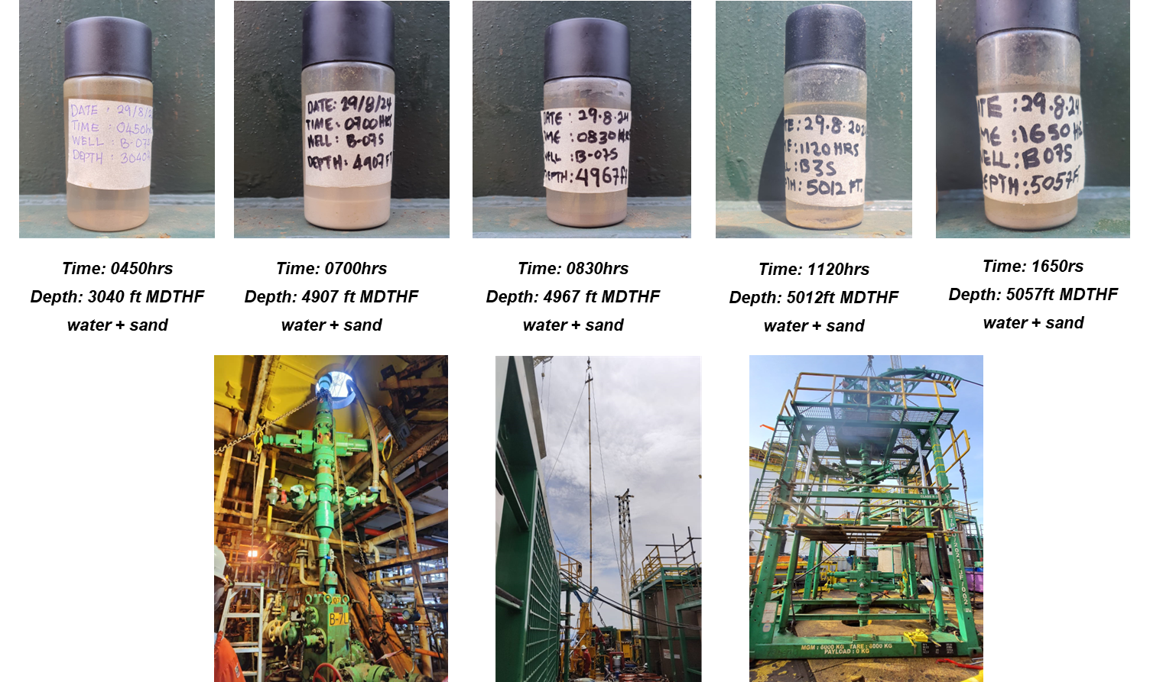
JOB ANALYSIS – CT RUN#1 – SCO

Slide 23
SUMMARY WELL B-07S
HIGHLIGHTS
Overall Operation was successfully completed without any HSE issue and no abnormalities encountered during RIH and POOH throughout the operation.
Successful method toward avoiding entanglement which was long BHA was deployed via a deployment method.
LOWLIGHTS
Successfully Rig Down all CTU Equipment, however DB facing difficulty to pack all the equipment due to no available cargo basket onboard (all empty basket and ETB were backload initially due to deck space limitation)
Waiting available sector boat for remaining basket to backload.

Slide 24
CONCLUSION
Dimension Bid has successfully completed sand clean out operation for well Dulang B-07S;
The Dulang B-07S Sand Clean Out Operation was successfully carried out as per planned with zero HSE incidents.
A deployment system was used to deploy the lengthy BHA. CT sand cleanout was successfully executed with no overpull recorded. Hence the successful approach towards avoiding entanglement.
Deployment system approach seeks to diminish the risk involve and provide a solution towards intervention beyond the SS into the annular of a dual string completion.

Slide 25
THANK YOU

Slide 26
# | Activity | Start | End | Duration | Note
1 | Platform/PCSB Activity | 25-Aug-24 06:30 | 25-Aug-24 07:40 | 1:10:00 | Attend DLB morning meeting, Toolbox meeting with WSS & all Intervention crew participant / highlight safety issues
2 | e-PTW Approval | 25-Aug-24 07:40 | 25-Aug-24 08:00 | 0:20:00 | Revalidate e-PTW
3 | Platform/PCSB Activity | 25-Aug-24 08:00 | 25-Aug-24 08:45 | 0:45:00 | Meeting OOP for B07S activity
4 | Wireline Activity | 25-Aug-24 08:45 | 25-Aug-24 11:00 | 2:15:00 | Goewell S/L still on ongoing to set MA plug on well B03L
5 | Surface Preparation | 25-Aug-24 11:00 | 25-Aug-24 18:30 | 7:30:00 | Measurement well stackup from B07S crown cap to stripper, remove 4ft riser above CBOP, Box up stripper to top CBOP, Remove pumping tee below CBOP, Redressed stam and beam choke and Clean sand screen box and drain surge tank
6 | Platform/PCSB Activity | 25-Aug-24 18:30 | 25-Aug-24 19:30 | 1:00:00 | Toolbox meeting with WSS & all Intervention crew participant / highlight safety issues
7 | e-PTW Approval | 25-Aug-24 19:30 | 25-Aug-24 20:30 | 1:00:00 | e-PTW approved
8 | Surface Preparation | 25-Aug-24 20:30 | 26-Aug-24 06:30 | 10:00:00 | Perform maintenance on powerpack, Washdown flowback area, Service & replace rubber debooster on CIDF, Calibrate with orion & Fill up lube oil on injector
9 | Platform/PCSB Activity | 26-Aug-24 06:30 | 26-Aug-24 07:40 | 1:10:00 | Attend DLB morning meeting & Toolbox meeting with WSS & all Intervention crew participant / highlight safety issues
10 | e-PTW Approval | 26-Aug-24 07:40 | 26-Aug-24 08:30 | 0:50:00 | Revalidate e-PTW
11 | Wireline Activity | 26-Aug-24 08:30 | 26-Aug-24 08:45 | 0:15:00 | Assist S/Line goewell rigdown Telescopic Mast on well B03L
12 | Rig up/down & Well Preparation | 26-Aug-24 08:45 | 26-Aug-24 11:00 | 2:15:00 | Rigdown SBOP on well B03L
13 | Platform/PCSB Activity | 26-Aug-24 11:00 | 26-Aug-24 14:00 | 3:00:00 | Attend HSE safety stand down (Finger Injury)
14 | Surface Preparation | 26-Aug-24 14:00 | 26-Aug-24 17:00 | 3:00:00 | Rearranged maindeck to spot Jacking frame on well B07S & function test Multi Jet Nozzle
15 | Lifting Activity | 26-Aug-24 17:00 | 26-Aug-24 18:30 | 1:30:00 | Attend MV Two Kasturi to offload 2 N2 tank and backload 2 cargo
16 | Platform/PCSB Activity | 26-Aug-24 18:30 | 26-Aug-24 19:30 | 1:00:00 | Toolbox meeting with WSS & all Intervention crew participant / highlight safety issues
17 | e-PTW Approval | 26-Aug-24 19:30 | 26-Aug-24 19:45 | 0:15:00 | e-PTW approved
18 | Rig up/down & Well Preparation | 26-Aug-24 19:45 | 27-Aug-24 03:00 | 7:15:00 | Rigging up well stack up include deployment BOP, Connect DBOP hose & function test RAM, Perform pressure test stack up & Upper & Lower pipe/slip ram
19 | Wait on Weather | 27-Aug-24 03:00 | 27-Aug-24 04:30 | 1:30:00 | WOW
20 | Surface Preparation | 27-Aug-24 04:30 | 27-Aug-24 05:30 | 1:00:00 | Connect straight bar each 10ft BHA make up, Disengage deployment bar at pipe/slip ram, CT tag stripper & slack off to normal weight
21 | Rig up/down & Well Preparation | 27-Aug-24 05:30 | 27-Aug-24 06:30 | 1:00:00 | Cooling down N2 & Perform purging coil prior to reposition CIDF align with well B07S
22 | Platform/PCSB Activity | 27-Aug-24 06:30 | 27-Aug-24 07:40 | 1:10:00 | Attend DLB morning meeting & Toolbox meeting with WSS & all Intervention crew participant / highlight safety issues
23 | e-PTW Approval | 27-Aug-24 07:40 | 27-Aug-24 08:30 | 0:50:00 | Revalidate e-PTW
24 | Rig up/down & Well Preparation | 27-Aug-24 08:30 | 27-Aug-24 14:00 | 5:30:00 | Reposition CIDF, Break QTS, skid out Injector Head from well B07S & Rigup flowback line to FlowCross
25 | Lifting Activity | 27-Aug-24 14:00 | 27-Aug-24 15:30 | 1:30:00 | Attend MV Two Kasturi. Offload full N2 tank 2ea, cargo basket and SL toolbox
26 | Wireline Activity | 27-Aug-24 15:30 | 27-Aug-24 18:30 | 3:00:00 | Assist SL spot telescopic mast on well B07S and reposition wireline unit & PowerPack
27 | Platform/PCSB Activity | 27-Aug-24 18:30 | 27-Aug-24 19:15 | 0:45:00 | Toolbox meeting with WSS & all Intervention crew participant / highlight safety issues
28 | e-PTW Approval | 27-Aug-24 19:15 | 27-Aug-24 19:30 | 0:15:00 | e-PTW approved
29 | Surface Preparation | 27-Aug-24 19:30 | 28-Aug-24 02:30 | 7:00:00 | Transfer nitrogen to working tank prior to perform SCO Job, fill up FST, Hook up DBOP hyd hose & function test ram, Calibrate BMX tank level with pump parameter & orion
30 | Wait on Weather | 28-Aug-24 02:30 | 28-Aug-24 03:15 | 0:45:00 | WOW
31 | Surface Preparation | 28-Aug-24 03:15 | 28-Aug-24 06:30 | 3:15:00 | Line up flowline prior to pressure test surface line & flowback line against CTU flowcross & flushing untill clear return
32 | Platform/PCSB Activity | 28-Aug-24 06:30 | 28-Aug-24 07:40 | 1:10:00 | Attend DLB morning meeting & Toolbox meeting with WSS & all Intervention crew participant / highlight safety issues
33 | e-PTW Approval | 28-Aug-24 07:40 | 28-Aug-24 09:00 | 1:20:00 | Revalidate e-PTW
34 | Wireline Activity | 28-Aug-24 09:00 | 28-Aug-24 12:45 | 3:45:00 | Assist Slickline make-up 12 section lubricator and pumping Tee on top crossover
35 | Rig up/down & Well Preparation | 28-Aug-24 12:45 | 28-Aug-24 18:30 | 5:45:00 | Rig Up Deployment System
36 | Platform/PCSB Activity | 28-Aug-24 18:30 | 28-Aug-24 19:30 | 1:00:00 | Toolbox meeting with WSS & all Intervention crew participant / highlight safety issues
37 | e-PTW Approval | 28-Aug-24 19:30 | 28-Aug-24 20:45 | 1:15:00 | e-PTW approved
38 | Rig up/down & Well Preparation | 28-Aug-24 20:45 | 29-Aug-24 02:00 | 5:15:00 | Hookup DBOP hydraulic hoses, Pressure test DKCV, upper ram and treating line & function test Multi Jet Nozzle
39 | CT Operation | 29-Aug-24 02:00 | 30-Aug-24 03:00 | 25:00:00 | CT RUN#1 SCO
40 | Rig up/down & Well Preparation | 30-Aug-24 03:00 | 30-Aug-24 06:30 | 3:30:00 | CT at surface & Rigdown surface line
41 | Platform/PCSB Activity | 30-Aug-24 06:30 | 30-Aug-24 07:40 | 1:10:00 | Attend DLB morning meeting & Toolbox meeting with WSS & all Intervention crew participant / highlight safety issues
42 | e-PTW Approval | 30-Aug-24 07:40 | 30-Aug-24 08:30 | 0:50:00 | Revalidate e-PTW
43 | Rig up/down & Well Preparation | 30-Aug-24 08:30 | 30-Aug-24 10:30 | 2:00:00 | Pressure test lower and upper DKCV & Skid the jacking frame with PCE on well B07S
44 | Wireline Activity | 30-Aug-24 10:30 | 30-Aug-24 16:30 | 6:00:00 | Assist slickline spot telescopic mast and slickline eqiupment on well B07S & Reverse Deployment
45 | Rig up/down & Well Preparation | 30-Aug-24 16:30 | 30-Aug-24 18:30 | 2:00:00 | Rig Down Deployment System
46 | Platform/PCSB Activity | 30-Aug-24 18:30 | 30-Aug-24 19:30 | 1:00:00 | Toolbox meeting with WSS & all Intervention crew participant / highlight safety issues
47 | e-PTW Approval | 30-Aug-24 19:30 | 30-Aug-24 20:30 | 1:00:00 | e-PTW approved
48 | Rig up/down & Well Preparation | 30-Aug-24 20:30 | 31-Aug-24 06:30 | 10:00:00 | Rig Down surface Equipment
49 | Platform/PCSB Activity | 31-Aug-24 06:30 | 31-Aug-24 07:40 | 1:10:00 | Attend DLB morning meeting & Toolbox meeting with WSS & all Intervention crew participant / highlight safety issues
50 | e-PTW Approval | 31-Aug-24 07:40 | 31-Aug-24 08:30 | 0:50:00 | Revalidate e-PTW
51 | Rig up/down & Well Preparation | 31-Aug-24 08:30 | 31-Aug-24 09:00 | 0:30:00 | Preparation for unstab CT from Injector Head
52 | Flowback well to flowback system | 31-Aug-24 09:00 | 01-Sep-24 02:30 | 17:30:00 | Flowing well B07S thru flowback descender to donor well B16
53 | Rig up/down & Well Preparation | 01-Sep-24 02:30 | 01-Sep-24 06:30 | 4:00:00 | Rigdown surface equipment
54 | Platform/PCSB Activity | 01-Sep-24 06:30 | 01-Sep-24 07:40 | 1:10:00 | Attend DLB morning meeting & Toolbox meeting with WSS & all Intervention crew participant / highlight safety issues
55 | e-PTW Approval | 01-Sep-24 07:40 | 01-Sep-24 09:00 | 1:20:00 | Revalidate e-PTW
56 | Rig up/down & Well Preparation | 01-Sep-24 09:00 | 01-Sep-24 13:30 | 4:30:00 | Rigdown surface equipment
57 | Lifting Activity | 01-Sep-24 13:30 | 01-Sep-24 18:30 | 5:00:00 | Attend MV Kasturi and MV Gemilang to offload and backload activity
58 | Single Shift Operation | 01-Sep-24 18:30 | 02-Sep-24 06:30 | 12:00:00 | SDFN
59 | Platform/PCSB Activity | 02-Sep-24 06:30 | 02-Sep-24 07:40 | 1:10:00 | Attend DLB morning meeting & Toolbox meeting with WSS & all Intervention crew participant / highlight safety issues
60 | e-PTW Approval | 02-Sep-24 07:40 | 02-Sep-24 09:30 | 1:50:00 | Revalidate e-PTW
61 | Rig up/down & Well Preparation | 02-Sep-24 09:30 | 02-Sep-24 18:30 | 9:00:00 | Rigdown surface equipment
62 | Single Shift Operation | 02-Sep-24 18:30 | 03-Sep-24 06:30 | 12:00:00 | SDFN
63 | Platform/PCSB Activity | 03-Sep-24 06:30 | 03-Sep-24 07:40 | 1:10:00 | Attend DLB morning meeting & Toolbox meeting with WSS & all Intervention crew participant / highlight safety issues
64 | e-PTW Approval | 03-Sep-24 07:40 | 03-Sep-24 09:30 | 1:50:00 | Revalidate e-PTW
65 | Rig up/down & Well Preparation | 03-Sep-24 09:30 | 03-Sep-24 18:30 | 9:00:00 | Rigdown surface equipment
66 | Single Shift Operation | 03-Sep-24 18:30 | 04-Sep-24 06:30 | 12:00:00 | SDFN
67 | Platform/PCSB Activity | 04-Sep-24 06:30 | 04-Sep-24 07:40 | 1:10:00 | Attend DLB morning meeting & Toolbox meeting with WSS & all Intervention crew participant / highlight safety issues
68 | e-PTW Approval | 04-Sep-24 07:40 | 04-Sep-24 09:30 | 1:50:00 | Revalidate e-PTW
69 | Lifting Activity | 04-Sep-24 09:30 | 04-Sep-24 18:30 | 9:00:00 | Attend MV Kasturi to offload and backload activity
70 | Demobilization | 04-Sep-24 18:30 | 07-Sep-24 09:30 | 63:00:00 | Two Kasturi Sailing to KSB
71 | Lifting Activity | 07-Sep-24 09:30 | 07-Sep-24 18:30 | 9:00:00 | Attend MV Kasturi to offload and backload activity
72 | Demobilization | 07-Sep-24 18:30 | 10-Sep-24 11:30 | 65:00:00 | Two Kasturi Sailing to KSB (estimated more than 30 hours sailing) due to engine boat problem
73 | Lifting Activity | 10-Sep-24 11:30 | 11-Sep-24 18:30 | 31:00:00 | Backload remaining 10 lift via GM Gemilang and all CTU equipment fully demob to KSB

