Slide 1
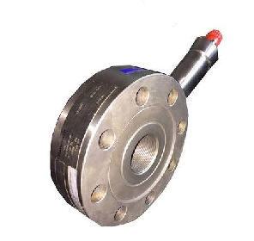
Load Cell Setup
And Zero Weight Procedure
By ZALANI B IBRAHIM
G.E.O CTS

Slide 2
Purpose of this slide:
To educate personnel on how to properly setup IH load cell during job and travelling
To educate personnel on how the WI working and what affect the WI reading through out the jobs
To educate personnel why is it important for properly setting up the IH Load Cell and it impact to the job and equipment
To standardize Zero Weight procedure among all CT Supervisor and CT Operator

Slide 3
Why is it important to properly setup IH Load Cell and Zero Weight?
  For correct WI reading through out the job
  To prevent any SQ event that might be catastrophic:
      CT buckled below IH head chain
      Lock up due to excessive force during RIH
      Tool damage due to excessive set down weight
      CT parted or break due to excessive force applied
      False high snub/pull force indicator

Slide 4
LOAD CELL SYSTEM
  The injector is designed to operate with:
      A single dual-acting electronic load cell
      One or two stacked hydraulic load cells on one end of the injector
      Electronic load pins at the pivot point connecting the injector to it’s base assembly.
  The load cells are on a 4:1 ratio, and each load pin is on a 3:8 ratio, for pipe heavy and pipe light.
  To isolate transport shock loads from the load cell, the load cell system is designed with tie down bolt

Slide 5
IH Load Cell Details:

Slide 6
Dimension Bid IH Load Cell Details:
  Manufactured by Sensotec.
  Calibrated by Honeywell
  Load cell model 41A - Tension & Compression / Strain Gauge Type.
  Load capacity: -40000~+40000 lbs.
  Exitation Voltage: 9 – 28 Volts
  Output mA: 4-20mA
      4 mA ~ -40000 lbs
      12 mA ~ 0 lbs
      20 mA ~ +40000 lbs
  Device that converts a force into an electrical signal.

Slide 7
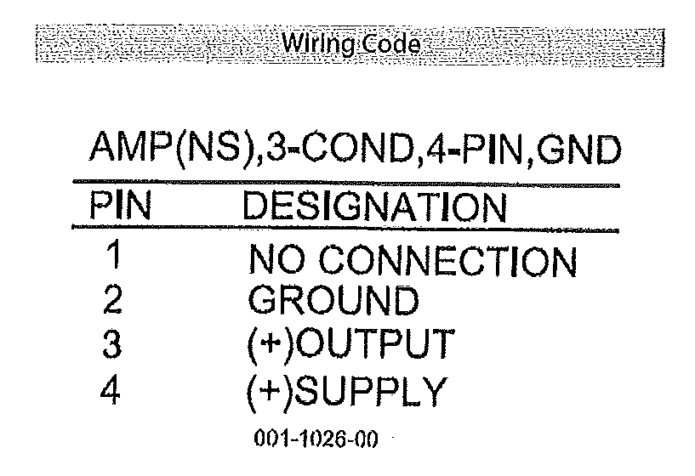

Slide 8
Load Cell Setup During Travelling
  During travelling there will be transport shock loads to the load cell
  This could affect or cause damage the load cell
  To isolate transport shock loads from the load cell:
      Lock out screws(tie down bolts) are tight
      The center load cell nut are loose
Load Cell Setup During Job
  During job the setup is opposite of the traveling which is:
      Lock out screws (tie down bolts) are loose
      The center load cell nut are tighten against the center load cell support

Slide 9
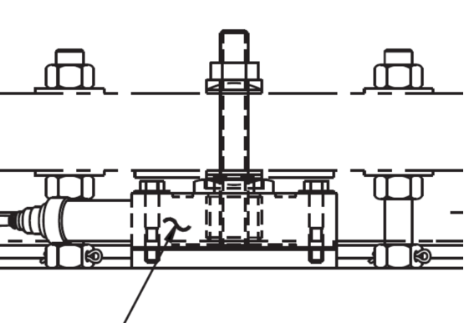
Center Load Cell Nut

Slide 10
1st Method of Zero Weight Procedure
  Perform before stab in CT and after rig up all electronic sensors and stack up
  Perform 1 time for every well
  WI readings more accurate:
      WI readings include RBT and SFL after stab in CT
      Only zero for IH Weight on load cell
  Simple steps compare to 2nd method

Slide 11
1st Method Zero Weight Steps:
  Power up CT DAS and open Orion in ISIS PC
  Back off center load cell nut to loosen up
  Jack up IH on the load cell by using the bottom lock out screw
      Just to take off any load sitting on the load cell
  Zero the CT weight on the Orion and CT Weight Gauge on the Panel. Load cell should read zero as there is no load on the load cell.
  Back off the lock out screw on the sit the IH on the load cell and tighten the center load cell nut against the center load cell support. This time the load cell should read the IH weight.
  Remark the IH weight reading and zero weight inside the Orion and CT weight gauge on the panel.
  After stab in, there will be a ± 500~1000 lbs WI reading due to RBT and SFL. The minus value will be bigger for RIH.

Slide 12
2nd Method of Zero Weight Procedure
  Perform after stab in CT and rig up on well
  Tool string for the job already being made up
  Perform incase there is any WI reading inconsistency through out the job. Done for the 2nd Run not during the job.
  Perform on each well not on each run on the same well
      To maintain weight reading consistency and accuracy on each run
      Different tool string and different fluid being pump or fluid flow regime on the job effects the WI reading
      This different is already being calculated and simulated by the TFM. 1st Run and 2nd Run WI reading differs doesn’t mean the weight reading is wrong unless all parameters for both runs is the same.
      Mistakes people do is to match the WI reading with TFM. TFM should match the WI readings.

Slide 13
2nd Method Zero Weight Steps:
  Power up CT DAS and open Orion in ISIS PC
  Make sure lock out screw is loosen and load cell center nut is tighten against the center load cell support.
  Set stripper on retract position and apply 1000 psi
  Perform several passes up and down inside riser. Minimal 3 passes and 5 ft of travel to get accurate WI readings. Set minimum RBT during RIH and POOH.
  Note down all WI readings during RIH and POOH
  Zero the CT weight after finish performing the passes. Always zero CT weight in POOH direction as CT is in tension and there is no residual force remaining as the CT in pipe light
  Repeat the passes to ensure the weight reading is within acceptable range which is ± 500~1000 lbs WI reading during POOH due to RBT and SFL. The minus value will be bigger for RIH.

Slide 14
Thank you

