Slide 1
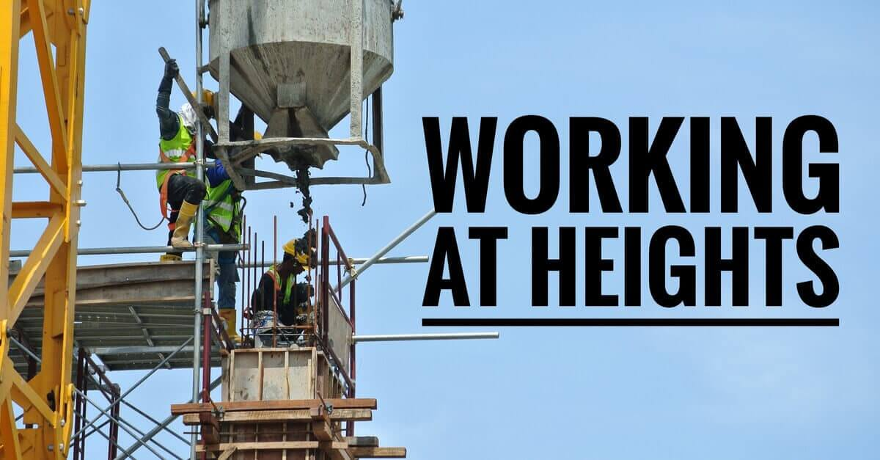

Slide 2
WORKING AT HEIGHT DEFINITION
Working on temporary or permanent structures that are greater than 1.8meters above the ground or floor level.

Slide 3
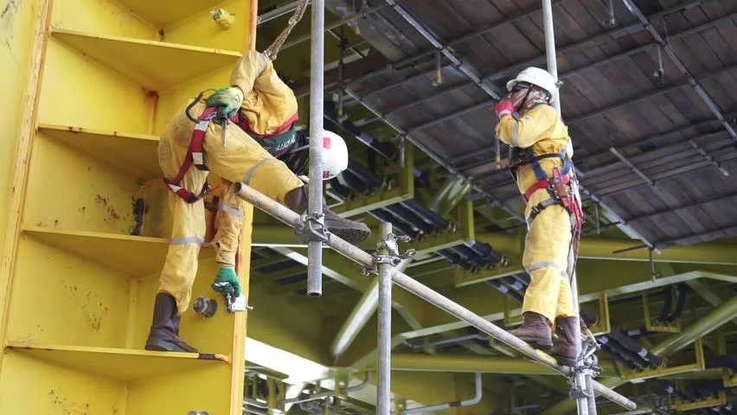
Example of working at height
Roof/Bridge/Ladder works
Scaffolding works
External window cleaning works
Construction framing/painting works

Slide 4
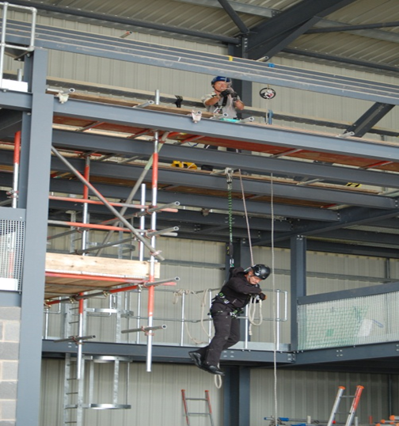
Working at height hazards
Falling of personnel
Fall of material
Dropped object
Collapse of scaffold
Floor/Hole openings
Slip trip and fall

Slide 5
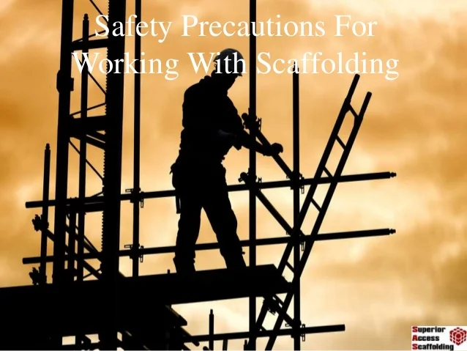
Safety Precautions working at height.
Valid work permit (work method statement and risk assessment)
Toolbox talk conduct
Full PPE mandatory
Identify and understand hazards.
Tool kit used while working at height
Barricade the area.

Slide 6
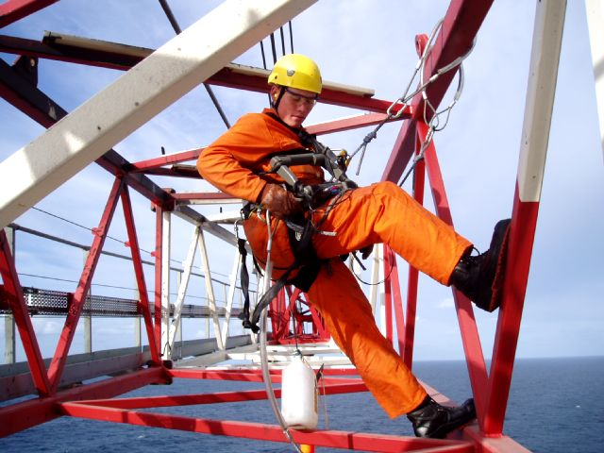
Any questions?
THANK YOU SAFETY COMES FIRST NO WORK SO URGENT

