Slide 1
Right Procedure Assambly Plug Valve
SMI Type
By ZALANI B IBRAHIM
G.E.O CTS

Slide 2
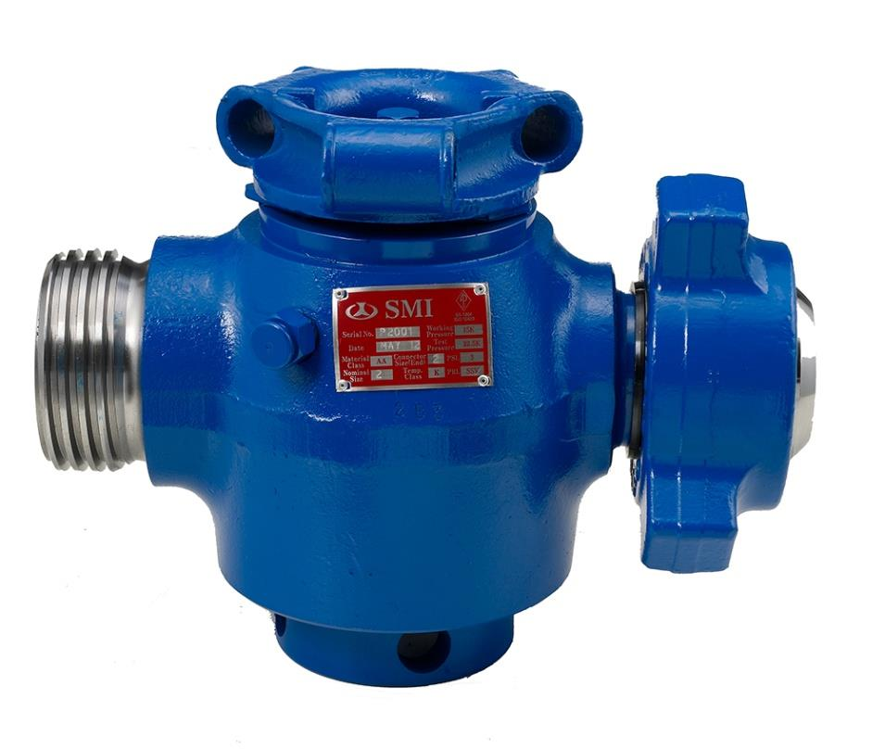
SPECIFICATIONS
Plug Valve Integral Type
Equipment for oil-field and designed to resist high pressure and severe temperature
Compliance with API 6A, ISO 9001 and NACE MR-0175.

Slide 3
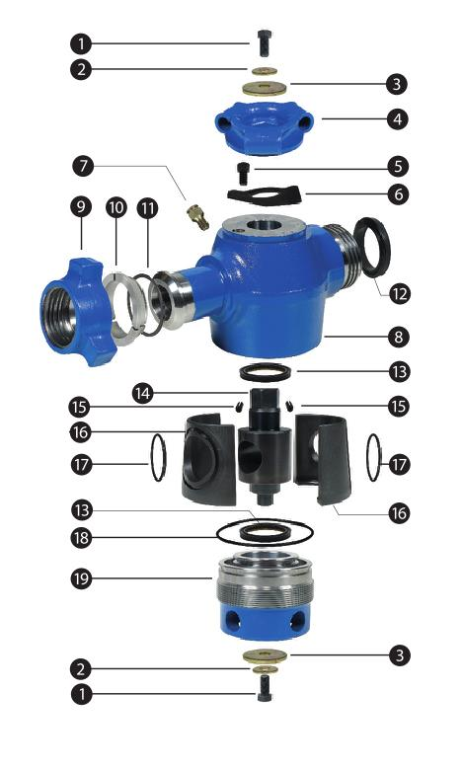
PART VIEW
CAP SCREW
WASHER (Small)
WASHER (Big)
HANDLE ADAPTER
GREASE FITTING
STOP BOLT
STOP COLLAR
BODY
PLUG
PLUG SEAL
ROLL PIN
INSERT
INSERT O-RING
ADJUST NUT O-RING
ADJUST NUT

Slide 4
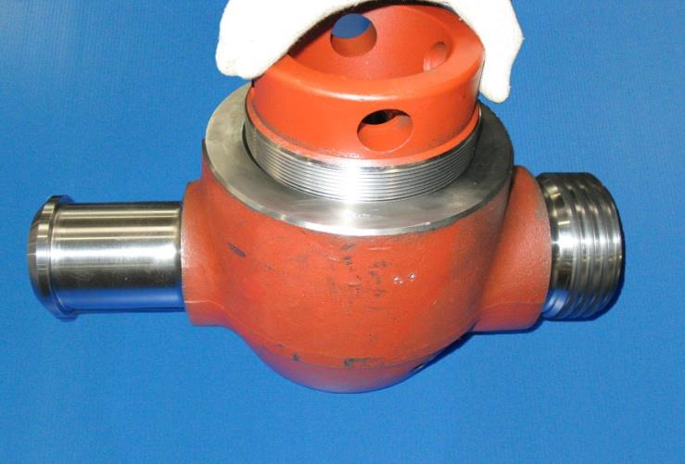
Assembly Procedure
Check surfaces around the valve
bore inside the valve for sharp
edges that could cause cutting of
the insert o-rings. Then screw the
clean adjusting nut into the valve
body to make sure the threads
are not damaged.

Slide 5
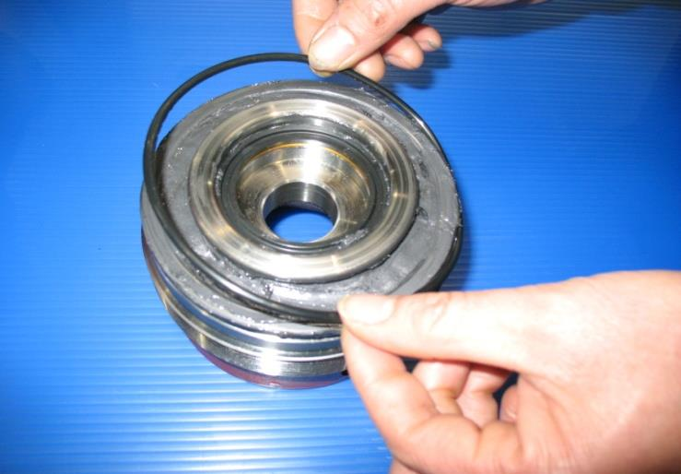
After inspection, remove the
adjusting nut, grease the sealing
groove and install the o-ring in
the groove.

Slide 6
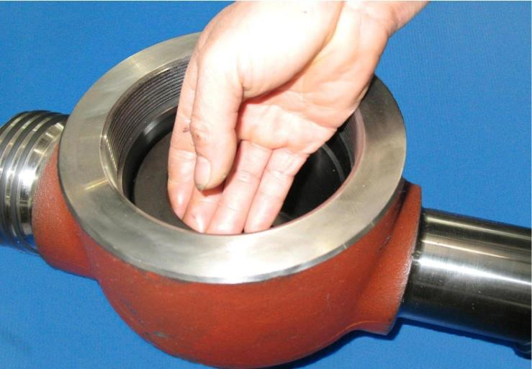
Check the roll pins in the valve
body by gently sliding a set of
insert into the valve. The inserts
should move freely up and down
the length of the roll pin slots
without interference.

Slide 7
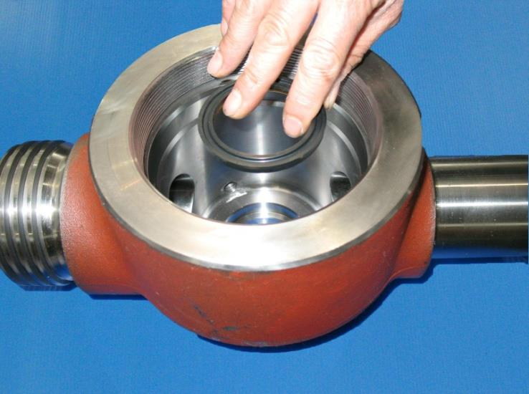
Apply a thin film of lubricant to
the recess in the valve body and
install the plug seal with the metal
back towards the recess facing
away from the pressure.

Slide 8
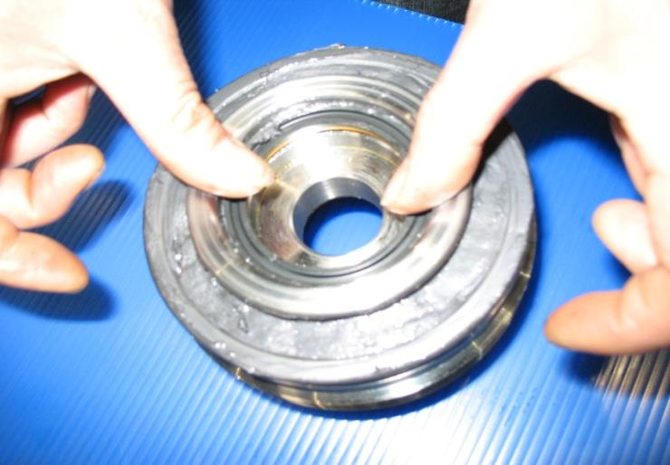
Apply a thin film of lubricant to
the recess in the adjusting nut and
install the plug seal with the metal
back towards the recess facing
away from the pressure.

Slide 9
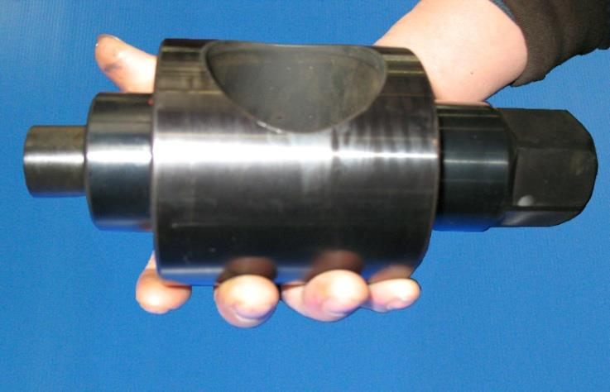
Check the plug outside diameter
for surface defects such as scratches,
dings, nicks, or sharp edges that could
affect the sealing area

Slide 10
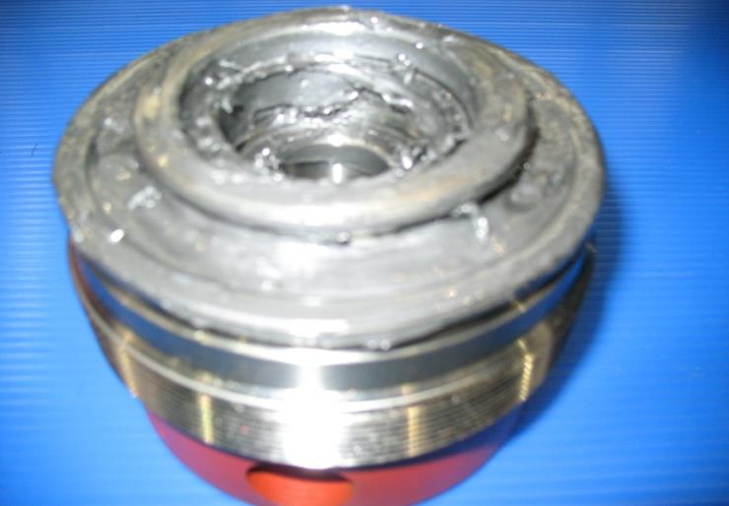
Apply grease to the plug seal in the
adjusting nut

Slide 11
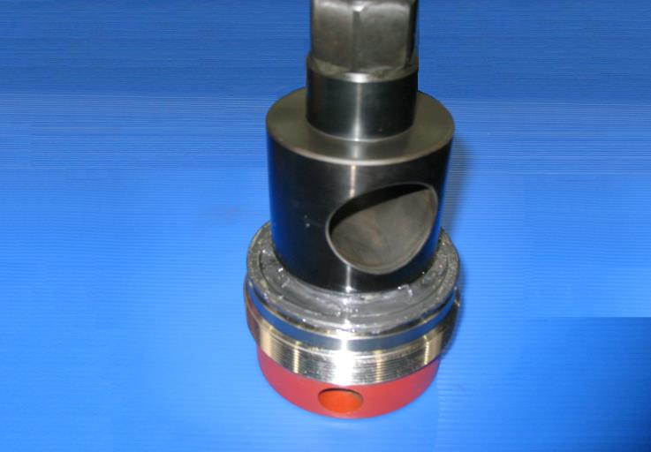
Install the lower end of the plug
(opposite the hex) in the adjusting
nut and push down until the plug
shoulders on the adjusting nut.

Slide 12
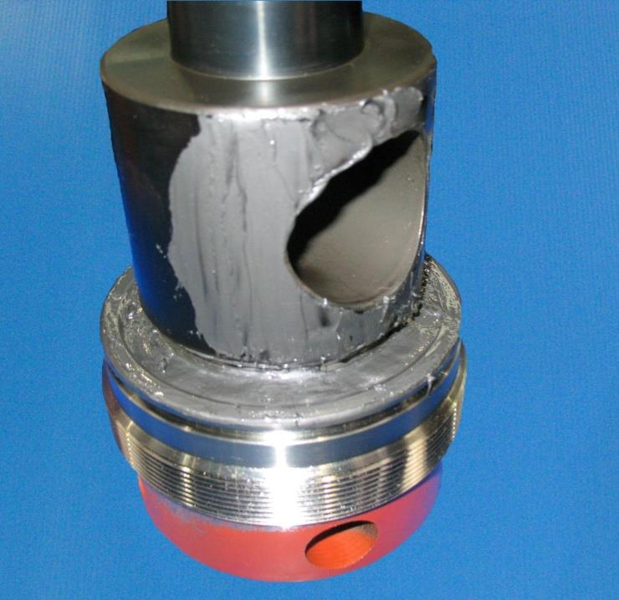
Apply a thin film of grease to the
entire O.D. of the plug

Slide 13
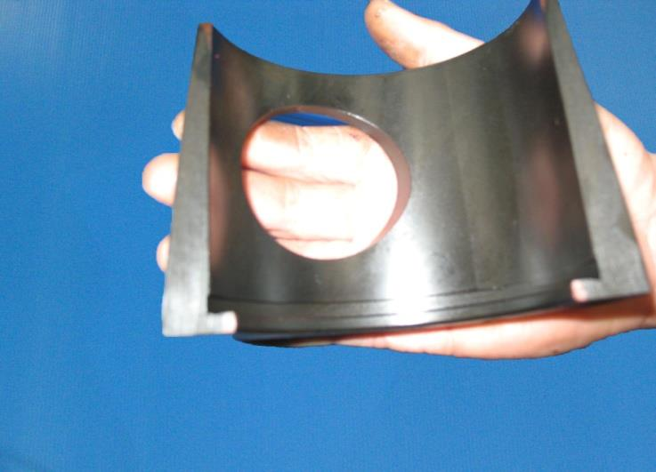
Check the surface finish of the
inserts making sure they do not
have any scratches, dings, nicks or
sharp edges that could affect the
sealing area.

Slide 14
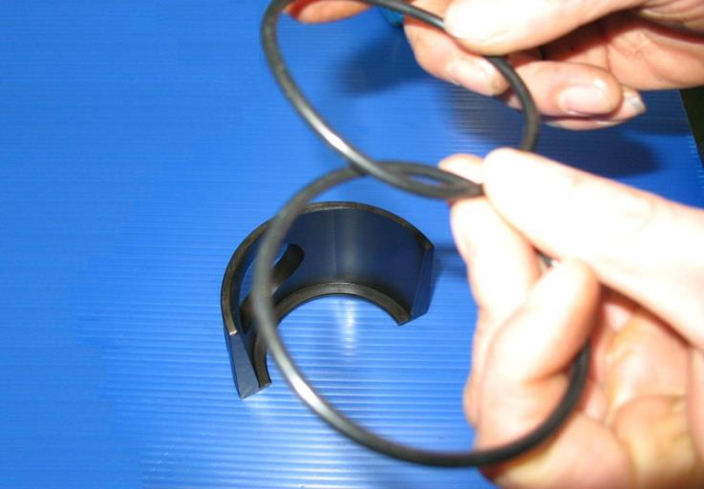
Inspect the insert o-rings for any
possible non-conformity.

Slide 15
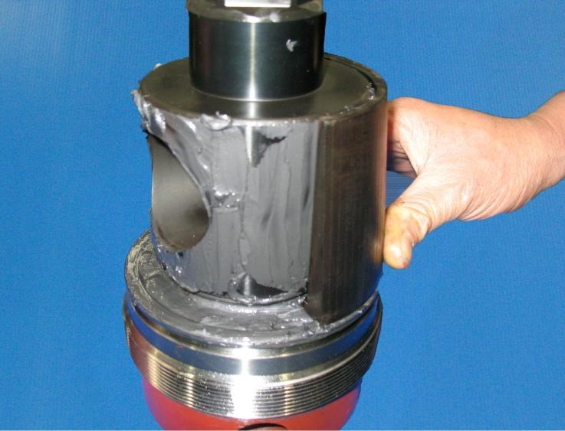
Place the inserts around the plug.

Slide 16
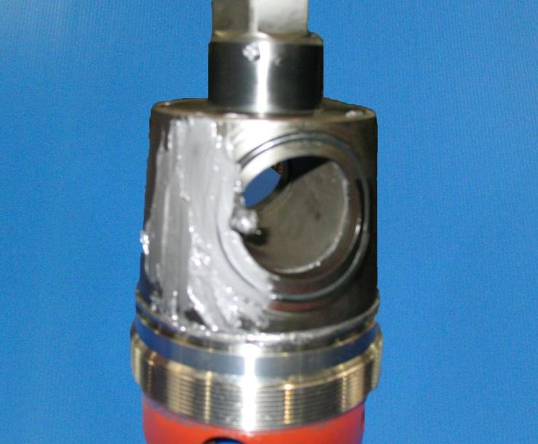
Install the insert o-rings into the
insert grooves and coat with
grease.

Slide 17
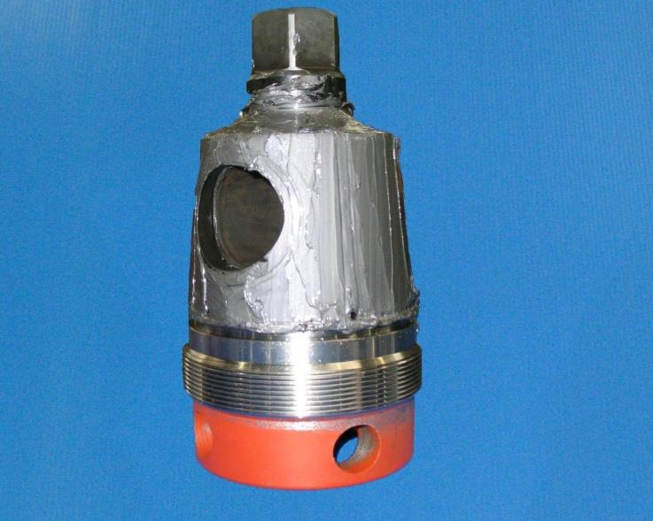
Make sure the entire sealing
surface is thoroughly greased.

Slide 18
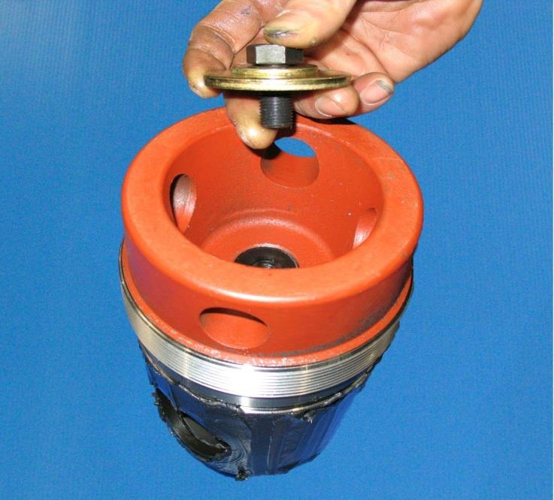
Secure the plug to the adjusting
nut with the cap screw and
washers

Slide 19
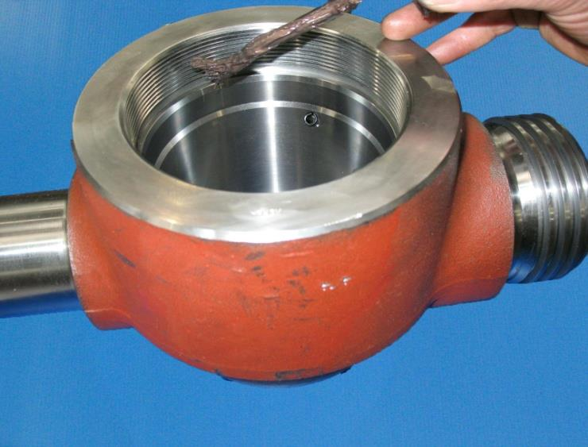
Lubricate the valve pocket and
apply thread compound (Never_x0002_
Seize) to the adjusting nut threads
and adjusting nut sealing surfaces.

Slide 20
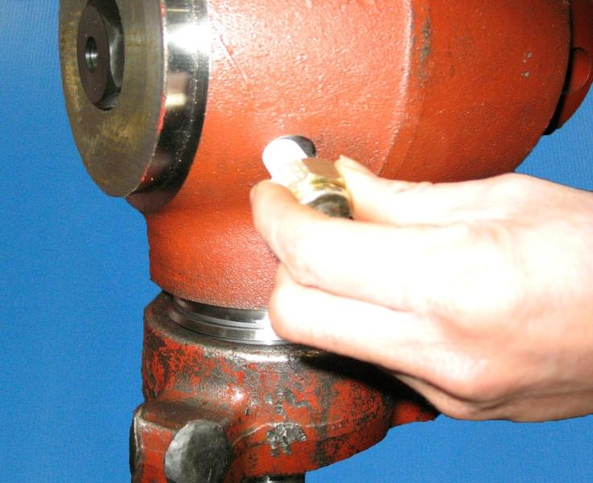
Install grease fitting with new
Teflon tape (two wraps maximum).
Tighten grease fitting to 50-60 ft_x0002_
lbs.

Slide 21
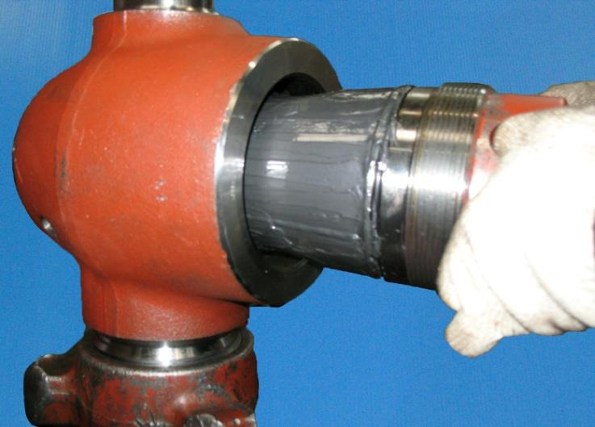
Install the plug, insert and
adjusting nut assembly into the
valve body.

Slide 22
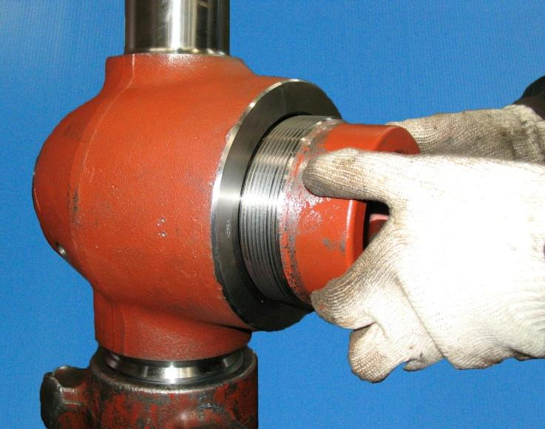
Support the valve so that the plug
hex can pass through
unobstructed.

Slide 23
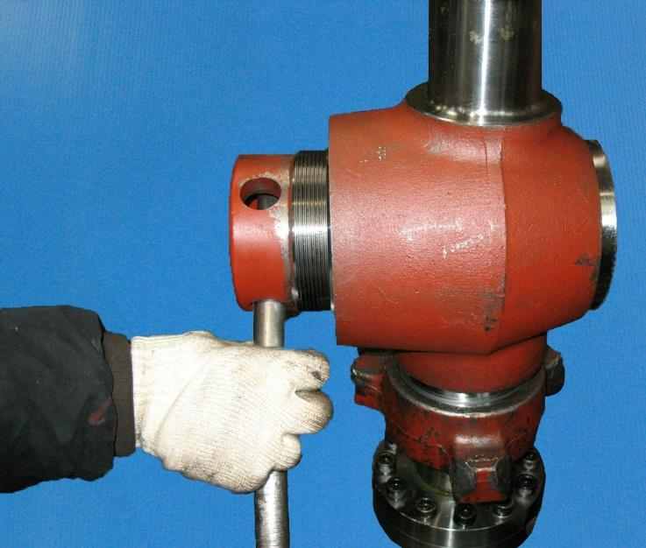
Tighten the adjusting nut

Slide 24
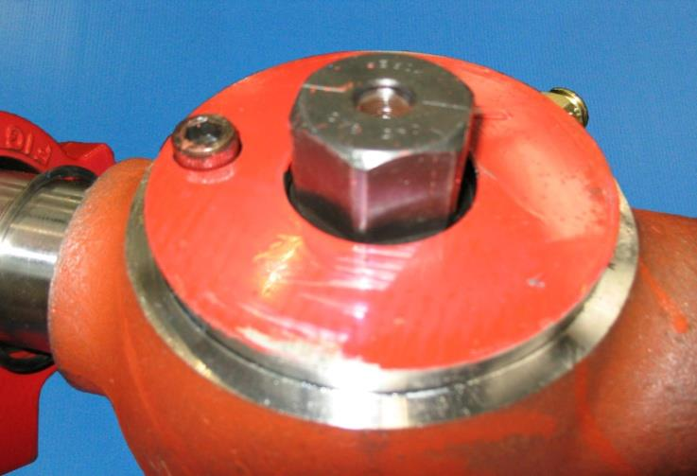
Install stop bolt.

Slide 25
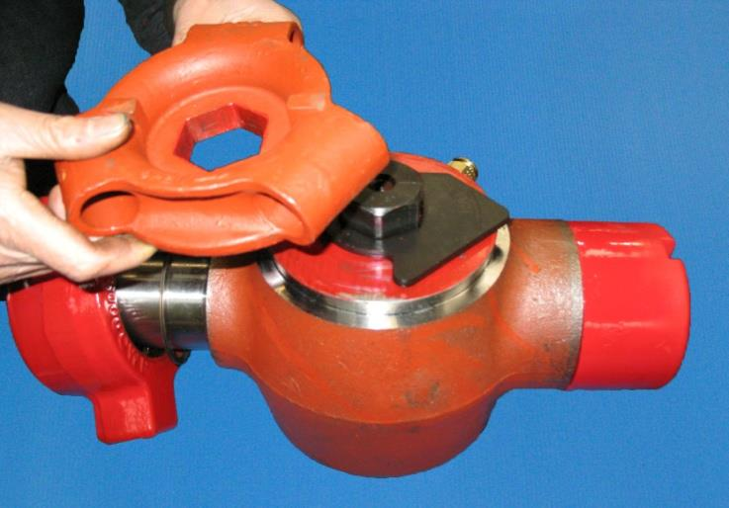
Install stop collar and handle
adapter.

Slide 26
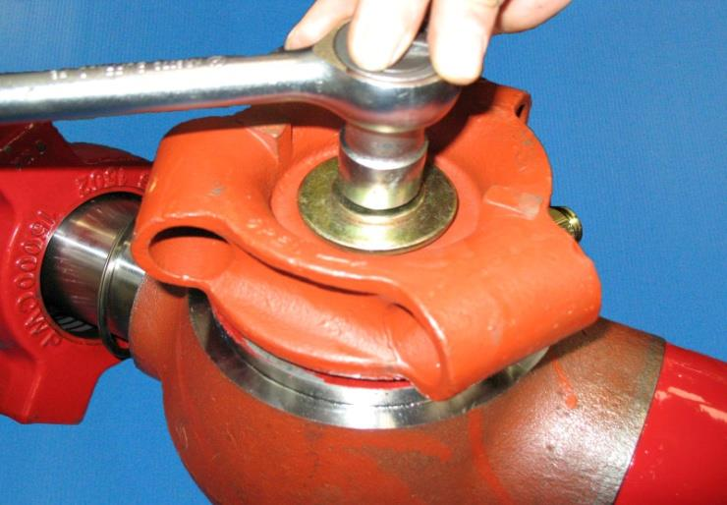
Secure handle adapter with the cap
screw and washers.

Slide 27
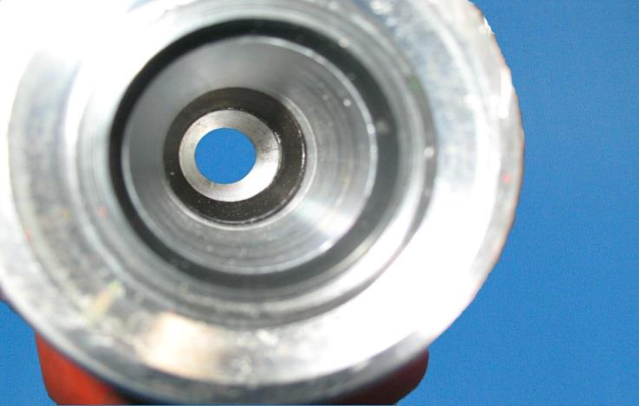
Inspect plug alignment and adjust as
necessary with adjusting nut.

Slide 28
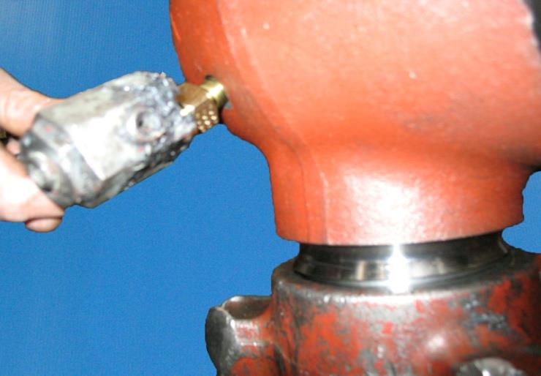
Open the valve with the handle
adapter and pump grease through
the grease fitting to approximately
3000 psi. Actuate the valve to
release the pressure. Repeat this
step a second time.

Slide 29
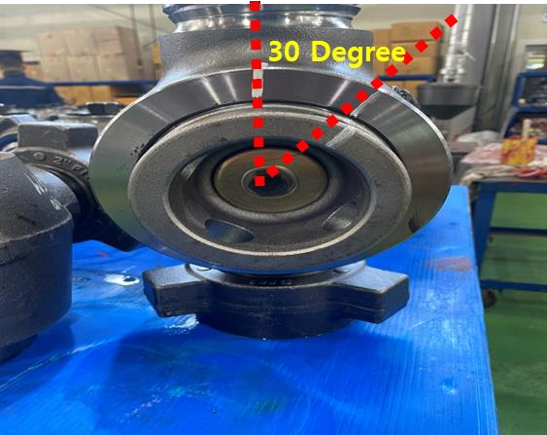
Remove excess grease from valve
bore. After Pressure Test, For
prevent leak at low pressure
(300~500psi), Tighten the a-nut by
30 degrees

Slide 30
Greasing Instruction
Put the valve in OPEN position.
Using a grease gun, inject the grease through the grease fitting. Injection pressure
Recommended grease injection pressure is approx. 3,000 to 6,000 psi
Close the valve and open again gently, three times.
Inject the grease through the grease fitting again for a few seconds.
Put the position of the valve in open or close as per your purpose.

Slide 31
GREASE
Use recommended greases as below.
Other greases may result in failure to achieve a good test and may actually damage the new parts.
Val-Tex 972-K General purpose biodegradable lube sealant
GREASE REQUIREMENTS
1˝ VALVE = 1/3 STICK
2˝ VALVE = 1/2 SITCK

Slide 32

THANK YOU

