Slide 1


Noise Tool Logging
Basic Qualitative
SUBSURFACE DATA SERVICES DEPARTMENT (SDS)
i-Solutions
© 2016 Dimension Bid All Rights Reserved
Basic Qualitative– Production Logging

Slide 2

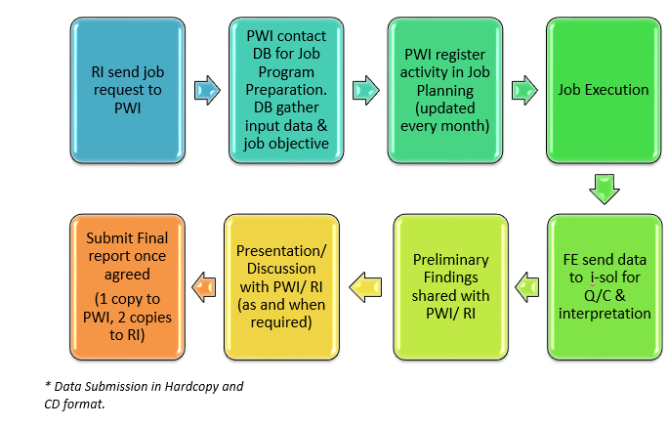
GENERAL LOGGING WORKFLOW IN PMO

Slide 3
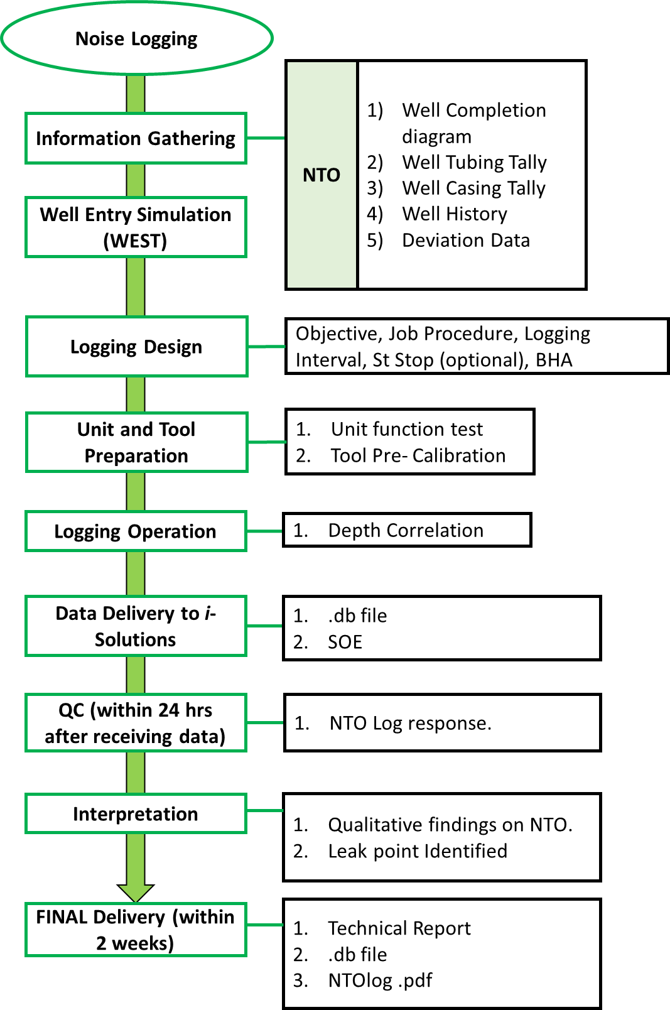
Account Manager
Field Engineer
Log Analyst

Slide 4
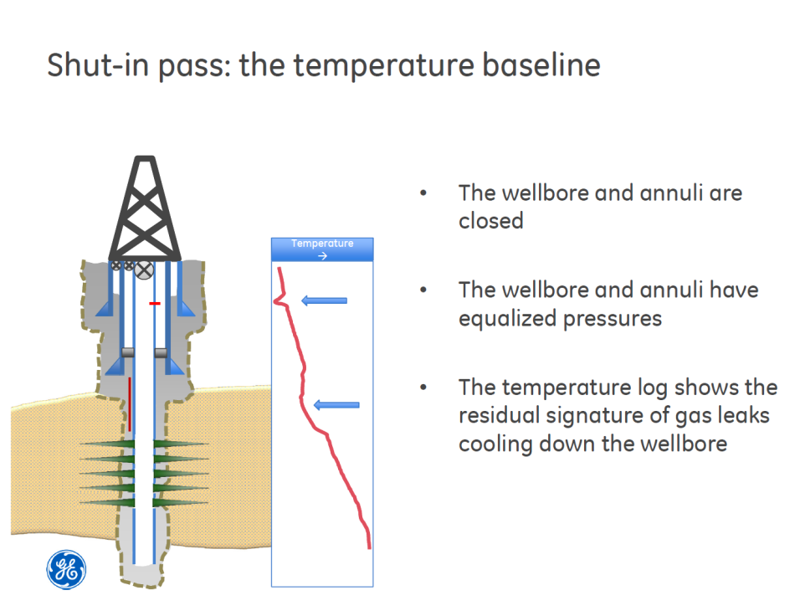
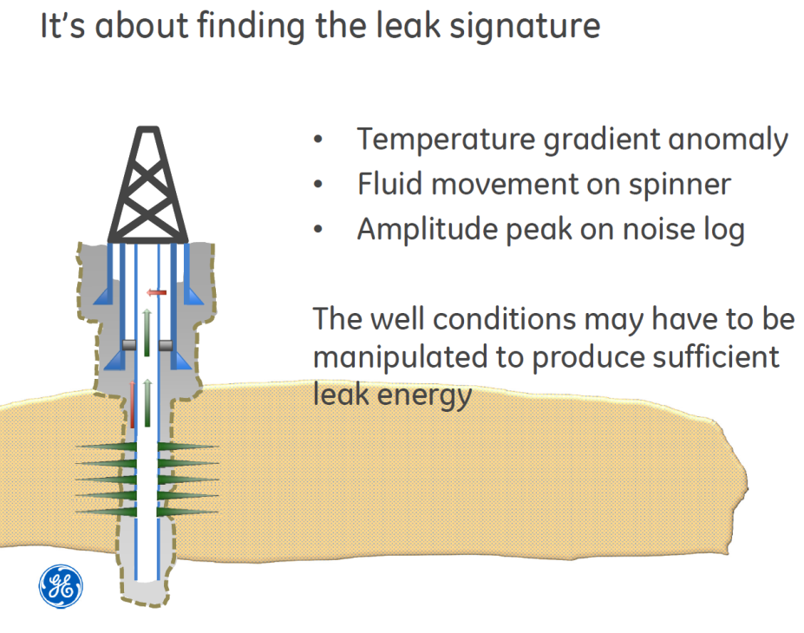
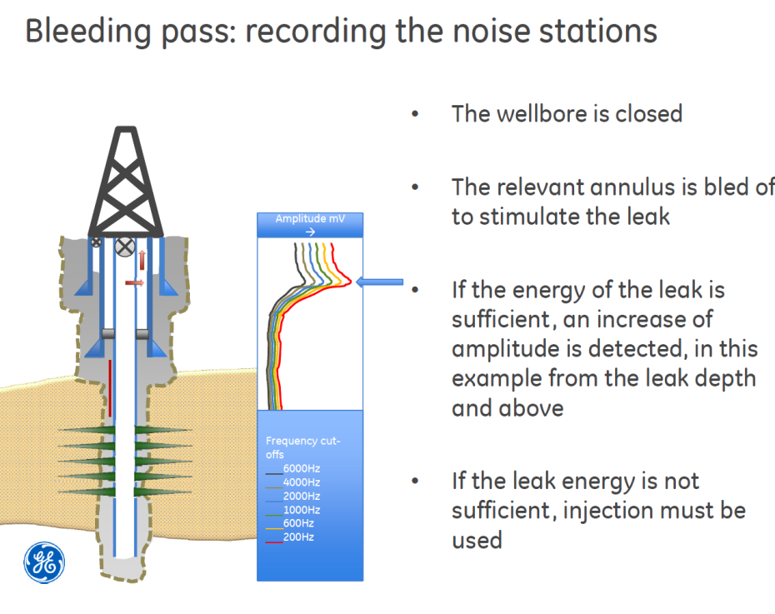
Noise Log Tool
- Concept

Slide 5


Slide 6
Used of NTO
NOISE TOOL (NTO) to HELP YOU
Evaluate flow profiles
Locate channels behind a well case
Locate gas-liquid interfaces
Locate leaks in a well case
Locate gas entries
.
Notes:
NTO is a sensitive hydrophone detect sounds from liquid or gas movement in leaks, channels or perforations, inside or outside the cased well

Slide 7
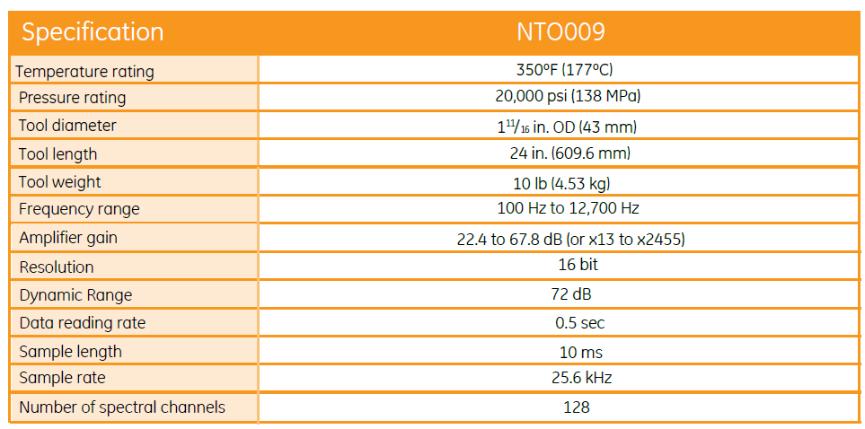
NTO Specification

Slide 8
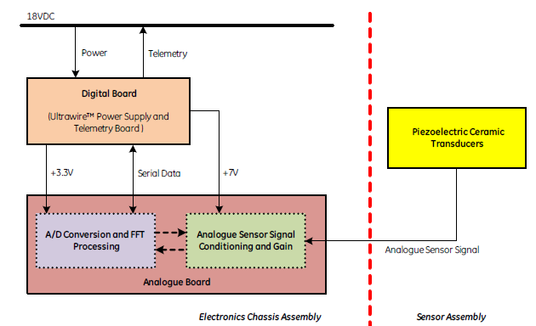
Principal of Operation

Slide 9
Principal of Operation
A piezoelectric crystal receives the sound in the audible frequency range of 100 Hz to 12700Hz.
The signal is sampled every 0.5 s in the software
A number of samples are averaged based on a selectable parameter (5 by default)
The instantaneous waveform and the averaged waveform can be displayed in a software window
The signal is also binned via 6 selectable high-pass filters. All frequency content amplitudes below each filter value is excluded and the result is displayed in the classic logarithmic format.
Example: 200Hz, 400Hz, 600Hz, 1000Hz, 2000Hz and 6000Hz.

Slide 10
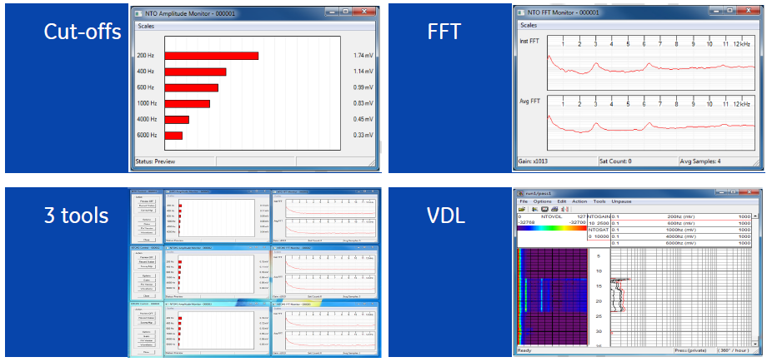
NTO Features
FFT-FAST FOURIER TRANSFORM SPECTRUM

Slide 11
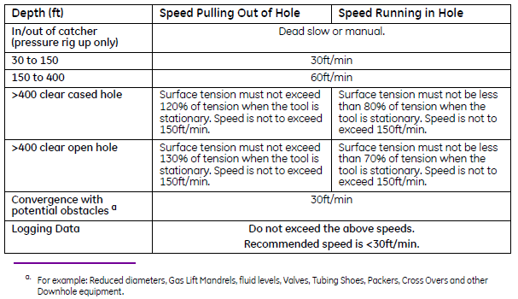
Logging Speed Guidance
**Note: This guidelines is for near vertical wells and must be adjusted when in deviated wells. However, refer with both downhole and surface condition is needed.

Slide 12
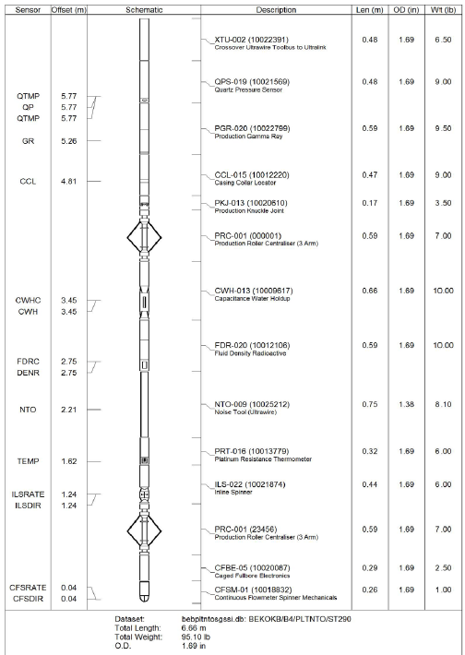
Tool Configuration

Slide 13
HOW LA READ THE LOG
HIGH FREQ, HIGH PITCH
LOW FREQ, LOW PITCH
FREQUENCY IS THE STRAIGHT LINE , THE WAVE OF FREQUENCY IS THE AMPLITUDE
LTEN= LOOK AT TENSION OF WIRE,TO MAKE SURE THE WIRELINE ACTIVITY

Slide 14
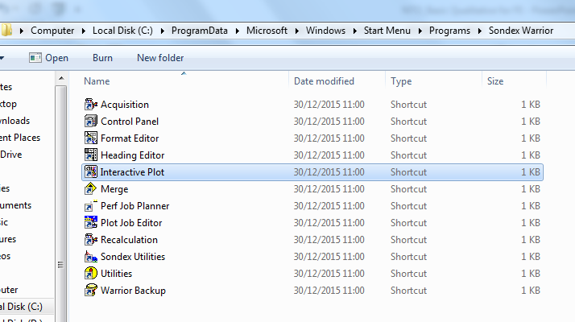
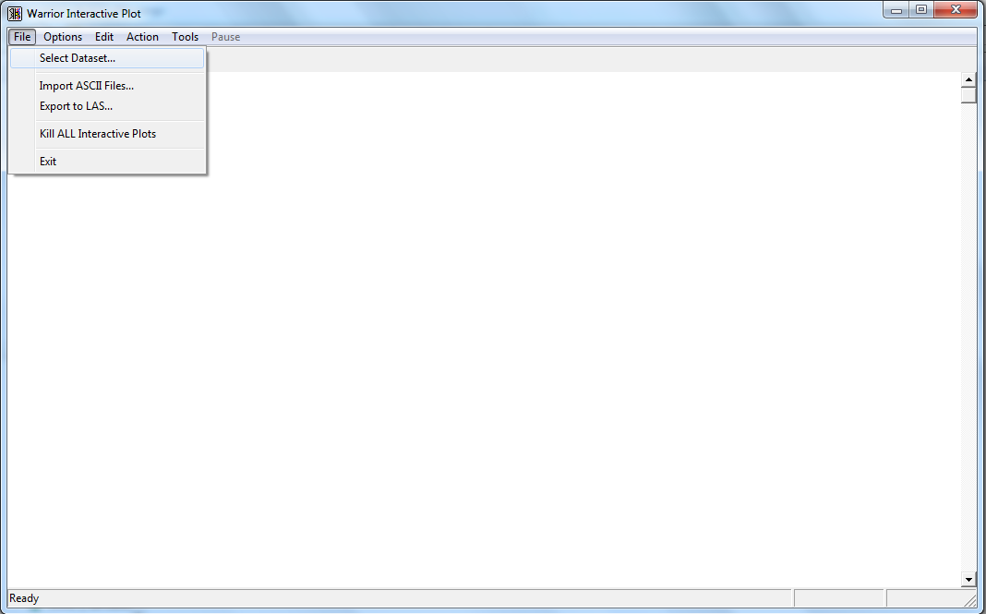
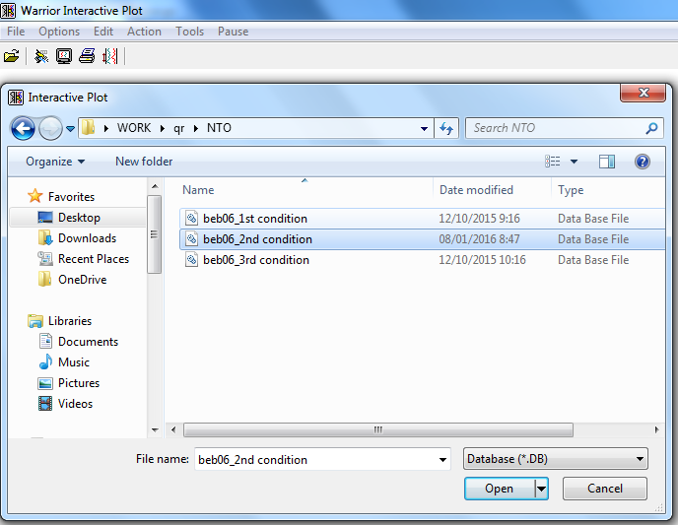
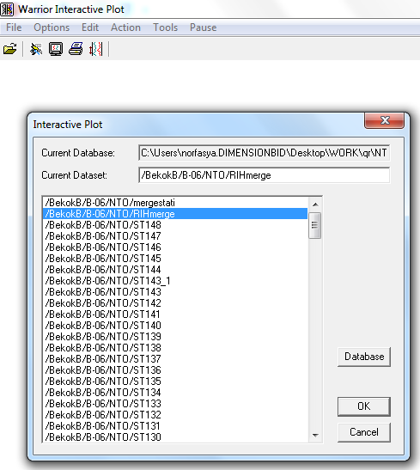
HOW TO OPEN LOG
2.
1.
3.
5.
4.
6.

Slide 15
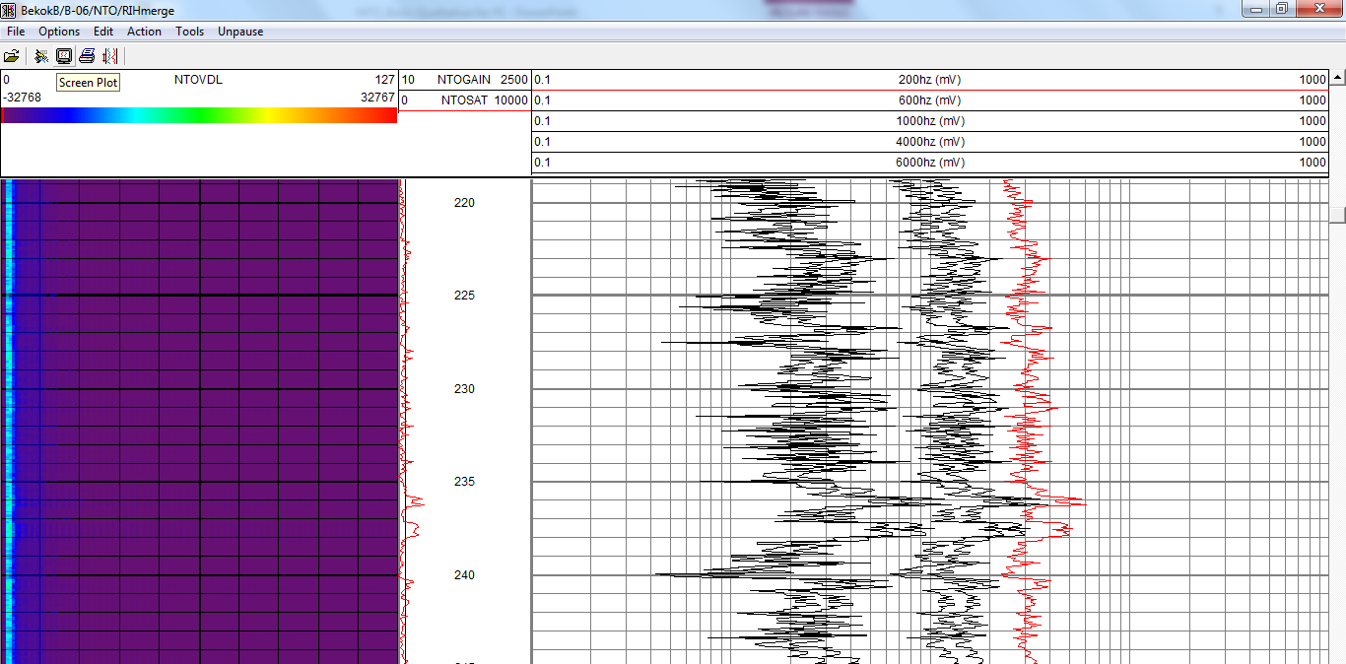
7.

Slide 16
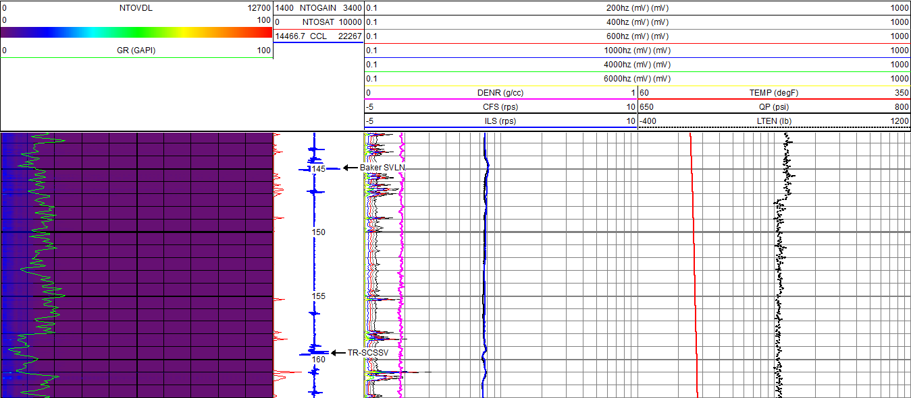
NOISE FEATURE AT SVLN & TR-SCSSV

Slide 17
Make sure u have correct .prs (rih & st)
Make annotation for every anomaly or accessories
Tie in depth – observed the difference between every accessories n well sketch,if the difference is same,u can use depth shift whole pass

Slide 18
NTO DB HISTORY
Client | Date | Field | Well | Details
PCSB | 19 &20/5/ 15 *B Annulus = Space between 9 5/8” Production Casing and 13 3/8” Production Casing | TGA | A-15 | Justification : Suspect leak at B annulus as there is increment in P. Objective : To identify leak point between Annulus and Tubing above 1st Packer Logging Interval : surface till 2480 mMDRKB Logging Speed : 10 meter/minutes in up and down manner. Depth Correlation : OHGR – PLGR Condition : 1) Condition A - Well Shut In, A Annulus Shut In, B Annulus Bleed Off 2)Condition B - Well shut in, A Annulus Pressured Up (injecting) & B Annulus Bled Off Result : 1)From noise log, indicate 2 possible leak point from NOISE signature 2)However, on Temperature Data, No clear anomaly of temperature signature was observes. The possible reason behind this is very low leak rate.

Slide 19
NTO DB HISTORY
Client | Date | Field | Well | Details
PCSB | 9 &11/10/ 15 *A Annulus = Space between 3 1/2" Tubing and 7” Production Casing | BEB | B-06 | Justification : Suspect leak as has build up in A annulus Objective : to identify leak point either at tubing or packer Logging Interval : surface till 984.00 m-MDDF Logging Speed : 10 meter/minutes in up and down manner. Depth Correlation : Well Accessories from schematic – PL-CCL Condition : 1) Condition A - Tubing Shut In, A Annulus Shut In 2) Condition B – Tubing Shut In, A Annulus Bleed 3) Condition C - Well shut in, A Annulus Pressured Up (injecting) Result : 1)There are some noise anomaly observed from Condition A. However most of the anomaly due to noise from tool movement either due to dragging or prior to pass through the smaller ID accessories. (Good Baseline) 2)From both Condition B and C condition, highest amplitude was recorded almost at the same depth which was surrounding GLM#1 especially at 957.19 m-MDDF.

Slide 20
NTO DB HISTORY
Client | Date | Field | Well | Details
PCSB | 16 &19/10/ 15 | BEB | B-04 | Justification : Retrieve Tubing Pack Off (2312 – 2280 Mmddf) to add perf Objective : To identify leak point Logging Interval : surface till 2632.1187 m-MDDF (for condition A & B) 2320 m-MDDF to surface (for condition C) Logging Speed : 10 meter/minutes in down manner m-MDDF (for condition A & B) 5 meter/minutes in up manner m-MDDF (for condition C) Depth Correlation : Well Accessories from schematic – PL-CCL Condition : 1) Condition A - Tubing Shut In, A Annulus Shut In 2) Condition B – Tubing Shut In, A Annulus Pressured Up (injecting) 3) Condition C - Well shut in, A Annulus Bleed

Slide 21
NTO DB HISTORY
Client | Date | Field | Well | Details
PCSB | 16 &19/10/ 15 | BEB | B-04 | Result : 1)There are some noise anomaly observed from Condition A. However most of the anomaly due to noise from tool movement either due to dragging or prior to pass through the smaller ID accessories. (Good Baseline) 2)As there is no clear indication during condition B, condition C was required. 3) Observed noise anomaly at depth in range 2301 to 2303 m-MDDF and also supported by temperature anomaly deflection suggesting suspect leak point. 4) Combination of Station Stops recorded highest Amplitude at depth in range 2301 to 2303 m-MDDF tally with POOH data. 5)Tubing pack-off was set after confirm the leak area, upper tubing stop set was at 2295 m-MDDF and lower tubing stop set was at 2305 m-MDDF. After pack-off, PCP was bleed. First reading after pack-off (1900hr, 20th October 15) was THP= 1000 PSI and PCP= 600 PSI. After a few hour bleed (0400hr, 21st October 15), PCP reading drop to 0 PSI with THP reading maintain 1000 PSI.

Slide 22
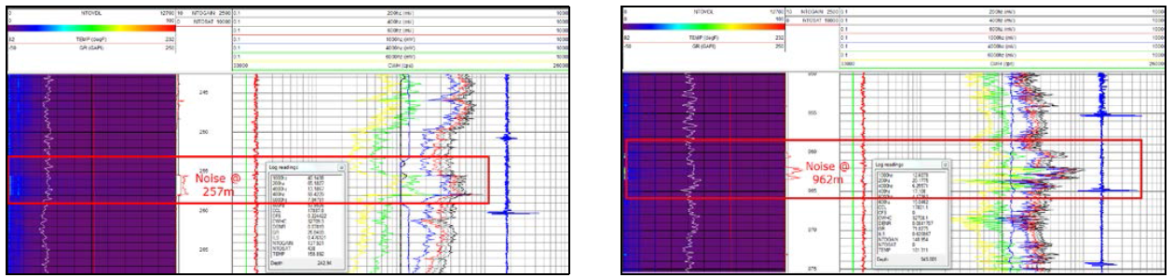
Case Study: Diagnosing Leak Behind Dual Concentric
Pipe Using Noise Tool
PROBLEM STATEMENT
Pressure in B Annulus of Well X encounter significant pressure increment.
As safety measure and prevention from any accident event, the source of leak need to be identified.
FIELD EXPERIENCE
Noise Logging was performed in 2 conditions;
  Shut in tubing & A annulus while bleed B annulus
  Shut in tubing, injecting A annulus while bleed B annulus
Those condition was to create conditions & evaluate integrity of each barrier
Noise Log successfully identify 2 possible leak points based on noise signature.
Useful input acquired from this logging can be utilized by field operator to keep operation in safely manner.

Slide 23
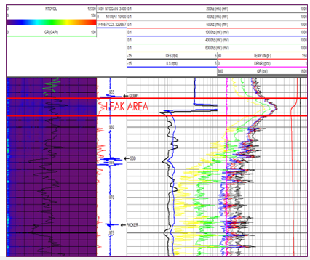
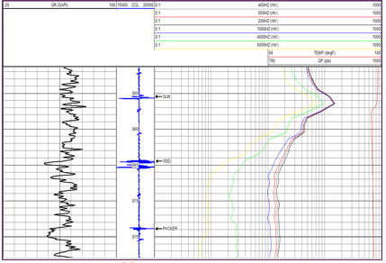
Case Study:Leaking Well Problems, How Should You Deal With It?
PROBLEM STATEMENT
In this challenging and critical period of oil and gas, well integrity issue is critical in sustaining production and can cause catastrophic impact to the environment. Leak and other associated issue related to well integrity
need to be identified proactively with integration of proper tool and method. A suitable approach need to be applied in order to get the best results and accurately identify the leak points whether at tubing, casing or
unknown source. The Noise Tool (NTO), a sensitive hydrophone that is highly effective in detecting flow inside or outside the cased well has been used in this wells.
FIELD EXPERIENCE
Two (2) wells; A and B has been identified.
For both wells, presumption of communication between Tubing and A annulus has been made.
Three conditions survey were introduced to create dynamic environment
  shut in tubing and A annulus for baseline
  shut in tubing, bleed A annulus
  shut in tubing and inject A annulus
Those condition was to create conditions & evaluate integrity of each barrier
As the result, these logging activities managed to pinpoint the exact location
of leak point primarily from noise tool and supported by temperature anomaly.

Slide 24
FREQUENT QUESTION ASK (FQA)
What concept that NTO used? Any analogy?
Just a microphone – digitizes sound downhole
Can NTO detect leak at intermediate casing (3 barrier)?
Depends on flowrate & fluid type – hard to say for sure without more details
Is there necessary to have correct condition to detect leak?
You maximize your chances with small leaks i.e. create largest pressure differential but big leaks will be found regardless.

Slide 25
FREQUENT QUESTION ASK (FQA)
What is estimate duration for 1 logging job?
Need more details!
Can NTO run alone without other sensors?
Yes but whole point is to run it in combination with other Ultrawire tools. Normally Temp/Spinner (if big leak) and GR/CCL but as it is only 60cm long often run with complete PL string
What is the length of the basic NTO tool string?
60cm tool

Slide 26
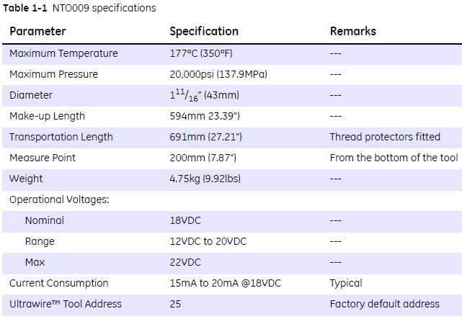
FREQUENT QUESTION ASK (FQA)
What are the pressure and temperature ratings of the NTO tool?

Slide 27
FREQUENT QUESTION ASK (FQA)
What is the maximum logging speed for NTO?
Both Stationary & moving, the faster you go the more road noise you record/generate – generally 10m/min or 30ft/min & stationary but decided by FE
Any limitation? (Gas well/ Oil well) Works in both
sounds are coupled better in fluid filled wells but gas OK
What is the borehole size limitation? How far NTO can detect the acoustic signal? (in terms of ID/OD)
Normal sizes e.g. up to 9 5/8”– depends on completion & sound strength larger pipes if sound loud enough

Slide 28
FREQUENT QUESTION ASK (FQA)
What are the recommended logging speeds and how many passes should be logged?
Depends on well – we can help design programmes if necessary for a free
what does the NTO tool measure?
Sound intensity & frequency vs time
Is the NTO tool memory-capable? YES, NTO capable in warrior SRO (Real Time) & MEMORY.
What does NTOGAIN log mean? If have deflection, what actually happen? How does it help in interpretation?
Gain is loudness adjustment by Engineer to see decent signal – see attached instructions

Slide 29
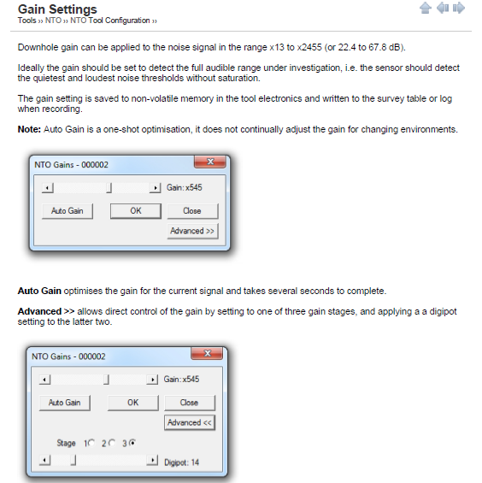
GAIN INSTRUCTION

Slide 30
FREQUENT QUESTION ASK (FQA)
What does NTOSAT log mean? If have high deflection, what actually happen? How does it help in interpretation?
NTOSAT shows if digital signal buckets are clipped/staurated – like digital sound recordings – you really want only a few Saturated signals but it’s a compromise with getting a loud enough signal. A few is OK.
What does NTOVDL log mean? How does it help in interpretation? SEE ATTACHMENT

Slide 31
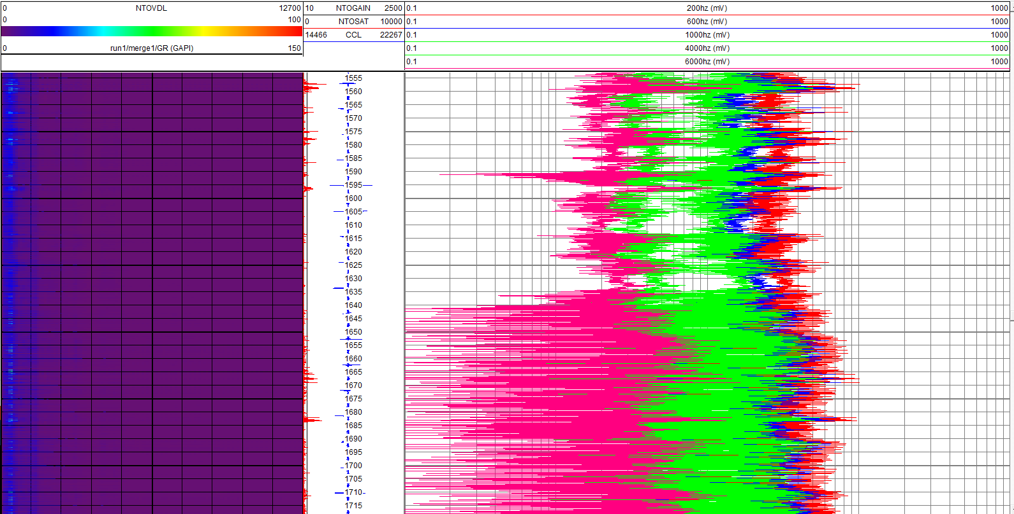
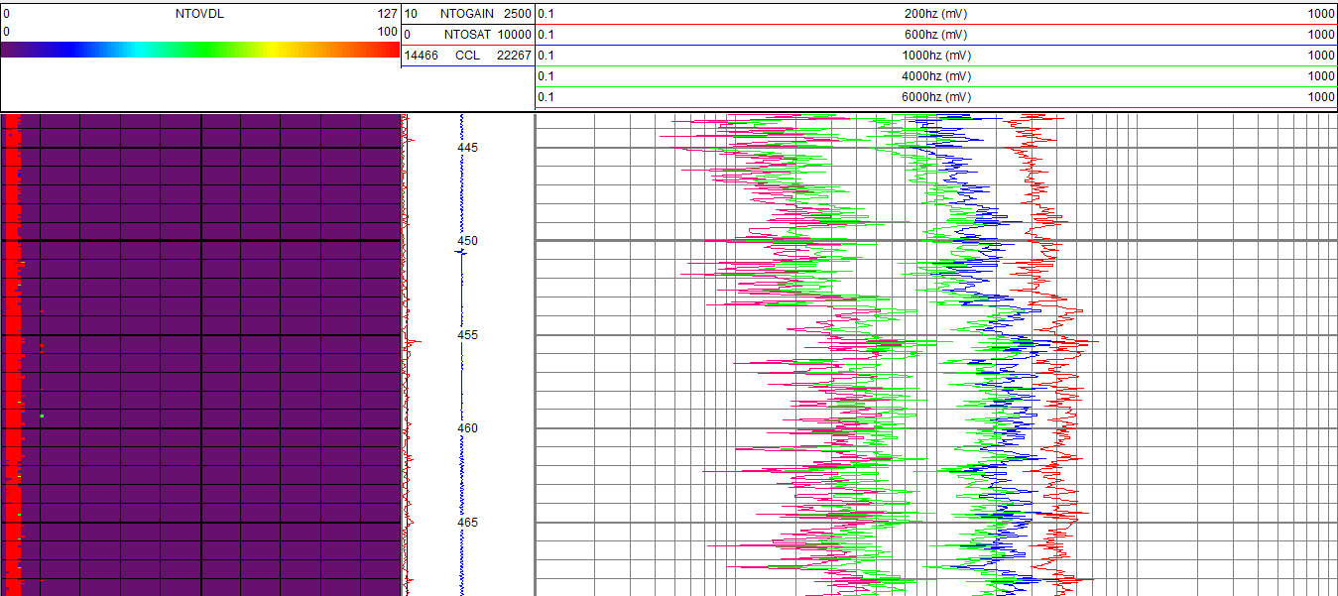
Why there is a difference signature
between above & below? Why below seems like too noisy? What actually happen there?
if the gain stayed the same & logging speed same then there is a change in noise. The low frequency noise is probably “road noise” generated by the tool being dragged up the hole. The way to tell for sure is to take a stationary reading which will have no road noise.
Why the color here get difference? What are the factor that influence this? I’m guessing the bottom one was logged faster if they are at the same depth.

Slide 32
FREQUENT QUESTION ASK (FQA)
Is the NTOVDL color depend on the average of amplitude from 6 frequency?
No – the VDL plot (the purple one on the left) plots amplitude as colour (purple lowest amplitude through blue, then green, yellow , orange & finally red for highest amplitude) versus frequency from left to right. So lowest frequency (0Hz) is on the left and the highest recorded is 12.7kHz on the right hand side. The tool records everything from 0 – 12.7 kHz & digitizes it downhole turning it into a Fourier transform.

Slide 33


