Slide 1
Name : Ammirol Ahmad Mahmud
Title: Safety Topic (LINE OF FIRE AWARENESS )

Slide 2
OBJECTIVES
What is “ Line Of Fire “
Common areas of concern
Line of fire examples
Behaviours
Identifying the hazards
What to do when hazards are identified

Slide 3
What is " LINE OF FIRE"

Slide 4
WHAT IS “LINE OF FIRE”?
Line of Fire, which was originally a military term, is now commonly used in industrial safety
Situations where workers put themselves in harm's way by virtue of the type of work they are carrying out.
Lack of awareness
Lack of education
Hazards can be hard to recognize and can
Incapacitate
Cause Injury
In severe cases, kill the employee or co-workers

Slide 5

WHAT IS “LINE OF FIRE”?
Line of fire hazards are one of the most common hazards found in manufacturing, second only to Slip, Trips, and Falls.
Between 80-90 percent of all workplace accidents are caused due to unsafe behaviors

Slide 6
COMMON TARGET AREAS OF CONCERN

Slide 7

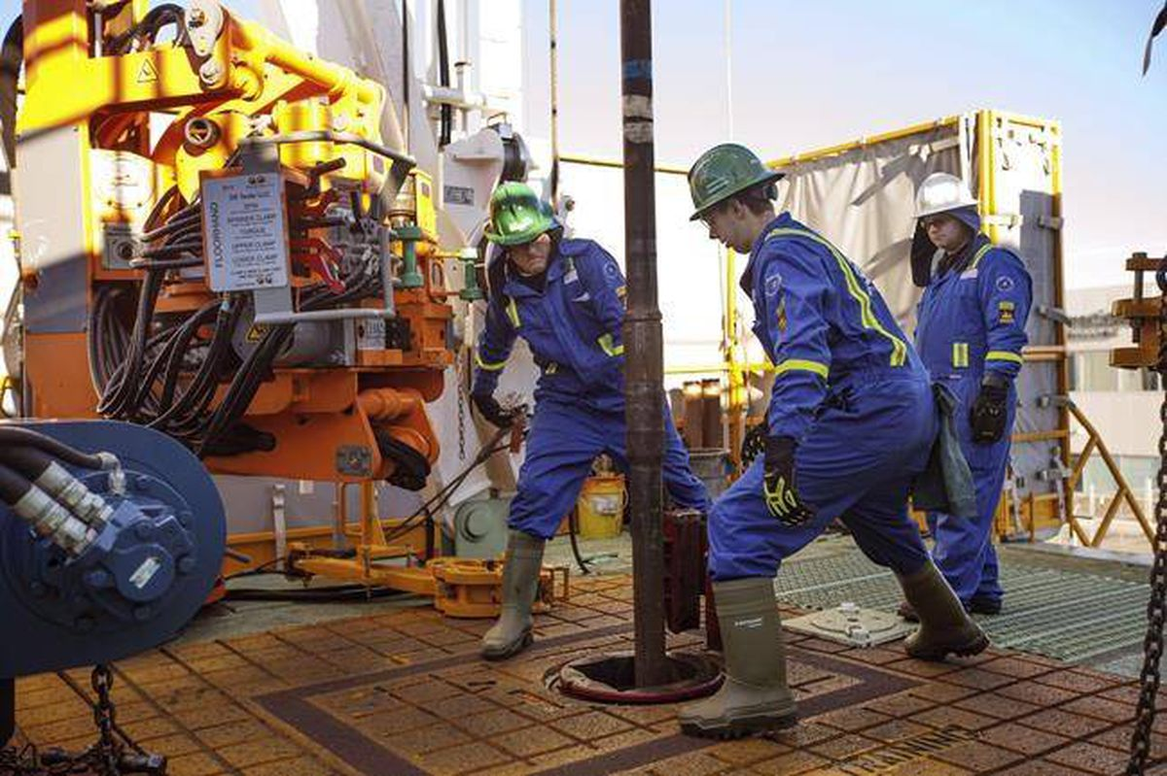
COMMON TARGET AREAS OF CONCERN
Heavy Equipment
Machinery
Manufacturing
Assembly
Hand and Power Tools
Material Handling
Mobile Equipment

Slide 8
LINE OF FIRE EXAMPLES

Slide 9
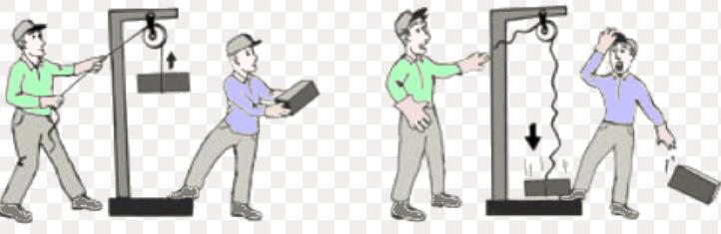
LINE OF FIRE EXAMPLES
Dangers presented by the sudden release of tension
Gravity
Moving Machinery
Path of travel
Flying debris and projectiles

Slide 10
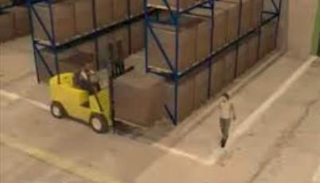
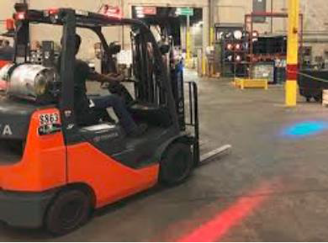
LINE OF FIRE EXAMPLES
Opening and closing energy control devices
Being aware of automated equipment and their potential movement
Pedestrians and moving vehicles
Contract with stationary hazards

Slide 11
BEHAVIORS THAT LEAD TO HAZARDS

Slide 12

BEHAVIORS THAT LEAD TO HAZARDS
Rushing - You are in a hurry to complete a task
Frustration – You are angry, irritate, or annoyed
Fatigue – you are tired
Complacency – You have completed a task many times and have never been hurt before

Slide 13
WAYS TO IDENTIFY THE HAZARDS

Slide 14

WAYS TO IDENTIFY THE HAZARDS
Look for hazards before you start working
SLAM risk ( Stop-Look-Assess-Manage )
Ask yourself, “ What can hurt me in this job “
If you don't know ask your co-worker or supervisor

Slide 15
WHAT TO DO WHEN HAZARDS ARE IDENTIFIED

Slide 16
WHAT TO DO WHEN HAZARDS ARE IDENTIFIED
Eliminate the hazard when possible
The best-case scenario is to remove the hazards completely
If you cannot eliminate, then control the hazards
If it is not possible to remove the hazards, neutralize them

Slide 17
WHAT TO DO WHEN HAZARDS ARE IDENTIFIED
Use best practices for minimizing hazards
Organize the work area to provide unobstructed and easy access to equipment
Use sign to warn of know line of fire
Keep pathway clear
Eliminate possible pinch points on guarding
Use correct tool for the job

Slide 18

KEEPING YOURSELF SAFE IN THE LINE OF FIRE
Be aware of the hazards around you
Understand the machines and operations in your work area
Take time to think about the consequences that could result from what you are about to do

Slide 19
Thank you !~

