Slide 1

POST JOB REVIEW
SAMARANG KECHIL A SMK-A01L GRCCL & M-RAPTOR
PREPARED BY
SAHIR SAMSURI

Slide 2
PRESENTATION OUTLINE
HSE & Governance
Operation Objective Overview
Background
Operation Summary
Operation Analysis
Conclusion

Slide 3
HSE & GOVERNANCE
HSE EVENTS (UAUC)
TOTAL
72
0
0
30
0
Example: OBSERVED PERSONNEL PERFORM AND MAINTAIN HOUSEKEEPING AT WORK AREA.
Action taken: COMPLIMENT THE PERSONNEL TO MAINTAIN GOOD PRACTICE AND AWARENESS.
UNSAFE CONDITION
POSITIVE OBSERVATION
UNSAFE OBSERVATION
NEAR MISS

Slide 4
HSE & GOVERNANCE
Crew unable to travel and perform boat transfer due to unfavorable weather condition. Waiting for further instruction for outstation to platform due to incoming squall.
An unfavourable and unexpected weather pick up. All mitigation in place to make sure all personnel safety and equipment secured in place prior to any job execution.
  Stop job during high wind and unfavorable weather.
  Crew unable to perform and continue lifting during bad weather.
  Slippery floor – PPE including safety boot checked before starting job. Oil absorbent in place.
  Job Preparation – Toolbox Talk and JHA briefing on each step taken before rig up and rig down.

Slide 5
SMK-A01L

Slide 6
OPERATION OBJECTIVE OVERVIEW
The plan is to run GRCCL correlation run prior to perform memory Raptor contact logging

Slide 7
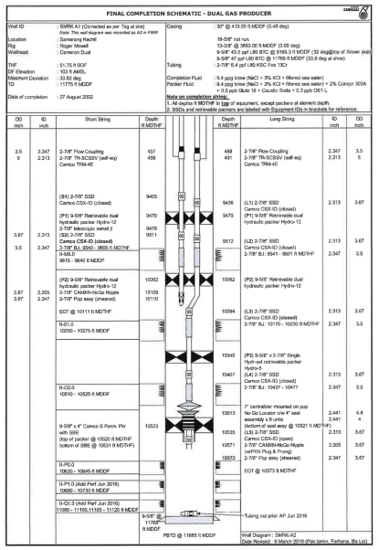
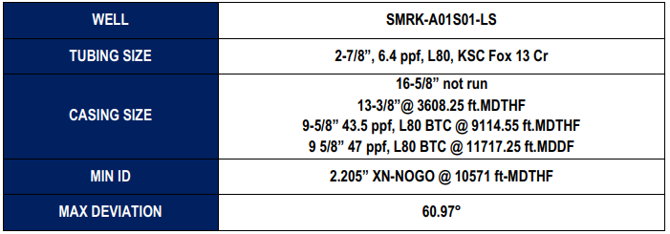
BACKGROUND
WELL INFO
OBJECTIVE
- To perform GRCCL correlation at interval 10200 ft-MDTHF – 10570 ft-MDTHF to perform Contact Logging.
- To perform Contact Logging at interval 8308 ft-MDTHF – 10570 ft-MDTHF.

Slide 8
OPERATION SUMMARY
Planned | Actual
RUN#1 – GRCCL Prior M-Raptor 10622-10252 ft-MDDF. | Perform GRCCL run at 10622-10252 ft-MDDF. The tool successfully recorded logging data. Depth offset 2.626 ft.
RUN#2 – N-Vission Up Pass 1 | Perform M-Raptor N-Vission Up pass 1 run at 10622-8357 ft-MDDF. The tool successfully recorded logging data
RUN#3 – C/O Up L4.0-L1.0 Pass 1 | Perform M-Raptor C/O Up L4.0-L1.0 Pass 1 run at 8730-8360 ft-MDDF. The tool successfully recorded logging data
RUN#4 – N-Vission Up Pass 2 | Perform M-Raptor N-Vission Up pass 2 run at 10622-8357 ft-MDDF. The tool successfully recorded logging data
RUN#5 – C/O Up L4.0-L1.0 Pass 2 | Perform M-Raptor C/O Up L4.0-L1.0 Pass 2 run at 8730-8360 ft-MDDF. The tool successfully recorded logging data

Slide 9
OPERATION SUMMARY
Planned | Actual
RUN#6 – CO Up O0.4-O1.0 Pass 1 ---CO M5.0 Pass 1 | Perform M-Raptor C/O Up O0.4-O1.0 Pass 1 run at 10622-10200 ft-MDDF and CO M5.0 Pass 1 at 9740-9580 ft-MDDF The tool successfully recorded logging data
RUN#7 – C/O Up L4.0-L1.0 Pass 3 | Perform M-Raptor C/O Up L4.0-L1.0 Pass 3 run at 8730-8360 ft-MDDF. The tool successfully recorded logging data
RUN#8 - C/O UP O0.4-O1.0 PASS 2(10622 - 10200 ft-MDDF), C/O INTERVAL PASS 2(10200 - 9740 ft-MDDF), C/O M5.0 PASS 2(9740 - 9580 ft-MDDF) RUN#9 -C/O M5.0 PASS 3(9740 - 9580 ft-MDDF) RUN#10 – C/O UP O0.4-O1.0 PASS 3(10622 - 10200 ft-MDDF) | Client decided to drop out these run since the data from pass 1 was already sufficient.

Slide 10
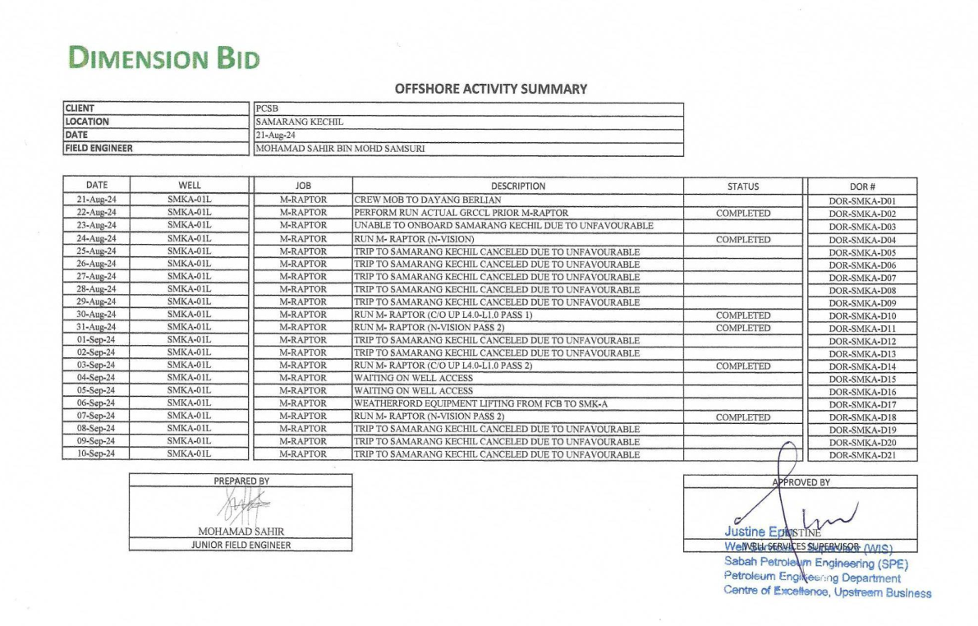
OPERATION ANALYSIS
OFFSHORE ACTIVITIY SUMMARY (OAS)

Slide 11
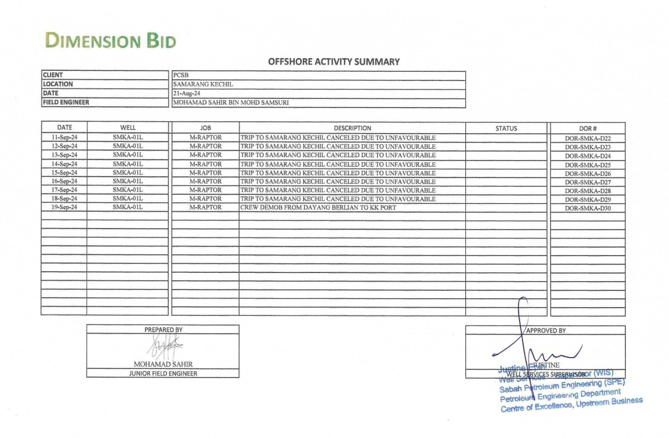
OPERATION ANALYSIS
OFFSHORE ACTIVITIY SUMMARY (OAS)

Slide 12
OPERATION ANALYSIS
DAY/ACTIVITY | MAD | HSE | JPR | WOW | OPT | SLO | SDFN | TOTAL OVERALL
TOTAL IN HOURS | 35.8 | 5.3 | 34.5 | 194.8 | 77.3 | 0.0 | 372.5 | 720.0
TOTAL IN DAYS | 1.5 | 0.2 | 1.4 | 8.1 | 3.2 | 0.0 | 15.5 | 30.0
DAYS PERCENTAGE | 5% | 1% | 5% | 27% | 11% | 0% | 52% | 100%
MAD | Mob/ Demob (to/ from field)
HSE | Toolbox Meeting/ Safety Meeting
JPR | Set up Equipment/Housekeeping
WOW | Waiting on Weather
OPT | Operation Time
SLO | Slickline operation
SDFN | End of activity

Slide 13
CONCLUSION
HIGHLIGHT
All crew comply to Health Safety and Environment Rules and participate HSE program etc. emergency drill and safety talk.
100% HSE compliance throughout operations – 100% UAUC submitted via app throughout operation.
Good communication between all parties include PCSB, DIMENSION BID, DELEUM, WEATHERFORD, AND CRANE OPERATOR.
Successfully executed the job for SMK-A01L safely despite time constraint and encounter hurdles.
LOWLIGHT
Unable to perform boat transfer due to unfavorable weather and squall.
Weather factor causing time constraint, unable to perform lifting and waiting on equipment mobilization.
Congested and limited deck space.

Slide 14
CONCLUSION
LESSON LEARN
Unexpected problem encountered such as well condition, weather pick up and equipment can cause the unproductive time of the operation.
Maintain good decision, communication, time synchronize, health and safety is essential during operation time to counter any unexpected difficulties.

Slide 15
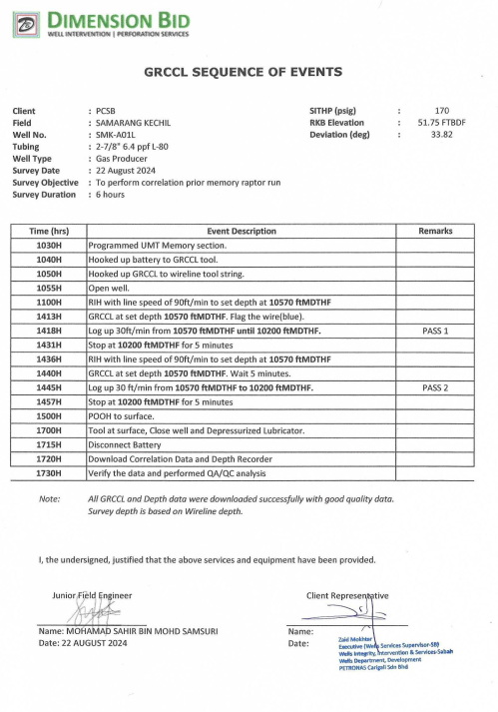

Slide 16
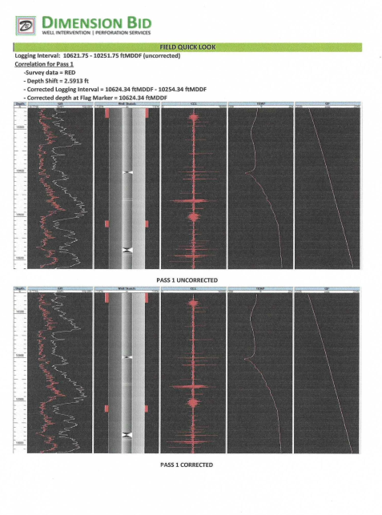
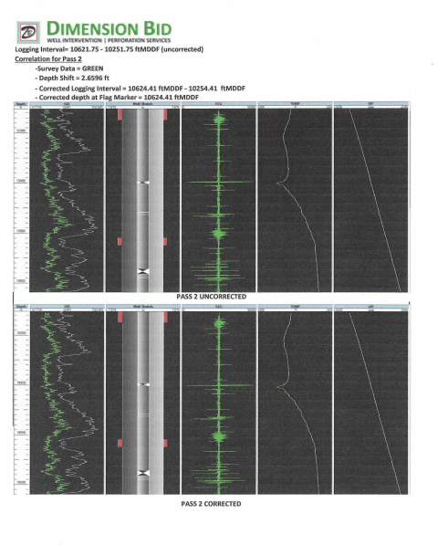

Slide 17
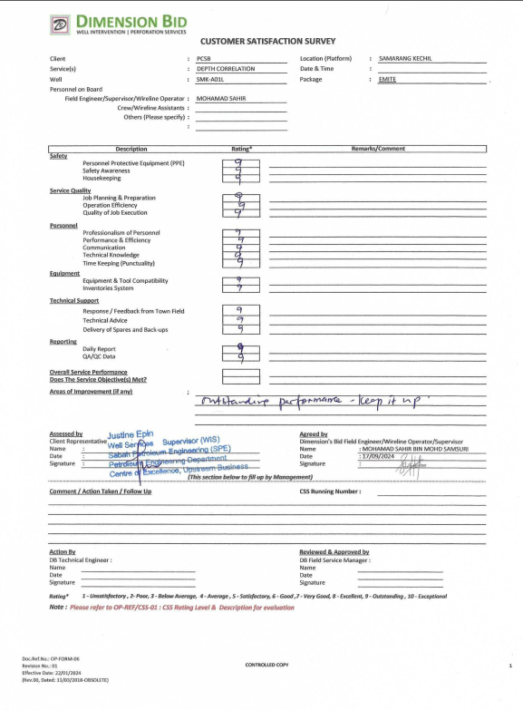
SAMARANG KECHIL
SMK-A01L
CUSTOMER SATISFACTION SURVEY

Slide 18
THANK YOU

