Slide 1
[NITROGEN CONVERTER]
By [Muhammad Shahir Munaqib Bin Harun]
[06/03/2024]

Slide 2
Content
[TOPIC]
① | INTRODUCTION
② | ENGINE
③ | PUMP
④ | VAPORISER
⑤ | SAFETY DEVICE
⑥ | TROUBLESHOOT

Slide 4
INTRODUCTION
Liquid nitrogen is one product of air separation
Nitrogen consist of 78% of the air by volume
Boiling point of liquid nitrogen is -320 F/-195.5 C
Weight of nitrogen 6.74 lbm/gal

Slide 5

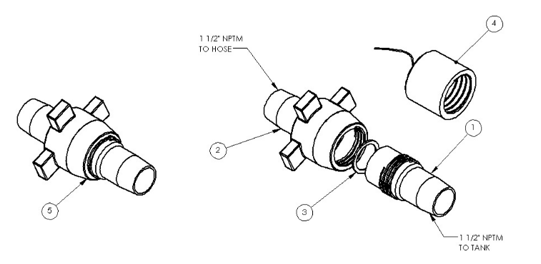
RIG UP
Rig up cryogenic hose at inlet and return of Nitrogen tank and Nitrogen converter.
Cryogenic Hose: 316 or 314 stainless steel
Fittings: NIT150
Treating Irons: 2 x 1 Plug Valve, Dart Check Valve, Tee, Pup Joint

Slide 6
Calculation Involve
Pump Rate? (scf/min)
N2 tank Volume? (inch > gallon)
Liquid N2 (Gallon) convert to Gas N2(scf)
Eg: How long can the Tank last for 300 scf/min pump rated if the volume of N2 tank left is 50”?
50” is 1809.5 gallon
1809.5 gallon X 93.12(constant variable) ÷ 300 ÷ 60 = 9.6 hours

Slide 7
PERFORMANCE SPECIFICATION
Maximum Working Pressure: 10,000 psi
Working Temperature Range: -10 °C to 50 °C
Maximum Flow Rate: 180,000 scf/hr or 3,000 scf/min
Design Maximum Flow Rate Temperature: 20 °C
Fuel capacity: 375 litres/100 USG
Design ambient temperature: -20 °C to 50 °C
Design environment: Onshore/Offshore
Hydrostatic Test Pressure: 15,000 psi

Slide 8
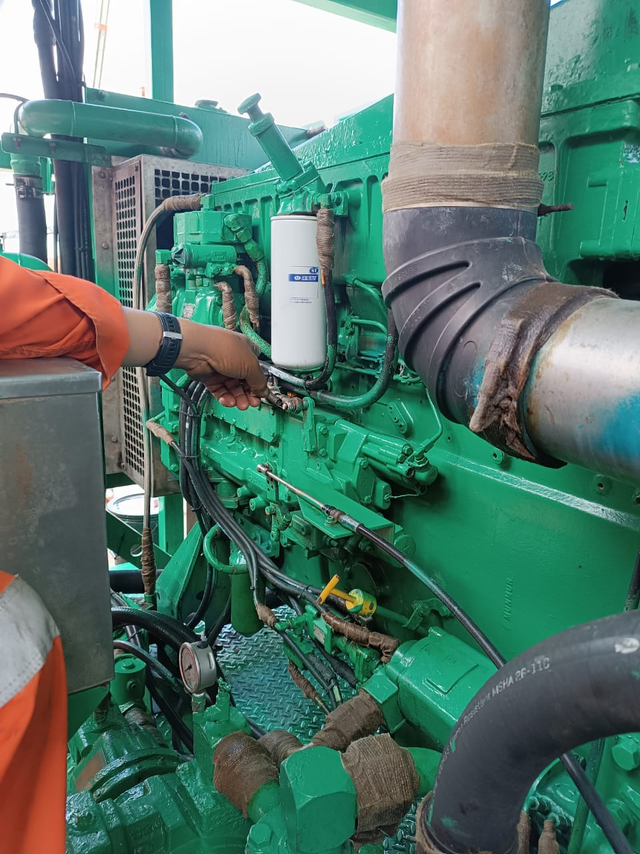
Engine Module
Engine Model: Caterpillar 3406c DITA
Type Burning Fuel: Diesel
Engine Rating: 490 bhp @ 2100 RPM
Engine Bore Size : 137mm ( 5.4”)
Stroke: 165 mm (6.5”)
Transmission: Auto

Slide 9
Triplex Pump
Cold End
1-5/8” (1.625inch) piston
10,000 psi and 180,000 scf/hr rated
The reciprocating positive displacement pistons that draw in low pressure LN2. Cold Ends are attached to and driven by the warm end
Warm End
The mechanical drive and plunger section of the Triplex pump assembly. The Warm End drives the attached Cold Ends.

Slide 10
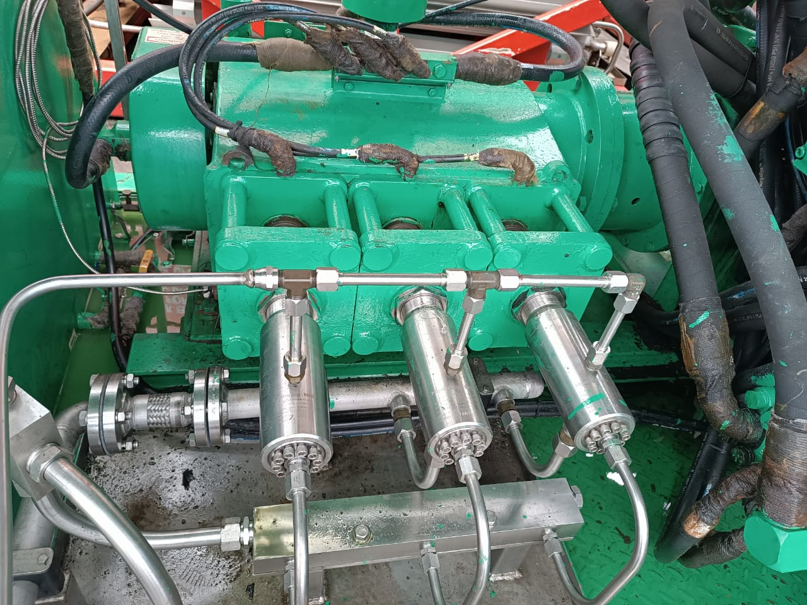
Triplex Pump
Warm End
Cold End

Slide 11
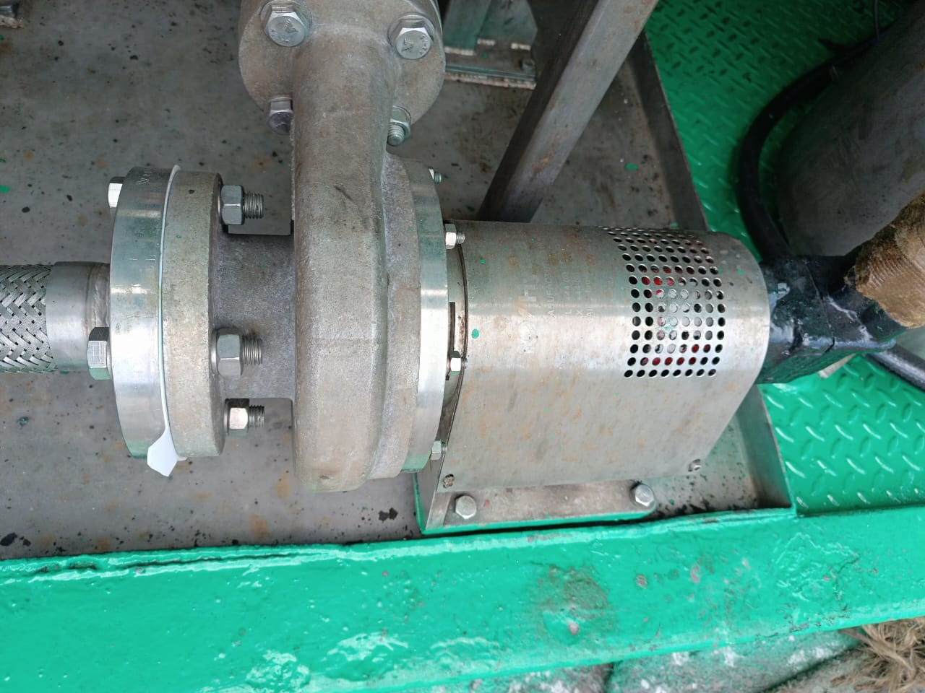
Centrifugal Charge “Boost Pump”
1-1/2” outlet x 2-1/2” inlet x 6” Impellor
Maintain pressure of 40-100 psig on the suction of cold end to ensure positive pressure of liquid nitrogen.
Cold end(s) require between 30 to 40 psig Net Positive Suction Head (NPSH) to pump efficiently.

Slide 12
Liquid Nitrogen Vaporiser
Converts the liquid nitrogen to a gas by absorbing heat from the Coolant Loop Circuit.
Coolant Loop Circuit: Water/Glycol system that collects unit generated heat for LN2 vaporization.
Discharge Gas: 15-20 Degree Celcius
Coolant Loop Temperature: 50-70 Degree Celcius
Corken pump to pump the coolant through Coolant Loop Circuit

Slide 13
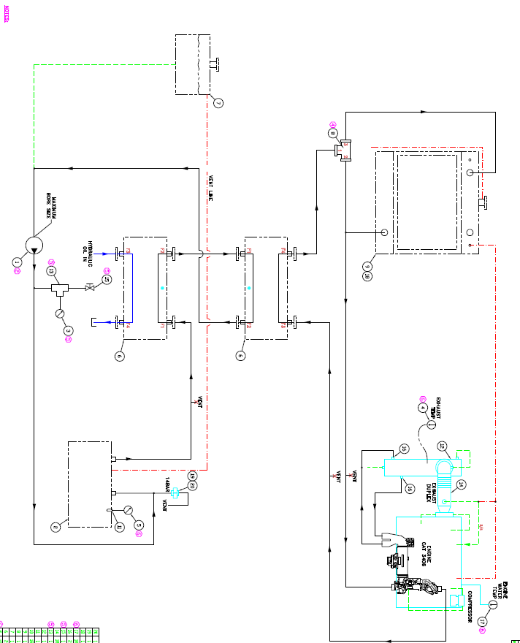
SCHEMATIC COOLANT

Slide 14
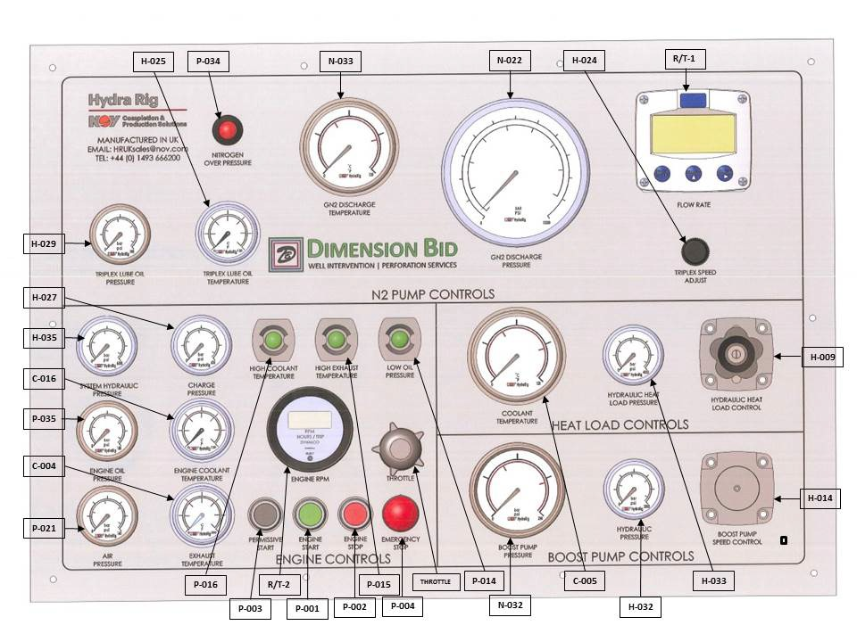
Engine Control And Indicators

Slide 15
Automated Shutdown Valves
Engine Overspeed Shutdown
Emergency Stop Shutdown
High Coolant Temperature Shutdown- 100 °C
Low Engine Oil Pressure Shutdown- below 10 psi
High Exhaust Temperature – 200 °C

Slide 16
Troubleshoot
Trouble | Cause | Ways to Overcome
Low flow rate to unit from N2 tank | Low tank pressure Supply valve not fully open Return valve closed or partly closed Clogged piping or transfer hoses | Increase tank pressure Open supply valve fully Open return valve fully Inspect piping and hoses to insure free flow
Boost pump not turn | Hydraulic valve closed at boost pump Suction valve to hydraulic pump closed Defective hydraulic pump | Open the valve Disconnect motor supply hose. Plug hose and cap motor. Test pump pressure if pump does not build up pressure check system relief valve, if OK, remove and replace pump
Tank not build up pressure | Line to pressure bulding coil obstruction or valve closed Low liquid level Leak to atmosphere | Clear obstruction and/or open valve Fill tank Locate leak and repair

