Slide 1
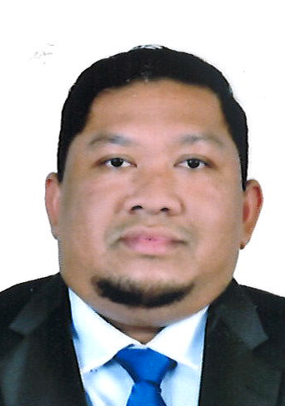
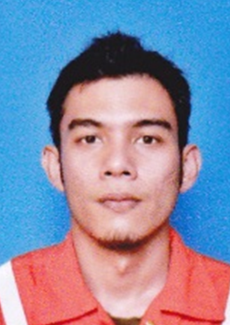
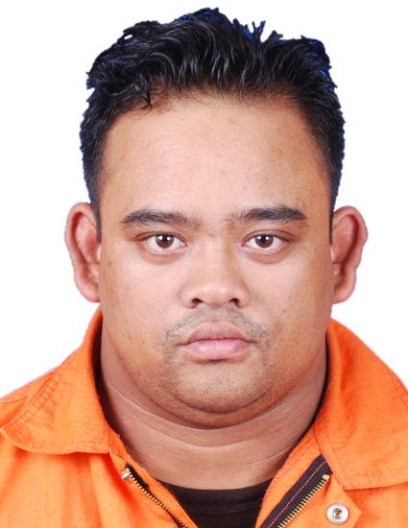
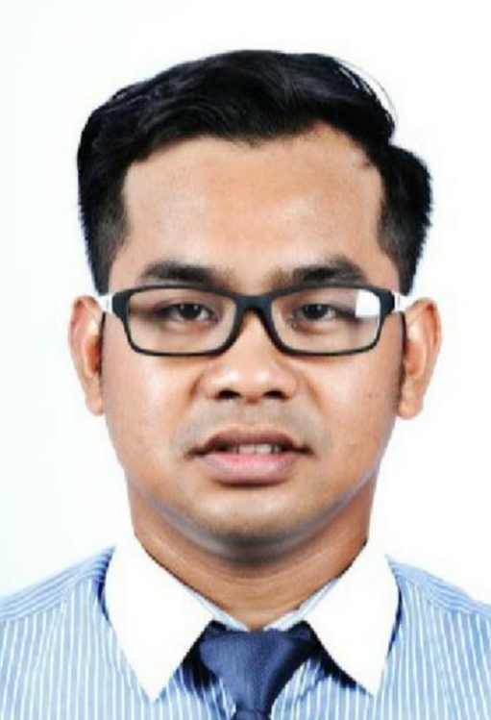
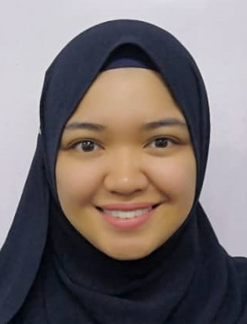
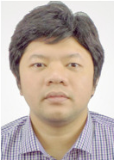
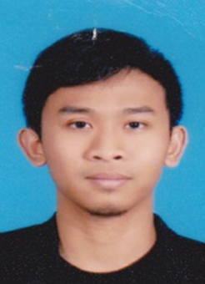
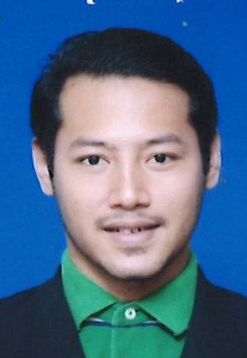
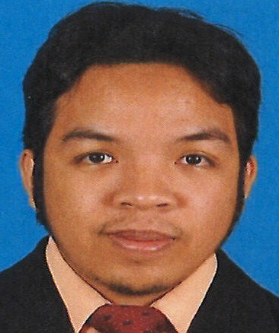
E-LINE DIVISION
OPERATION MANAGER
ZAHIR MANAN
OPERATION
PEXS
CLIENT RELATIONS
DATA MANAGEMENT
FARIS M. FIRDAUS
Field Service Manager
MOHD ISMADY
Team Leader
AZAHARI SUHARI
Business Development Manager
BABY CINTAMI
Log Analyst /
EIC WMO
M. SYAMIM
Reservoir Product Champion
PEXS TEAM
LUQMAN
Account Manager
(IWS, ROC Oil, Vestigo, Petra Energy, Exxon & SLB )
EMO
M. SAFDAN (Sr FS)
M. ISMIRUZIKA (M. Perf. Specialist)
WMO
M. ZAIMIE (Explosive Handler)
KAMEL
Training & Development Engineer
M. AMRI AZRI
Sr. Account Manager (SBA & SEAH)
VACANT
Maintenance Manager
WAN ABDULLAH
Account Manager (QEM SARAWAK)
GRACE SHINDA
Sales Engineer
(QEB & QEM SARAWAK)
ASYRAF
Technical Sales Engineer
(QEB SARAWAK)
Approved by :
DATO’ AZIZ AYOB
President

Slide 2
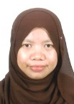
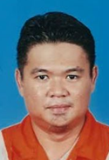
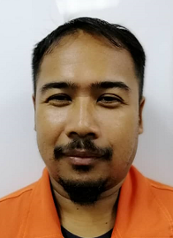
E-LINE EAST MALAYSIA OPERATION
OPERATION MANAGER
ZAHIR MANAN
SABAH OPERATION
FARIS M. FIRDAUS
Field Service Manager
Asset Coordinator
VACANT
SITI FATIMAH HANIM
Executive, Operations
FIELD ENGINEER UNIT 1
FIELD ENGINEER UNIT 2
FIELD ENGINEER UNIT 3
FIELD ENGINEER UNIT 4
FIELD ENGINEER UNIT 5
EMITE
POOL ENGINEER
AZRIQ AFIF (SFE 2)
VACANT FE
M AZWAN S (SFE 1)
M ZAIFULNIZAM (SFE1)
M.ARIFFIN (FE 1)
VACANT
M ISMAIL (SFE 2)
VACANT
VACANT (FE)
VACANT (FE)
M. AZMI (SFE 2)
CASSIDY JANA (SFE 2)
M HAFIZ Z (SFS)
S. ABD GHAFFUR* (SFS)
M. ARZIZI (JFE)
IKRAM (JFE)
VACANT (FE)
VACANT (JFE)
VACANT (JFE)
M. KHAIRI
Foreman
MAZLAN MOHD
Assistant Foreman
UNIT 1
UNIT 2
UNIT 3
UNIT 4
UNIT 5
POOL CREW
MAINTENANCE
Crew Chief:
M.NORASMADI (SCC)
STEPHEN (SCC)
M. RIDZUAN (SCC)
M. ROSLI (SCC)
Operator:
M. FAIZOL (CC)
M.AZHAM (TCC)
Crew Chief :
ABD HALIM (SCC)
ARSAD (SCC)
FABIAN (SCC)
WAN SAUFI (SCC)
Operator :
M. HASHFIZOL (TCC)
MAX SPENSER (JFO)
Crew Chief:
M. TARMIZIE (SCC)
M. HASBULLAH (SCC)
WALTER (CC)
M. HAFIZ R (SCC)
Operator:
M. HAFIZUDDIN (TCC)
M. AL- AMIN (TCC)
Crew Chief
MIKE WELLER (SCC)
ZUBIR ZAKARIA (SCC)
JEZZIE (CC)
Operator :
JACOB (TCC)
CHAMPBELL (JFO)
VACANT (JFO)
Crew Chief:
AZMAN W (CC)
M ASROL NIZAM (SCC)
Operator :
VACANT (SFO)
AZWAN ROJI (JFO)
SAID AZREEN (JFO)
IKHWAN (JFO)
Crew Chief:
VACANT (CC)
Operator :
VACANT (SFO)
VACANT (JFO)
VACANT (JFO)
Surface Equipment :
SYLEVISTER (TL)
WAN MUKHLIS (TL)
ABU ZAR
VACANT
Lab :
ARMAN SHAH (TL)
M. ISMIRUDYKA
PCE :
VACANT
VACANT
Approved by :
DATO’ AZIZ AYOB
President

