Slide 1



Right Procedure to Redress Double Flapper Check Valve
Prepared By: Zainuddin Bin Yaacob

Slide 2


Table Of Content
Connection Codes
Make Up Torque
Technical Information
Maintenance
Disassembly
Assembly
Assembly Drawing

Slide 3


Connection Codes

Slide 4
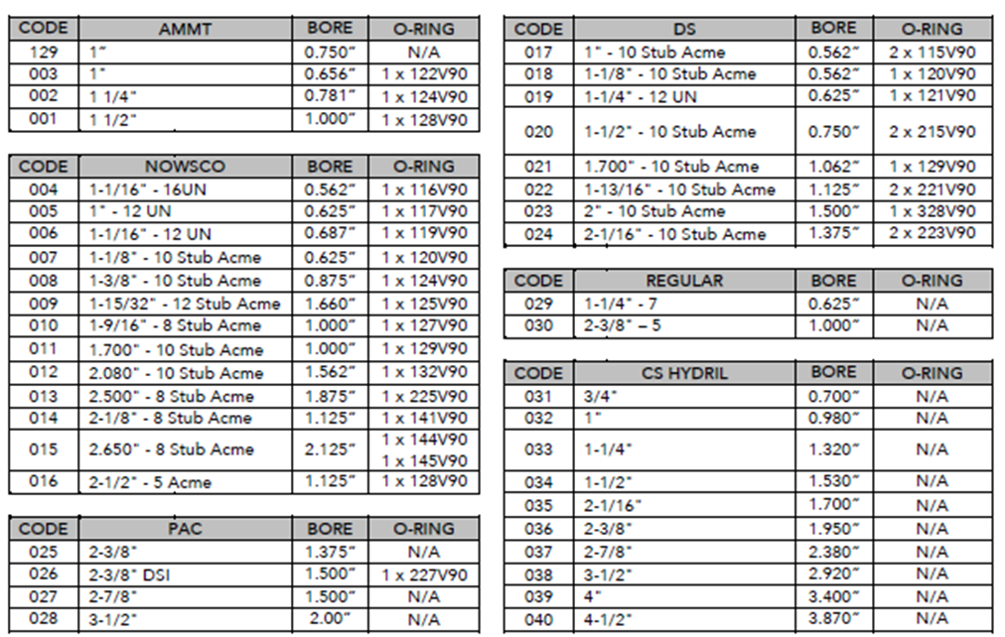

Connection Codes

Slide 5
Make Up Torque

Slide 6
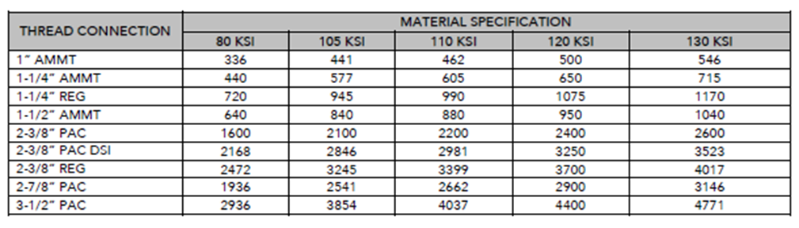
Make Up Torque

Slide 7
Technical Information & Maintenance

Slide 8
Technical Information
Remember! Ensure to refer to the assembly diagram prior to every redressing procedure.
Maintenance
Recommend that the tool is disassembled after each operation. Check all parts for wear or any sign of corrosion. Refer to disassembly and assembly instructions in the Operation and Service Manual for details.
Use suitable grease during assembly to lubricate all moving parts.

Slide 9
Disassembly

Slide 10

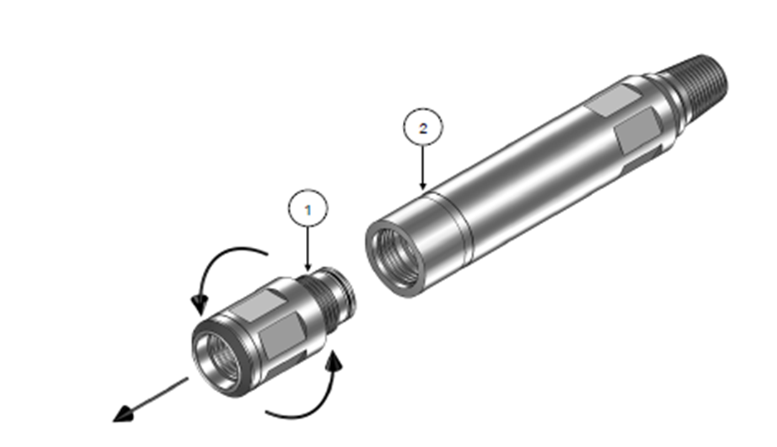
Tools Required
  Pipe Wrench
  O-ring Pick
  Pin Punch
  Hammer
Unscrew Top Sub (1) from Housing (2)
IMPORTANT: ENSURE THAT THE TOOL IS ONLY GRIPPED ACROSS THE FLATS

Slide 11
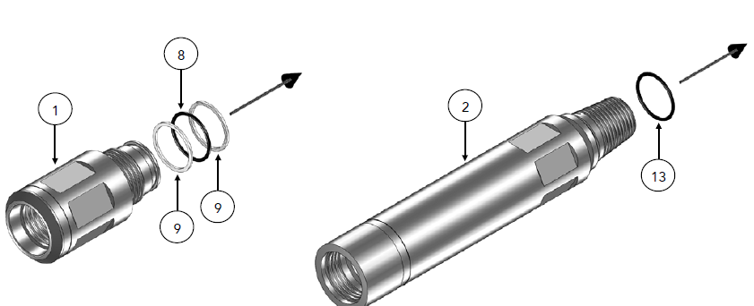
  Remove Back-Up Rings (9) and O-Ring (8) from Top Sub (1) .
  Remove O-Ring (13) from Housing (2)

Slide 12
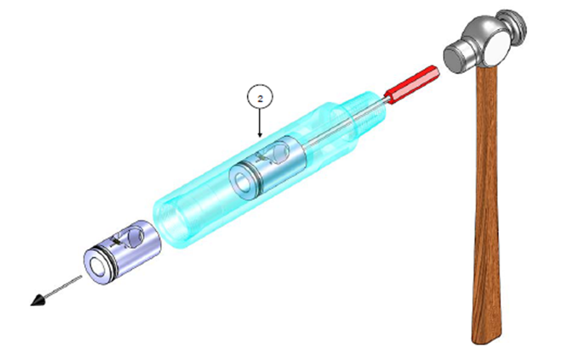
  Insert a suitable sized Pin Punch into the lower end of Housing (2).
  Lightly tap with hammer to remove the Flapper Cartridge Assemblies from Housing (2)

Slide 13
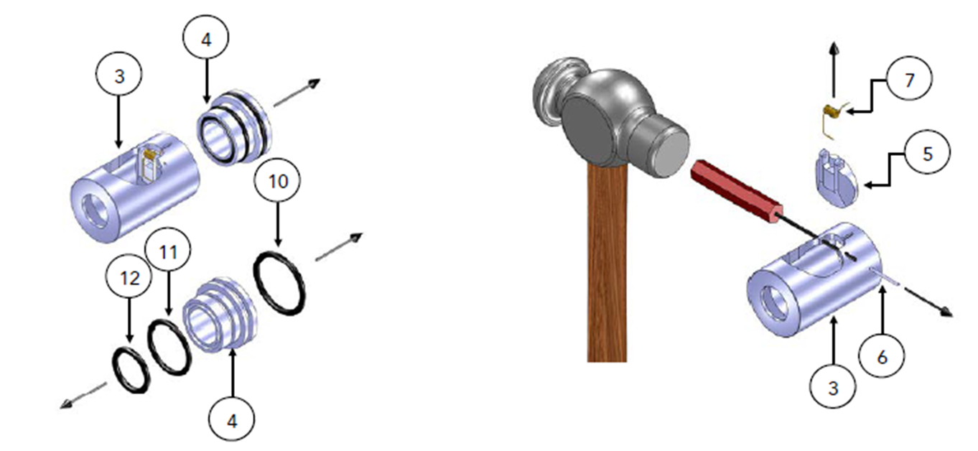
  Remove Flapper Seat (4) from Flapper Cartridge Body & remove all O-Rings (10, 12 & 11) from Flapper Seat (4)
  Using suitable Pin Punch knockout the Flapper Pin (6) & remove Flapper (5) & Flapper Spring (7) from Flapper Cartridge Body (3)
  The tool is now ready for cleaning inspection.

Slide 14
Assembly

Slide 15
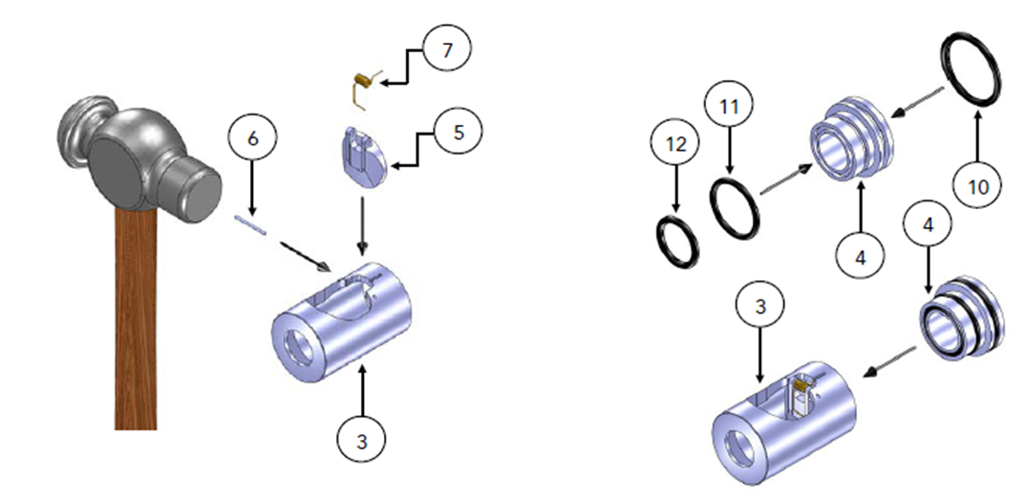

Tools Required
  Pipe Wrench
  O-ring Pick
  Pin Punch
  Hammer
  Install O-RIngs (10, 11 & 12) into Flapper Seat (4) . Insert the Flapper Seat (4) into the end of the Cartridge Body (3).
  Before assembly, check all components for wear & corrosions; lubricate all seal areas & install O-RIngs / Back-Up Rings (noting the correct way for the Back-Up Rings; small radius on 1 side facing the centre of the groove, flat edge facing groove edge).
  Lubricate all threads with a suitable anti-seize thread compound.
  Position the Flapper (5) and Flapper Spring (7) inside the Flapper Cartridge Body (3) & insert the Flapper Pin (6) into the Flapper Cartridge (5) to hold the assembly in position
IMPORTANT: ENSURE THAT THE TOOL IS ONLY GRIPPED ACROSS THE FLATS

Slide 16
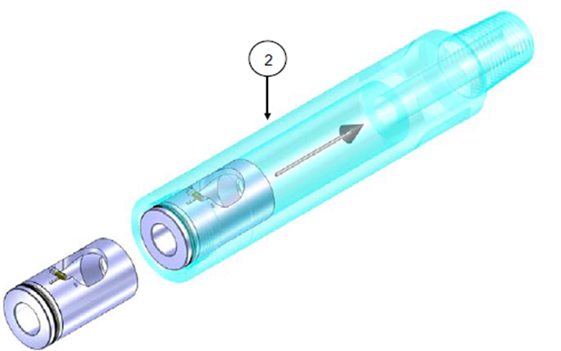


  Slide Flapper Cartridge Assemblies into Housing (2).
  Ensure correct orientation of Flapper Cartridge, refer drawing

Slide 17
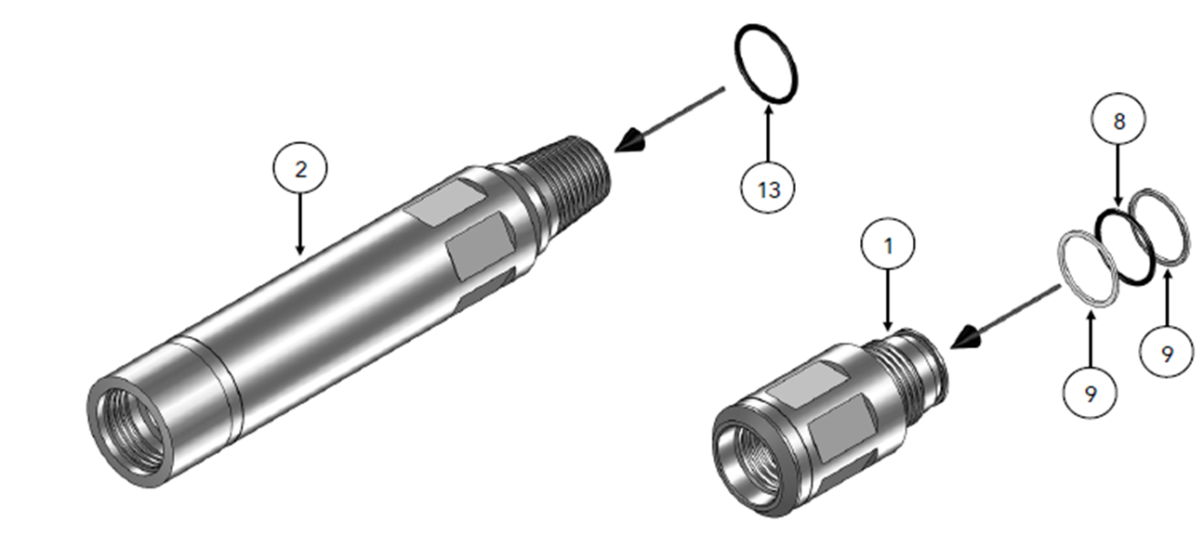
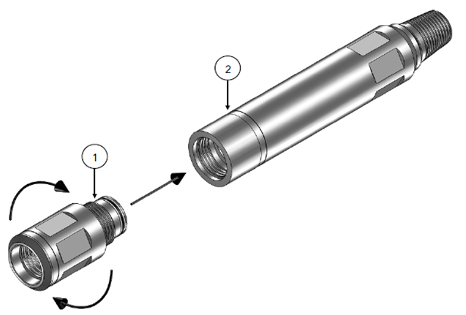
  Install O-Ring (13) onto Housing (2) .
  Install Back-Up Rings (9) and O-Ring (8) onto Top Sub (1).
  Screw Top-Sub (1) into Housing (2)

Slide 18
Assembly Drawing

Slide 19
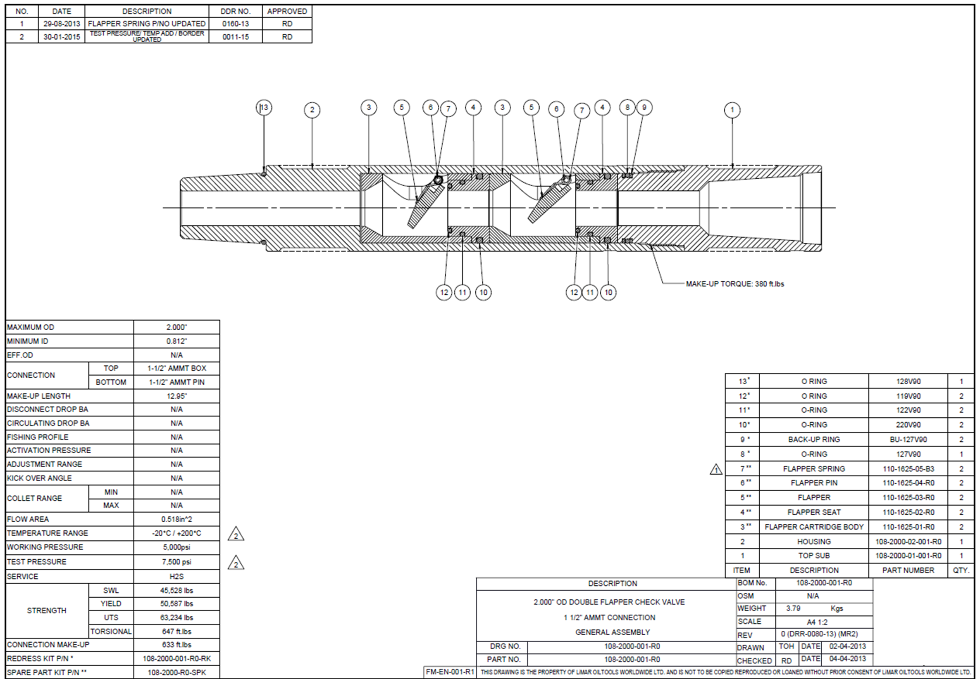

Slide 20

Thank you!

