Slide 1
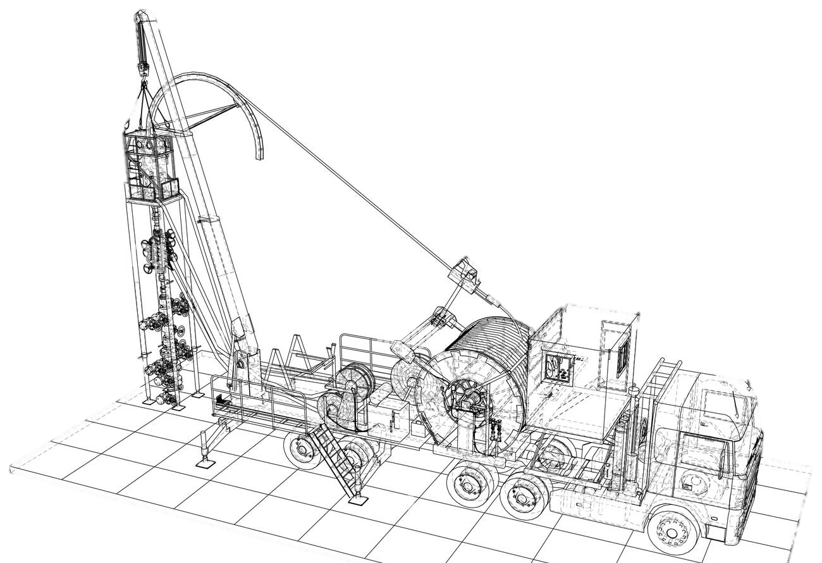
Packing Plunger
Prepared by: MOHD BURHAN BIN YUSOF
Department: Coiled Tubing Services
Notes:
Assalamualaikum and good morning, everyone. We are Junior Field Engineer from Dimension Bid. My name is Nur Izzah and here is my teammates, Haziq, Farhanah and Shahir. As you all know, the purpose of this presentation is to provide a brief overview of Coiled Tubing Services. If you have any questions during my presentation, you may interrupt or list your questions to ask during the Q&A session at the end.
For this presentation, we have 3 objectives, firstly to

Slide 2
Table of Content
01
Function of packing
02
Packing Assembly
03
Troubleshoot

Slide 3
Objectives
01
Identify component of packing
02
Ably Maintenance and service
03
Troubleshoot common problem

Slide 4
Function
01

Slide 5
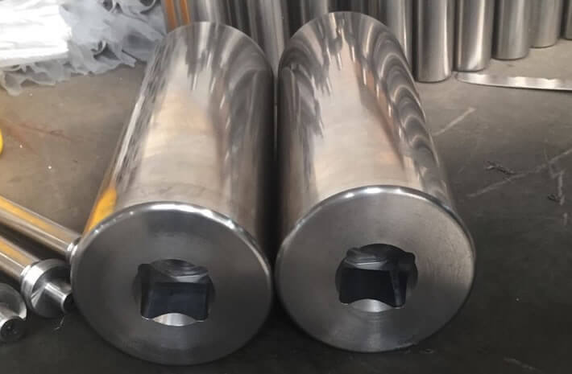
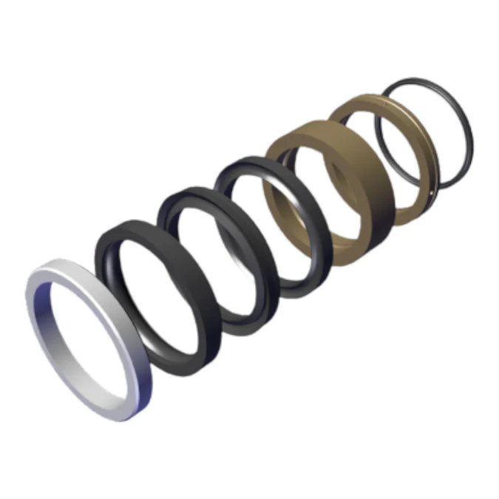
Function
Pump packing is used to protect a plunger
create a seal between the plunger and the inner wall of a plunger pump housing
plunger
Packing seal set
Notes:
Coiled tubing is a long and continuos length of pipe wound on a spool. The origin was a technology pioneered by Allied engineering teams during second world war and the project was named PLUTO. It involved deployment of pipelines from the coast of England to several points along the coast of France.

Slide 6
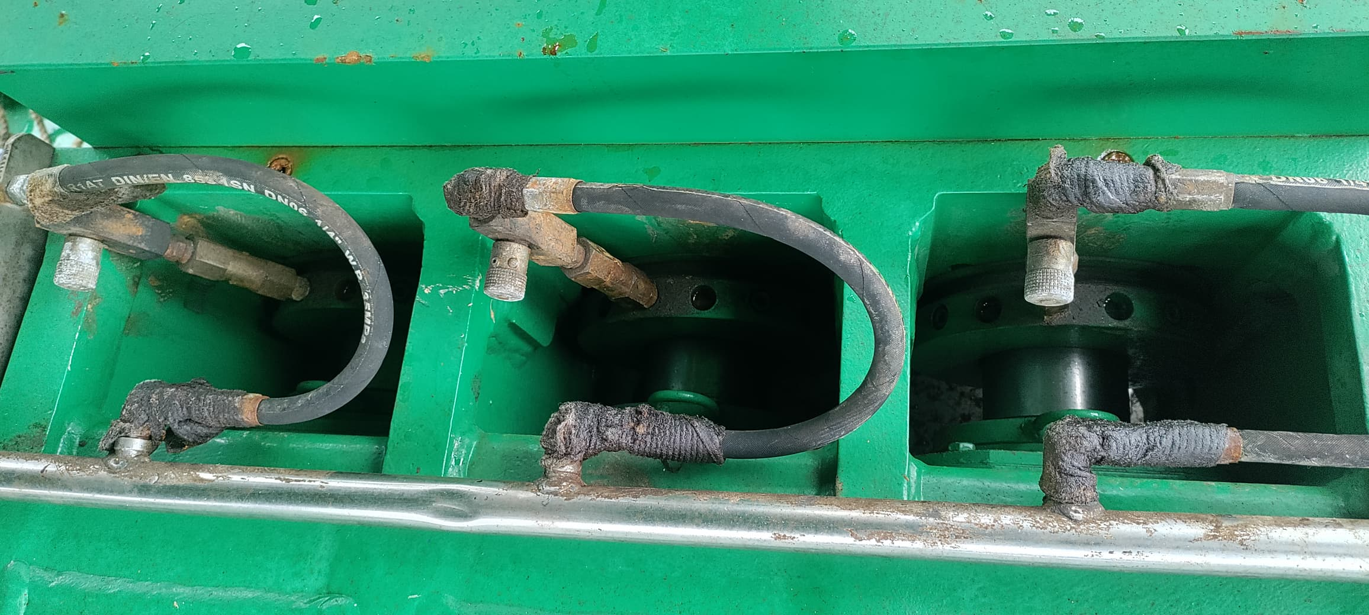
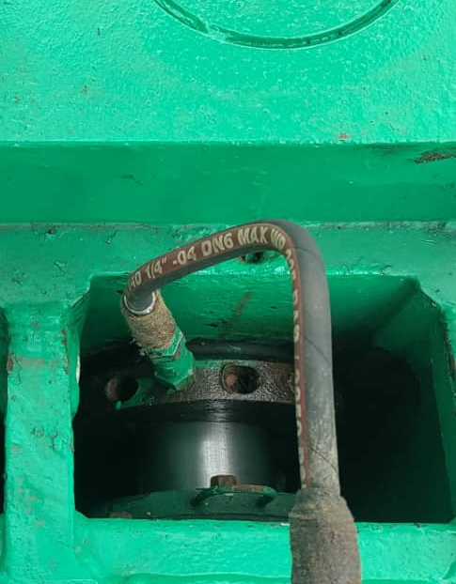
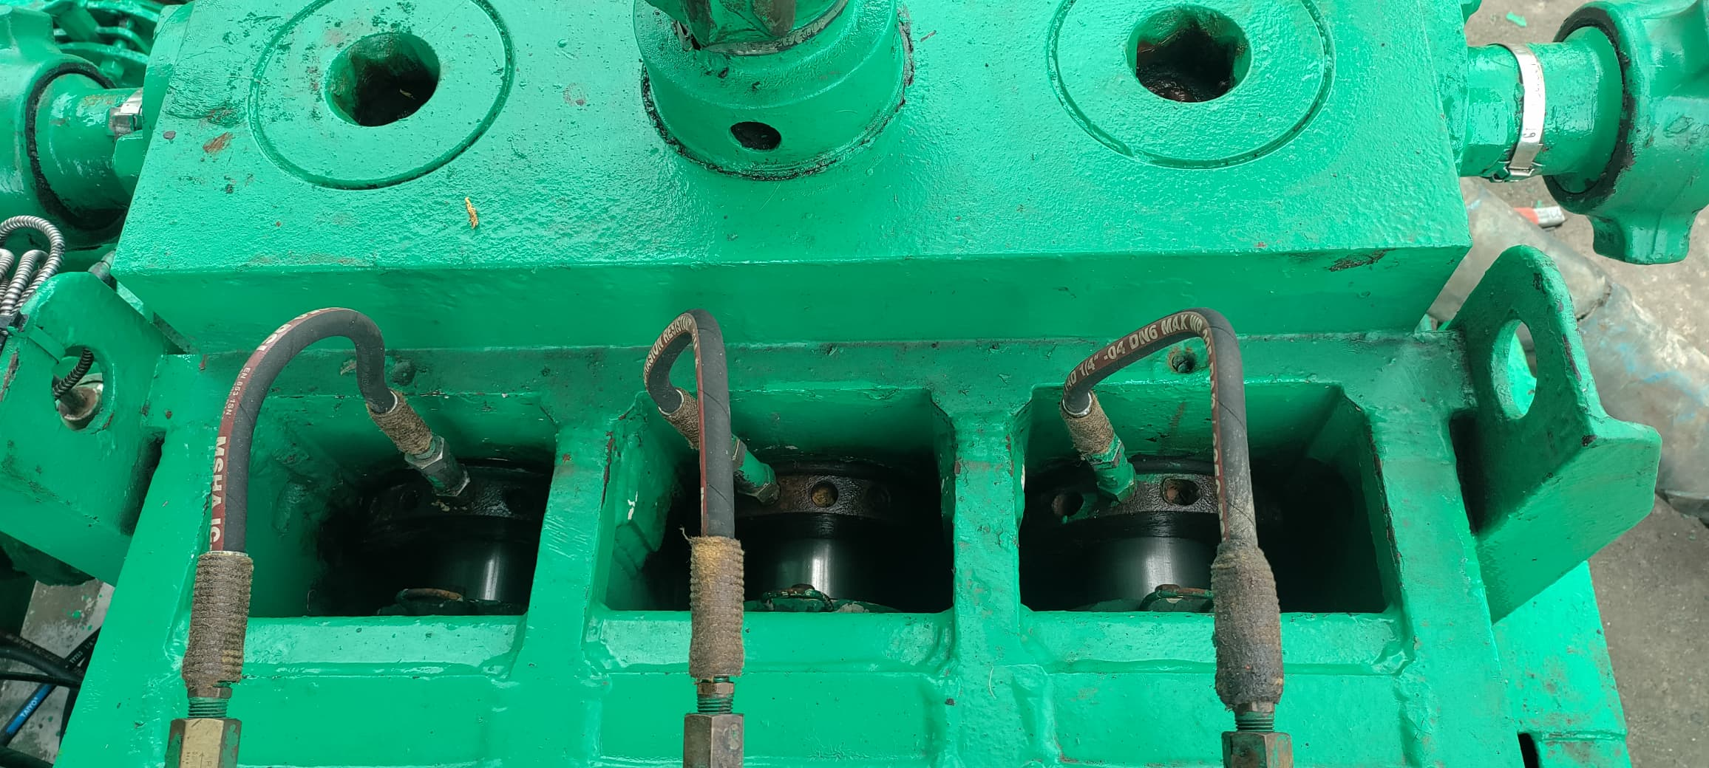
Packing Seal
Notes:
Coiled tubing is a long and continuos length of pipe wound on a spool. The origin was a technology pioneered by Allied engineering teams during second world war and the project was named PLUTO. It involved deployment of pipelines from the coast of England to several points along the coast of France.

Slide 7
Packing Assembly
02

Slide 8
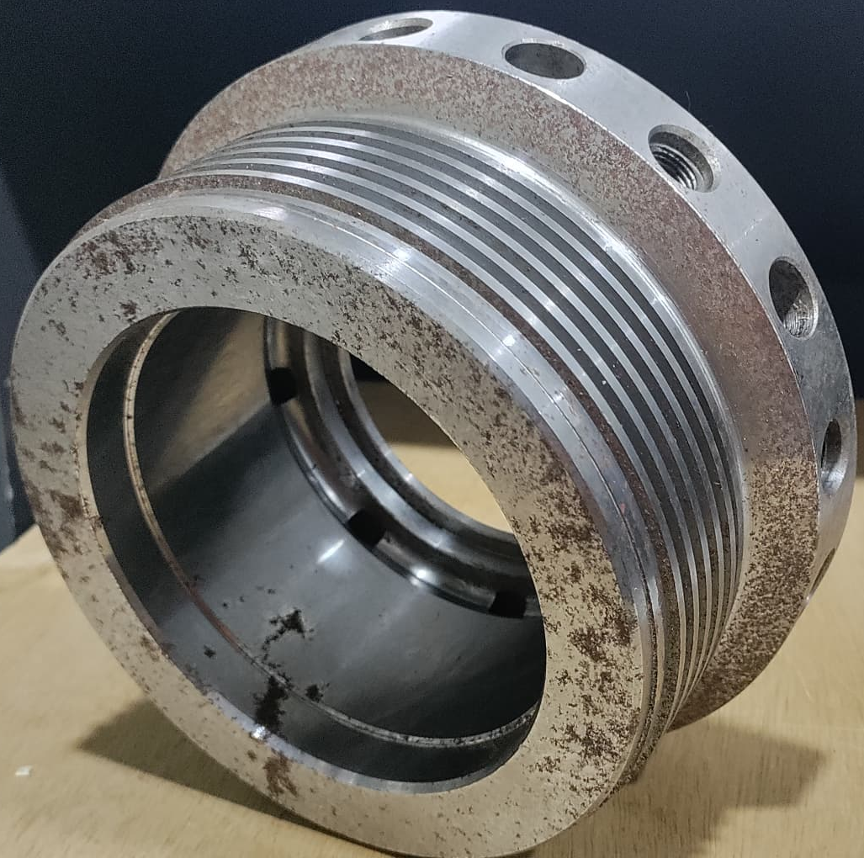
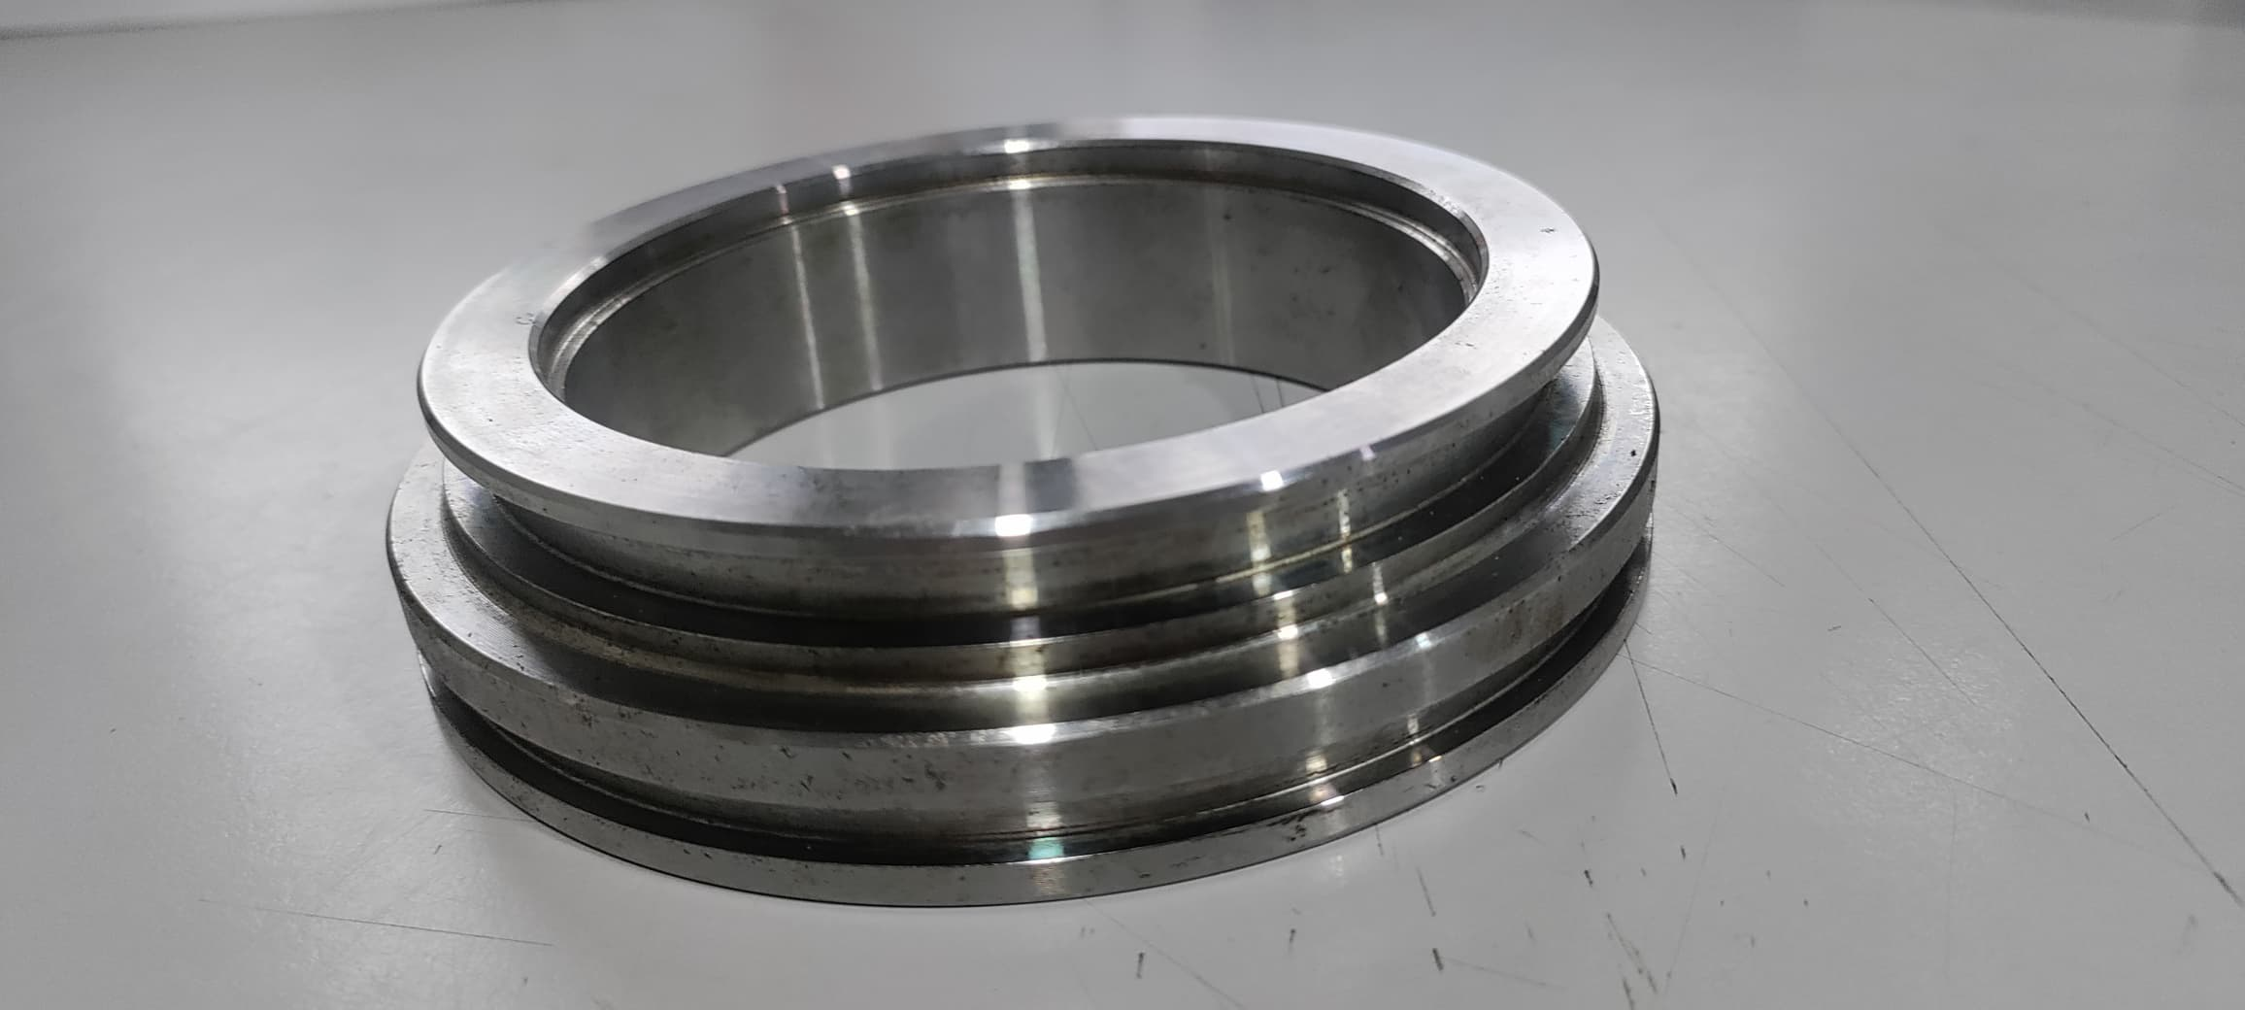
Packing assembly
Gland nut
Packing seal set
Spacer ring/Seal Ring
Notes:
Coiled tubing is a long and continuos length of pipe wound on a spool. The origin was a technology pioneered by Allied engineering teams during second world war and the project was named PLUTO. It involved deployment of pipelines from the coast of England to several points along the coast of France.

Slide 9
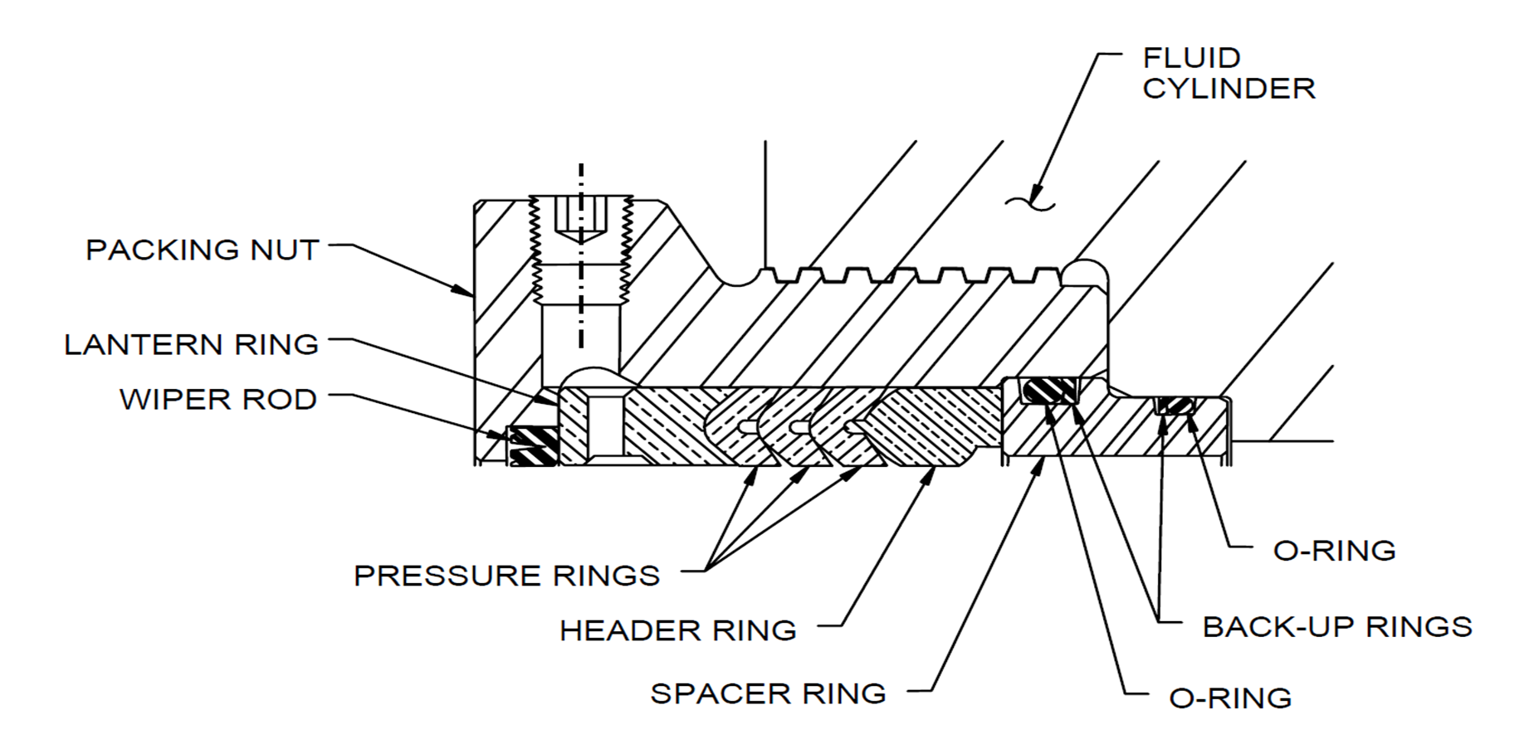
Packing assembly
Notes:
Coiled tubing is a long and continuos length of pipe wound on a spool. The origin was a technology pioneered by Allied engineering teams during second world war and the project was named PLUTO. It involved deployment of pipelines from the coast of England to several points along the coast of France.

Slide 10
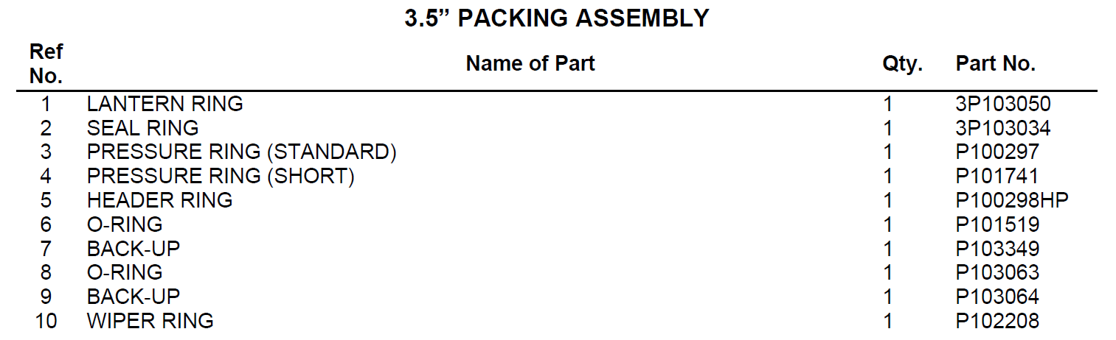
Packing assembly

Slide 11
Troubleshoot
03

Slide 12
Troubleshoot
Symptom | Cause | Correction
Packing life is short | 1. Clogged lubricator line 2. Improper installation | 1. Service and clean divider block and check valve. 2. Replace plungers. 3. See packing manual.
Packing is smoking | 1. No oil 2. Clogged lubricator line 3. Packing nut too tight | 1. Check lubricator reservoir.
Packing is leaking | 1. Worn out or too loose 2. Worn plunger | 1. Tighten or replace packing. 2. Replace plunger.

Slide 13
Thank you

