Slide 1


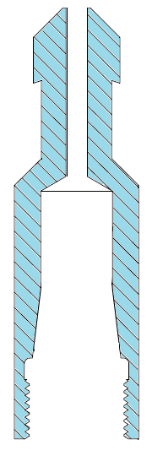

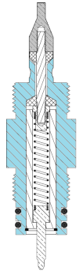
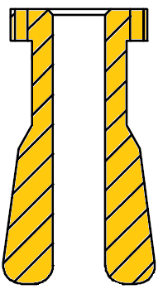

HUNTING-TITAN CABLE HEAD PARTS
CROSS CHECK TABLE FOR ⁹/₃₂” OD LINE SIZE
CABLE HEAD OD | TYPE | FISHING NECK | SLEEVE BODY | CONTACT SUB | CONE | WASHER | TESTED WP STRENGTH, 3 X 3 CONFIG
1⁷/₁₆” OD | I | 3915-002-288 | 3916-001-000 | 3903-000-001 | 3915-003-288 | 3916-0CW-218 | 1800 IBS
 | II | 3916-002-288 | 3916-001-000 | 3903-000-001 | 3915-003-288 3916-328-040 | 3916-0CW-218 | 1800 IBS
1¹¹/₁₆” OD | I | 5915-002-288 | 5915-001-000 | 3903-000-301 | 3915-003-288 | 3916-0CW-218 | 1800 IBS
 | II | 5916-002-288 | 5916-001-000 | 3903-000-301 | 3915-003-288 3916-328-040 | 3916-0CW-218 | 1800 IBS
WARNING : FAILURE TO FOLLOW THIS TABLE MIGHT CAUSE PARTS FAILED TO MATCH TOGETHER
DATE : 30-OCT-2012
PREPARED BY : CFO HASBULLAH

