Slide 1
Wellhead
By Ikram Muslim

Slide 2
Wellheads and Christmas Trees
The wellhead consists of three components
- casing head
- tubing head
- Christmas tree
The wellhead must be able to withstand pressures of up
to 140 MPa (1,400 Bar, or about 2,100 psi) or greater
A wellhead is the component at the surface of an oil or gas well that provides the structural and pressure-containing interface for the drilling and production equipment.

Slide 3
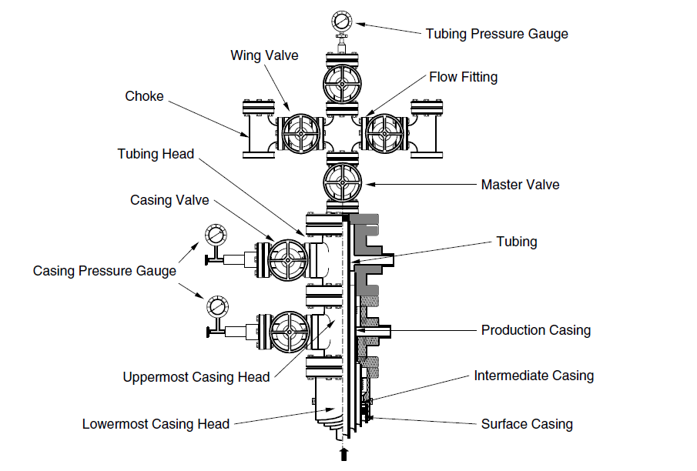
Components of a Wellhead
- Tubing pressure gauge
- Wing valve
- Flow fitting
- Choke
- Tubing head
- Christmas tree
- Master valve
- Casing valve
- Tubing
- Tubing head
- Casing pressure
gauges
- Production casing
- Uppermost casing head
- Intermediate casing
- Casing head
- Lowermost casing head
- Surface casing

Slide 4

Thank you !
Questions and Answering Session
© Neu Dimension 2020

Slide 5
Prepared by,
_________________________________
Name : Muhammad Ikram Muslim
Designation : Field Engineer 1
© Neu Dimension 2020

