Slide 1
4” Low Pressure Manifold
By Zalani B Ibrahim
G.E.O CTS

Slide 2
Abstract
This project is a solution to the problem of time constraints as well as the use of many 4” hoses and fitting during rigup activities.
In addition, this project also takes the safety factor of workers when they are in the area where a lot of hoses are scattered around can cause an accident.
For the company can also generate income by charging rent to client.

Slide 3
Introduction
The start of this project after finding that there are always complaints especially from client and crew about the problem of time constraints and insufficient materials during the rigup activity

Slide 4
Problem Definition
Effects of problems:
The company's reputation is not trusted
The work done is quite slow
More hazard at workplace

Slide 5
Benefit to Dimension Bid to Client
●
Reduce rigup time
Reduce use 4” hose and fitting
Reduce hazard at workplace
Generate income by charging rent to client.

Slide 6
Project Objectives
This project is believed to be effective after taking into the time factor, the use of reduced materials and the limited work area.
Project Deliverables
We are confident that this project achieves the main goal of saving time, reducing the use of a lot of materials and creating a safer work environment.
The effectiveness of this project will increase customer confidence in the company.

Slide 7
Project Time Line
Estimated time line for this project from start to end include timing received order from supplier around 45 to 60 day

Slide 8
Project Resources
The meterial needed for this project:
6.5” Pipe SCH 80mm X 5 feet = 1 ea RM 495
6.0” Flange butt weld 150 = 2 ea RM 640
6.0” Butterfly valve EPDM seat = 1 ea RM 450
6.0” Buttweld cap = 2 ea RM 660
4.0” Flange butt weld 150 = 12 ea RM 2640
4.0” Butterfly valve EPDM seat = 6 ea RM 1740
4.0” Hammer Union 206 NPT Thread = 3 set RM 2850
A193 B7 Stud Bolt c/w 2pc Nut 7/8x6.5lg = 56 ea RM 1568
Paint and Others RM 2000
Manpower (Welder and Helper) RM 2000

Slide 9
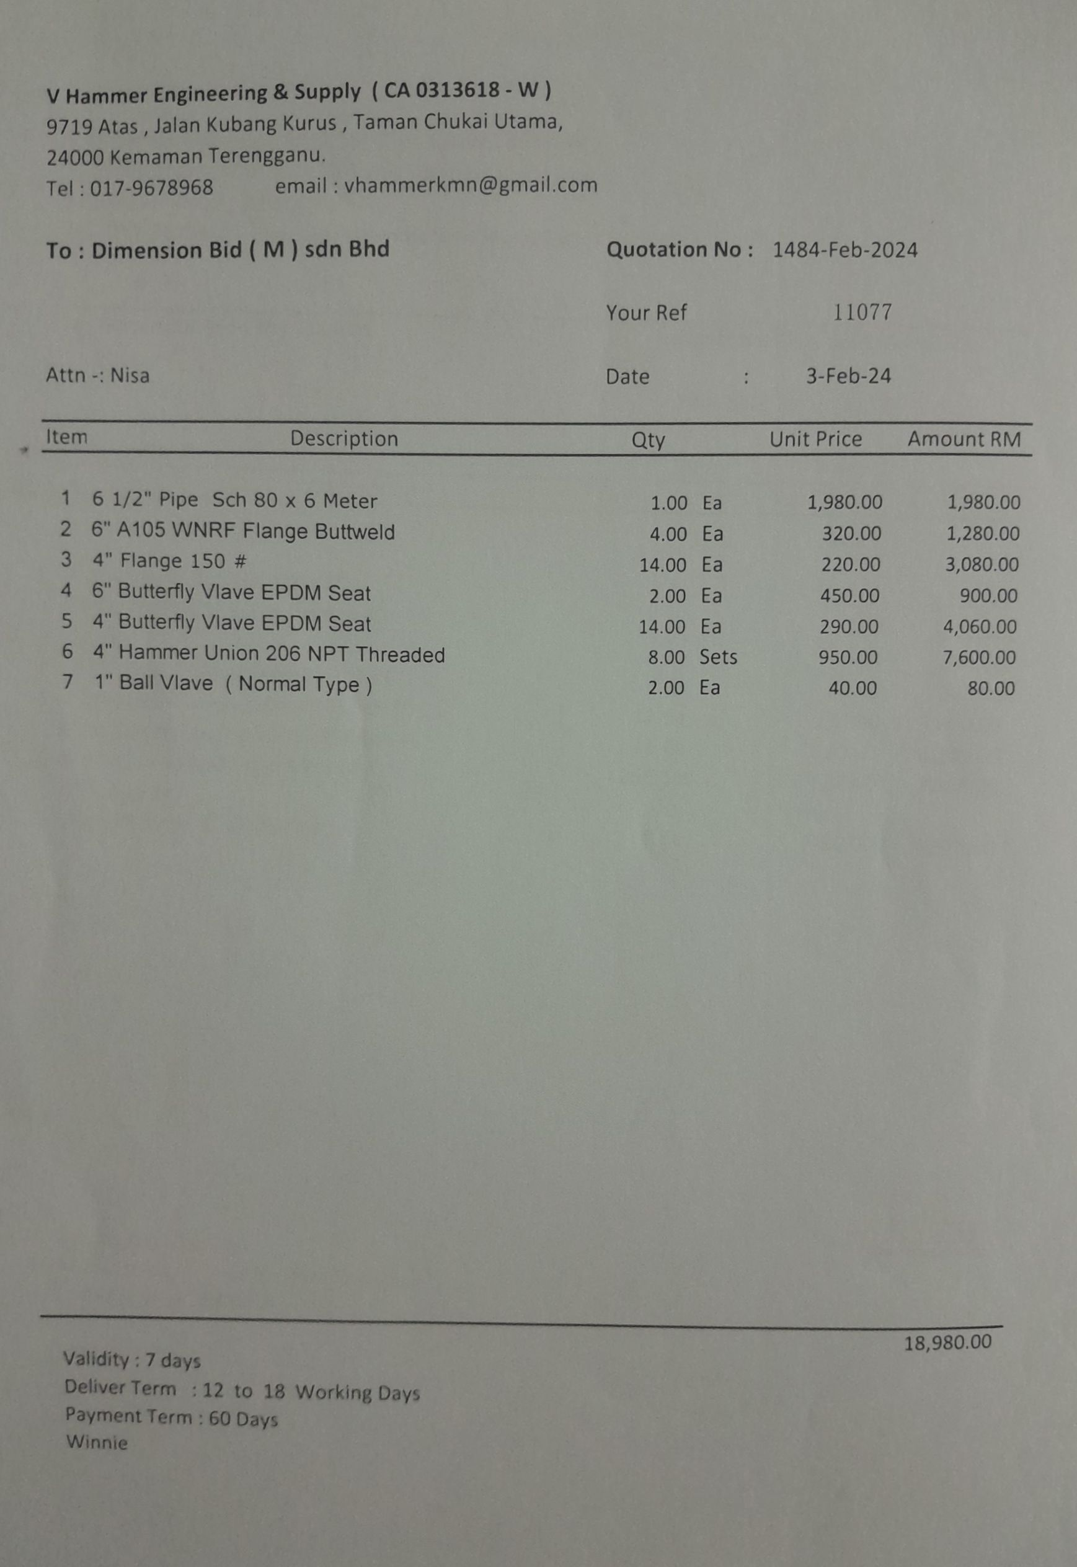
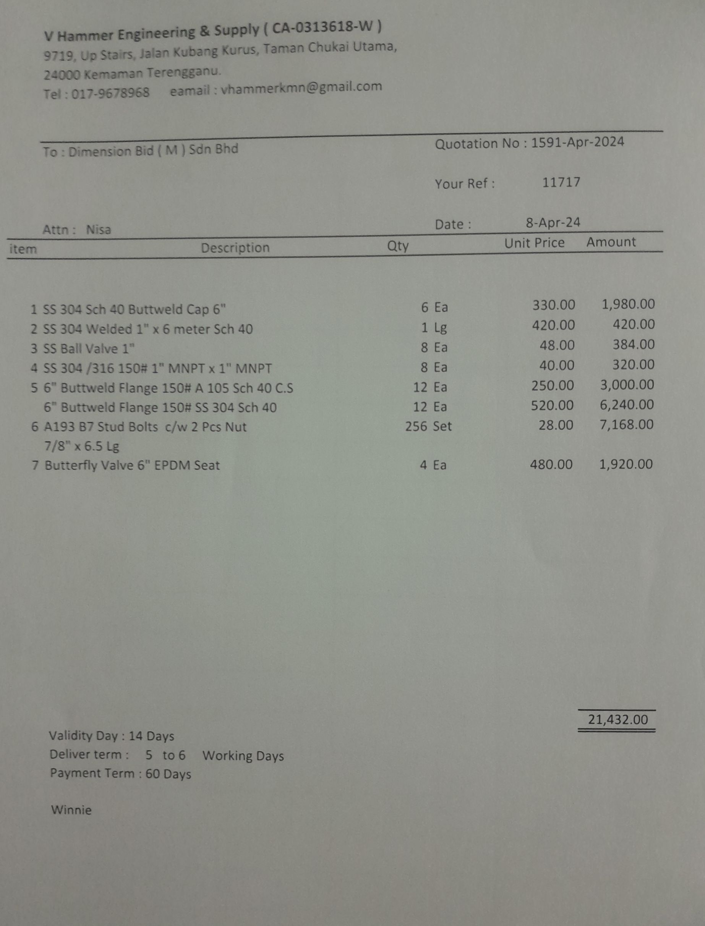
Quotation from Supplier

Slide 10
Project Cost
According from quotation from supplier for material and added with manpower, cost this project RM 15 043.00 per unit.
Project Risk
The risk is very minimal because this project is very necessary.
Cost which can be said to be very worthwhile and with the lack of maintenance.

Slide 11
Conlusion
For the conlusion, this project is not costly and doable project.
The risk for this project very minimal, can be used for long period of time.
Minimal maintenance and most important it can solve the problem about time.

Slide 12
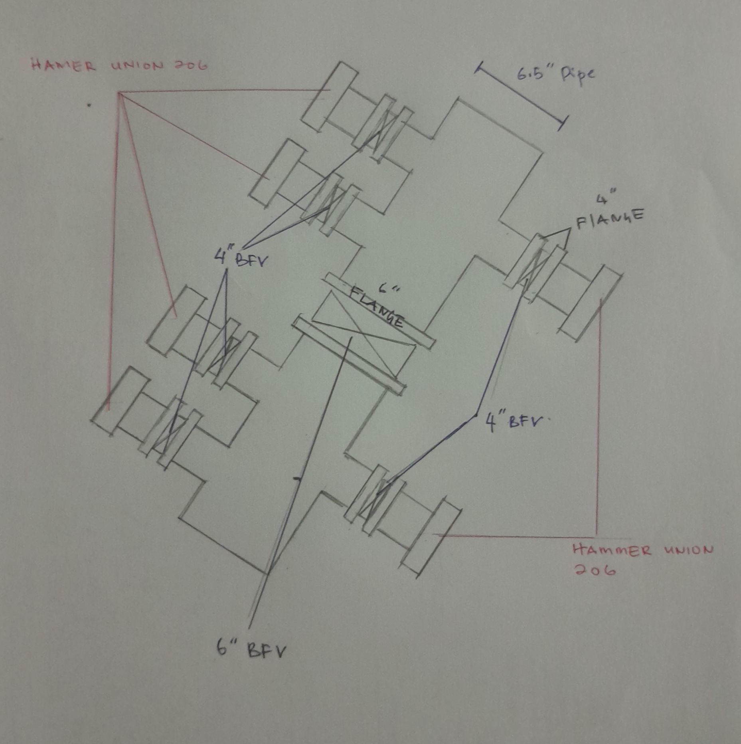
Drawing

Slide 13
THANK YOU

