Slide 1
CWOP
Angsi Besar Infill 5
CT Job Scope

Slide 2
Table of Content:
1. Introduction & Well Overview
    Objective & Well Background
    Well Schematic
2. Job Execution
    Operation Summary
    Lifting Plan
    Well Stack Up
    CT P&ID
    VOS Flowback Setup
    CT Operation Timing
    Fluid Consumption Summary
    Decision Tree CT Run #1 (Cleanout to 10m below I-105 fracsleeve @ 2,155m MDDF) - Contingency
    Decision Tree CT Run #2 (Cleanout to 10m below I-100 fracsleeve @ 2,046m MDDF) - Contingency
    Decision Tree CT Run #3 Contingency CT Milling until Float Collar @ 2,640m MDDF
    RCP Settling Test Result
3. Equipment Readiness

Slide 3
Objective & Well Background
Objective
The objective of this job is:
To perform CT proppant cleanout inside tubing post fracturing until Float Collar at 2,640 m MDDF.
To perform CT set Nipples Plug at target depth 2,547 m MDDF
Well Background
  Angsi Besar Infill 5 is a single monobore completion complete with frac sleeve which planned to drill expected on November 2023 with maximum deviation of 71 degree at 1,230 m MDDF.

Slide 4
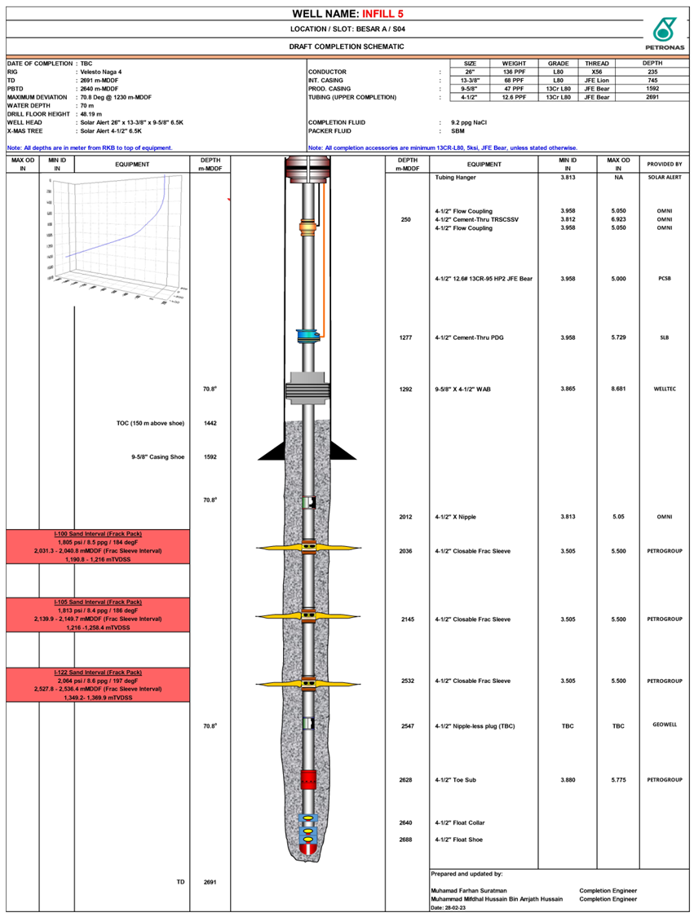
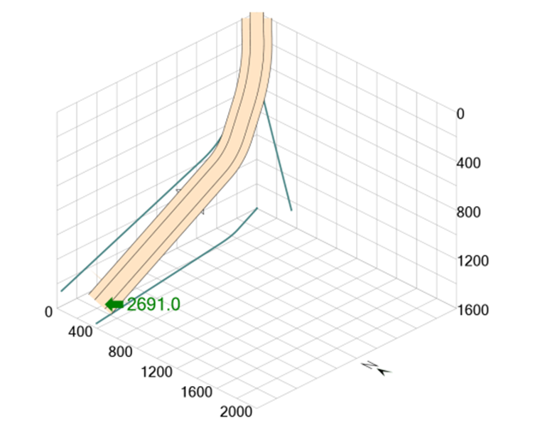
Angsi Besar A-09 : Well Diagram
 | Parameter Value
Field | Angsi Besar Infill 5
Max. Deviation (degrees) | 71 degree @ 1,230 m MDDF
Min. Restriction (inch) | @ 2,036 m, 2,145 m, 2,532 m MDDF 3.505” (Frac Sleeve)
Tubing Specification | 4-1/2” Production Tubing, 12.6# ppf, 13Cr
Type of Fluid & Density | 12.8 ppg (Gel & RCP)
Top of Fluid | N/A (Assuming well full of Gel)
Current Well Status | N/A
Depth of zone, pressure & temperature | I-100: 2,031.3 m – 2,040.8 m MDDF (1,805 psi, 184 deg F) I-105: 2,139.9 m – 2,149.7 m MDDF (1,813 psi, 186 deg F) I-122: 2,527.8 m – 2,536.4 m MDDF (2,064 psi, 197 deg F)
Porosity | I-100: 22% I-105: 23% I-122: 21%
Permeability | I-100: 88 mD I-105: 96 mD I-122: 66 mD
Fracture Pressure | 5,014 psi
2nd Contingency Cleanout with JB @ I-100 Frac Sleeve
1st Contingency Cleanout with JB @ I-105 Frac Sleeve
Set Plug below I-122 Frac Sleeve
3rd Milling of Limitless Dat and Cleanout til Float Collar
4th Post Milling Cleanout and Drift til Float Collar

Slide 5
Operation Summary

Slide 6
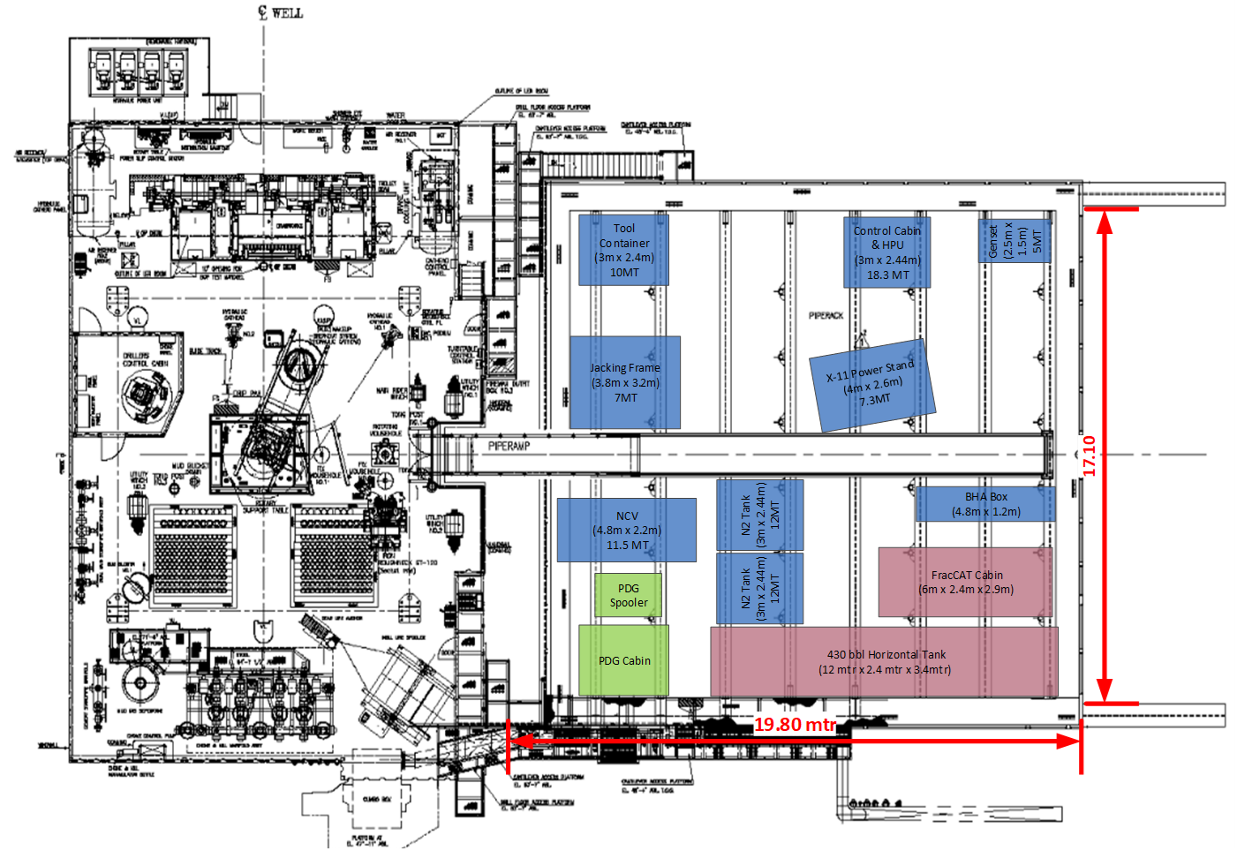
Coiled Tubing Equipment Layout

Slide 7
Coiled Tubing Equipment List
NO | ITEM |  |  |  |  | REMARKS
 |  | LENGTH (ft) | WIDTH (ft) | HEIGHT (ft) | (mT)
1 | 10ft Tool Container | 2.99 | 2.44 | 2.59 | 10
2 | BHA Container | 4.8 | 1.2 | 0.8 | 10
3 | Zone 2 Generator Set | 2.5 | 1.5 | 2 | 5
4 | Jacking Frame | 3.76 | 3.23 | 3.86 | 7
5 | Power Stand | 3.99 | 2.59 | 3.73 | 30
 | Coiled Tubing Drum #604463
 | Spreader Bar
6 | Hydraulic Power Unit | 2.99 | 2.44 | 2.59 | 11.34
7 | X-11 Control Cabin | 2.99 | 2.44 | 2.59 | 7
9 | Injector Head Basket | 2.99 | 2.44 | 2.9 | 12.7 | Store at supply boat once unpacked
 | Injector Head (HR560)
 | Side Door Stripper
10 | 13ft Cargo Basket | 3.96 | 1.68 | 1.8 | 10 | Store at supply boat once unpacked
 | BOP Control Cart
 | Single BOP
11 | Open Top Basket | 2.99 | 2.44 | 2.76 | 12 | Store at supply boat once unpacked
 | Gooseneck
 | Combi BOP
12 | Iron Rack | 3.51 | 1.64 | 1.67 | 7 | Store at supply boat once unpacked
13 | OTT Basket (Hoses) | 2.99 | 2.45 | 1.39 | 12.5 | Store at supply boat once unpacked
14 | Nitrogen Converter | 4.8 | 2.2 | 2.59 | 13
15 | Nitrogen Tank | 2.99 | 2.44 | 2.59 | 12
16 | Nitrogen Tank | 2.99 | 2.44 | 2.59 | 12
17 | Nitrogen Tank | 2.99 | 2.44 | 2.59 | 12
18 | Nitrogen Tank | 2.99 | 2.44 | 2.59 | 12
19 | OTT Basket (Cons Oils) | 3.6 | 1.2 | 1.3 | 10 | Store at supply boat once unpacked
20 | OTT Basket (JB & FL) | 3.6 | 1.2 | 1.3 | 10 | Store at supply boat once unpacked
21 | OTT Basket (Misc) | 2.99 | 2.44 | 1.22 | 7 | Store at supply boat once unpacked
22 | Chemical Basket | TBA | TBA | TBA | TBA | Store at supply boat once unpacked
23 | Nitrogen Tank | 2.99 | 2.44 | 2.59 | 12 | Store at supply boat until needed

Slide 8
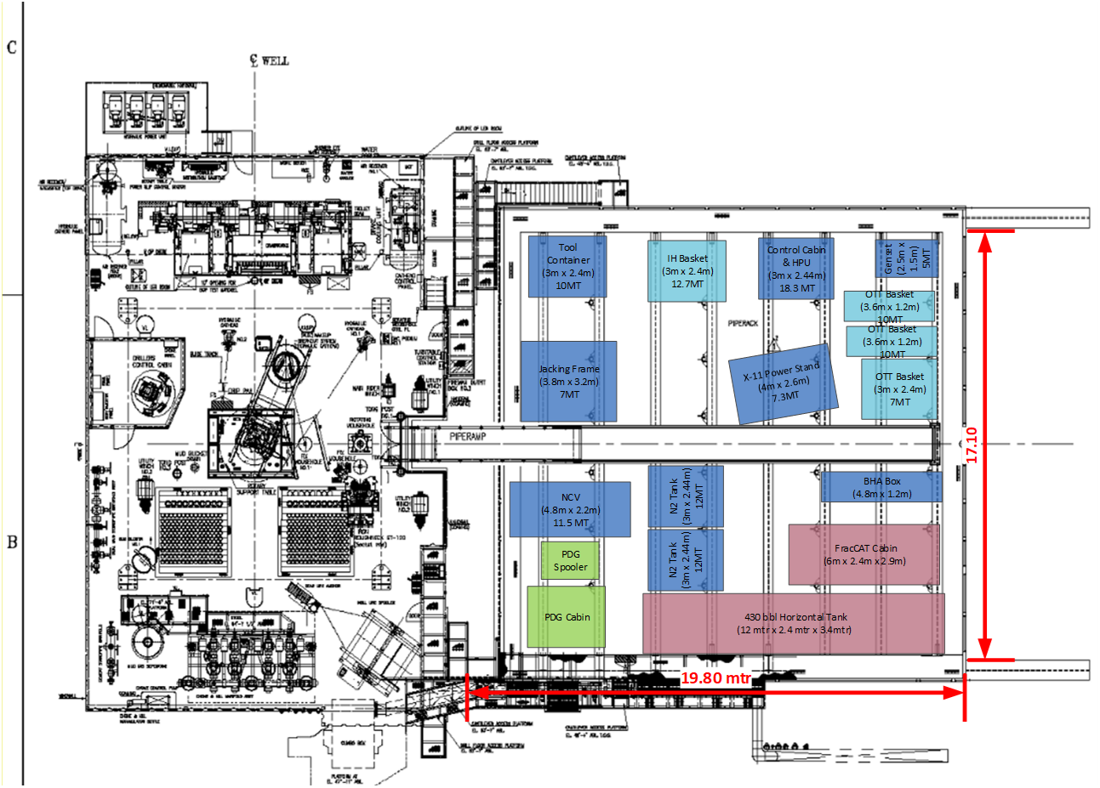
Coiled Tubing Equipment (During Lifting)

Slide 9
Well Stackup
Injector Head HR560 c/w 100” Gooseneck
Side Door Stripper
4-1/16” Lubricator
4-1/16” Combi BOP
4-1/16” Flowcross
4-1/16” Single BOP (Pipe/Slip)
Crossover to Geowell

Slide 10
Coiled Tubing PnID

Slide 11
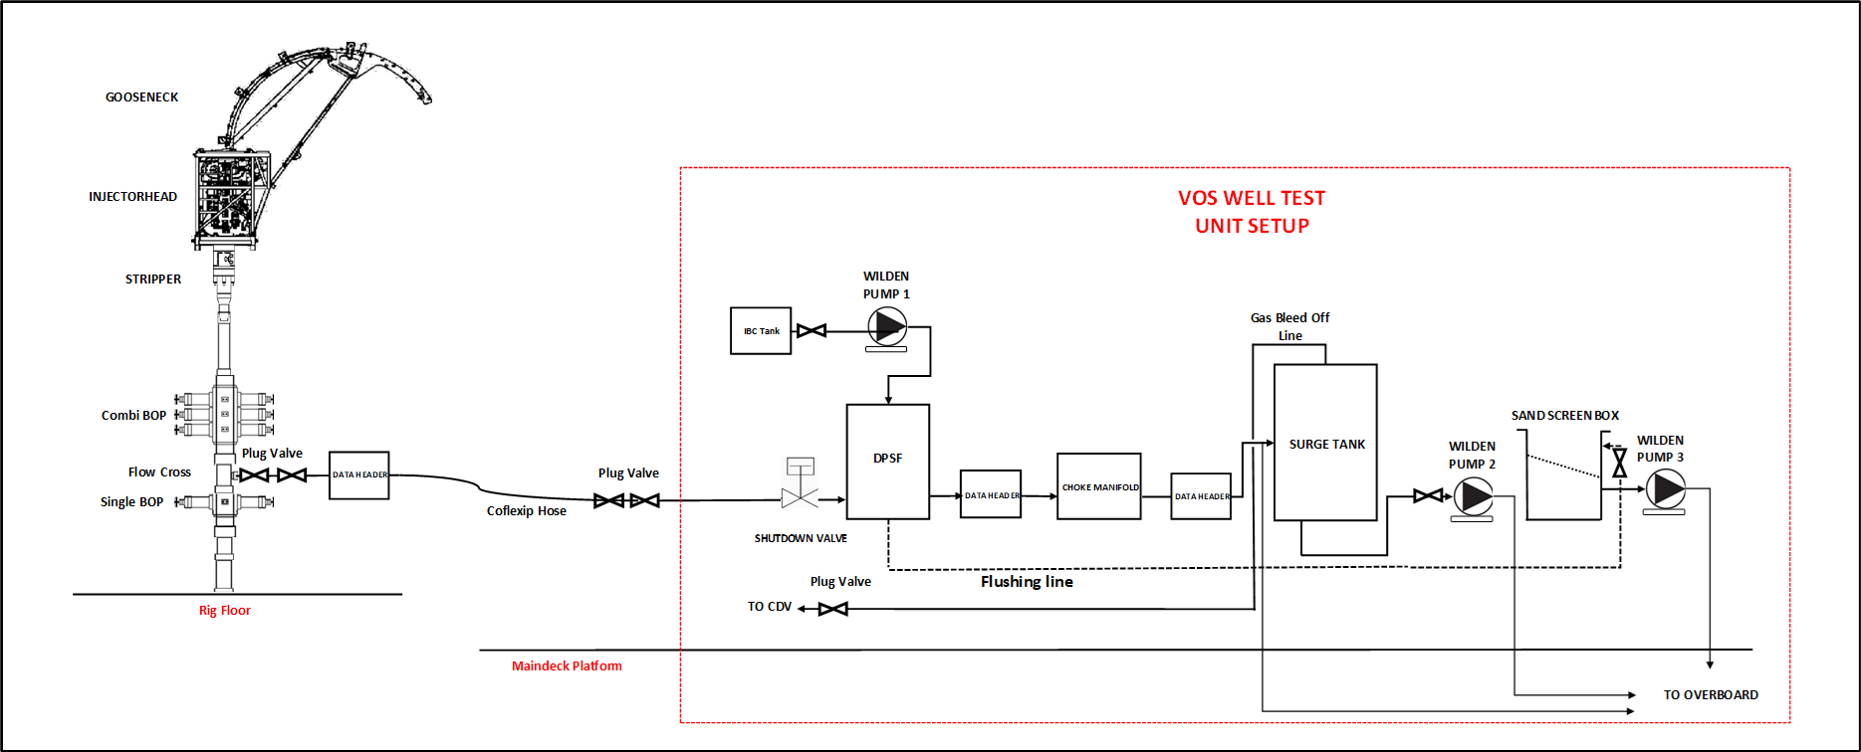
VOS Flowback Setup

Slide 12
CT Operation Timing
Run# |  | BHA | Time
 |  |  | Hrs
1 | Cleanout until 10m below I-120 Frac Sleeve (2,516.0m MDDF) | 2-1/8” PowerCLEAN | 15.0
2 | Cleanout until 10m below I-105 Frac Sleeve (2208.6m MDDF) | 2-1/8” PowerCLEAN | 13.0
3 | Cleanout until 10m below I-100 Frac Sleeve (2101.1m MDDF) | 2-1/8” PowerCLEAN | 13.0
4 | Post Frac Clean Out until Float Collar (2,702m MDDF) | 2-1/8” PowerCLEAN | 33.0
5 | Milling Limitless Dart until Float Collar (2,702m MDDF) | 3-3/8” Bear Claw Mill with 2-7/8” Motor | 27.0
** Timing for Rig Up & Rig Down
Initial Rig Up : 10 hours (inc. rig up well stack on TD, PT, make up tool)
Rig down with IH : 5 hours
Rig up if IH on TD : 4 hours (inc. make up tool & PT)
Rig down without IH : 3 hours

Slide 13
Fluid Consumption Summary
Run# |  | 9.2ppg Brine (gal) | Seawater (gal) | Gel Quantity (bbls) | N2 Quantity (scf)
1 | C | 205 | 1,500 | 45 | 4,000
2 | C | 205 | 1,500 | 45 | 3,500
3 | C | 205 | 1,500 | 45 | 3,500
4 | P | 205 | 5,000 | 1,40 | 8,000
5 | C | 205 | 3,500 | 380 | 7,500

Slide 14
2-1/8 and 2-7/8 Motor with 2inch Coil

Slide 15
Decision Tree : 1st Contingency Cleanout Run

Slide 16
Run 1 : BHA Configuration
2-7/8” External Dimple Connector
2-7/8” CS Dual Flapper Check Valve
2-7/8” CS Hydraulic Disconnect
2-7/8” CS Circulation Sub
2-7/8” Straight Bars
2-7/8” PowerClean Nozzle

Slide 17
Run 1 : Cleanout until 2,155m MDDF (10m below I-105) – Simulation Results
Percentage of Total Fill removed | 100%
CT Max Internal Pressure | 5,290 psi
Top of max formation Pressure | 2,229 psi
90-99% Solids at surface | 384.1 mins
Total Job Time | 573.6 mins
Pump Rate | 3.0 bpm

Slide 18
Decision Tree : 2nd Contingency Cleanout Run

Slide 19
Run 2 : BHA Configuration
2-7/8” External Dimple Connector
2-7/8” CS Dual Flapper Check Valve
2-7/8” CS Hydraulic Disconnect
2-7/8” CS Circulation Sub
2-7/8” Straight Bars
PowerClean Nozzle

Slide 20
Run 2 : Cleanout until 2,155m MDDF (10m below I-105) – Simulation Results
Percentage of Total Fill removed | 100%
CT Max Internal Pressure | 5,539 psi
Top of max formation Pressure | 1,914 psi
90-99% Solids at surface | 297.3 mins
Total Job Time | 618.4 mins
Pump Rate | 3.0 bpm

Slide 21
Decision Tree : 3rd Milling Limitless Dart until 2,640m MDDF (Float Collat)

Slide 22
Run 3 : BHA Configuration
2-7/8” External Dimple Connector
2-7/8” CS Dual Flapper Check Valve
2-7/8” CS Hydraulic Disconnect
2-7/8” CS Circulation Sub
2-7/8” BiCO Downhole Motor
3.375” BearCLAW Mill

Slide 23
Run 3 : Milling until 2,640m MDDF shoe collar – Simulation Results
Percentage of Total Fill removed | 99.5%
CT Max Internal Pressure | 3,169 psi
Top of max formation Pressure | 2,212 psi
90-99% Solids at surface | 931.0 mins
Total Job Time | 1108.8 mins
Pump Rate | 3.0 bpm

Slide 24
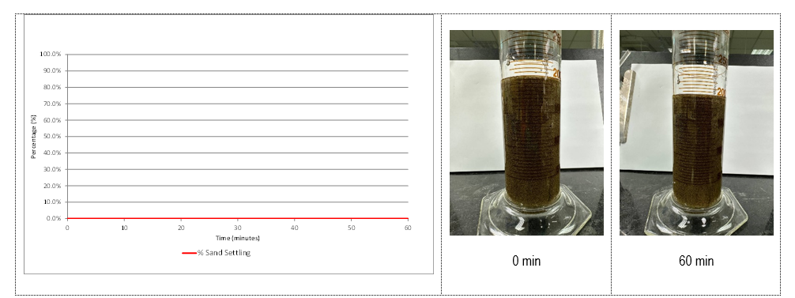
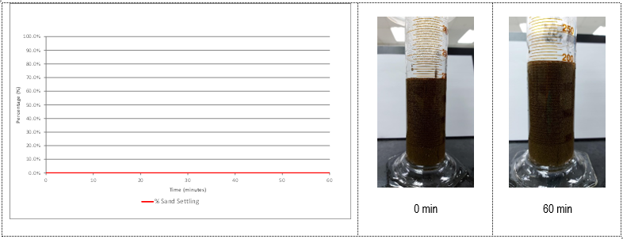
RCP Settling Test
Proppant Settling @ 77F = 0%
Proppant Settling @ 140F = 0%

Slide 25
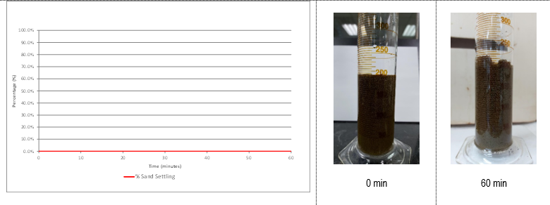
RCP Settling Test
Proppant Settling @ 197F = 0%
Conclusion :
At different temperature, there’s no affect on the interaction between resin coated proppant and J572 gel at different temperature. Thus, it is safe to proceed with using J572 gel for cleanout of the resin coated proppant.

Slide 26
Equipment Readiness Update
Item | Equipment | Update
1 | CT Unit | Operating Package (completed by early of Nov)
2 | 2inch CT
3 | Pumping Unit and Treating Line
4 | PCE for 2inch
5 | BHA – Bear Claw Mill Bit | Fabrication done, await shipment ETA : End of October
Target Date
SIT : 15th Nov 2023
Inspection Date : 18th Nov 2023

