Slide 1
DIMENSION BID (M) SDN BHD
INTRODUCTION TO COILED TUBING SERVICES
ZAINUDDIN YAACOB
GEO
4 SEPTEMBER 2024

Slide 2
TABLE OF CONTENTS
DB Coiled Tubing Services Milestone
Basic CT Equipment
CT Pressure Control Equipment (PCE)
CT Down Hole Tools (BHA)
DB’s CTU Jobs Summary
Operations Highlight
New Application: SpinCat Wash Tool
E-Coiled Tubing
Coiled Tubing Fracturing
Coiled Tubing Catenary

Slide 3
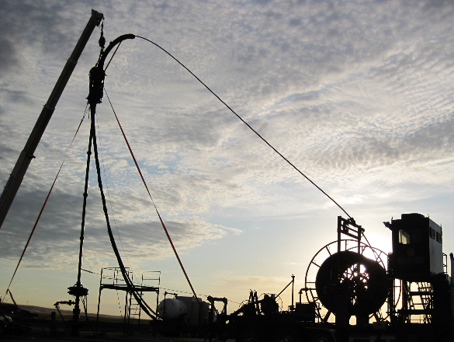
DB COILED TUBING SERVICES MILESTONE
Nov 14
Hired Key Personnel
June 15
Full CT crew hired
Aug 15
Arrival of CT and Pumping Package
Aug 15
CT Software Training
Sept 15
Pre-CAT Audit
Oct 15
VDP Audit
Mar 16
First Coiled Tubing Operation in Dulang C
Nov 14
Awarded CTU VDP

Slide 4
BASIC COILED TUBING EQUIPMENT?
Injector Head
Stripper
Control Cabin
Blow Out Preventer
Reel
/ CT String
Power Pack

Slide 5
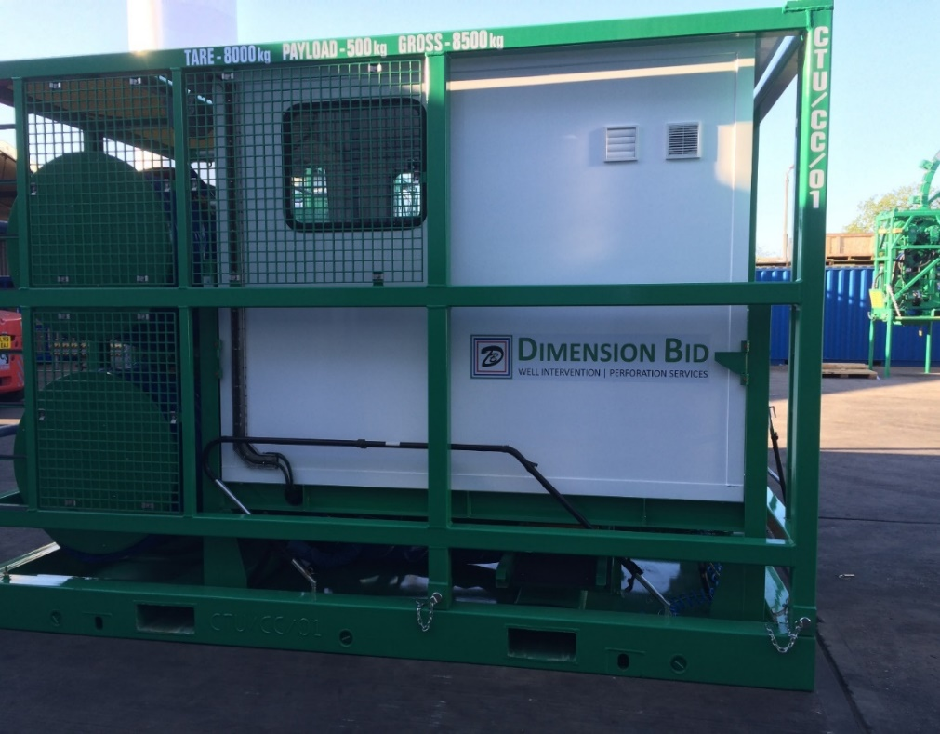
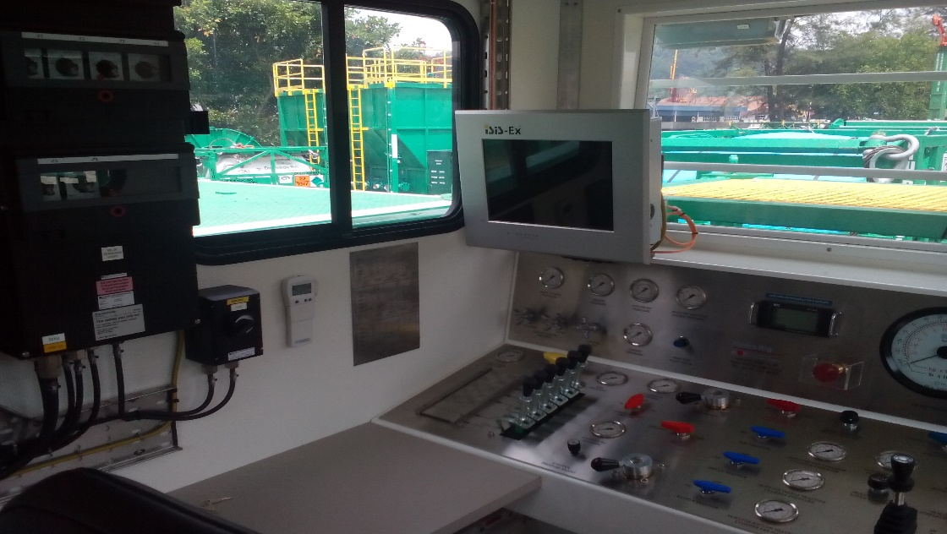
CONTROL CABIN
Primary control during CT operation.
  CT controls
  BOP Controls
  Monitoring Instruments ( depth, weight, pressure, speed, pump rate)
  Monitoring Instruments (engine/hydraulic system)
  Back up system (manual & air operated hydraulic pump)
  Hose Reel

Slide 6
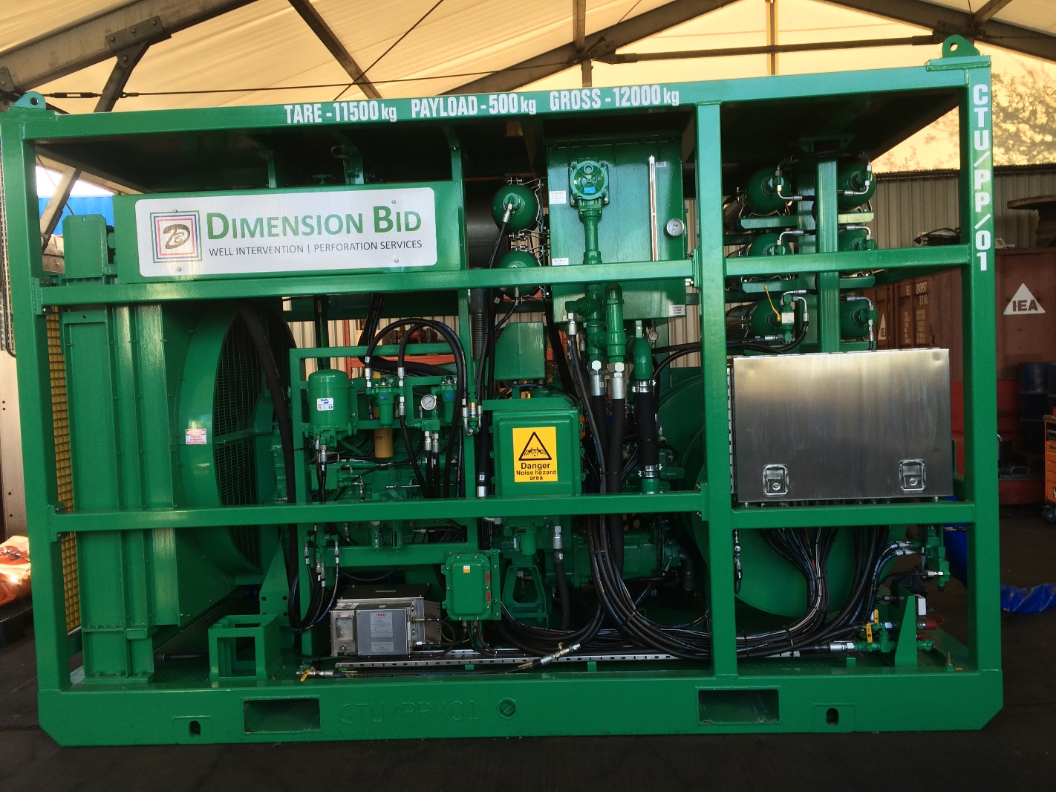
POWER PACK
Generate hydraulic and pneumatic power required by the other CT unit.
  Diesel Engine
  Drive hydraulic pumps to power individual systems. (Reel, BOP, Injector, Leverwind, Priority & Auxilliary)
  Accumulator for BOP as contingency.

Slide 7
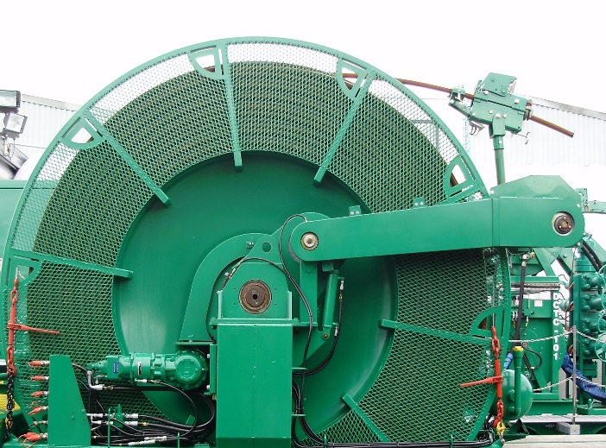
CT REEL
Provided the force to spool CT in and out from the reel
  Reel Manifold – Continuous pumping while rotating the reel and allow drop balls.
  Lever wind – Assist CT to be in safe position during RIH and POOH.
  Horse Head.
  Mechanical Depth Counter

Slide 8
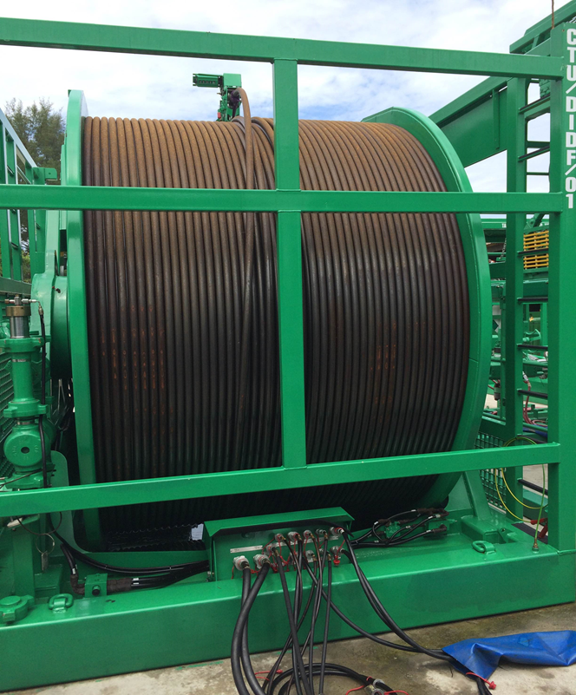
CT REEL
CT String
Materials : High Strength Low Alloy Steel (HSLAS)
Various size of CT. (1”, 1.25”, 1.5”, 2.0” & etc)
Types of CT String
Straight Wall
Tapered String
True Tapered String

Slide 9
CT REEL
Fatigue factors for CT
Bending (Picture)
Internal Pressure
Corrosion
Ovality

Slide 10
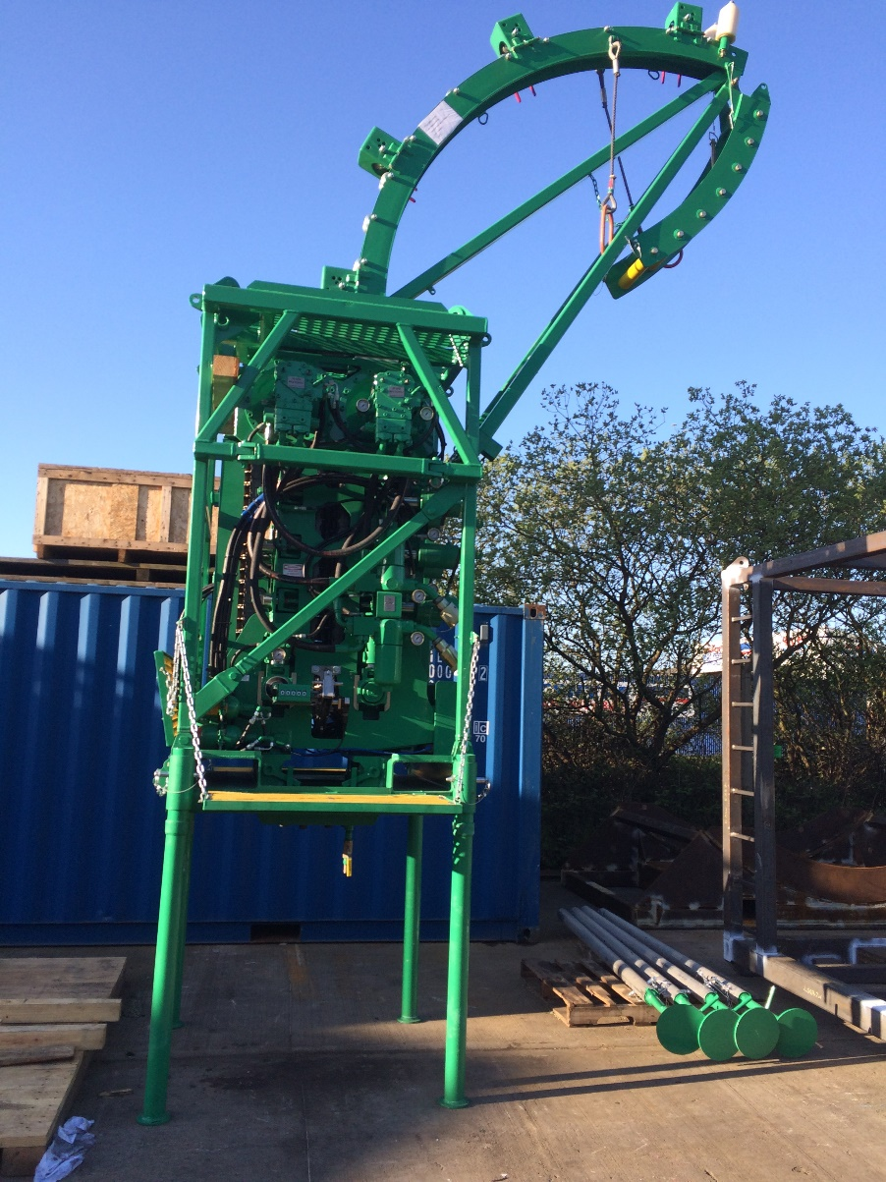
INJECTOR HEAD
Basic functions of the injector head includes:
  Injecting and retrieving the CT string (chain drive system)
  Holding the CT string static (chains and braking system)
  Guiding the CT to the reel (gooseneck)
  Tension / compression measurement (weight indicator)(Load Cell)
  Depth / speed measurement (depth system sensor)
  Mounting place for primary pressure barrier (stripper)

Slide 11
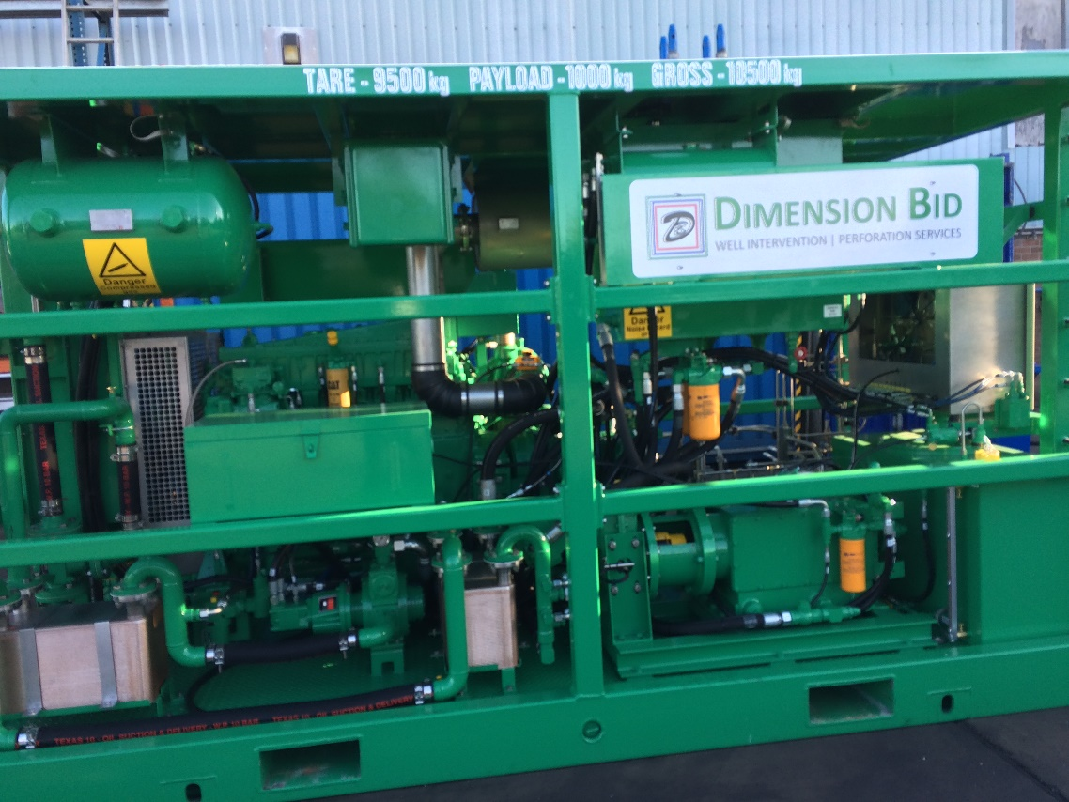
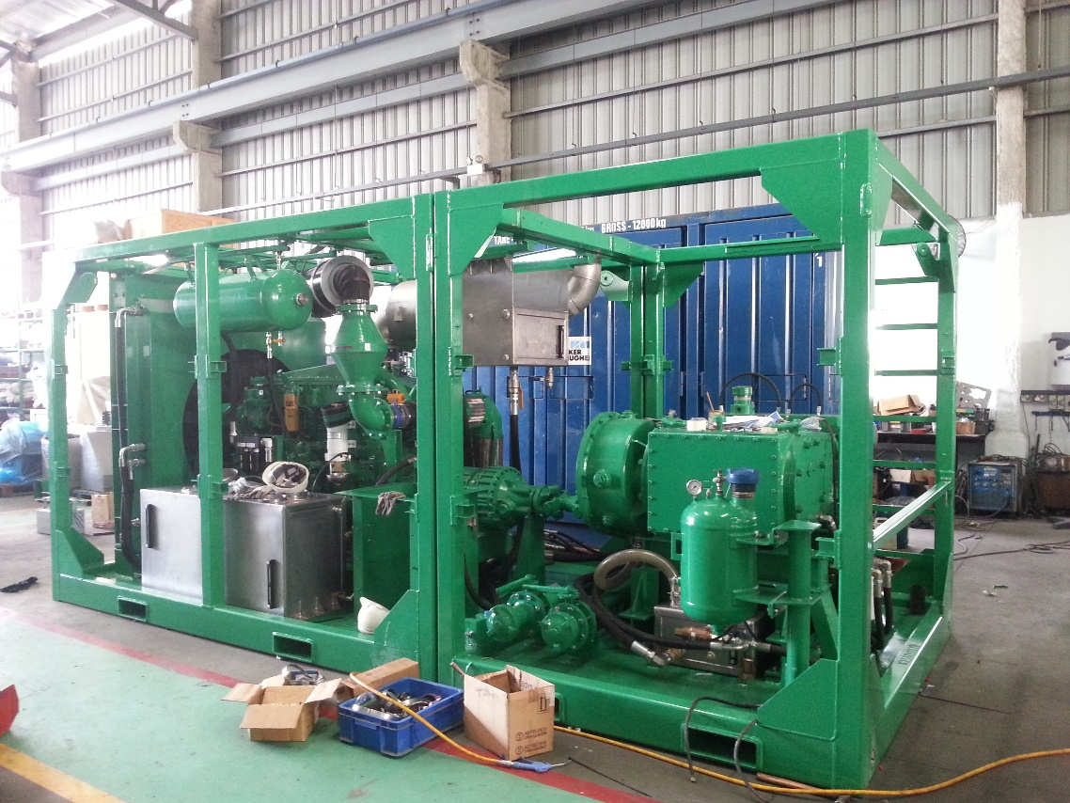
SURFACE EQUIPMENT
NITROGEN CONVERTER
FLUID PUMP SKID

Slide 12
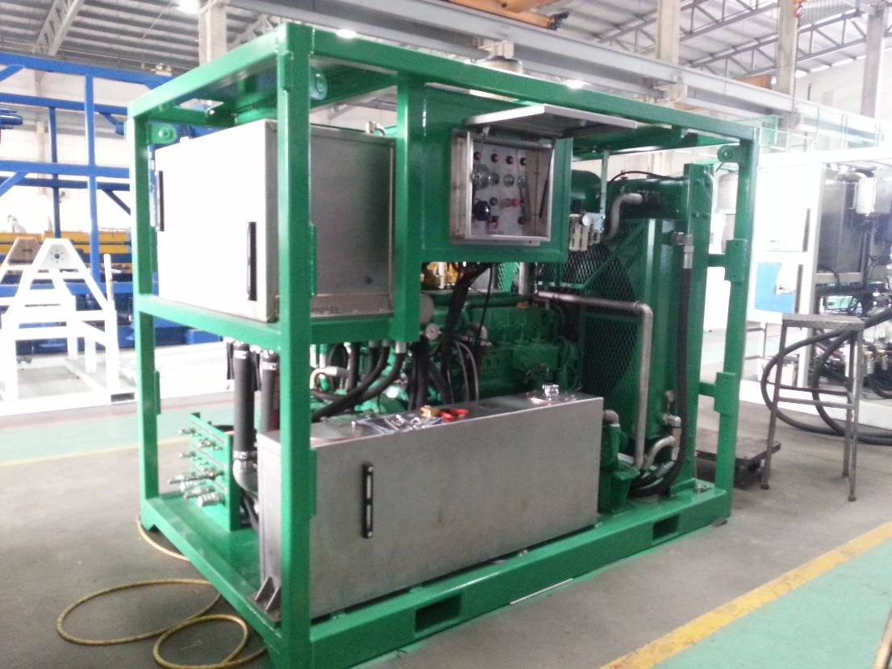
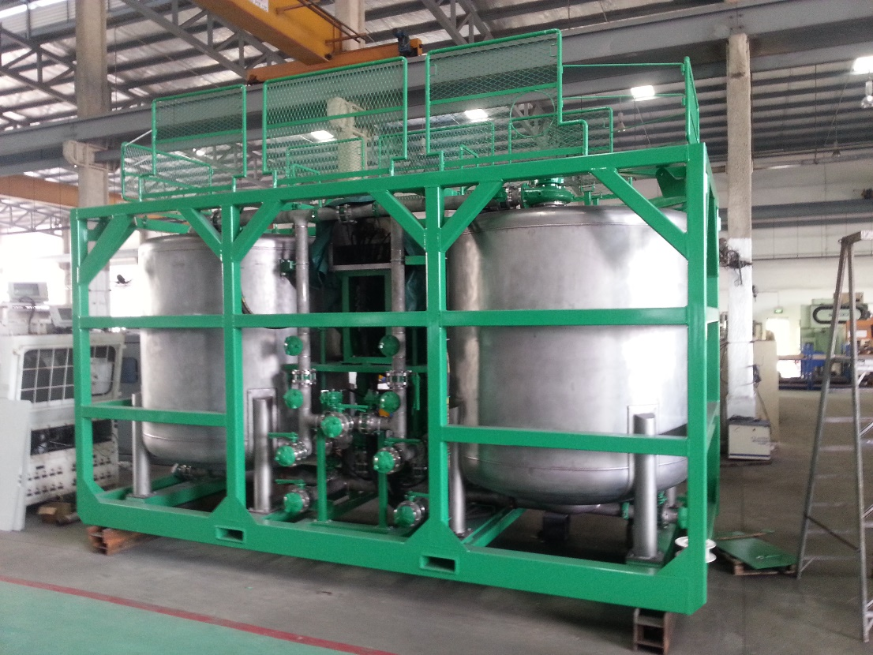
SURFACE EQUIPMENT
BATCH MIXER

Slide 13
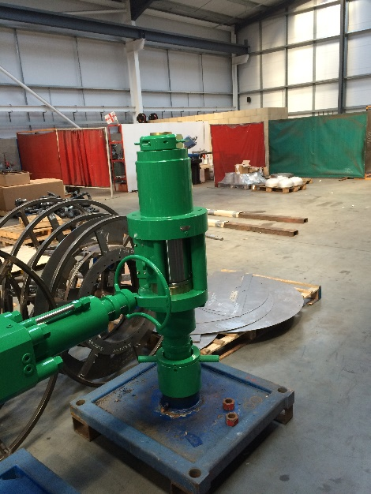
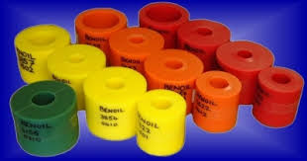
CT PRESSURE CONTROL EQUIPMENT (PCE)
Equipment which provides pressure control in live well operations
  Stripper
Types of stripper :
Single Stripper
Double Stripper
Stripper Rubber
Red ( HTHP)
Orange (MTMP)
Yellow (LTLP)

Slide 14
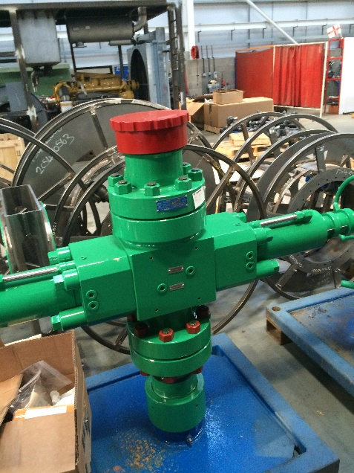
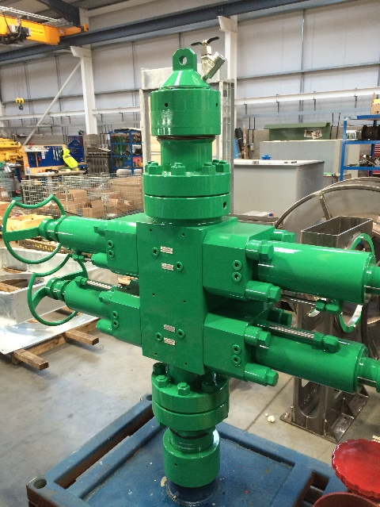
CT PRESSURE CONTROL EQUIPMENT (PCE)
  BOP
Types of BOP :
Single BOP
Dual Combi BOP
Triple Combi BOP
Quad BOP
BOP Ram insert depend on type of BOP
- Pipe, Slip, Shear & Blind Ram Inserts.

Slide 15
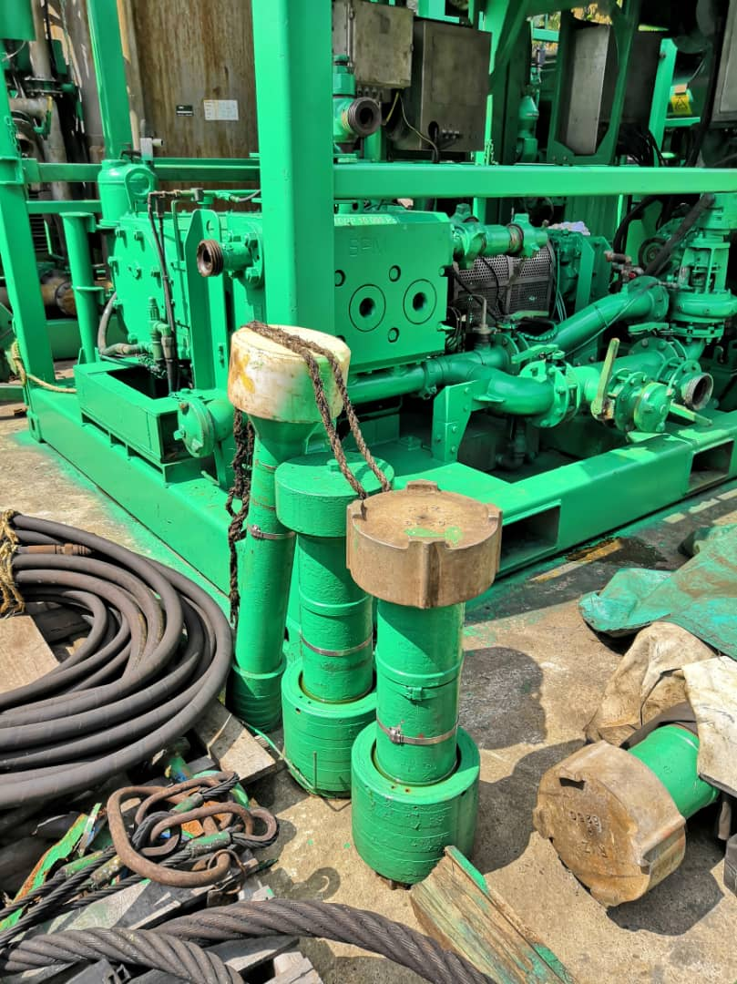
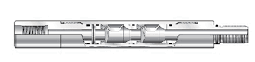
CT PRESSURE CONTROL EQUIPMENT (PCE)
  Riser / lubricator
  Downhole check valve

Slide 16
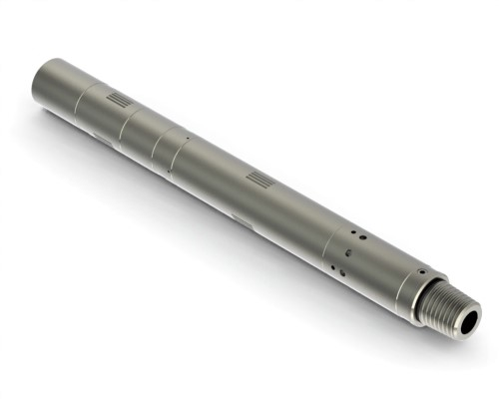
CT DOWNHOLE TOOLS
Basic Down Hole Tools (BHA)
CT Connector
Motor Head Assembly (MHA)
Double Flapper Check Valve
Hydraulic Disconnect
Circulating Sub

Slide 17
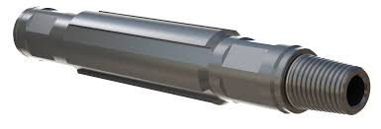
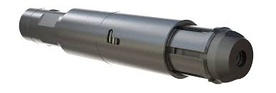
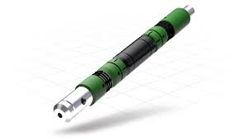
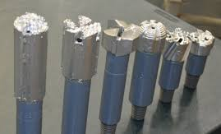
CT DOWNHOLE TOOLS
Down Hole Tools (Extra)
Straight Bar
X-Over
Nozzle
Fishing Tools
Cement Retainer
Hydraulic Setting Tools
Milling Bit
Centralizer

Slide 18
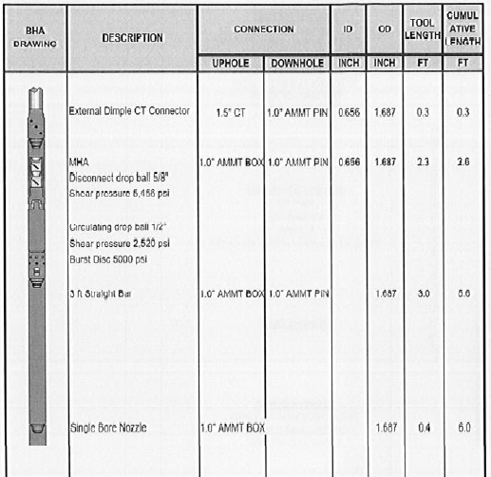
CT DOWNHOLE TOOLS
Example of 1 complete BHA for Sand Clean Out job

Slide 19
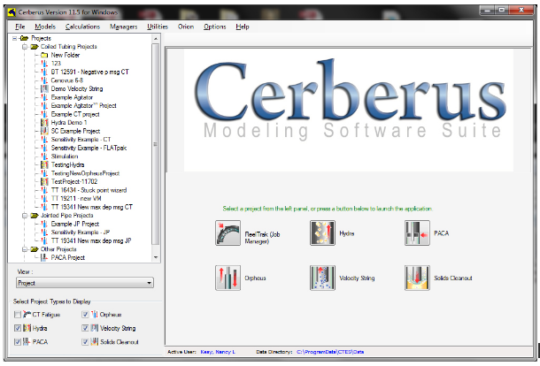
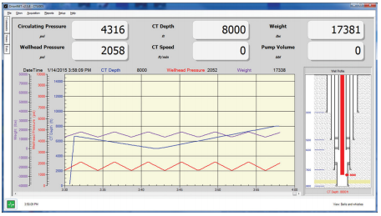
COILED TUBING SOFTWARE
CerberusTM:
Fatigue Life (AchillesTM)
Hydraulics (HydraTM)
Tubing Forces (OrpheusTM)
OrionNETTM:
Acquisition System
Acquires data from multiple source
Monitor real time forces, fatigue, CT string limits, pressures etc.

Slide 20
CT APPLICATIONS
Types of job that can be deployed or carried out by CTU:
Wellbore Cleanout
Scale Cleanout
Nitrogen Kick Off
Cementing
Acidizing
Fishing
CT Logging
CT Perforation
Water Shut-Off

Slide 21
DB CTU JOBS SUMMARY
Job Type | 2016 | 2017 | 2018 | TOTAL
Sand Clean Out | 16 | 2 | 3 | 21
Scale Removal | 0 | 1 | 0 | 1
Kick Off | 0 | 0 | 3 | 3
Fishing/ Milling | 0 | 1 | 0 | 1
Tool/Fluid Conveyance | 0 | 0 | 4 | 4
Matrix Acidizing | 0 | 0 | 0 | 0
Water Shut-Off | 1 | 0 | 0 | 1
CT Cementing | 2 | 0 | 0 | 2
CT Perforating | 0 | 0 | 0 | 0
Pumping | 19 | 0 | 0 | 19
TOTAL | 38 | 4 | 10 | 52

Slide 22
OPERATIONS HIGHLIGHT
DULANG B, C & D
Successfully performed sand cleanout at Dulang C for C-27S, C-07L, C-15L, C-20S and C-20L with increment gain of oil production rate.
Well C-22: Successfully perform Water Shut-Off and manage to reduce Water Cut from 90% to 80%.
Successfully performed sand cleanout at Dulang B for B-12, B-10L and B-26L.
Successfully performed sand cleanout at Dulang D for D-18L and D-11L.
Perform first Water Shut-Off treatment with inflatable packer.

Slide 23
OPERATIONS HIGHLIGHT
ANGSI E
Successfully performed Sand Cleanout for wells E-09, E-10 and E-02.
PULAI A
Successfully performed first CT cementing job for well A-26.
Perform first Scale Cleanout (BaSO4) with Bead Blaster system for well E-02.
Successfully performed first CT Fishing to retrieve the PXN Plug at well E-10.
Experienced stuck cemented CT in well A-10.

Slide 24
OPERATIONS HIGHLIGHT
OIL PRODUCTION COMPARISON
Oil Rate (bopd)

Slide 25
COILED TUBING CATENARY JOB
Coiled Tubing job execution which:
- Equipment spotted on the work boat
CT Reel
CT Control Cabin 2
CT Power Pack 2
Coil Feeder & BOP
Pumping Unit
Nitrogen Converter
Batch Mixer
Fluid Tanks
Barge Cradle
- Equipment spotted on the Platform
CT Control Cabin 1
CT Power Pack 1
CT Jacking Frame + Injector Head
Platform Gooseneck
Platform Cradle

Slide 26
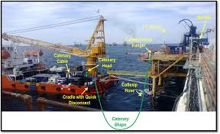
COILED TUBING CATENARY JOB

Slide 27

Q&A

