Slide 1
WEM SIMULATION TUTORIAL
Well Evaluation Model for Perforating Design
Prepared by: Baby Cintami Massaugee Abdullah
Date: January 2020

Slide 2
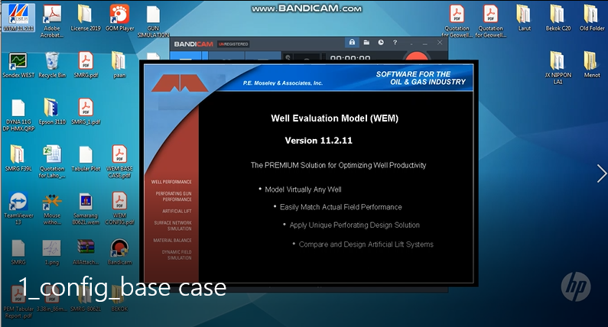
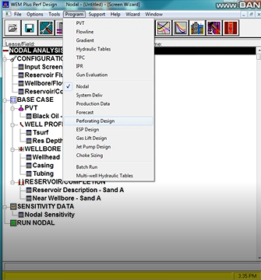
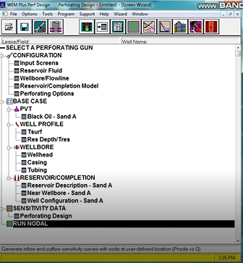
CONFIGURATIONS - SELECT WELL PROGRAM
Open WEM 11.2.11
Click Screen Wizard > OK
Note: Screen Wizard represents all input screens required to make a run.
3. Go to Program > Select Perforating Design.
Note: There are 3 Group of Program. In the middle section of the dropdown menu, there are 8 programs which consist the Perforating Design.
4. The selected program comprised 4 main branches: CONFIGURATIONS, BASE CASE, SENSITIVITY DATA & RUN NODAL.

Slide 3
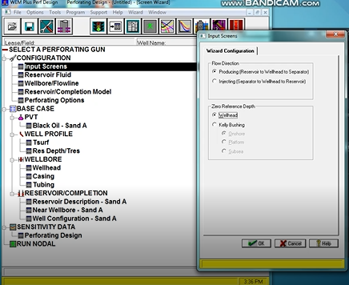
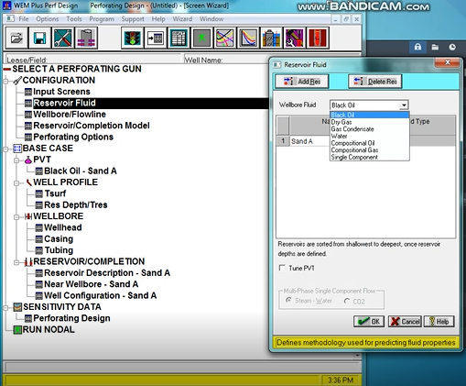
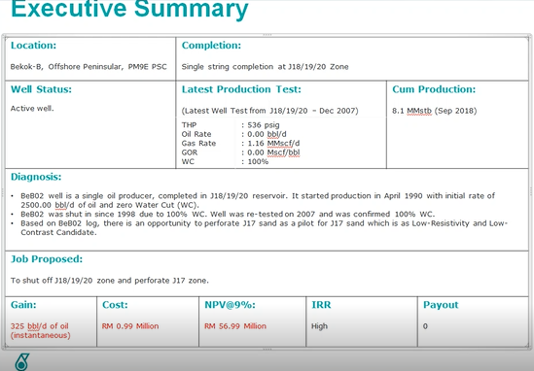
INPUT SCREEN / RES FLUID
Flow Direction > Producing (Reservoir to Wellhead to Seperator)
Zero reference depth > Wellhead
Note: reference datum as either the wellhead or the Kelly rig bushing. If Kelly bushing option is selected, all actual lengths in the well are corrected back to the wellhead for calculation purposes. The reference depth has no influence on the Flowline profile.
3. Choose Reservoir Fluid that is expected to be produced – this will define the PVT model used. You may refer to the job proposal.
4. Rename sand accordingly.

Slide 4
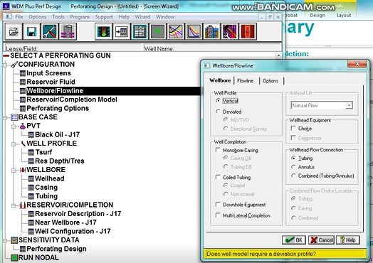
WELLBORE/FLOWLINE
Wellbore/flowline config screen provides choices for configuring the flow system that connects bottom hole to the end of flowline. For this simulation, choke size and flowline will be an option as it can be adjusted during sensitivity (if known or specific request by client). If choke or flowline been chosen, you need to input all the data for both (next tab).
For this section, tick only well profile and wellhead flow connection.
Note: Downhole equipment is generally for all accessories downhole installed such as SSD, TRSV etc. This will counted later on the pressure losses for Outflow Calculation.

Slide 5
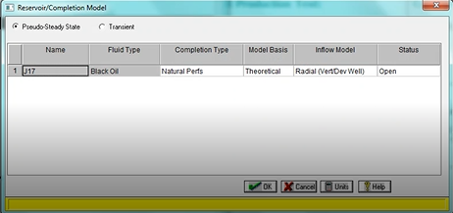
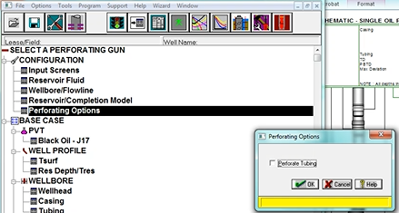
RES/COMPLETION MODEL
Completion type describes method used to establish flow communication between reservoir and wellbore.
Completion Type – Natural Perfs.
Model Basis – Theoretical (distinguish between formation pressure drop and completion pressure drop with no welltest data available).
Inflow Model – Radial / Horizontal (based on well trajectory).
Status – Open (must set ‘Open’ otherwise could not run the model).
Perforating Options – tick if perforate through tubing. If perf directly to casing, leave the box unchecked.

Slide 6
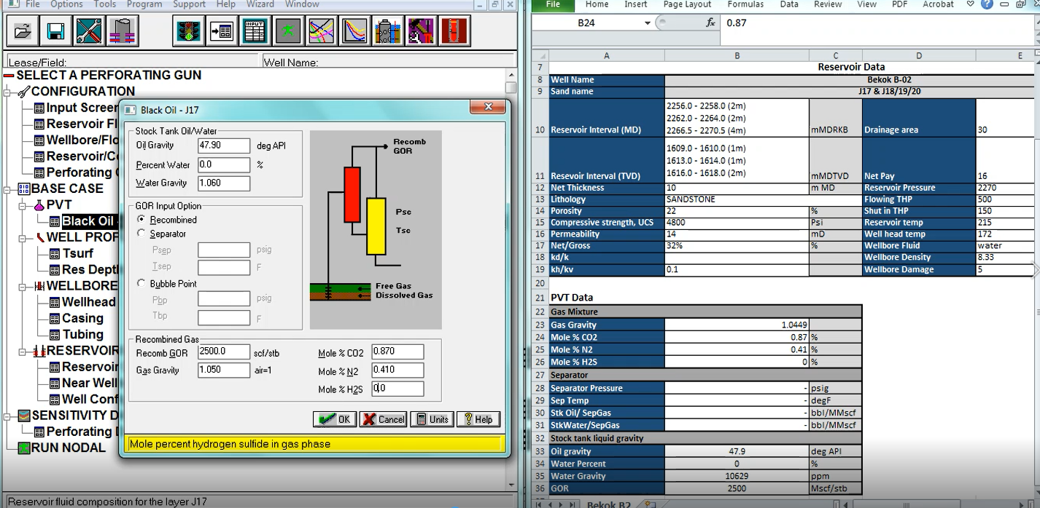
BASE CASE - PVT
Refer to the data that filled by client on WEM Input Template and fill in the PVT accordingly.

Slide 7
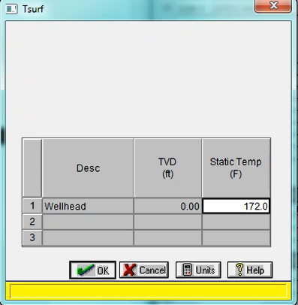
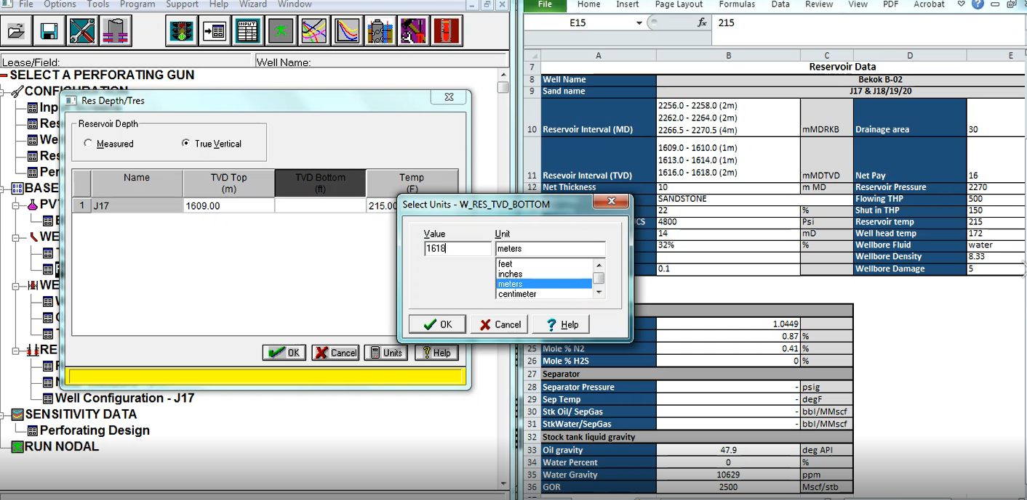
WELL PROFILE
Wellhead Temp.
Res Depth/Tres – Fill up both Perforation depth in ‘Measured’ & ‘TVD’.

Slide 8
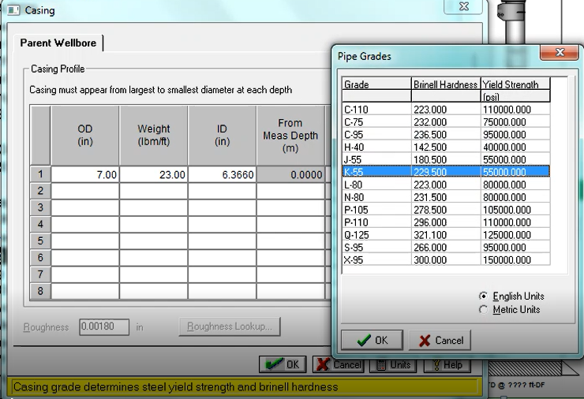
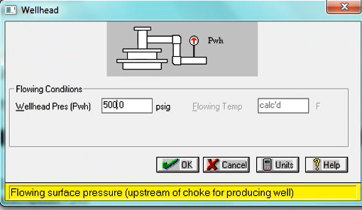
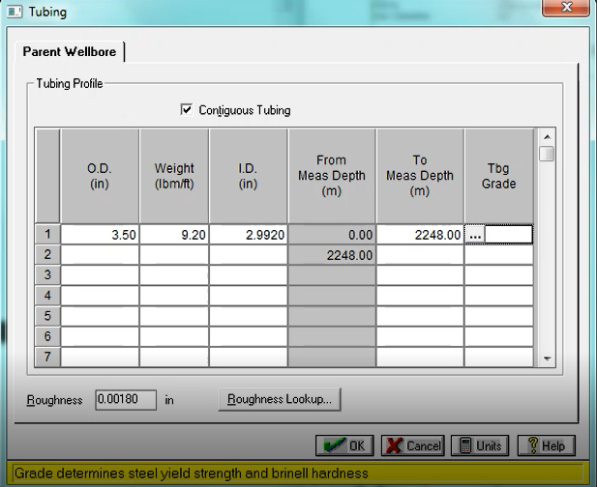
WELL PROFILE
Pwh – Flowing THP
Fill up the casing and tubing details as per well schematic provided

Slide 9
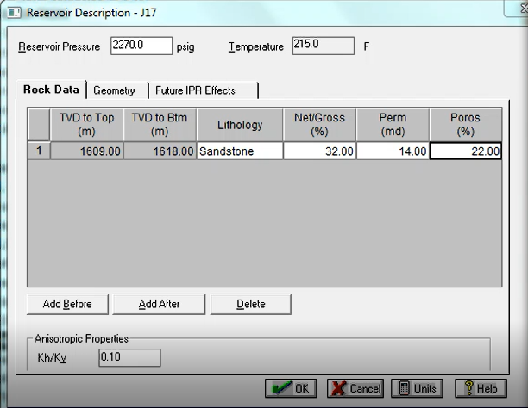
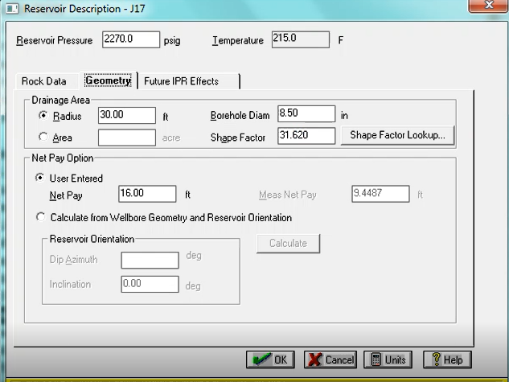
RESERVOIR DESCRIPTION
Fill up the reservoir details for rock data and geometry. You may refer to drill bit size chart for borehole diameter if no information provide by client.
Note: For radius of drainage area, minimum value is 150ft.

Slide 10
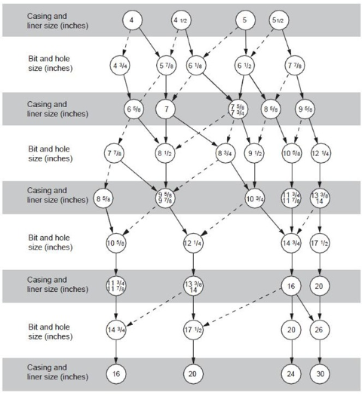
RESERVOIR DESCRIPTION
Use straight line as primary bit size and dotted line as secondary bit size.

Slide 11
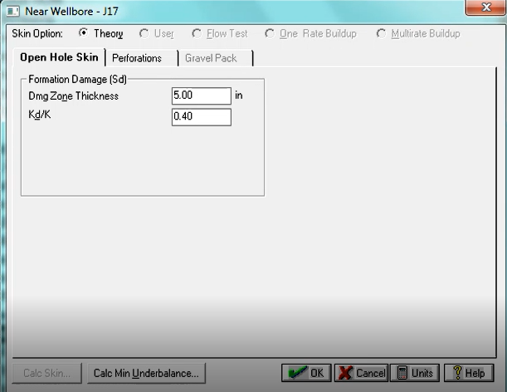
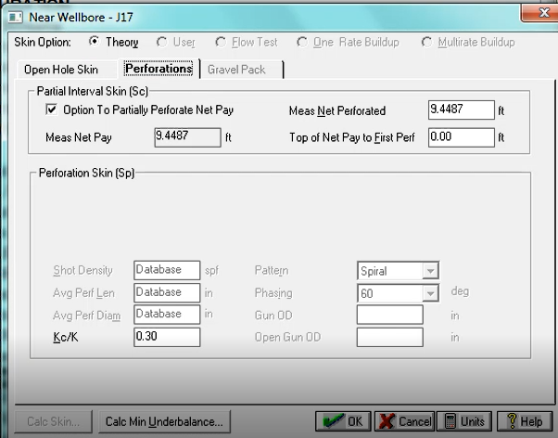
NEAR WELLBORE
Fill in formation damage zone thickness and Kd/K (ratio of permeability in damage zone to virgin zone). Note: Use default value of 6” for damage zone thickness and 0.40 for the ratio.
Tick partial skin (Sc) if you’re intended to partially perforated the zone. If no, leave the box unchecked.
Cut the video from 3:15mins to 7:31mins – not using

Slide 12
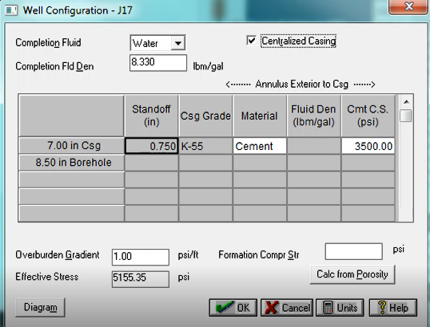
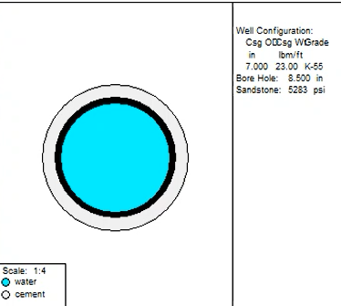
WELL CONFIGURATION
Current wellbore fluid and density (ppg) inside the tubing/casing during the perforation job –Water/diesel/mud/gas.
Input referring to tubular annulus (exterior to casing).
Eg. Behind 7” casing is cement thus cement compressive strength input is required. If you choose water, then the water density is required.
Note: If you are perforating through tubing, where you tick perforated tubing (in Perforating Options @ configuration setup branch), the tubing size will appear here. Therefore, you will need to define type of material for both tubing and casing.
Formation CS: use as per input from client; IF no info, it can be calculated from porosity.
Click on Diagram to check if your wellbore configuration setup is OK (without gun).
Blue: Water (completion fluid inside the wellbore where your gun is)
Black: Casing
Grey: Cement

Slide 13
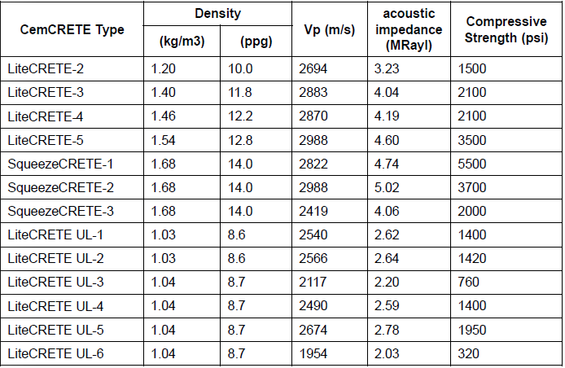
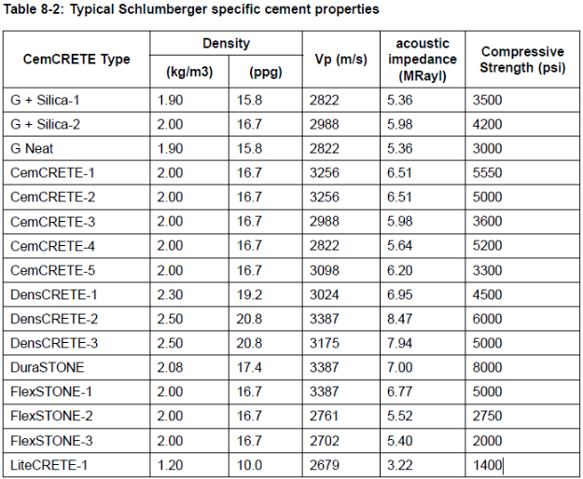
WELL CONFIGURATION
Typical SLB cement properties – can be use as guideline as well. If there is no info from completion report, use G-cement properties with 15.8 ppg and cement CS 3500 psi.

Slide 14
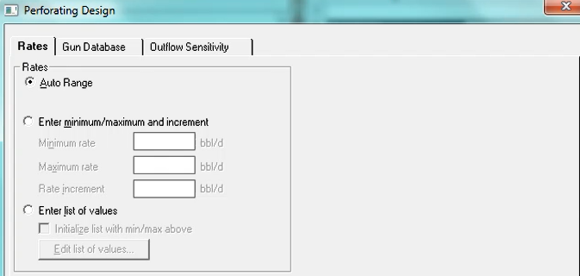
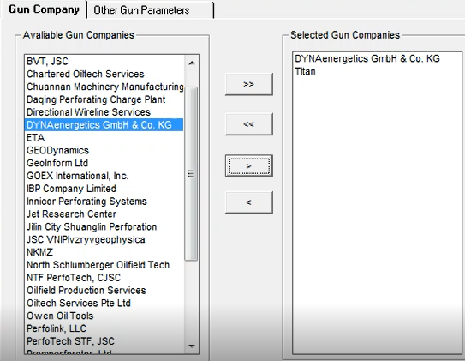
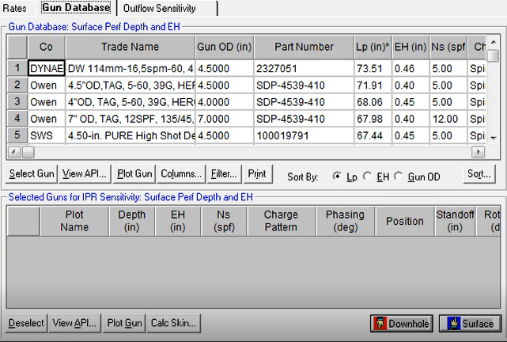
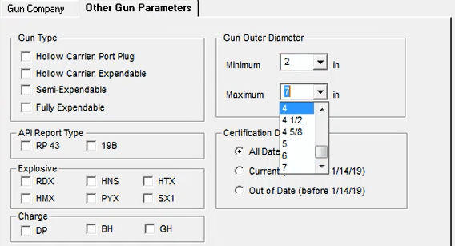
SENSITIVITY DATA
On the Rates tab – use Auto Range
Click Gun Database tab, click filter to choose gun manufacturer.
Click other gun parameters tab to filter gun size or shape charges type.

Slide 15
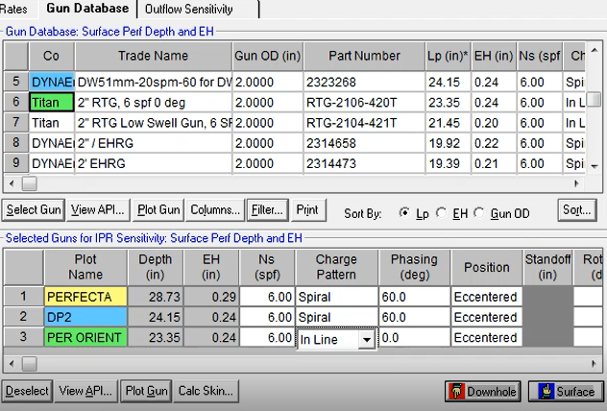
SENSITIVITY DATA
Click select gun for the gun chosen and name the shape charges (SC) accordingly.
For this simulation, the type of SC are as below:
2” PERFECTA, 6 SPF, 60 DEG Phasing
2” DP2, 6 SPF, 60 DEG Phasing
2” PERFECTA, 6 SPF, 0 DEG Phasing (Oriented Perf)
Click View API – to view each SC Performance according to API19B
Click Plot Gun – to view simulated gun plot summary for each SC Penetration Length and Entrance Hole Diameter.
Click Calc Skin – to view skin value.

Slide 16
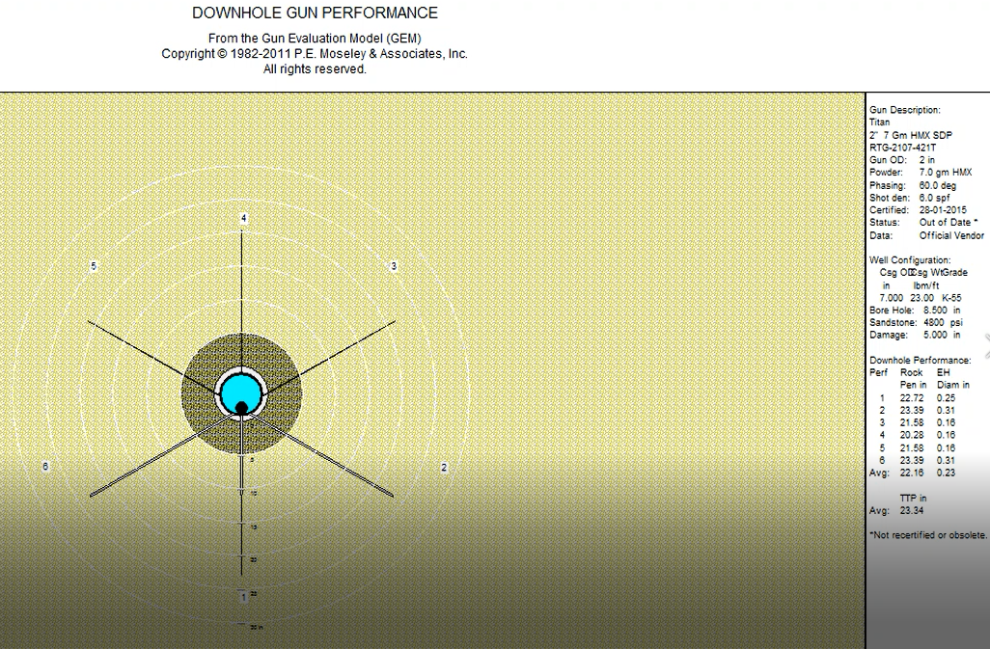
SENSITIVITY DATA
Gun Downhole Performance Plot can be view for 1 gun at a time. You may need to click at each selected gun to produce each report.
To save file: Go to Options and Print Auto Scale > PDF > Name the file (Gun Performance Plot_PERFECTA_6SPF_60DEG)
Go to Other Plots > Tabular Results to view detailed reports for the gun performance.
To save file: Go to Printer > PDF > Name the file (PEM Tabular Report_PERFECTA_6SPF_60DEG)
Note: Double check all the input in the summary prior to print the report(s).

Slide 17
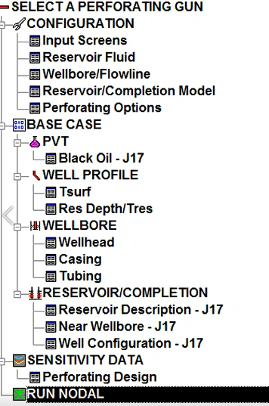
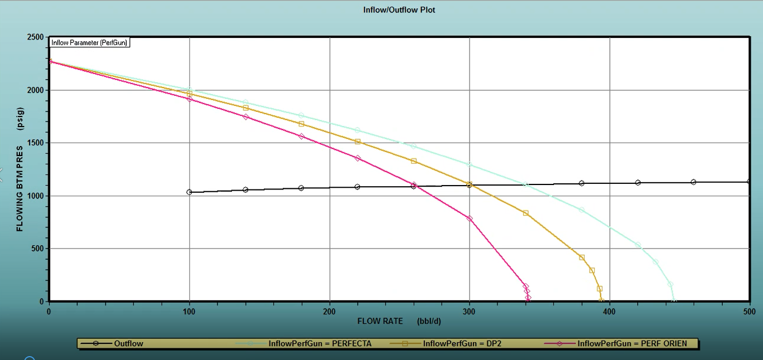
RUN NODAL
Click Run Nodal – nodal couldn’t be run until all input is fixed.
Once OK, the software will plot Inflow/Outflow Curves (FBHP vs Q).
To save file: Go to File > Import > Name the file > change format type to .BMP (Inflow_Outflow Plot)
There are 3 input curves for selected SC and the intersection point of Inflow/Outflow curve is the estimated production rates (bbl/d) based on the base case you have input.

Slide 18
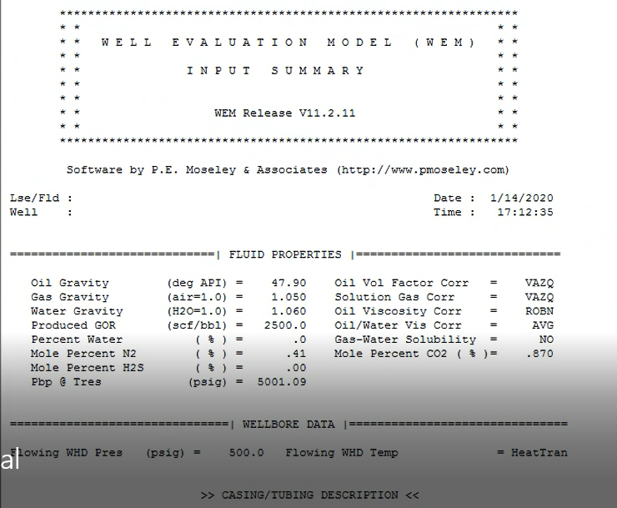
RUN NODAL
To view Nodal Report Summary, go to View > View Tab Report > Detailed
All parameters input were summarized in the report as follow:
Fluid Properties
Wellbore Data
Reservoir Description
Interval Profile
Near Wellbore Data
IPR/Tubing Performance Report for each inflow curve for perf gun.
To save file: Go to Printer > PDF > Name the file (Inflow_Outflow Input Summary)

Slide 19
-END OF SLIDE-
THANK YOU

