Slide 1
Kaseum K-Set
By Ikram Muslim

Slide 2
INFO SUMMARY
K-Set PCM Test Panel
Assembly of Force Gauge to the Slick Rod of the K-Set
Programming a Surface Test
Initialization period
Force Gauge reading
Programming a Set Command

Slide 3
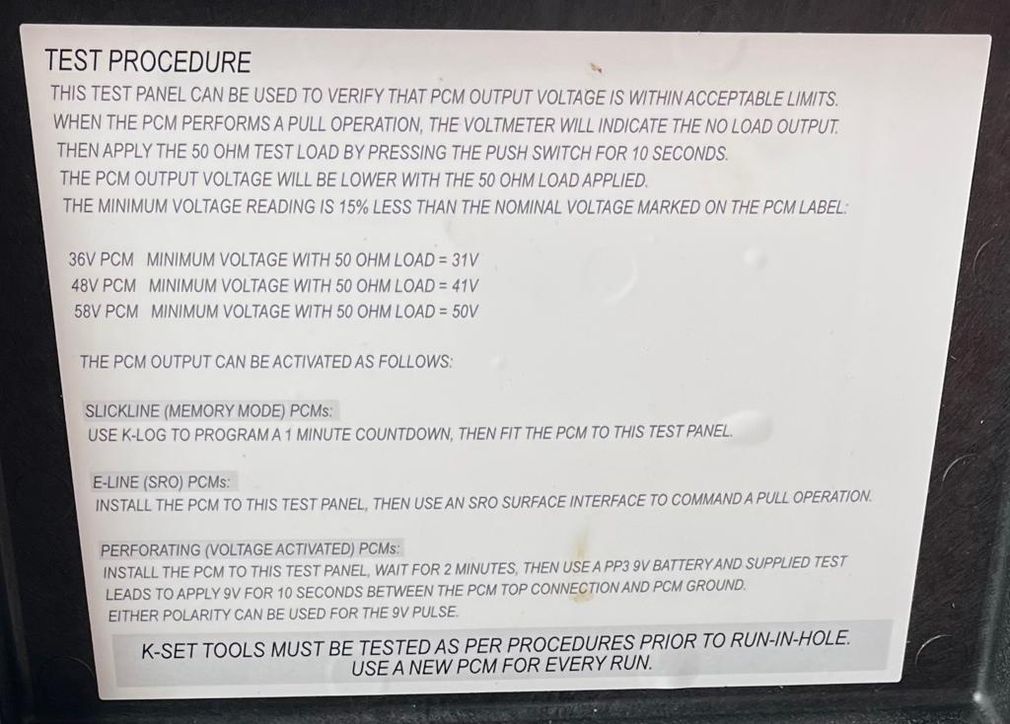
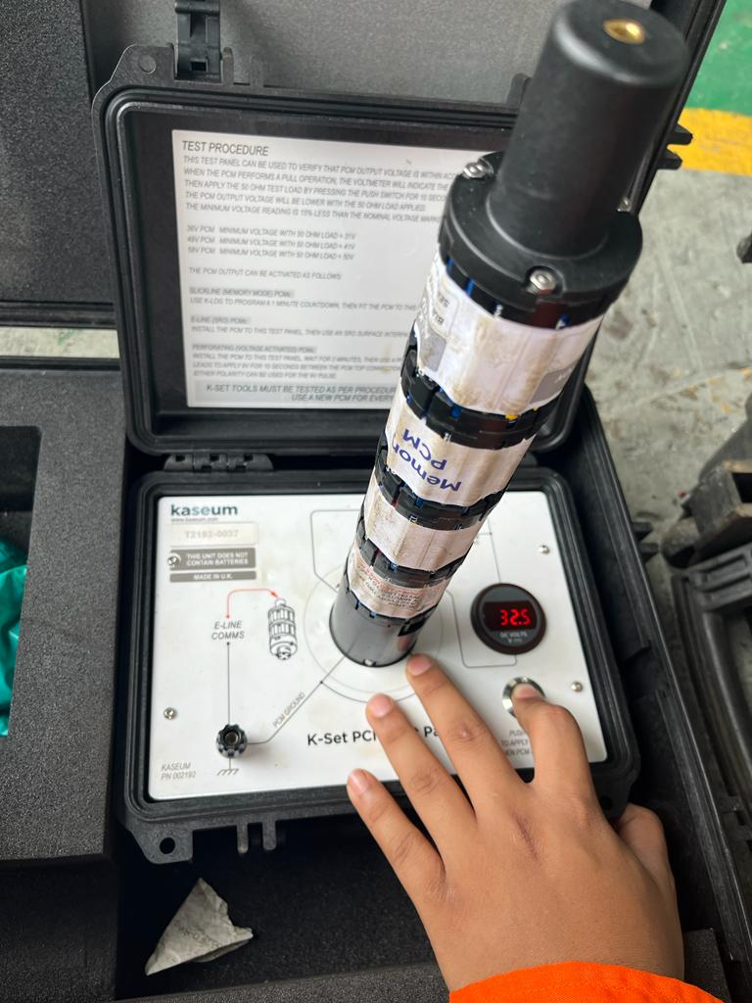
K-Set
K-Set PCM Test Panel
1
Verify either PCM output voltage within acceptable limits or not

Slide 4
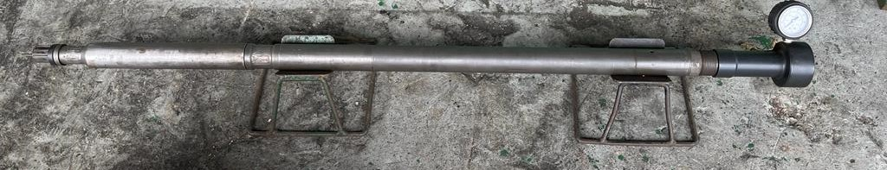
K-Set
Assembly of Force Gauge to the Slick Rod of the K-Set
2
Fitting Force Gauge onto the Slick Rod

Slide 5
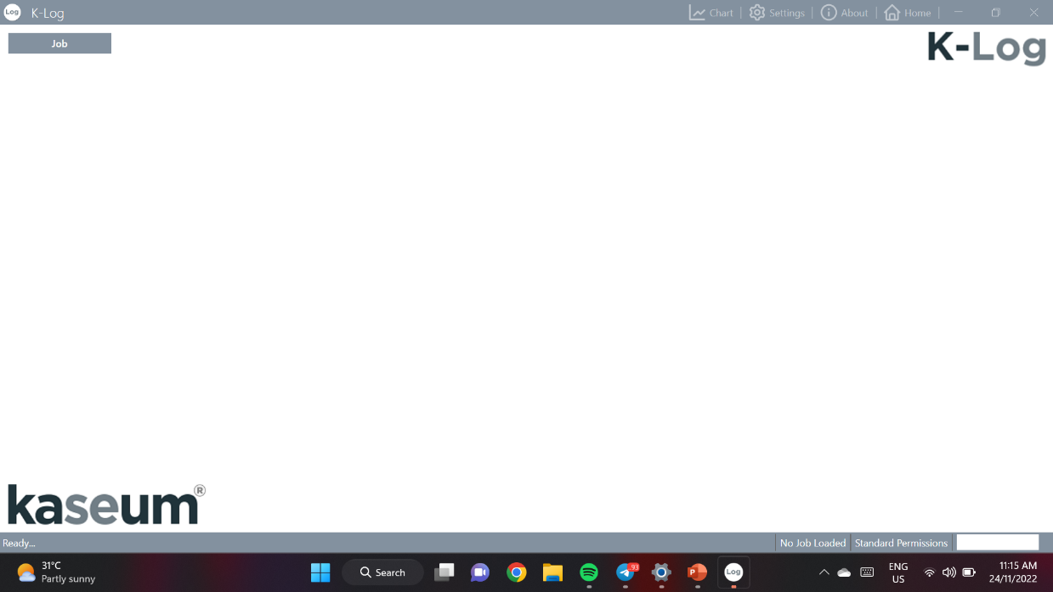
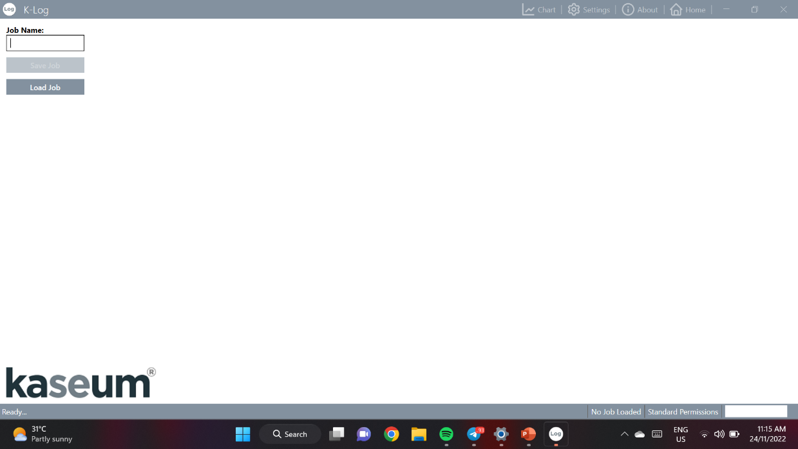
K-Set
Programming a Surface Test in Slickline Mode using K-Log
3
4
Launch K-Log software
K-Log home screen will pop out
Job icon must be selected first
Create new job or load job to find previously created folder

Slide 6
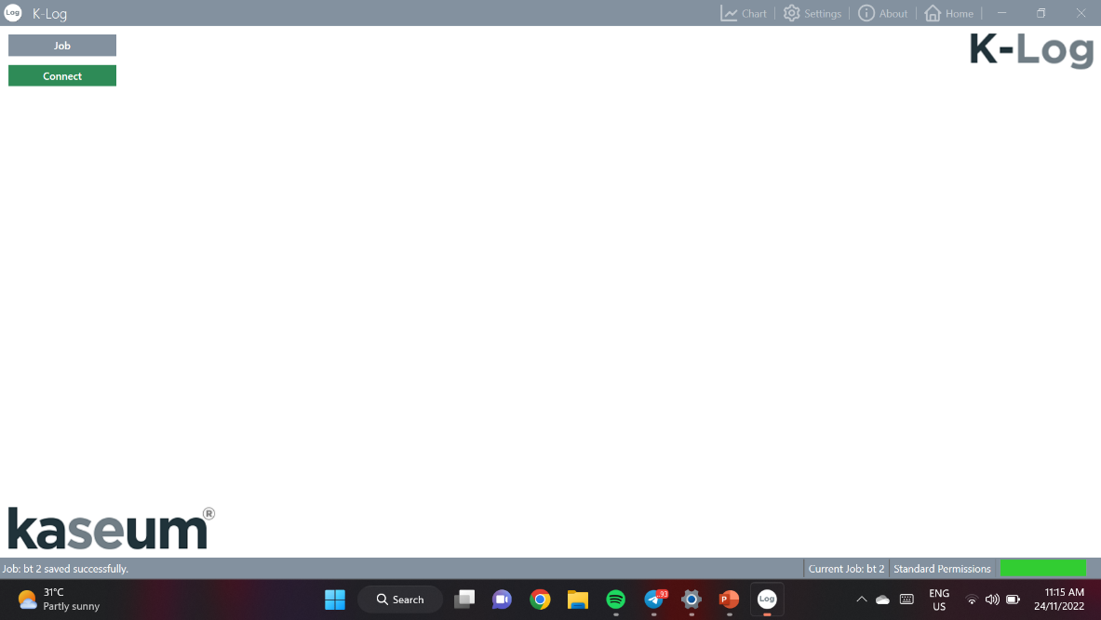
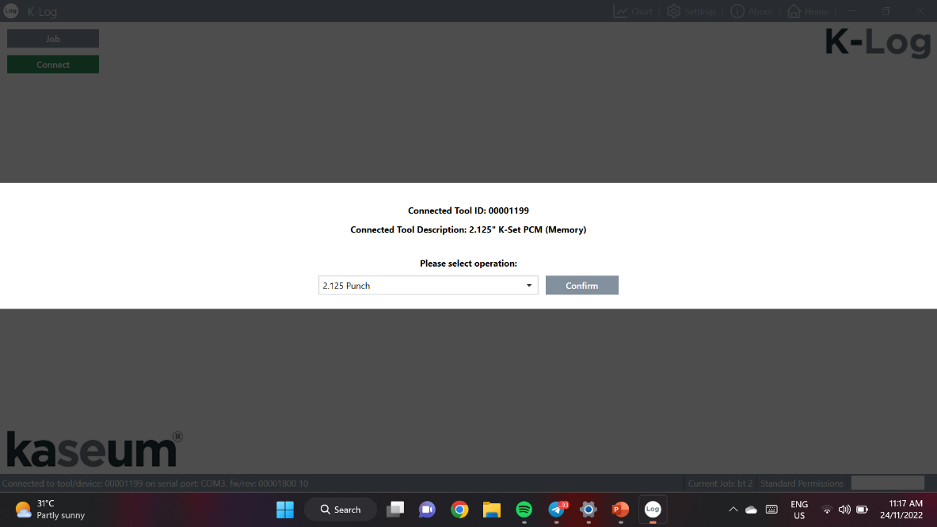
K-Set
Programming a Surface Test in Slickline Mode using K-Log
5
6
‘Connect’ icon will appear once a job has been create / selected
Software will interrogate all connected com ports to establish communication with the PCM by this command
Select the type of operation from the list, either 2.125” punch / 2.125” set
Then select the ‘Confirm’ icon

Slide 7
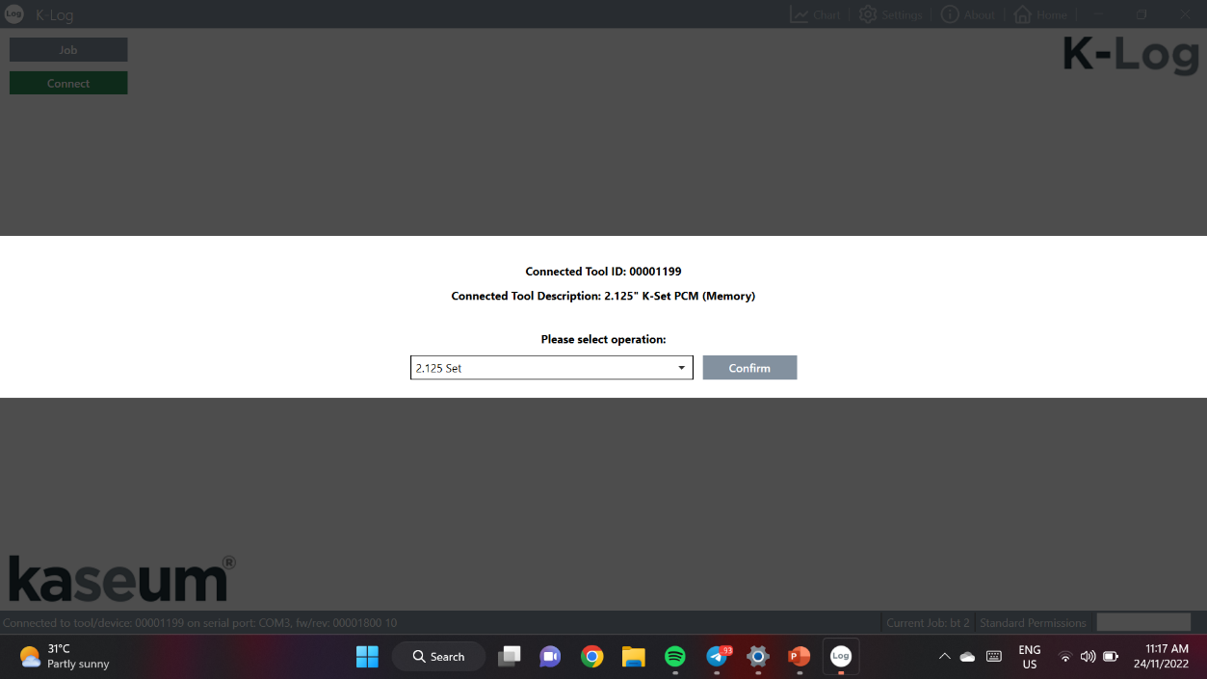
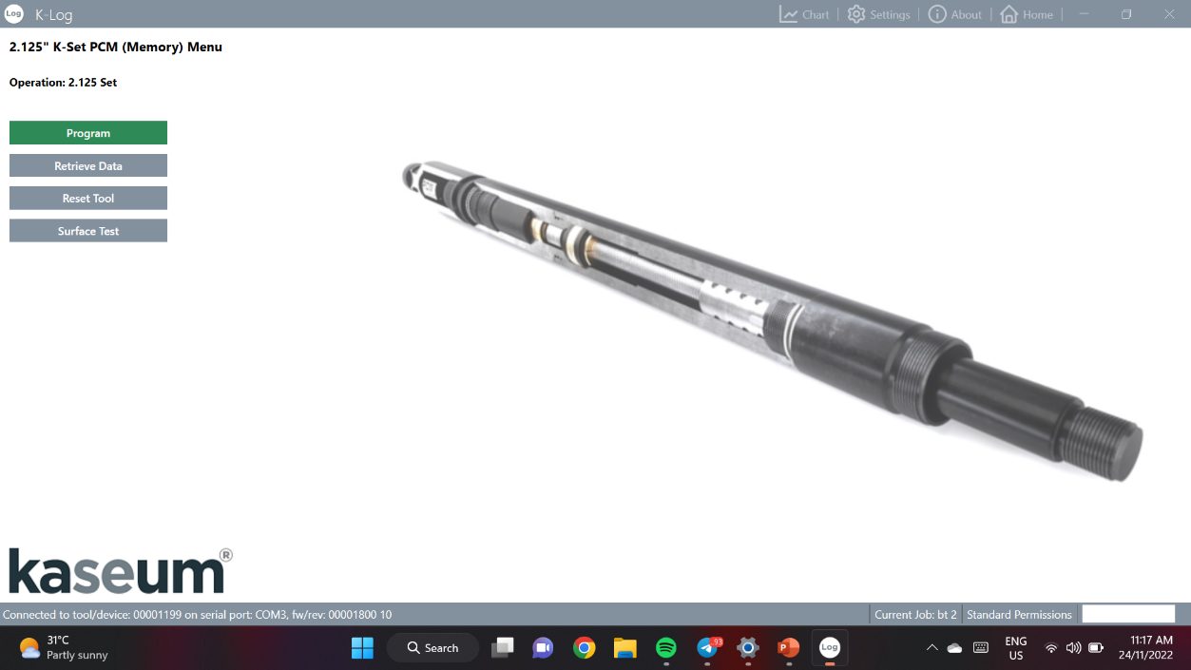
K-Set
Programming a Surface Test in Slickline Mode using K-Log
8
7
Once operation type has been confirmed, the slickline menu (memory) will pop out
The message status bar shown if the PCM has been connected or not, along with the PCM part number
Select ‘Surface Test’ commend icon
Select the type of operation from the list, either 2.125” punch / 2.125” set
Then select the ‘Confirm’ icon

Slide 8
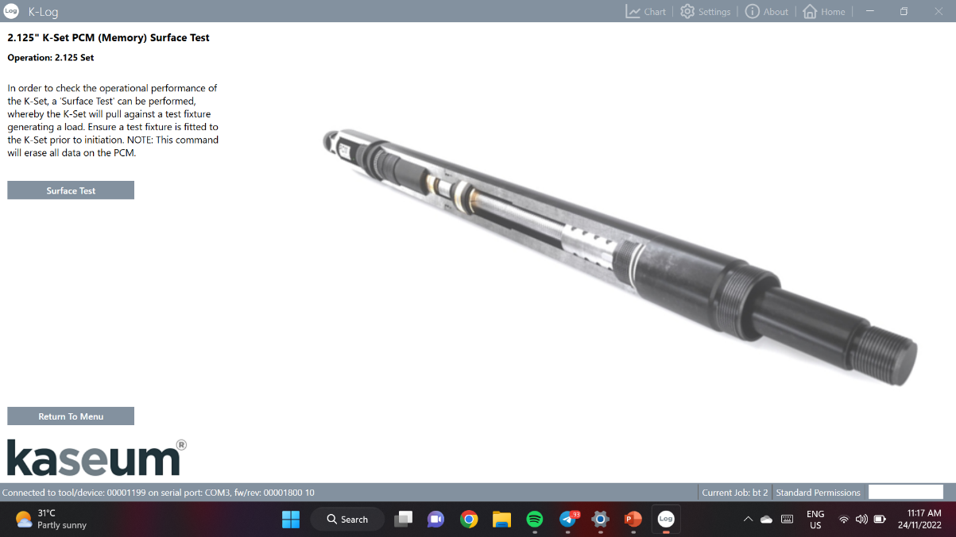
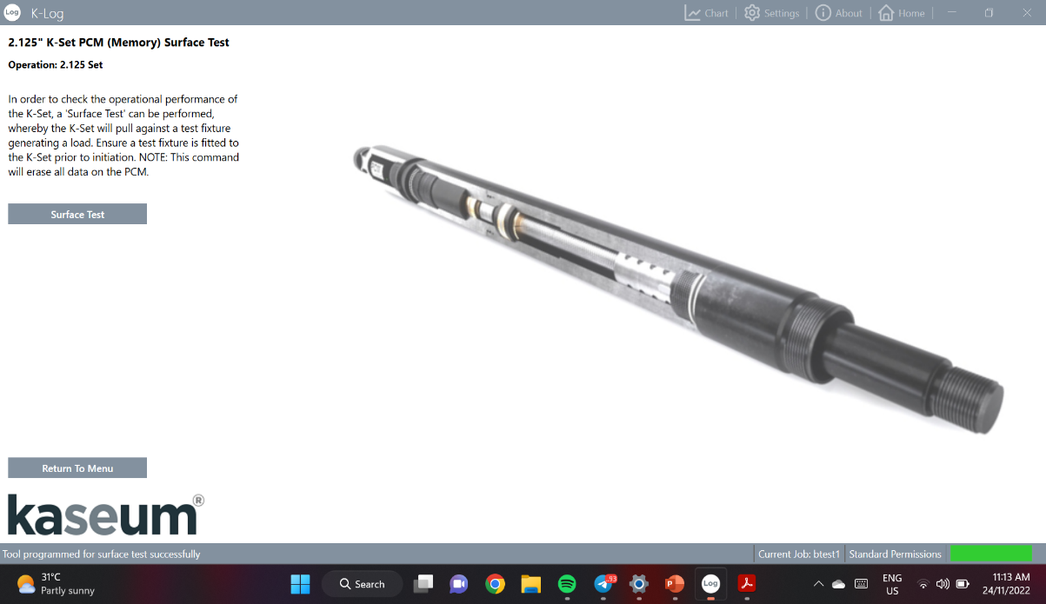
K-Set
Programming a Surface Test in Slickline Mode using K-Log
10
9
‘Surface Test’ can be performed once the slickline mode PCM has been programmed with correct parameters
The PCM ready to perform the ‘Surface Test’ once a ‘Successful’ status message appeared
The warning screen explained the function of ‘Surface Test’
After warning screen appeared, select ‘Surface Test’ command icon

Slide 9
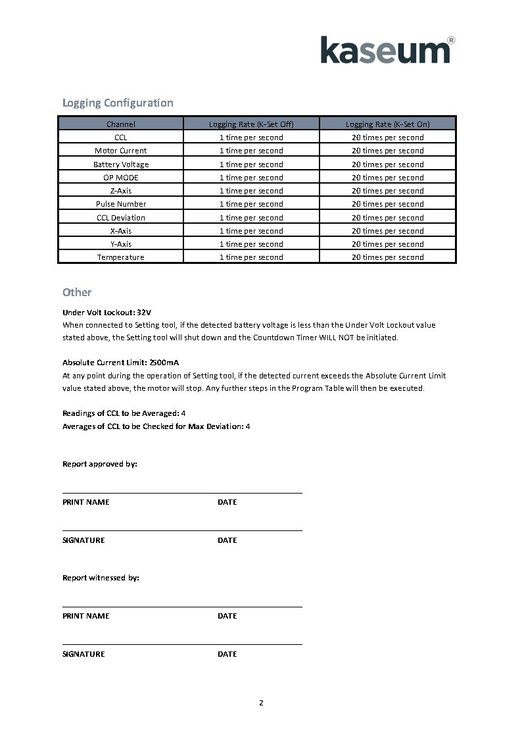
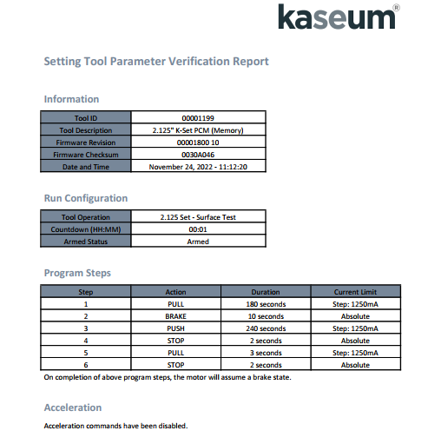
K-Set
Programming a Surface Test in Slickline Mode using K-Log
11
The verification report for the ‘Surface Test’ will generate as below following steps

Slide 10
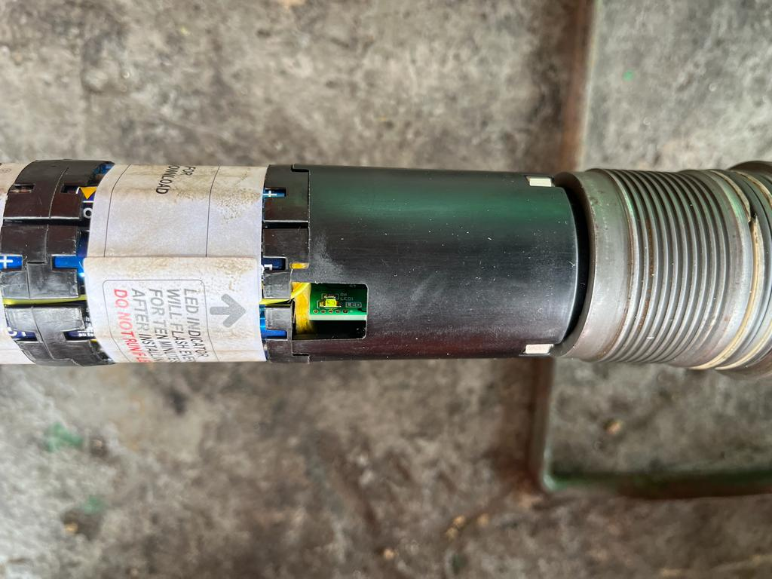
K-Set
Initialization period
12
LED in the PCM will flashing once ‘Surface Test’ has been programmed by using K-Log software
The flash indicate the K-Set is in Countdown Timer mode

Slide 11

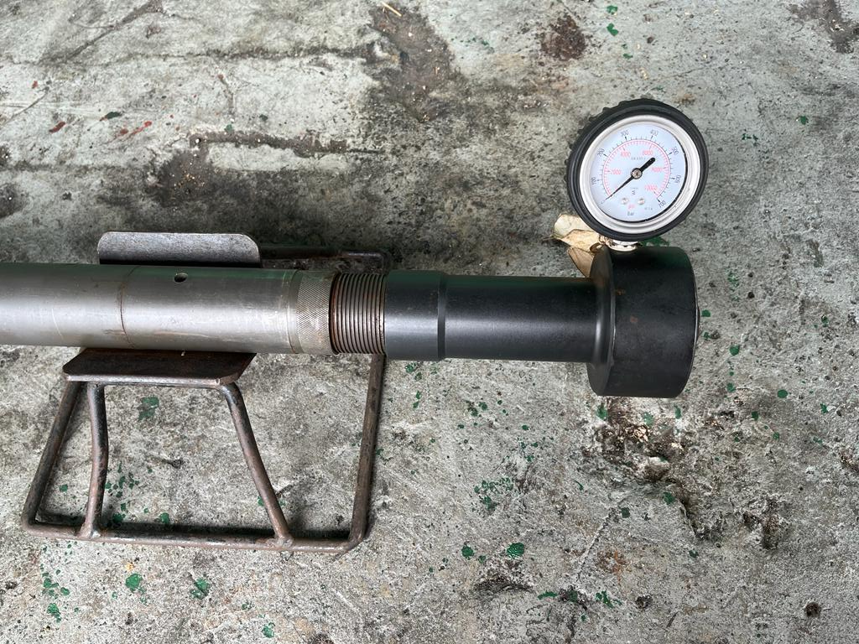
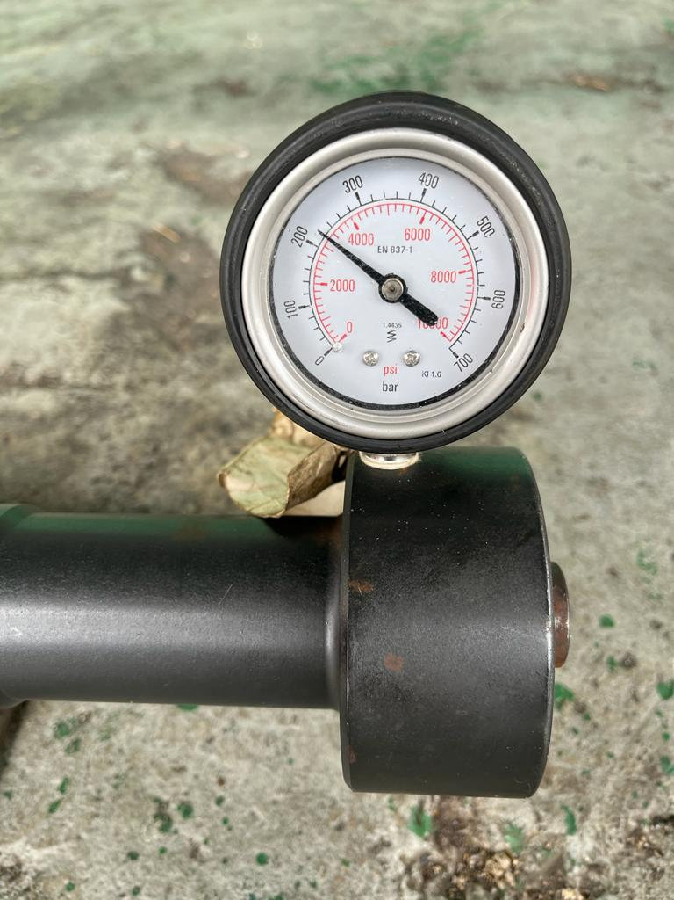
K-Set
Force Gauge Reading
13
After 10 seconds, K-Set will power up and back to its Ready to Run position, then power down
Remove Force Gauge from Slick Rod
Force Gauge loaded up to 3200 psi, then power down
The load held for about 10 seconds
14

Slide 12
K-Set
Programming a Set Command in Slickline Mode using K-Log
1
2
Launch K-Log software
K-Log home screen will pop out
Job icon must be selected first
Create new job or load job to find previously created folder

Slide 13
K-Set
Programming a Set Command in Slickline Mode using K-Log
3
4
‘Connect’ icon will appear once a job has been create / selected
Software will interrogate all connected com ports to establish communication with the PCM by this command
Select the type of operation from the list, either 2.125” punch / 2.125” set
Then select the ‘Confirm’ icon
13

Slide 14
K-Set
Programming a Set Command in Slickline Mode using K-Log
6
5
Once operation type has been confirmed, the slickline menu (memory) will pop out
The message status bar shown if the PCM has been connected or not, along with the PCM part number
Select ‘Program’ command icon
Select the type of operation from the list, either 2.125” punch / 2.125” set
Then select the ‘Confirm’ icon

Slide 15
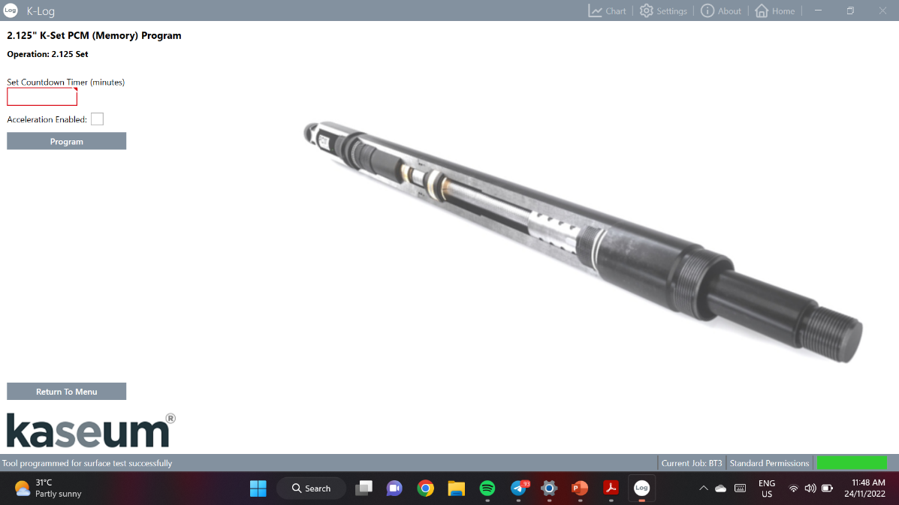
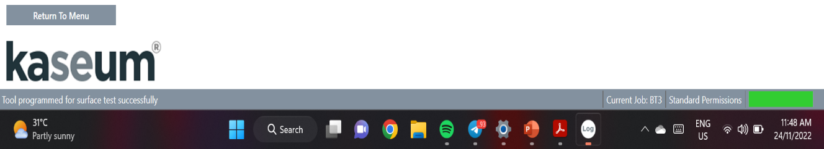
K-Set
Programming a Set Command in Slickline Mode using K-Log
7
Insert the Countdown Timer Delay needed in ‘Set Countdown Timer’. Countdown Timer value prior to duration of the running job to reach the Target Depth
Select on ‘Program’ to commence the programming
Acceleration will force the tool into a fail-safe status by performing a unique acceleration sequence. Only can be enable on Slickline Mode NOT Surface Interface Box
Tick on ‘Acceleration Enable’ if it is required prior to job
8
A successful completion status will appeared once the programming has been completed

Slide 16
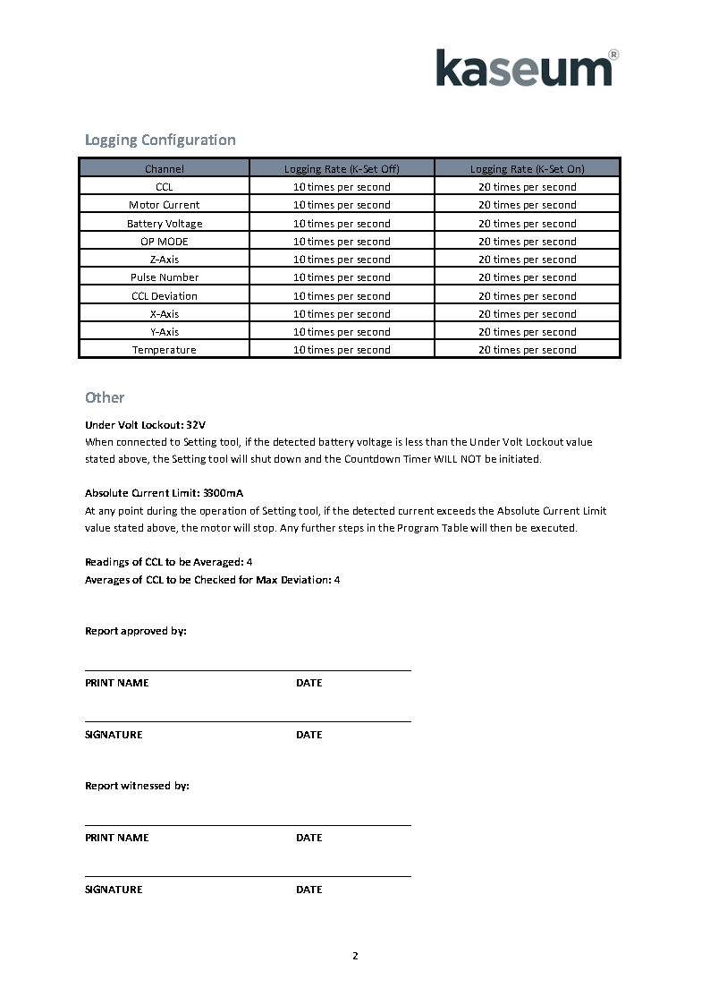
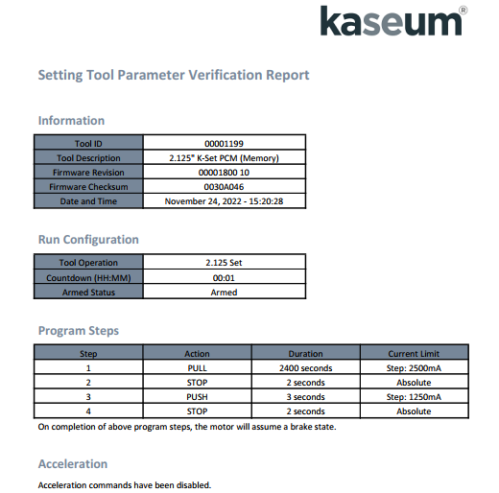
K-Set
Programming a Set Command in Slickline Mode using K-Log
9
The verification report for the ‘Surface Test’ will generate as below following steps

Slide 17

Thank you !
Questions and Answering Session
© Neu Dimension 2020

Slide 18
Prepared by,
_________________________________
Name : Muhammad Ikram Muslim
Designation : Field Engineer 1
© Neu Dimension 2020

