Slide 1
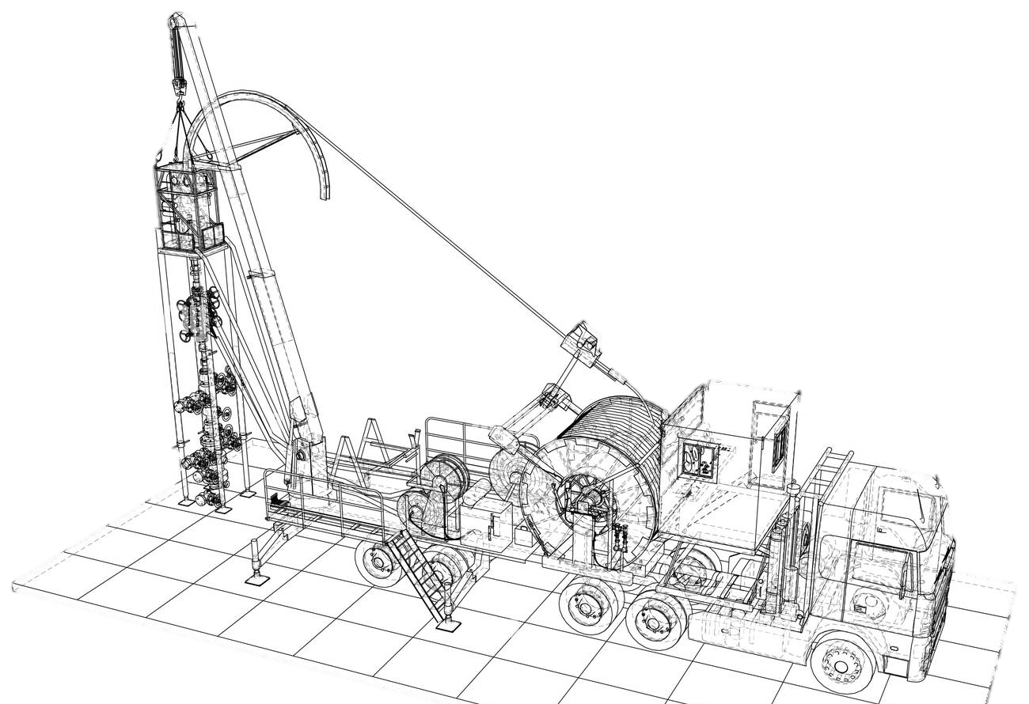
Low Pressure Equipment
Prepared by: MOHD BURHAN BIN YUSOF
Department: Coiled Tubing Services
Notes:
Assalamualaikum and good morning, everyone. We are Junior Field Engineer from Dimension Bid. My name is Nur Izzah and here is my teammates, Haziq, Farhanah and Shahir. As you all know, the purpose of this presentation is to provide a brief overview of Coiled Tubing Services. If you have any questions during my presentation, you may interrupt or list your questions to ask during the Q&A session at the end.
For this presentation, we have 3 objectives, firstly to

Slide 2
Table Of Content
01
Introduction
02
Low Pressure Hose
03
Certifugal Pump
04
Butterfly Valve

Slide 3
Objectives
01
Explain where is low pressure line
02
Identify a low pressure equipment
03
Know part of Low pressure Equipment

Slide 4
Introduction
01

Slide 5
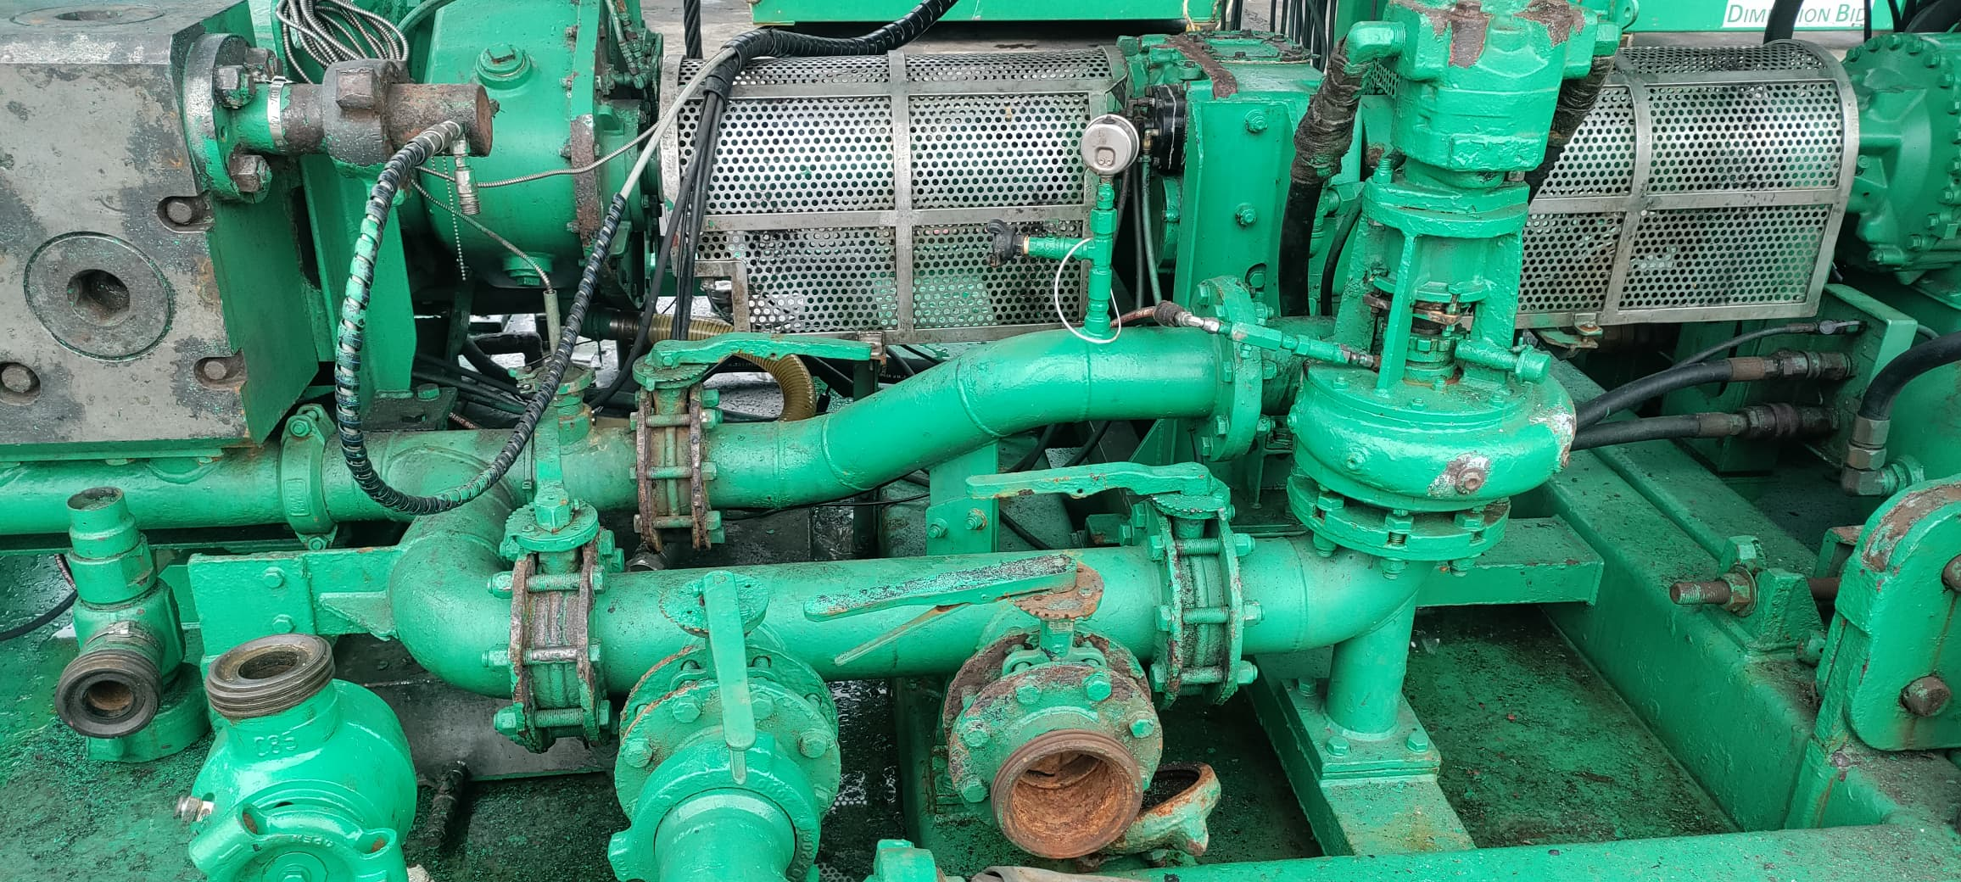
Introduction
Low-pressure equipment consists of various types of hoses, fittings, unions, and butterfly valves. These parts are required to connect to low-pressure pumps, such as the centrifugal pump.
Low-pressure fluid handling for transfer, and store fluids from location to location
Notes:
Coiled tubing is a long and continuos length of pipe wound on a spool. The origin was a technology pioneered by Allied engineering teams during second world war and the project was named PLUTO. It involved deployment of pipelines from the coast of England to several points along the coast of France.

Slide 6
Low Pressure Hoses
02

Slide 7
Suction/Discharge Hose
Low-pressure hose are used on the suction side of positive displacement pumps on the suction and discharge sides of centrifugal pumps in the transfer of fluids from one point to another.
There are two types which are :
- suction hose/Hard hose
- discharge hose/Soft hose
Thread
Wing

Slide 8
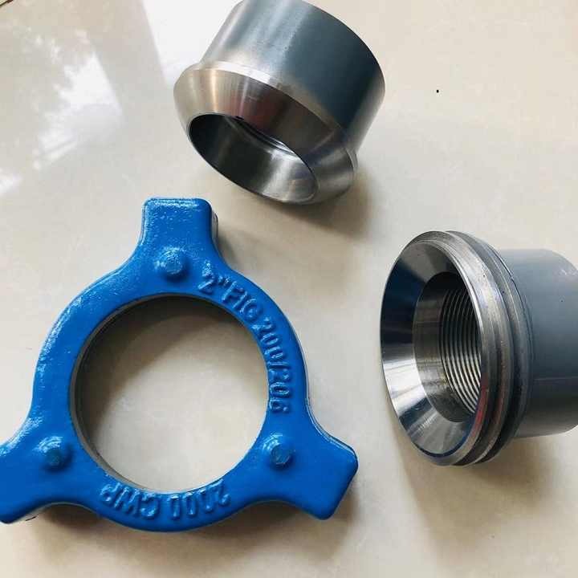
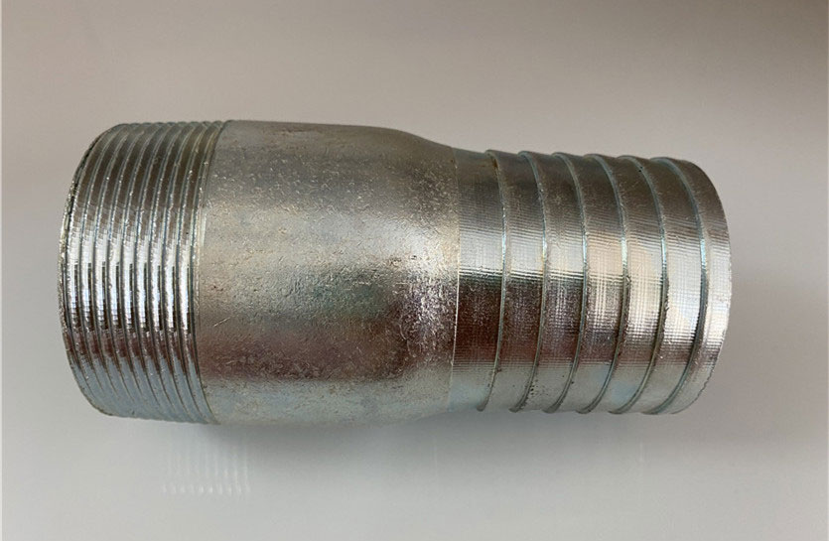
Hose connection
Pressure Rating : 2000 psi
Temprature -20°F to 250°F(-6.67°C-121.11°C)
Male sub and female sub

Slide 9
Suction/Discharge Hose
Suction Hose (Hard hose) | Discharge Hose (Soft hose)
This hose is hard because it is made of fabric that is woven with wire coil to prevent it from collapsing when the pump sucks the fluid from the tank | A discharge hose is a soft, collapsible hose made up of layers of fabric and rubber
Maximum fluid flow for suction hose is (8-10bbl/min) | Maximum fluid flow for discharge hoses is slightly higher than for suction hoses (10 to 12 bbl/min) because of their expansive, flexible properties
Suction hose are commonly used between a storage tank and a centrifugal pump for blending or pumping. | The primary function of a discharge hose is to allow the movement of fluids to the suction side of high-pressure triplex pumps
a

Slide 10
Certifugal Pump
03

Slide 11
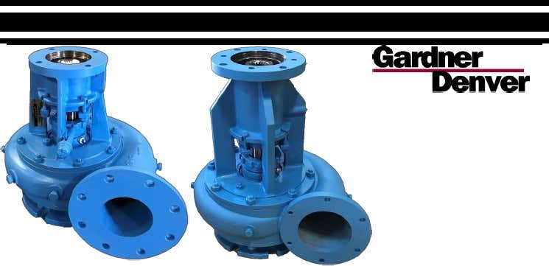
Type Of C-Pump
Type of C-Pump :
C-pump is a high-volume but its produce low pressure on the transfer
-Serva(5X6)
-Shut in pressure(50-60 psi)
-Gardner Denver (4x5)
-Shut in pressure(40-50 psi)

Slide 12
Butterfly Valve
04

Slide 13
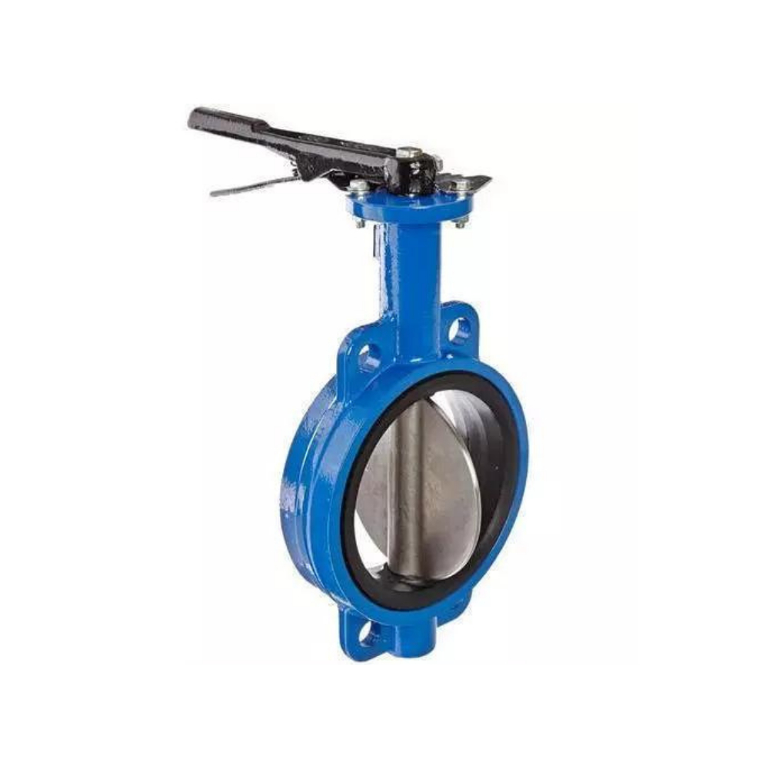
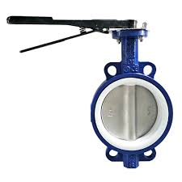
Butterfly valve
Low-pressure butterfly valves are generally used on low-pressure suction and discharge lines.
The maximum working pressure of these valves is 175 psi.
A butterfly valve should always be closed slowly to prevent the water-hammer effect, which can cause breakage or abrupt pressure changes.

Slide 14
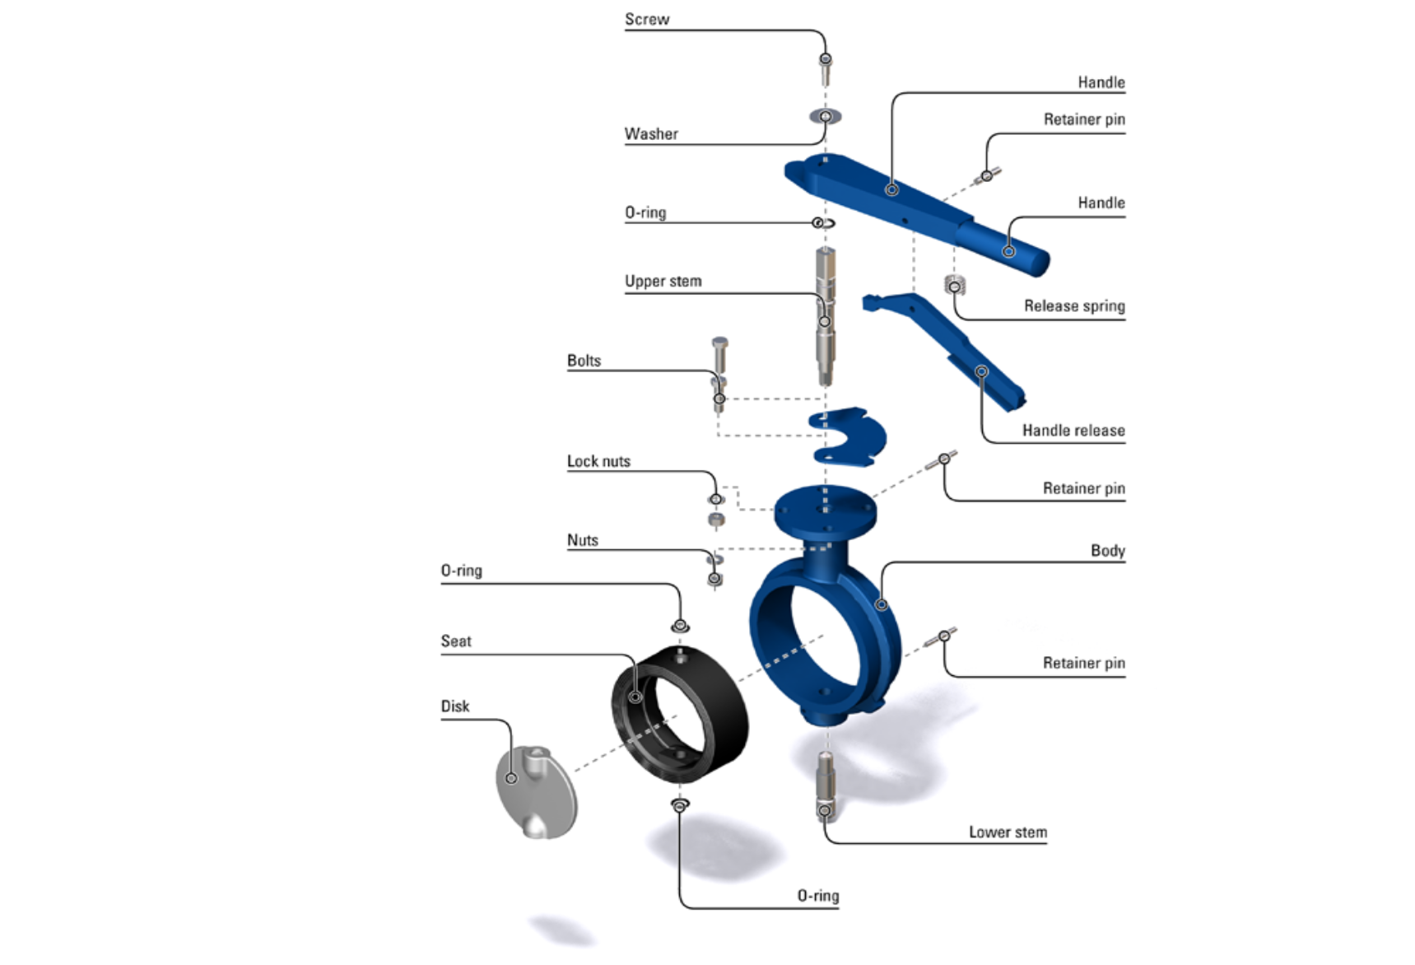
Butterfly valve
Butterfly valve component

Slide 15
THANK YOU

