Slide 1
GS PULLING TOOL
Presented by : Lennon Chung
Date : 2/8/2023

Slide 2
Table of Content:
What is GS Pulling Tool.
GS Pulling Tool Function.
GS Pulling Tool (Running Procedure) .
GS Pulling Tool Pinning & Servicing Procedure.

Slide 3
What is GS Pulling Tool?
The GS pulling tool is a shear down releasing tool used to run or pull subsurface devices which have internal fishing necks. It is used to deploy and retrieve subsurface devices with internal fishing necks. The tool is advised where the downward jarring on subsurface device is needed before pulling.

Slide 4
GS Pulling Tool Function
The GS pulling tool design permits continuous upward jarring and can be released by jarring down.
On contact with the correct size fishing neck in the well bore, the lower part of the core will pass into the top of the internal fishing neck profile, the dogs are forced upwards and collapse inward into a recess in the core, permitting the GS pulling tool to fully enter the fishing neck profile.

Slide 5
After the dogs have passed the upper shoulder of the internal fishing neck profile they will spring back into position in the recess below under the action of the dog spring and fully engage the internal fishing profile.

Slide 6
GS Pulling Tool (Running Procedure)
Upward jarring is used to recover the device, if in the event the device cannot be recovered, jarring down is used to shear the pin in the pulling tool.
Only with the pulling tool skirt in contact with the device's fishing neck will the shear pin will be sheared by jarring down.

Slide 7
With the pin sheared the core moves downwards relative to the body of the pulling tool and is retained in the sheared position by action of the core spring, the dogs will have moved upwards and collapsed inwards relative to the core and will release from the internal fishing neck profile.

Slide 8
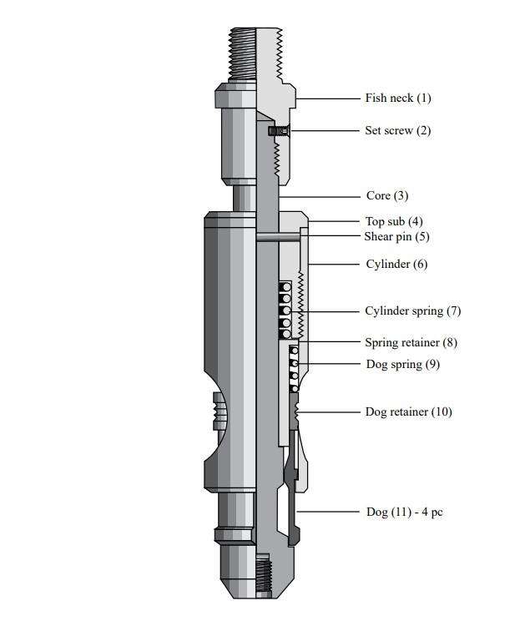
GS Pulling Tool Pinning and Servicing Procedure.
Disassembly Procedure.
Place the "cylinder" (6) in a vice.
Unscrew the "top sub" (4) far enough to expose the sheared pieces of the "shear pin" (5).
Remove the "set screw" (2), and unscrew the "fish neck" (1) from the "core" (3).
Pull the "core" (3) out through the lower end of the "cylinder" (6).
Remove the "top sub" (4). This allows the "cylinder spring" (7), "spring retainer" (8), "dog spring" (9), "dog retainer" (10) and "dogs" (11) to be removed from the "cylinder" (6).
Clean and inspect all parts thoroughly.

Slide 9
Assembly Procedure
Place the "cylinder" (6) horizontally in the jaws of the vice with one window of the "cylinder"(6) facing up.
Slide the "dog retainer" (10) through the threaded end of the "cylinder" (6) and position the "dog retainer" (10) so that one of its dog slots is visible in the window.
Insert one "dog" (11) through the lower end of the "cylinder" (6), and position it in the "dog retainer" (10).
Reaching through the threaded end of the "cylinder" (6), rotate the "dog retainer" (10) until the next dog slot appears in the window of the cylinder. Insert the next "dog" (11) as before, andcontinue until all dogs are in place.

Slide 10
When all "dogs" (11) are in place, move the "dog retainer" (10) and attached dogs all the way down into the cylinder (6).
Install the "dog spring" (9) over the "spring retainer" (8), and insert the spring retainer (small end first) through the threaded end of the "cylinder" (6).
Insert the "cylinder spring" (7) (the heaviest of the two springs) into the area under the threads of the "top sub" (4).
Screw the "top sub" (4) into the "cylinder" (6), and remove it from the vice.
Grasp the flats on the lower end of the "core" (3) in the vice with the "core" (3) in a vertical position.
Slide the cylinder assembly down over the "core" (3).
Make up the "fish neck" (1) onto the "core" (3), and tighten the connections.
Install the "set screw" (2)

Slide 11
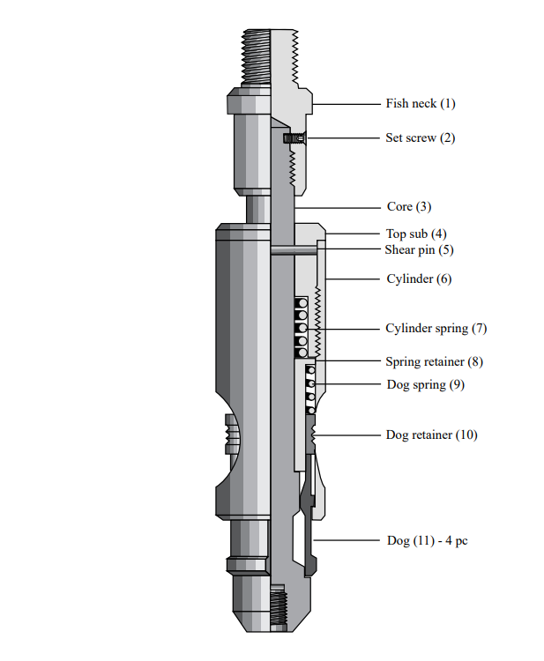
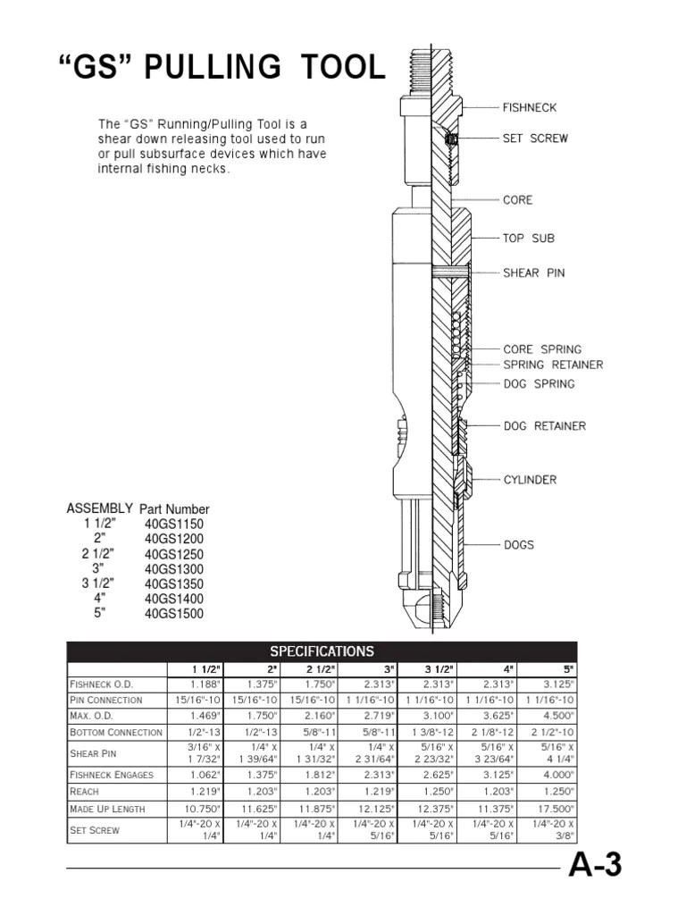

Slide 12
THANK YOU

