Slide 1
CT FATIGUE
By: Muhammad Ameerul Zaeem
Dimension Bid

Slide 2
CT Fatigue Theory
Any bending at radius (eg. CT Reel & Gooseneck) will causes plastic deformation
Every time the CT string is bent and straightened coming off the reel and over the gooseneck, or being spooled from one drum to another, it becomes fatigued.
Cycling the CT string over the gooseneck with high internal pressures is extremely detrimental to the CT life. High-pressure cycling must be minimized.
This fatigue does decrease the working life of the CT string.

Slide 3
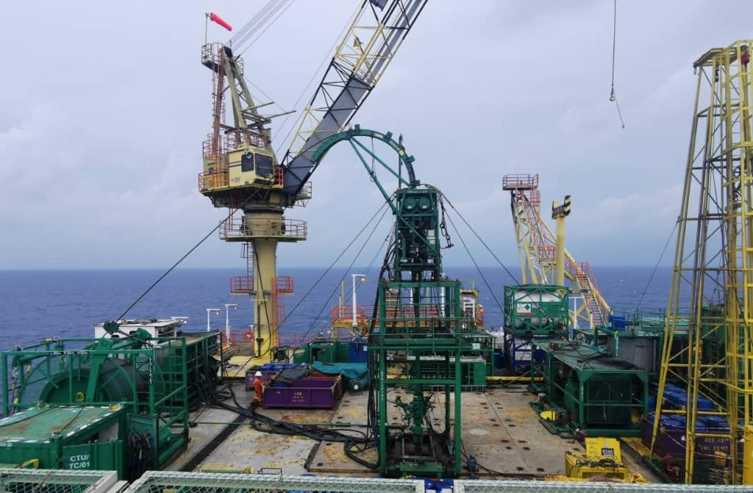
CT Fatigue Theory
There are 6 bending events on CT String while RIH & POOH.
2
5
4
3
1
6

Slide 4
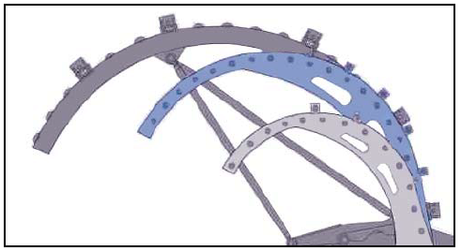
Factor Affecting CT Fatigue Life
Size of bending radius (A large gooseneck causes less string fatigue than a smaller gooseneck).
Internal Pressure (Cycling the CT string at the same point at high pressure over the gooseneck will contribute high fatigue)
Size of CT (Larger sizes of CT string becomes more fatigued than smaller sizes if bent over the same gooseneck)
Wall Thickness (A low wall thickness section of CT string fatigues more quickly)
Type of welds (Butt weld have less resistance to fatigue failure compared to bias weld)

Slide 5
Fatigue Model Theory
In Cerberus, Achilles CT Fatigue model is used to calculate fatigue for each segment of a CT String.
Achilles assumes that the CT is cycled for its entire life using consistent bending radius and pressure.
The amount of fatigue that a bending event causes depends primarily on the CT material, the CT geometry, the pressure, the bending radius, and the current fatigue.
Achilles uses these factors to calculate the amount of fatigue created by a trip into and out of the hole at 6 bending events.
CT does not fatigue downhole because the radius of curvature of the wellbore trajectory is not really affected to cause plastic yielding of the CT. CT also does not fatigue when the CT doesn't move, even if there is pressure changes (eg. pressure test).

Slide 6
How To Minimize Fatigue?
Use a thicker CT wall
Use a larger guide arch
Perform fewer cycles
Cycle with lower pump pressure
Place the string on reel with a larger core
Cut the string to shift new fatigue away from areas with current high fatigue

Slide 7
CT Fatigue Records
For CT units equipped with a data acquisition system (DAS), data will be recorded electronically. However, CT SV / Operator will keep record manually on the (fluid used, CT cut length, max pressure, H2S presence, 13Cr).
In Cerberus, CT Fatigue modelling software called Reel Trak was used to predict, track, and analyze coiled tubing fatigue.
For every CT job, CT SV / CT Operator must launch Reel Trak & Orpheus (Tubing Force Analysis Simulation) to ensure all data is recorded during CT operation.

Slide 8
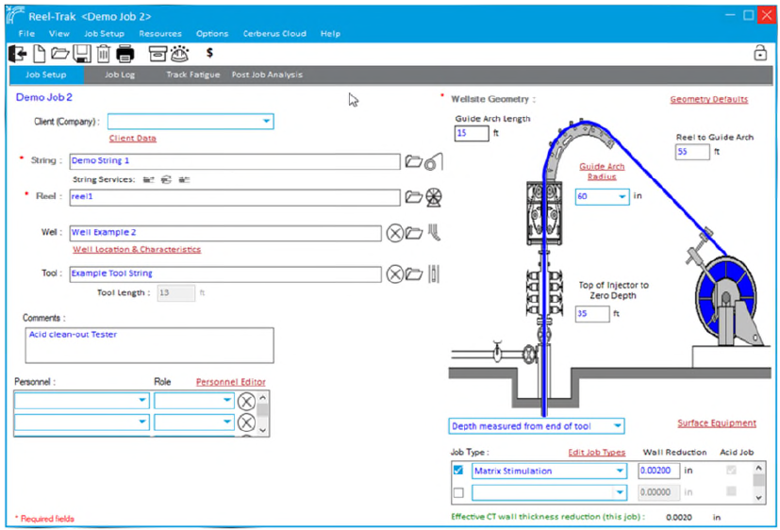
Example of Job Setup Prior CT Operation
Launch Reel Trak & input all the parameter.

Slide 9
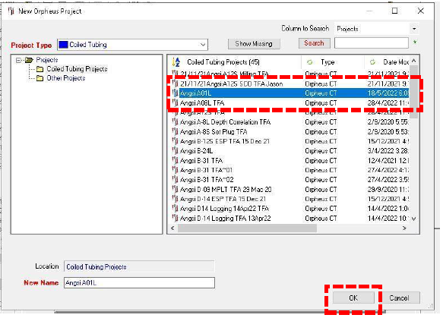
Example of Job Setup Prior CT Operation
Launch Orpheus & select correct job file (TFA simulation) as per given by Engineer at town.

Slide 10
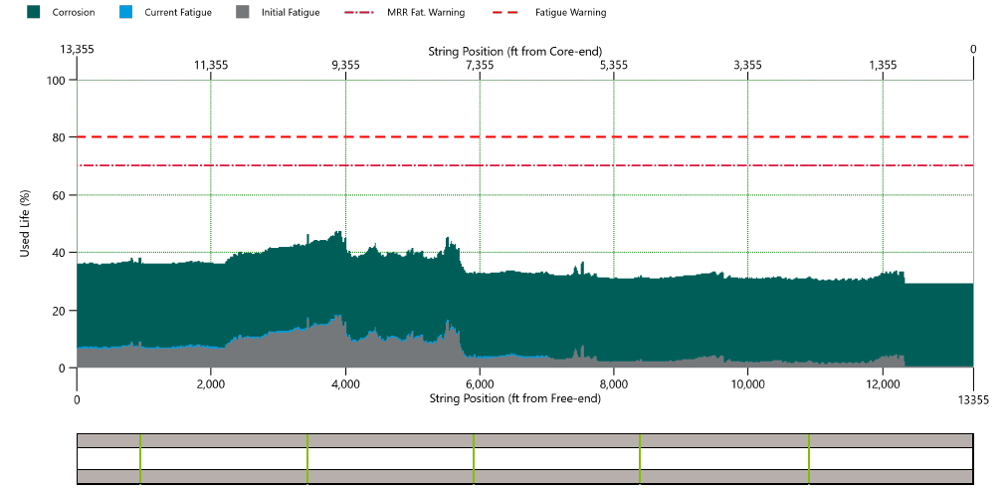
Example CT Fatigue Graph Report
48
From the graph above, it shows that maximum fatigue has reach 48% in between depth 3,800 – 3,900 ft from the free end.

Slide 11
Corrosion Derating Factor
Corrosion Reference Value Table:

Slide 12
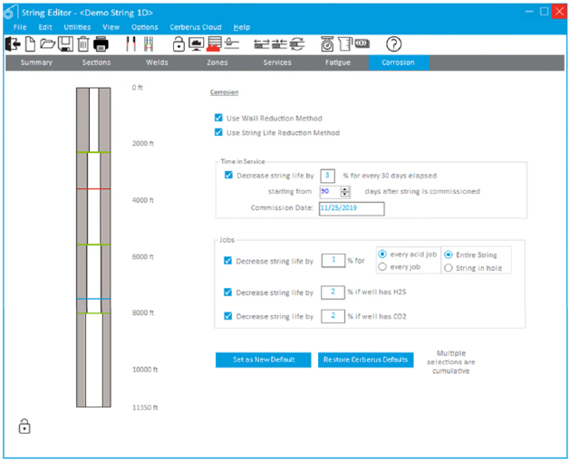
Example of corrosion input

Slide 13
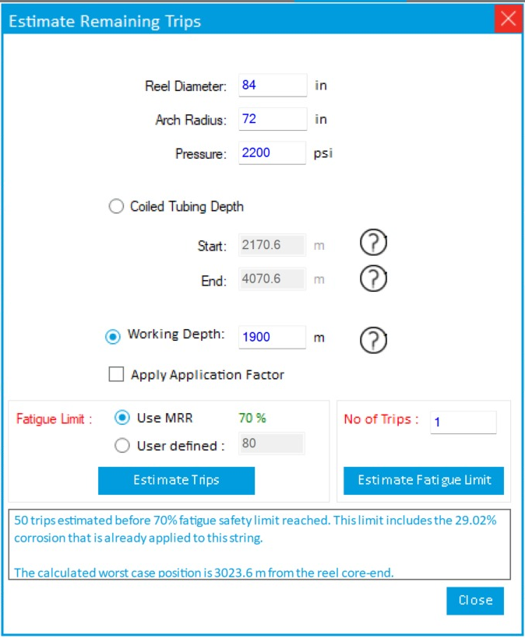
Maximum no. of cycle trip at same depth

Slide 14
Thank you

