Slide 1
WEM SIMULATION TRAINING
Well Evaluation Model for Perforating Design
Prepared by: Mohammad Azwan Shahmee
Date: 23 September 2021

Slide 2
TOPICS TO BE COVERED
WEM INTRODUCTION
WEM INPUT TEMPLATE
WEM SIMULATION
WEM REPORT

Slide 3
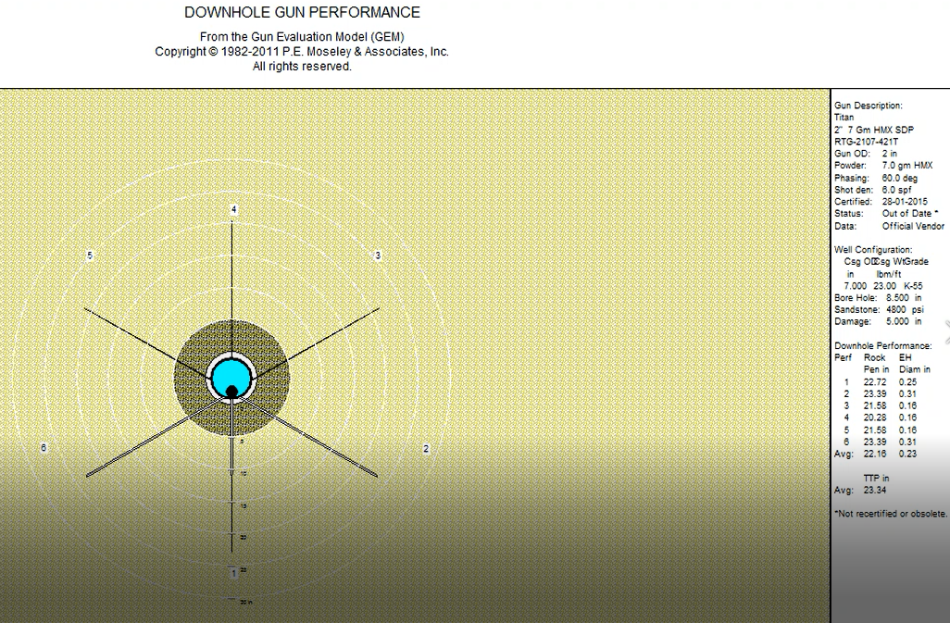
WEM INTRODUCTION
Well Evaluation Model is offered by P.E Moseley and Associate
Well Performance program, mainly for single well application such as PVT, Nodal Analysis, Artifical Lift, Perforating Design
Can be upgraded to WEMPRO for more complex analysis such as comingled multi layered reservoir analysis, detailed heat transfer prediction and etc
For DB application, perforating design was used to provide client a simulation for gun downhole performance by utilizing surface test performance.

Slide 4
WEM INPUT TEMPLATE

Slide 5
RESERVOIR PARAMETER
Additional data required – Well Schematic / Tubing Tally & Deviation Survey

Slide 6
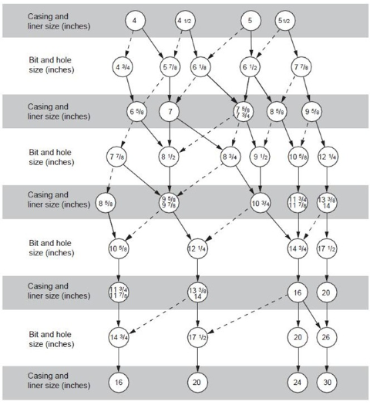
BOREHOLE SELECTION
Use straight line as primary bit size and dotted line as secondary bit size.

Slide 7
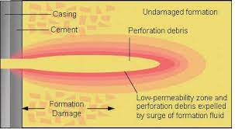
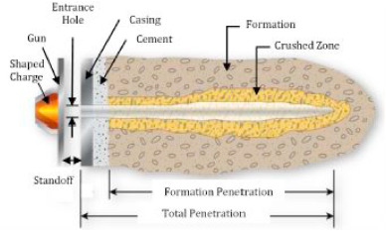
DAMAGE VS CRUSH ZONE

Slide 8
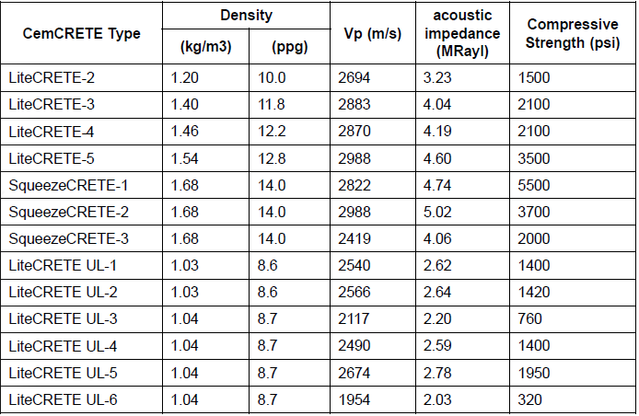
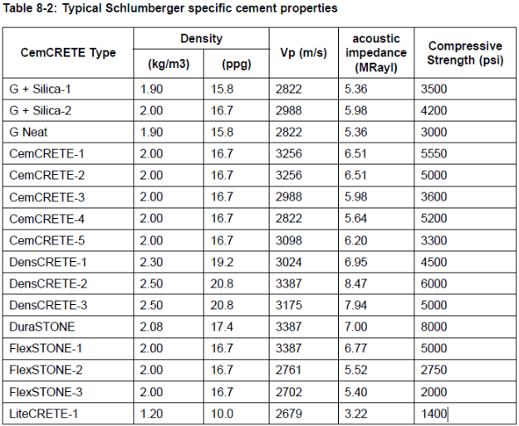
CEMENT SELECTION
Typical SLB cement properties – can be use as guideline as well. If there is no info from completion report, use G-cement properties with 15.8 ppg and cement CS 3500 psi.

Slide 9
PVT DATA

Slide 10
WEM SIMULATION - PRACTICAL

Slide 11
WEM REPORT

Slide 12
-END OF SLIDE-
THANK YOU

